Slide 1

Review
Instruction Sets: Characteristics and functions
Instruction Sets: Addressing

Slide 2
Main Content
Addressing Mode
Pipelining
RISC and CISC
Intel Architecture
MIPS Architecture

Slide 3
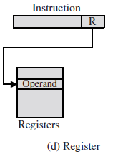
Register Addressing
EA = R
Operand is held in register named in address field
Limited number of registers
Very small address field needed
  Shorter instructions
  Faster instruction fetch
No memory access
Very fast execution
Very limited address space
Notes:
10

Slide 4
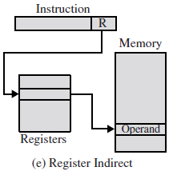
Register Indirect Addressing
EA = (R)
Operand is in memory cell pointed to by contents of register R
Large address space (2^{n})
One less memory reference than indirect addressing
Notes:
13

Slide 5
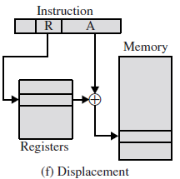
Displacement Addressing
EA = A + (R)
Combines the capabilities of direct addressing and register indirect addressing
Address field hold two values, at least one of which is explicit
  A = base value (explicit)
  R = register that holds displacement (implicit)
  or vice versa
Three of the most common
displacement addressing
  Relative addressing
  Base-register addressing
  Indexing
Notes:
15

Slide 6
Base-Register Addressing using special register
EA = ( BR ) + A
BR – special base register
AM
OP
A
Memory
BR
ALU
operand
Easy to move all program code in the memory
Content of BR is specified by OS
Program can change the content of A, but not of BR
Notes:
18

Slide 7
Displacement Addressing
--Indexed Addressing
Address field contains a main memory address
Referenced register contains a positive displacement from that address
EA = A + (R)
An important use of indexing is to provide an efficient mechanism for performing iterative operations.
Good for accessing arrays
  EA = A + (R)
  R++
Notes:
19

Slide 8
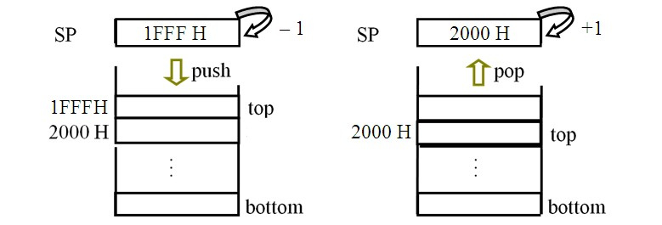
Stack Addressing
Operand is (implicitly) on top of stack
Stack characteristic:
  Hardware stack (composed by multi registers)
  Software stack (specified memory block)
  FILO, SP register = stack top pointer
Push: （SP）– 1 SP
Pop: （SP）+ 1 SP
Notes:
21

Slide 9
More About Addressing Modes
A Summary of Basic Addressing Modes
Addressing Mode
To Find Operand
Immediate
Operand Value present in the instruction
Direct
Effective address of operand in address field
Register
Operand Value located in Register
Indirect
Address field points to address of the actual operand
Register Indirect
Register contains address of actual operand
Indexed or Based
(Displacement)
Effective address of operand generated by adding value in address field to content of a register
Stack
Operand located on stack

Slide 10
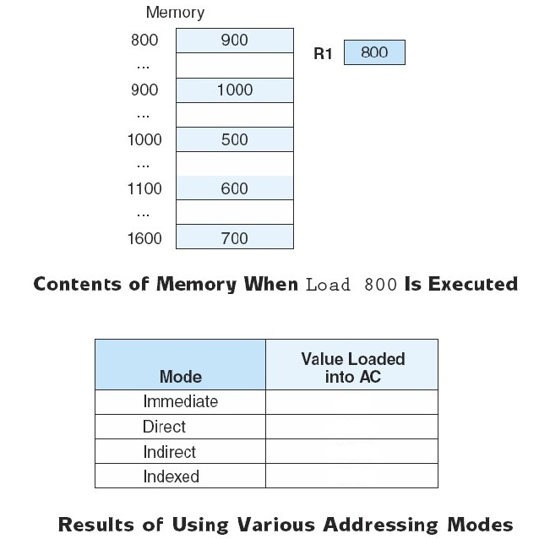
More About Addressing Modes
Assuming R1 is implied in the indexed addressing mode.

Slide 11
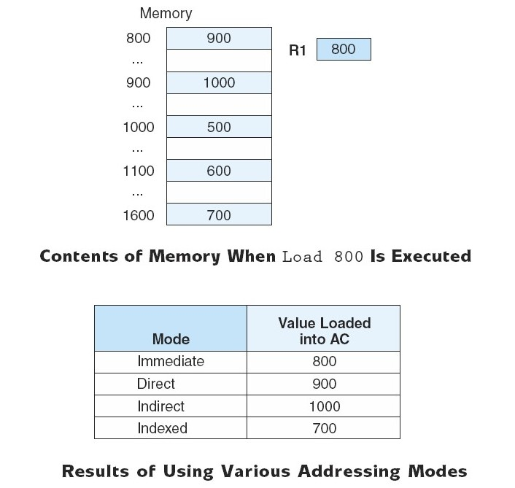
More About Addressing Modes
Assuming R1 is implied in the indexed addressing mode.

Slide 12
Implicit Addressing
Operand is (implicitly) coded in the opcode
AM
Memory
ADD
A
ACC
A
operand
An other operand is in the ACC register (implicitly)
ALU
e.g. 8086
MUL instruction
Multiplicand is in AX（16bit）or AL（8bit）
Notes:
21

Slide 13
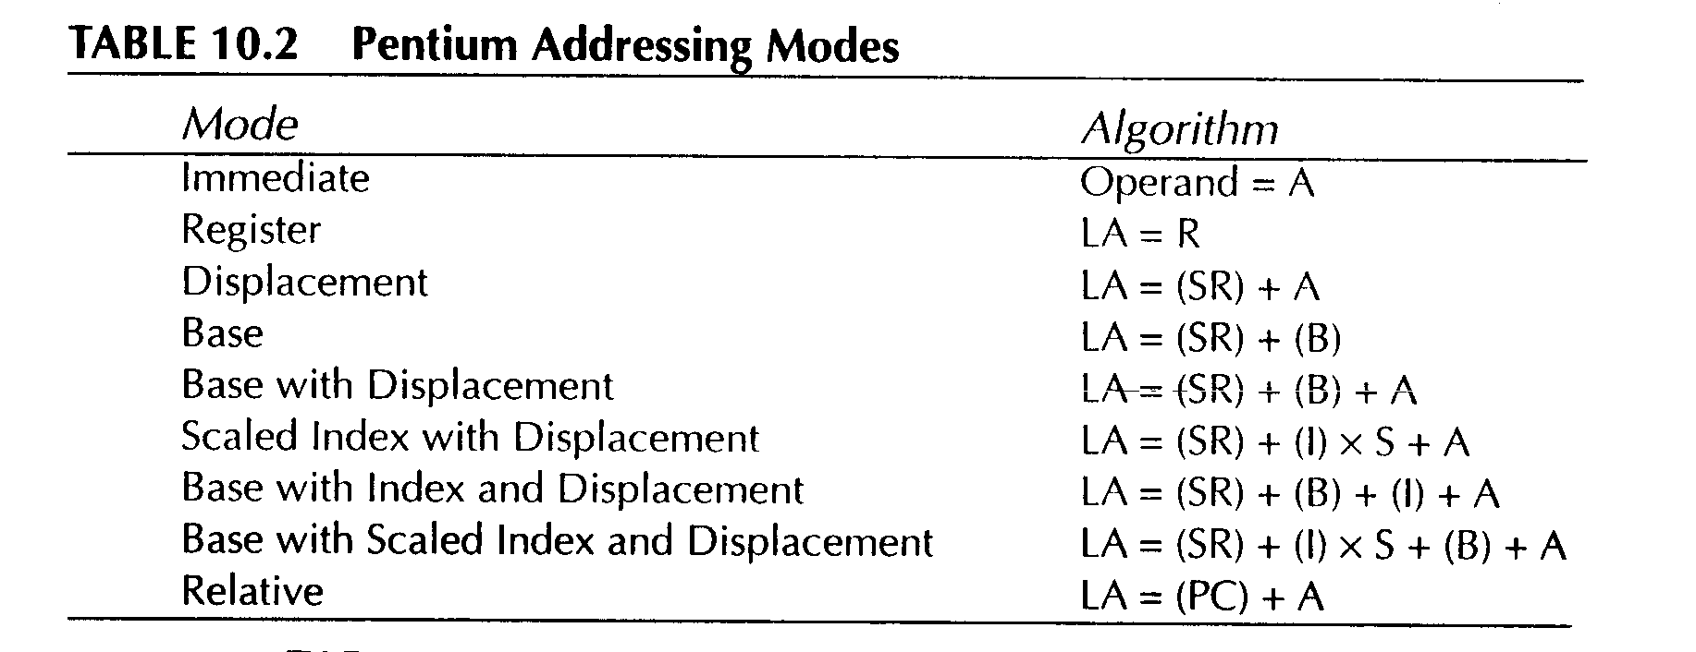
Pentium Addressing Modes

Slide 14
Instruction Formats
The instruction format defines the layout of instruction word in terms of its constituent parts
An instruction format must include an opcode and, implicitly or explicitly, zero or more operands
The format must, implicitly or explicitly, indicate the addressing mode for each operand
Usually more than one instruction format in an instruction set

Slide 15
Instruction Length Consideration
Affected by and affects:
  Memory size
  Memory organization
  Bus structure
  CPU complexity
  CPU speed
Trade off between powerful instruction repertoire and saving space

Slide 16
Variable-length Instructions
Provide a variety of instruction formats of different lengths
Variable-length instruction format can
  Easy to provide a large repertoire of opcodes, with different opcode length
  Provide more flexible addressing, with various combinations of register and memory references plus addressing mode
Variable-length format example
Single word
Double word
Three word
opcode
opcode
operand
opcode
operand
operand

Slide 17
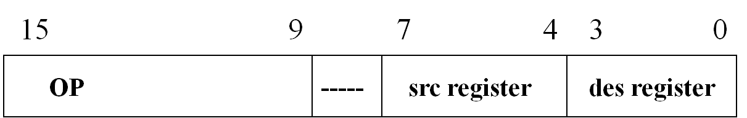
Analysis instruction format
(1)single word length instruction。
(2)opcode field can provide 2⁷=128 instructions
(3)source operand: provide registers 2⁴=16
(4)destination operand: provide registers 2⁴=16
(5)the instructions are usually used arithmetic and logic computation

Slide 18
Number of Operands and Instruction Length
Fixed Length: Wastes space but is fast and results in better performance when instruction-level pipelining is used.
Variable Length: More complex to decode but saves storage space.

Slide 19
Expanding Opcode
Expanding opcodes represent a compromise between the need for a rich set of opcodes and the desire to have short opcodes, and thus short instructions.
There are longer opcodes with fewer operands as well as shorter opcodes with more operands.
Each instruction must be unique.

Slide 20
Expanding Opcode
Example: Consider a machine with 32-bit instructions. The following formats are designed
Opcode only (zero address)
Opcode + 1 address
Opcode + 2 addresses
The size of address field is 12 bits. One shorter opcode is reserved for the expanding opcode.
How many 0-addesss, 1-address and 2-address instructions can be formulated?

Slide 21
Expanding Opcode
Solution:
2-address instructions (2⁸-1)
0000 0000 A1 (12bits) A2(12bits)
… … … …
1111 1110 A1(12bits) A2(12bits)
1-address instructions (2¹²-1)
1111 1111 0000 0000 0000 A1(12bits)
… … … …
1111 1111 1111 1111 1110 A1(12bits)
0-address instructions (2¹²)
1111 1111 1111 1111 1111 0000 0000 0000
… … … …
1111 1111 1111 1111 1111 1111 1111 1111

Slide 22
Instruction-Level Pipelining
The speed of execution programs is influenced by many factors.
One way to improve performance is to use faster circuit technology to build the processor and the main memory.
Another way is that more than one operation can be performed at the same time.
Pipelining is a particularly effective way of organizing concurrent activity in a computer system.

Slide 23
Instruction-Level Pipelining
The processor executes a program by fetching and executing instruction, one after the other. Execution of a program consists of sequence of fetch and execute steps.
Fetch 1
Exec 1
Fetch 2
Exec 2
Fetch 3
Exec 3
……

Slide 24
Instruction-Level Pipelining
Now consider a computer has two separate hardware units, one for fetching instructions and another for executing them. The instruction fetched by the fetch unit is deposited in an intermediate storage buffer.
Interstage Buffer
Instruction
Fetch
Unit
Exection
Unit

Slide 25
Instruction-Level Pipelining
Time
Clock cycle 1 2 3 4
Instruction
I₁
I₂
I₃
Fetch 1
Exec 1
Fetch 2
Exec 2
Fetch 3
Exec 3

Slide 26
Instruction-Level Pipelining
CPU breaks the fetch-decode-execute cycle down into smaller steps, where some of these smaller steps can be performed in parallel. This overlapping speeds up
execution. This method is known as pipelining.
For the implement of overlap processing of different instructions (fetching and executing) , each separate hardware unit has individual control logic.

Slide 27
Instruction-Level Pipelining
The computer is controlled by a clock whose period is such that the fetch and execute steps of any instruction can each be completed in one clock cycle.
Each stage in a pipeline is expected to complete its operation in one clock cycle.

Slide 28
Instruction-Level Pipelining
Generally, the potential increase in performance resulting from pipelining is proportional to the number of pipeline stages.

Slide 29
Instruction-Level Pipelining
Suppose the fetch-decode-execute cycle were broken into the following “mini-steps”:
1. Fetch instruction
2. Decode opcode
3. Calculate effective address of operands
4. Fetch operands
5. Execute instruction
6. Store result

Slide 30
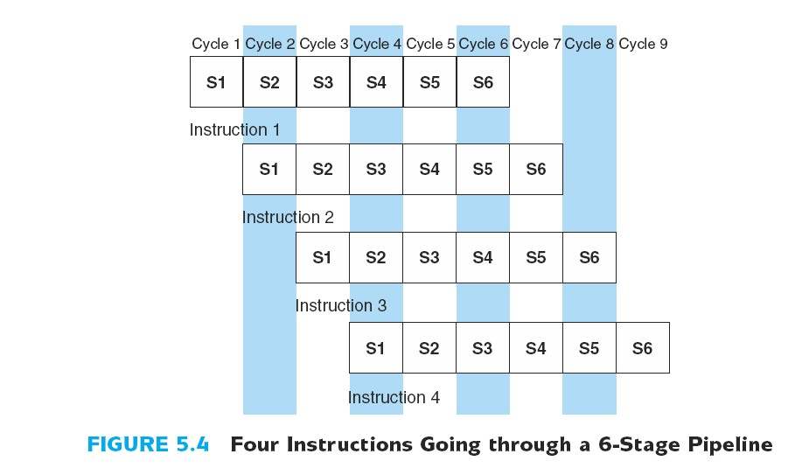
Instruction-Level Pipelining

Slide 31
Instruction-Level Pipelining
We have four instructions to process.
Without a pipeline the time required is 24 clock cycles. With a pipeline the time required is 9 clock cycles.

Slide 32
Instruction-Level Pipelining
Features of the pipeline
The pipeline consists several sequential stages.
Each stage is implemented by special hardware unit.
The required time of implement the operation of each stage is same.

Slide 33
Instruction-Level Pipelining
Some stages may not be able to complete its processing task for a given instruction in the time allotted.
As a result some operation has to be delayed, the pipeline stalls.

Slide 34
Instruction-Level Pipelining
A pipelined processor may process each instruction in four steps, as follows:
F Fetch: read the instruction from the memory
D Decode: decode the instruction and fetch the source operands.
E Execute: perform the operation specified by the instruction
W Write: store the result in the destination location

Slide 35
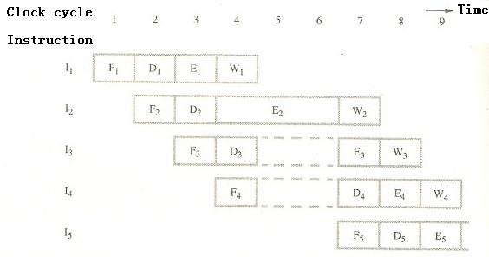
Instruction-Level Pipelining
Effect of an execution operation taking more than one clock cycle

Slide 36
Instruction-Level Pipelining
The usually used method to describe the pipelining is space-time diagram.
x-coordinate represents the time
y-coordinate represents the stage

Slide 37
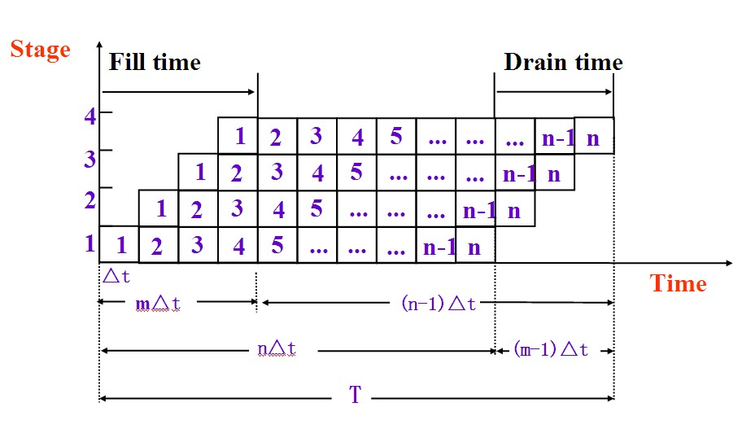
Instruction-Level Pipelining

Slide 38
Instruction-Level Pipelining
Fill time: from the start of fetching the first instruction to the end of executing the first instruction.
Drain time: from the end of fetching the last instruction to the end of executing the last instruction.
Total time: from the start of fetching the first instruction to the end of executing the last instruction.

Slide 39
Instruction-Level Pipelining
Suppose we have a m-stage pipeline, the clock cycle time is ∆t, that is, it takes ∆t time per stage. Assume also we have n instruction to process.
Fill time: m ∆t
Drain time: (m-1) ∆t
Total time: (n+m-1) ∆t

Slide 40
Instruction-Level Pipelining
Performance Considerations
Throughput rate is the number of instructions executed per clock cycle time.
Speedup ratio is the ratio of the execution time of instructions without a pipeline to the execution time of instruction with a pipeline.
Efficiency is the ratio of the portion occupied by n instructions in the space-time diagram to the full area in the space-time diagram.

Slide 41
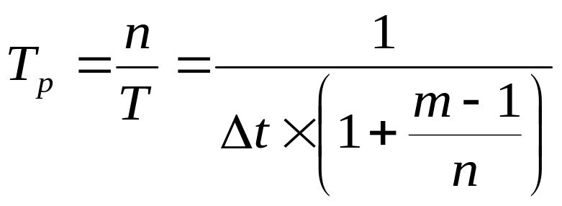
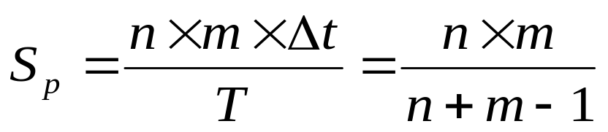
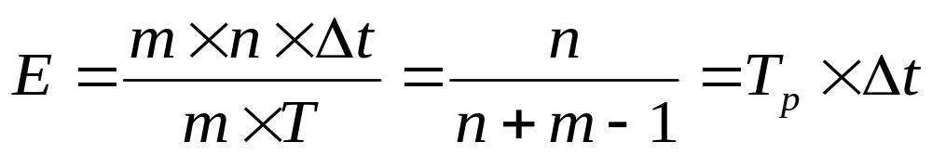
Instruction-Level Pipelining
Performance Considerations
Throughput rate
Speedup ratio
Efficiency

Slide 42
Instruction-Level Pipelining
According to the style of connection of stages, the pipelines can be formatted in two ways:
Static Pipeline: in the same time, every stages only can perform the same function instruction.
Dynamic Pipeline: in the same time, every stages can perform different function instruction.

Slide 43
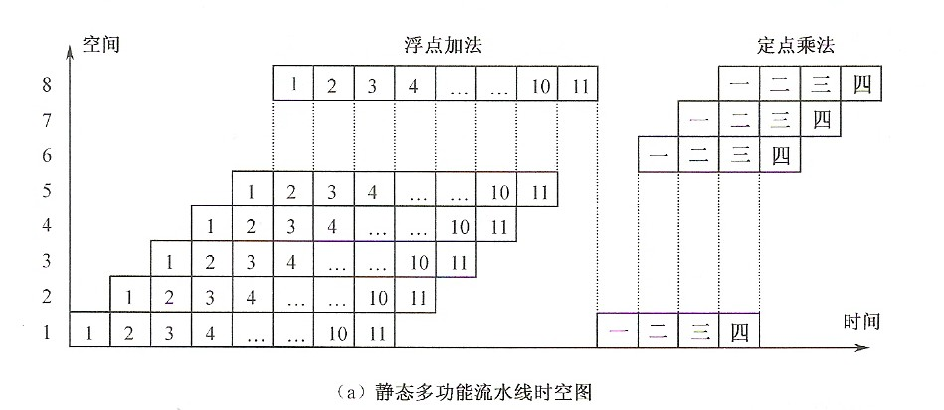
Instruction-Level Pipelining

Slide 44
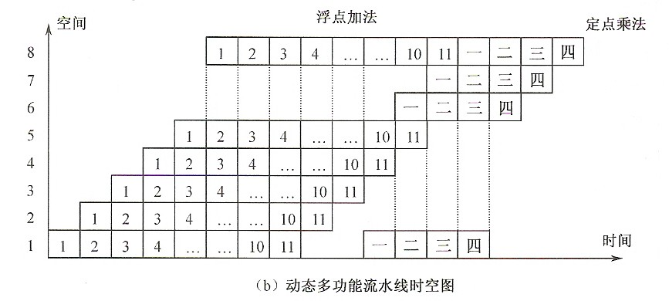
Instruction-Level Pipelining

Slide 45
Instruction-Level Pipelining
Suppose we have a 4-stage pipeline, where:
S1 = fetch instruction
S2 = decode and calculate effective address
S3 = fetch operand
S4 = execute the instruction and store results

Slide 46
Instruction-Level Pipelining
A conditional branch instruction can alter execution sequence. The instruction I3 is a branch instruction, after the execution of I3, I4, I5 and I6 are no longer needed. It transfers control to I8.

Slide 47
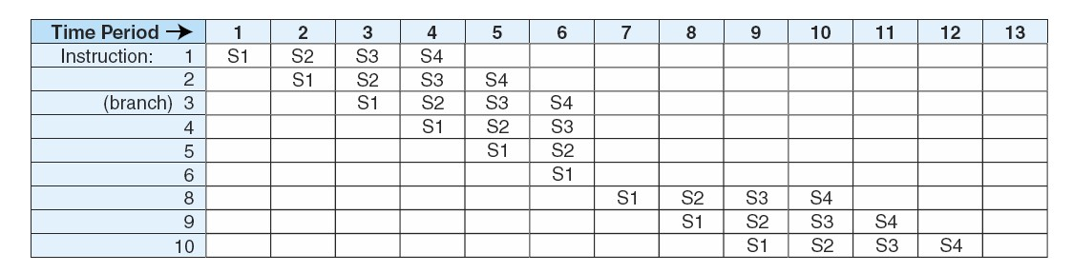
Instruction-Level Pipelining

Slide 48
Instruction-Level Pipelining
Pipeline Conflict
There are several conditions that result in “pipeline conflicts”, which keeps us from reaching the goal of executing one instruction in the pipeline . These include:
resource conflicts
data dependencies
conditional branch statements

Slide 49
Instruction-Level Pipelining
Resource conflicts
Resource conflicts are a major concern in instruction-level parallelism. For example, if one instruction is storing a value to memory while another is being fetched, both need access to memory.

Slide 50
Instruction-Level Pipelining
Resource conflicts
Solution:
1. allowing the instruction executing to continue, while forcing the instruction fetch to wait.
2. providing two separate pathways.

Slide 51
Instruction-Level Pipelining
Resource conflicts
Suppose we have a 6-stage pipeline, where:
Fetch Instruction (FI)
Decode Instruction (DI)
Calculate Operands (CO)
Fetch Operands (FO)
Execute Instruction (EI)
Write Results (WO)

Slide 52
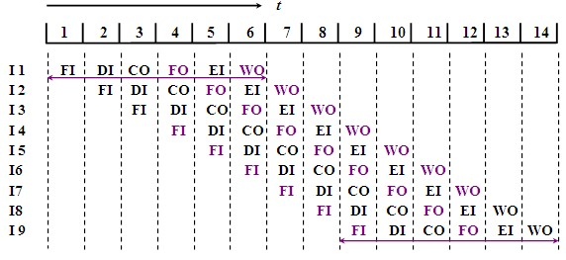
Instruction-Level Pipelining
Resource conflicts

Slide 53
Instruction-Level Pipelining
Data dependency
Data dependencies arise when the result of one instruction, not yet available, is to be used as an operand to a following instruction.
Solution: Special hardware can be added to detect instructions whose source operands destinations for instructions further up the pipeline. This hardware can insert a brief delay into the pipeline.

Slide 54
Instruction-Level Pipelining
Data dependency
M ADD X, D
INX
CPX #N
BNE M Instruction BNE will wait for the result of the previous instruction CPX
….

Slide 55
Instruction-Level Pipelining
Data dependency
ADD R1, R2
SUB R1, R3
Register R1 is used consecutively.

Slide 56
Instruction-Level Pipelining
Data dependency
A ← 3 + A
B ← 4 x A
The data used in the second instruction depend on the result of the first instruction.
A ← 3 + C
B ← 4 x C
The operations are independent.

Slide 57
Instruction-Level Pipelining
Conditional Branch Statements
Branch instructions allow us to alter the flow of execution in a program, which, in terms of pipelining, cause major problem.
Many architectures offer branch prediction, using logic to make the best guess as to which instructions will be needed next.

Slide 58
CISC and RISC
CISC machines have a large number of instructions, of variable length, with complex layouts. Many of these instructions are quite complicated, performing highly complex activities.
That slows down the system considerably.

Slide 59
CISC and RISC
The number of RISC instructions is reduced. The main objective of RISC machines is to simplify instructions so they can execute more quickly.

Slide 60
CISC and RISC
Feature 1 of RISC
RISC processors have a fixed instruction size.
  The size of all instructions is fixed at 4 bytes (32 bits).
In cases where instructions do not require all 32 bits, they are filled with zeros.
  The CPU can decode the instructions quickly.

Slide 61
CISC and RISC
Feature 2 of RISC
In RISC, instructions can only load from memory into registers or store registers into memory locations.
There is no direct way of doing arithmetic & logic instructions between registers and contents of memory locations.
  All these instructions must be performed by first bringing both operands into the registers inside the CPU, then performing the arithmetic or logic operation, and then sending the result back to memory.

Slide 62
CISC and RISC
Feature 3 of RISC
A major characteristic of RISC architecture is a large number of registers.

Slide 63
CISC and RISC
Feature 4 of RISC
RISC processors have a small instruction set. RISC processors have only the basic instructions.
Since RISC has very few instructions, it is the job of the programmer to implement the complicated tasks using available RISC instructions.

Slide 64
CISC and RISC
Feature 5 of RISC
  99% of instructions are executed with only 1 clock.
    The 1% of the RISC instructions executed with
    2 clocks can be executed with one clock cycle by
    juggling instructions (code scheduling).

Slide 65
CISC and RISC
Feature 6 of RISC
In RISC, due to the small instruction set, they are implemented using the hardwire method.

Slide 66
CISC and RISC
RISC
CISC
Multiple Registers Sets
Single Register Set
Three register operands allowed per instruction
One or two register operands allowed per instruction
Single-cycle instructions
Multi-cycle instructions
Parameter passing through efficient on-chip register windows
Parameter passing through inefficient off-chip memory
Hardwired Control
Microprogrammed control
Highly pipelined
Less pipelined

Slide 67
CISC and RISC
RISC
CISC
Simple instructions that are few in number
Many complex instructions
Fixed length instructions
Variable length instructions
Complexity in compiler
Complexity in microcode
Only load and store instructions can access memory
Many instructions can access memory
Few addressing modes
Many addressing modes

Slide 68
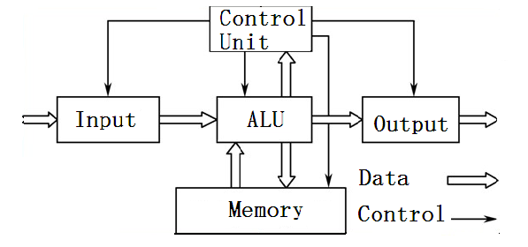
Harvard and von Neumann architectures
von Neumann architecture

Slide 69
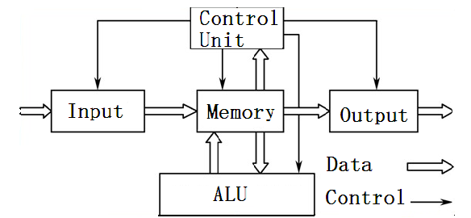
Harvard and von Neumann architectures
von Neumann architecture (modification)

Slide 70
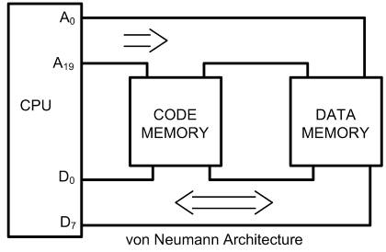
Harvard and von Neumann architectures
Early computers used the same bus
for accessing both the code and data.
Commonly referred to as von Neumann architecture.

Slide 71
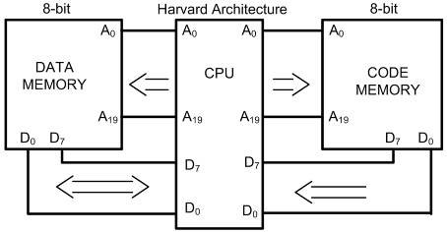
Harvard and von Neumann architectures
To speed execution, some
CPUs Harvard architecture.
Separate buses for the code and data memory.

Slide 72
Harvard and von Neumann architectures
There are four sets of buses in Harvard Architectures.
(1)A set of data buses for carrying data into and out of the CPU
(2)A set of address buses for accessing the data
(3)A set of data buses for carrying code into the CPU
(4)An address bus for accessing the code

Slide 73
Intel Architecture
little endian
two-address architecture
variable-length instruction
register-memory architecture
all the addressing modes

Slide 74
MIPS Architecture
little endian
encoded in a single 32-bit word format
three-address architecture
fixed-length instruction
load and store architecture
base addressing

Slide 75
Homework
1. What is theoretical speedup for a 4-stage pipeline with a 20ns clock cycle if it is processing 100 tasks?
2. What are the pipeline conflicts that can cause a slowdown in the pipeline?
3. Why is RISC called load/store architecture?
4. In a computer instruction format, the instruction length is 11 bits and the size of address field is 4 bits. Is it possible to have
a) 5 2-address instructions
b) 45 1-address instructions
c) 32 0-address instructions
using the format? Justify your answer.
CHAPTER 0

Slide 76
Next Lesson
Computer Arithmetic
CHAPTER 0

