Slide 1

Review
Addressing Mode
Pipelining
RISC and CISC
Intel Architecture
MIPS Architecture

Slide 2
Main Content
Chinese Character Codes
Fixed-point Representation
Floating-point Representation
Fixed-point Arithmetic
Floating-point Arithmetic
IEEE Standard for Floating-point Numbers (IEEE 754)

Slide 3
Area codes (区位码)
Chinese Character Code
1981年我国制定了《信息交换用汉字编码字符集基本集GB2312-80》国家标准（简称国标码）。每个汉字的二进制编码用两个字节表示。共收录一级汉字3755个，二级汉字3008个，共6763个两级汉字。
将两级汉字分为94个区，每个区94位。实际上把汉字表示成二维数组，每个汉字在数组中的下标就是区位码。

Slide 4
Area codes (区位码 GB2312)
Chinese Character Code
区码和位码各两位十进制数字。
例如：“中”位于 第54区 48位， 区位码是 5448。
“啊”位于 第16区 01位， 区位码是 1601。
在计算机中用数字编码输入的优点是没有重码，缺点是难以记忆。

Slide 5
National Location Code (国标区位码)
Chinese Character Code
将区位码中的区码和位码两位十进制数字，分别转化为16进制数，再分别加上20H。占两个字节。
例如：“中”位于 第54区 48位， 区位码是 5448。
其国标码是 5650H。
“啊”位于 第16区 01位， 区位码是 1601。
其国标码是 3021H。

Slide 6
Chinese character input methods
Chinese Character Code
数字编码
  国标区位码(national location code)，用数字串代表一个汉字输入
拼音码
  以汉字拼音为基础的输入方法
字形编码
  用汉字的形状（笔划）来进行的编码
  例如五笔字形

Slide 7
汉字内码 Chinese character internal Code
（汉字ASCII码）
Chinese Character Code
将汉字国标码，分别加上8080H，占两个字节。
例如：“中” 国标码是 5650H，其内码为
D6D0H。
“啊” 国标码是 3021H，其内码为
B0A1H。

Slide 8
Chinese Character Code
汉字 “大” 的区位码是2083，
其国标码是
机内码是
3473H
B4F3H

Slide 9
Chinese Character Code
2000年国家颁布的标准是 GB18030。该标准全面兼容GB2312，收录了27484个汉字。
采用单字节、双字节和四字节等三种方式对字符编码。

Slide 10
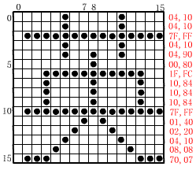
Chinese Character Font Code（汉字字模码）
16点阵汉字的字模码为：
16位× 16位=32字节
汉字字模点阵及编码(汉字库)
字模码

Slide 11
Chinese Character Code
字符代码化（输入）
汉字的输入编码、汉字内码、字模码是计算机中用于输入、内部处理、输出几种不同用途的编码。
输入码向机内码转换
机内码
机内码向字模码转换
显示输出
打印输出

Slide 12
Fixed-Point Number
With a fixed-point notation, it is possible to represent a range of positive and negative integers. By assuming a fixed binary or radix point, this format allows the representation of numbers with a fractional component.
The default location of radix point is behind the numbers, this number is Fixed-point Integer.
The default location of radix point is in front of the numbers, this number is Fixed-point Decimal.

Slide 13
Fixed-Point Number
In the fixed-point representation, the leftmost bit stores the sign of the number. The radix point is not represented.
+ 0.1011
0 1011
Radix Point
– 0.1011
1 1011
Radix Point
+ 1100
0 1100
Radix Point
– 1100
1 1100
Radix Point

Slide 14
Fixed-Point Number
Original Number Sign-Magnitude Representation
    Fixed-point Integer
    X = + 1011010B， [X] = 0, 1011010B；
    Y = – 1011010B， [Y] = 1, 1011010B；
    Fixed-point Decimal
    Z = + 0.1101010B， [Z] = 0. 1101010B；
    K = – 0.1101010B， [K] = 1. 1101010B.

Slide 15
Fixed-Point Number
    A n-bit fixed-point integer in sign-magnitude representation can be one of the numbers ( -(2^{n-1}-1)~(2^{n-1}-1) );
    A n-bit fixed-point decimal in sign-magnitude representation can be one of the numbers ( -(1-2^{-(n-1)}) ~ +(1-2^{-(n-1)}) ).

Slide 16
Fixed-Point Number
    Radix Complement Representation
The advantage that complement systems give us over signed magnitude is that there is no need to process sign bits separately, but we still can easily check the sign of a number by looking at its high-order bit.

Slide 17
Fixed-Point Number
    Radix Complement Representation
Two’s complement is an example of a radix complement. Given a number N in base r and having d digits, the radix complement of N is defined to be r^{d}-N for N≠0, and 0 for N=0.

Slide 18
Fixed-Point Number
    Radix Complement Representation
The radix complement representation of decimal number 35 is
10²-35=65
55-35=55+(-35)=(55+65)_{mod 100}=(120)_{mod 100}=20

Slide 19
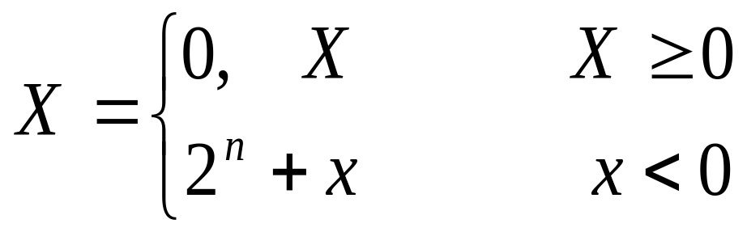
Fixed-Point Number
    Radix Complement Representation
Given a fixed-point integer number X in base 2 and having n digits, the 2’s complement representation is:

Slide 20
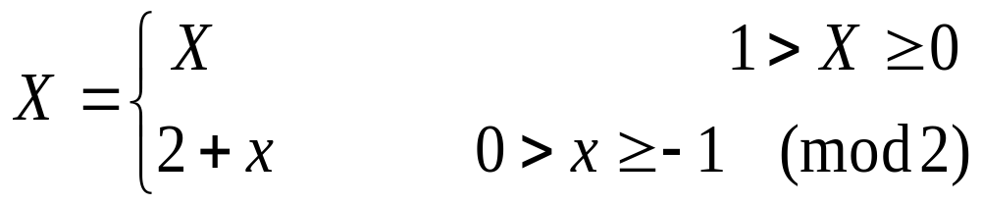
Fixed-Point Number
    Radix Complement Representation
Given a fixed-point decimal number X in base 2 and having n digits, the 2’s complement representation is:

Slide 21
Fixed-Point Number
    Radix Complement Representation
The 2’s complement representation of binary number 0101 is 2⁴-0101=10000-0101=1011
Upon closer examination, we will discover that two’s complement is nothing more than one’s complement incremented by 1.
Remember, only negative numbers need to be converted to two’s complement notation.

Slide 22
Fixed-Point Number
Original Number 2’s Complement Representation
    Fixed-point Integer
    X = + 1011010B， [X] = 0, 1011010B；
    Y = – 1011010B， [Y] = 1, 0100110B；
    Fixed-point Decimal
    Z = + 0.1101010B， [Z] = 0. 1101010B；
    K = – 0.1101010B， [K] = 1. 0010110B.

Slide 23
Fixed-Point Number
    In the 2’s complement number representation system, n bits fixed-point integer can represent values in the range -2^{n-1} to 2^{n-1}-1;
    In the 2’s complement number representation system, n bits fixed-point decimal can represent values in the range -1 to +(1-2^{-(n-1)}).

Slide 24
Fixed-Point Number
    Overflow in Integer Arithmetic
When the result of an arithmetic operation is outside the representable range, an arithmetic overflow has occurred.

Slide 25
Fixed-Point Number
    Overflow in Integer Arithmetic
A simple rule for detecting an overflow condition:
If the carry into the sign bit equals the carry out of the bit, no overflow has occurred. If the carry into the sign bit is different from the carry out of the bit, overflow has occurred.

Slide 26
Fixed-Point Number
    Single symbol fixed-point numbers
    X = + 1011010B， [X] = 0, 1011010B；
    Y = – 1011010B， [Y] = 1, 0100110B；
    Z = + 0.1101010B， [Z] = 0. 1101010B；
    K = – 0.1101010B， [K] = 1. 0010110B.
    Fixed-point numbers on two symbols
    X = + 1011010B， [X] = 00, 1011010B；
    Y = – 1011010B， [Y] = 11, 0100110B；
    Z = + 0.1101010B， [Z] = 00. 1101010B；
    K = – 0.1101010B， [K] = 11. 0010110B.

Slide 27
Fixed-Point Number
    Addition of Two Fixed-point numbers on two symbols
    X = + 1110101B， Y=+0001100B； X+Y=?
    A=-0101010B, B=-1010B; A+B=?
    Solution: 1) X= 00 1110101 Y=00 0001100
    00 1110101
    + 00 0001100
    01 0000001
    2) A= 11 1010110 B=11 1110110
    11 1010110
    + 11 1110110
    11 1001100
The overflow has occurred.
No overflow

Slide 28
Floating-Point Number
Floating-point number consist of three parts: a sign bit, an exponent part (representing the exponent on a power of 2 ), and a fractional part, called a mantissa.
17₁₀=10001₂=1000.1₂x2¹=100.01₂x2²=10.001₂x2³=1.0001₂x2⁴
=0.10001₂x2⁵ =100010₂x2⁻¹

Slide 29
Floating-Point Number
The exponent part can be positive or negative, we can add a sign bit in it, but it turns out that it is more efficient to use a biased exponent.
The bias value is a number near the middle of the range of possible values that we select to represent zero.

Slide 30
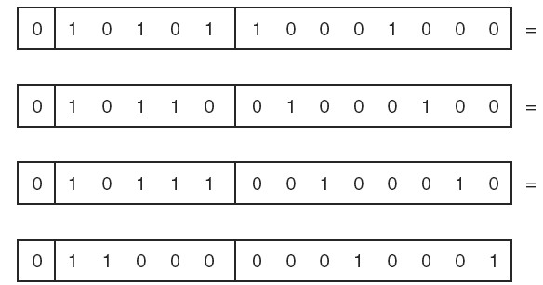
Floating-Point Number
17₁₀=10001₂=1000.1₂x2¹=100.01₂x2²=10.001₂x2³=1.0001₂x2⁴
=0.10001₂x2⁵ =100010₂x2⁻¹
A 14-bit model (a sign bit, 5-bit exponent, 8-bit mantissa) to represent the given number, select 16 as bias value
0.10001₂x2⁵ 5+16=21
0.010001₂x2⁶ 6+16=22
0.0010001₂x2⁷ 7+16=23
0.00010001₂x2⁸ 8+16=24

Slide 31
Floating-Point Number
The leftmost bit of the mantissa will always be a 1, this is called normalization.
17₁₀=0.10001₂x2⁵

Slide 32
Floating-Point Number
Overflow: During the period of normalization, the absolute value of exponent exceeds the maximum possible exponent value.
Underflow: During the period of normalization, the absolute value of exponent is less than the minimum possible exponent value.

Slide 33
IEEE 754
In 1985, IEEE published a floating-point standard for both single- and double-precision floating-point numbers.
This standard is officially known as IEEE-754(1985).

Slide 34
IEEE 754
Single-precision has 32bits
Double-precision has 64bits
Extended-precision has 80bits
S(1bit) | Exponent(8bits) | Mantissa (23bits)
S(1bit) | Exponent(11bits) | Mantissa (52bits)
S(1bit) | Exponent(15bits) | Mantissa (64bits)

Slide 35
IEEE 754
Single-precision standard uses excess 127 bias over an 8-bit exponent.
Double-precision standard uses excess 1023 bias over an 11-bit exponent.
Extended-precision standard uses excess 16383 bias over a 15-bit exponent.

Slide 36
IEEE 754
Single-precision
Exponent (E) | Mantissa (M) | Value (V)
E=0 | M=0 | V=0
E=0 | M≠0 | V=(-1)^{s}2⁻¹²⁶(0.M) Denormalnumber
1≤E≤254 |  | V=(-1)^{s}2^{E-127}(1.M) Normalnumber
E=255 | M=0 | V=(-1)^{s}∞
E=255 | M≠0 | V=NaN (Not a number)

Slide 37
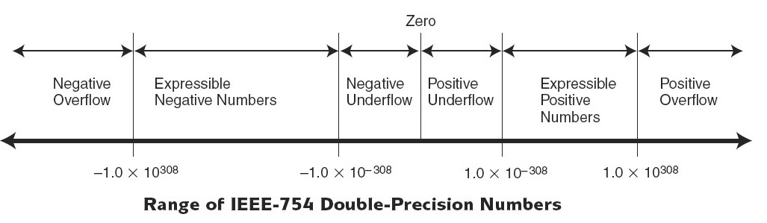
IEEE 754

Slide 38
IEEE 754
Example: Convert a single-precision floating number (41360000)₁₆ to a decimal number.
Solution: 41360000H=0100 0001 0011 0110 0000 0000 0000 0000B
Sign bit =0
Exponent bits 100 00010
Exponent 10000010-01111111=00000011B=3₁₀
Mantissa Bits 011 0110 0000 0000 0000 0000
Mantissa 1.011011B
N=(-1)⁰x(1.011011)x2³=1011.011B=(11.375)₁₀

Slide 39
IEEE 754
Example: Convert 20.59375₁₀ to single-precision floating point.
Solution: decimal 20.59375 = binary 10100.10011
=1.010010011x2⁴
Sign bit =0
Exponent bits 01111111+100=10000011
Mantissa Bits 010 0100 1100 0000 0000 0000
Putting it all together gives the following binary form,
0100 0001 1010 0100 1100 0000 0000 0000
4 1 A 4 C 0 0 0

Slide 40
Multiplication of Fixed-point Positive Numbers
The product of two n-digit numbers can be accommodated in 2n digits.
In the binary system, multiplication of the multiplicand by one bit of multiplier is easy. If the multiplier bit is 1, the multiplicand is entered in the appropriate position to be the partial.

Slide 41
Multiplication of Fixed-point Positive Numbers
1 1 0 1 (13) Multiplicand M
x 1 0 1 1 (11) Multiplier Q
1 1 0 1
1 1 0 1
0 0 0 0
1 1 0 1
1 0 0 0 1 1 1 1 (143) Product P

Slide 42
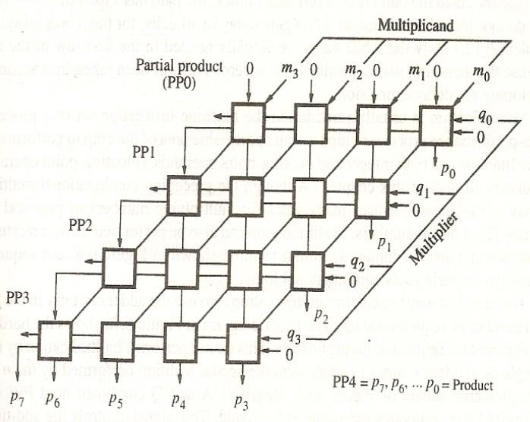
Multiplication of Fixed-point Positive Numbers

Slide 43
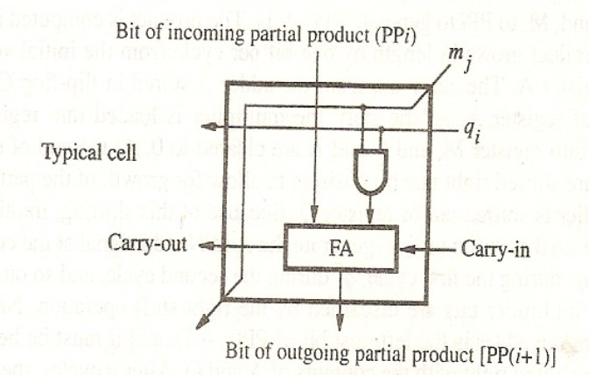
Multiplication of Fixed-point Positive Numbers

Slide 44
Multiplication of Fixed-point Signed Numbers
For multiplication of fixed-point signed numbers, the straightforward solution is to form the 2’s- complement of both multiplicand and multiplier and proceed as in the case of a positive numbers.

Slide 45
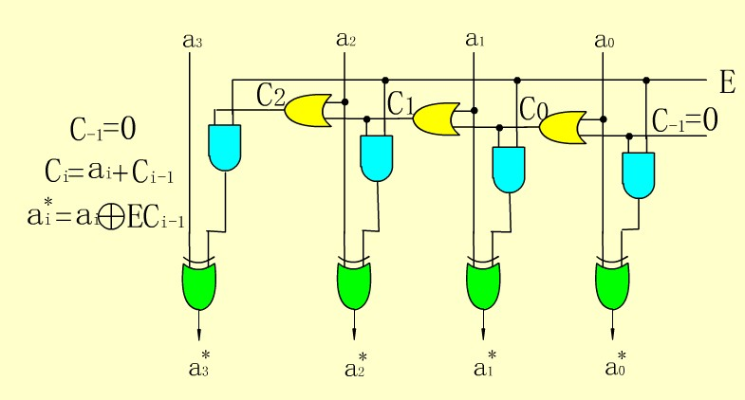
Multiplication of Fixed-point Signed Numbers
Get the 2’s complement of a n-bit binary number.

Slide 46
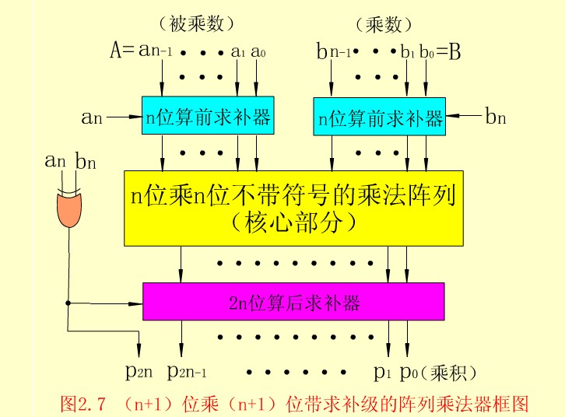
Multiplication of Fixed-point Signed Numbers

Slide 47
Booth Algorithm
The Booth algorithm generates a 2n-bit product and treat both positive and negative 2’s-complement n-bit operands uniformly.
Consider a multiplier 0011110,
0100000 32
- 0000010 2
0011110 30
The multiplier can be 0 +1 000 -1 0 instead of 0011110.

Slide 48
Booth Algorithm
In the Booth scheme, -1 times the shifted multiplicand is selected when moving from 0 to 1, and +1 times the shifted multiplicand is selected when moving from 1 to 0, as the multiplier is scanned from the right to left.

Slide 49
Booth Algorithm
Consider 0101101 x 0011110
0 1 0 1 1 0 1
x 0 0 1 1 1 1 0
0 0 0 0 0 0 0
0 1 0 1 1 0 1
0 1 0 1 1 0 1
0 1 0 1 1 0 1
0 1 0 1 1 0 1
0 0 0 0 0 0 0
0 0 0 0 0 0 0
0 0 0 1 0 1 0 1 0 0 0 1 1 0
Normal multiplication

Slide 50
Booth Algorithm
Consider 0101101 x 0011110
0 1 0 1 1 0 1
x 0+10 0 0-1 0
0 0 0 0 0 0 0 0 0 0 0 0 0
1 1 1 1 1 1 0 1 0 0 1 1
0 0 0 0 0 0 0 0 0 0 0
0 0 0 0 0 0 0 0 0 0
0 0 0 0 0 0 0 0 0
0 0 1 0 1 1 0 1
0 0 0 0 0 0 0
0 0 0 1 0 1 0 1 0 0 0 1 1 0
Booth multiplication
2’s complement of the multiplicand

Slide 51
Booth Algorithm
Example +13 x (-6)=-78 01101 x 11010= 01101 x (0 -1 +1 -1 0)
0 1 1 0 1
x 0 -1 +1 -1 0
0 0 0 0 0 0 0 0 0 0 0
1 1 1 1 1 1 0 0 1 1
0 0 0 0 0 1 1 0 1
1 1 1 1 0 0 1 1
0 0 0 0 0 0 0
1 1 1 1 0 1 1 0 0 1 0 (-78)₁₀
Booth multiplication
2’s complement of the multiplicand

Slide 52
Booth Algorithm
Recoding the multiplier is the main step of booth algorithm.
Multiplier |  | Version of Multiplicand selected by bit i
Bit i | Bit i-1
0 | 0 | 0 x M
0 | 1 | +1 x M
1 | 0 | -1 x M
1 | 1 | 0 x M

Slide 53
Booth Algorithm
The worst case, alternating 1s and 0s in the multiplier.
Multiplier 0 1 0 1 0 1 0 1 0 1
Recoded multiplier +1 -1 +1 -1 +1 -1 +1 -1 +1 -1

Slide 54
Booth Algorithm
The sequence of events in Booth Algorithm
Calculate (-5)x(-3)=15 1011 x 1101 = 0001111
A | Q | Q₋₁ | M | Initial values
0000 | 1101 | 0 | 1011
0101 | 1101 | 0 | 1011 | A←A-M | First cycle
0010 | 1110 | 1 | 1011 | Shift
1101 | 1110 | 1 | 1011 | A←A+M | Second cycle
1110 | 1111 | 0 | 1011 | Shift
0011 | 1111 | 0 | 1011 | A←A-M | Third cycle
0001 | 1111 | 1 | 1011 | Shift
0001 | 1111 | 1 | 1011 | A←A+0 | Fourth cycle (no shift in the last cycle)
0001 | 1111 | 1 | 1011 | No Shift

Slide 55
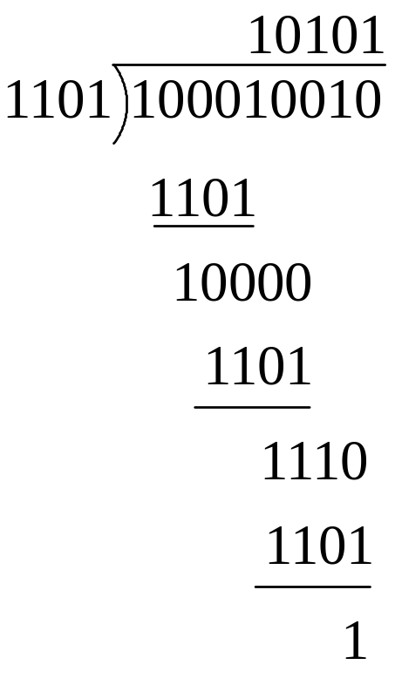
Unsigned Integer Division
It positions the divisor appropriately with respect to the dividend and performs a subtraction.

Slide 56
Unsigned Integer Division
A n-bit positive divisor is loaded into register M and a n-bit positive dividend is loaded into register Q at the start of the operation. Register A is set to zero. After the division is complete, the n-bit quotient is in register Q and the remainder is in register A.
Do the following n times:
Shift A and Q left one binary position
Subtract M from A, and place the answer back in A.
If the sign of A is 1, set q₀ to 0 and add M back to A; otherwise, set q₀ to 1.

Slide 57
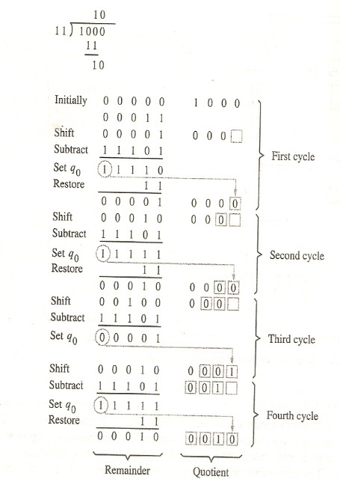
Unsigned Integer Division

Slide 58
Arithmetic Operations on Floating-Point Numbers
Add/Subtract Rule
Choose the number with the smaller exponent and shift its mantissa right a number of steps equal to the difference in exponents.
Set the exponent of result equal to the larger exponent.
Perform addition/subtraction on the mantissas and determine the sign of the result.
Normalize the resulting value, if necessary.

Slide 59
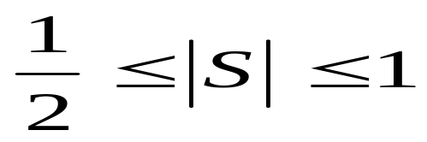
Arithmetic Operations on Floating-Point Numbers
When performing addition/subtraction on the mantissas, overflow may occur sometimes.
For a normalized decimal, the first number after the radix point is always 1.
The format of positive decimal is 00.1xxxx
The format of negative decimal is 11.0xxxx
x can be 1 or 0.

Slide 60
Arithmetic Operations on Floating-Point Numbers
If the result of addition/subtraction on the mantissas is,
11.1xxx or 00.0xxx
The mantissa need to shifted left one binary bit, subtract 1 to the exponent.

Slide 61
Arithmetic Operations on Floating-Point Numbers
Truncation and Rounding (Two methods)
If the bit to be removed is 0, it is simply dropped, with no changes to the retained bits.
If the bit to be removed is 1, add 1 to the retained bits.
2. No matter what number is removed ( 1 or 0), the least significant bit of the retained bit is set to 1.

Slide 62
Arithmetic Operations on Floating-Point Numbers
Example: Show how the following floating-point subtraction is performed. X=2⁻¹⁰¹ x (-0.101000); Y=2⁻¹⁰⁰ x (+0.111011)
X-Y=?
Exponent Mantissa
Solution: 1. X= 11,011 11.011000
Y=11,100 00.111011
X_{exp}-Y_{exp}=11,011+00,100=11,111=(-1)₁₀
The mantissa of X will shifted right one binary bit, add 1 to exponent,
X=11,100 11.101100

Slide 63
Arithmetic Operations on Floating-Point Numbers
Example: Show how the following floating-point subtraction is performed. X=2⁻¹⁰¹ x (-0.101000); Y=2⁻¹⁰⁰ x (+0.111011)
X-Y=?
Exponent Mantissa
Solution: 2. Subtraction of the mantissas
X_{mantissa}-Y_{mantissa}=11.101100+11.000101=10.110001
[X-Y]_{2’s complement} =11,100 10.110001

Slide 64
Arithmetic Operations on Floating-Point Numbers
Example: Show how the following floating-point subtraction is performed. X=2⁻¹⁰¹ x (-0.101000); Y=2⁻¹⁰⁰ x (+0.111011)
X-Y=?
Exponent Mantissa
Solution: 3. Normalization
Mantissa is 10.110001, it need to be shifted right one binary bit, add I to exponent
[X-Y]_{2’s complement} =11,101 11.011000

Slide 65
Arithmetic Operations on Floating-Point Numbers
Example: Show how the following floating-point subtraction is performed. X=2⁻¹⁰¹ x (-0.101000); Y=2⁻¹⁰⁰ x (+0.111011)
X-Y=?
Exponent Mantissa
Solution: 4. Rounding
1 is removed, add 1 to the retained numbers
[X-Y]_{2’s complement} =11,101 11.011000
+1
[X-Y]_{2’s complement} =11,101 11.011001

Slide 66
Arithmetic Operations on Floating-Point Numbers
Multiply Rule for Single-precision Floating-point Numbers
Add the exponents and subtract 127.
Multiply the mantissas and determine the sign of the result.
Normalize the resulting value, if necessary.

Slide 67
Arithmetic Operations on Floating-Point Numbers
Divide Rule for Single-precision Floating-point Numbers
Subtract the exponents and add 127.
Divide the mantissas and determine the sign of the result.
Normalize the resulting value, if necessary.

Slide 68
Homework
Given X=0.110100 x 2⁻⁰¹¹, Y=0.101110 x 2⁻¹⁰⁰,
Perform the following calculations.
X+Y=?
2. Use Booth algorithm to multiply -11/16 by -13/16.
3. Express the following numbers in IEEE 754 32-bit floating-point format,
384, -1.5

Slide 69
Next Lesson
Control Unit （控制单元）
Control Unit Operation
Microprogrammed Control

