Slide 1

Review
Chinese Character Codes
Fixed-point Representation
Floating-point Representation
Fixed-point Arithmetic
Floating-point Arithmetic
IEEE Standard for Floating-point Numbers (IEEE 754)

Slide 2
Main Content
Micro-Operations
Control of the Processor
Hardwired Implementation
Microprogrammed Control

Slide 3
Control Unit
The control unit (CU) is that portion of the processor that actually causes things to happen
The control unit issues control signals external to the processor to cause data exchange with memory and I/O modules
The control unit issues control signals internal to the processor to move data between registers, to cause the ALU to perform a specified function, and to regulate other internal operations

Slide 4
Micro-Operations
Programs are executed as a sequence of instructions
Each instruction consists of a series of steps that make up the instruction cycle -- fetch, decode, etc.
Each of these steps are, in turn, made up of a smaller series of steps called micro-operations
micro-operations are the functional, or atomic, operations of a processor

Slide 5
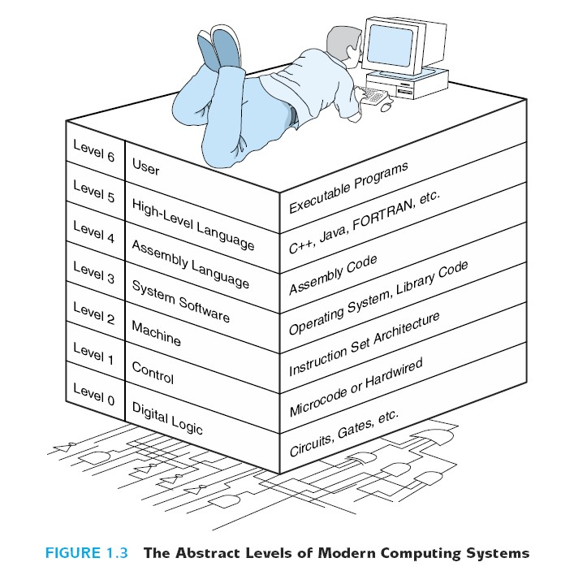
Micro-Operations

Slide 6
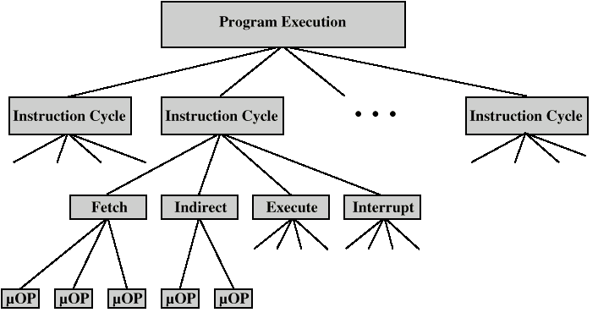
Constituent Elements of Program Execution

Slide 7
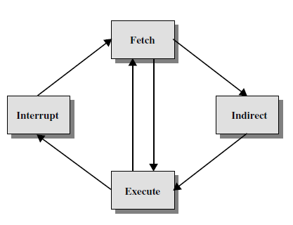
Operation analysis
There are 4 processor cycle for the
complementation of a instruction
The Fetch cycle
The Indirect cycle
The Execute cycle
The Interrupt cycle
Only fetch and execute cycles always occurring

Slide 8
The things needed to specify the function of a processor
Operations (opcode)
Addressing modes
Registers
I/O module interface
Memory module interface
Interrupt processing structure
Control bus
Address
Data bus
CPU
PC
MAR
Memory
I/O
CU
ALU
+1
IR
MBR

Slide 9
Fetch - 4 Registers
Memory Address Register (MAR)
  Connected to address bus
  Specifies address for read or write op
Memory Buffer Register (MBR)
  Connected to data bus
  Holds data to write or last data read
Program Counter (PC)
  Holds address of next instruction to be fetched
Instruction Register (IR)
  Holds last instruction fetched

Slide 10
Fetch Sequence
Address of next instruction is in PC
Address (MAR) is placed on address bus
Control unit issues READ command
Result (data from memory) appears on data bus
Data from data bus copied into MBR
PC incremented by 1 (in parallel with data fetch from memory)
Data (instruction) moved from MBR to IR
MBR is now free for further data fetches

Slide 11
Fetch cycle – micro-operations
Control bus
Address
Data bus
PC MAR Address Bus
CPU
R
(Control unit issues READ command)
PC
Memory MBR
MAR
Memory
I/O
MBR IR
CU
ALU
+1
( PC ) + 1 PC
IR
MBR

Slide 12
Rules for Clock Cycle Grouping
Proper sequence must be followed
  MAR <- (PC) must precede MBR <- (memory)
Conflicts must be avoided
  Must not read & write same register at same time
  MBR <- (memory) & IR <- (MBR) must not be in same cycle
Also: PC <- (PC) +1 involves addition
  Use ALU
  May need additional micro-operations

Slide 13
Indirect Cycle
(IR(Address)) MAR Address bus
Address bus
Data bus
Control bus
1 R
CPU
Memory MBR
MAR
Memory
MBR IR(Address)
CU
IR
MBR

Slide 14
Interrupt Cycle
At the completion of the execute cycle, a test is made to determine whether any enabled interrupts have occurred
The nature of interrupt cycle varies greatly from one machine to another
A simple sequence of events as follow
  MBR <-(PC)
  MAR <- save-address
  PC <- routine-address
  memory <- (MBR)

Slide 15
Execute Cycle
The fetch, indirect, and interrupt cycles are simple and predictable – each involves a small, fixed sequence of micro-operations
The execute cycle, different for each instruction
Can be discussed in three types
  Instruction without memory access
  Instruction with memory access
  Branch instruction

Slide 16
1. Instruction without memory access
(1) CLA clean A
0 ACC
(2) COM complement
ACC ACC
(3) STP halt
0 G

Slide 17
2. Instruction with memory access
(1) Add instruction
ADD R1, X
(IR(Address)) MAR
1 R (control bus)
Memory MBR
(R1) + (MBR) R1
(2) Store data instruction
STA X
(IR(Address)) MAR
1 W (control bus)
ACC MBR
MBR Memory

Slide 18
3. Branch instruction
ISZ X – The content of location X is incremented by 1. If the result is 0, the next instruction is skipped.
  (MBR) → memory
  if (MBR) == 0 then (PC)+1→PC
Notes:
  The steps in red can be done simultaneously.
(IR(Address)) MAR
1 R (control bus)
Memory MBR
(MBR)+1 MBR

Slide 19
Instruction Cycle
Each phase of the instruction can be decomposed into a sequence of elementary micro-operations
  E.g. fetch, indirect, and interrupt cycles
For execute cycle
  One sequence of micro-operations for each opcode
Need to tie sequences of micro-operations together, so, assume new 2-bit Instruction Cycle Code (ICC) register designates which part of cycle processor is in
    00: Fetch
    01: Indirect
    10: Execute
    11: Interrupt

Slide 20
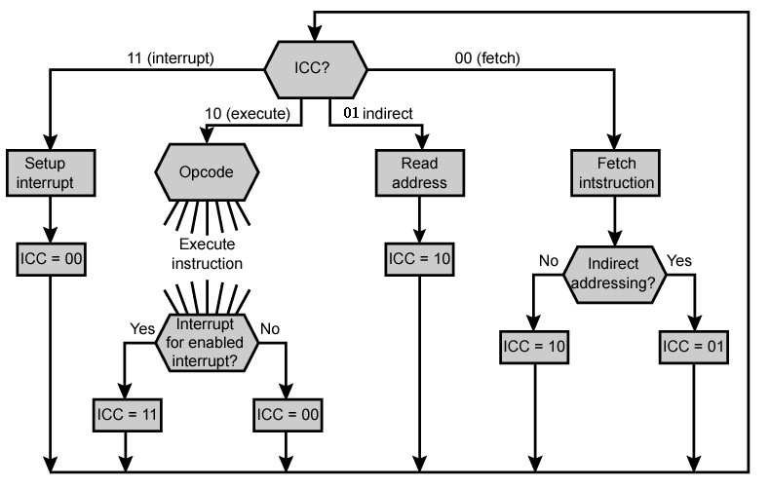
Flowchart for Instruction Cycle

Slide 21
Functional Requirements
The definition of control unit functional requirements is the basis for the design and implementation of the control unit
The following three-step process leads to a characterization of the control unit:
  Define basic elements of processor
  Describe micro-operations that processor performs
  Determine the functions that the control unit must perform to cause the micro-operations to be performed

Slide 22
Basic Elements of Processor
ALU – is the functional essence of CPU
Registers – are used to store data or status information internal to the CPU
Internal data paths – are used to move data between registers and between register and ALU
External data paths – link registers to memory and I/O modules, often by means of a system bus
Control Unit – causes operations to happen within the CPU

Slide 23
Types of Micro-operation
Transfer data between registers
Transfer data from register to external
Transfer data from external to register
Perform arithmetic or logical ops

Slide 24
Functions of Control Unit
More explicitly, the control unit performs two basic task: sequencing and execution
Sequencing
  Causing the CPU to step through a series of micro-operations
Execution
  Causing the performance of each micro-op
This is done using Control Signals

Slide 25
Control Signals
Must have inputs that allow it to determine the state of the system
Must have outputs that allow it to control the behavior of the system
IR
System control bus
Control signals within CPU
flags
…
Control
Unit
Control signals to system bus
clock
Control signals from system bus

Slide 26
Control Signals- Inputs
Clock
  One micro-instruction (or set of parallel micro-instructions) per clock cycle
Instruction register
  Op-code for current instruction
  Determines which micro-instructions are performed
Flags
  State of CPU
  Results of previous operations
From control bus
  Interrupts
  Acknowledgements

Slide 27
Control Signals - output
Within CPU
  Cause data movement
  Activate specific functions
Via control bus
  To memory
  To I/O modules

Slide 28
Example Control Signal Sequence - Fetch
MAR <- (PC)
  Control unit activates signal to open gates between PC and MAR
MBR <- (memory)
  Open gates between MAR and address bus
  Memory read control signal
  Open gates between data bus and MBR

Slide 29
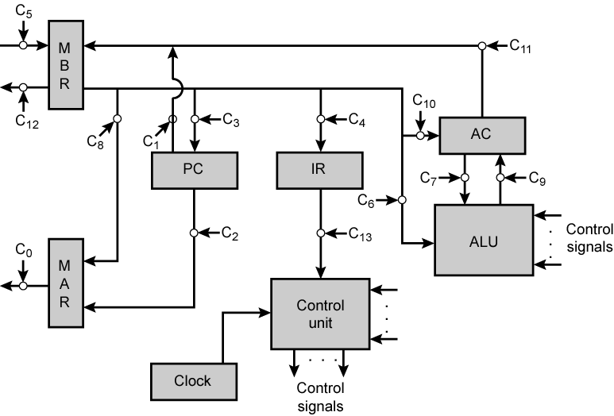
Data Paths and Control Signals

Slide 30
Internal Organization
Usually a single internal bus
Gates control movement of data onto and off the bus
Control signals control data transfer to and from external systems bus
Temporary registers needed for proper operation of ALU

Slide 31
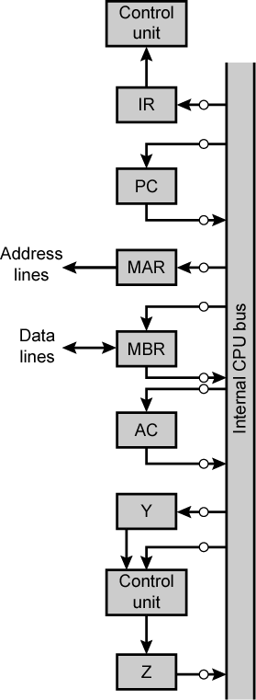
CPU with
Internal
Bus

Slide 32
CPU with internal bus example
control signals
…
(1) ADD @ X fetch cycle
CU
clock
CU
IR_{i}
IR
IR
IR
PC
MAR
address bus
PC_{O}
MAR_{i}
PC
PC
PC
PC_{O}
CPU internal bus
CU 1 R
address bus
MAR
MAR_{i}
MAR
data bus
MBR
data bus
MBR
MBR
MBR
MBR_{O}
MBR
IR
MBR_{O}
IR_{i}
AC
OP（IR）
CU
Y
（PC）+ 1 PC
control signals
…
ALU
Z

Slide 33
(2) ADD @ X indirect cycle
control signals
…
clock
CU
Address MAR
IR_{i}
IR
IR
MBR
MAR
address bus
MBR_{O}
MAR_{i}
PC
CPU internal bus
1 R
address bus
MAR
MAR_{i}
MAR
data bus
MBR
data bus
MBR
MBR
MBR
MBR
MBR_{O}
MBR_{O}
MBR_{O}
MBR_{O}
MBR_{O}
MBR
IR
MBR_{O}
IR_{i}
AC
Y
Effective Address (IR(Address))
control signals
ALU
…
Z

Slide 34
control signals
(3) ADD @ X execute cycle
…
clock
CU
MBR
MAR
address bus
MBR_{O}
MAR_{i}
IR
1 R
PC
data bus
MBR
CPU internal bus
MAR_{i}
address bus
MAR
MAR
MBR
Y
ALU
MBR_{O}
Y_{i}
data bus
MBR
MBR
MBR
MBR
MBR_{O}
MBR_{O}
MBR_{O}
MBR_{O}
MBR_{O}
MBR_{O}
MBR_{O}
AC
ALU
AC_{i}
AC
AC
AC
AC
AC
AC
AC_{O}
ALU_{i}
AC
AC_{O}
Y
Y_{i}
（AC）+（Y）
Z
Y
ALU_{i}
Z
AC
ALU
ALU
control signals
…
ALU
Z_{O}
AC_{i}
Z_{O}
Z
Z
Z

Slide 35
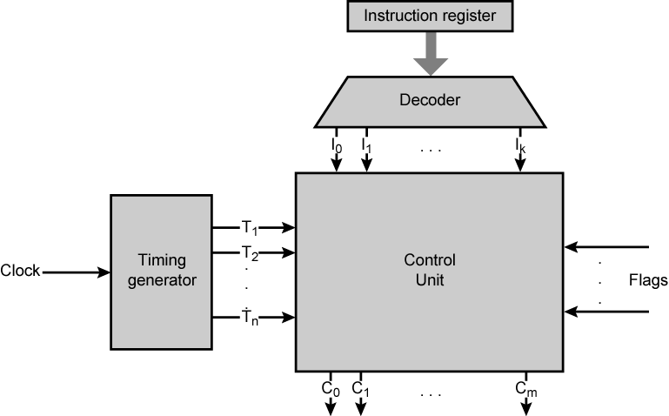
Control Unit with Decoded Inputs

Slide 36
Hardwired Implementation (1)
Control unit inputs
Flags and control bus
  Each bit means something
Instruction register
  Op-code causes different control signals for each different instruction
  Unique logic for each op-code
  Decoder takes encoded input and produces single output
  n binary inputs and 2^{n} outputs

Slide 37
Hardwired Implementation (2)
Clock
  Repetitive sequence of pulses
  Useful for measuring duration of micro-ops
  Must be long enough to allow signal propagation
  Different control signals at different times within instruction cycle

Slide 38
Timing Signals
Clock Cycle
CLK
T₀
T₁
T₂
T₃
T₀
T₁
T₂
T₃
T₀
T₁
T₂
T₃
Machine Cycle
Machine Cycle

Slide 39
Hardwired Implementation
The key inputs are the instruction register, the clock, flags, and control bus signal.
The outputs are control signals, each control signal has individual Boolean expression.
Derive the Boolean expression between the inputs and output.

Slide 40
Problems With Hard Wired Designs
Complex sequencing & micro-operation logic
Difficult to design and test
Inflexible design
Difficult to add new instructions

Slide 41
Micro-programmed Control
The term microprogram was first coined by M.V.Wilkes in the early 1950s
Use sequences of instructions to control complex operations
Called micro-programming or firmware

Slide 42
Implementation
All the control unit does is generate a set of control signals
Each control signal is on or off
Represent each control signal by a bit
Have a control word for each micro-operation
Have a sequence of control words for each machine code instruction
Add an address to specify the next micro-instruction, depending on conditions

Slide 43
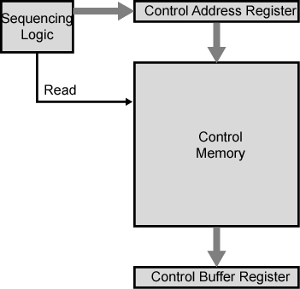
Control Unit
The set of microinstructions is stored in the control memory.
The control address register contains the address of the next microinstruction to be read.
When a microinstruction is read from the control memory, it is transferred to a control buffer register.

Slide 44
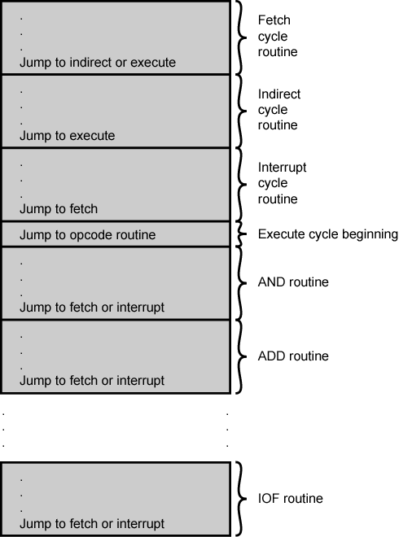
Organization of
Control Memory

Slide 45
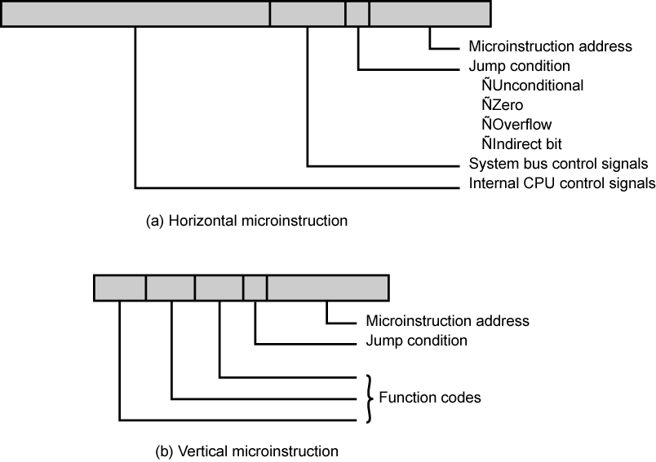
Typical Microinstruction Formats

Slide 46
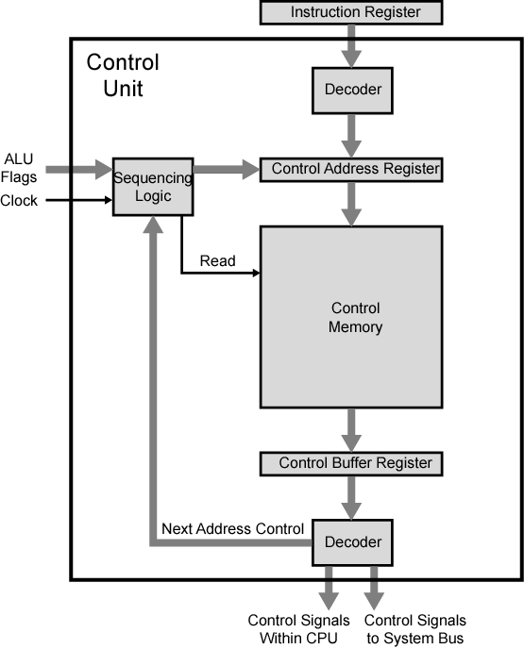
Functioning of Microprogrammed Control Unit

Slide 47
Micro-instruction Types
Each micro-instruction specifies single (or few) micro-operations to be performed
  (vertical micro-programming)
Each micro-instruction specifies many different micro-operations to be performed in parallel
  (horizontal micro-programming)

Slide 48
Horizontal Micro-programming
Wide memory word
High degree of parallel operations possible
Little encoding of control information

Slide 49
Vertical Micro-programming
Width is narrow
n control signals encoded into log₂ n bits
Limited ability to express parallelism
Considerable encoding of control information requires external memory word decoder to identify the exact control line being manipulated

Slide 50
Execute the Micro-programming
Control signals | Condition bits | Microinstruction address
Turn on all the control lines indicated by a 1 bit; leave off all control lines indicated by a 0 bit.
If the condition indicated by the condition bits is false, execute the next microinstruction in sequence.
If the condition indicated by the condition bits is true, the next microinstruction to be executed is indicated in the address field.

Slide 51
Micro-program Word Length
Based on 3 factors
  Maximum number of simultaneous micro-operations supported
  The way control information is represented or encoded
  The way in which the next micro-instruction address is specified

Slide 52
Design Considerations
Size of microinstructions
Address generation time
  Determined by instruction register
    Once per cycle, after instruction is fetched
  Next sequential address
    Common in most designed
  Branches
    Both conditional and unconditional

Slide 53
Advantages and Disadvantages of Microprogramming
Simplifies design of control unit
  Cheaper
  Less error-prone
Slower

Slide 54
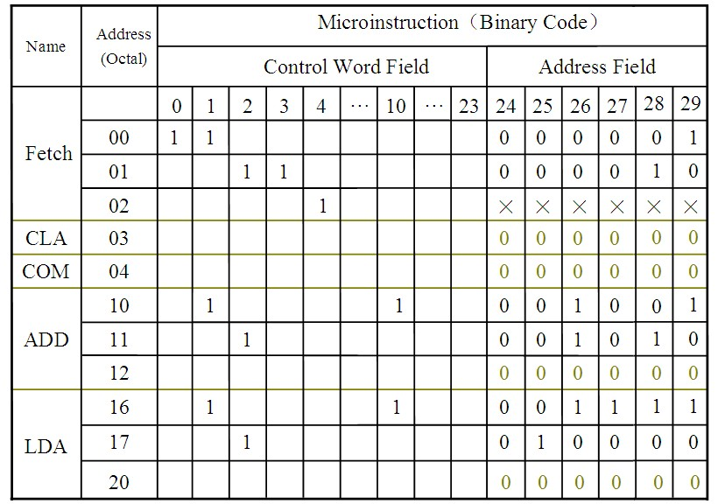
Example (The address of next microinstruction can be obtained in the address field directly.)

Slide 55
Review Questions (思考题)
1. Provide a typical list of the inputs and outputs of a control unit.
2. What is the difference between a hardwired implementation and a microprogrammed implementation of a control unit?
CHAPTER 0

Slide 56
Next Lesson
Memory （存储器）
CHAPTER 0

