Slide 1
Review
Micro-Operations
Control of the Processor
Hardwired Implementation
Microprogrammed Control

Slide 2
Main Content
Characteristics of Memory System
Types of Memory
The Memory Hierarchy
Cache Memory
Virtual Memory

Slide 3
Characteristics of Memory Systems
Location
CPU
Internal
External
Capacity
Word
Byte
Unit of Transfer
Internal
  Usually governed by data bus width
External
  Usually a block which is much larger than a word

Slide 4
Access Methods (1)
Characteristics of Memory Systems
Sequential(顺序存储)
  Start at the beginning and read through in order
  Access time depends on location of data and previous location
  e.g. tape
Direct(直接存储)
  Individual blocks have unique address
  Access is by jumping to vicinity plus sequential search
  Access time depends on location and previous location
  e.g. disk

Slide 5
Access Methods (2)
Characteristics of Memory Systems
Random
  Individual addresses identify locations exactly
  Access time is independent of location or previous access
  e.g. RAM
Associative
  Data is located by a comparison with contents of a portion of the store
  Access time is independent of location or previous access
  e.g. cache

Slide 6
Performance
Characteristics of Memory Systems
Access time
  Time between presenting the address and getting the valid data
Memory Cycle time
  Time may be required for the memory to “recover” before next access
  Cycle time is access + recovery
Transfer Rate
  Rate at which data can be moved

Slide 7
Physical Types
Characteristics of Memory Systems
Semiconductor
  RAM
Magnetic
  Disk & Tape
Optical(光介质)
  CD & DVD
Others
  Hologram

Slide 8
The Bottom Line
How much? (Capacity)
  Greater capacity, smaller cost per bit
  Greater capacity, slower access time
How fast? (Access time)
  Faster access time, greater cost per bit
How expensive? (Cost)

Slide 9
Memory Hierarchy
Registers
  In CPU
Internal or Main memory
  May include one or more levels of cache
  “RAM”
External memory
  Backing store

Slide 10
Hierarchy List
Registers
L1 Cache
L2 Cache
Main memory
Disk
Optical
Tape

Slide 11

Memory Hierarchy - Diagram

Slide 12
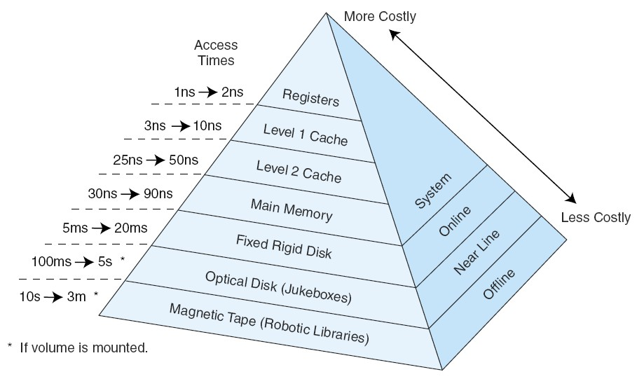
Hierarchy List

Slide 13

Cache
Small amount of fast memory
Sits between normal main memory and CPU
May be located on CPU chip or module

Slide 14
Content addressable memory
What makes cache “special”?
Cache is not accessed by address; it is accessed by content.
For this reason, cache is sometimes called content addressable memory or CAM.

Slide 15
Principle of Locality(局部性原理)
The effectiveness of the cache mechanism is based on a property of computer programs called locality of reference.
Temporal Locality(时间局部性), means that a recently executed instructions is likely to be executed again very soon.
Spatial Locality(空间局部性), means that instructions in close proximity to a recently instruction are also likely to be executed soon.

Slide 16
Terminology
Hit(命中): The requested data resides in a given level of memory.
Miss(缺失): The requested data is not found in the given level of memory.
Hit Rate: The percentage of memory accesses found in a given level of memory.
Miss Rate: The percentage of memory accesses not found in a given level of memory. Miss Rate=1-Hit Rate
Hit Time: The time required to access the requested information in a given level of memory(某个特定的存储器的层次).
Miss Penalty: The time required to process a miss, which includes replacing a block in an upper level of memory, plus the additional time to deliver the requested data to the processor.(缺失后再次回到内存,将与之有关的所有信息作为数据块取出存到高速缓存中,以增加下次访问的命中率)

Slide 17
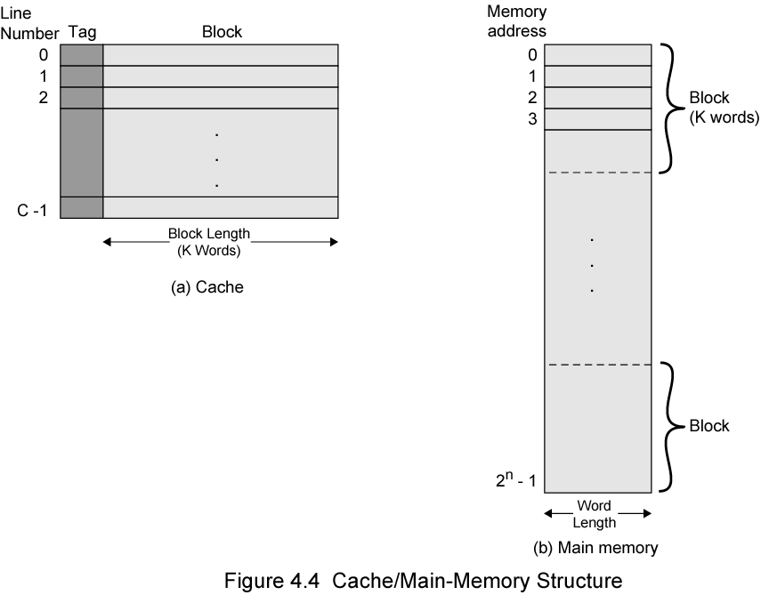
Cache/Main Memory Structure
主存和cache被分成若干数据块,
且大小是匹配的

Slide 18
Cache operation – overview
CPU requests contents of memory location
Check cache for this data
If present, get from cache (fast)
If not present, read required block from main memory to cache
Then deliver from cache to CPU
Cache includes tags to identify which block of main memory is in each cache slot

Slide 19
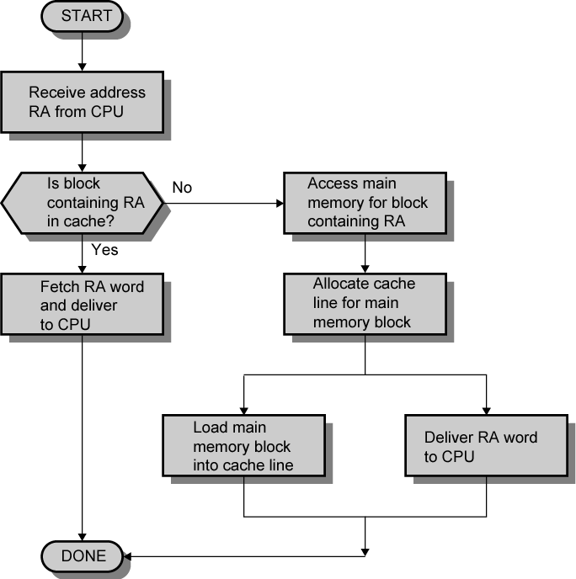
Cache Read Operation - Flowchart
首先在cache中匹配

Slide 20

Typical Cache Organization

Slide 21
Cache Design
Size
Mapping Function(映射机制)
Replacement Algorithm(替换算法)
Write Policy(回写策略)
Block Size(块大小,根据关联程度设计)
Number of Caches(一级缓存,二级缓存,数据缓存,etc)

Slide 22
Cache Size(根据价格与访问速度来衡量)
Small enough so overall cost/bit is close to that of main memory
Large enough so overall average access time is close to that of the cache alone
  Access time = main memory access time plus cache access time
Large caches tend to be slightly slower than small caches
It is impossible to arrive at a single “optimum” cache size

Slide 23
Comparison of Cache Sizes
Processor
Type
Year of Introduction
L1 cachea
L2 cache
L3 cache
IBM 360/85
Mainframe
1968
16 to 32 KB
—
—
PDP-11/70
Minicomputer
1975
1 KB
—
—
VAX 11/780
Minicomputer
1978
16 KB
—
—
IBM 3033
Mainframe
1978
64 KB
—
—
IBM 3090
Mainframe
1985
128 to 256 KB
—
—
Intel 80486
PC
1989
8 KB
—
—
Pentium
PC
1993
8 KB/8 KB
256 to 512 KB
—
PowerPC 601
PC
1993
32 KB
—
—
PowerPC 620
PC
1996
32 KB/32 KB
—
—
PowerPC G4
PC/server
1999
32 KB/32 KB
256 KB to 1 MB
2 MB
IBM S/390 G4
Mainframe
1997
32 KB
256 KB
2 MB
IBM S/390 G6
Mainframe
1999
256 KB
8 MB
—
Pentium 4
PC/server
2000
8 KB/8 KB
256 KB
—
IBM SP
High-end server/ supercomputer
2000
64 KB/32 KB
8 MB
—
CRAY MTAb
Supercomputer
2000
8 KB
2 MB
—
Itanium
PC/server
2001
16 KB/16 KB
96 KB
4 MB
SGI Origin 2001
High-end server
2001
32 KB/32 KB
4 MB
—
Itanium 2
PC/server
2002
32 KB
256 KB
6 MB
IBM POWER5
High-end server
2003
64 KB
1.9 MB
36 MB
CRAY XD-1
Supercomputer
2004
64 KB/64 KB
1MB
—
a Two values seperated by a slash refer to instruction and data caches
b Both caches are instruction only; no data caches

Slide 24
Mapping Function(重点)
Direct Mapping(直接映射)
Associative Mapping(相连映射)
Set Associative Mapping(组相连映射)
The elements included in the following example:
Cache of 64k Byte (即需要16条8位的地址总线)
Cache block of 4 bytes(即内存中的数据块大小也是4个字节)
  i.e. cache is 16k (2¹⁴) lines(槽) of 4 bytes
16MBytes main memory
24 bit address
  (2²⁴=16M)(即有16/4M的数据块)

Slide 25
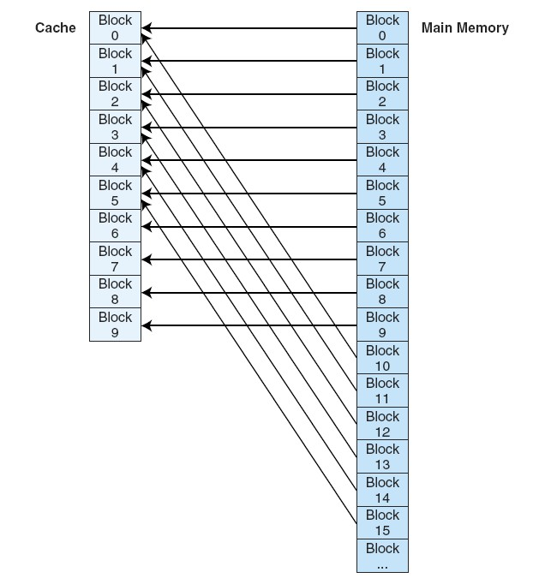
Direct Mapping
内存中的数据块映射到
cache中的槽是一对一的;
cache的槽映射到内存中
是多对一的.

Slide 26
Direct Mapping
Each block of main memory maps to only one cache line
  i.e. if a block is in cache, it must be in one specific place
  i = j mod m
  Where
  i=cache line number
  j=main memory block number
  m=number of lines in the cache

Slide 27
Direct Mapping
Address is in two parts
Least Significant w bits identify unique word(最低w位来定义数据块的大小)
Most Significant s bits specify one memory block
The MSBs are split into a cache line field r(对应的槽号) and a tag of s-r(标签) (most significant) Cache m=2^{r}

Slide 28
Direct Mapping
Cache Line Table
Cache line Main Memory blocks held
0 0, m, 2m, 3m…2^{s}-m
1 1,m+1, 2m+1…2^{s}-m+1
m-1 m-1, 2m-1,3m-1…2^{s}-1

Slide 29
Direct Mapping
Address Structure
Tag s-r
Line or Slot r
Word w
8
14
2
24 bit address
2 bit word identifier (4 byte block)
22 bit block identifier
  8 bit tag (=22-14)
  14 bit slot or line
No two blocks in the same line have the same Tag field
Check contents of cache by finding line and checking Tag

Slide 30
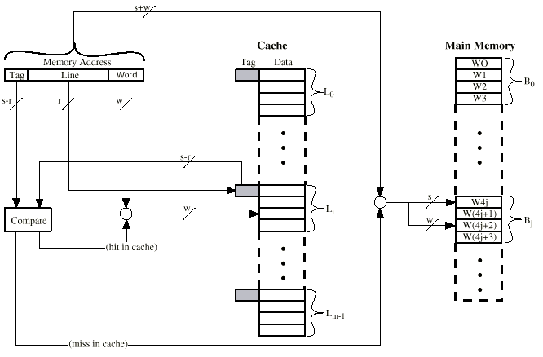
Direct Mapping Cache Organization

Slide 31
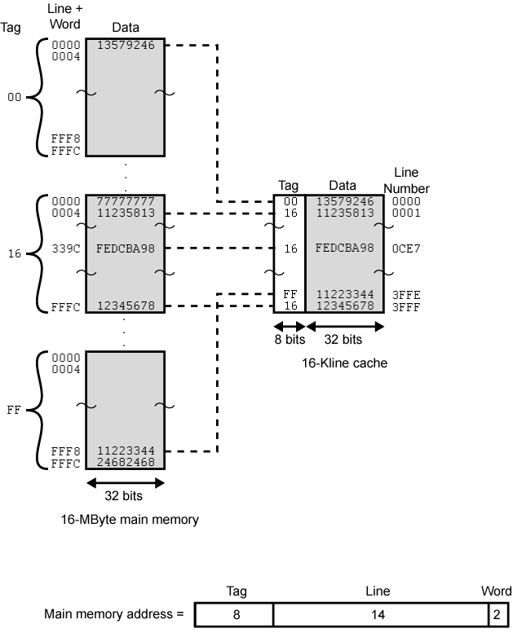
Direct Mapping
Example

Slide 32
Direct Mapping Summary
Address length = (s + w) bits
Number of addressable units = 2^{s+w} words or bytes
Block size = line size = 2^{w} words or bytes
Number of blocks in main memory = 2^{s+ w}/2^{w} = 2^{s}
Number of lines in cache = m = 2^{r}
Size of tag = (s – r) bits

Slide 33
Direct Mapping pros & cons
Simple
Inexpensive
Fixed location for given block
  If a program accesses 2 blocks that map to the same line repeatedly, cache misses are very high

Slide 34
Associative Mapping
A main memory block can load into any line of cache
Memory address is interpreted as tag and word
Tag uniquely identifies block of memory
Every line’s tag is examined for a match
Cache searching gets expensive

Slide 35
Associative Mapping
多对多
Memory
Block
0
1
Line
Number
Tag Cache
2
3
0
4
1
5
2
6
3
7
4
8
5
9
6
10
7
11
12
13
14
15
Associative Mapping

Slide 36

Associative Cache Organization
将每一个槽的标记
都取出并匹配

Slide 37
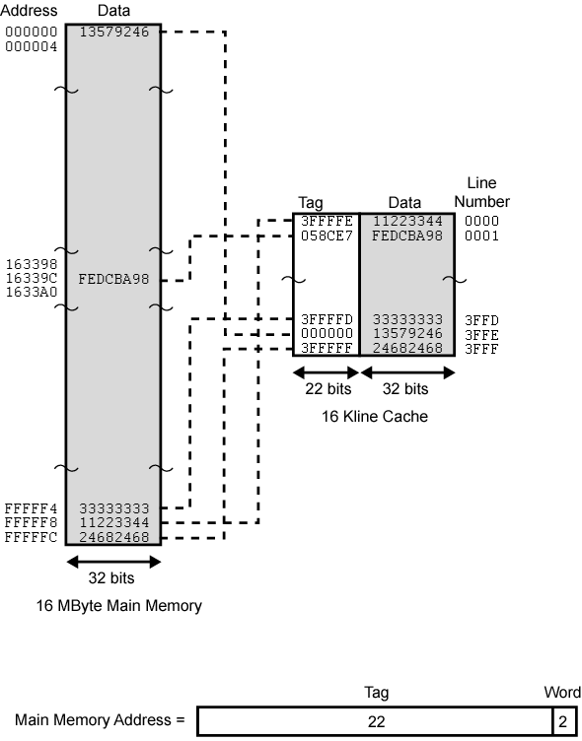
Associative
Mapping Example

Slide 38
Associative Mapping
Address Structure
Word
2 bit
Tag 22 bit
22 bit tag stored with each 32 bit block of data
Compare tag field with tag entry in cache to check for hit
Least significant 2 bits of address identify which 16 bit word is required from 32 bit data block
e.g.
  Address Tag Data Cache line
  FFFFFC 3FFFFF 24682468 3FFF

Slide 39
Associative Mapping Summary
Address length = (s + w) bits
Number of addressable units = 2^{s+w} words or bytes
Block size = line size = 2^{w} words or bytes
Number of blocks in main memory = 2^{s+ w}/2^{w} = 2^{s}
Number of lines in cache = undetermined
Size of tag = s bits

Slide 40
Set Associative Mapping
Cache is divided into a number of sets
Each set contains a number of lines
A given block maps to any line in a given set
  e.g. Block B can be in any line of set i
e.g. 2 lines per set
  2 way associative mapping
  A given block can be in one of 2 lines in only one set

Slide 41
Set Associative Mapping
Memory
Block
0
1
Line
Number
Cache
2
3
0
Set 0
4
1
5
2
Set 1
6
3
7
4
Set 2
8
5
9
6
Set 3
10
7
11
12
13
14
15
Set Associative Mapping

Slide 42
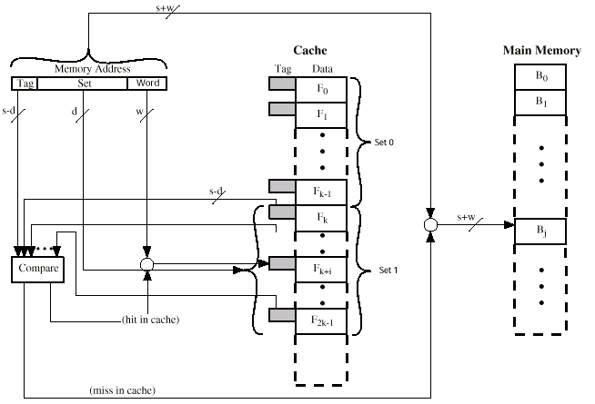
K Way Set Associative Cache Organization

Slide 43
Set Associative Mapping
Address Structure
Word
2 bit
Tag 9 bit
Set 13 bit
Use set field to determine cache set to look in
Compare tag field to see if we have a hit
e.g
  Address Tag Data Set number
  FFFFFC 1FF 12345678 1FFF
  00FFFC 001 11223344 1FFF

Slide 44
Set Associative Mapping Example
13 bit set number
000000, 008000, 018000, FF8000 … map to same set 0000

Slide 45
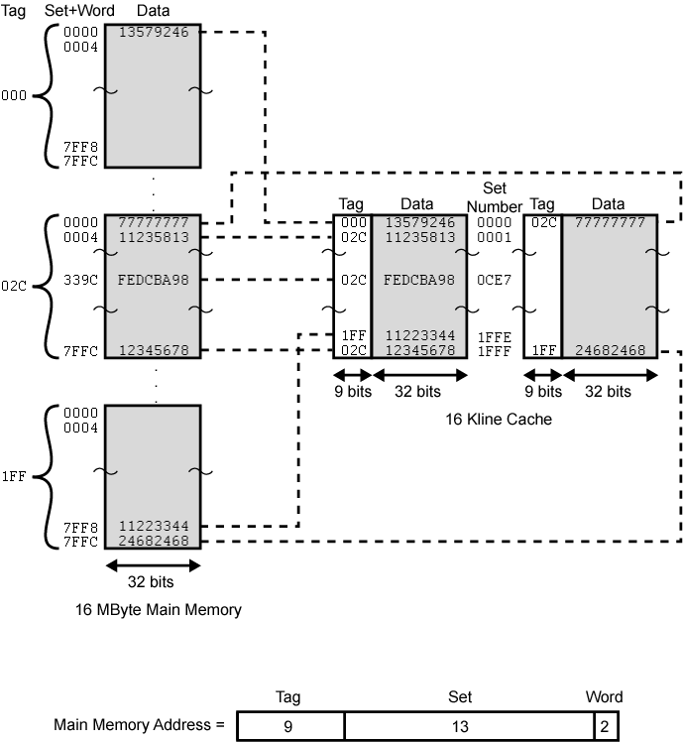
Two Way
Set
Associative
Mapping
Example
Two Way
Set
Associative
Mapping
Example

Slide 46
Set Associative Mapping Summary
Address length = (s + w) bits
Number of addressable units = 2^{s+w} words or bytes
Block size = line size = 2^{w} words or bytes
Number of blocks in main memory = 2^{s+w}/2^{w}=2^{s}
Number of lines in set = k
Number of sets = v = 2^{d}
Number of lines in cache = k×v = k×2^{d}
Size of tag = (s – d) bits

Slide 47
Set Associative Mapping Summary
When v=m, k=1, the set associative mapping reduces to direct mapping.
When v=1, k=m, the set associative mapping reduces to associative mapping.
The use of two lines per set (v=m/2, k=2) is the common set associative mapping organization.

Slide 48
Replacement Algorithms (1)
Direct mapping
No choice
Each block only maps to one line
Replace that line

Slide 49
Replacement Algorithms (2)
Associative & Set Associative
Hardware implemented algorithm (speed)
Least Recently used (LRU)
e.g. in 2 way set associative
  Which of the 2 block is LRU?
First in first out (FIFO)
  replace block that has been in cache longest
Least frequently used
  replace block which has had fewest hits
Random

Slide 50
Write Policy
Must not overwrite a cache block unless main memory is up to date
Multiple CPUs may have individual caches
I/O may address main memory directly

Slide 51
Write through
All writes go to main memory as well as cache
Multiple CPUs can monitor main memory traffic to keep local (to CPU) cache up to date
Lots of traffic
Slows down writes

Slide 52
Write back
Updates initially made in cache only
Update bit for cache slot is set when update occurs
If block is to be replaced, write to main memory only if update bit is set
Other caches get out of sync
I/O must access main memory through cache

Slide 53
Line Size (块的大小)
As the block size increases from very small to larger sizes, the hit rate will at first increase because the data in the vicinity of a referenced word are likely to be referenced in the near future.
The hit rate will begin to decrease, as the block becomes even bigger.
64~128 byte cache line sizes are most frequently used.

Slide 54
Number of Caches
Multilevel Caches (L1 / L2)
On-chip Cache
Off-chip Cache
Split Caches
Data Cache
Instruction Cache

Slide 55
Pentium 4 Cache
80386 – no on chip cache
80486 – 8k using 16 byte lines and four way set associative organization
Pentium (all versions) – two on chip L1 caches
  Data & instructions
Pentium III – L3 cache added off chip
Pentium 4
  L1 caches
    8k bytes
    64 byte lines
    four way set associative
  L2 cache
    256k
    128 byte lines
    8 way set associative
  L3 cache on chip

Slide 56
Intel Cache Evolution
Problem
Solution
Processor on which feature first appears
External memory slower than the system bus.
Add external cache using faster memory technology.
386
Increased processor speed results in external bus becoming a bottleneck for cache access.
Move external cache on-chip, operating at the same speed as the processor.
486
Internal cache is rather small, due to limited space on chip
Add external L2 cache using faster technology than main memory
486
Contention occurs when both the Instruction Prefetcher and the Execution Unit simultaneously require access to the cache. In that case, the Prefetcher is stalled while the Execution Unit’s data access takes place.
Create separate data and instruction caches.
Pentium
Increased processor speed results in external bus becoming a bottleneck for L2 cache access.
Create separate back-side bus that runs at higher speed than the main (front-side) external bus. The BSB is dedicated to the L2 cache.
Pentium Pro
Move L2 cache on to the processor chip.
Pentium II
Some applications deal with massive databases and must have rapid access to large amounts of data. The on-chip caches are too small.
Add external L3 cache.
Pentium III
Move L3 cache on-chip.
Pentium 4

Slide 57
PowerPC Cache Organization
601 – single 32kb 8 way set associative
603 – 16kb (2 x 8kb) two way set associative
604 – 32kb
620 – 64kb
G3 & G4
  64kb L1 cache
    8 way set associative
  256k, 512k or 1M L2 cache
    two way set associative
G5
  32kB instruction cache
  64kB data cache

Slide 58
Virtual Memory
The purpose of virtual memory is to use the hard disk as an extension of RAM, thus increasing the available address space a process can use.
The most common way to implement virtual memory is using paging, a method in which main memory is divided into fixed-size blocks and programs are divided into the same size blocks.

Slide 59
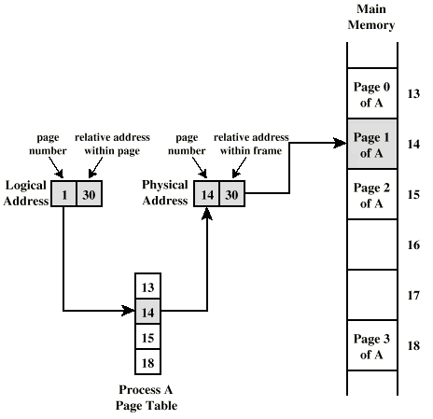
Virtual Memory
  Each program has a page table associated with it that maps each program page to a memory page frame.
  Thus, logical addresses in a program are interpreted as a physical address -- page frame number and an offset within the page.

Slide 60
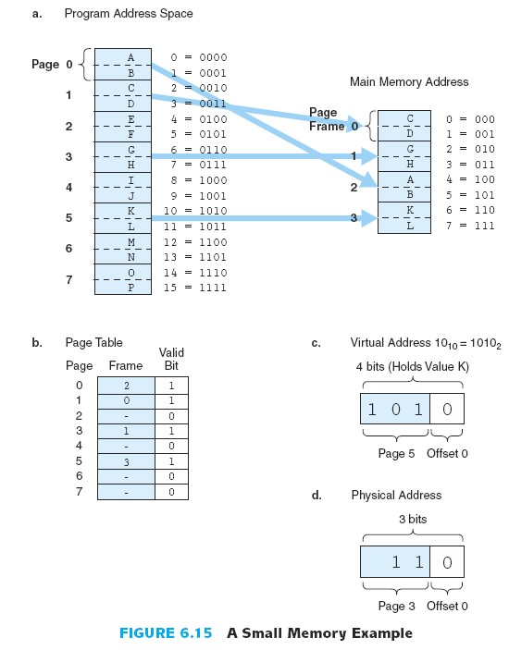
Virtual Memory
Suppose a program is 16 bytes long, has access to an 8-byte memory that uses bytes addressing, and a page is 2 bytes in length. As the program executes, it generates the following addresses reference string: 0,1,2, 3,6,7,
10,11.

Slide 61
Review Questions (思考题)
1. Explain the purpose of virtual memory and cache.
2. Explain how associative mapping cache is different from direct mapping cache.
CHAPTER 0

Slide 62
Next Lesson
System Bus
CHAPTER 0

