Slide 1

Review
Characteristics of Memory System
Types of Memory
The Memory Hierarchy
Cache Memory
Virtual Memory

Slide 2
Main Content
System Buses

Slide 3
Buses
There are a number of possible interconnection systems
Single and multiple BUS structures are most common
e.g. Control/Address/Data bus (PC)

Slide 4
What is a Bus?
A communication pathway connecting two or more devices
Usually broadcast
Often grouped
  A number of channels in one bus
  e.g. 32 bit data bus is 32 separate single bit channels
Power lines may not be shown

Slide 5
Data Bus
Carries data
  Remember that there is no difference between “data” and “instruction” at this level
Width is a key determinant of performance
  8, 16, 32, 64 bit

Slide 6
Address bus
Identify the source or destination of data
e.g. CPU needs to read an instruction (data) from a given location in memory
Bus width determines maximum memory capacity of system
  e.g. 8080 has 16 bit address bus giving 64k address space

Slide 7
Control Bus
Control and timing information
  Memory read/write signal
  Interrupt request
  Clock signals

Slide 8
Single Bus Structure
The simplest way to interconnect functional units is to use a single bus, all units are connected to this bus.
Because the bus can be used for only one transfer at a time, only two units can actively use the bus at any given time.

Slide 9

Bus Interconnection Scheme

Slide 10
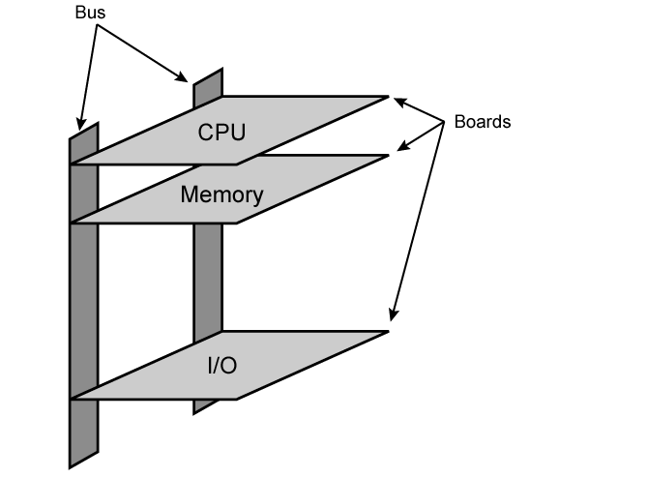
Physical Realization of Bus Architecture

Slide 11
Single Bus Problems
Lots of devices on one bus leads to:
  Propagation delays
    Long data paths mean that co-ordination of bus use can adversely affect performance
    If aggregate data transfer approaches bus capacity
Most systems use multiple buses to overcome these problems

Slide 12
Multiple-Bus Hierarchies
System bus
CPU
Memory
…
I/O Interface
I/O Interface
Local Bus
DMA Bus
Device
…
Device

Slide 13

Multiple-Bus Hierarchies

Slide 14
Bus Types
Dedicated
  Separate data & address lines
Multiplexed
  Shared lines
  Address valid or data valid control line
  Advantage - fewer lines
  Disadvantages
    More complex control
    Ultimate performance

Slide 15
Bus Arbitration
The device that is allowed to initiate data transfers on the bus at any given time is called the bus mater.
When the current master relinquishes control of the bus, another device can acquire this status.

Slide 16
Bus Arbitration
Bus arbitration is the process by which the next device to become the bus master is selected and bus mastership is transferred to it.
The selection of the bus master must take into account the needs of various devices by establishing a priority system for gaining access to the bus.

Slide 17
Bus Arbitration
More than one module controlling the bus
e.g. CPU and DMA controller
Only one module may control bus at one time
Arbitration may be centralised or distributed

Slide 18
Centralised or Distributed Arbitration
Centralised
  Single hardware device controlling bus access
    Bus Controller
    Arbiter
  May be part of CPU or separate
Distributed
  Each module may claim the bus
  Control logic on all modules

Slide 19
Centralised Arbitration
Daisy chain arbitration
(菊花链查询 或称为 串行链接方式 )
Arbitration independent timing query
（定时查询）
Independent claim
（独立请求）

Slide 20
Daisy chain arbitration
BS -Bus Busy
BR-Bus Request
BG-Bus Grant
Bus control device
Data Bus
Address Bus
BS
BR
I/O₀
I/O₁
I/O_{n}
I/O₁
…
BG
…

Slide 21
Arbitration independent timing query
BS -Bus Busy
BR-Bus Request
Bus Control Device
Data Bus
Address Bus
Device ID
Device ID
BS
1
0
BR
Counter
I/O₀
I/O₁
I/On
I/O₁
…

Slide 22
Independent claim
BG-Bus Grant
BR-Bus Request
Bus Control Device
Data
Address
BG_{n}
BR_{n}
BG₁
BR₁
BG₀
BR₀
I/O₀
I/O₁
…
I/O_{n}
Queue
Queue

Slide 23
Distributed Arbitration
Distributed arbitration means that all devices waiting to use the bus have equal responsibility in carrying out the arbitration process, without using a central arbiter.

Slide 24
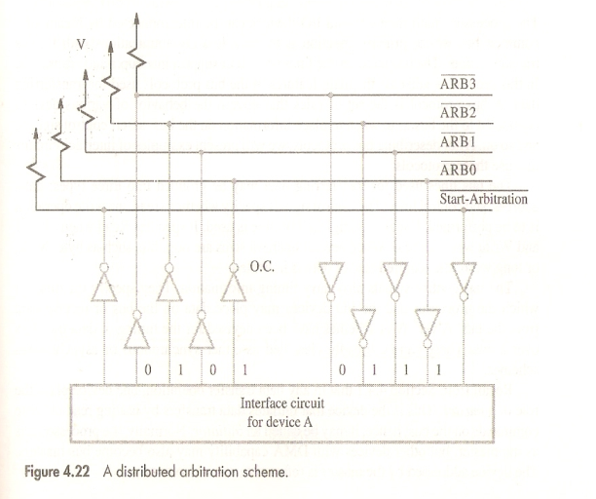
Distributed Arbitration
O.C (集电极开路)

Slide 25
Distributed Arbitration
Each device on the bus is assigned a 4-bit ID number. When one or more devices request the bus, they assert the Start-Arbitration signal and place their 4-bit ID numbers on four open-collector lines.
A winner is selected as a result of the interaction among the signals transmitted over these lines by all contenders.

Slide 26
Timing
The bus control signals carry timing information. They specify the times at which the processor and the I/O devices may place data on the bus or receive data from the bus.
synchronous
asynchronous

Slide 27
Synchronous Bus
In a synchronous bus, all devices derive timing information from a common clock line.

Slide 28
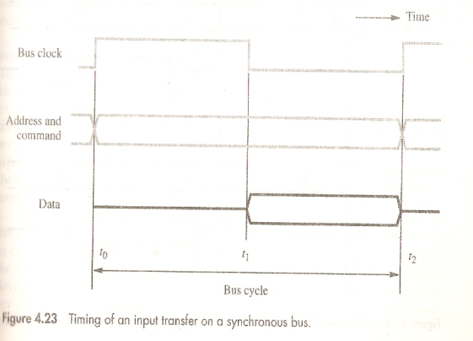
Synchronous Bus

Slide 29
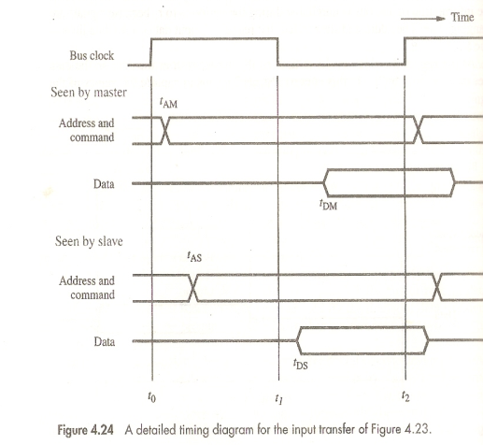
Synchronous Bus

Slide 30
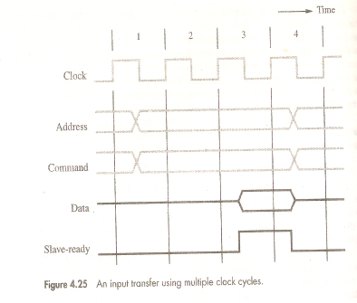
Synchronous Bus

Slide 31
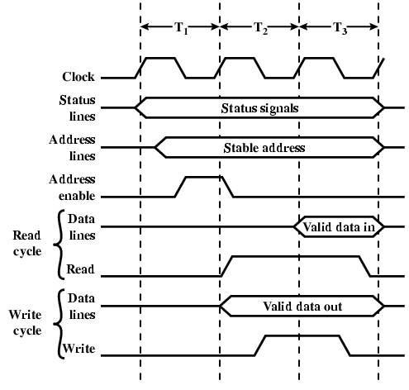
Synchronous Timing Diagram

Slide 32
Asynchronous Bus
An alternative scheme for controlling data transfers on the bus is based on the use of a handshake between the master and the slave.

Slide 33
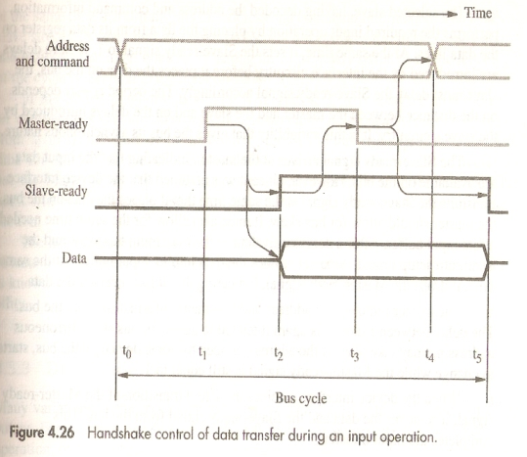
Asynchronous Bus

Slide 34
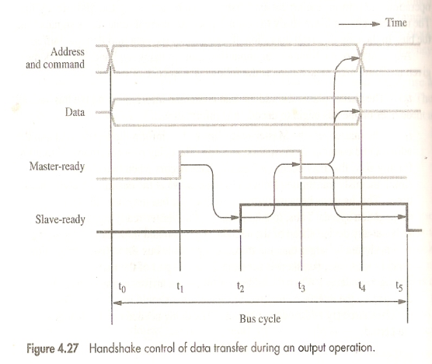
Asynchronous Bus

Slide 35
Bus Bandwidth
There are some terminologies associated with the bus.
Bus Frequency: Working frequency of the bus
Bus Width: The number of data bus
Bus Bandwidth: The transfer rate of data

Slide 36
Bus Bandwidth
The bus bandwidth is a measure of how fast buses transfer information between the CPU and the memory or peripherals. It is measured in megabytes per second. The bus bandwidth depends on
the bus frequency, bus width.
Bus Bandwidth = Bus frequency x (Bus width / 8)
=(1 / Bus cycle time) x Bus Width in Bytes

Slide 37
Bus Bandwidth
The ISA Bus Bandwidth is
8MHz x (16/8) =16 MB/S
The PCI Bus Bandwidth is
133MHz x (64/8) =1064MB/S

Slide 38
Next Lesson
Chapter 1
The 80x86 Microprocessor
CHAPTER 0

