Slide 1

Chapter 1
The 80x86 Microprocessor
THE 80x86 IBM PC AND COMPATIBLE COMPUTERS

Slide 2
Main Content
Registers of the 80x86
MOV and ADD instructions
Code segment, Data segment, Stack segment and Extra segment
Logical address and Physical address
PUSH and POP instructions
Flag register
Addressing modes of the 8086
CHAPTER 1

Slide 3
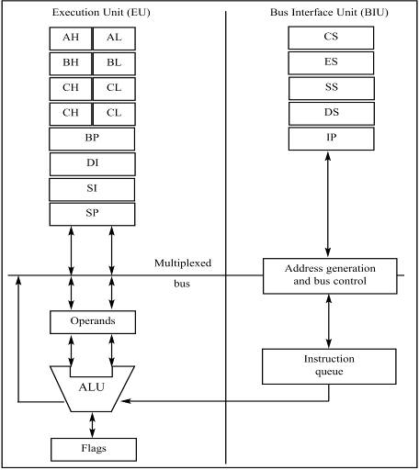
Sec.1.2 Inside the 8088/8086
Figure 1-1
Internal Block Diagram of the 8088/86 CPU
(Reprinted by permission of Intel Corporation,
Copyright Intel Corp.1989)
CHAPTER 1

Slide 4
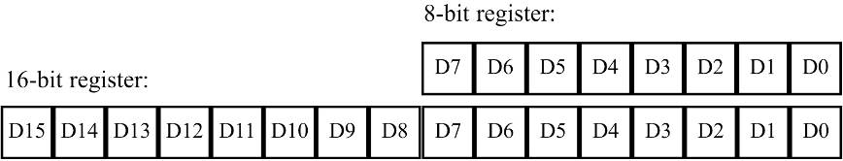
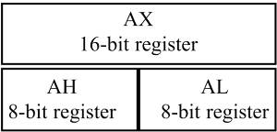
Sec.1.2 Inside the 8088/8086
Registers
Different registers in the 8088/86 are used for different functions.
The first letter of each register indicates its use.
  AX is used for the accumulator.
  BX is a base addressing register.
  CX is a counter in loop operations.
  DX points to data in I/O operations.
CHAPTER 1

Slide 5
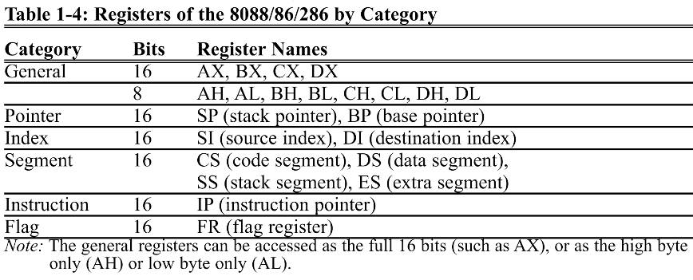
Sec.1.2 Inside the 8088/8086
Registers
Different registers in the 8088/86 are used for different functions.
CHAPTER 1

Slide 6
Sec.1.3 Introduction to assembly programming
A program that consists of 0s and 1s is called machine language.
Assembly languages provides mnemonics for the machine code instructions, plus other features that made programming faster and less
prone to error.
Assembly language programs must be translated into machine code by a program called an assembler. Assembly language is referred to as a low-level language because it deals directly with the internal structure of the CPU.
CHAPTER 1

Slide 7
Sec.1.3 Introduction to assembly programming
One of the most commonly used assemblers is MASM by Microsoft.
Other tools:
Link
Debug
Debug. exe can be found in C:\windows\system32\ OS ( XP )
CHAPTER 1

Slide 8
Sec.1.3 Introduction to assembly programming
MOV instruction
Simply stated, the MOV instruction copies data from one location to another.
It has the following format:
MOV destination, source ; copy source operand to destination
The following program first loads CL with value 55H, then moves this value
around to various registers inside the CPU.
MOV CL, 55H
MOV DL, CL
MOV AH, DL
The use of 16-bit registers is demonstrated below.
MOV CX, 468FH
MOV AX, CX
MOV DX, AX
CHAPTER 1

Slide 9
Sec.1.3 Introduction to assembly programming
MOV instruction
In the 8086 CPU, data can be moved among all the registers shown in Table 1-2 (except the flag register) as long as the source and destination registers match in size. Code such as “MOV AL, DX” will cause an error.
The exception of the flag register means that there is no such instruction as “MOV FR, AX”.
Data can be moved directly into nonsegment registers only, using the MOV instruction. For example,
MOV AX, 58FCH ;LEGAL
MOV DX, 6678H ;LEGAL
MOV SI, 924BH ;LEGAL
MOV BP, 2459H ;LEGAL
MOV DS, 2341H ;ILLEGAL
MOV CX, 8876H ;LEGAL
MOV CS, 3F47H ;ILLEGAL
MOV BH, 99H ;LEGAL
CHAPTER 1

Slide 10
Sec.1.3 Introduction to assembly programming
MOV instruction
From the discussion above, note the following three points:
1. Values cannot be loaded directly into any segment register (CS, DS, ES, or SS).
MOV AX, 2345H ;load 2345H into AX
MOV DS, AX ;then load the value of AX into DS
MOV DI, 1400H ;load 1400H into DI
MOV ES, DI ;then move it into ES, now ES=DI=1400
2. If a value less than FFH is moved into a 16-bit register, the rest of the bits are assumed to be all zeros.
For example, in “MOV BX, 5” the result will be BX = 0005; that is BH = 00 and BL = 05.
3. Moving a value that is too large into a register will cause an error.
MOV BL, 7F2H ;ILLEGAL: 7F2H is larger than 8 bits
MOV AX, 2FE456h ;ILLEGAL
CHAPTER 1

Slide 11
Sec.1.3 Introduction to assembly programming
MOV instruction
In the 8086 CPU, data can be moved among all the registers, as long as the source and destination registers match in size (Except the flag register.)
  There is no such instruction as "MOV FR, AX ".
Code such as "MOV AL,DX" will cause an error.
  One cannot move the contents of a 16-bit register
  into an 8-bit register.
CHAPTER 1

Slide 12
Sec.1.3 Introduction to assembly programming
ADD instruction
The ADD instruction has the following format:
ADD destination, source ;ADD the source operand to the destination
To add two numbers such as 25H and 34H, each can be moved to a register
and then added together:
MOV AL, 25H ;move 25 into AL
MOV BL, 34H ;move 34 into BL
ADD AL, BL ;AL = AL + BL
The program above can be written in many ways, depending on the registers
used. Another way might be:
MOV DH, 25H ;move 25 into DH
MOV CL, 34H ;move 34 into CL
ADD DH, CL ;add CL to DH: DH = DH + CL
CHAPTER 1

Slide 13
Sec.1.3 Introduction to assembly programming
ADD instruction
It is not necessary to move both data items into registers before adding them
together.
MOV DH, 25H ;load one operand into DH
ADD DH, 34H ;add the second operand to DH
The program above can be written in many ways, depending on the registers
used. Another way might be:
MOV DH, 25H ;move 25 into DH
MOV CL, 34H ;move 34 into CL
ADD DH, CL ;add CL to DH: DH = DH + CL
The largest number that an 8-bit register can hold is FFH.
MOV AX, 34EH ;move 34EH into AX
MOV DX, 6A5H ;move 6A5H into DX
ADD DX, AX ;add AX to DX: DX = DX + AX
Again, any 16-bit nonsegment registers could have been used to perform the
action above. E. g. MOV CX, 34EH; ADD CX, 6A5H
CHAPTER 1

Slide 14
Sec.1.4 Introduction to program segments
A typical Assembly language program consists at least three
segments: a code segment, a data segment, and a stack segment.
The code segment contains the Assembly language instructions that perform the tasks that the program was designed to accomplish.
The data segment is used to store information (data) that needs to be processed by the instructions in the code segment.
The stack is used to store information temporarily.
CHAPTER 1

Slide 15
Sec.1.4 Introduction to program segments
A segment is an area of memory that includes up to 64K bytes and
begins on an address evenly divisible by 16 (Such an address ends in 0H).
The 8088/86 can only handle a maximum of 64K bytes of code and 64K
bytes of data and 64K bytes of stack at any given time, although it has a
range of 1 megabyte of memory because of its 20 address pins (2²⁰ = 1
megabyte).
How to move this window of 64K bytes to cover all 1 megabyte of memory ?
CHAPTER 1

Slide 16
Sec.1.4 Introduction to program segments
Logical address and physical address
In Intel literature concerning the 8086, there are three types of
addresses mentioned frequently: the physical address, the offset address,
and the logical address.
The physical address is the 20-bit address that is actually put on the address pins of the 8086 microprocessors and decoded by the memory interfacing circuitry. This address can have a range of 00000H to FFFFFH for the 8086 and real-mode 286, 386, and 486 CPUs. This is an actual physical location in RAM or ROM within the 1 megabyte memory range.
The offset address is a location with a 64K-byte segment range. There, an offset address can range from 0000H to FFFFH.
The logical address consists of a segment value and an offset address.
CHAPTER 1

Slide 17
Sec.1.4 Introduction to program segments
Code segment
The logical address of an instruction always consists of a CS (code segment)
and an IP (instruction pointer), shown in CS:IP format.
CS IP
2
5
0
0
9
5
F
3
:
Start with CS.
Shift left CS.
Add IP.
2
5
0
0
2
5
0
0
0
2
E
5
F
3
CHAPTER 1

Slide 18
Sec.1.4 Introduction to program segments
Code segment
Example 1-1
If CS = 24F6H and IP = 634AH, show:
The logical address
The offset address
And calculate:
(c) The physical address
(d) The lower range
(e) The upper range of the code segment
Solution:
24F6:634A (b) 634A
(c) 2B2AA (24F60 + 634A) (d) 24F60 (24F60 + 0000)
(e) 34F5F (24F60 + FFFF)
CHAPTER 1

Slide 19
Sec.1.4 Introduction to program segments
Logical address vs. physical address in the code segment
The three columns show the logical address of CS:IP, the machine code
stored at that address and the corresponding Assembly language code.
Logical address
CS:IP
Machine language
Opcode and operand
Assembly language
mnemonics and operand
1132:0100
B057
MOV AL, 57H
1132:0102
B686
MOV DH, 86H
1132:0104
B272
MOV DL, 72H
1132:0106
89D1
MOV CX, DX
1132:0108
88C7
MOV BH, AL
1132:010A
B39F
MOV BL, 9FH
1132:010C
B420
MOV AH, 20H
1132:010E
01D0
ADD AX, DX
1132:0110
01D9
ADD CX, BX
1132:0112
05351F
ADD AX, 1F35H

Slide 20
Sec.1.4 Introduction to program segments
Logical address vs. physical address in the code segment
The three columns show the logical address of CS:IP, the machine code
stored at that address and the corresponding Assembly language code.
Logical address
CS:IP
Machine language
Opcode and operand
Assembly language
mnemonics and operand
1132:0100
B057
MOV AL, 57H
  Instruction "MOV AL,57" has a machine code of B057.
  B0 is the opcode and 57 is the operand.
  The byte at address 1132:0100 contains B0, the opcode for moving a value into register AL.
  Address 1132:0101 contains the operand to be moved to AL.

Slide 21
Sec.1.4 Introduction to program segments
Data segment
Assume that a program is being written to add 5 bytes of data,
such as 25H, 12H, 15H, 1FH, and 2BH, where each byte represents a
person’s daily overtime pay. One way to add them is as follows.
MOV AL, 00H
ADD AL, 25H
ADD AL, 12H
ADD AL, 15H
ADD AL, 1FH
ADD AL, 2BH
In the program above, the data and code are mixed together in the
instructions. The problem with writing the program this way is that if
the data changes, the code must be searched for every place the data
is included, and the data retyped.
CHAPTER 1

Slide 22
Sec.1.4 Introduction to program segments
Data segment
The following demonstrates how data can be stored in the data
segment and the program rewritten so that it can be used for any set
of data. Assume that the offset for the data segment begins at 200H.
The data is placed in memory locations:
DS:0200 = 25H; DS:0201 = 12H; DS:0202 = 15H; DS:0203 = 1FH; DS:0204 = 2BH
And the program can be rewritten as follows:
MOV AL, 00H
ADD AL, [0200]
ADD AL, [0201]
ADD AL, [0202]
ADD AL, [0203]
ADD AL, [0204]
CHAPTER 1

Slide 23
Sec.1.4 Introduction to program segments
Data segment
The 8086/88 allows only the use of registers BX, SI, and DI as
offset registers for the data segment. In other words, while CS uses
only the IP register as an offset, DS uses only BX, DI, and SI to hold
the offset address of the data.
The term pointer is often used for a register holding an offset
address. In the following example, BX is used as a pointer:
MOV AL, 00H
MOV BX, 0200H
ADD AL, [BX]
INC BX
ADD AL, [BX]
INC BX
ADD AL, [BX]
CHAPTER 1

Slide 24
Sec.1.4 Introduction to program segments
Logical address and physical address in the data segment
The physical address for data is calculated using the same rules as for the
code segment.
Example 1-2
Assume the DS is 5000 and offset is 1950. Calculate the physical address of
the byte.
Solution: DS : offset
5
0
0
0
1
9
5
0
:
Start with DS.
Shift DS left.
Add the offset.
5
0
0
0
5
0
0
0
0
5
1
9
5
0
CHAPTER 1

Slide 25
Sec.1.4 Introduction to program segments
Logical address and physical address in the data segment
Example 1-3
If DS = 7FA2H and the offset is 438EH,
Calculate the physical address. (b) Calculate the lower range.
(c) Calculate the upper range of the data segment. (d) Show the logical address.
Solution:
83DAE (7FA20 + 438E) (b) 7FA20 (7FA20+0000)
(c) 8FA1F (7FA20 + FFFF) (d) 7FA2:438E
Example 1-4
Assume that the DS register is 578C. To access a given byte of data at physical
memory location 67F66, does the data segment cover the range where the data is
located? If not, what changes need to be made?
Solution:
No, since the range is 578C0 to 678BF, location 67F66 is not included in this
range. To access that byte, DS must be changed so that its range will include that
byte.
CHAPTER 1

Slide 26
Sec.1.4 Introduction to program segments
Little endian convention
Previous examples used 8-bit or 1-byte data. In this case the bytes are stored
one after another in memory. What happens when 16-bit data is used?
MOV AX, 35F3H
MOV [1500], AX
In cases like this, the low byte goes to the low memory location and the high
bytes goes to the high memory address.
DS:1500 = F3 DS:1501 = 35
Example 1-5
Assume memory locations with the following contents: DS:6826 = 48 and
DS:6827 = 22. Show the contents of register BX in the instruction
MOV BX, [6826]
Solution:
DS:6826 = 48
DS:6827 = 22 BH BL
22
48
CHAPTER 1

Slide 27
Sec.1.5 More about segments in the 80x86
What is a stack?
The stack is a section of read/write memory (RAM) used by the CPU to store information temporarily. The CPU needs this storage area since there are only a limited number of registers.
Since the stack is in RAM, it takes much longer to access compared to access time of registers.
CHAPTER 1

Slide 28
Sec.1.5 More about segments in the 80x86
How stacks are accessed
The two main registers used to access the stack are the SS (stack segment) and SP (stack pointer) register.
These registers must be loaded before any instructions accessing the stack are used.
The storing of a CPU register in the stack is called a push , and loading the contents of the stack into the CPU register is called a pop.
The principle is “Last in , First out” .
CHAPTER 1

Slide 29
Sec.1.5 More about segments in the 80x86
Push onto the stack
When PUSH is executed, the contents of the register are saved on the stack and SP is decremented by 2. For every byte of data saved on the stack, SP is decremented once, and since push is saving the contents of a 16-bit register, it is decremented twice,
Popping the contents of the stack back into the CPU register is the opposite process of pushing.
CHAPTER 1

Slide 30
Sec.1.5 More about segments in the 80x86
More about Push and POP
Push IP; ILLEGAL
POP IP; ILLEGAL
Push 1234H; ILLEGAL in 8086
legal in 80286
PUSHA and POPA are legal instructions in 80286, PUSHA copies AX, CX, DX, BX, SP, BP, DI, and SI to the stack. POPA removes the word contents for the following registers from the stack: SI, DI, BP, SP, BX, DX, CX, AX.
CHAPTER 1

Slide 31
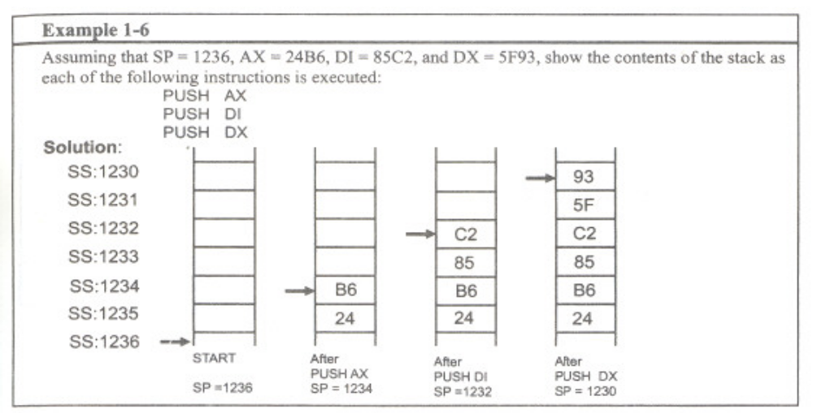
Sec.1.5 More about segments in the 80x86
Pushing onto the stack
CHAPTER 1

Slide 32
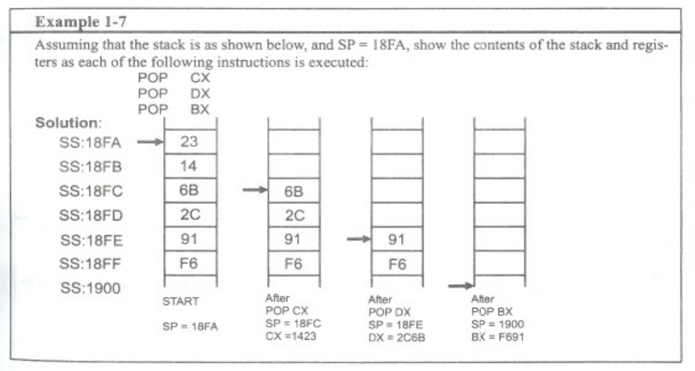
Sec.1.5 More about segments in the 80x86
Popping the stack
CHAPTER 1

Slide 33
Sec.1.5 More about segments in the 80x86
Logic address vs. physical address for the stack
The exact physical location of the stack depends on the value of the stack segment (SS) and SP, the stack pointer.
The logic address is SS:SP. To computer the physical address for the stack, the same principle is applied as was used for the code (CS:IP) and data segment (DS:BX , DS:DI or DS:SI).
CHAPTER 1

Slide 34
Sec.1.5 More about segments in the 80x86
A few more words about segments in the 80x86
A single physical address can belong to many different logical addresses. E. g.
Logical address (hex) Physical address (hex)
1000:5020 15020
1500:0020 15020
1502:0000 15020
1400:1020 15020
1302:2000 15020
CHAPTER 1

Slide 35
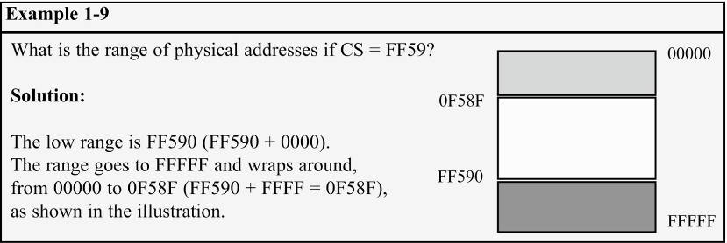
Sec.1.5 More about segments in the 80x86
A few more words about segments in the 80x86
When adding the offset to the shifted segment register results in an address beyond the maximum allowed range of FFFFFH, wrap-around will occur.
CHAPTER 1

Slide 36
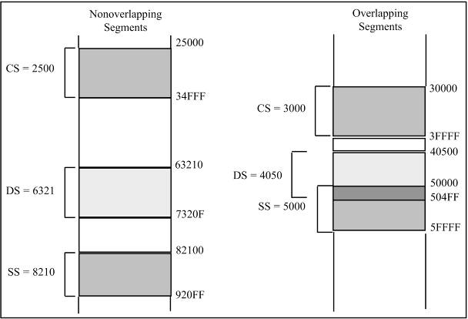
Sec.1.5 More about segments in the 80x86
Overlapping
In calculating the physical address, it is possible that two segments can
overlap, which is desirable in some circumstances.
CHAPTER 1

Slide 37
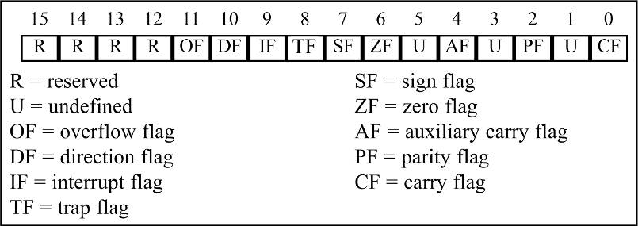
Sec.1.5 More about segments in the 80x86
Flag register
Six flags, called conditional flags, indicate some condition resulting after an instruction executes.
  These six are CF, PF, AF, ZF, SF, and OF.
  The remaining three, often called control flags, control
  the operation of instructions before they are executed.
CHAPTER 1

Slide 38
Sec.1.5 More about segments in the 80x86
Codes for the Flag Register
Flag
Code When Set (=1)
Code When Reset (=0)
OF overflow flag
OV (overflow)
NV (no overflow)
DF direction flag
DN (down)
UP (up)
IF interrupt flag
EI (enable interrupt)
DI (disable interrupt)
SF sign flag
NG (negative)
PL (plus, or positive)
ZF zero flag
ZR (zero)
NZ (not zero)
AF auxiliary carry flag
AC (auxiliary carry)
NA (no auxiliary carry)
PF parity flag
PE (parity even)
PO (parity odd)
CF carry flag
CY (carry)
NC (no carry)
CHAPTER 1

Slide 39
Sec.1.5 More about segments in the 80x86
Flag register and ADD instruction
The overflow flag will be covered in Chapter 6, since it relates only to signed
number arithmetic.
Example 1-10
Show how the flag register is affected by the addition of 38H and 2FH.
Solution:
MOV BH, 38H ;BH = 38H
ADD BH, 2FH ;add 2F to BH, now BH = 67H
38 0011 1000
+ 2F 0010 1111
67 0110 0111
CF = 0 since there is no carry beyond d7
PF = 0 since there is an odd number of 1s in the result
AF = 1 since there is a carry from d3 to d4
ZF = 0 since the result is not zero
SF = 0 since d7 of the result is zero
CHAPTER 1

Slide 40
Sec.1.5 More about segments in the 80x86
Flag register and ADD instruction
The same concepts apply for 16-bit addition, as shown in Example 1-12.
Example 1-13
Show how the flag register is affected by
MOV AX, AAAAH ;AX = AAAAH
ADD AX, 5556H ;now AX = 0000H
Solution:
AAAA 1010 1010 1010 1010
+ 5 5 5 6 0101 0101 0101 0110
0 0 0 0 0000 0000 0000 0000
CF = 1 since there is a carry beyond d15
PF = 1 since there is an even number of 1s in the lower byte
AF = 1 since there is a carry from d3 to d4
ZF = 1 since the result is zero
SF = 0 since d15 of the result is zero
CHAPTER 1

Slide 41
Sec.1.5 More about segments in the 80x86
Use of the zero flag for looping
One of the most widely used applications of the flag register is the use of zero
flag to implement program loops.
MOV CX, 05H ;CX holds the loop count
MOV BX, 0200H ;BX holds the offset data address
MOV AL, 00H ;initialize AL
ADD_LP: ADD AL, [BX] ;add the next byte to AL
INC BX ;increment the data pointer
DEC CX ;decrement the loop counter
JNZ ADD_LP ;jump to next iteration if counter not zero
CHAPTER 1

Slide 42
Sec.1.6 80x86 addressing modes
The CPU can access operands (data) in various ways, called
addressing modes. The number of addressing modes is determined
when microprocessor is designed and cannot be changed. The 80x86
provides a total of seven distinct addressing modes:
1. Register
2. Immediate
3. Direct
4. Register indirect
5. Based relative
6. Indexed relative
7. Based indexed relative
CHAPTER 1

Slide 43
Sec.1.6 80x86 addressing modes
Register addressing mode
The register addressing mode involves the use of
registers to hold the data to be manipulated. Memory is not
accessed when this addressing mode is executed; therefore,
it is relatively fast.
MOV BX, DX
MOV ES, AX
ADD AL, BH
It should be noted that the source and destination registers must match in size.
CHAPTER 1

Slide 44
Sec.1.6 80x86 addressing modes
Immediate addressing mode
In the immediate addressing mode, the source operand is a constant. Immediate
addressing mode can be used to load information into any of the registers except
the segment registers and flag registers. Examples:
MOV AX, 2550H ;move 2550H into AX
MOV CX, 625 ;load the decimal value 625 into CX
MOV BL, 40H ;load 40H into BL
To move information to the segment registers, the data must first be moved to a
general-purpose register and then to the segment register. Example:
MOV AX, 2550H
MOV DS, AX
In other words, the following would produce an error:
MOV DS, 0123H ;illegal!!!
CHAPTER 1

Slide 45
Sec.1.6 80x86 addressing modes
Direct addressing mode
This address is the offset address and one can calculate the physical address by
shifting left the DS register and adding it to the offset as follows:
MOV DL, [2400] ;move contents of DS:2400H into DL
Example 1-15
Find the physical address of the memory location and its contents after the
execution of the following, assuming that DS = 1512H.
MOV AL, 99H
MOV [3518H], AL
Solution:
First AL is initialized to 99H, then in line two, the contents of AL are moved to
logical address DS:3518H which is 1512:3518. Shifting DS left and adding it to
the offset gives the physical address of 18638H (15120H + 3518H = 18638H).
That means after the execution of the second instruction, the memory location
with address 18638H will contain the value 99H.
CHAPTER 1

Slide 46
Sec.1.6 80x86 addressing modes
Register indirect addressing mode
The registers used for this purpose are SI, DI, and BX. If these registers are
used as pointers, that is, if they hold the offset of the memory location, they must
be combined with DS in order to generate the 20-bit physical address.
MOV AL, [BX] ;moves into AL the contents of the memory location
;pointed to by DS:BX
MOV CL, [SI] ;move contents of DS:SI into CL
MOV [DI], AH ;move contents of AH into DS:DI
Example 1-16
Assume that DS = 1120, SI = 2498, and AX = 17FE. Show the contents of
memory locations after the execution of
MOV [SI], AX
Solution:
The contents of AX are moved into memory locations with logical address DS:SI
and DS:SI+1. Low address 13698H contain FE, and high address 13699H contains
17H.
CHAPTER 1

Slide 47
Sec.1.6 80x86 addressing modes
Based relative addressing mode
In the based relative addressing mode, base registers are BX and BP. The
default segments are DS for BX and SS for BP. For example:
MOV CX, [BX]+10 ;move DS:BX+10 and DS:BX+10+1 into CX
;PA = DS (shifted left) + BX + 10
Alternative codings are
MOV CX, [BX+10] or MOV CX, 10[BX]
In the case of the BP register,
MOV AL, [BP]+5 ;PA = SS (shifted left) + BP + 5
Again, alternative codings are
MOV AL, [BP+5] or MOV AL, 5[BP]
CHAPTER 1

Slide 48
Sec.1.6 80x86 addressing modes
Indexed relative addressing mode
The indexed relative addressing mode works the same as the based relative
addressing mode, except that registers DI and SI hold the offset address. Examples:
MOV DX, [SI]+5 ;PA = DS (shifted left) + SI + 5
MOV CL, [DI]+20 ;PA = DS (shifted left) + DI + 20
Example 1-17
Assume that DS = 4500, SS = 2000, BX = 2100, SI = 1486, DI = 8500, BP = 7814,
and AX = 2512. Show the exact physical memory location where AX is stored in
each of the following. All values are in hex.
MOV [BX]+20, AX (b) MOV [SI]+10, AX
(c) MOV [DI]+4, AX (d) MOV [BP]+12, AX
Solution:
DS:BX+20 location 47120 = (12) and 47121 = (25)
DS:SI+10 location 46496 = (12) and 46497 = (25)
DS:DI+4 location 4D504 = (12) and 4D505 = (25)
SS:BP+12 location 27826 = (12) and 27827 = (25)
CHAPTER 1

Slide 49
Sec.1.6 80x86 addressing modes
Based indexed addressing mode
By combining based and indexed addressing modes, a new addressing mode is
derived called the based indexed addressing mode.
MOV CL, [BX][DI]+8 ;PA = DS (shifted left) + BX + DI + 8
MOV CH, [BX][SI]+20 ;PA = DS (shifted left) + BX + SI + 20
MOV AH, [BP][DI]+12 ;PA = SS (shifted left) + BP + DI + 12
MOV AH, [BP][SI]+29 ;PA = SS (shifted left) + BP + SI + 29
The coding of the instructions above can vary; for example, the last example
could have been written
MOV AH, [BP+SI+29]
Or
MOV AH, [SI+BP+29]
Note that
MOV AX, “[SI][DI]+displacement” is illegal.
CHAPTER 1

Slide 50
Sec.1.6 80x86 addressing modes
Segment overrides
Table 1-3: Offset Registers for Various Segments
Segment register:
CS
DS
ES
SS
Offset register(s):
IP
SI, DI, BX
SI, DI, BX
SP, BP
Table 1-4: Sample Segment Overrides
Instruction
Segment Used
Default Segment
MOV AX, CS:[BP]
CS:BP
SS:BP
MOV DX, SS:[SI]
SS:SI
DS:SI
MOV AX, DS:[BP]
DS:BP
SS:BP
MOV CX, ES:[BX]+12
ES:BX+12
DS:BX+12
MOV SS:[BX][DI]+32, AX
SS:BX+DI+32
DS:BX+DI+32
CHAPTER 1

Slide 51
Sec.1.6 80x86 addressing modes
Summary
Table 1-5: Summary of 80x86 addressing modes
Addressing Mode
Operand
Default
Register
reg
None
Immediate
Data
None
Direct
[offset]
DS
Register indirect
[BX], [SI], [DI]
DS, DS, DS
Based relative
[BX]+disp, [BP]+disp
DS, SS
Indexed relative
[DI]+disp, [SI]+disp
DS, DS
Based indexed relative
[BX][SI]+disp, [BX][DI]+disp
[BP][SI]+disp, [BP][DI]+disp
DS, DS
SS, SS
CHAPTER 1

Slide 52
Chapter 2
Assembly Language Programming

Slide 53
Chapter 2 Assembly Language Programming
Main Contents
Instructions and Pseudo-instructions
Identify the segments of an Assembly language program
Simple assembly language instructions
Assemble, Link, Run a simple assembly language program
Transfer instructions
Full segment definition and simplified segment definition
COM and EXE files

Slide 54
Sec.2.1 Directives and a sample program
Directives
A given Assembly language program is a series of statements, or lines, which are either Assembly language instructions such as ADD or
MOV, or statements called directives.
Directives , also called pseudo-instructions, give directions to the assembler about how it should translate the Assembly language
instructions into machine code.
CHAPTER 2

Slide 55
Sec.2.1 Directives and a sample program
An Assembly language instruction consists of four fields:
[label:] mnemonic [operands] [;comment]
1. The Assembly language mnemonic (instruction) and operand(s) field together perform the real work of the program and accomplish the tasks for which the program was written.
CHAPTER 2

Slide 56
Sec.2.1 Directives and a sample program
2. The comment field begins with a “;”.
3. The label field allows the program to refer to a line of code by name. The label field cannot exceed 31 characters. Labels for directives do not need to end with a colon.
CHAPTER 2

Slide 57
Sec.2.1 Directives and a sample program
Model definition
The model directive selects the size of the memory model. Among the options for the memory model are TINY, SMALL, MEDIUM, COMPACT, LARGE, HUGE.
CHAPTER 2

Slide 58
Sec.2.1 Directives and a sample program
Model definition
.MODEL SMALL 64KB for code and another 64KB for data
.MODEL TINY 64KB for code and data
.MODEL MEDIUM data must fit into 64KB, code can exceed 64KB
.MODEL COMPACT code must fit into 64KB, data can exceed 64KB
.MODEL LARGE data and code can exceed 64KB, no single data
items can not exceed 64KB
.MODEL HUGE data and code can exceed 64KB, data items can
exceed 64KB
CHAPTER 2

Slide 59
Sec.2.1 Directives and a sample program
Segment definition
There are four segment registers in 80x86. Every line of an Assembly language program must correspond to one of the segments.
The simplified segment definition format uses three directives: “.CODE”, “.STACK”, “.DATA” , which correspond to the CS, SS, DS.
CHAPTER 2

Slide 60
Sec.2.1 Directives and a sample program
Segment definition
.STACK ;marks the beginning of the stack segment
.DATA ;marks the beginning of the data segment
.CODE ;marks the beginning of the code segment
CHAPTER 2

Slide 61
Sec.2.1 Directives and a sample program
Segment definition
. STACK 64
. DATA
DATA1 DB 52H
DATA2 DB 29H
SUM DB ?
CHAPTER 2

Slide 62
Sec.2.1 Directives and a sample program
Code Segment definition
The first line of the code segment after the .CODE directive is the
PROC directive.
A procedure is a group of instructions designed to accomplish a specific function. A code segment may consist of only one procedure, but usually is organized into several small procedures in order to make
the program more structured.
CHAPTER 2

Slide 63
Sec.2.1 Directives and a sample program
Code Segment definition
.CODE
MAIN PROC FAR ; this is the program entry point
MOV AX, @DATA
MOV DS, AX
…..
MOV AH,4CH ; set up to
INT 21H ; return to DOS
MAIN ENDP
END MAIN ; this is the program exit point
CHAPTER 2

Slide 64
Sec.2.1 Directives and a sample program
;THE FORM OF AN ASSEMBLY LANGUAGE PROGRAM
;NOTE: USING SIMPLIFIED SEGMENT DEFINITION
.MODEL SMALL
.STACK 64
.DATA
DATA1 DB 52H
DATA2 DB 29H
SUM DB ?
.CODE
MAIN PROC FAR ;this is the program entry point
MOV AX,@DATA ;load the data segment address
MOV DS,AX ;assign value to DS
MOV AL,DATA1 ;get the first operand
MOV BL,DATA2 ;get the second operand
ADD AL,BL ;add the operands
MOV SUM,AL ;store the result in location SUM
MOV AH,4CH ;set up to return to DOS
INT 21H ;
MAIN ENDP
END MAIN ;this is the program exit point
CHAPTER 2

Slide 65
Sec.2.1 Directives and a sample program
Figure 2-2 shows a sample shell of an Assembly language program.
;THE FORM OF AN ASSEMBLY LANGUAGE PROGRAM
USING SIMPLIFIED SEGMENT DEFINITION
.MODEL SMALL
.STACK 64
.DATA
;
;place data definitions here
;
.CODE
MAIN PROC FAR ;this is the program entry point
MOV AX,@DATA ;load the data segment address
MOV DS,AX ;assign value to DS
;
;place code here
;
MOV AH,4CH ;set up to
INT 21H ;return to DOS
MAIN ENDP
END MAIN ;this is the program exit point
CHAPTER 2

Slide 66
Homework
Chapter 1
12, 16, 29, 33(a), 34(b),(f),(j),(l)
CHAPTER 1

Slide 67
Next Lesson
Assembly Language Programming
2.2, 2.3, 2.4, 2.5, 2.6
Arithmetic and Logic Instructions and Programs
3.1, 3.2
CHAPTER 1

