Slide 1
Chapter 10: File-System Interface

Slide 2
Chapter 10: File-System Interface
File Concept
Access Methods
Directory Structure
File-System Mounting
File Sharing
Protection

Slide 3
Objectives
To explain the function of file systems
To describe the interfaces to file systems
To discuss file-system design tradeoffs, including access methods, file sharing, file locking, and directory structures
To explore file-system protection

Slide 4
File Concept
Contiguous logical address space
Types:
  Data
    numeric
    character
    binary
  Program

Slide 5
File Structure
None - sequence of words, bytes
Simple record structure
  Lines
  Fixed length
  Variable length
Complex Structures
  Formatted document
  Relocatable load file
Can simulate last two with first method by inserting appropriate control characters
Who decides:
  Operating system
  Program

Slide 6
File Attributes
Name – only information kept in human-readable form
Identifier – unique tag (number) identifies file within file system
Type – needed for systems that support different types
Location – pointer to file location on device
Size – current file size
Protection – controls who can do reading, writing, executing
Time, date, and user identification – data for protection, security, and usage monitoring
Information about files are kept in the directory structure, which is maintained on the disk

Slide 7
File Operations
File is an abstract data type
Create
Write
Read
Reposition within file
Delete
Truncate
Open(F_{i}) – search the directory structure on disk for entry F_{i}, and move the content of entry to memory
Close (F_{i}) – move the content of entry F_{i} in memory to directory structure on disk

Slide 8
Open Files
Several pieces of data are needed to manage open files:
  File pointer: pointer to last read/write location, per process that has the file open
  File-open count: counter of number of times a file is open – to allow removal of data from open-file table when last processes closes it
  Disk location of the file: cache of data access information
  Access rights: per-process access mode information

Slide 9

File Types – Name, Extension

Slide 10
扩展
文件扩展名是一个文件的必要构成部分。
任何 显示文件扩展名一个文件可以有或没有扩展名。对于打开文件操作，没有扩展名的文件需要选择程序去打开它，有扩展名的文件会自动用设置好的程序（如有）去尝试打开。
文件扩展名表明了该文件是何种类型。
文件扩展名可以人为设定，扩展名为TXT的文件有可能是一张图片，同样，扩展名为MP3的文件，依然可能是一个视频。
文件扩展名大小写的区别
在一个文件中的扩展名的大小写，系统的大小写是不予区别的。
4.文件扩展名的漏洞
  有些木马文件(扩展名为exe)会伪装成图片文件或其他的文件. hack.jpg.exe.它的图标也是jpg图片的图标,如果你选择了隐藏文件扩展名,那显示为hack.jpg,且图标是图片的,那你就很容易上当,双击它的话,就是运行了一个木马程序.有些更毒的,它还绑定了图片,双击这类文件时,会出现一个图片,但木马程序已悄悄地在后台运行安装了,而你又以为真的是一张图片而已.

Slide 11
扩展知识
扩展名对文件类别的知识仅仅是指示性的，并不具有强制性。
  UNIX下，扩展名仅仅提醒用户，系统并不遵守，只要是一个文件是可执行文件，即使其扩展名不是.exe，该文件也能在UNIX下运行。但有些系统却对扩展名进行了强制服从，否则无法使用。例如Windows

Slide 12
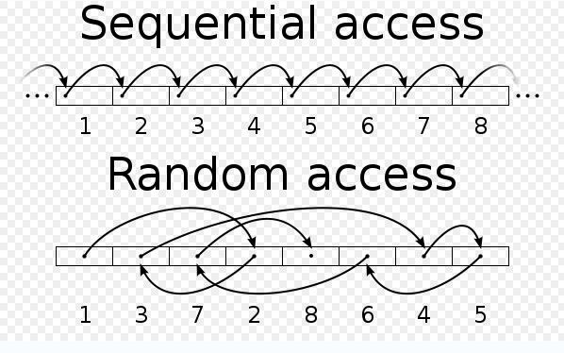
Access Methods
Sequential Access
read next
write next
reset
no read after last write
(rewrite)
Direct Access
read n
write n
position to n
read next
write next
rewrite n
n = relative block number

Slide 13

Sequential-access File

Slide 14
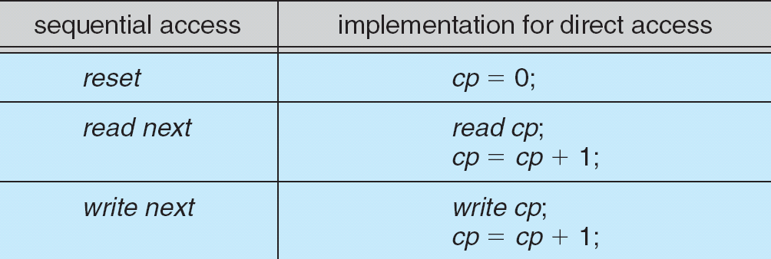
Simulation of Sequential Access on a Direct-access File

Slide 15

Example of Index and Relative Files

Slide 16
Directory Structure
A collection of nodes containing information about all files
Directory
Files
F 1
F 2
F 3
F 4
F n
Both the directory structure and the files reside on disk
Backups of these two structures are kept on tapes

Slide 17

A Typical File-system Organization

Slide 18
Operations Performed on Directory
Search for a file
Create a file
Delete a file
List a directory
Rename a file
Traverse the file system

Slide 19
Organize the Directory (Logically) to Obtain
Efficiency – locating a file quickly
Naming – convenient to users
  Two users can have same name for different files
  The same file can have several different names
Grouping – logical grouping of files by properties, (e.g., all Java programs, all games, …)

Slide 20

Single-Level Directory
A single directory for all users
Naming problem
Grouping problem

Slide 21

Two-Level Directory
Separate directory for each user
Path name
Can have the same file name for different user
Efficient searching

Slide 22

Tree-Structured Directories

Slide 23
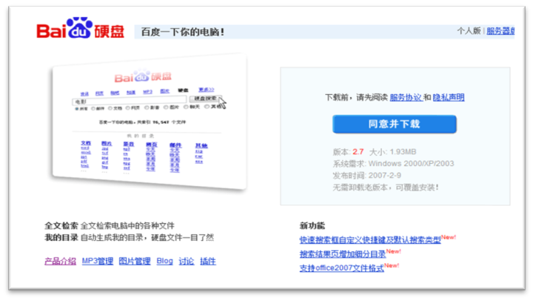
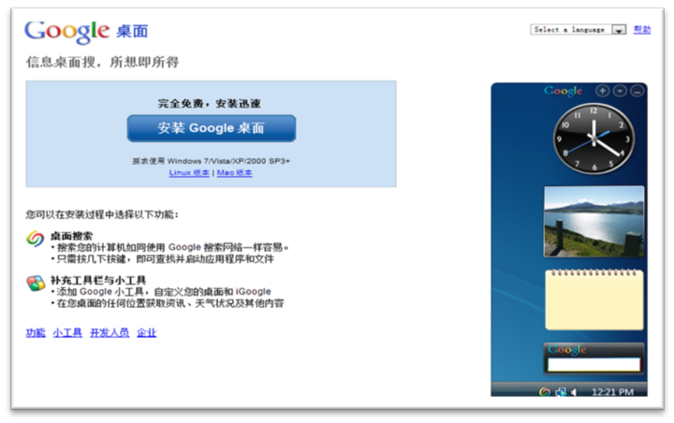
Tree-Structured Directories (Cont)
http://disk.baidu.com/
Efficient searching
Grouping Capability
Current directory (working directory)
  cd /spell/mail/prog
  type list
http://desktop.google.com/zh/

Slide 24
Tree-Structured Directories (Cont)
Absolute or relative path name
Creating a new file is done in current directory
Delete a file
rm <file-name>
Creating a new subdirectory is done in current directory
  mkdir <dir-name>
Example: if in current directory /mail
mkdir count
mail
prog
copy
prt
exp
count
Deleting “mail” ⇒ deleting the entire subtree rooted by “mail”

Slide 25
File System Mounting
A file system must be mounted before it can be accessed
A unmounted file system (i.e. Fig. 11-11(b)) is mounted at a mount point

Slide 26

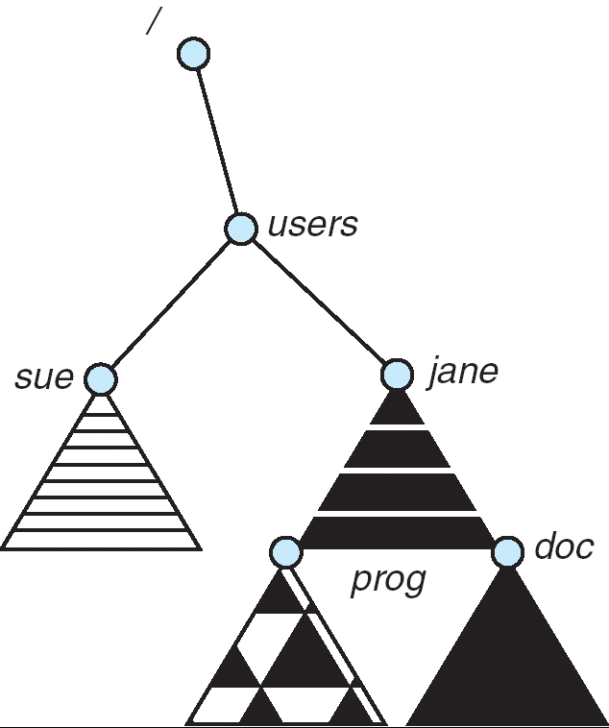
(a) Existing. (b) Unmounted Partition
Mount Point

Slide 27
File Sharing
Sharing of files on multi-user systems is desirable
Sharing may be done through a protection scheme
On distributed systems, files may be shared across a network
Network File System (NFS) is a common distributed file-sharing method

Slide 28
File Sharing – Multiple Users
User IDs identify users, allowing permissions and protections to be per-user
Group IDs allow users to be in groups, permitting group access rights

Slide 29
Protection
File owner/creator should be able to control:
  what can be done
  by whom
Types of access
  Read
  Write
  Execute
  Append
  Delete
  List

Slide 30
Access Lists and Groups
Mode of access: read, write, execute
Three classes of users
RWX
a) owner access 7 ⇒ 1 1 1
RWX
b) group access 6 ⇒ 1 1 0
RWX
c) public access 1 ⇒ 0 0 1
Ask manager to create a group (unique name), say G, and add some users to the group.
For a particular file (say game) or subdirectory, define an appropriate access.
owner
group
public
chmod
761
game
Attach a group to a file
chgrp G game

Slide 31

Windows XP Access-control List Management

Slide 32

A Sample UNIX Directory Listing

Slide 33
End of Chapter 10

