Slide 1
Chapter 12: Mass-Storage Systems

Slide 2
Chapter 12: Mass-Storage Systems
Overview of Mass Storage Structure
Disk Structure
Disk Attachment
Disk Scheduling
Disk Management
Swap-Space Management
RAID Structure
Disk Attachment
Stable-Storage Implementation
Tertiary Storage Devices
Operating System Issues
Performance Issues

Slide 3
Objectives
Describe the physical structure of secondary and tertiary storage devices and the resulting effects on the uses of the devices
Explain the performance characteristics of mass-storage devices
Discuss operating-system services provided for mass storage, including RAID and HSM

Slide 4
Overview of Mass Storage Structure
Magnetic disks provide bulk of secondary storage of modern computers
  Drives rotate at 60 to 200 times per second
  Transfer rate is rate at which data flow between drive and computer
  Positioning time (random-access time) is time to move disk arm to desired cylinder (seek time) and time for desired sector to rotate under the disk head (rotational latency)
  Head crash results from disk head making contact with the disk surface
    That’s bad
Disks can be removable
Drive attached to computer via I/O bus
  Busses vary, including EIDE, ATA, SATA, USB, Fibre Channel, SCSI
  Host controller in computer uses bus to talk to disk controller built into drive or storage array

Slide 5

Moving-head Disk Machanism

Slide 6
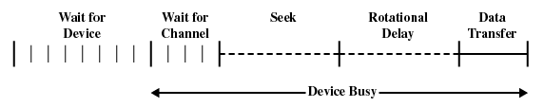
磁盘性能参数
为了读写，磁头必须定位于指定的磁道和该磁道中指定的扇区开始处
寻道时间
  磁头定位到磁道所需要的时间；
旋转延迟
  磁头到达扇区开始位置的时间；
传送时间
  传送所需的时间；

Slide 7
时序比较
平均寻道时间为4ms,转速为7500r/m,每个磁道有500个扇区，读取2500个扇区
顺序访问?
随机访问?

Slide 8
时序比较
平均寻道时间为4ms,转速为7500r/m,每个磁道有500个扇区，读取2500个扇区
顺序访问
  读第一个磁道4ms(平均寻址)+
  4ms(旋转延迟)+
  8ms(读500个扇区)=16ms
  总时间=16+4*（4+8）=64ms
随机访问
  读一个扇区4+4+0.016=8.016ms
  总时间=2500*8.016=20040ms
显然，磁盘读取扇区的顺序对I/O性能影响很大！

Slide 9
Overview of Mass Storage Structure (Cont.)
Magnetic tape
  Was early secondary-storage medium
  Relatively permanent and holds large quantities of data
  Access time slow
  Random access ~1000 times slower than disk
  Mainly used for backup, storage of infrequently-used data, transfer medium between systems
  Kept in spool and wound or rewound past read-write head
  Once data under head, transfer rates comparable to disk
  20-200GB typical storage
  Common technologies are 4mm, 8mm, 19mm, LTO-2 and SDLT

Slide 10
Disk Structure
Disk drives are addressed as large 1-dimensional arrays of logical blocks, where the logical block is the smallest unit of transfer.
The 1-dimensional array of logical blocks is mapped into the sectors of the disk sequentially.
  Sector 0 is the first sector of the first track on the outermost cylinder.
  Mapping proceeds in order through that track, then the rest of the tracks in that cylinder, and then through the rest of the cylinders from outermost to innermost.

Slide 11
Disk Scheduling
The operating system is responsible for using hardware efficiently — for the disk drives, this means having a fast access time and disk bandwidth.
Access time has two major components
  Seek time is the time for the disk are to move the heads to the cylinder containing the desired sector.
  Rotational latency is the additional time waiting for the disk to rotate the desired sector to the disk head.
Minimize seek time
Seek time ≈ seek distance
Disk bandwidth is the total number of bytes transferred, divided by the total time between the first request for service and the completion of the last transfer.

Slide 12
Disk Scheduling (Cont.)
Several algorithms exist to schedule the servicing of disk I/O requests.
We illustrate them with a request queue (0-199).
98, 183, 37, 122, 14, 124, 65, 67
Head pointer 53

Slide 13

FCFS
Illustration shows total head movement of 640 cylinders.

Slide 14
SSTF
Selects the request with the minimum seek time from the current head position.
SSTF scheduling is a form of SJF scheduling; may cause starvation of some requests.
Illustration shows total head movement of 236 cylinders.

Slide 15

SSTF (Cont.)

Slide 16
SCAN
The disk arm starts at one end of the disk, and moves toward the other end, servicing requests until it gets to the other end of the disk, where the head movement is reversed and servicing continues.
Sometimes called the elevator algorithm.
Illustration shows total head movement of 208 cylinders.

Slide 17

SCAN (Cont.)

Slide 18
C-SCAN
Provides a more uniform wait time than SCAN.
The head moves from one end of the disk to the other. servicing requests as it goes. When it reaches the other end, however, it immediately returns to the beginning of the disk, without servicing any requests on the return trip.
Treats the cylinders as a circular list that wraps around from the last cylinder to the first one.

Slide 19

C-SCAN (Cont.)

Slide 20
C-LOOK
Version of C-SCAN
Arm only goes as far as the last request in each direction, then reverses direction immediately, without first going all the way to the end of the disk.

Slide 21

C-LOOK (Cont.)

Slide 22
Selecting a Disk-Scheduling Algorithm
SSTF is common and has a natural appeal
SCAN and C-SCAN perform better for systems that place a heavy load on the disk.
Performance depends on the number and types of requests.
Requests for disk service can be influenced by the file-allocation method.
The disk-scheduling algorithm should be written as a separate module of the operating system, allowing it to be replaced with a different algorithm if necessary.
Either SSTF or LOOK is a reasonable choice for the default algorithm.

Slide 23
Disk Management
Low-level formatting, or physical formatting — Dividing a disk into sectors that the disk controller can read and write.
To use a disk to hold files, the operating system still needs to record its own data structures on the disk.
  Partition the disk into one or more groups of cylinders.
  Logical formatting or “making a file system”.
Boot block initializes system.
  The bootstrap is stored in ROM.
  Bootstrap loader program.
Methods such as sector sparing used to handle bad blocks.

Slide 24
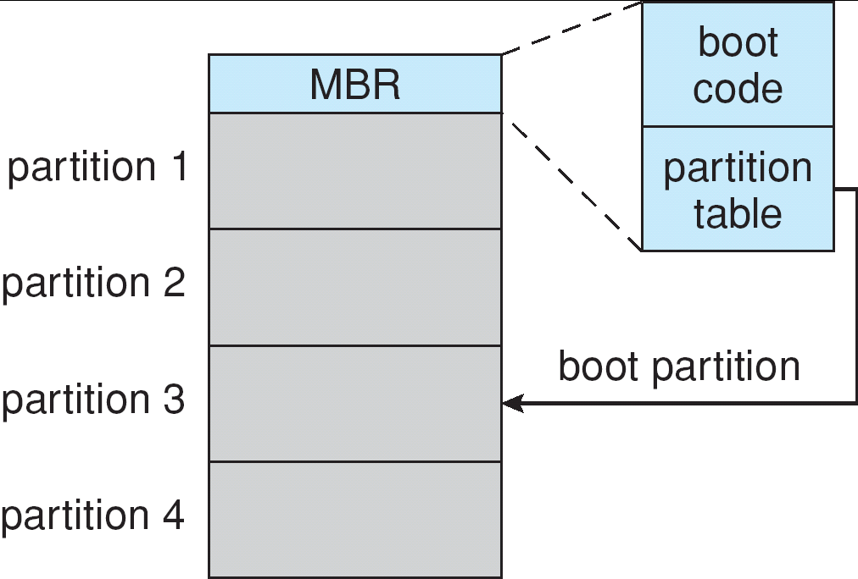
Booting from a Disk in Windows 2000

Slide 25
Swap-Space Management
Swap-space — Virtual memory uses disk space as an extension of main memory.
Swap-space can be carved out of the normal file system,or, more commonly, it can be in a separate disk partition.
Swap-space management
  4.3BSD allocates swap space when process starts; holds text segment (the program) and data segment.
  Kernel uses swap maps to track swap-space use.
  Solaris 2 allocates swap space only when a page is forced out of physical memory, not when the virtual memory page is first created.

Slide 26
RAID Structure
RAID – multiple disk drives provides reliability via redundancy.
RAID is arranged into six different levels.

Slide 27
RAID
独立磁盘冗余阵列是利用一台磁盘阵列控制器统一管理和控制一组磁盘驱动器，组成一个速度快 、可靠性高的大容量磁盘系统。
  RAID是一组物理磁盘驱动器，操作系统把它看作是一个单独的逻辑驱动器；
  数据分布在物理驱动器阵列中；
  使用冗余的磁盘容量保存奇偶校验信息，从而保证当一个磁盘失败时，数据具有可恢复性；

Slide 28
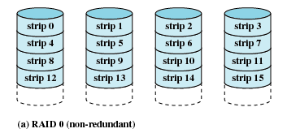
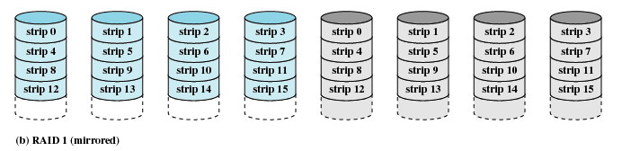
RAID
RAID0 无冗余
RAID1
镜像

Slide 29
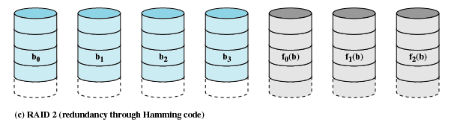
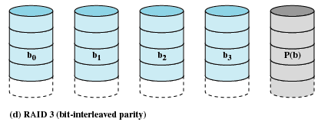
RAID
RAID2
通过汉明码冗余
RAID3
交错位奇偶校验

Slide 30
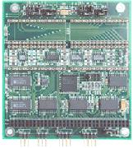

SSD
SSD = solid state disk，固态硬盘，用固态电子存储芯片阵列而制成的硬盘。
固态硬盘的接口规范和定义、功能及使用方法上与普通硬盘的相同，在产品外形和尺寸上也与普通硬盘一致。其芯片的工作温度范围很宽（-40~85℃）;
由于固态硬盘技术与传统硬盘技术不同，所以产生了不少新兴的存储器厂商。厂商只需购买NAND存储器，再配合适当的控制芯片，就可以制造固态硬盘了。新一代的固态硬盘普遍采用SATA-2接口。

Slide 31
SSD
固态硬盘的存储介质分为两种，一种是采用闪存（FLASH芯片）作为存储介质，另外一种是采用DRAM作为存储介质。
基于闪存的固态硬盘：采用FLASH芯片作为存储介质，这也是我们通常所说的SSD。这种SSD固态硬盘最大的优点就是可以移动，而且数据保护不受电源控制，能适应于各种环境，但是使用年限不高，适合于个人用户使用。在基于闪存的固态硬盘中，存储单元又分为两类：SLC（Single Layer Cell 单层单元）和MLC（Multi-Level Cell多层单元）。SLC的特点是成本高、容量小、但是速度快，而MLC的特点是容量大成本低，但是速度慢。MLC的每个单元是2bit的，相对SLC来说整整多了一倍。不过，由于每个MLC存储单元中存放的资料较多，结构相对复杂，出错的几率会增加，必须进行错误修正，这个动作导致其性能大幅落后于结构简单的SLC闪存。此外，SLC闪存的优点是复写次数高达100000次，比MLC闪存高10倍。此外，为了保证MLC的寿命，控制芯片都校验和智能磨损平衡技术算法，使得每个存储单元的写入次数可以平均分摊，达到100万小时故障间隔时间(MTBF)。
基于DRAM的固态硬盘
基于DRAM的固态硬盘：采用DRAM作为存储介质，目前应用范围较窄。它仿效传统硬盘的设计、可被绝大部分操作系统的文件系统工具进行卷设置和管理，并提供工业标准的PCI和FC接口用于连接主机或者服务器。应用方式可分为SSD硬盘和SSD硬盘阵列两种。它是一种高性能的存储器，而且使用寿命很长，美中不足的是需要独立电源来保护数据安全。

Slide 32
End of Chapter 12

