Slide 1
Chapter 4: Threads

Slide 2
Chapter 4: Threads
Overview
Multithreading Models
Threading Issues
Pthreads
Windows XP Threads
Linux Threads
Java Threads

Slide 3
Process
Resource ownership - process includes a virtual address space to hold the process image
Scheduling/execution- follows an execution path that may be interleaved with other processes
These two characteristics are treated independently by the operating system
Separate two ideas:
  Process: Ownership of memory, files, other resources
  Thread: Unit of execution we use to dispatch

Slide 4
Process/Thread
Process--Resource ownership
Have a virtual address space which holds the process image
Protected access to processors, other processes, files, and I/O resources
Thread--Scheduling/Execution
An execution state (running, ready, etc.)
Saved thread context when not running
Some per-thread static storage for local variables
Access to the memory and resources of its process

Slide 5
Multithreading
DOS
Java
one process
one thread
one process
multiple threads
UNIX
Windows
Linux
OS/2
multiple processes
one thread per process
multiple processes
multiple threads per process
Operating system supports multiple threads of execution within a single process

Slide 6
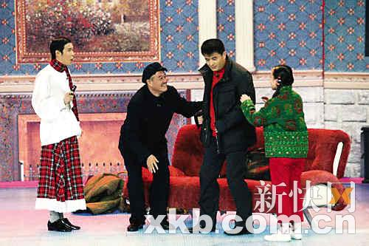
Multithreading
Operating system supports multiple threads of execution within a single process

Slide 7
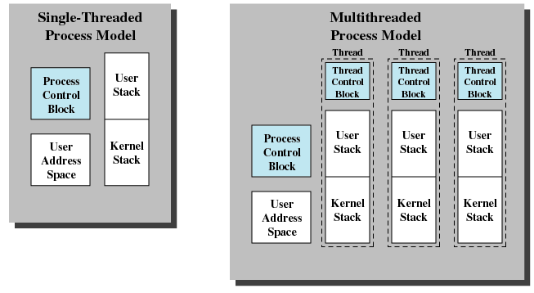


Single and Multithreaded Processes
Operating System Concepts

Slide 8
Benefits
Responsiveness
Resource Sharing
Economy
Utilization of MP Architectures

Slide 9
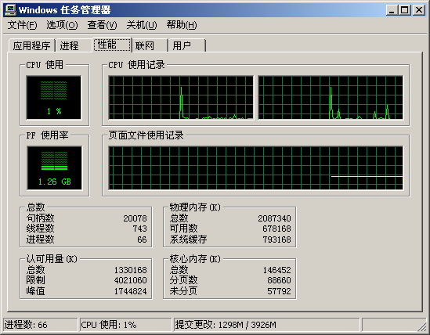
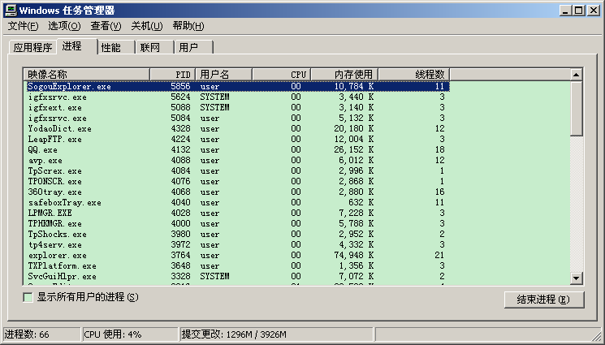
Examples
Thread sorting demo
Dual Core Processor

Slide 10
User and Kernel Threads
User threads - Thread management done by user-level threads library.
Kernel threads - Threads directly supported by the kernel.

Slide 11
User Threads
Thread management done by user-level threads library
Three primary thread libraries:
  POSIX Pthreads
  Win32 threads
  Java threads

Slide 12
Kernel Threads
Supported by the Kernel
Examples
  Windows XP/2000
  Solaris
  Linux
  Tru64 UNIX
  Mac OS X

Slide 13
Multithreading Models
Mapping user threads to kernel threads:
Many-to-One
One-to-One
Many-to-Many

Slide 14
Many-to-One
Many user-level threads mapped to single kernel thread
Examples:
  Solaris Green Threads
  GNU Portable Threads

Slide 15

Many-to-One Model

Slide 16
One-to-One
Each user-level thread maps to kernel thread
Examples
  Windows NT/XP/2000
  Linux
  Solaris 9 and later

Slide 17

One-to-one Model

Slide 18
Many-to-Many Model
Allows many user level threads to be mapped to many kernel threads
Allows the operating system to create a sufficient number of kernel threads
Solaris prior to version 9
Windows NT/2000 with the ThreadFiber package

Slide 19

Many-to-Many Model

Slide 20
Two-level Model
Similar to M:M, except that it allows a user thread to be bound to kernel thread
Examples
  IRIX
  HP-UX
  Tru64 UNIX
  Solaris 8 and earlier

Slide 21

Two-level Model

Slide 22
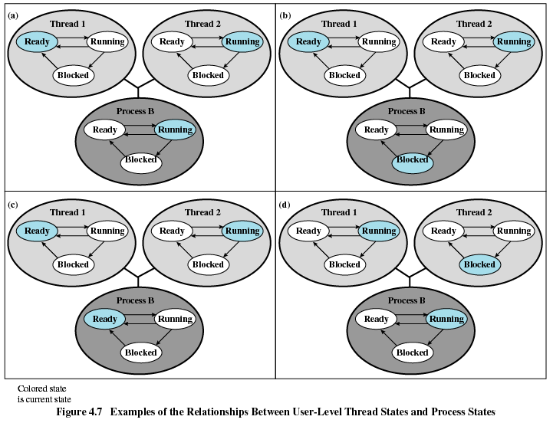
User Threads

Slide 23


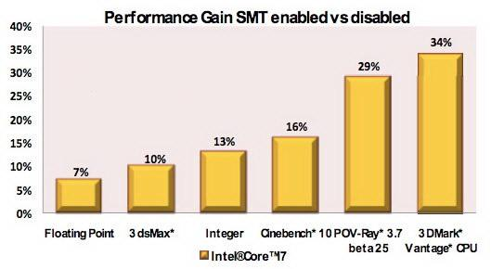
Hyper-Threading Technology
Parallelism via better utilization of existing resources
Hyper-threading is an Intel-proprietary technology used to improve parallelization of computations (doing multiple tasks at once) performed on PC microprocessors.

Slide 24
Threading Issues
Semantics of fork() and exec() system calls
Thread cancellation
Signal handling
Thread pools
Thread specific data
Scheduler activations

Slide 25

Java Threads
Java threads are managed by the JVM
Java threads may be created by:
  Implementing the Runnable interface

Slide 26
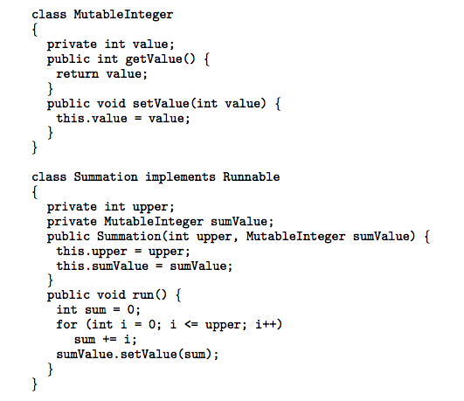
Java Threads - Example Program

Slide 27
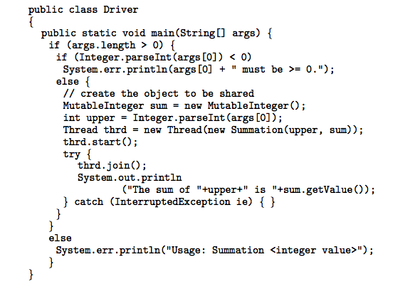
Java Threads - Example Program

Slide 28
Thread Pools
Create a number of threads in a pool where they await work
Advantages:
  Usually slightly faster to service a request with an existing thread than create a new thread
  Allows the number of threads in the application(s) to be bound to the size of the pool

Slide 29
Thread Specific Data
Allows each thread to have its own copy of data
Useful when you do not have control over the thread creation process (i.e., when using a thread pool)

Slide 30
Windows XP Threads
Implements the one-to-one mapping
Each thread contains
  A thread id
  Register set
  Separate user and kernel stacks
  Private data storage area
The register set, stacks, and private storage area are known as the context of the threads
The primary data structures of a thread include:
  ETHREAD (executive thread block)
  KTHREAD (kernel thread block)
  TEB (thread environment block)

Slide 31
Linux Threads
Linux refers to them as tasks rather than threads
Thread creation is done through clone() system call
clone() allows a child task to share the address space of the parent task (process)

Slide 32
End of Chapter 4

