Slide 1
Chapter 6: Process Synchronization

Slide 2
Process Synchronization
Background
The Critical-Section Problem
Peterson’s Solution
Synchronization Hardware
Semaphores
Classic Problems of Synchronization
Monitors
Synchronization Examples

Slide 3
Background
Concurrent access to shared data may result in data inconsistency
Maintaining data consistency requires mechanisms to ensure the orderly execution of cooperating processes
Suppose that we wanted to provide a solution to the consumer-producer problem that fills all the buffers. We can do so by having an integer count that keeps track of the number of full buffers. Initially, count is set to 0. It is incremented by the producer after it produces a new buffer and is decremented by the consumer after it consumes a buffer.

Slide 4
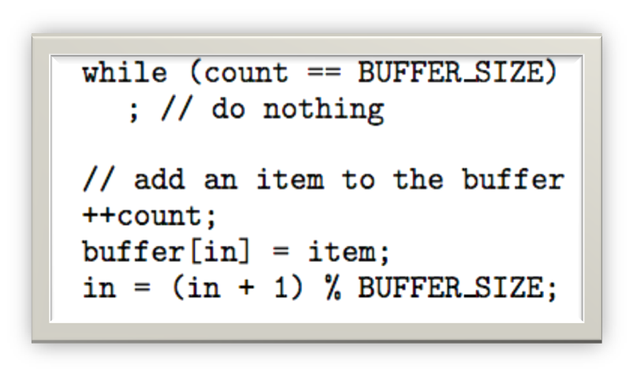
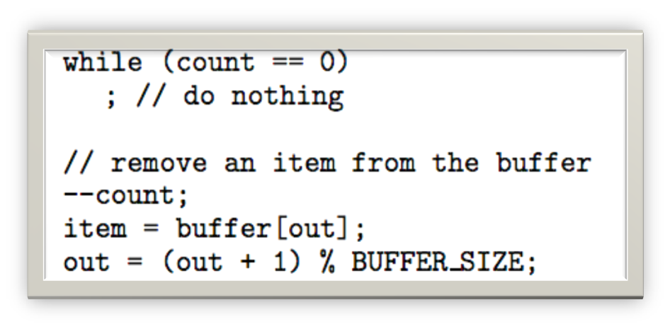
Producer
Consumer

Slide 5
Race Condition
count++ could be implemented as
register1 = count
register1 = register1 + 1
count = register1
count-- could be implemented as
register2 = count
register2 = register2 - 1
count = register2
Consider this execution interleaving with “count = 5” initially:
S0: producer execute register1 = count {register1 = 5}
S1: producer execute register1 = register1 + 1 {register1 = 6}
S2: consumer execute register2 = count {register2 = 5}
S3: consumer execute register2 = register2 - 1 {register2 = 4}
S4: producer execute count = register1 {count = 6 }
S5: consumer execute count = register2 {count = 4}

Slide 6
Solution to Critical-Section Problem
1. Mutual Exclusion - If process P_{i} is executing in its critical section, then no other processes can be executing in their critical sections
2. Progress - If no process is executing in its critical section and there exist some processes that wish to enter their critical section, then the selection of the processes that will enter the critical section next cannot be postponed indefinitely
3. Bounded Waiting - A bound must exist on the number of times that other processes are allowed to enter their critical sections after a process has made a request to enter its critical section and before that request is granted
  Assume that each process executes at a nonzero speed
  No assumption concerning relative speed of the N processes

Slide 7
Solution to Critical-Section Problem
必须强制实施互斥：在具有关于相同资源或共享对象的临界区的所有进程中，一次只允许一个进程进入临界区；
一个在非临界区的进程必须不干涉其他进程；
不允许一个需要访问临界区的进程被无限延迟；
没有进程在临界区时，任何需要进入临界区的进程必须能够立即进入；
相关进程的速度和处理器数目没有任何要求和限制；
一个进程阻留在临界区中的时间必须是有限的；
  有空让进;
  无空等待;
  择一而入;
  算法可行;

Slide 8
Critical-Section Problem
Race Condition - When there is concurrent access to shared data and the final outcome depends upon order of execution.
Critical Section - Section of code where shared data is accessed.
Entry Section - Code that requests permission to enter its critical section.
Exit Section - Code that is run after exiting the critical section

Slide 9
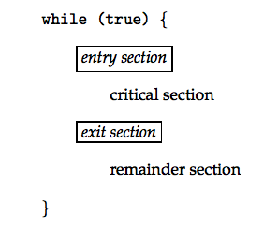
Structure of a Typical Process
进入区
临界区
退出区
剩余区

Slide 10
Peterson’s Solution
Two process solution
Assume that the LOAD and STORE instructions are atomic; that is, cannot be interrupted.
The two processes share two variables:
  int turn;
  Boolean flag[2]
The variable turn indicates whose turn it is to enter the critical section.
The flag array is used to indicate if a process is ready to enter the critical section. flag[i] = true implies that process P_{i} is ready!

Slide 11
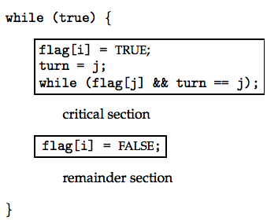
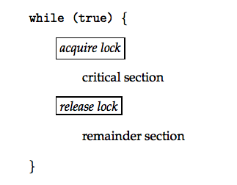
Algorithm for Process P_{i}
Critical Section Using Locks

Slide 12
Synchronization Hardware
Many systems provide hardware support for critical section code
Uniprocessors – could disable interrupts
  Currently running code would execute without preemption
  Generally too inefficient on multiprocessor systems
    Operating systems using this not broadly scalable
Modern machines provide special atomic hardware instructions
    Atomic = non-interruptable
  Either test memory word and set value
  Or swap contents of two memory words

Slide 13
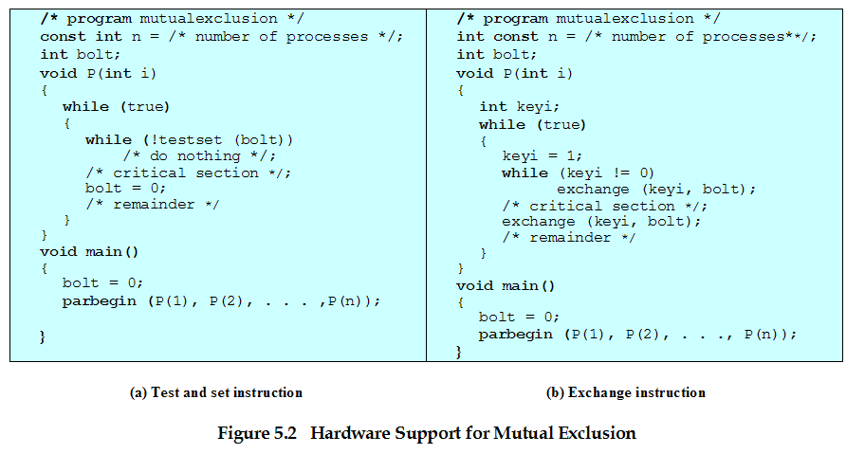
Test-And-Set Instruction
boolean testset (int i)
{ if (i == 0)
{ i = 1;
    return true;}
else
{ return false;}
}
忙等待/自旋等待
While !TS(Blot);
临界区
Blot=0
剩余区

Slide 14
Solution using Exchange
void exchange (int register, int memory)
{
int temp;
temp = memory;
memory = register;
register = temp; }
keyi=1;
While(keyi != 0)
Exchange(Blot,key);
临界区
Exchange(Blot,key);
剩余区

Slide 15
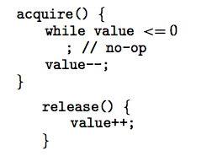
Semaphore
Synchronization tool that does not require busy waiting
Semaphore S – integer variable
Two standard operations modify S: acquire() and release()
  Originally called P() and V()
Less complicated
Can only be accessed via two indivisible (atomic) operations

Slide 16
Semaphore
前面方法解决临界区调度问题的缺点:
1)对不能进入临界区的进程，采用忙式等待测试法，浪费CPU时间。
2)将测试能否进入临界区的责任推给各个竞争的进程会削弱系统的可靠性，加重了用户编程负担。
1965年E.W.Dijkstra(荷兰人）提出了新的同步工具--信号量和P （荷兰语的测试Proberen）semWait、V操作（荷兰语的增量Verhogen）semSignal。

Slide 17
Semaphore
信号量和P、V操作 ，将交通管制中多种颜色的信号灯管理交通的方法引入操作系统，让两个或多个进程通过特殊变量展开交互。
信号量：一种软资源
  一个进程在某一特殊点上被迫停止执行直到接收到一个对应的特殊变量值，这种特殊变量就是信号量(Semaphore)，复杂的进程合作需求都可以通过适当的信号结构得到满足。
原语：内核中执行时不可被中断的过程

Slide 18
Semaphore as General Synchronization Tool
Counting semaphore – integer value can range over an unrestricted domain
Binary semaphore – integer value can range only between 0
and 1; can be simpler to implement
  Also known as mutex locks
Can implement a counting semaphore S as a binary semaphore
Provides mutual exclusion
  Semaphore S; // initialized to 1
  wait (S);
  Critical Section
  signal (S);

Slide 19
Semaphore Implementation
Must guarantee that no two processes can execute wait () and signal () on the same semaphore at the same time
Thus, implementation becomes the critical section problem where the wait and signal code are placed in the crtical section.
  Could now have busy waiting in critical section implementation
    But implementation code is short
    Little busy waiting if critical section rarely occupied
Note that applications may spend lots of time in critical sections and therefore this is not a good solution.

Slide 20
Semaphore Implementation with no Busy waiting
With each semaphore there is an associated waiting queue. Each entry in a waiting queue has two data items:
  value (of type integer)
  pointer to next record in the list
Two operations:
  block – place the process invoking the operation on the appropriate waiting queue.
  wakeup – remove one of processes in the waiting queue and place it in the ready queue.

Slide 21
Semaphore Implementation with no Busy waiting (Cont.)
Implementation of wait:
wait (S){
value--;
if (value < 0) {
add this process to waiting queue
block(); }
}
Implementation of signal:
Signal (S){
value++;
if (value <= 0) {
remove a process P from the waiting queue
wakeup(P); }
}

Slide 22
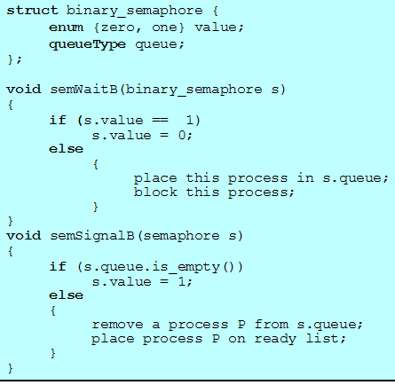
Binary semaphore
  一个信号量可以初始化成0或1
  semWaitB操作检查信号量的值，若值为0，则执行semWaitB的进程被阻塞，否则，将值改为0，继续执行；
  semSignalB操作检查是否有任何进程在该信号上受阻，若有，受阻的进程就会被唤醒，若没有进程受阻，那么信号量设为1。

Slide 23
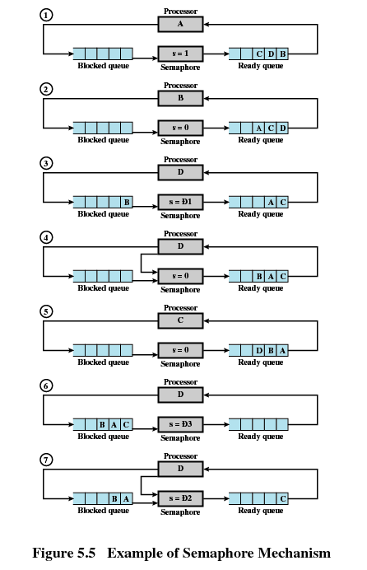

Slide 24
Summary
若信号量s.count>=0，则该值等于可以执行semWait(s)而不需要挂起的进程数。
若信号量s.count为负值，则其绝对值等于登记排列在该信号量s.queue队列之中等待的进程个数、亦即恰好等于对信号量s实施semSignal操作而被封锁起来并进入信号量s.queue队列的进程数。
>=0 表示可用临界资源的实体数；
信号量 s.count
<0 表示挂起在s.queue对列中的进程数

Slide 25
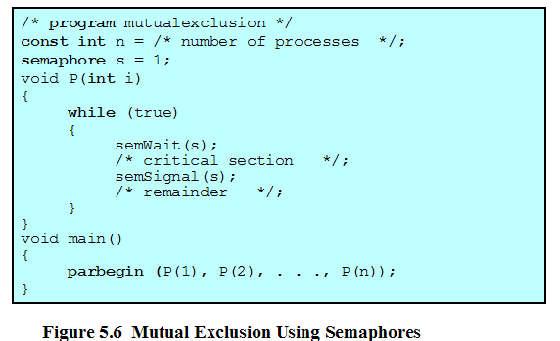
互斥
有三个进程A、B、C需共享一个临界资源，
信号量s A B C
1
0
semWait(lock)
B
-1
semWait(lock)
C B
-2
semWait(lock)
C
-1
semSignal(lock)
0
semSignal(lock)
1
semSignal(lock)

Slide 26
Deadlock and Starvation
Deadlock – two or more processes are waiting indefinitely for an event that can be caused by only one of the waiting processes
Let S and Q be two semaphores initialized to 1
P₀P₁
S.acquire(); Q.acquire();
Q.acquire(); S.acquire();
. .
. .
. .
S.release(); Q.release();
Q.release(); S.release();
Starvation – indefinite blocking. A process may never be removed from the semaphore queue in which it is suspended.

Slide 27
Classical Problems of Synchronization
Bounded-Buffer Problem
Readers and Writers Problem
Dining-Philosophers Problem

Slide 28
Bounded-Buffer Problem
有n(>=1)个生产者产生某种类型的数据，并放置在缓冲区，有m(>=1)个消费者从缓冲区取数据，每次取一项；系统保证对缓冲区的重复操作。其中，P和C都是并发进程，生产者P生产的产品投入缓冲区；只要缓冲区不空，消费者进程C就可从缓冲区取走并消耗产品。
消费进程C
从缓冲区取一产品
打印
生产进程P
生产一个产品
送缓冲区
buffer
缓冲区

Slide 29
Bounded-Buffer Problem
Shared data
semaphore full, empty, mutex;
Initially:
full = 0, empty = n, mutex = 1

Slide 30
Bounded-Buffer Problem Producer Process
do {
…
produce an item in nextp
…
wait(empty);
wait(mutex);
…
add nextp to buffer
…
signal(mutex);
signal(full);
} while (1);
Consumer Process
do {
wait(full)
wait(mutex);
…
remove an item from buffer to nextc
…
signal(mutex);
signal(empty);
…
consume the item in nextc
…
} while (1);
Producer Process
Initially:
full = 0, empty = n, mutex = 1

Slide 31
Readers-Writers Problem
有两组并发进程：读者和写者，共享一个文件F，要求：
任意多个读者可以同时读文件；
一次只有一个写进程可以往文件中写；
写进程执行写操作前，则禁止任何读进程读文件；
读者
一个文件
写者

Slide 32
Readers-Writers Problem
问题：在计算机系统中当若干个并发进程都要访问某个共享文件时应区分是读还是写。
允许多个进程同时读文件（读－读允许）；
不允许在进程读文件时让另外一进程去写文件；有进程在写文件时不让另外一个进程去读该文件（“读-写”互斥）；
更不允许多个写进程同时写同一文件（“写-写”互斥）。
因此读-写进程之间关系为：“读-写”互斥、和“读-读”允许。

Slide 33
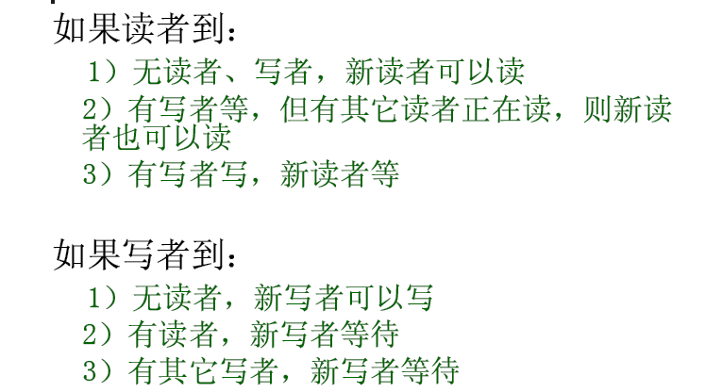
Readers-Writers Problem

Slide 34
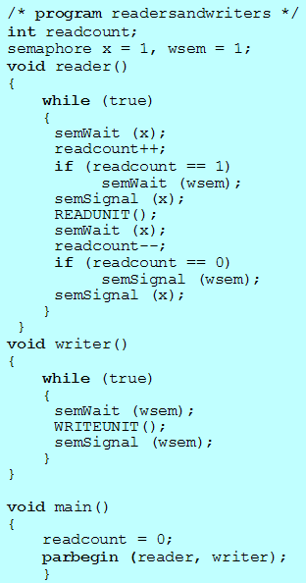
Readers-Writers Problem
读者优先：当存在读者时，写操作将被延迟，并且只要有一个读者活跃，随后而来的读者都将被允许访问文件。从而，导致了写进程长时间等待，并有可能出现写进程被饿死。

Slide 35
Readers-Writers Problem
实际的系统为写者优先：即当有进程在读文件时，如果有进程请求写，那么新的读进程被拒绝，待现有的读者完成读操作后，立即让写者运行，只有当无写者工作时，才让读者工作。

Slide 36
Readers-Writers Problem
A data set is shared among a number of concurrent processes
  Readers – only read the data set; they do not perform any updates
  Writers – can both read and write.
Problem – allow multiple readers to read at the same time. Only one single writer can access the shared data at the same time.
Shared Data
  Data set
  Semaphore mutex initialized to 1.
  Semaphore db initialized to 1.
  Integer readerCount initialized to 0.

Slide 37
Readers-Writers Problem
wait(wrt);
…
writing is performed
…
signal(wrt);
Reader Process
wait(mutex);
readcount++;
if (readcount == 1)
wait(wrt);
signal(mutex);
…
reading is performed
…
wait(mutex);
readcount--;
if (readcount == 0)
signal(wrt);
signal(mutex):
Writer Process
Shared data
semaphore mutex, wrt;
Initially
mutex = 1, wrt = 1, readcount = 0

Slide 38
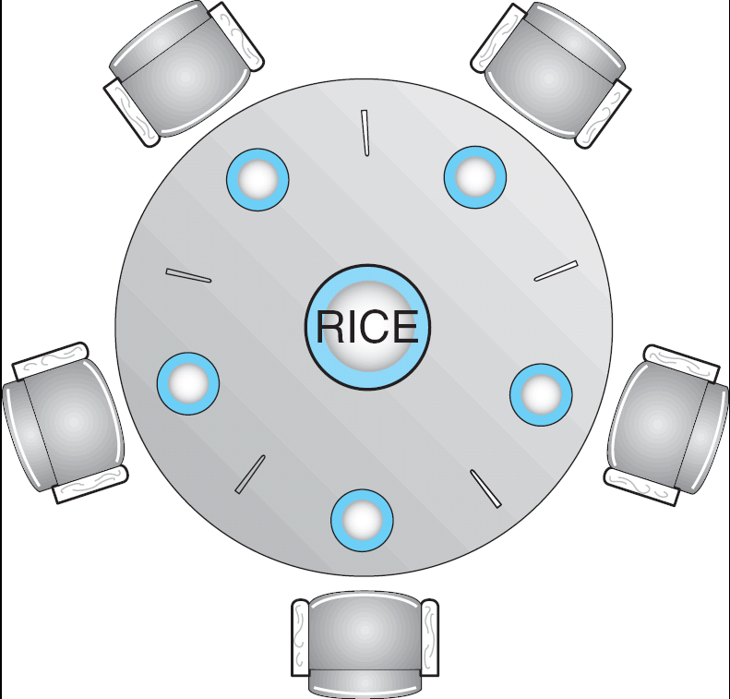
Dining-Philosophers Problem
Solution to Dining Philosophers
Philosopher i:
do {
wait(chopstick[i])
wait(chopstick[(i+1) % 5])
…
eat
…
signal(chopstick[i]);
signal(chopstick[(i+1) % 5]);
…
think
…
} while (1);
Shared data
  Bowl of rice (data set)
  Semaphore chopStick [5] initialized to 1

Slide 39
Monitors
A high-level abstraction that provides a convenient and effective mechanism for process synchronization
Only one process may be active within the monitor at a time
    monitor monitor-name
    {
    // shared variable declarations
    procedure P1 (…) { …. }
    …
    procedure Pn (…) {……}
    Initialization code ( ….) { … }
    …
    }
    }

Slide 40
Monitors-Background
  用信号量机制可以实现进程间的同步和互斥，但由于信号量的控制信息分布在整个程序中，其正确性分析很困难，使用不当还可能导致进程死锁。针对信号量的问题，Dijkstra与1971年提出，为每个共享资源设立一个“秘书”来管理对它的访问，一切来访者都要通过秘书，而秘书每次仅允许一个来访者（进程）访问共享资源。这样既便于系统管理共享资源，有能保证呼哧访问和进程间同步。1973年，Hansen和Hoare又把“秘书”的概念发展成为管程。

Slide 41
Monitors
管程定义了一个数据结构和能为并发进程所执行的一组操作，这组操作能同步进程和改变管程中的数据。
  局部数据变量只能被管程的过程访问，任何外部过程都不能访问；
  一个进程通过调用管程的一个过程进入管程；
  在任何时候，只能有一个进程在管程中执行，调用管程的任何其他进程都被挂起，以等待管程变为可用；

Slide 42
Monitors
管程的组成部分
  －管程的局部数据（共享变量）
  －对该数据结构进行操作的一组过程（自己定义别人引用、引用别人）
  －初始值
  ＋管程名字

Slide 43
Monitors
等待调用的进程队列
入口
管程等待区域
管程
condition c1
局部数据
wait(c1)
条件变量
…
过程1
condition cn
…
wait(cn)
过程k
Urgent queue
signal
初始化代码
出口

Slide 44
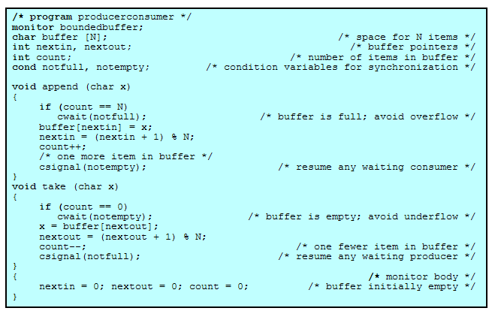
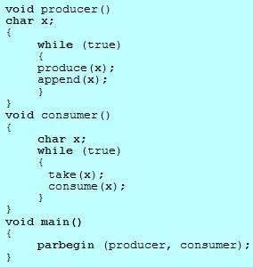
使用管程
有界缓冲生产者/消费者问题

Slide 45
Windows XP Synchronization
Uses interrupt masks to protect access to global resources on uniprocessor systems
Uses spinlocks on multiprocessor systems
Also provides dispatcher objects which may act as either mutexes and semaphores
Dispatcher objects may also provide events
  An event acts much like a condition variable

Slide 46
End of Chapter 6

