Slide 1
Chapter 8: Main Memory

Slide 2
Chapter 8: Memory Management
Background
Swapping
Contiguous Memory Allocation
Paging
Structure of the Page Table
Segmentation

Slide 3
Objectives
To provide a detailed description of various ways of organizing memory hardware
To discuss various memory-management techniques, including paging and segmentation

Slide 4
Background
Program must be brought (from disk) into memory and placed within a process for it to be run
Main memory and registers are only storage CPU can access directly
Register access in one CPU clock (or less)
Main memory can take many cycles
Cache sits between main memory and CPU registers
Protection of memory required to ensure correct operation

Slide 5
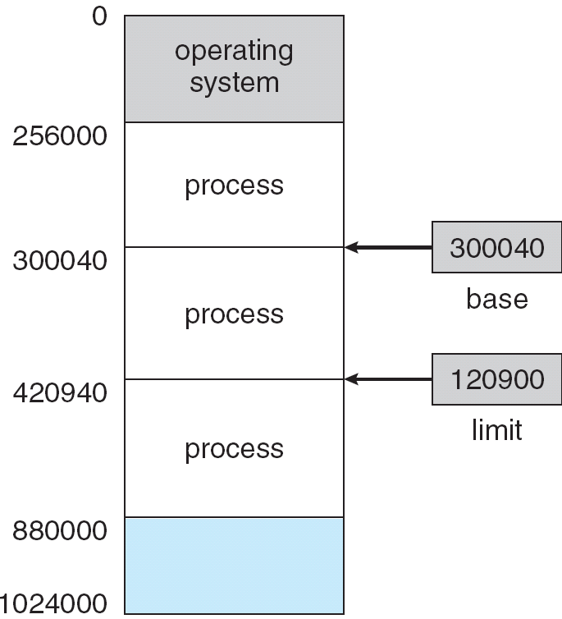
Base and Limit Registers
A pair of base and limit registers define the logical address space

Slide 6
Binding of Instructions and Data to Memory
Address binding of instructions and data to memory addresses can happen at three different stages
  Compile time: If memory location known a priori, absolute code can be generated; must recompile code if starting location changes
  Load time: Must generate relocatable code if memory location is not known at compile time
  Execution time: Binding delayed until run time if the process can be moved during its execution from one memory segment to another. Need hardware support for address maps (e.g., base and limit registers)

Slide 7

Multistep Processing of a User Program

Slide 8
Logical vs. Physical Address Space
The concept of a logical address space that is bound to a separate physical address space is central to proper memory management
  Logical address – generated by the CPU; also referred to as virtual address
  Physical address – address seen by the memory unit
Logical and physical addresses are the same in compile-time and load-time address-binding schemes; logical (virtual) and physical addresses differ in execution-time address-binding scheme

Slide 9
Memory-Management Unit (MMU)
Hardware device that maps virtual to physical address
In MMU scheme, the value in the relocation register is added to every address generated by a user process at the time it is sent to memory
The user program deals with logical addresses; it never sees the real physical addresses

Slide 10

Dynamic relocation using a relocation register

Slide 11
Dynamic Loading
Routine is not loaded until it is called
Better memory-space utilization; unused routine is never loaded
Useful when large amounts of code are needed to handle infrequently occurring cases
No special support from the operating system is required implemented through program design

Slide 12
Dynamic Linking
Linking postponed until execution time
Small piece of code, stub, used to locate the appropriate memory-resident library routine
Stub replaces itself with the address of the routine, and executes the routine
Operating system needed to check if routine is in processes’ memory address
Dynamic linking is particularly useful for libraries
System also known as shared libraries

Slide 13
Swapping
A process can be swapped temporarily out of memory to a backing store, and then brought back into memory for continued execution
Backing store – fast disk large enough to accommodate copies of all memory images for all users; must provide direct access to these memory images
Roll out, roll in – swapping variant used for priority-based scheduling algorithms; lower-priority process is swapped out so higher-priority process can be loaded and executed
Major part of swap time is transfer time; total transfer time is directly proportional to the amount of memory swapped
Modified versions of swapping are found on many systems (i.e., UNIX, Linux, and Windows)
System maintains a ready queue of ready-to-run processes which have memory images on disk

Slide 14

Schematic View of Swapping

Slide 15
Contiguous Allocation
Main memory usually into two partitions:
  Resident operating system, usually held in low memory with interrupt vector
  User processes then held in high memory
Relocation registers used to protect user processes from each other, and from changing operating-system code and data
  Base register contains value of smallest physical address
  Limit register contains range of logical addresses – each logical address must be less than the limit register
  MMU maps logical address dynamically

Slide 16

HW address protection with base and limit registers

Slide 17
Contiguous Allocation (Cont.)
Multiple-partition allocation
  Hole – block of available memory; holes of various size are scattered throughout memory
  When a process arrives, it is allocated memory from a hole large enough to accommodate it
  Operating system maintains information about:
  a) allocated partitions b) free partitions (hole)
OS
OS
OS
OS
process 5
process 5
process 5
process 5
process 9
process 9
process 8
process 10
process 2
process 2
process 2
process 2

Slide 18
Dynamic Storage-Allocation Problem
How to satisfy a request of size n from a list of free holes
First-fit: Allocate the first hole that is big enough
Best-fit: Allocate the smallest hole that is big enough; must search entire list, unless ordered by size
  Produces the smallest leftover hole
Worst-fit: Allocate the largest hole; must also search entire list
  Produces the largest leftover hole
First-fit and best-fit better than worst-fit in terms of speed and storage utilization

Slide 19
Fragmentation
External Fragmentation – total memory space exists to satisfy a request, but it is not contiguous
Internal Fragmentation – allocated memory may be slightly larger than requested memory; this size difference is memory internal to a partition, but not being used
Reduce external fragmentation by compaction
  Shuffle memory contents to place all free memory together in one large block
  Compaction is possible only if relocation is dynamic, and is done at execution time

Slide 20
Paging
大小不等的固定分区和大小可变的分区效率低下，会产生内部或外部碎片。若将主存划分为固定大小块，并且块较小，每个进程也被分为同样大小的小块，可以将进程的块（称为页）指定到内存中的可用块（称为帧或页帧），最后一页可能形成内部碎片，没有外部碎片。

Slide 21
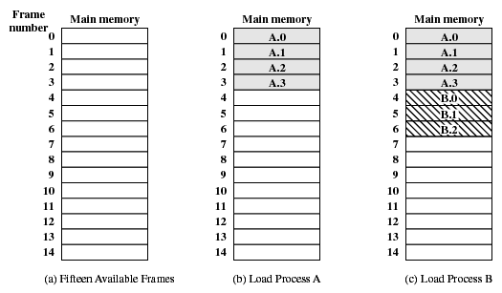
Paging

Slide 22
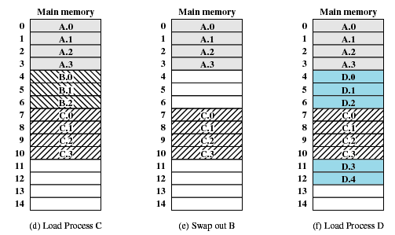
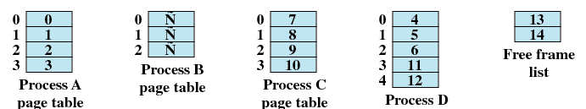
Paging
页表

Slide 23
Paging
Logical address space of a process can be noncontiguous; process is allocated physical memory whenever the latter is available
Divide physical memory into fixed-sized blocks called frames (size is power of 2, between 512 bytes and 8,192 bytes)
Divide logical memory into blocks of same size called pages
Keep track of all free frames
To run a program of size n pages, need to find n free frames and load program
Set up a page table to translate logical to physical addresses
Internal fragmentation

Slide 24
Address Translation Scheme
Address generated by CPU is divided into:
  Page number (p) – used as an index into a page table which contains base address of each page in physical memory
  Page offset (d) – combined with base address to define the physical memory address that is sent to the memory unit
  For given logical address space 2^{m} and page size 2^{n}
page number
page offset
p
d
m - n
n

Slide 25
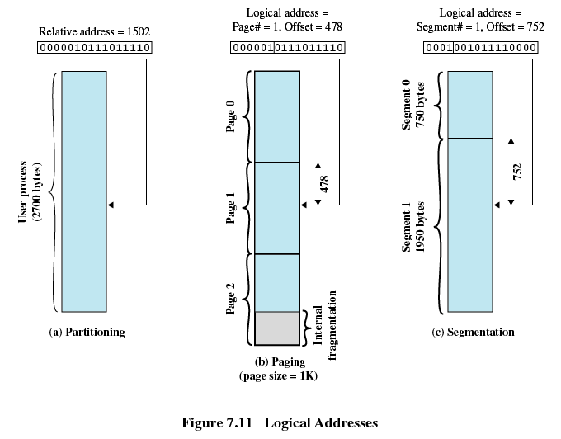
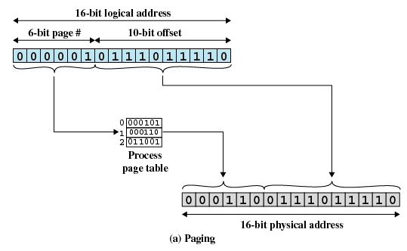
Paging
为了方便使用，规定页的大小及帧的大小必须是2的幂，以便容易表示出相对地址；
相对地址由程序的起点和逻辑地址定义，可以用页号和偏移量表示。

Slide 26

Paging Hardware

Slide 27

Paging Model of Logical and Physical Memory

Slide 28

Paging Example
32-byte memory and 4-byte pages

Slide 29

Free Frames
Before allocation
After allocation

Slide 30
Implementation of Page Table
Page table is kept in main memory
Page-table base register (PTBR) points to the page table
Page-table length register (PRLR) indicates size of the page table
In this scheme every data/instruction access requires two memory accesses. One for the page table and one for the data/instruction.
The two memory access problem can be solved by the use of a special fast-lookup hardware cache called associative memory or translation look-aside buffers (TLBs)
Some TLBs store address-space identifiers (ASIDs) in each TLB entry – uniquely identifies each process to provide address-space protection for that process

Slide 31
Associative Memory
Associative memory – parallel search
Address translation (p, d)
  If p is in associative register, get frame # out
  Otherwise get frame # from page table in memory
Page #
Frame #

Slide 32

Paging Hardware With TLB

Slide 33
Effective Access Time
Associative Lookup = ε time unit
Assume memory cycle time is 1 microsecond
Hit ratio – percentage of times that a page number is found in the associative registers; ratio related to number of associative registers
Hit ratio = α
Effective Access Time (EAT)
EAT = (1 + ε) α + (2 + ε)(1 – α)
= 2 + ε – α

Slide 34
Memory Protection
Memory protection implemented by associating protection bit with each frame
Valid-invalid bit attached to each entry in the page table:
  “valid” indicates that the associated page is in the process’ logical address space, and is thus a legal page
  “invalid” indicates that the page is not in the process’ logical address space

Slide 35

Valid (v) or Invalid (i) Bit In A Page Table

Slide 36
Structure of the Page Table
Hierarchical Paging
Hashed Page Tables
Inverted Page Tables

Slide 37
Hierarchical Page Tables
Break up the logical address space into multiple page tables
A simple technique is a two-level page table

Slide 38

Two-Level Page-Table Scheme

Slide 39
Two-Level Paging Example
A logical address (on 32-bit machine with 1K page size) is divided into:
  a page number consisting of 22 bits
  a page offset consisting of 10 bits
Since the page table is paged, the page number is further divided into:
  a 12-bit page number
  a 10-bit page offset
Thus, a logical address is as follows:
where p_{i} is an index into the outer page table, and p₂ is the displacement within the page of the outer page table
page number
page offset
p_{i}
p₂
d
12
10
10

Slide 40

Address-Translation Scheme

Slide 41


Three-level Paging Scheme

Slide 42
Hashed Page Tables
Common in address spaces > 32 bits
The virtual page number is hashed into a page table. This page table contains a chain of elements hashing to the same location.
Virtual page numbers are compared in this chain searching for a match. If a match is found, the corresponding physical frame is extracted.

Slide 43

Hashed Page Table

Slide 44
Inverted Page Table
One entry for each real page of memory
Entry consists of the virtual address of the page stored in that real memory location, with information about the process that owns that page
Decreases memory needed to store each page table, but increases time needed to search the table when a page reference occurs
Use hash table to limit the search to one — or at most a few — page-table entries

Slide 45

Inverted Page Table Architecture

Slide 46
Shared Pages
Shared code
  One copy of read-only (reentrant) code shared among processes (i.e., text editors, compilers, window systems).
  Shared code must appear in same location in the logical address space of all processes
Private code and data
  Each process keeps a separate copy of the code and data
  The pages for the private code and data can appear anywhere in the logical address space

Slide 47
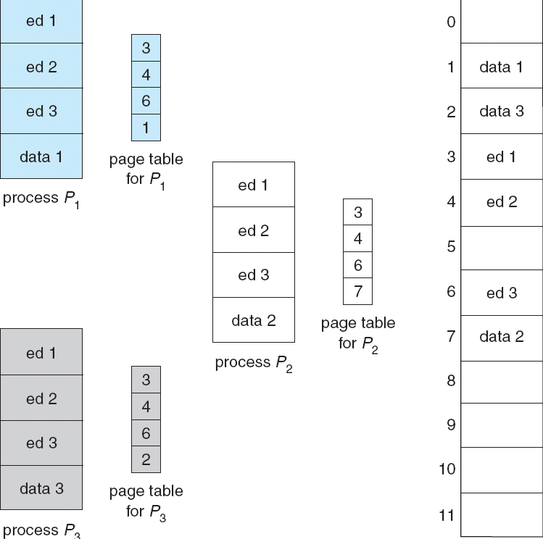
Shared Pages Example

Slide 48
Segmentation
Memory-management scheme that supports user view of memory
A program is a collection of segments. A segment is a logical unit such as:
main program,
procedure,
function,
method,
object,
local variables, global variables,
common block,
stack,
symbol table, arrays

Slide 49

User’s View of a Program

Slide 50
Logical View of Segmentation
1
1
4
2
3
4
2
3
user space
physical memory space

Slide 51
分段技术
程序和相关的数据被划分成一组段（segment）。
分段技术的逻辑地址由两部分组成：段号和偏移量。
由于使用大小不等的段，分段类似于动态分区。与动态分区不同的是，在分段方案中，一个程序可以占据多个分区，并且这些分区不要求是连续的。
分段消除了内部碎片，但是和动态分区一样，会产生很多外部碎片。
由于进程被分为许多小块，外部碎片较小。

Slide 52
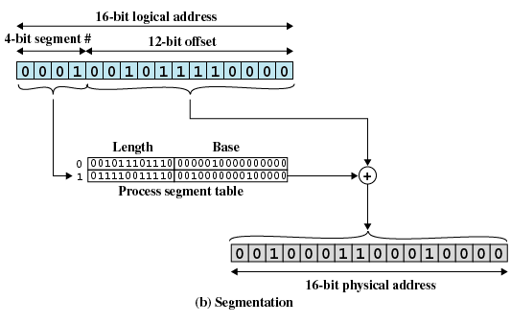
分段技术
一般情况，程序和数据指定到不同的段。
上图中，段长度=4，偏移量=12。最大段长度2¹²=4096
  提取段号（最左边4位）；
  查找物理地址；
  比较偏移量和段长度，是否地址有效；
  物理地址=该段起始地址+偏移量

Slide 53
Segmentation Architecture
Logical address consists of a two tuple:
<segment-number, offset>,
Segment table – maps two-dimensional physical addresses; each table entry has:
  base – contains the starting physical address where the segments reside in memory
  limit – specifies the length of the segment
Segment-table base register (STBR) points to the segment table’s location in memory
Segment-table length register (STLR) indicates number of segments used by a program;
segment number s is legal if s < STLR

Slide 54
Segmentation Architecture (Cont.)
Protection
  With each entry in segment table associate:
    validation bit = 0 ⇒ illegal segment
    read/write/execute privileges
Protection bits associated with segments; code sharing occurs at segment level
Since segments vary in length, memory allocation is a dynamic storage-allocation problem
A segmentation example is shown in the following diagram

Slide 55

Segmentation Hardware

Slide 56

Example of Segmentation

Slide 57
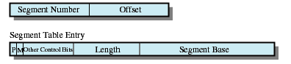
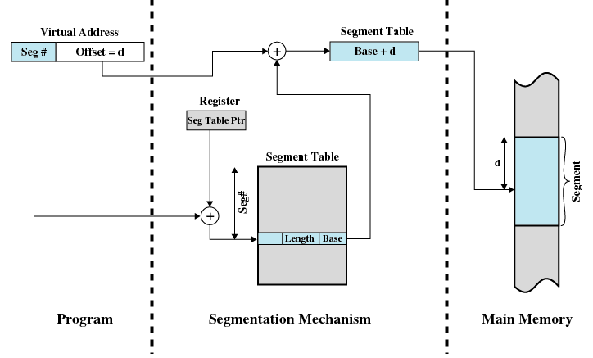
分段式虚拟内存
  仅仅分段
分段系统中地址转换

Slide 58
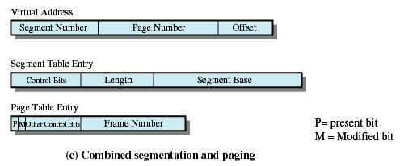
分段和分页结合
用户的地址空间被程序员划分为多个段，段由大小相同的若干页构成，页面有页内地址。
段页式管理系统的地址结构为（S,P,d),其中S为段号，P为段内页号，d为页内偏移量。

Slide 59
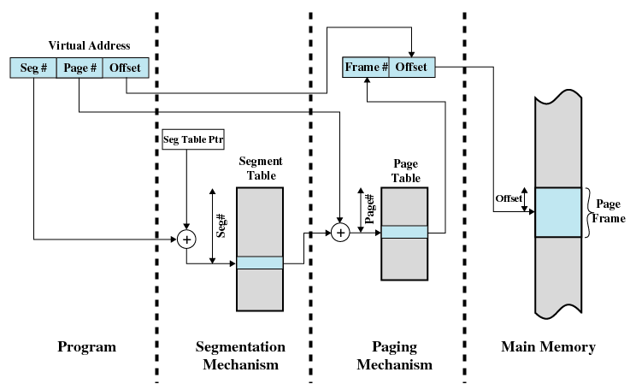
分段和分页结合

Slide 60
End of Chapter 8

