Slide 1
Chapter 9: Virtual Memory

Slide 2
Chapter 9: Virtual Memory
Background
Demand Paging
Copy-on-Write
Page Replacement
Allocation of Frames
Thrashing

Slide 3
Objectives
To describe the benefits of a virtual memory system
To explain the concepts of demand paging, page-replacement algorithms, and allocation of page frames
To discuss the principle of the working-set model

Slide 4
Background
Virtual memory – separation of user logical memory from physical memory.
  Only part of the program needs to be in memory for execution
  Logical address space can therefore be much larger than physical address space
  Allows address spaces to be shared by several processes
  Allows for more efficient process creation
Virtual memory can be implemented via:
  Demand paging
  Demand segmentation

Slide 5
虚拟内存
两个特点：
  进程中所有存储器访问都是逻辑地址，这些逻辑地址在运行时被转换为物理地址；
  一个进程可以划分为许多块，在执行过程中，这些块不需要连续地位于主存中。

Slide 6
虚拟内存
两个效果：
在主存中保留多个进程：
  由于对任何特定的进程都仅仅装入它的某些块，因此就有足够的空间放置更多进程。
进程可以比主存的全部空间还大
  通过分段或分页的虚拟内存，程序员可以获得巨大的主存，大小与磁盘储存器相关。

Slide 7
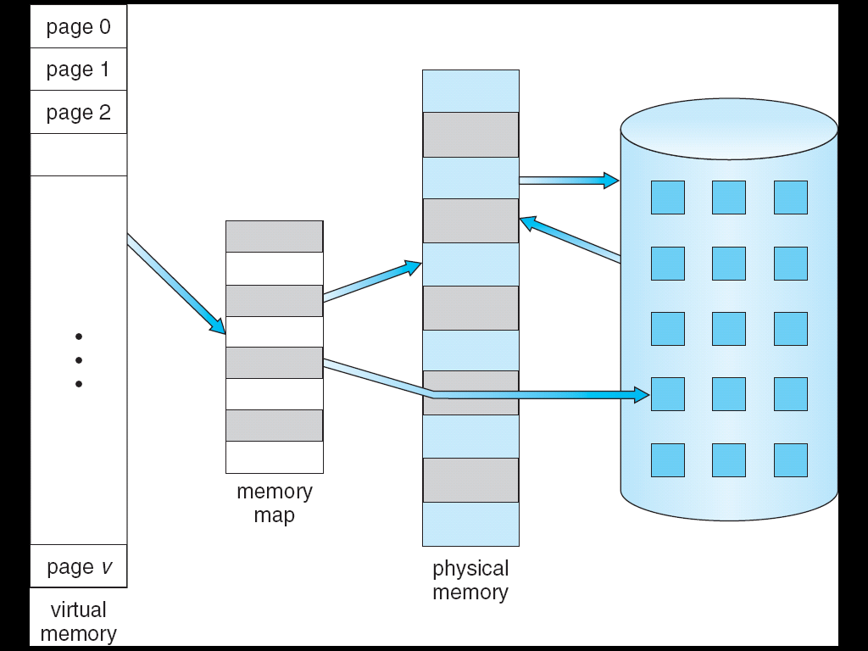
Virtual Memory That is Larger Than Physical Memory
⇒

Slide 8
虚拟内存
在具有层次结构存储器的计算机系统中，采用自动实现部分装入和部分对换功能，为用户提供一个比物理主存容量大得多的，可寻址的一种“主存储器”。
物理地址空间
虚拟地址空间
主存
辅存
虚地址
存储
管理
部件
实地址
处理器

Slide 9

Virtual-address Space

Slide 10

Shared Library Using Virtual Memory

Slide 11
Demand Paging
Bring a page into memory only when it is needed
  Less I/O needed
  Less memory needed
  Faster response
  More users
Page is needed ⇒ reference to it
  invalid reference ⇒ abort
  not-in-memory ⇒ bring to memory
Lazy swapper – never swaps a page into memory unless page will be needed
  Swapper that deals with pages is a pager

Slide 12
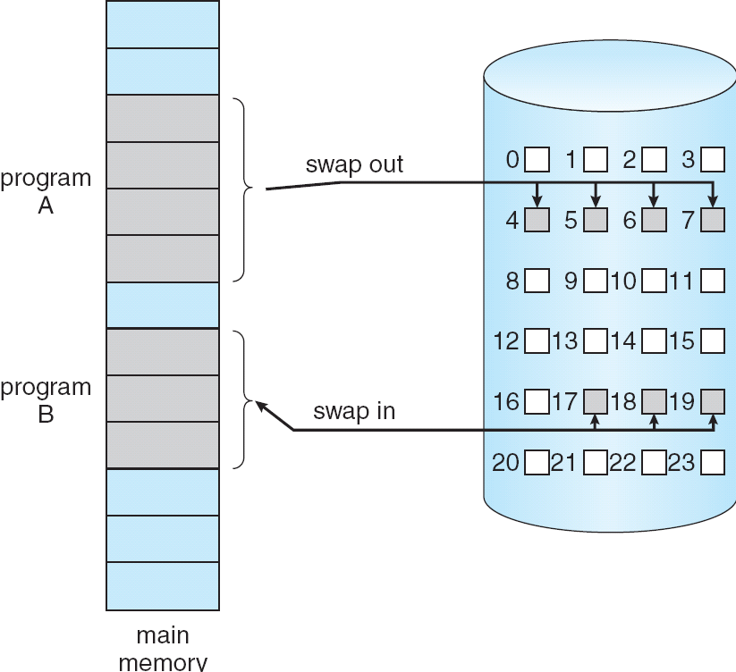
Transfer of a Paged Memory to Contiguous Disk Space

Slide 13
Valid-Invalid Bit
With each page table entry a valid–invalid bit is associated
(v ⇒ in-memory, i ⇒ not-in-memory)
Initially valid–invalid bit is set to i on all entries
Example of a page table snapshot:
During address translation, if valid–invalid bit in page table entry
is I ⇒ page fault
Frame #
valid-invalid bit
v
v
v
v
i
….
i
i
page table

Slide 14
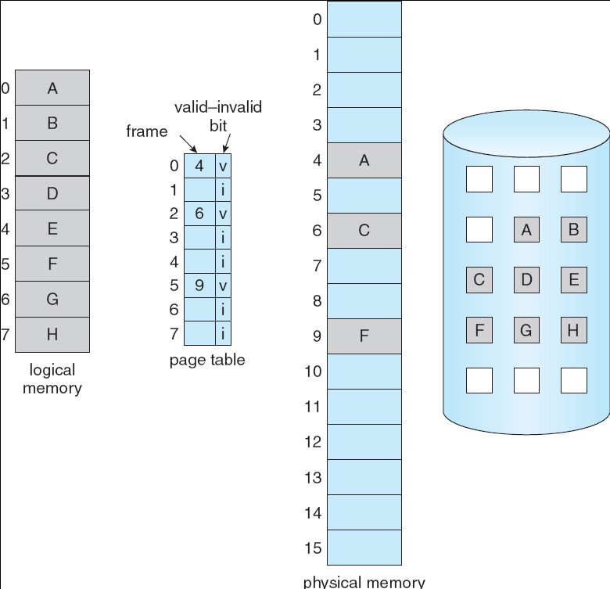
Page Table When Some Pages Are Not in Main Memory

Slide 15
Page Fault
If there is a reference to a page, first reference to that page will trap to operating system:
page fault
Operating system looks at another table to decide:
  Invalid reference ⇒ abort
  Just not in memory
Get empty frame
Swap page into frame
Reset tables
Set validation bit = v
Restart the instruction that caused the page fault

Slide 16

Steps in Handling a Page Fault

Slide 17
Performance of Demand Paging
Page Fault Rate 0 ≤ p ≤ 1.0
  if p = 0 no page faults
  if p = 1, every reference is a fault
Effective Access Time (EAT)
EAT = (1 – p) x memory access
+ p (page fault overhead
+ swap page out
+ swap page in
+ restart overhead
)

Slide 18
Demand Paging Example
Memory access time = 200 nanoseconds
Average page-fault service time = 8 milliseconds
EAT = (1 – p) x 200 + p (8 milliseconds)
= (1 – p x 200 + p x 8,000,000
= 200 + p x 7,999,800
If one access out of 1,000 causes a page fault, then
EAT = 8.2 microseconds.
This is a slowdown by a factor of 40!!

Slide 19
Process Creation
Virtual memory allows other benefits during process creation:
- Copy-on-Write
- Memory-Mapped Files (later)

Slide 20
Copy-on-Write
Copy-on-Write (COW) allows both parent and child processes to initially share the same pages in memory
If either process modifies a shared page, only then is the page copied
COW allows more efficient process creation as only modified pages are copied
Free pages are allocated from a pool of zeroed-out pages

Slide 21
What happens if there is no free frame?
Page replacement – find some page in memory, but not really in use, swap it out
  algorithm
  performance – want an algorithm which will result in minimum number of page faults
Same page may be brought into memory several times

Slide 22
Page Replacement
Prevent over-allocation of memory by modifying page-fault service routine to include page replacement
Use modify (dirty) bit to reduce overhead of page transfers – only modified pages are written to disk
Page replacement completes separation between logical memory and physical memory – large virtual memory can be provided on a smaller physical memory

Slide 23

Need For Page Replacement

Slide 24
Basic Page Replacement
Find the location of the desired page on disk
Find a free frame:
- If there is a free frame, use it
- If there is no free frame, use a page replacement algorithm to select a victim frame
Bring the desired page into the (newly) free frame; update the page and frame tables
Restart the process

Slide 25

Page Replacement

Slide 26
Page Replacement Algorithms
Want lowest page-fault rate
Evaluate algorithm by running it on a particular string of memory references (reference string) and computing the number of page faults on that string
In all our examples, the reference string is
1, 2, 3, 4, 1, 2, 5, 1, 2, 3, 4, 5

Slide 27

Graph of Page Faults Versus The Number of Frames

Slide 28
First-In-First-Out (FIFO) Algorithm
Reference string: 1, 2, 3, 4, 1, 2, 5, 1, 2, 3, 4, 5
3 frames (3 pages can be in memory at a time per process)
4 frames
Belady’s Anomaly: more frames ⇒ more page faults
1
1
4
5
2
2
1
3
9 page faults
3
3
2
4
1
1
5
4
2
2
1
5
10 page faults
3
3
2
4
4
3

Slide 29
替换策略-先进先出（FIFO）
算法：总是淘汰最先调入主存的那一页，或者说在主存中驻留时间最长的那一页（常驻的除外）。
理由：最早调入内存的页面，其不再被访问的可能性最大。

Slide 30
替换策略-先进先出（FIFO）
特点：实现简单、适合线性访问、对其他情况效率不高
异常情况：在某些情况下会出现分配给进程的页面数增多，缺页次数反而增加的奇怪现象。

Slide 31

FIFO Illustrating Belady’s Anomaly

Slide 32
替换策略-先进先出（FIFO）
时刻
0
1
2
3
4
5
6
7
8
9
10
11
12
13
14
15
16
17
18
19
P
7
0
1
2
0
3
0
4
2
3
0
3
2
1
2
0
1
7
0
1
7
0
1
2
2
3
0
4
2
3
0
0
0
1
2
2
2
7
0
1
M
7
0
1
1
2
3
0
4
2
3
3
3
0
1
1
1
2
7
0
7
0
0
1
2
3
0
4
2
2
2
3
0
0
0
1
2
7
F
f
f
f
f
v
f
f
f
f
f
f
v
v
f
f
v
v
f
f
f
缺页率σ =15/20=75%

Slide 33
Optimal Algorithm
Replace page that will not be used for longest period of time
4 frames example
1, 2, 3, 4, 1, 2, 5, 1, 2, 3, 4, 5
How do you know this?
Used for measuring how well your algorithm performs
1
6 page faults
4
2
3
4
5

Slide 34
替换策略-最佳替换算法（OPT）
算法：调入一页而必须淘汰一个旧页时，所淘汰的页应该是以后不再访问的页或距现在最长时间后再访问的页。
特点：不是实际可行的算法，可用来作为衡量各种具体算法的标准，具有理论意义。

Slide 35
替换策略-最佳替换（OPT）
时刻
0
1
2
3
4
5
6
7
8
9
10
11
12
13
14
15
16
17
18
19
7
0
1
2
0
3
0
4
2
3
0
3
2
1
2
0
1
7
0
1
P
7
0
1
2
2
2
2
2
2
2
2
2
2
2
2
2
2
7
7
7
M
7
0
1
1
3
3
3
3
3
3
3
3
1
1
1
1
1
1
1
7
0
0
0
0
4
4
4
0
0
0
0
0
0
0
0
0
0
F
f
f
f
f
v
f
v
f
V
V
f
v
v
f
v
V
v
f
v
v
缺页率σ =9/20=45%

Slide 36
Least Recently Used (LRU) Algorithm
Reference string: 1, 2, 3, 4, 1, 2, 5, 1, 2, 3, 4, 5
Counter implementation
  Every page entry has a counter; every time page is referenced through this entry, copy the clock into the counter
  When a page needs to be changed, look at the counters to determine which are to change
1
1
1
1
5
2
2
2
2
2
3
5
5
4
4
4
4
3
3
3

Slide 37
替换策略-最近最少使用（LRU）
算法：淘汰的页面是在最近一段时间里较久未被访问的那页。
原理：根据程序局部性原理，那些刚被使用过的页面，可能马上还要被使用，而在较长时间里未被使用的页面，可能不会马上使用到。

Slide 38
替换策略-最近最少使用算法（LRU）
时刻
0
1
2
3
4
5
6
7
8
9
10
11
12
13
14
15
16
17
18
19
7
0
1
2
0
3
0
4
2
3
0
3
2
1
2
0
1
7
0
1
P
7
0
1
2
2
2
2
4
4
4
0
0
0
1
1
1
1
1
1
1
M
7
0
1
1
3
3
3
2
2
2
2
2
2
2
2
2
7
7
7
7
0
0
0
0
0
0
3
3
3
3
3
3
0
0
0
0
0
F
f
f
f
f
v
f
v
f
f
f
f
v
v
f
v
f
v
f
v
v
缺页率σ =12/20=60%

Slide 39
Counting Algorithms
Keep a counter of the number of references that have been made to each page
LFU Algorithm: replaces page with smallest count
MFU Algorithm: based on the argument that the page with the smallest count was probably just brought in and has yet to be used

Slide 40
替换策略-时钟策略（Clock）
时钟策略
  每一个帧关联一个附加位，称为使用位；
  页第一次调入内存，使用位设为1；
  当该页被随后访问到时，使用位也被置为1；
  当置换页发生时，查找使用位为0的一帧；
  当置换检索过程中，遇到的使用位为1的帧，操作系统将其置为0；

Slide 41
Allocation of Frames
Each process needs minimum number of pages
Example: IBM 370 – 6 pages to handle SS MOVE instruction:
  instruction is 6 bytes, might span 2 pages
  2 pages to handle from
  2 pages to handle to
Two major allocation schemes
  fixed allocation
  priority allocation

Slide 42
Global vs. Local Allocation
Global replacement – process selects a replacement frame from the set of all frames; one process can take a frame from another
Local replacement – each process selects from only its own set of allocated frames

Slide 43
Thrashing
If a process does not have “enough” pages, the page-fault rate is very high. This leads to:
  low CPU utilization
  operating system thinks that it needs to increase the degree of multiprogramming
  another process added to the system
Thrashing ≡ a process is busy swapping pages in and out

Slide 44

Thrashing (Cont.)

Slide 45
Demand Paging and Thrashing
Why does demand paging work?
Locality model
  Process migrates from one locality to another
  Localities may overlap
Why does thrashing occur?
Σ size of locality > total memory size

Slide 46

Locality In A Memory-Reference Pattern

Slide 47
Working-Set Model
Δ ≡ working-set window ≡ a fixed number of page references
Example: 10,000 instruction
WSS_{i} (working set of Process P_{i}) =
total number of pages referenced in the most recent Δ (varies in time)
  if Δ too small will not encompass entire locality
  if Δ too large will encompass several localities
  if Δ = ∞ ⇒ will encompass entire program
D = Σ WSS_{i} ≡ total demand frames
if D > m ⇒ Thrashing
Policy if D > m, then suspend one of the processes

Slide 48

Working-set model

Slide 49

Page-Fault Frequency Scheme
Establish “acceptable” page-fault rate
  If actual rate too low, process loses frame
  If actual rate too high, process gains frame

Slide 50
End of Chapter 9

