Slide 1
Chapter 4 - C++ Classes
Outline
4.1 Introduction
4.2 const (Constant) Objects and const Member Functions
4.3 Composition: Objects as Members of Classes
4.4 friend Functions and friend Classes
4.5 Using the this Pointer
4.6 Dynamic Memory Allocation with Operators new and delete
4.7 static Class Members
4.8 Data Abstraction and Information Hiding
4.8.1 Example: Array Abstract Data Type
4.8.2 Example: String Abstract Data Type
4.8.3 Example: Queue Abstract Data Type
4.9 Container Classes and Iterators

Slide 2
Objectives
4.1 Introduction
In this chapter, you will learn:
  To be able to create and destroy objects dynamically.
  To be able to specify const (constant) objects and const member functions.
  To understand the purpose of friend functions and friend classes.
  To understand how to use static data members and member functions.
  To understand the use of the this pointer.

Slide 3
4.2 const (Constant) Objects and const Member Functions
Principle of least privilege
  Only give objects permissions they need, no more
Keyword const
  Coding Standard Rule: Use const whenever possible
  Specify that an object is not modifiable
  Any attempt to modify the object is a syntax error
  For example:
const Time noon( 12, 0, 0 );
  Defines a const object noon of class time and initializes it to 12 noon

Slide 4
4.2 const (Constant) Objects and const Member Functions (II)
const objects require const functions
  const对象只能调用const函数
  Functions declared const cannot modify the object
  Functions declared const can only call the function which is also declared const
  const specified in function prototype and definition
  Prototype: ReturnType FunctionName(param1,param2…) const;
  Definition: ReturnType FunctionName(param1,param2…) const { …};
  Example:
  int A::getValue() const
  { return privateDataMember };
  Returns the value of a data member, and is appropriately declared const
Constructors / Destructors cannot be const
  They need to initialize variables (therefore modifying them)

Slide 5
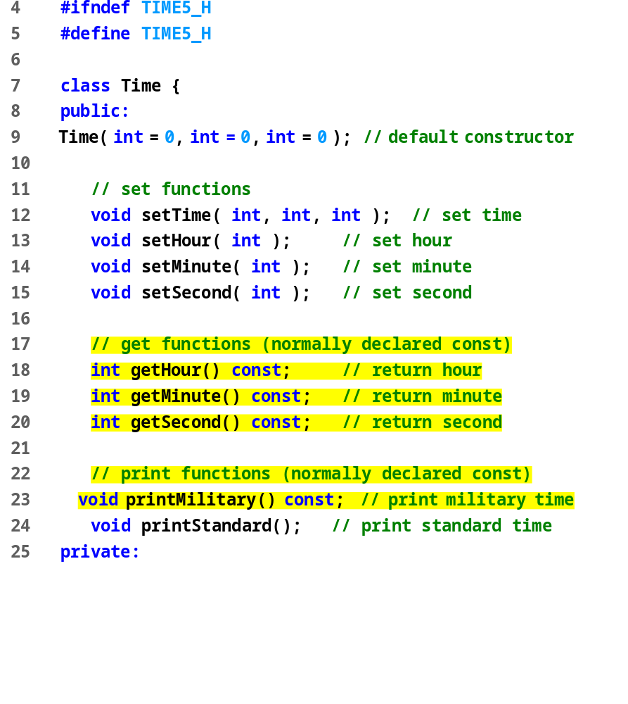
time5.h (Part 1 of 2)

Slide 6
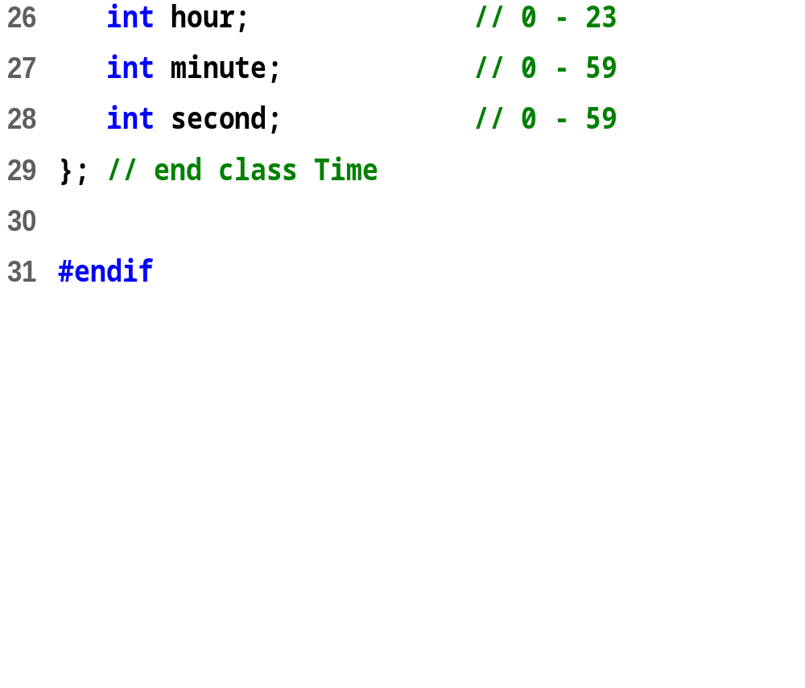
time5.h (Part 2 of 2)

Slide 7
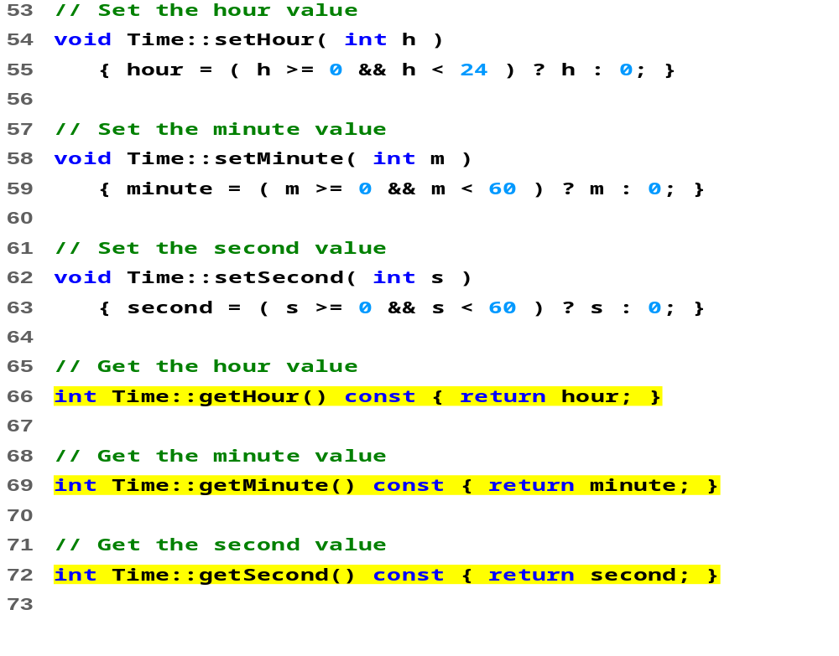
time5.cpp (Part 1 of 2)

Slide 8
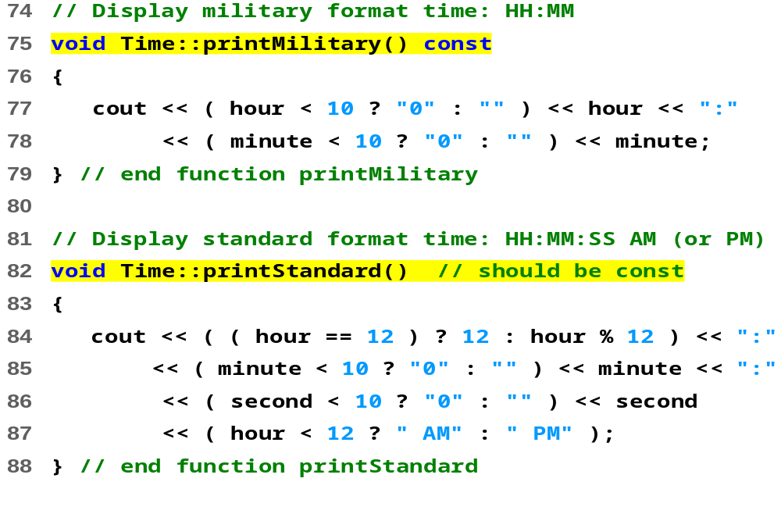
time5.cpp (Part 2 of 2)

Slide 9
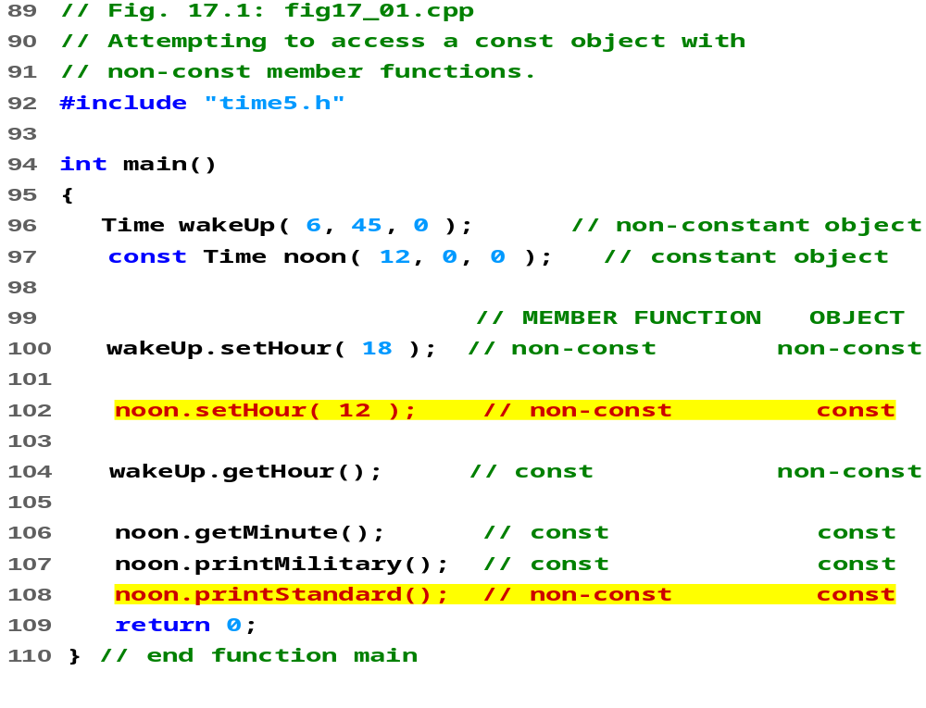
fig4_01.cpp

Slide 10
fig4_01.cpp
Compiling...
Fig4_01.cpp
d:fig4_01.cpp(14) : error C2662: 'setHour' :
cannot convert 'this' pointer from 'const class Time' to 'class Time &'
Conversion loses qualifiers
d:\fig4_01.cpp(20) : error C2662: 'printStandard' :
cannot convert 'this' pointer from 'const class Time' to 'class Time &'
Conversion loses qualifiers
Time5.cpp
Error executing cl.exe.est.exe - 2 error(s), 0 warning(s)
错误分析：
类对象noon是const类型，const类型的类对象只能调用const函数，而setHour()、printStandard()并不是const函数

Slide 11
4.2 const (Constant) Objects and const Member Functions (III)
Member initializer syntax
  Const data member increment in class Increment.
  Constructor for Increment is modified as follows:
Increment::Increment( int c, int i )
: increment(i)， count(c)
{}
  ": increment(i), count(c)" initializes const increment to the value of i.
  Any data member can be initialized using member initializer syntax
  consts and references must be initialized this way
  构造函数初始化列表只在构造函数的定义中而不是声明中指定
Multiple member initializers
  Use comma-separated(逗号) list after the colon(冒号)
构造函数初始化列表以一个冒号开始，接着是一个以逗号分隔的数据成员列表，每个数据成员后跟一个放在圆括号中的初始化式

Slide 12
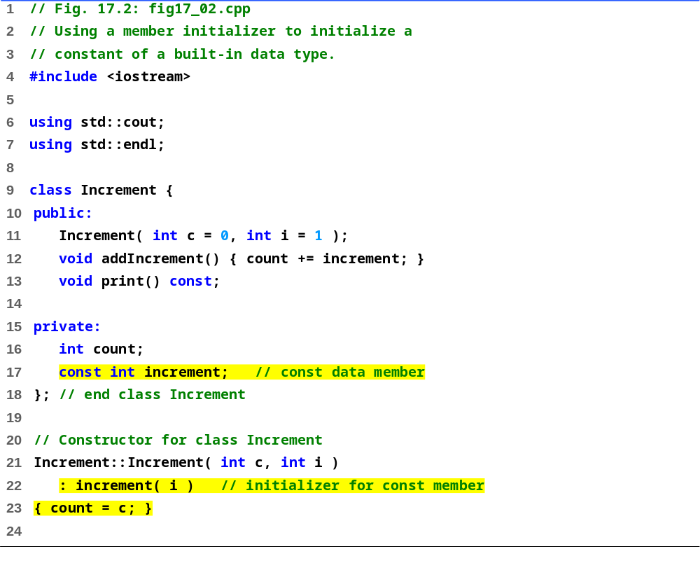
fig4_02.cpp
(Part 1 of 2)

Slide 13
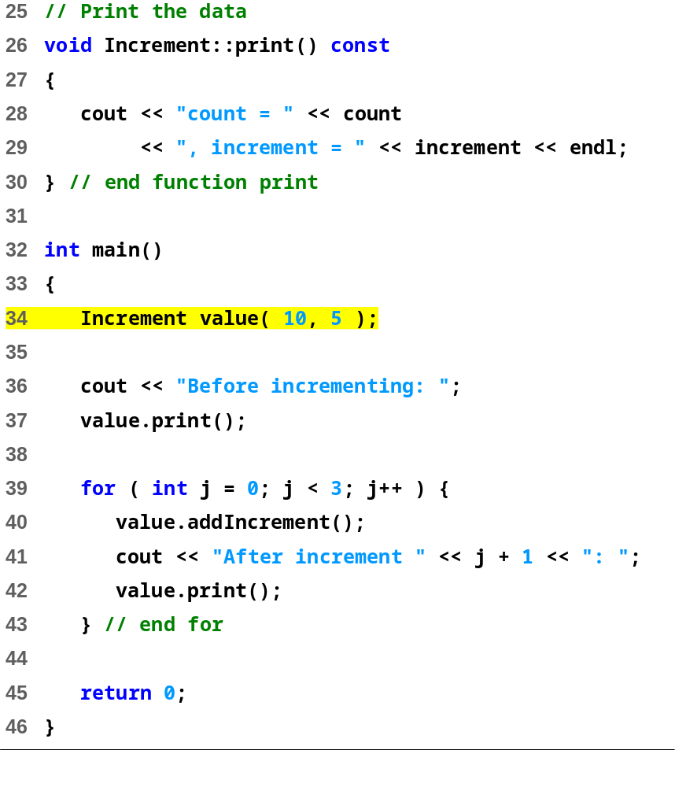
fig4_02.cpp
(Part 2 of 2)
Before incrementing: count = 10, increment = 5
After increment 1: count = 15, increment = 5
After increment 2: count = 20, increment = 5
After increment 3: count = 25, increment = 5

Slide 14
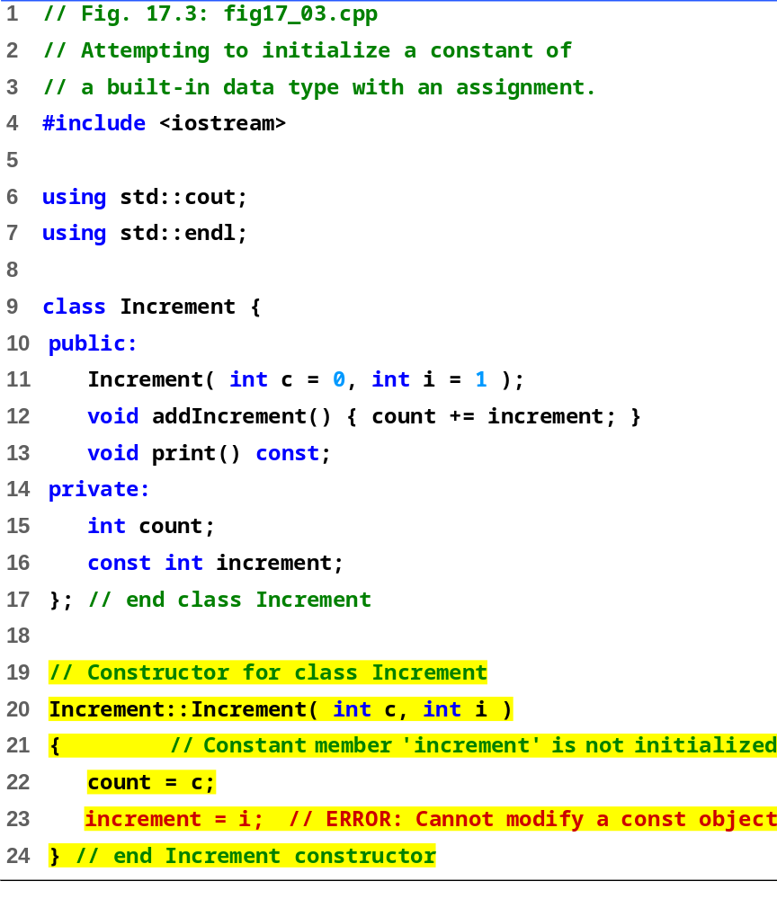
fig4_03.cpp
(Part 1 of 2)

Slide 15
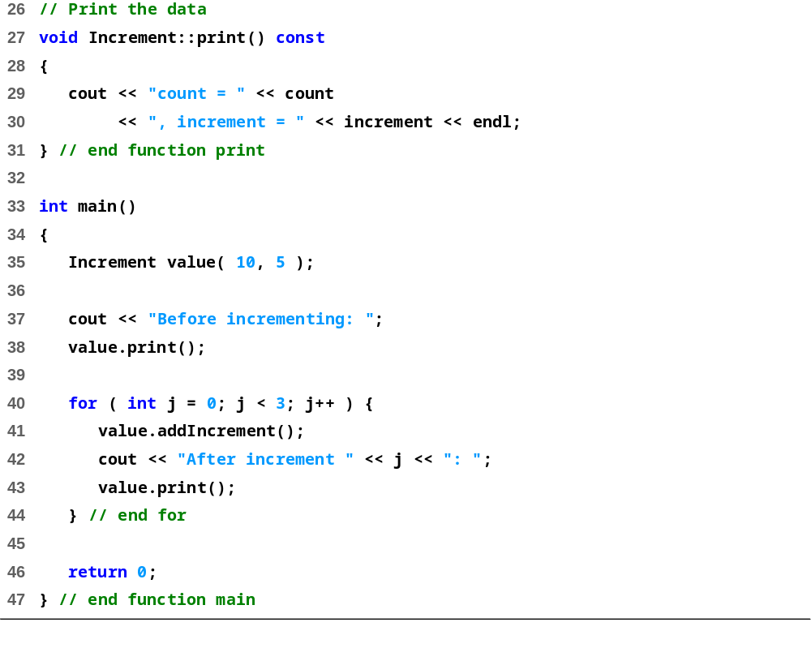
fig4_03.cpp
(Part 2 of 2)

Slide 16
fig4_03.cpp
Compiling...
Fig4_03.cpp
D:\Fig4_03.cpp(21) : error C2758: 'increment‘
: must be initialized in constructor base/member initializer list
D:\Fig4_03.cpp(16) : see declaration of 'increment'
D:\Fig4_03.cpp(23) : error C2166
: l-value specifies const object
Error executing cl.exe.
test.exe - 2 error(s), 0 warning(s)
错误分析：
const修饰的类成员(非静态)只能通过成员初始化列表进行初始化，不能在函数体类改变它的值

Slide 17
4.3 Composition: Objects as Members of Classes
Composition
  Class has objects of other classes as members
Construction of objects
  Member objects constructed in order declared
    Not in order of constructor’s member initializer list
    例： class A {
        int i;
        int j;
        public:
        A(int val): j(val), i(j){}
        };
  Constructed before their enclosing class objects (host objects)
  Constructors called inside out (从里到外)
  Destructors called outside in (从外到里)
实际上，初始化列表的执行顺序是：
i = j;
j = val;
i先于j初始化，所以会出现i未初始化的情况。

Slide 18
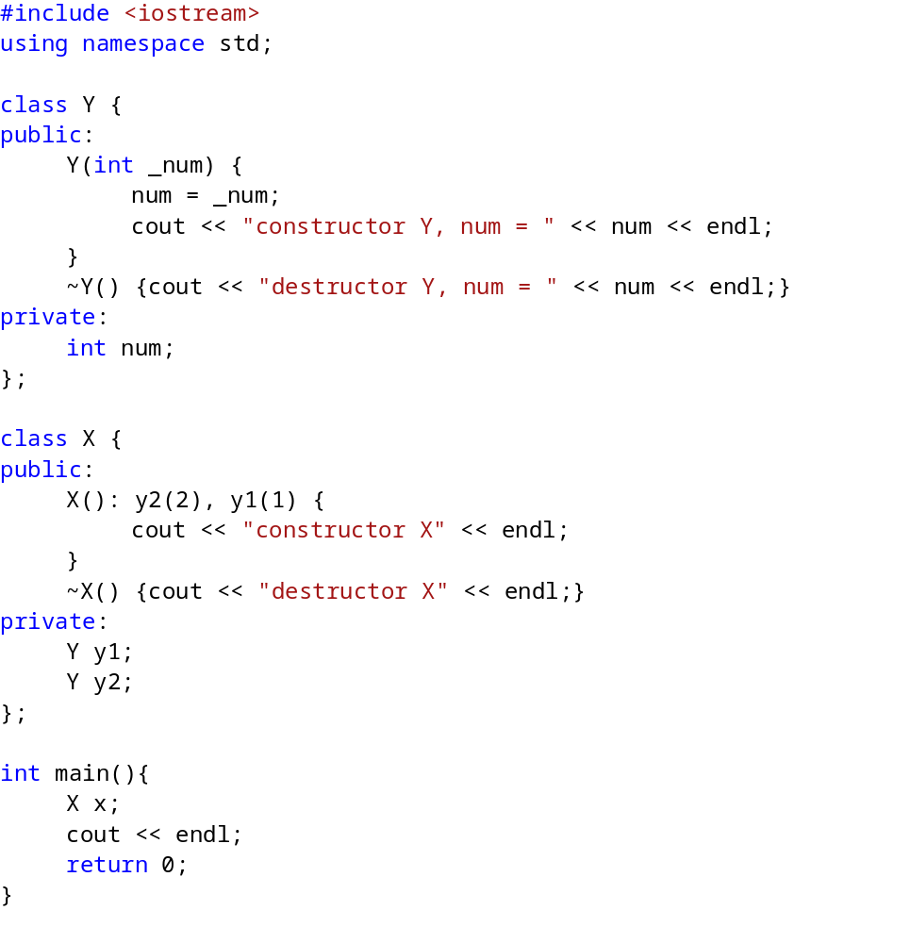
fig4_04.cpp

Slide 19
Program Output
constructor Y, num = 1
constructor Y, num = 2
constructor X
destructor X
destructor Y, num = 2
destructor Y, num = 1
fig4_04.cpp
输出分析及补充：
从概念上讲，可以认为构造函数分两个阶段执行：（1）初始化阶段，（2）普通计算阶段。计算阶段由构造函数函数体中的所有语句组成。
在构造函数初始化列表中没有显式提及的每个成员，使用该变量类型的默认初始化规则来进行初始化：
若变量类型为类类型，则调用该类的默认构造函数来进行初始化。（这警示我们没有默认构造函数的的类对象必须在初始化列表中进行初始化，否则容易出现问题）
内置或复合类型的变量依赖于其作用域：局部作用域则不被初始化，全局作用域则被初始化为0
而变量的初始化顺序是按照其在类中声明的顺序。所以虽然在成员初始化列表中y2的位置比y1前，但是由于y1比y2早声明，所以先初始化y1再初始化y2，然后再初始化该类对象，析构的时候顺序则相反。
Notes:
内置类型：int/char/float等基本类型
复合类型：数组/指针/引用等类型

Slide 20
4.4 friend Functions and friend Classes
friend function and friend classes
  Can access private and protected members of another class
  friend functions are not member functions of class
    Defined outside of class scope
Properties
  Friendship is granted, not taken (主动给予)
  NOT symmetric
  if B is a friend of A, A is not necessarily a friend of B
  NOT transitive
  if A is a friend of B, B a friend of C, A is not necessarily a friend of C

Slide 21
4.4 friend Functions and friend Classes
1.含义：类的体内以 friend 加以限定的非成员函数，从而可以在此函数体内利用对象访问类中private成员。
2.为什么需要友元：
（1）在封装和快速性方面合理选择---类的主要特点是实现数据隐藏，既不允许非成员函数对它访问，但在某些场合下，非成员函数体中需要通过对象名访问private成员，这可以通过友元函数来实现。
（2）有些函数需要放在外面或者类设计完后补充的，而不能成为成员函数，但是又需要访问类中的私有成员。
3.作用：实现直接访问数据。
4.友元函数不是本类的成员函数，但是它可以通过对象名访问类的所有成员，包括私有和保护成员。
5. 慎用友元函数

Slide 22
4.4 friend Functions and friend Classes
friend declarations
  friend function
    Keyword friend before function prototype in class that is giving friendship.
    friend int myFunction( int x );
    Appears in the class granting friendship
  friend class (practice after class)
    Type friend class Classname in class granting friendship
    If ClassOne granting friendship to ClassTwo,
  friend class ClassTwo;
  appears in ClassOne's definition

Slide 23
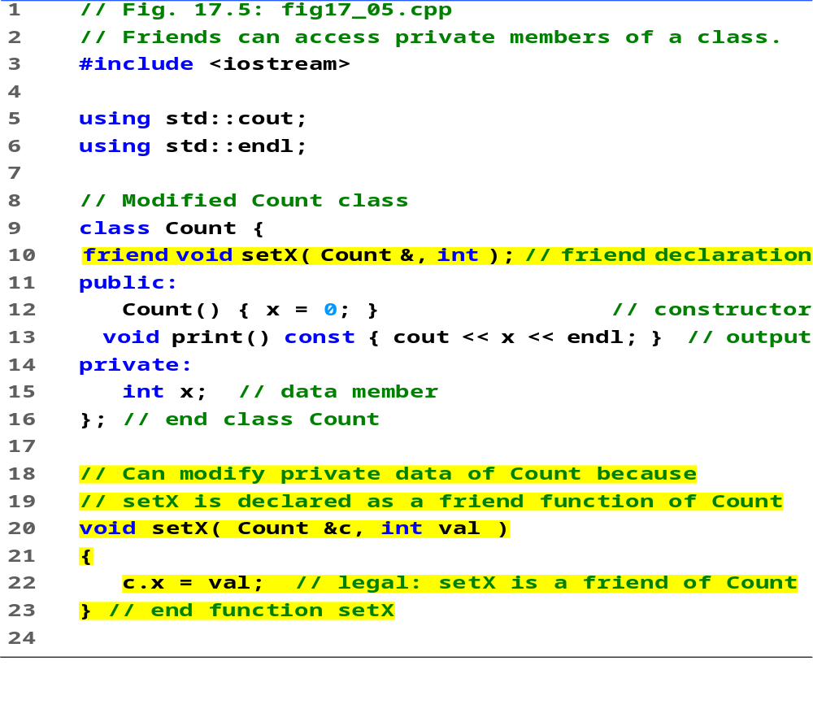

Slide 24
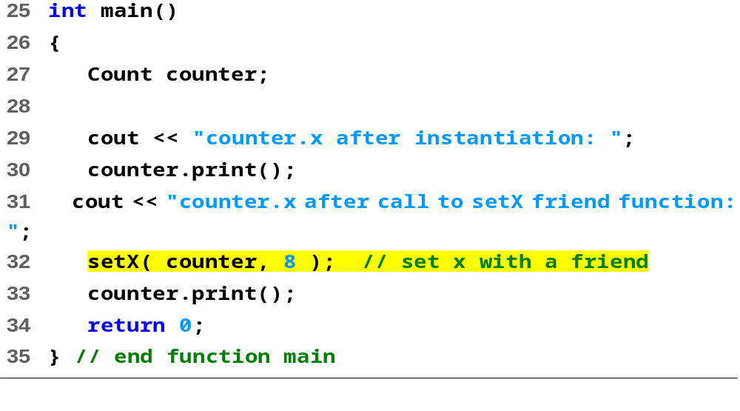
Program Output
counter.x after instantiation: 0
counter.x after call to setX friend function: 8

Slide 25
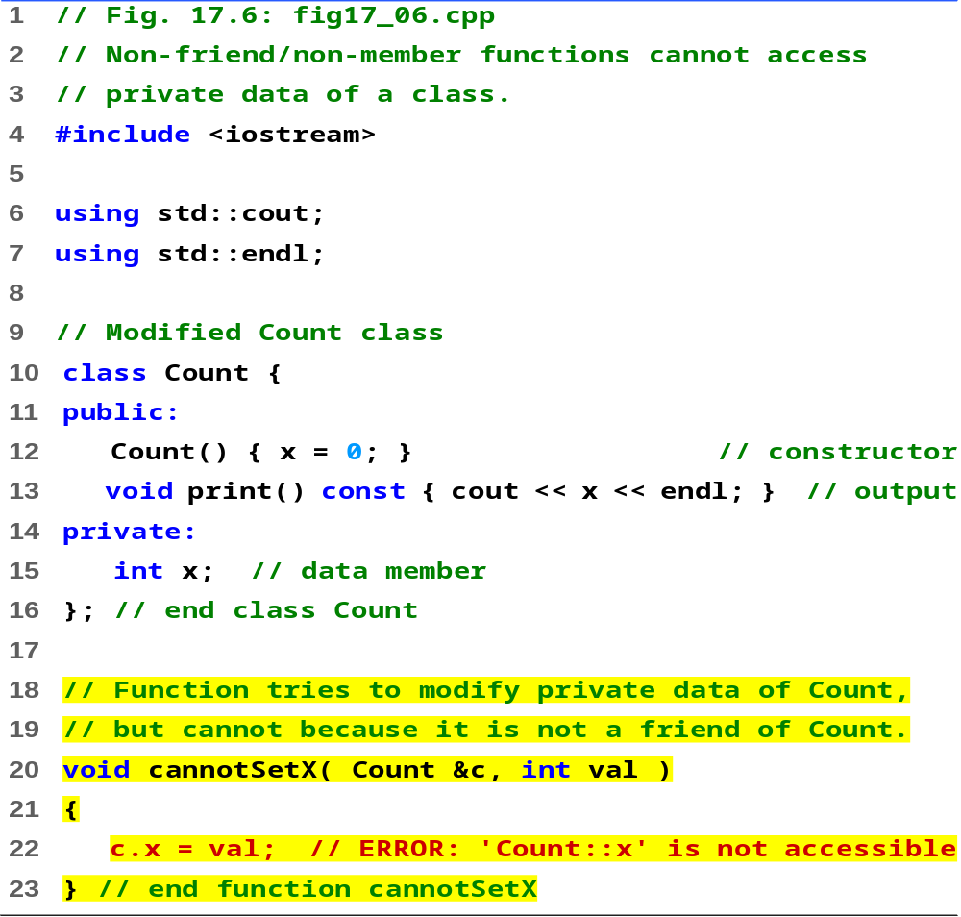

Slide 26
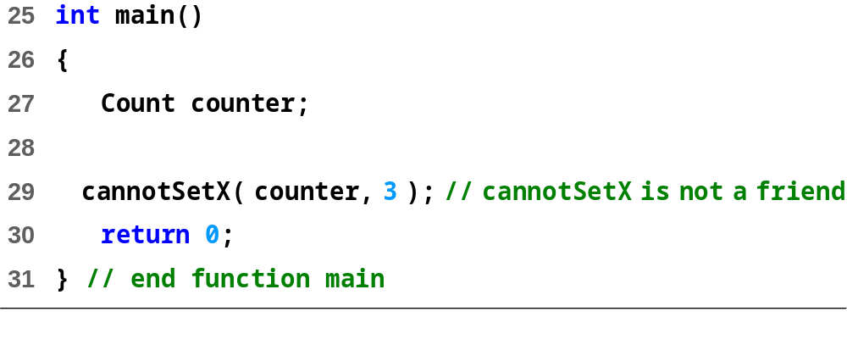
Compiling...
Fig4_06.cpp
D:\Fig4_06.cpp(22) :
error C2248: 'x' : cannot access private member declared in
class 'Count'
D:\Fig4_06.cpp(15) : see declaration of 'x'
Error executing cl.exe.
test.exe - 1 error(s), 0 warning(s)
错误分析：
函数cannotSetX既不是类Count的成员函数，也不是其友元函数，所以不能直接访问类Count的私有成员变量

Slide 27
4.5 Using the this Pointer
this pointer (this指针指向调用该函数的对象)
  Allows objects to access their own address
  Not part of the object itself
  Implicit first argument on non-static member function call to the object (每个成员函数(除了static成员函数)都有一个额外的、隐含的形参this)
    例：
    Class Test {
    public void func(int a) {};
    };
    Test test;
    test.func(1);
    编译器会重写这个函数的调用：test.func(&test, 1)，即加上形参this
  Implicitly reference member data and functions

Slide 28
4.5 Using the this Pointer (II)
Cascaded member function calls
  Function returns a reference pointer to the same object
    {return *this;}
  Other functions can operate on that pointer
  Functions that do not return references must be called last

Slide 29
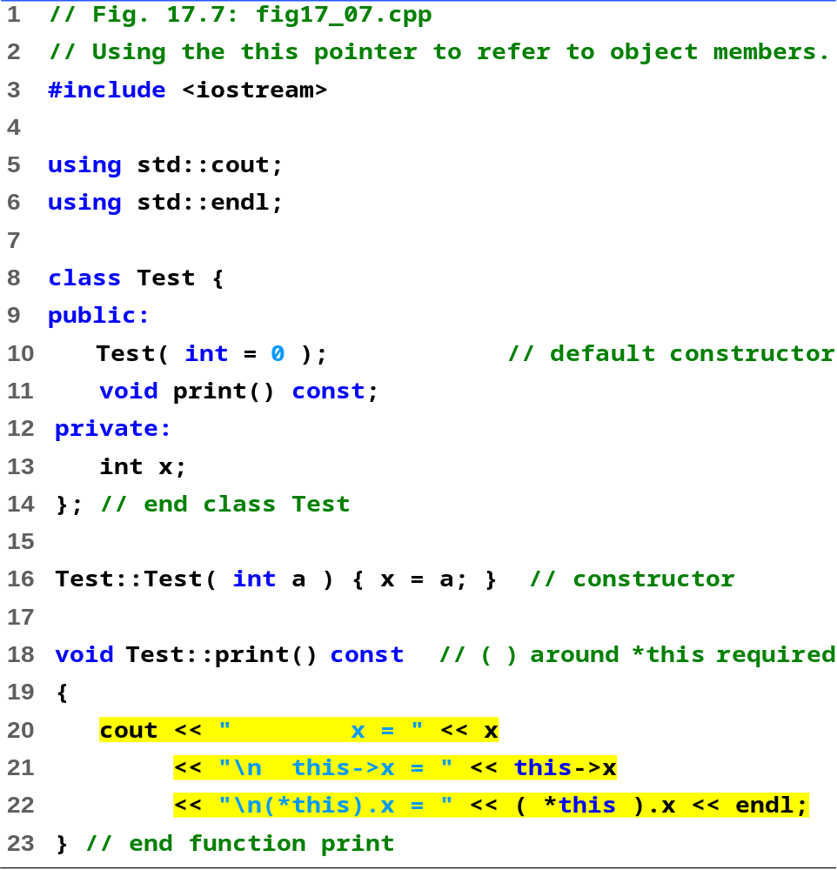
fig4_07.cpp (Part 1 of 2)

Slide 30
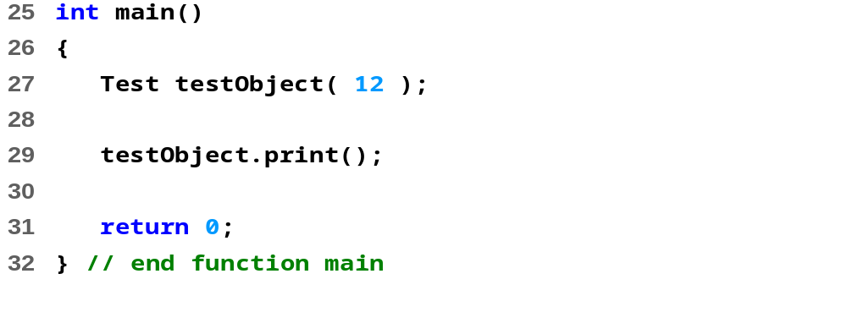
fig4_07.cpp (Part 2 of 2)
x = 12
this->x = 12
(*this).x = 12

Slide 31
4.5 Using the this Pointer (III)
Example
  Member functions setHour, setMinute, and setSecond all return *this (reference to an object)
  For object t, consider
  t.setHour(1).setMinute(2).setSecond(3);
  Executes t.setHour(1) and returns *this (reference to object), and expression becomes
  t.setMinute(2).setSecond(3);
  Executes t.setMinute(2), returns reference, and becomes
  t.setSecond(3);
  Executes t.setSecond(3), returns reference, and becomes
  t;
  Has no effect

Slide 32
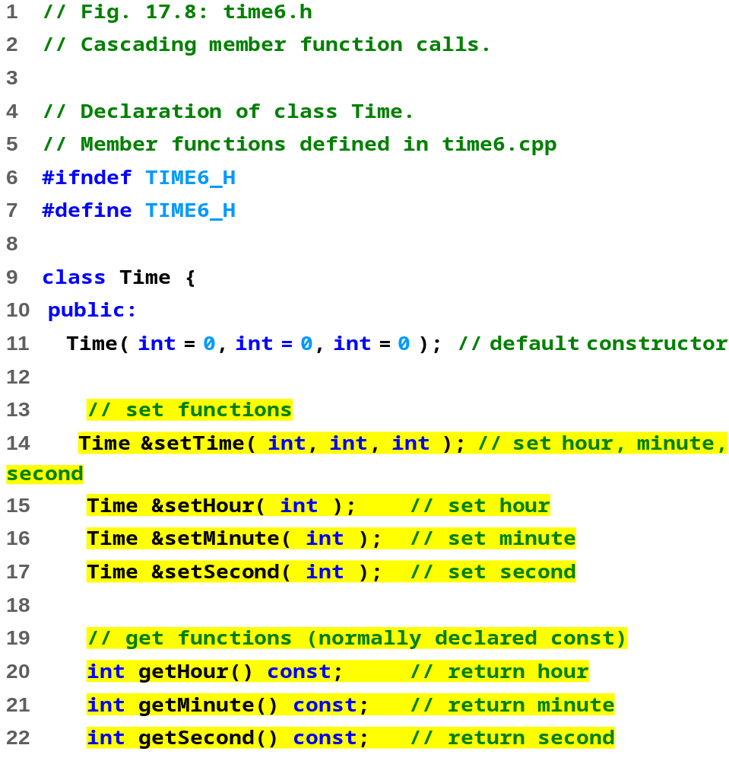
time6.h (Part 1 of 2)

Slide 33
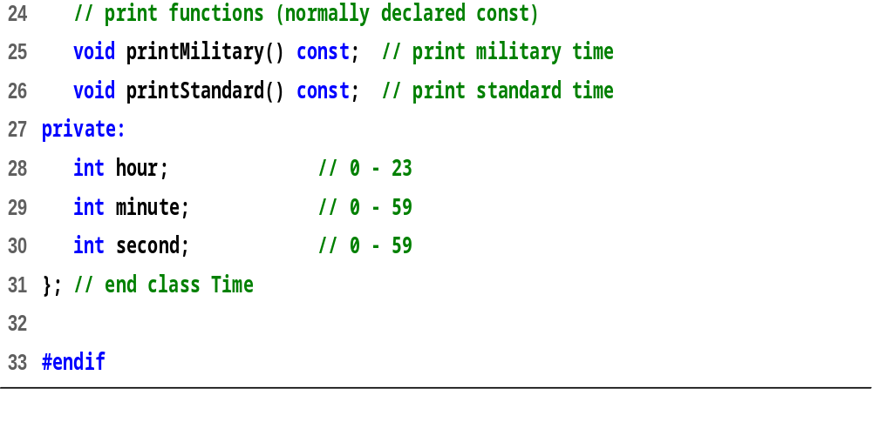
time6.h (Part 2 of 2)

Slide 34
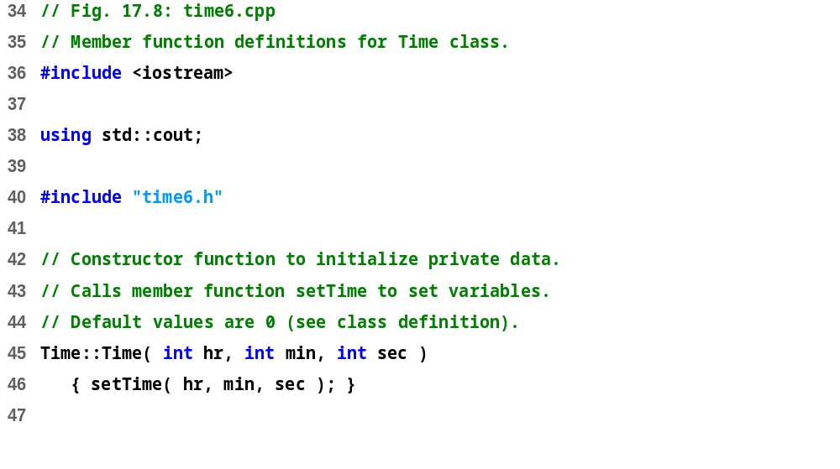
time6.cpp (Part 1 of 3)

Slide 35
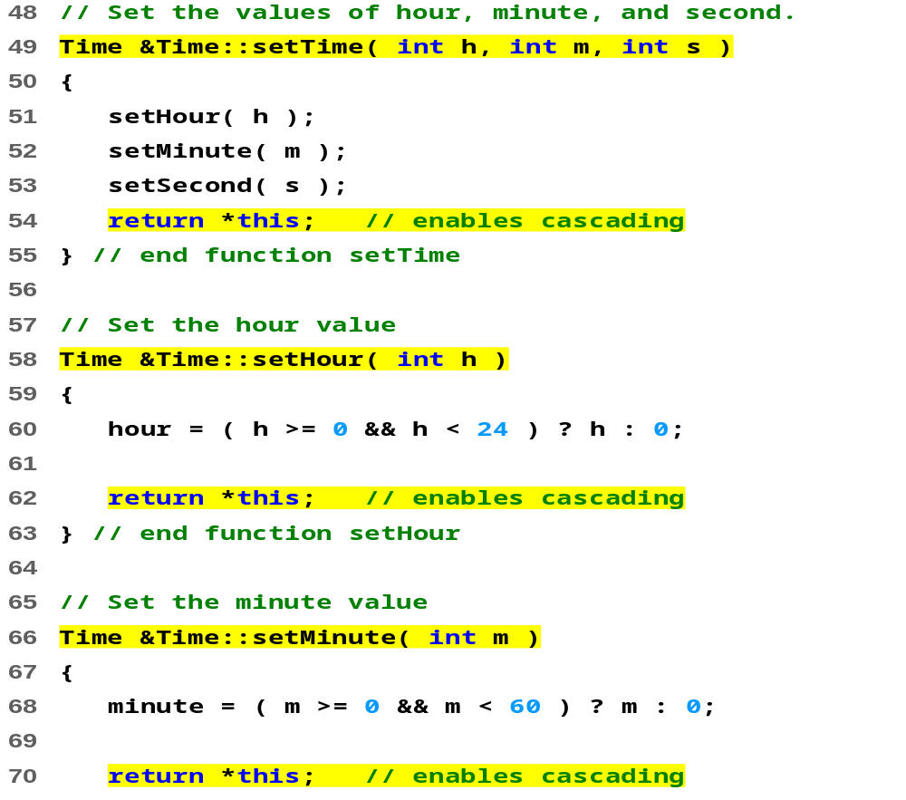
time6.cpp (Part 2 of 3)

Slide 36
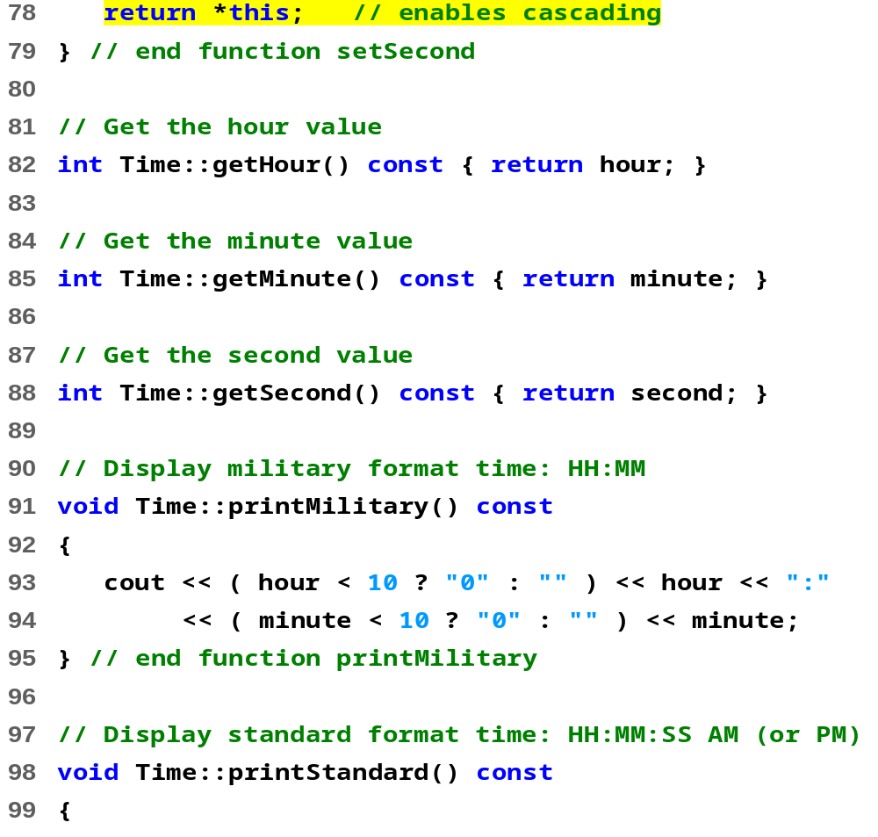
time6.cpp (Part 3 of 3)

Slide 37
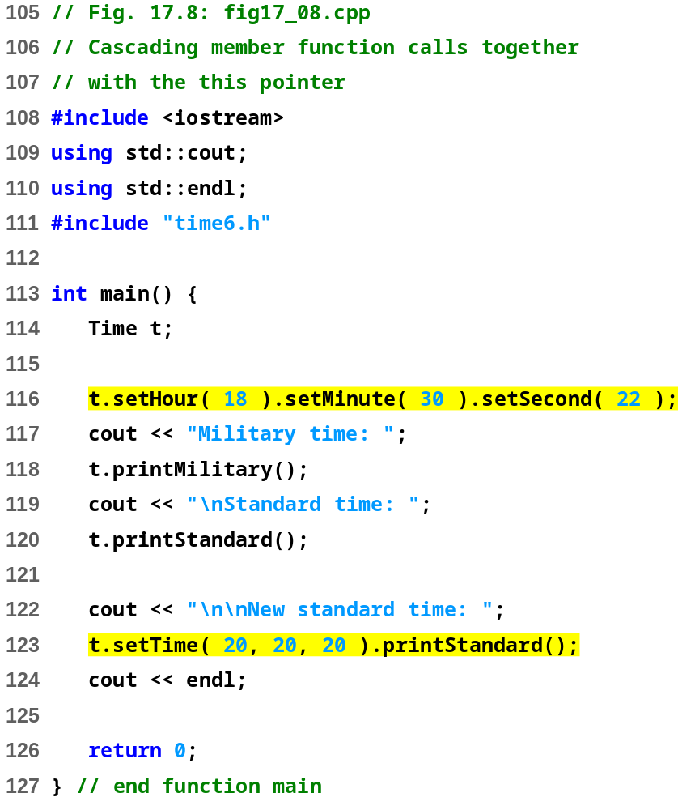
Military time: 18:30
Standard time: 6:30:22 PM
New standard time: 8:20:20 PM

Slide 38
4.6 Dynamic Memory Allocation with Operators new and delete
new and delete
  Better dynamic memory allocation than C’s malloc and free
  new - automatically creates object of proper size, calls constructor, returns pointer of the correct type
  delete - destroys object and frees space
Example:
  TypeName *typeNamePtr;
    Creates pointer to a TypeName object
  typeNamePtr = new TypeName;
    new creates TypeName object, returns pointer (which typeNamePtr is set equal to)
  delete typeNamePtr;
    Calls destructor for TypeName object and frees memory

Slide 39
4.6 Dynamic Memory Allocation with Operators new and delete (II)
Initializing objects
  double *thingPtr = new double( 3.14159 );
  Initializes object of type double to 3.14159
  int *arrayPtr = new int[ 10 ];
  Create ten element int array, assign to arrayPtr.
  Use
    delete [] arrayPtr;
    to delete arrays

Slide 40
4.7 Static Class Members
static class members
  Shared by all objects of a class (该类的所有对象维护该成员的同一个拷贝)
    By contrast, each object gets its own copy of each variable
  Efficient when a single copy of data is enough
    Only the static variable has to be updated
  May seem like global variables, but have class scope
    Only accessible to objects of same class
  Initialized at file scope(必须初始化才能使用)
  Exist even if no instances (objects) of the class exist
  Can be variables or functions
    public, private, or protected

Slide 41
4.7 Static Class Members (II)
类的普通数据成员:
类的静态数据成员:
在类的每一个对象中都拥有一个拷贝，每个对象的同名数据成员分别存储不同的数值，这也是每个对象拥有自身特征的保证。
是类的数据成员的一种特例。每个类只有一个静态数据成员拷贝，它由该类的所有对象共同维护和使用，从而实现了同一个类的不同对象之间的数据共享。

Slide 42
4.7 Static Class Members (III)
Accessing static members
  public static variables: accessible through any object of the class Or use class name and (::)
  (可以采用“类名::成员名”或“对象名.成员名”访问。)
    Employee::count
  private static variables: a public static member function must be used.(在外部只能通过公有的静态成员函数访问)
    Prefix with class name and (::)
    Employee::getCount()
  static member functions cannot access non-static data or functions
    function exists independent of objects

Slide 43
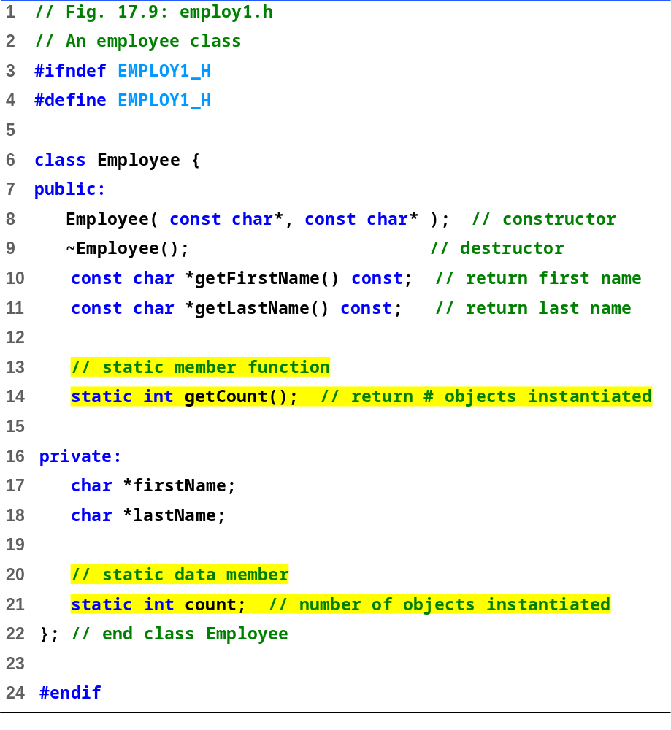
employ.h

Slide 44
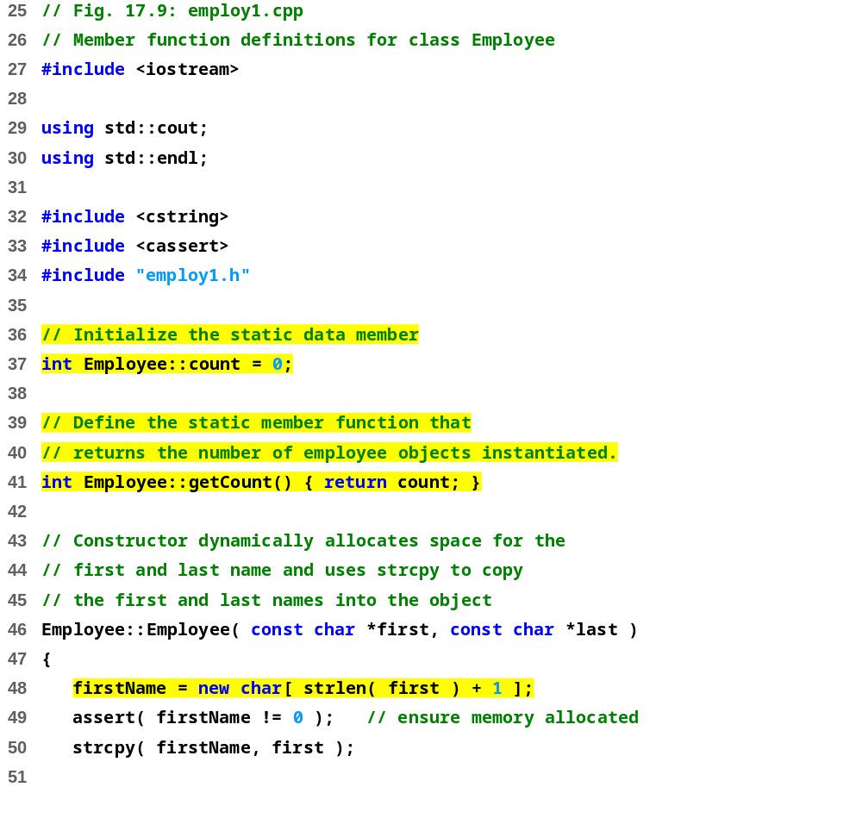
employ.cpp (Part 1 of 3)

Slide 45
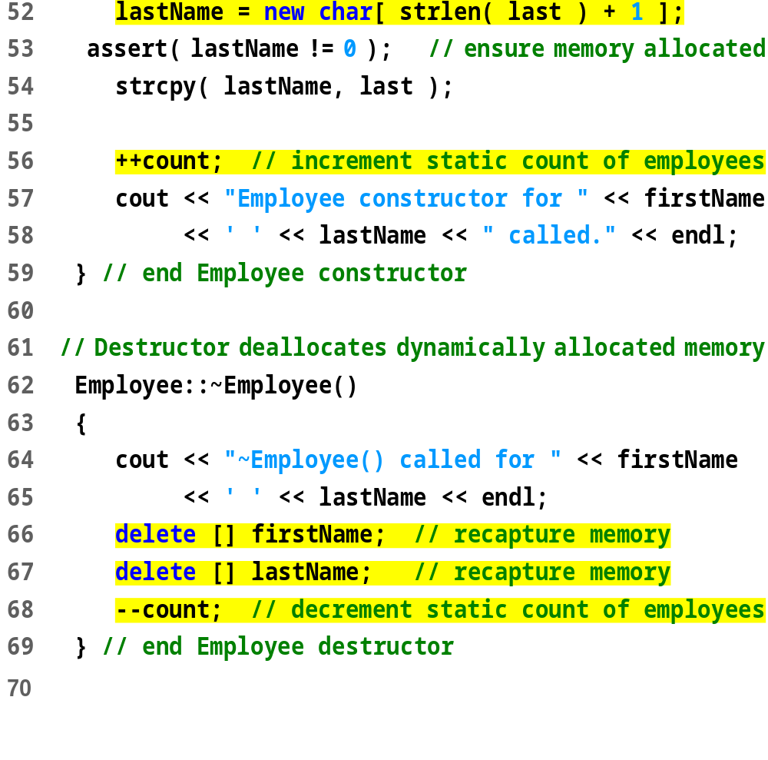
employ.cpp (Part 2 of 3)

Slide 46
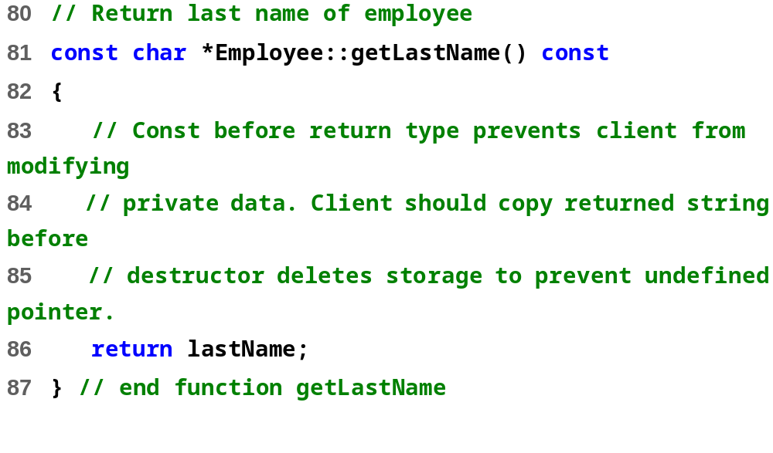
employ.cpp (Part 3 of 3)

Slide 47
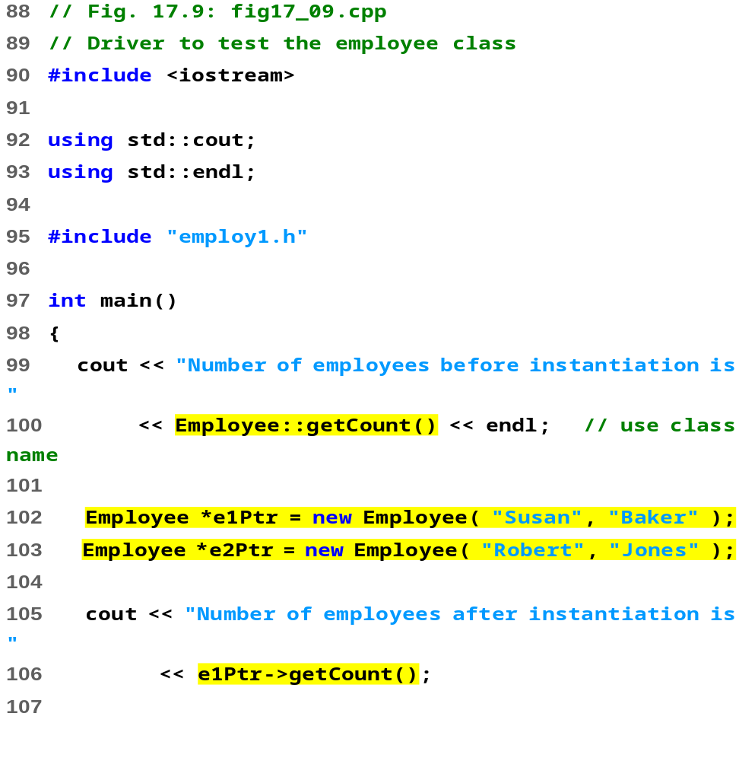

Slide 48
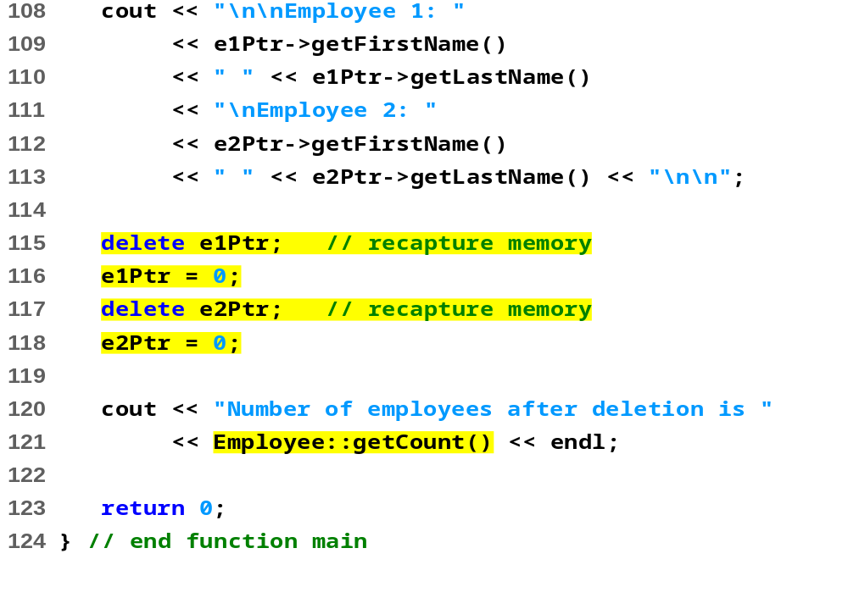
Number of employees before instantiation is 0
Employee constructor for Susan Baker called.
Employee constructor for Robert Jones called.
Number of employees after instantiation is 2
Employee 1: Susan Baker
Employee 2: Robert Jones
~Employee() called for Susan Baker
~Employee() called for Robert Jones
Number of employees after deletion is 0

Slide 49
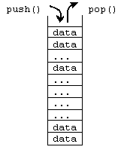
4.8 Data Abstraction and Information Hiding
Information hiding
  Classes hide implementation details from clients
  Example: stack data structure
    Data elements like a pile of dishes - added (pushed) and removed (popped) from top
    Last-in, first-out (LIFO) data structure
  Client does not care how stack is implemented, only wants LIFO data structure

Slide 50
4.8 Data Abstraction and Information Hiding (II)
Abstract data types (ADTs)
  Model real world objects
    int, float are models for a number
    Imperfect - finite size, precision, etc.
C++ an extensible language
  Base cannot be changed, but new data types can be created

Slide 51
4.8.1 Example: Array Abstract Data Type
Array
  Essentially a pointer and memory locations
Programmer can make an ADT array
  New capabilities
    Subscript range checking, array assignment and comparison, dynamic arrays, arrays that know their sizes...
New classes
  Proprietary to an individual, to small groups or to companies, or placed in standard class libraries

Slide 52
4.8.2 Example: String Abstract Data Type
C++ intentionally sparse
  Reduce performance burdens
  Use language to create what you need, i.e. a string class
string not a built-in data type
  Instead, C++ enables you to create your own string class

Slide 53
4.8.3 Example: Queue Abstract Data Type
Queue - a waiting line
  Used by computer systems internally
  We need programs that simulate queues
Queue has well-understood behavior
  Enqueue - put things in a queue one at a time
  Dequeue - get those things back one at a time on demand
  Implementation hidden from clients
Queue ADT - stable internal data structure
  Clients may not manipulate data structure directly
  Only queue member functions can access internal data

Slide 54
4.9 Container Classes and Iterators
Container classes (collection classes)
  Classes designed to hold collections of objects
  Services such as insertion, deletion, searching, sorting, or testing an item
  Examples:
  Arrays, stacks, queues, trees and linked lists
Iterator objects (iterators)
  Object that returns the next item of a collection (or some action)
  Can have several iterators per container
    Book with multiple bookmarks
  Each iterator maintains its own “position” information

Slide 55
Thank you !

