Slide 1
Chapter 5 - C++ Operator Overloading
Outline
5.1 Introduction
5.2 Fundamentals of Operator Overloading
5.3 Restrictions on Operator Overloading
5.4 Operator Functions as Class Members vs. as friend Functions
5.5 Overloading Stream-Insertion and Stream-Extraction Operators
5.6 Overloading Unary Operators
5.7 Overloading Binary Operators
5.8 Case Study: An Array Class
5.9 Converting between Types
5.10 Overloading ++ and --

Slide 2
Objectives
In this chapter, you will learn:
  To understand how to redefine (overload) operators to work with new types.
  To understand how to convert objects from one class to another class.
  To learn when to, and when not to, overload operators.
  To study several interesting classes that use overloaded operators.
  To create an Array class.

Slide 3
4.1 Introduction
（1）运算符重载是对已有的运算符赋予多重含义，使同一个运算符作用于不同类型的数据时，产生不同类型的行为。C++允许同一运算符具有多种不同运算功能的机制。
（2）为什么需要运算符重载：C++中预定义了许多运算符,能够满足用户的一般应用要求,但是其运算的对象应是基本数据类型,而不适用于用户自定义数据类型(如类),这可以使用运算符重载。
（3）明智地使用操作符重载可以使类类型的使用像内置类型一样直观
（4）操作符的实质是函数重载。

Slide 4
4.1 Introduction
Operator overloading
  Use traditional operators with user-defined objects
  Straightforward and natural way to extend C++
  Requires great care
    When overloading is misused, programs become difficult to understand
class point
{
public:
point(int xx=0,int yy=0){ x=xx;y=yy; }
int get_x();
int get_y();
//...
private:
int x;
int y ;
};
point p1(1,1),p2(3,3)，实现“p1 + p2”则需要编写程序来说明“+”如何作
用于point对象（p1, p2），即p1的私有成员 x，y 与p2的私有成员 x，y 分别相
加这一功能。

Slide 5
4.2 Fundamentals of Operator Overloading
Use operator overloading to improve readability
  Avoid excessive or inconsistent usage
Format
  Write function definition as normal(重载函数跟普通函数一样，具有返回类型和形参表)
  Function name is keyword operator followed by the symbol for the operator being overloaded.
  operator+ would be used to overload the addition operator (+).

Slide 6
4.2 Fundamentals of Operator Overloading
Assignment operator (=)
  may be used with every class without explicit overloading
  memberwise assignment (不需专门定义，默认存在，逐一复制数据成员)
class MyClass {
public:
...
MyClass& operator=(const MyClass& rhs);
...
}
MyClass& MyClass::operator=(const MyClass& rhs){
...
return *this;
}
MyClass a, b, c;
...
a = b = c; // Same as b.operator=(a);

Slide 7
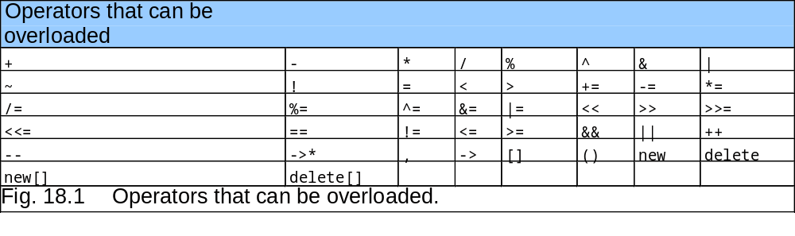
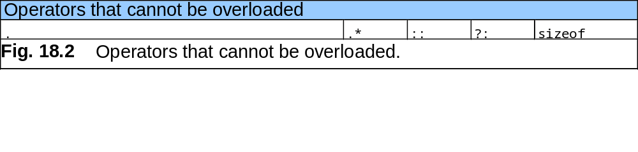
4.3 Restrictions on Operator Overloading
Most of C++’s operators can be overloaded
有四个符号（+, -, * 和 &）既可作一元操作符又可作二元操作符，可以同时定义一元和二元操作符
重载操作符不能改变原操作符的优先级、结合性或操作数目
重载操作符必须具有至少一个自定义类类型类型的操作数，也就是说重载操作符不能重新定义用于内置类型对象的操作符的含义，比如不能重载”+”号操作符用于两个整数相加。

Slide 8
Example
An overloading for the operator “+” for this class
class point
{
public:
point(int xx=0,int yy=0){ x=xx;y=yy; }
int get_x();
int get_y();
point operator+ (const point& rpt);
//...
private:
int x;
int y ;
};
point point::operator+ (const point& rpt){
int tempx = x + rpt.get_x();
int tempy = y + rpt.get_y();
point temp(tempx, tempy);
return temp;
}

Slide 9
Example
An overloading for the operator “+” for this class
//**
include “point.h”;
include <iostream>
main(){
point a(15, 20), b(5, 13);
point testpoint;
testpoint = a + b;
}

Slide 10
Class practice
Write an overloading for the operator “*=” for this class
class point
{
public:
point(int xx=0,int yy=0){ x=xx;y=yy; }
int get_x();
int get_y();
//...
private:
int x;
int y ;
};
point p1(1,1),p2(3,3)，实现“p1 *= p2”，即p1的私有成员 x，y
与p2的私有成员 x，y 分别相乘，并将结果分别赋于p1的私有成员。

Slide 11
Class practice
Write an overloading for the operator “*=”
class point
{
public:
point(int xx=0,int yy=0){ x=xx;y=yy; }
int get_x();
int get_y();
point& operator*= (const point& rpt);
//...
private:
int x;
int y ;
};
point& point::operator*=(const point& rpt){
x = x * rpt.get_x();
y = y * rpt.get_y();
return *this;
}

Slide 12
4.4 Operator Functions as Class Members vs. as friend Functions
Operator functions
  Can be member or non-member functions
Overloading the assignment operators
  i.e:(), [], ->,=
  Operator must be a member function

Slide 13
4.4 Operator Functions as Class Members vs. as friend Functions
Operator functions as member functions
  Leftmost operand must be an object (or reference to an object) of the class
  If left operand of a different type(与定义的class不一致), operator function must be a non-member function
  A non-member operator function must be a friend if private or protected members of that class are accessed directly 如果需要访问类的私有或者保护对象

Slide 14
4.4 Operator Functions as Class Members vs. as friend Functions
Non-member overloaded operator functions
  Enable the operator to be commutative(可交换的)，because the leftmost operand can be another type.
  HugeInteger bigInteger1;
  long int number;
  bigInteger1 = number + bigInteger1;
  or
  bigInteger1 = biginteger1 + number;

Slide 15
4.4 Operator Functions as Class Members vs. as friend Functions
类成员的操作符函数与其等价的友元函数：
 | Friend function | Member Function
a + b | operator+(a,b) | a.operator+(b)
a++ | operator++(a,1) | a.operator++(1)
-a | operator-(a) | a.operator-( )

Slide 16
4.4 Operator Functions as Class Members vs. as friend Functions
友元运算符函数无this指针，因而在函数体内必须通过对象名来使用private成员数据；一般将一元运算符函数重载为成员运算符函数。强调：与赋值相关的运算符必须重载成成员函数。
一般将二元运算符重载为友元运算符函数，以免出现使用错误。因为时常需要操作数可交换
“=”、“（）”、“[]”和“->”不能重载为友元。

Slide 17
4.5 Overloading Stream-Insertion and Stream-Extraction Operators
Overloaded << and >> operators
  Must have left operand of types ostream &, istream & respectively
  It must be a non-member function (left operand not an object of the class)
  It must be a friend function if it accesses private data members
  注意：在本课程学习的Operator Overloading中，通过non-member function来定义operator，就是指用friend function来实现

Slide 18
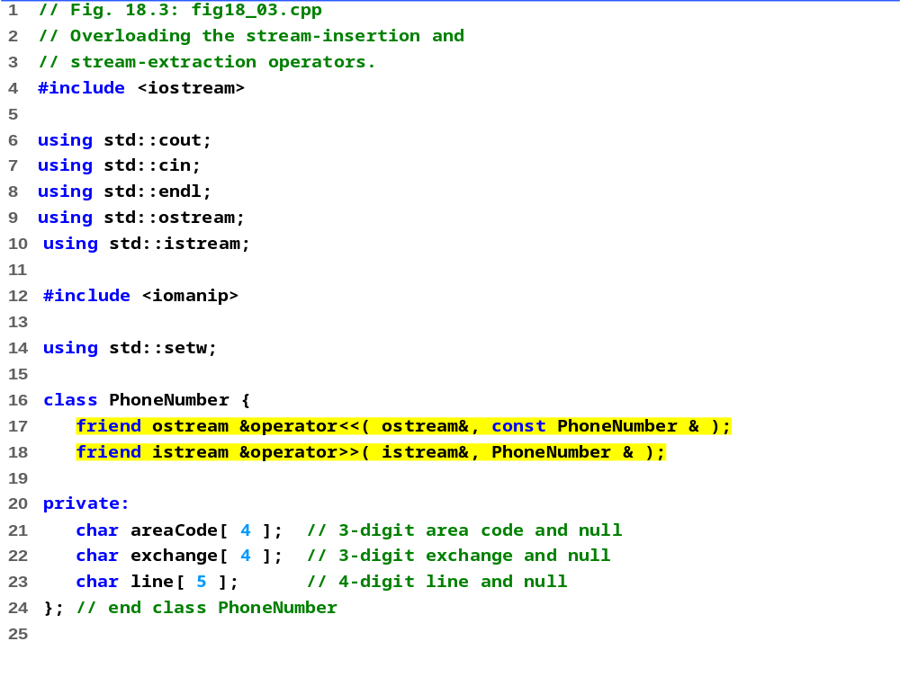
fig18_03.cpp (1 of 3)
语法：
friend<函数类型> operator<运算符>(形参表)
{
函数体；
}

Slide 19
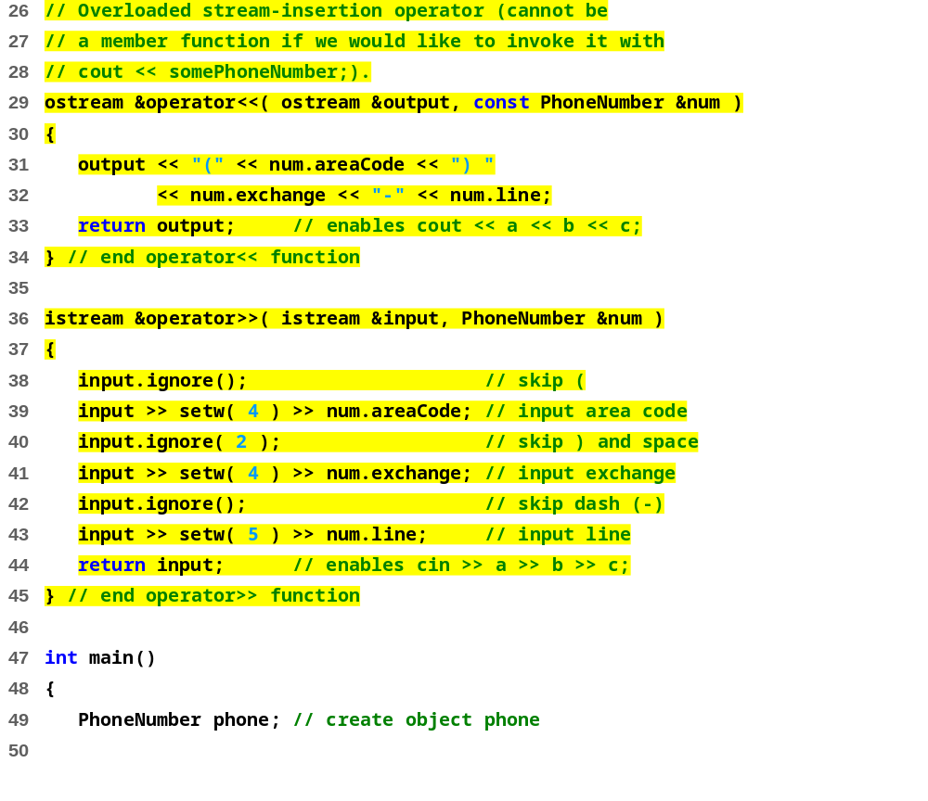
fig18_03.cpp (2 of 3)

Slide 20
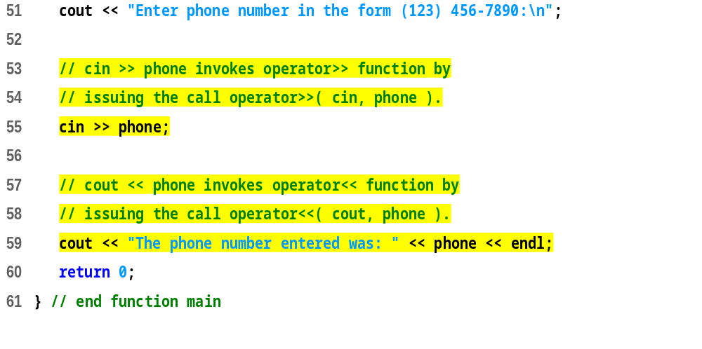
fig18_03.cpp (3 of 3)
Enter phone number in the form (123) 456-7890:
(800) 555-1212
The phone number entered was: (800) 555-1212

Slide 21
4.6 Overloading Unary Operators
Overloading unary operators
  Avoid friend functions and friend classes unless absolutely necessary.
  Use of friends violates the encapsulation of a class.
  As a member function:
  class String {
  public:
  bool operator!() const;
  ...
  };
<函数类型> operator<运算符>(形参表)
{
函数体；
}

Slide 22
4.7 Overloading Binary Operators
Overloaded binary operators
  Non-static member function, one argument
  Non-member function (friend), two arguments
class String {
public:
const String &operator+=( const String & );
...
}; // end class String
y += z;
  equivalent to
  y.operator+=( z );

Slide 23
4.7 Overloading Binary Operators
Example
class String
{
friend const String &operator+=( String &, const String & );
...
}; // end class String
  y += z;
  equivalent to
  operator+=( y, z );
语法：
friend<函数类型> operator<运算符>(形参表)
{
函数体；
}

Slide 24
4.8 Case Study: An Array class
Implement an Array class with
  Range checking
  Array assignment
  Arrays that know their size
  Outputting/inputting entire arrays with << and >>
  Array comparisons with == and !=

Slide 25
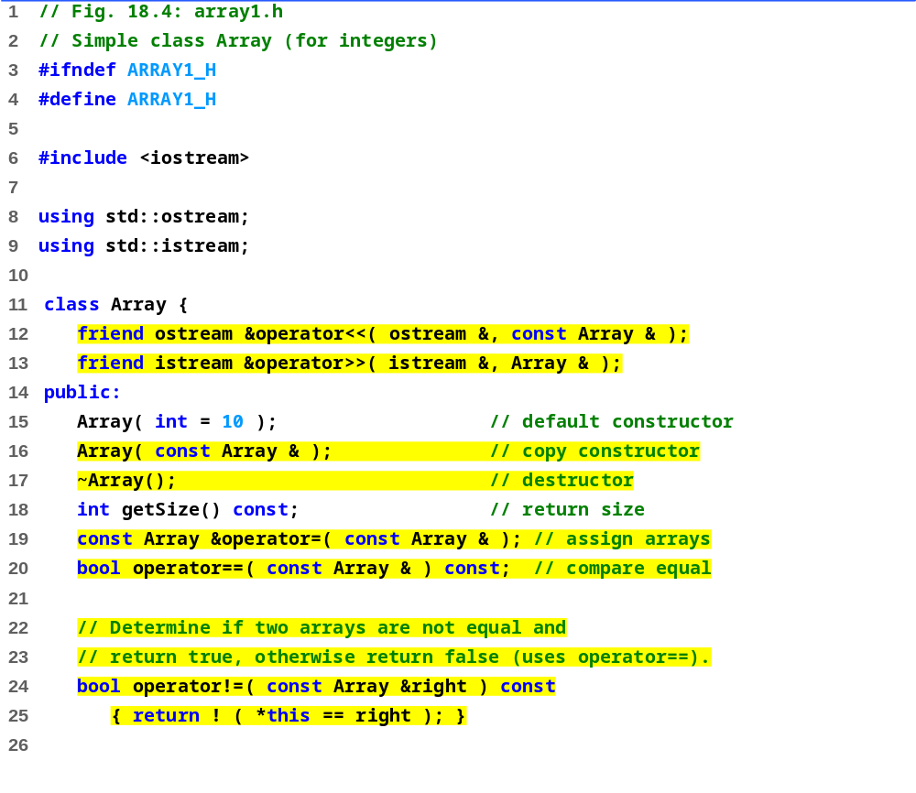
array1.h (1 of 2)

Slide 26
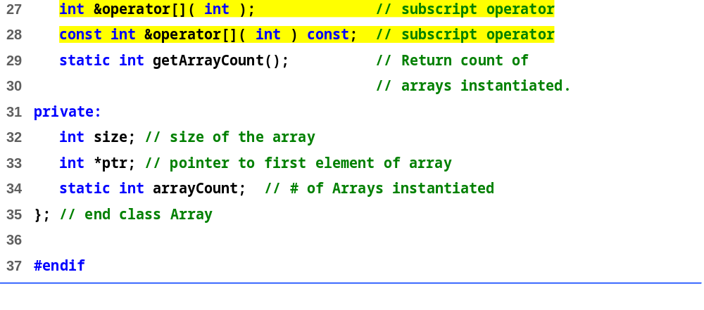
array1.h (2 of 2)

Slide 27
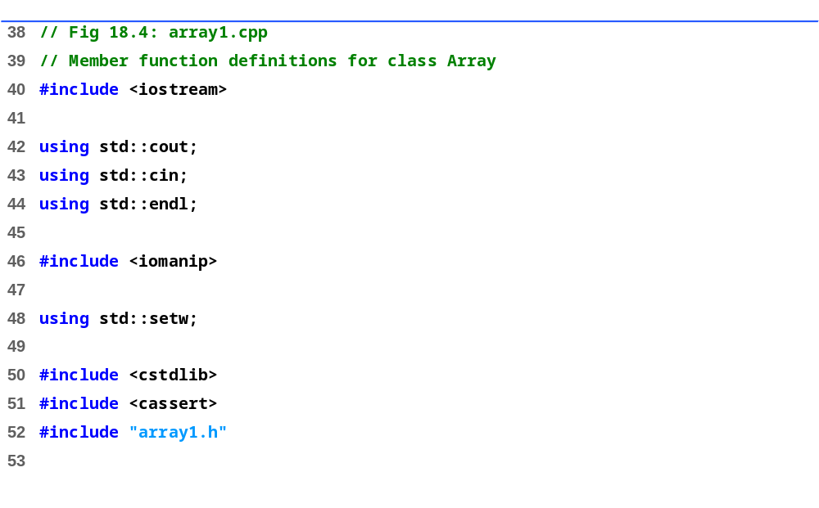
array1.cpp (1 of 6)

Slide 28
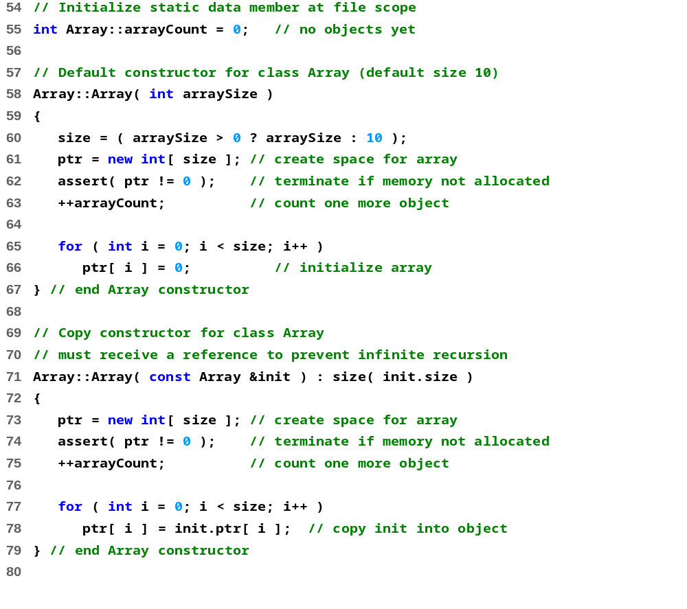
array1.cpp (2 of 6)

Slide 29
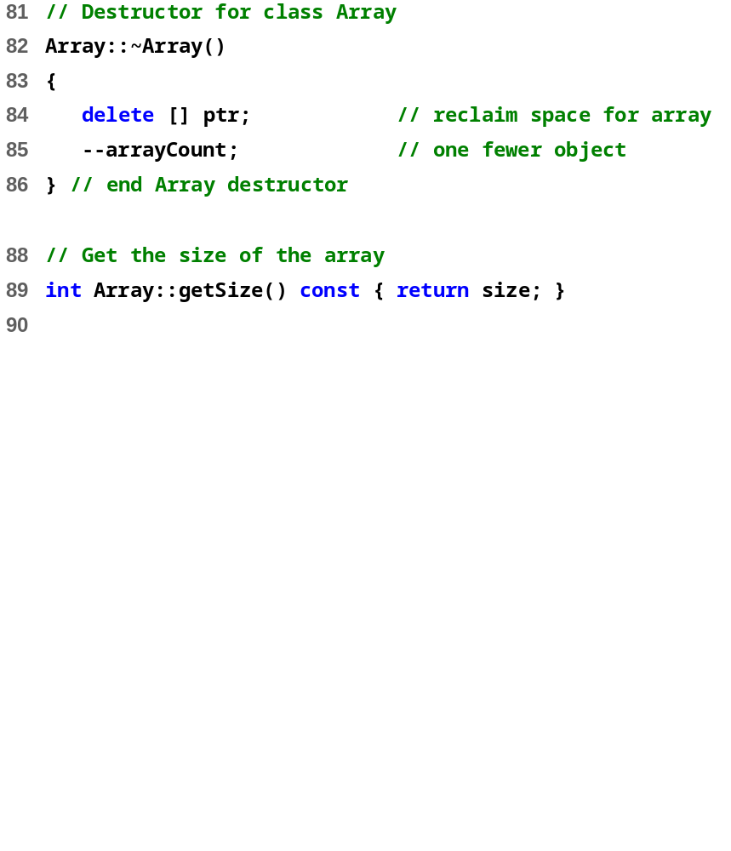
array1.cpp (3 of 6)

Slide 30
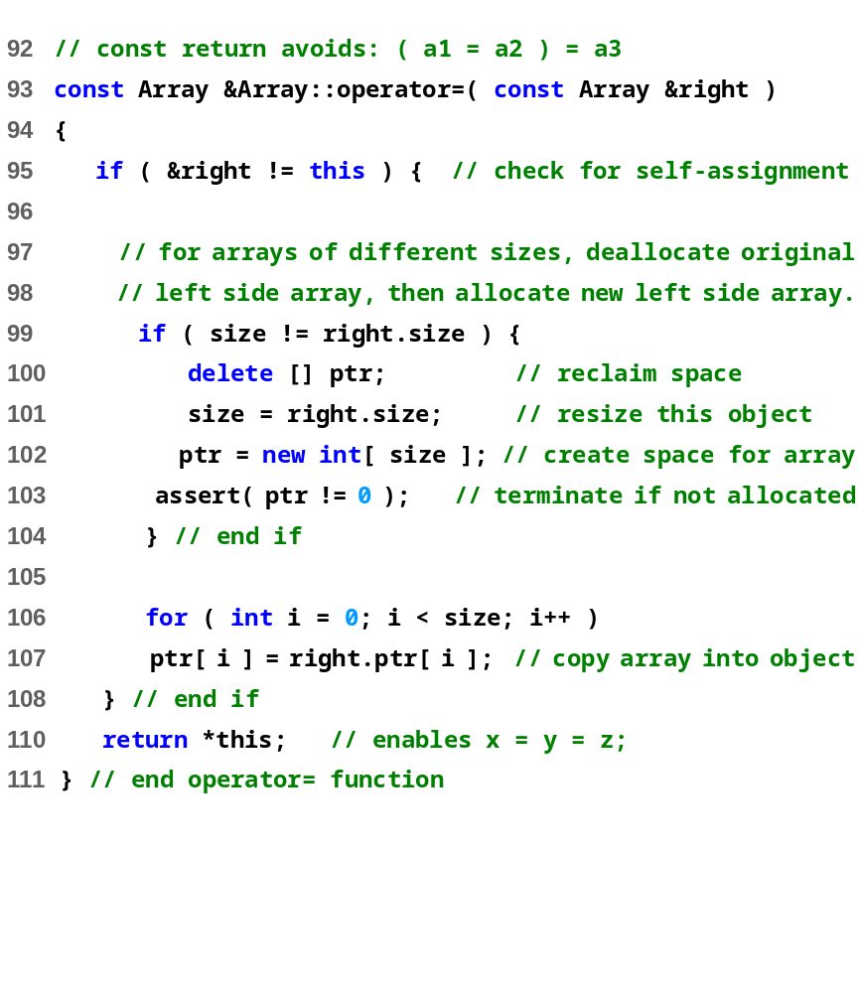
array1.cpp (3 of 6)

Slide 31
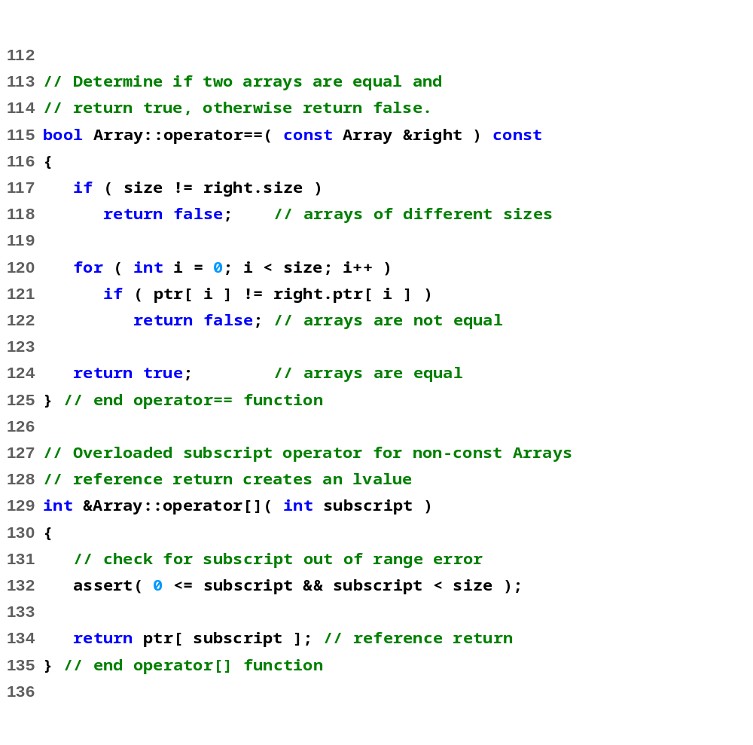
array1.cpp (4 of 6)

Slide 32
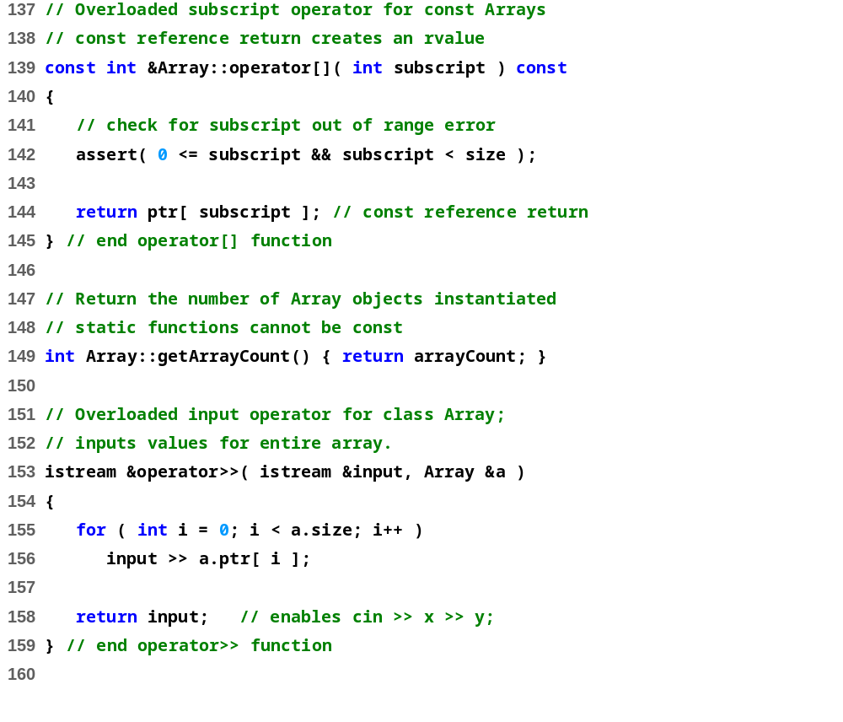
array1.cpp (5 of 6)

Slide 33
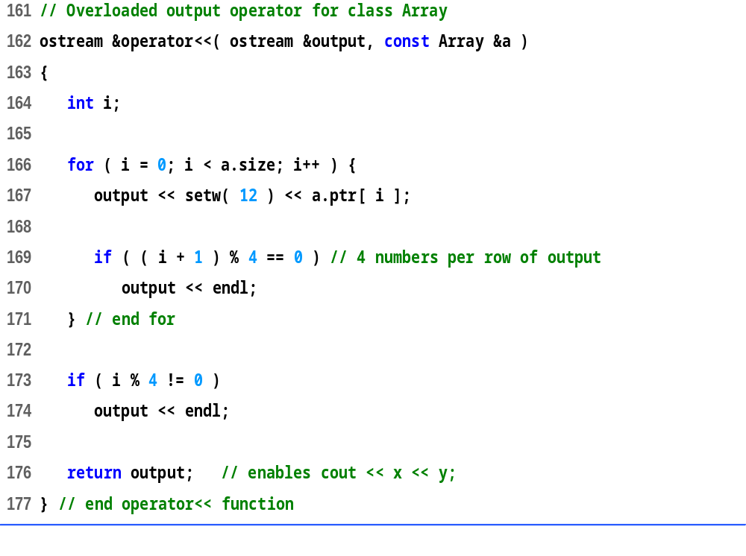
array1.cpp (6 of 6)

Slide 34
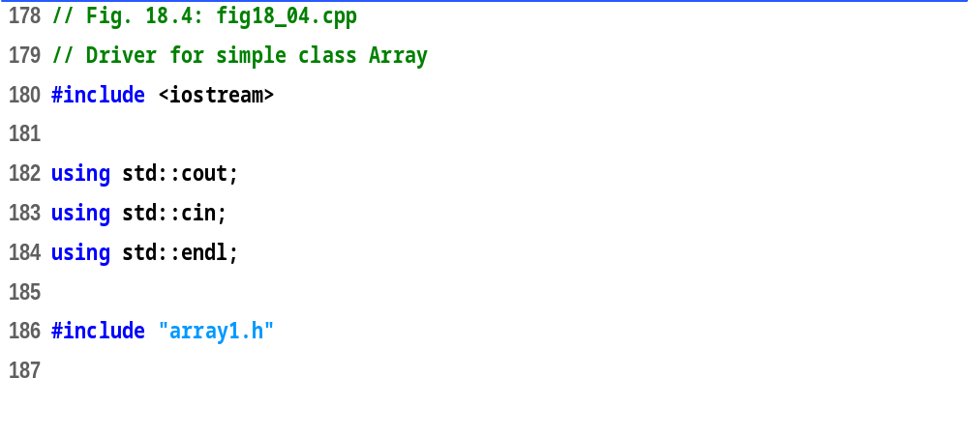
fig18_04.cpp (1 of 4)

Slide 35
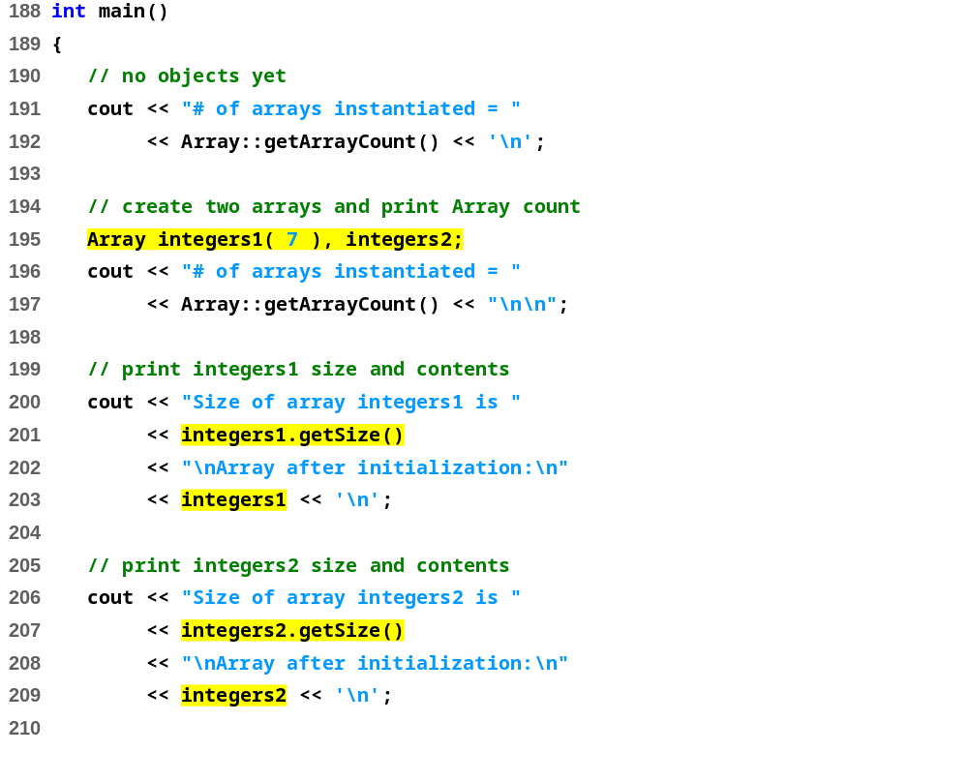
fig18_04.cpp (2 of 4)

Slide 36
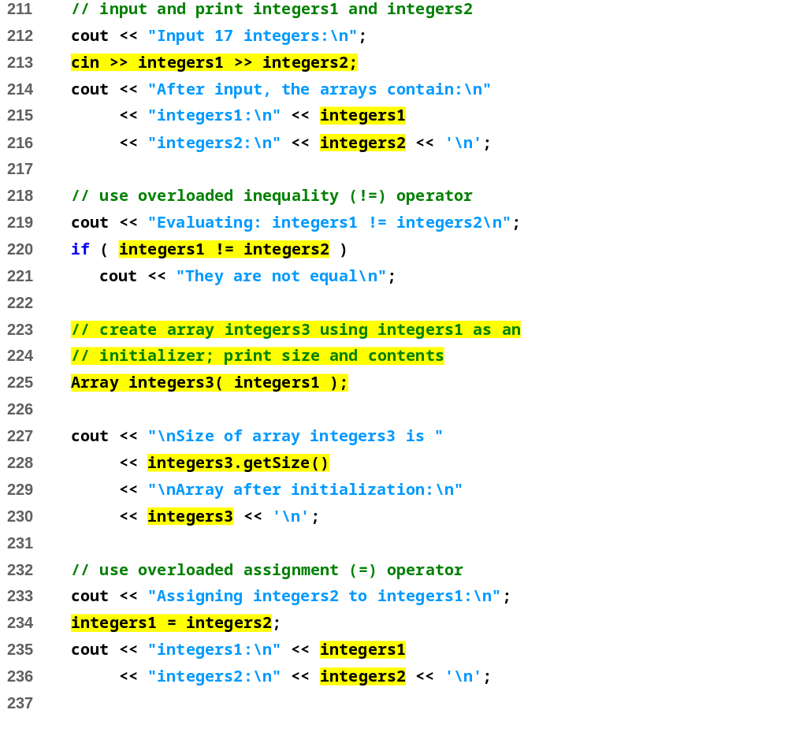
fig18_04.cpp (3 of 4)

Slide 37
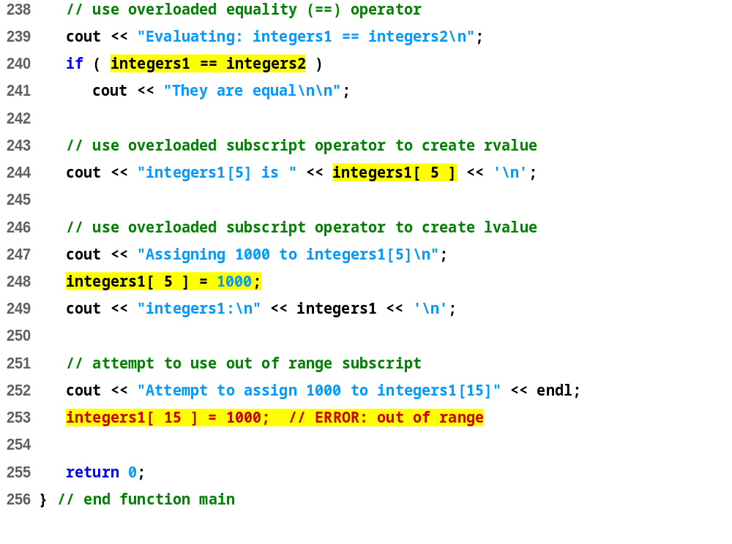
fig18_04.cpp (4 of 4)

Slide 38
# of arrays instantiated = 0
# of arrays instantiated = 2
Size of array integers1 is 7
Array after initialization:
0 0 0 0
0 0 0
Size of array integers2 is 10
Array after initialization:
0 0 0 0
0 0 0 0
0 0
Input 17 integers:
1 2 3 4 5 6 7 8 9 10 11 12 13 14 15 16 17
After input, the arrays contain:
integers1:
1 2 3 4
5 6 7
integers2:
8 9 10 11
12 13 14 15
16 17
Evaluating: integers1 != integers2
They are not equal
Size of array integers3 is 7
Array after initialization:
1 2 3 4
5 6 7
Array output (1 of 1)

Slide 39
Assigning integers2 to integers1:
integers1:
8 9 10 11
12 13 14 15
16 17
integers2:
8 9 10 11
12 13 14 15
16 17
Evaluating: integers1 == integers2
They are equal
integers1[5] is 13
Assigning 1000 to integers1[5]
integers1:
8 9 10 11
12 1000 14 15
16 17
Attempt to assign 1000 to integers1[15]
Assertion failed: 0 <= subscript && subscript < size, file Array1.cpp, line 95 abnormal program termination
Array output (2 of 2)

Slide 40
4.9 Converting between Types
Cast operator
  Convert objects into built-in types or other objects
  Conversion operator must be a non-static member function.
  Cannot be a friend function
  形参表必须为空
  不能指定返回类型，但是必须显式返回一个指定类型的值
  转换函数采用如下通用形式：
  operator type();
  type 表示内置类型名、类类型名或由类型别名定义的名字，对任何可作为函数返回类型的类型（除了 void 之外）都可以定义转换函数。
  For user-defined class A
  A::operator char *() const;
  A::operator int() const;
  A::operator otherClass() const;
  When compiler sees (char *) s it calls
s.operator char*()

Slide 41
4.9 Converting between Types
The compiler can call these functions to create temporary objects.
  If s is not of type char *
  Calls A::operator char *() const; for
cout << s;

Slide 42
4.10 Overloading ++ and --
Pre/post-incrementing/decrementing operators
  Can be overloaded
  How does the compiler distinguish between the two?
  Prefix versions overloaded same as any other prefix unary operator would be. i.e. d1.operator++(); for ++d1;
Postfix versions
  When compiler sees postincrementing expression, such as d1++;
    Generates the member-function call
  d1.operator++( 0 );
  Prototype:
  Date::operator++( int );

Slide 43
4.10 Overloading ++ and --
前置单目运算符和后置单目运算符重载的区别：函数的形参。
语法规定，前置单目运算符重载为成员函数时没有形参，
而后置单目运算符重载为成员函数时，需要有一个 int 型形参。
（这个int 型参数在函数体中并不使用,专门用来区别前置与后置）

Slide 44
Thank you !

