Slide 1
Chapter 6 - C++ Inheritance
Outline
6.1 Introduction
6.2 Inheritance: Base Classes and Derived Classes
6.3 Public, Protected and Private Inheritance
6.4 Single Inheritance and Multiple Inheritance
6.5 Direct Base Classes and Indirect Base Classes
6.6 Overriding Base-Class Members in a Derived Class
6.7 Using Constructors and Destructors in Derived Classes
6.8 Implicit Derived-Class Object to Base-Class Object Conversion
6.9 Software Engineering with Inheritance
6.10 Composition vs. Inheritance
6.11 Uses A and Knows A Relationships
6.12 Case Study: Point, Circle, Cylinder

Slide 2
Objectives
In this chapter, you will learn:
  To understand the notions of base classes and derived classes.
  To be able to create new classes by inheriting from existing classes.
  To understand how inheritance promotes software reusability.

Slide 3
6.1 Introduction
Inheritance
  New classes created from existing classes
  Absorb(吸纳) attributes and behaviors.
Polymorphism
  Write programs in a general fashion
  Handle a wide variety of existing (and unspecified) related classes
Derived class
  Class that inherits data members and member functions from a previously defined base class

Slide 4
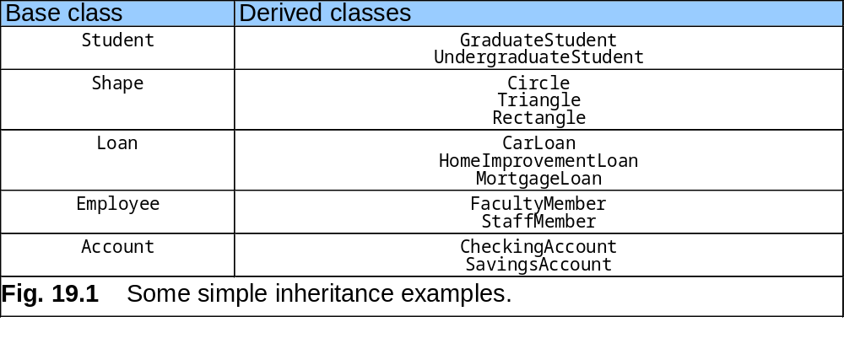
6.2 Base and Derived Classes
Often an object from a derived class (subclass) “is an” object of a base class (superclass)

Slide 5
#include <iostream.h>
class Animal
{
public:
void eat()
{ cout << "eating“ << endl ; }
void sleep()
{ cout << "sleeping“ << endl ; }
void swim()
{ cout << “swimming“ << endl ; }
};
class Bird: public Animal
{
void fly()
{ cout << “flying” << endl ; }
void swim()
{ cout << “can not swim” << endl ; }
};
int main()
{
Animal anAnimal ;
Bird aBird ;
anAnimal.eat() ;
anAnimal.swim() ;
cout << endl ;
aBird.eat() ;
aBird.swim() ;
aBird.fly() ;
return 0 ;
}
// Derived class can add new members
and override the members that
Inherited from base class
Base Class
Derived Class
eating
swimming
eating
can not swim
flying

Slide 6
继承与派生
继承与派生的概念：
继承：保持已有类的特征而构造新类的过程
派生：在已有类的基础上新增自己的特性而产生新类 的过程。
基类和派生类：
基类（或父类）：被继承特性的类。
派生类（或子类）：新增特性从而派生出的类。
继承与派生的目的：
继承的目的：实现代码重用。
派生的目的：在不改变原有程序的情况下，对原有程序 进行改造。

Slide 7
派生类生产的过程
步骤：
吸收基类成员—代码重用的过程
改造基类成员
添加新的成员
1.吸收基类成员：
    派生类包含了它的所有基类中除构造与析构函数之外的所有成员。
2.改造基类成员：
（1）对基类成员的访问控制——依靠派生类声明时的 继承方式来控制。
（2）对基类数据或函数成员的覆盖。
3.添加新的成员（继承与派生机制的核心）
--原有代码的扩充过程

Slide 8
6.2 Base and Derived Classes
What a derived class can't inherit ?
  （1）The base class's constructors and destructors
  （2）The base class's assignment operators
  （3）The base class's friend functions
What a derived class can add ?
（1）New data members
（2）New member functions
（3）New constructors and destructors
（4）New friend functions

Slide 9
复习：C++访问控制-- private, public, protected
private：只能由(1)该类中的函数、(2)其友元函数访问。
不能被任何其他访问，该类的对象也不能访问。
protected：可以被(1) 该类中的函数、(2) 子类的函数、(3) 其友元函数访问。
但不能被该类的对象访问。
public：可以被 (1) 该类中的函数、(2) 子类的函数、(3) 其友元函数访问，(4) 该类的对象访问。

Slide 10
6.3 Public, Private, and Protected Inheritance
Public Inheritance:
Publicly accessible members inherited from the base class stay publicly accessible in the derived class.
Private Inheritance:
Publicly accessible members inherited from the base class stay private in the derived class.
Protected Inheritance:
Data members which are not publicly accessible, but are accessible to derived classes.

Slide 11
6.3 Public, Private, and Protected Inheritance
private 属性不能够被继承。
使用private继承，父类的protected和public属性在子类中变为private；
使用protected继承，父类的protected和public属性在子类中变为protected；
使用public继承，父类中的protected和public属性不发生改变;

Slide 12
6.3 Public, Private, and Protected Inheritance
类成员共有三种级别的继承:public，protected和private。对于基类成员的存取操作应该依赖于下面两个因素:
1) 派生类声明其类头(public, protected 或 private)的方式
2) 对类成员的存取访问标志(public, protected 或 private)
基类（父类）的访问特性 | 类的继承特性 | 派生类（子类）的访问特性
Public Protected Private | Public | Public Protected No access
Public Protected Private | Protected | Protected Protected No access
Public Protected Private | Private | Private Private No access

Slide 13
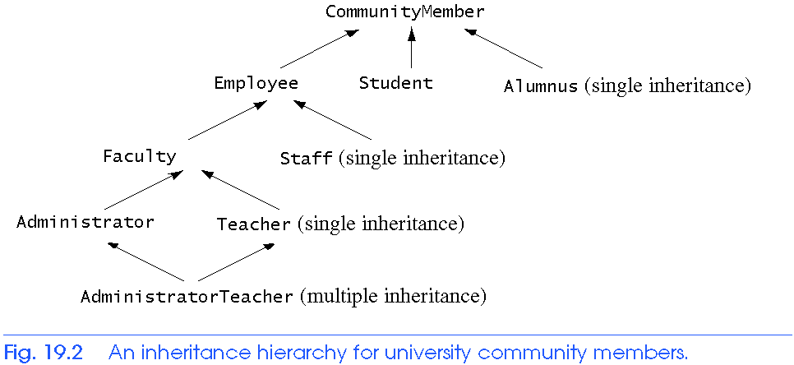
6.4 Single Inheritance and Multiple Inheritance
Inheritance
  Single Inheritance
    Class inherits from one base class
  Multiple Inheritance
    Class inherits from multiple base classes

Slide 14
6.5 Direct and Indirect Base Classes
Direct base class
  Explicitly listed derived class’ header with the colon (:) notation when that derived class is declared.
  class HourlyWorker : public Employee
    Employee is a direct base class of HourlyWorker
Indirect base class
  Inherited from two or more levels up the class hierarchy
  class MinuteWorker : public HourlyWorker
    Employee is an indirect base class of MinuteWorker

Slide 15
6.6 Overriding Base-Class Members in a Derived Class
To override a base-class member function
  In derived class, supply new version of that function
    Same function name, different definition
  The scope-resolution operator may be used to access the base class version from the derived class

Slide 16
2 // Definition of class Employee
3 #ifndef EMPLOY_H
4 #define EMPLOY_H
5
6 class Employee {
7 public:
8 Employee( const char *, const char * ); // constructor
9 void print() const; // output first and last name
10 ~Employee(); // destructor
11 private:
12 char *firstName; // dynamically allocated string
13 char *lastName; // dynamically allocated string
14 }; // end class Employee
16 #endif
employ.h
employ.cpp (1 of 2)
17 // Fig. 6.5: employ.cpp
18 // Member function definitions for class Employee
19 #include <iostream>
20
21 using std::cout;
22
23 #include <cstring>
24 #include <cassert>
25 #include "employ.h"

Slide 17
27 // Constructor dynamically allocates space for the
28 // first and last name and uses strcpy to copy
29 // the first and last names into the object.
30 Employee::Employee( const char *first, const char *last )
31 {
32 firstName = new char[ strlen( first ) + 1 ];
33 assert( firstName != 0 ); // terminate if not allocated
34 strcpy( firstName, first );
35
36 lastName = new char[ strlen( last ) + 1 ];
37 assert( lastName != 0 ); // terminate if not allocated
38 strcpy( lastName, last );
39 } // end Employee constructor
40
41 // Output employee name
42 void Employee::print() const
43 { cout << firstName << ' ' << lastName; }
44
45 // Destructor deallocates dynamically allocated memory
46 Employee::~Employee()
47 {
48 delete [] firstName; // reclaim dynamic memory
49 delete [] lastName; // reclaim dynamic memory
50 } // end Employee destructor
employ.cpp (2 of 2)

Slide 18
51 // Fig. 6.5: hourly.h
52 // Definition of class HourlyWorker
53 #ifndef HOURLY_H
54 #define HOURLY_H
55
56 #include "employ.h"
57
58 class HourlyWorker : public Employee {
59 public:
60 HourlyWorker( const char*, const char*, double, double );
61 double getPay() const; // calculate and return salary
62 void print() const; // overridden base-class print
63 private:
64 double wage; // wage per hour
65 double hours; // hours worked for week
66 }; // end class HourlyWorker
67
68 #endif
hourly.h
hourly.cpp (1 of 2)
69 // Fig. 6.5: hourly.cpp
70 // Member function definitions for class HourlyWorker
71 #include <iostream>
72
73 using std::cout;
74 using std::endl;
75
76 #include <iomanip>

Slide 19
78 using std::ios;
79 using std::setiosflags;
80 using std::setprecision;
82 #include "hourly.h"
83
84 // Constructor for class HourlyWorker
85 HourlyWorker::HourlyWorker( const char *first,
86 const char *last,
87 double initHours, double initWage )
88 : Employee( first, last ) // call base-class constructor
89 {
90 hours = initHours; // should validate
91 wage = initWage; // should validate
92 } // end HourlyWorker constructor
93
94 // Get the HourlyWorker's pay
95 double HourlyWorker::getPay() const { return wage * hours; }
96
97 // Print the HourlyWorker's name and pay
98 void HourlyWorker::print() const
99 {
100 cout << "HourlyWorker::print() is executing\n\n";
101 Employee::print(); // call base-class print function
102
103 cout << " is an hourly worker with pay of $"
104 << setiosflags( ios::fixed | ios::showpoint )
105 << setprecision( 2 ) << getPay() << endl;
106 } // end function print
hourly.cpp (2 of 2)

Slide 20
107 // Fig. 6.5: fig19_05.cpp
108 // Overriding a base-class member function in a
109 // derived class.
110 #include "hourly.h"
111
112 int main()
113 {
114 HourlyWorker h( "Bob", "Smith", 40.0, 10.00 );
115 h.print();
116 return 0;
117 } // end function main
fig19_05.cpp
HourlyWorker::print() is executing
Bob Smith is an hourly worker with pay of $400.00

Slide 21
6.7 Using Constructors and Destructors in Derived Classes
Base class initializer
  Uses member-initializer syntax
  Can be provided in the derived class constructor to call the base-class constructor explicitly
  Otherwise base class’ default constructor called implicitly
  Base-class constructors and base-class assignment operators are not inherited by derived classes
  However, derived-class constructors and assignment operators still can call them

Slide 22
6.7 Using Constructors and Destructors in Derived Classes
Derived-class constructor
  Calls the constructor for its base class first to initialize its base-class members
  If the derived-class constructor is omitted, its default constructor calls the base-class’ default constructor
Destructors are called in the reverse order of constructor calls
  Derived-class destructor is called before its base-class destructor

Slide 23
1 // Fig. 6.7: point2.h
2 // Definition of class Point
3 #ifndef POINT2_H
4 #define POINT2_H
5
6 class Point {
7 public:
8 Point( int = 0, int = 0 ); // default constructor
9 ~Point(); // destructor
10 protected: // accessible by derived classes
11 int x, y; // x and y coordinates of Point
12 }; // end class Point
13
14 #endif
point2.h

Slide 24
15 // Fig. 6.7: point2.cpp
16 // Member function definitions for class Point
17 #include <iostream>
18
19 using std::cout;
20 using std::endl;
21
22 #include "point2.h"
24 // Constructor for class Point
25 Point::Point( int a, int b )
26 {
27 x = a;
28 y = b;
29
30 cout << "Point constructor: "
31 << '[' << x << ", " << y << ']' << endl;
32 } // end Point constructor
33
34 // Destructor for class Point
35 Point::~Point()
36 {
37 cout << "Point destructor: "
38 << '[' << x << ", " << y << ']' << endl;
39 } // end Point destructor
point2.cpp

Slide 25
40 // Fig. 6.7: circle2.h
41 // Definition of class Circle
42 #ifndef CIRCLE2_H
43 #define CIRCLE2_H
44
45 #include "point2.h"
46
47 class Circle : public Point {
48 public:
49 // default constructor
50 Circle( double r = 0.0, int x = 0, int y = 0 );
51
52 ~Circle();
53 private:
54 double radius;
55 }; // end class Circle
56
57 #endif
circle2.h

Slide 26
58 // Fig. 6.7: circle2.cpp
59 // Member function definitions for class Circle
60 #include <iostream>
61
62 using std::cout;
63 using std::endl;
64
65 #include "circle2.h"
66
67 // Constructor for Circle calls constructor for Point
68 Circle::Circle( double r, int a, int b )
69 : Point( a, b ) // call base-class constructor
70 {
71 radius = r; // should validate
72 cout << "Circle constructor: radius is "
73 << radius << " [" << x << ", " << y << ']' << endl;
74 } // end Circle constructor
75
76 // Destructor for class Circle
77 Circle::~Circle()
78 {
79 cout << "Circle destructor: radius is "
80 << radius << " [" << x << ", " << y << ']' << endl;
81 } // end Circle destructor
circle2.cpp

Slide 27
82 // Fig. 6.7: fig19_07.cpp
83 // Demonstrate when base-class and derived-class
84 // constructors and destructors are called.
85 #include <iostream>
87 using std::cout;
88 using std::endl;
89
90 #include "point2.h"
91 #include "circle2.h"
92
93 int main()
94 {
95 // Show constructor and destructor calls for Point
96 {
97 Point p( 11, 22 );
98 } // end block
100 cout << endl;
101 Circle circle1( 4.5, 72, 29 );
102 cout << endl;
103 Circle circle2( 10, 5, 5 );
104 cout << endl;
105 return 0;
106 } // end function main
fig19_07.cpp (1 of 2)

Slide 28
Point constructor: [11, 22]
Point destructor: [11, 22]
Point constructor: [72, 29]
Circle constructor: radius is 4.5 [72, 29]
Point constructor: [5, 5]
Circle constructor: radius is 10 [5, 5]
Circle destructor: radius is 10 [5, 5]
Point destructor: [5, 5]
Circle destructor: radius is 4.5 [72, 29]
Point destructor: [72, 29]
fig19_07.cpp (2 of 2)

Slide 29
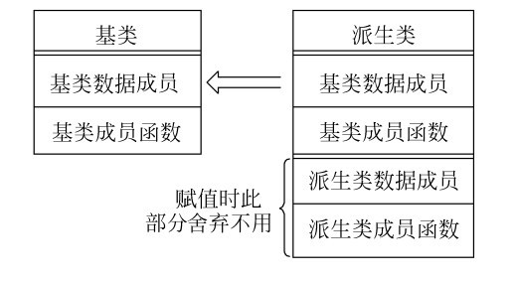
6.8 Implicit Derived-Class Object to Base-Class Object Conversion
baseClassObject = derivedClassObject;
  This will work
    原因是父类对象中的除私有外的数据成员都能在子类对象中找到对应。
    Extra data is not given to the base class
    基类的私有数据成员也不会被赋值

Slide 30
6.8 Implicit Derived-Class Object to Base-Class Object Conversion
derivedClassObject = baseClassObject;
  May not work properly
    Unless an assignment operator is overloaded in the derived class, data members exclusive to the derived class will be unassigned
  主要原因是那些派生类对象中新添加的数据成员在父类对象中找不到对应的数据成员。

Slide 31
6.8 Implicit Derived-Class Object to Base-Class Object Conversion
Four ways to mix base and derived class pointers and objects:
  Referring to a base-class object with a base-class pointer
    Allowed
  Referring to a derived-class object with a derived-class pointer
    Allowed
  Referring to a derived-class object with a base-class pointer
    It is Safe but need to be used carefully
    但是只能引用基类成员。若试图通过基类指针引用那些只在派生类中才有的成员，编译器会报告语法错误。（解决该问题的答案是虚函数和多态性）
  Referring to a base-class object with a derived-class pointer
    Syntax error
    The derived-class pointer must first be cast to a base-class pointer

Slide 32
6.9 Software Engineering With Inheritance
Classes are often closely related
  “Factor out” (提取) common attributes and behaviors and place these in a base class
  Use inheritance to form derived classes
Modifications to a base class
  Derived classes do not change as long as the public and protected interfaces are the same
  Derived classes may need to be recompiled

Slide 33
6.10 Composition vs. Inheritance
"is a" relationship
  Inheritance
"has a" relationship
  Composition - class has an object from another class as a data member
Employee “is a” BirthDate; //Wrong!
Employee “has a” BirthDate;//Composition

Slide 34
6.11 Uses A And Knows A Relationships
“uses a” relationship
  One object issues a function call to a member function of another object
“knows a” relationship
  One object is aware of another
    Contains a pointer handle or reference handle to another object
  Also called an association

Slide 35
6.12 Case Study: Point, Circle, Cylinder
Define class Point
  Derive Circle
    Derive Cylinder

Slide 36
1 // Fig. 6.8: point2.h
2 // Definition of class Point
3 #ifndef POINT2_H
4 #define POINT2_H
5
6 #include <iostream>
7
8 using std::ostream;
9
10 class Point {
11 friend ostream &operator<<( ostream &, const Point & );
12 public:
13 Point( int = 0, int = 0 ); // default constructor
14 void setPoint( int, int ); // set coordinates
15 int getX() const { return x; } // get x coordinate
16 int getY() const { return y; } // get y coordinate
17 protected: // accessible to derived classes
18 int x, y; // coordinates of the point
19 }; // end class Point
20
21 #endif
point2.h

Slide 37
22 // Fig. 6.8: point2.cpp
23 // Member functions for class Point
24 #include "point2.h"
25
26 // Constructor for class Point
27 Point::Point( int a, int b ) { setPoint( a, b ); }
28
29 // Set the x and y coordinates
30 void Point::setPoint( int a, int b )
31 {
32 x = a;
33 y = b;
34 } // end function setPoint
35
36 // Output the Point
37 ostream &operator<<( ostream &output, const Point &p )
38 {
39 output << '[' << p.x << ", " << p.y << ']';
40
41 return output; // enables cascading
42 } // end operator<< function
point2.cpp

Slide 38
43 // Fig. 6.8: fig19_08.cpp
44 // Driver for class Point
45 #include <iostream>
47 using std::cout;
48 using std::endl;
50 #include "point2.h"
51
52 int main()
53 {
54 Point p( 72, 115 ); // instantiate Point object p
56 // protected data of Point inaccessible to main
57 cout << "X coordinate is " << p.getX()
58 << "\nY coordinate is " << p.getY();
59
60 p.setPoint( 10, 10 );
61 cout << "\n\nThe new location of p is " << p << endl;
62
63 return 0;
64 } // end function main
fig19_08.cpp
X coordinate is 72
Y coordinate is 115
The new location of p is [10, 10]

Slide 39
1 // Fig. 6.9: circle2.h
2 // Definition of class Circle
3 #ifndef CIRCLE2_H
4 #define CIRCLE2_H
5
6 #include <iostream>
7
8 using std::ostream;
9
10 #include "point2.h"
11
12 class Circle : public Point {
13 friend ostream &operator<<( ostream &, const Circle & );
14 public:
15 // default constructor
16 Circle( double r = 0.0, int x = 0, int y = 0 );
17 void setRadius( double ); // set radius
18 double getRadius() const; // return radius
19 double area() const; // calculate area
20 protected: // accessible to derived classes
21 double radius; // radius of the Circle
22 }; // end class Circle
23
24 #endif
circle2.h

Slide 40
25 // Fig. 6.9: circle2.cpp
26 // Member function definitions for class Circle
27 #include <iomanip>
29 using std::ios;
30 using std::setiosflags;
31 using std::setprecision;
32
33 #include "circle2.h"
35 // Constructor for Circle calls constructor for Point
36 // with a member initializer and initializes radius
37 Circle::Circle( double r, int a, int b )
38 : Point( a, b ) // call base-class constructor
39 { setRadius( r ); }
41 // Set radius
42 void Circle::setRadius( double r )
43 { radius = ( r >= 0 ? r : 0 ); }
44
45 // Get radius
46 double Circle::getRadius() const { return radius; }
47
48 // Calculate area of Circle
49 double Circle::area() const
50 { return 3.14159 * radius * radius; }
circle2.cpp (1 of 2)

Slide 41
52 // Output a circle in the form:
53 // Center = [x, y]; Radius = #.##
54 ostream &operator<<( ostream &output, const Circle &c )
55 {
56 output << "Center = " << static_cast< Point > ( c )
57 << "; Radius = "
58 << setiosflags( ios::fixed | ios::showpoint )
59 << setprecision( 2 ) << c.radius;
60
61 return output; // enables cascaded calls
62 } // end operator<< function
circle2.cpp (2 of 2)
fig19_09.cpp (1 of 2)
63 // Fig. 6.9: fig19_09.cpp
64 // Driver for class Circle
65 #include <iostream>
66
67 using std::cout;
68 using std::endl;
69
70 #include "point2.h"
71 #include "circle2.h"
72

Slide 42
73 int main()
74 {
75 Circle c( 2.5, 37, 43 );
77 cout << "X coordinate is " << c.getX()
78 << "\nY coordinate is " << c.getY()
79 << "\nRadius is " << c.getRadius();
81 c.setRadius( 4.25 );
82 c.setPoint( 2, 2 );
83 cout << "\n\nThe new location and radius of c are\n"
84 << c << "\nArea " << c.area() << '\n';
86 Point &pRef = c;
87 cout << "\nCircle printed as a Point is: " << pRef << endl;
88
89 return 0;
90 } // end function main
fig19_09.cpp (2 of 2)
X coordinate is 37
Y coordinate is 43
Radius is 2.5
The new location and radius of c are
Center = [2, 2]; Radius = 4.25
Area 56.74
Circle printed as a Point is: [2, 2]

Slide 43
1 // Fig. 6.10: cylindr2.h
2 // Definition of class Cylinder
3 #ifndef CYLINDR2_H
4 #define CYLINDR2_H
5
6 #include <iostream>
8 using std::ostream;
10 #include "circle2.h"
11
12 class Cylinder : public Circle {
13 friend ostream &operator<<( ostream &, const Cylinder & );
15 public:
16 // default constructor
17 Cylinder( double h = 0.0, double r = 0.0,
18 int x = 0, int y = 0 );
19
20 void setHeight( double ); // set height
21 double getHeight() const; // return height
22 double area() const; // calculate and return area
23 double volume() const; // calculate and return volume
24
25 protected:
26 double height; // height of the Cylinder
27 }; // end class Cylinder
28
29 #endif
cylindr2.h

Slide 44
30 // Fig. 6.10: cylindr2.cpp
31 // Member and friend function definitions
32 // for class Cylinder.
33 #include "cylindr2.h"
35 // Cylinder constructor calls Circle constructor
36 Cylinder::Cylinder( double h, double r, int x, int y )
37 : Circle( r, x, y ) // call base-class constructor
38 { setHeight( h ); }
39
40 // Set height of Cylinder
41 void Cylinder::setHeight( double h )
42 { height = ( h >= 0 ? h : 0 ); }
43
44 // Get height of Cylinder
45 double Cylinder::getHeight() const { return height; }
46
47 // Calculate area of Cylinder (i.e., surface area)
48 double Cylinder::area() const
49 {
50 return 2 * Circle::area() +
51 2 * 3.14159 * radius * height;
52 } // end function area
53
54 // Calculate volume of Cylinder
55 double Cylinder::volume() const
56 { return Circle::area() * height; }
cylindr2.cpp (1 of 2)

Slide 45
58 // Output Cylinder dimensions
59 ostream &operator<<( ostream &output, const Cylinder &c )
60 {
61 output << static_cast< Circle >( c )
62 << "; Height = " << c.height;
63
64 return output; // enables cascaded calls
65 } // end operator<< function
cylindr2.cpp (2 of 2)
fig19_10.cpp (1 of 3)
66 // Fig. 6.10: fig19_10.cpp
67 // Driver for class Cylinder
68 #include <iostream>
70 using std::cout;
71 using std::endl;
72
73 #include "point2.h"
74 #include "circle2.h"
75 #include "cylindr2.h"
76
77 int main()
78 {
79 // create Cylinder object
80 Cylinder cyl( 5.7, 2.5, 12, 23 );

Slide 46
82 // use get functions to display the Cylinder
83 cout << "X coordinate is " << cyl.getX()
84 << "\nY coordinate is " << cyl.getY()
85 << "\nRadius is " << cyl.getRadius()
86 << "\nHeight is " << cyl.getHeight() << "\n\n";
87
88 // use set functions to change the Cylinder's attributes
89 cyl.setHeight( 10 );
90 cyl.setRadius( 4.25 );
91 cyl.setPoint( 2, 2 );
92 cout << "The new location, radius, and height of cyl are:\n"
93 << cyl << '\n';
94
95 cout << "The area of cyl is:\n"
96 << cyl.area() << '\n';
97
98 // display the Cylinder as a Point
99 Point &pRef = cyl; // pRef "thinks" it is a Point
100 cout << "\nCylinder printed as a Point is: "
101 << pRef << "\n\n";
102
103 // display the Cylinder as a Circle
104 Circle &circleRef = cyl; // circleRef thinks it is a Circle
105 cout << "Cylinder printed as a Circle is:\n" << circleRef
106 << "\nArea: " << circleRef.area() << endl;
107
108 return 0;
109 } // end function main
fig19_10.cpp (2 of 3)

Slide 47
X coordinate is 12
Y coordinate is 23
Radius is 2.5
Height is 5.7
The new location, radius, and height of cyl are:
Center = [2, 2]; Radius = 4.25; Height = 10.00
The area of cyl is:
380.53
Cylinder printed as a Point is: [2, 2]
Cylinder printed as a Circle is:
Center = [2, 2]; Radius = 4.25
Area: 56.74
fig19_10.cpp (3 of 3)

Slide 48
Thank you !

