Slide 1
Chapter 08 - C++ Stream Input/Output
Outline
8.1 Introduction
8.2 Stream Input / Output Classes
8.3 File Streams
Objectives
In this chapter, you will learn:
  To understand how to use C++ object-oriented stream input/output.
  To understand the stream I/O class hierarchy.（C++输入输出库的类层次结构异常复杂，但是展现了因结合多态和多重继承机制而获得的巨大功能。）

Slide 2
8.1 Introduction
Stream
  A transfer of information in the form of a sequence of bytes(流是一种抽象，它负责在数据的生产者和数据的消费者之间建立联系，并管理数据的流动。)
I/O Operations:
  Input: A stream that flows from an input device ( i.e.: keyboard, disk drive, network connection) to main memory
  Output: A stream that flows from main memory to an output device ( i.e.: screen, printer, disk drive, network connection)

Slide 3
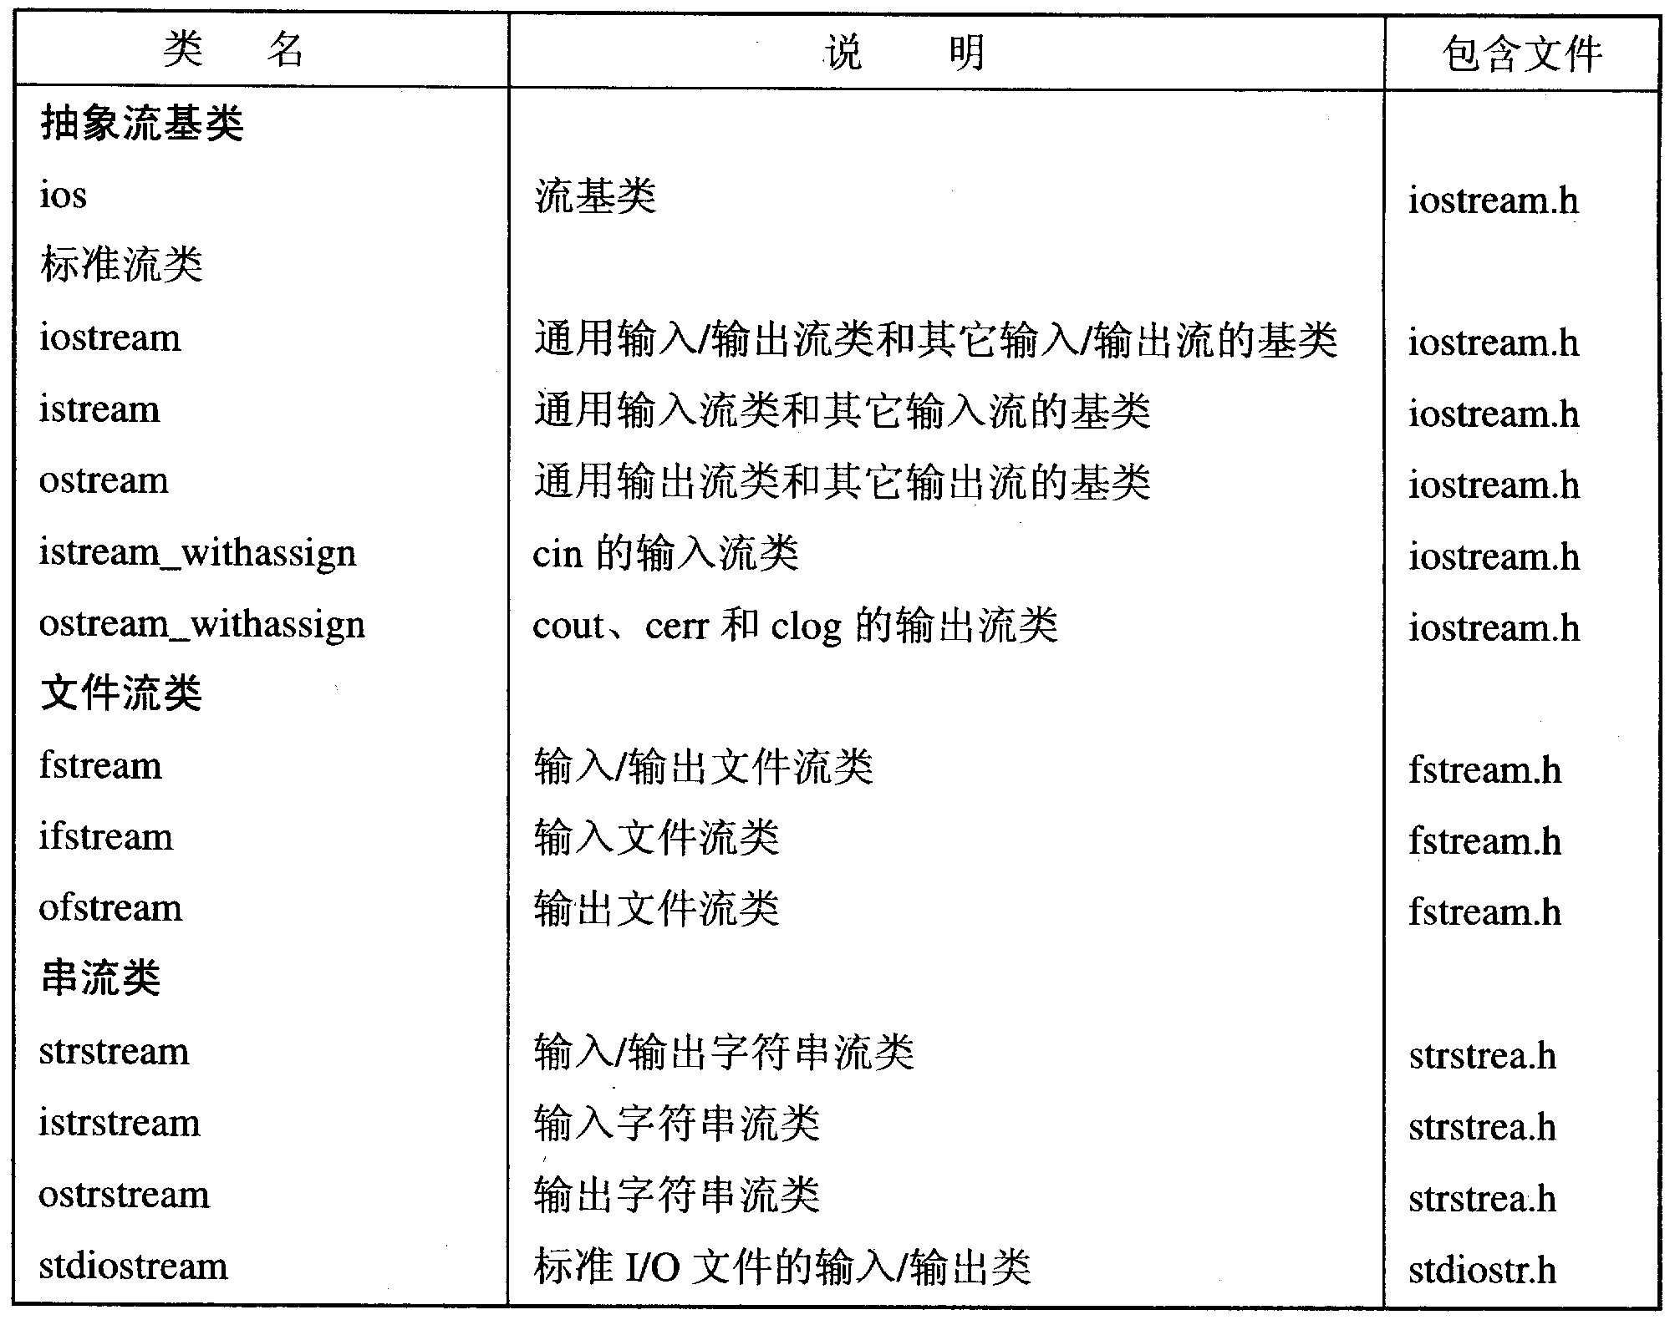
8.1 Introduction

Slide 4
8.2 Stream Input / Output Classes
为类及其派生类提供对数据的缓冲支持。
设置流的状态，虚基类
ios
streambuf
istream
ostream
定义了从流中提取数据的有关操作
定义了向流中插入数据的有关操作
多重继承
iostream
综合了istream类和ostream类的行为，使该类的对象执行插入和提取的有关操作

Slide 5
8.2 Stream Input / Output Classes
cin
  Input stream connected to the keyboard
cout
  Output stream connected to the screen
cin and cout defined in the iostream library
  Use include directive: #include <iostream>
-<number>-

Slide 6
8.3 File Stream Classes
Why use files ?
Files allow you to store data permanently!
Data output to a file lasts after the program ends(持久化)
An input file can be used over and over
  No typing of data again and again for testing
Create a data file or read an output file at your convenience
Files allow you to deal with larger data sets

Slide 7
8.3 File Stream Classes
fstream、ifstream和ofstream是文件流类，在头文件fstream中，
其层次结构如下：
公共基类
ios
streambuf
filebuf
istream
fstreamBase
ostream
管理文件缓冲区
ifstream
iostream
ofstream
用于从文件提取
用于向文件插入
fstream
多重继承

Slide 8
Declaring An Input-file Stream Variable
8.3 File Stream Classes
Input-file streams are of type ifstream
Ouput-file streams of are type ofstream
Type ifstream and ofstream is defined in the fstream library
  You must use the include and using directives
  #include <fstream>
  using namespace std;
Declare an input-file stream variable using
ifstream in_stream;
ofstream out_stream;

Slide 9
8.3 File Stream Classes
Once a stream variable is declared, connect it to
a file(eg, infile.dat )
  Connecting a stream to a file is opening the file
  Use the open function of the stream object
  in_stream.open("infile.dat");
  out_stream.open("outfile.dat");
  like cin and cout
  in_stream >> number1 >> number2 ;
  out_stream << number1 << number2 ;
从文件读入数据到number1和number2
将number1和number2的值写入到文件中

Slide 10
8.3 File Stream Classes
After using a file, it should be closed
  This disconnects the stream from the file
  Close files to reduce the chance of a file being
  corrupted if the program terminates abnormally
  in_stream.close() ;
  out_stream.close() ;

Slide 11
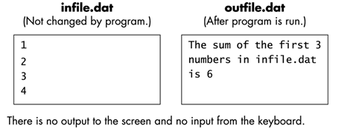
8.3 File Stream Classes
1 #include <fstream>
using namespace std ;
2 int main() {
ifstream in_stream ;
ofstream out_stream ;
in_stream.open( “infile.dat” ) ;
Out_stream.open( “outfile.dat” ) ;
int first, second, third ;
in_stream >> first >> second >> third ;
out_stream << “The sum of the first 3” << endl
<< “numbers infile.dat” << endl
<< “is “ << (first + second + third) << endl ;
in_stream.close() ;
out_stream.close() ;
return 0 ;
}
可以增加文件打开失败的判断：
if( in_stream.fail( ) ){
cout << "Input file opening failed.\n";
exit(1) ;
}

