Slide 1
习题解答

Slide 2
A, B and C are sets, prove or disprove the following statements.
(1). if A – B = A – C, then B = C
(2). if A × B = A × C, A ≠ ∅, then B = C
(1). 错误

Slide 3
(2). B ⊆ C
∀y ∈ B
⇒ x ∈ A ∧ y ∈ B (A ≠ ∅)
⇒ (x, y) ∈ A × B
⇒ (x, y) ∈ A × C (A × B = A × C)
⇒ y ∈ C (笛卡尔积的定义)
所以, 有: B ⊆ C.

Slide 4
(2.2) C ⊆ B
∀y ∈ C
⇒ x ∈ A ∧ y ∈ C (A ≠ ∅)
⇒ (x, y) ∈ A × C
⇒ (x, y) ∈ A × B (A × B = A × C)
⇒ y ∈ B (笛卡尔积的定义)
所以, 有: C ⊆ B.
由(2.1)和(2.2)可知: B = C.

Slide 5
2. Write each of the following statements in terms of propositional variables, predicates, quantifiers and logical connectives. You can choose any propositional variables and predicates freely.
(1). If I like the course or the teacher, I will attend the class. (Statement and its negation)
(2). For all students of our school, someone studies hard and has good score, someone studies hard and has not good score.
(1) Suppose: p – I like the course, q – I like the teacher, r – I will attend the class
Conditional statement: (p ∨ q) ⇒ r
Negation statement: ~((p ∨ q) ⇒ r) ≡ ~(~(p ∨ q) ∨ r) ≡ (p ∨ q) ∧ (~r)
(2) Suppose: P(x) – x studies hard, Q(x) – x has good score
Predicate logical statement: ∃x(P(x) ∧ Q(x)) ∧ ∃x(P(x) ∧ ~Q(x)), x ∈ { all students of our school }

Slide 6
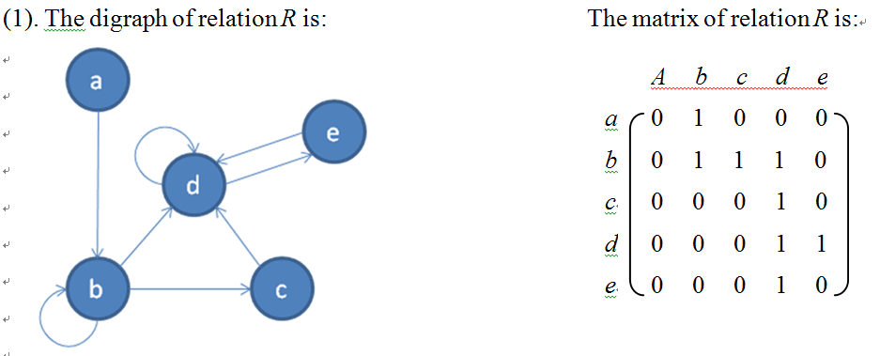
3. Let A={a,b,c,d,e}, a relation R on A is {(a,b), (b,b), (b,c), (b,d), (c,d), (d,d), (d,e), (e,d)}.
(1) Give the digraph and matrix of relation R;
(2) Compute R², reflexive closure r(R) and symmetric closure s(R).

Slide 7
(2) R² = {(a,b), (a,c), (a,d), (b,b), (b,c), (b,d), (b,e), (c,d), (c,e), (d,d), (d,e), (e,d), (e,e)}
r(R) = {(a,b), (b,b), (b,c), (b,d), (c,d), (d,d), (d,e), (e,d), (a,a), (c,c), (e,e)}
s(R) = {(a,b), (b,b), (b,c), (b,d), (c,d), (d,d), (d,e), (e,d), (b,a), (c,b), (d,b), (d,c)}

Slide 8
4. (15 points) Let S∈Z⁺ and A=S×S. Define the following relation R on A:
(a,b) R (a′,b′) if and only if ab′ = a′b
(1) Show that R is an equivalent relation;
(2) Let S={1,2,3,4,5,6,7,8,9}, compute the equivalent class [(2,4)].

Slide 9
由关系R的定义可知: (a,b) R (a′,b′) if and only if a/b = a′/b′
  (1) 证明: 关系R是等价关系.
  (1.1) 关系R是自反的
  ∀(a,b)∈A
  ⇒ a∈Z⁺ ∧ b∈Z⁺
  ⇒ a/b=a/b
  ⇒ (a,b) R (a,b)
  ∴ R is reflexive.
(1.2) 关系R是对称的
∀(a,b) R (a′,b′)
⇒ a/b = a′/b′
⇒ a′/b′ = a/b
⇒ (a′,b′) R (a,b)
∴ R is symmetric.
(1.3) 关系R是对称的
∀(a,b) R (a′,b′), (a′,b′) R (a′′,b′′)
⇒ a/b = a′/b′ ∧ a′/b′ = a′′/b′′
⇒ a/b = a′′/b′′
⇒ (a,b) R (a′′,b′′)
∴ R is transitive.
所以,由(1.1)~(1.3)可知: R is an equivalent relation on A.

Slide 10
(2) [(2,4)] = {(1,2), (2,4), (3,6), (4,8)}.

Slide 11
5. (10 points) Let function f(x, y)=( x+3y, 2x+y), (x, y)∈R×R, prove that f is bijection.
(1) 证明: f是单射.
假设: f((x,y)) = f((u,v)).
(x+3y, 2x+y) = (u+3v, 2u+v)
⇒ (x+3y = u+3v) ∧ (2x+y = 2u+v)
⇒ (u=x) ∧ (v=y)
⇒ (x,y) = (u,v)
所以, f是单射.
(2) 证明: f是满射.
∀(u, v) ∈ R×R.
假设: ∃(x, y) ∈ R×R, 使得: f(x,y)=(u, v).
(x+3y, 2x+y) = (u, v)
⇒ (x+3y = u) ∧ (2x+y = v)
⇒ x=(3v-u)/5, y=(2u-v)/5
所以, ∀(u, v) ∈ R×R, 都存在: (x, y) ∈ R×R, 使得: f(x, y) = (u, v), 即: f是满射.

Slide 12
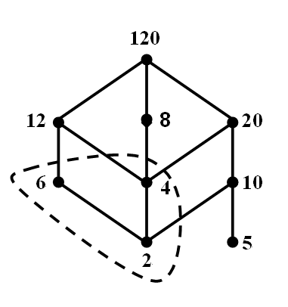
6. (15 points) Let A={2, 4, 5, 6, 8, 10, 12, 20, 120}, R is the relation of divisibility on A.
(1) Draw the Hasse diagram of the poset <A, R>;
(2) Find all the minimal elements, the maximal elements, the least element and the greatest element of the poset <A, R> if they exist;
(3) Let B = {2, 4, 6}, find the upper bound, the lower bound, the least upper bound and the greatest lower bound of B if they exist.
(1) the Hasse diagram of the poset <A, R>
(2) the minimal element: 2, 5;
the maximal element: 120;
the least element: None;
the greatest element: 120.

Slide 13
for set B = {2, 4, 6},
the upper bound: 12, 120;
the lower bound: 2;
the least upper bound: 12;
the greatest lower bound: 2.

