Slide 1
Chapter 2 Basic Structures
Section 1
Sets
javascript:;

Slide 2

6.1 集合的基本概念
1. 集合定义
集合没有精确的数学定义
理解：由离散个体构成的整体称为集合，称这些个体为集
合的元素
常见的数集：N, Z, Q, R, C 等分别表示自然数、整数、有
理数、实数、复数集合
2. 集合表示法
枚举法----通过列出全体元素来表示集合
谓词表示法----通过谓词概括集合元素的性质
实例：
枚举法 自然数集合 N={0,1,2,3,…}
谓词法 S={ x | x是实数，x²−1=0}

Slide 3
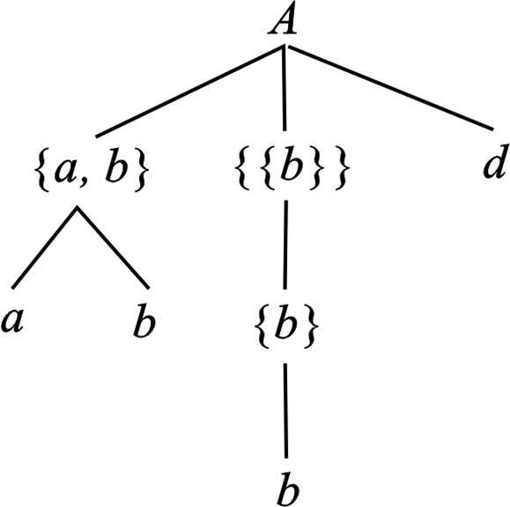
元素与集合
1. 集合的元素具有的性质
无序性：元素列出的顺序无关
相异性：集合的每个元素只计
数一次
确定性：对任何元素和集合都
能确定这个元素是否
为该集合的元素
任意性：集合的元素也可以是
集合
2．元素与集合的关系
隶属关系：∈或者∉
3．集合的树型层次结构
d ∈A , a ∉A

Slide 4
集合与集合
集合与集合之间的关系：⊆, =, ⊈, ≠, ⊂, ⊄
定义6.1 A ⊆ B ⇔ ∀x ( x∈A → x∈B )
定义6.2 A = B ⇔ A ⊆ B ∧ B ⊆ A
定义6.3 A ⊂ B ⇔ A ⊆ B ∧ A ≠ B
A ⊈ B ⇔ ∃x ( x∈A ∧ x∉B )
思考：≠ 和 ⊄ 的定义
注意 ∈ 和 ⊆ 是不同层次的问题

Slide 5
6.2 集合的运算
初级运算
集合的基本运算有
定义6.7 并 A∪B = {x | x∈A ∨ x∈B}
交 A∩B = {x | x∈A ∧ x∈B}
相对补 A−B = {x | x∈A ∧ x∉B}
定义6.8 对称差 A⊕B = (A−B)∪(B−A)
定义6.9 绝对补 ∼A = E−A

Slide 6
Sets: Intuitive Definition
Remark
  Sets are used to group objects together
  Many important discrete structures are built using sets
    Combinations: unordered collections of objects used extensively in counting组合:无序的对象集合广泛用于计数
    Relations: sets of ordered pairs that present ordered relationships between objects
    Graphics: sets of vertices and edges that connect vertices
    Finite state machines: used to model computer machines

Slide 7
Sets: Intuitive Definition
Set
  A set is an unordered collection of objects
    An intuitive definition
      The term object has been used without specifying what an object is
      Based on the intuitive notion of an object
    Stated by Georg Cantor, 1895
    Leads to Russell’s paradoxes
    Naive set theory (朴素集合论)
  Objects of a set often have similar properties
    all students enrolled登记at the same university
    all students currently taking discrete mathematics

Slide 8
Sets: Intuitive Definition
DEFINITION 1
A set is an unordered collection of objects, called elements or members of the set. A set is said to contain its elements. We write a ∈ A to denote that a is an element of the set A. The notation a ∉ A denotes that a is not an element of the set A.

Slide 9
The Description of a Set
Describing a set
  There are several ways to describe a set
    To list all the member of a set, if this is possible
    To use set builder notation (构造性描述)
Examples
  Listing all the member of a set
    The set of all vowels in the English alphabet can be written as V = {a, e, i, o, u}
    The set of odd positive integers less than 10 can be expressed by O = {1, 3, 5, 7, 9}
    Nothing prevents a set from having seemingly unrelated elements such as {a, 2, Fred, New Jersey}
    The set of positive integers<100: {1,2,3,…, 99}

Slide 10
The Description of a Set
Set builder
  give a rule that characterizes the elements by stating the property or properties
Examples
  using set builder notation
    The set O of all odd positive integers < 10:
    O={x|x is an odd positive integer < 10}
    The universe as the set of positive integers
    O={x∈Z⁺|x is odd and x<10}
    The set of positive rational numbers
    Q⁺={x∈R|x=p/q for some positive integers p and q}

Slide 11
The Description of a Set
Examples
  It is useful to remember the following sets:
    N = {0, 1, 2, 3, …}, the set of natural numbers
    Z = {…, -2, -1, 0, 1, 2, …}, the set of integers
    Z⁺ = {1, 2, 3, …}, the set of positive integers
    Q = {p/q | p ∈ Z, q ∈ Z, and q ≠ 0}, the set of rational numbers
    Q⁺ = the set of positive rational numbers
    R = the set of real numbers
  The set {N, Z, Q, R} is a set containing four elements, each of which is a set

Slide 12
The Description of a Set
Remark
  Note that anything within a set of curly braces花括号can be considered a set. The elements of a set don’t necessarily have to have anything to do with one another
  Example
    {Boston, “7”, iPod, 2.7, Sleepy} is a legal set
  The order in which elements occur in sets is irrelevant
    {a, b, c, d, e} and {c, e, a, d, b} are the same
  It does not matter if an element of a set is listed more than once
    For example, {a, a, a, b, c} and {a, b, c} are equivalent.
  We ignore any duplicates. In our later discussion, objects in a set should be distinct

Slide 13
The Description of a Set
The axioms of extensionality 外延性公理
  Two sets A and B are equal if and only if they have the same elements. Write as A=B
  Consider sets A and B. Then A = B iff
  ∀x ((x ∈ A) ↔ (x ∈ B))
  It is called the axioms of extensionality

Slide 14
Empty Set and Singleton
Empty set
  A set that has no elements is called the empty set or null set, denoted by ∅, or by { }.
  An empty set is still considered a real set, even though it has no elements
  Example
    {x|x is a positive integer and x>x²}
Remark
  Since the empty set is a set, another set can contain the empty set as one of its elements:
    A ={∅, a} set A has 2 elements
    B = {∅} set B has 1 element
    C = ∅ set C has 0 elements

Slide 15
Empty Set and Singleton
Singleton 单元素集
  A set with only one element is called a singleton
  A common mistake is to confuse ∅ with {∅}

Slide 16
Subset
Subset
  The set A is a subset of B if and only if every element of A is also an element of B, denoted by A⊆B
  We see A ⊆ B if and only if ∀x(x∈A→x∈B)
  Obviously, according to the preceding definition, if A = B, it must be true that A ⊆ B and B ⊆ A
  moreover, it should be self-evident that every set is a subset of itself. That is: A ⊆ A

Slide 17
Subset
Theorem
  for every set S
  (i) ∅⊆S, and
  (ii) S⊆S
  Proof of (i)
    Let S be a set, to show ∅⊆S, we need to show ∀x(x∈∅→x∈S) is true.
    But x∈∅ is always false, and thus the conditional statement is always true
    An example of vacuous proof
  (ii) is left as an exercise

Slide 18
Proper Subset
Proper Subset 真子集
  A is a proper subset of B: Emphasize that A is a subset of B but that A≠B
  write it as A⊂B
  ∀x(x∈A→x∈B)∧∃x(x∈B∧x∉A)
A
B
A⊂B

Slide 19
Sets Have Other Sets as Members
Sets as Members
  A Set can have Other Sets as its members
  Examples
    A={∅, {a}, {b}, {a, b}}
    B={x|x is a subset of the set {a, b}}
      Note that A=B and {a}∈A but a∉A
  Sets are used extensively in computing problem
Differences between ∈ and ⊆
  Let B = {A, {A}}, A is a set.
    A∈B, {A}∈B, {A} ⊆ B and {{A}} ⊆ B.
    A⊄B.
  If A is a set, then ∅⊆A is true.
    The empty set is a subset of any set.

Slide 20
Venn Diagram
Venn Diagram 文氏图
  Sets can be represented graphically using Venn diagrams.
  Rectangle: represents the Universal set U (universe of discourse) that contains all the objects
    U contains all the objects under consideration
    U varies depending on which objects are interest
  Circle (and other geometric figures) : represents sets
  Points (or words) : represent elements

Slide 21
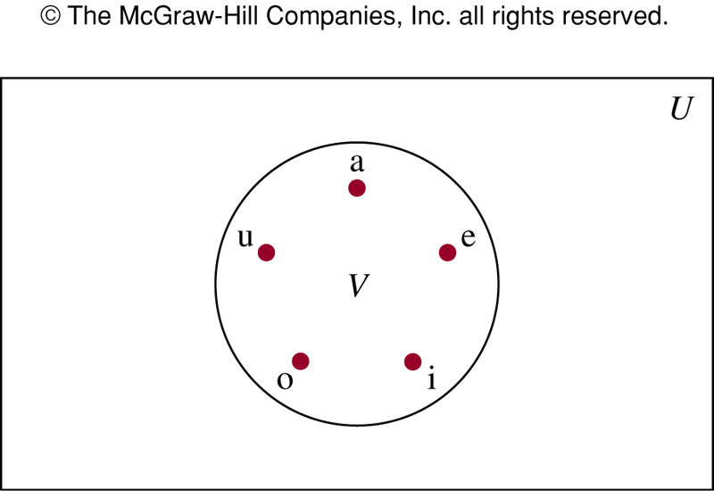
Venn Diagram
Example
  U: 26 letters of English alphabet
  V: a set of vowels in the English alphabet

Slide 22
Venn Diagram
Example
B
A
A
B
A=B
A⊂B
B⊂A
B
B
A
A
A∩B=∅
The fifth correspondent position

Slide 23
Cardinality of a finite Set
Finite sets
  Let S be a set. If there are exactly n distinct elements in S where n is a non-negative integer, then S is a finite set
    We say |S|=n, n is the cardinality (基数/阶) of S
  Examples
    Let A be the set of odd positive integers < 10, |A|=5
    Let S be the set of letters in English alphabet, |S|=26
    The null set has no elements, thus |∅|=0

Slide 24
Infinite Set and Power Set
Infinite sets
  A set is said to be infinite if it is not finite
  Example
    The set of positive integers is infinite
  The cardinality of an infinite set will be discussed in section 2.5
Power set 幂集
  Given a set S, the power set of S is the set of all subsets of the set S. The power set of S is denoted by P(S)
Example
  The power set of {0,1,2}
    P({0,1,2})={∅,{0},{1},{2},{0,1},{1,2},{0,2},{0,1,2}}
    The empty set and set itself are members of this set of subsets

Slide 25
Infinite Set and Power Set
Examples
  What is the power set of the empty set?
    ANS: P(∅)={∅}
  The set {∅} has exactly two subsets, i.e., ∅, and the set {∅}. Thus P({∅})={∅,{∅}}
  If a set has n elements, then its power set has 2^{n} elements

Slide 26
Ordered Pairs
Ordered n-tuple有序n元组
  Sets are unordered
  The ordered n-tuple (a₁, a₂, …, a_{n}) is the ordered collection that has a₁ as its first element, a₂ as its second element, and a_{n} as its n^{th} element
  (a₁, a₂, …, a_{n})= (b₁, b₂, …, b_{n}) if and only if a_{i}=b_{i} for i=1, 2,.., n
Ordered pair 序偶
  If n=2, 2-tupels are called ordered pairs, written as (a, b)
  (a, b) and (c, d) are equal if and only if a=c and b=d
  Note that (a, b) and (b, a) are not equal unless a=b

Slide 27
Cartesian Product
Cartesian product 笛卡尔乘积
  The Cartesian product of sets A and B, denoted by A×B, is the set of all ordered pairs (a, b), where a∈A and b∈B
  A×B={(a, b)|a∈A ∧ b∈B}
Example
  A: students of the university, B: all courses offered at the university
  A×B consists of all ordered pairs of (a, b), i.e., all possible enrollments of students at the university
Example
  Let A={1, 2}, B={a, b, c}
    A×B = {(1, a), (1, b), (1, c), (2, a), (2, b), (2, c)}
    B×A = {(a, 1), (a, 2), (b, 1), (b, 2), (c, 1), (c, 2)}
    A×B≠B×A

Slide 28
Cartesian Product
Relation
  A subset R of the Cartesian product A×B is called a relation
Example
  A={a, b, c} and B={0, 1, 2, 3}, R={(a, 0), (a, 1), (a,3), (b, 1), (b, 2), (c, 0), (c,3)} is a relation from A to B

Slide 29
Cartesian Product
General case of Cartesian product
  Cartesian product of A₁, A₂, …, A_{n}, denoted by A₁×A₂× … ×A_{n} , is the set of ordered n-tuples (a₁, a₂, …, a_{n}) where a_{i} belongs to A_{i} for i=1, 2, …, n
  A₁×A₂× … ×A_{n}={(a₁, a₂, …, a_{n})| a_{i}∈A_{i} for i=1, 2, …, n}
Example
  Let A={0,1}, B={1,2}, C={0,1,2}
  A×B×C={{0, 1, 0},{0, 1, 1}, {0, 1, 2}, {0, 2, 0}, {0, 2, 1}, {0, 2, 2}, {1, 1, 0}, {1, 1, 1}, {1, 1, 2}, {1, 2, 0}, {1, 2, 1}, {1, 2, 2}}

Slide 30
**Using Set Notation with Quantifiers
Example
  ∀x∈S(P(x)) denotes the universal quantification of P(x) over all elements in the set S
  It means “for all x that are elements of S, P(x) is true”
  Shorthand for ∀x(x∈S→P(x))
Example
  ∃x∈S(P(x)) denotes the existential quantification of P(x) over all elements in the set S
  It means “there is an x that is an element of S and makes P(x) true”
  Shorthand for ∃x(x∈S∧P(x))

Slide 31
**Using Set Notation with Quantifiers
Example
  What do they man?
    ∀x∈R(x²≥0)
      The square of every real number is non-negative
    ∃x∈Z(x²=1)
      There is an integer whose square is 1

Slide 32
**Truth Sets of Quantifiers
Truth set of a predicate P 谓词P的成真个体集
  Given a predicate, P, and a domain, D, the truth set of P is defined as the set of elements in D for which P(x) is true
  Denoted by {x∈D|P(x)}
  Means “those elements of domain D such that P(x) is true”

Slide 33
**Truth Sets of Quantifiers
Example
  P(x) is |x|=1, Q(x) is x²=2, and R(x) is |x|=x and the domain is the set of integers
    Truth set of P, {x∈Z||x|=1}, i.e., the truth set of P is {-1,1}
    Truth set of Q, {x∈Z|x²=2}, i.e., the truth set is ∅
    Truth set of R, {x∈Z||x|=x}, i.e., the truth set is N

Slide 34
**Truth Sets of Quantifiers
Example
  ∀xP(x) is true over the domain U if and only if the truth set of P is the set U
  ∃xP(x) is true over the domain U if and only if the truth set of P is non-empty

Slide 35
Assignment
Exercises after 2.1: No. 9, 22 (Ver.7)

