Slide 1
Chapter 2 Basic Structures
Section 3
Functions

Slide 2
Outline
Introduction
Injections, Surjections and Bijections
Inverse Functions and Compositions of Functions
The Graphs of Functions
Some Important Functions

Slide 3
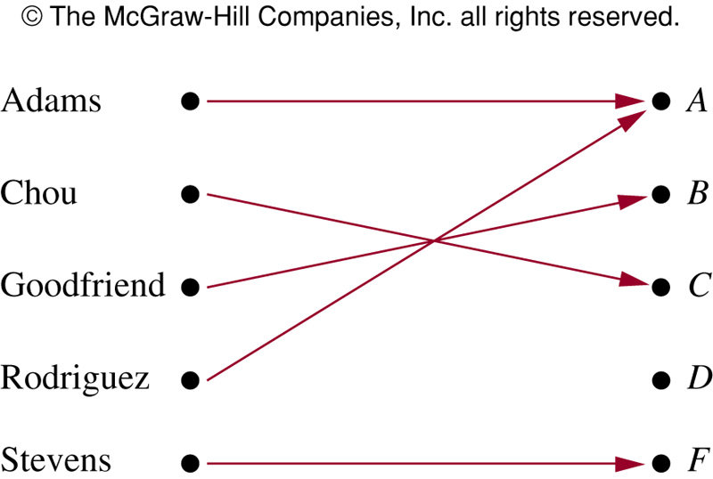
Functions
Assign each element of a set to a particular element of a second set

Slide 4
Functions
Definition
  Let A and B be two nonempty sets. A function f from A to B is an assignment of exactly one element of B to each element of A
  Write
  f: A → B
  if f is a function from A to B
  A and B are nonempty sets
  f(a) = b if b is the unique element of B assigned by the function f to the element a
  Sometimes also called mapping or transformation
  In such a definition we say function f is everywhere defined.

Slide 5
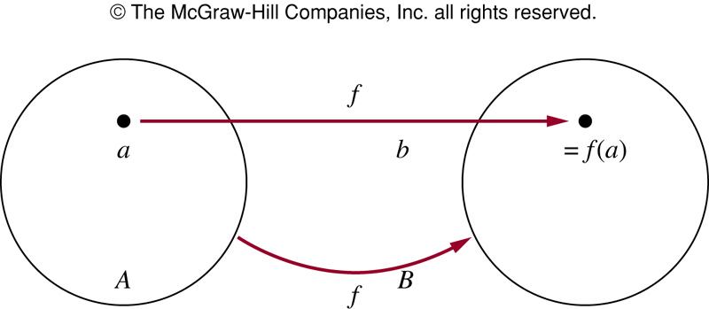
Functions
Remark (details in chapter 9)
  A function f: A→B can also be defined in terms of a relation from A to B. A relation from A to B is just a subset of AxB
  A relation from A to B that contains one, and only one, ordered pair (a, b) for every element a∈A, defines a function f from A to B
  f(a) = b where (a, b) is the unique ordered pair in the relation

Slide 6
Functions
Definition
  If f is a function from A to B
    A is the domain (定义域) of f
    B is the codomain (共域/陪域/上域) of f
    If f(a) = b, b is the image (像) of a and a is a preimage (原像) of b
    Range (值域) of f: set of all images of element of A
    We also say that f maps (映射) A to B
  Note that the range is not necessarily the same as the codomain, but a subset of it
  By some authors, a function that is not everywhere defined may have its domain been a proper subset of A.

Slide 7
Functions
Remark.
  We specify a function by
    Domain
    Codomain
    Mapping of elements of the domain to those in the codomain
  Two functions are equal if they have
    Same domain, codomain, mapping of elements

Slide 8
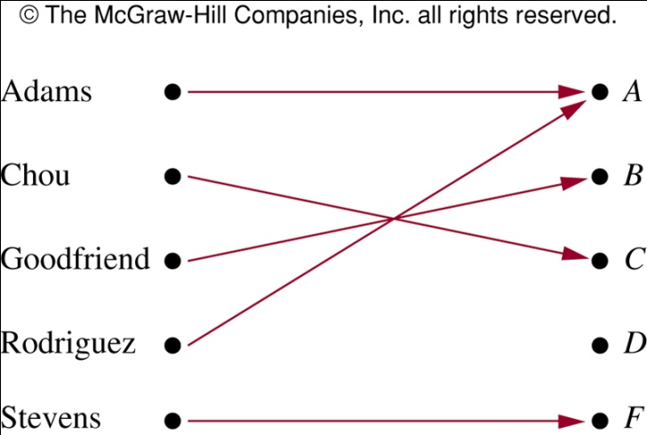
Functions
Example.
  G: function that assigns a grade to a student, G(Adams)=A
  Domain of G: {Adams, Chou, Goodfriend, Rodriguez, Stevens}
  Codomain of G: {A, B, C, D, F}
  Range of G is: {A, B, C, F}

Slide 9
Functions
Example.
  Let R be the relation consisting of (Abdul, 22), (Brenda, 24), (Carla, 21), (Desire, 22), (Eddie, 24) and (Felicia, 22). What is the function R determines?
    f: f(Abdul)=22, f(Brenda)=24, f(Carla)=21, f(Desire)=22, f(Eddie)=24, and f(Felicia)=22
    Domain: {Abdul, Brenda, Carla, Desire, Eddie, Felicia}
    Codomain: set of positive integers
    Range: {21, 22, 24}

Slide 10
Functions
Example.
  f: assigns the last two bits of a bit string of length 2 or greater to that string, e.g., f(11010)=10
    Domain: all bit strings of length 2 or greater
    Codomain: {00, 01, 10, 11}
    Range: {00, 01, 10, 11}

Slide 11
Functions
Example.
  f: Z → Z, assigns the square of an integer to this integer, f(x) = x²
    Domain: the set of all integers
    Codomain: the set of all integers
    Range: all integers that are perfect squares, i.e., {0, 1, 4, 9, …}

Slide 12
Functions
Example.
  In programming languages, a function floor is defined as
  int floor(float x){…}
    Domain: the set of real numbers
    Codomain: the set of integers

Slide 13
Functions
Addition and product of functions
  Two real-valued functions with the same domain can be added and multiplied
  Let f₁ and f₂ be functions from A to R, then f₁+f₂, and f₁f₂ are also functions from A to R defined by
    (f₁ + f₂)(x) = f₁(x) + f₂(x)
    (f₁ f₂)(x) = f₁(x) f₂(x)
  Note that the functions f₁+f₂ and f₁f₂ are defined by specifying their values at x in terms of the values of f₁ and f₂ at x
  Note that f₁(x) f₂(x) ≠ f₁(f₂(x)). The product of functions f₁f₂ is different from their composition (written as f₁◦f₂)

Slide 14
Functions
Example.
  Let f₁(x) = x² and f₂(x) = x-x²
    (f₁+f₂)(x) = f₁(x) + f₂(x) = x² + x-x² = x
    (f₁f₂)(x) = f₁(x) f₂(x) = x² (x-x²) = x³-x⁴
  Note that f₁(x) f₂(x) ≠ f₁(f₂(x))
  f₁(f₂(x)) may be meaningless because the value of f₂(x) may rest out of the domain of f₁

Slide 15
Function and subset
Definition
  Let f be a function from A to B (f: A→B), S be a subset of A, the image of a subset S of A under function f is the subset of B that consists of the images of the elements of S.
  Denote the image of S by f(S)
  f(S) = {t|∃s∈S (t = f(s)) }
  or f(S) = {f(s)|s∈S } as shorthand

Slide 16
Function and subset
Example.
  Let A = {a, b, c, d, e} and B = {1, 2, 3, 4}
    f is defined as f(a) = 2, f(b) = 1, f(c) = 4, f(d) = 1, f(e) = 1
    For S = {b, c, d} ⊆ A, f(S) = {1, 4}

Slide 17
One-to-one functions
Definition
  A function f is said to be one-to-one (一对一的) or injective (单的), if and only if f(a) = f(b) implies a = b for all a and b in the domain of f
  Write as ∀a∀b((f(a) = f(b)) → (a = b))
  In another word, a function f is one-to-on if and only if f(a) ≠ f(b) whenever a ≠ b
  If f(a) = c, then a is the unique preimage of c
  A function f is said to be an injection (单射) if it is one-to-one

Slide 18
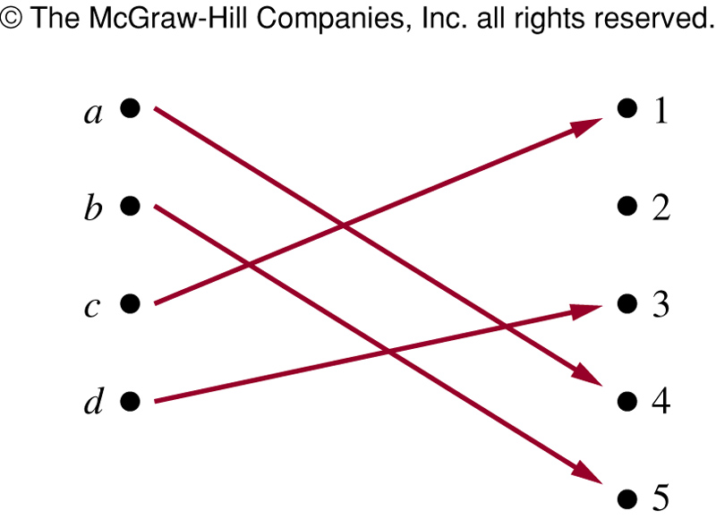
One-to-one functions
Example.
  f maps {a, b, c, d} to {1, 2, 3, 4, 5} with f(a) = 4, f(b) = 5, f(c) = 1, f(d) = 3
  Is f an one-to-one function? YES

Slide 19
One-to-one functions
Example.
  Let f(x)=x², from the set of integers to the set of integers. Is it one-to-one?
    NO
    f(1)=1, f(-1)=1, f(1)=f(-1) but 1≠-1
    However, f(x)=x² is one-to-one for Z⁺
  Determine f(x)=x+1 from real numbers to itself is one-to-one or not
    It is one-to-one. To show this, note that x+1 ≠ y+1 when x ≠ y

Slide 20
Monotonic Functions
Definition
  Monotonically increasing ( or decreasing)(单调增/减函数): if f(x) ≤ f(y), whenever x < y and x, y are in the domain of f
  Increasing ∀x∀y(x < y → f(x) ≤ f(y))
  Decreasing ∀x∀y(x < y → f(x) ≥ f(y))
Definition
  Strictly increasing (or decreasing)(严格单调增/减函数): if f(x) < f(y) whenever x < y, and x, y are in the domain of f
  A function that is either strictly increasing or decreasing must be one-to-one

Slide 21
Onto functions
Definition
  A function f from A to B is said to be onto (映上的) or surjective (满的), if and only if for every element b∈B there is an element a∈A with f(a) = b
  Write as ∀y∃x(x=y) where x is in the domain and y in the codomain
  Every element of B is the image of some element in A
  The range of f covers the codomain

Slide 22
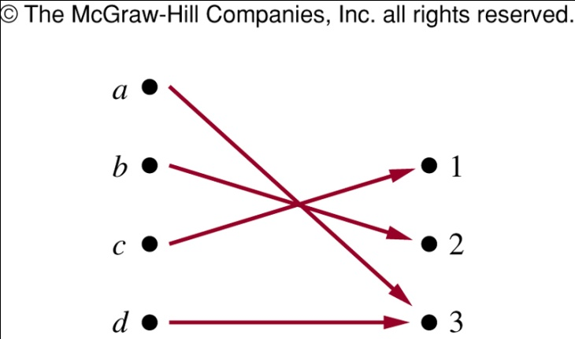
Onto functions
Example.
  f maps from {a, b, c, d} to {1, 2, 3} as shown, is f onto?
    YES

Slide 23
Onto functions
Example.
  Is f(x)=x² from the set of integers to the set of integers onto?
    NO
    Element -1 in the codomain of integers has no preimage in f
  Is f(x)=x+1 from the set of integers to the set of integers onto?
    YES
    It is onto, as for each integer y there is an integer x such that f(x)=y
    To see this, f(x)=y iff x+1=y, which holds if and only if x=y-1

Slide 24
One-to-one Correspondence
Definition
  The function f is a one-to-one correspondence (一一对应), or bijection (双射), if it is both one-to-one and onto
Example.
  Let f be the function from {a, b, c, d} to {1, 2, 3, 4} with f(a) = 4, f(b) = 2, f(c) = 1, and f(d) = 3, is f bijective?
    It is one-to-one as no two values in the domain are assigned the same function value
    It is onto as all four elements of the codomain are images of elements in the domain

Slide 25
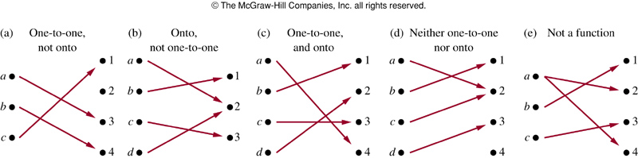
One-to-one Correspondence
Example
  (a) One-to-one, not onto
  (b) Onto, not one-to-one
  (c) One-to-one,and onto
  (d) Neither one-to-one, nor onto
  (e) Not a function

Slide 26
One-to-one Correspondence
Example.
  The Identity function (恒等函数) on a set A is the function
  ι_{A}: A→A, ι_{A}(x) = x for all x∈A
    It is one-to-one and onto, bijective

Slide 27
Inverse Functions
Remark
  Consider a one-to-one correspondence f from A to B
    Since f is onto, every element of B is the image of some element in A
    Since f is also one-to-one, every element of B is the image of a unique element of A
  Thus, we can define a new function from B to A that reverses the correspondence given by f

Slide 28
Inverse Functions
Definition
  Let f be a one-to-one correspondence from the set A to the set B. The inverse function (逆函数) of f is the function that assigns an element b belonging to B the unique element a in A such that f(a) = b
  Denoted by f⁻¹, hence f⁻¹(b) = a when f(a) = b
  Note f⁻¹ is not the same as 1/f

Slide 29
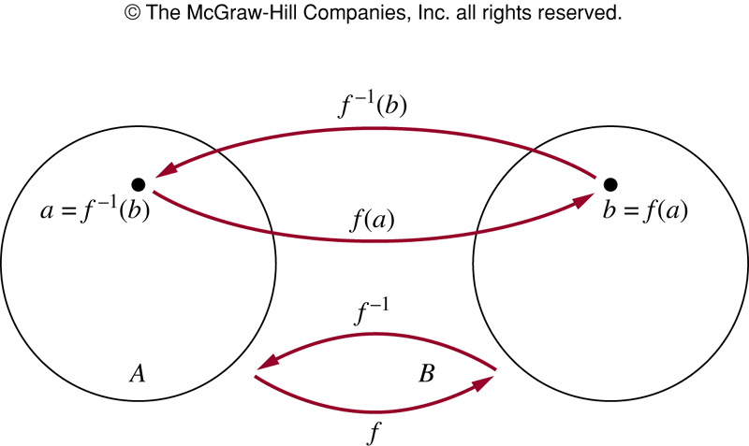
Inverse Functions

Slide 30
Inverse Functions
Remark.
  We cannot define an inverse of function f, If f is not one-to-one correspondence
  A one-to-one correspondence is invertible

Slide 31
Inverse Functions
Example.
  f is a function from {a, b, c} to {1, 2, 3} with f(a) = 2, f(b) = 3, f(c) = 1. Is it invertible? What is it its inverse?
  Let f: Z→Z such that f(x) = x+1, Is f invertible? If so, what is its inverse?
    y = x+1, x = y-1, f⁻¹(y) = y-1
  Let f: R→R with f(x) = x², Is it invertible?
    Since f(2) = f(-2) = 4, f is not one-to-one, and so not invertible

Slide 32
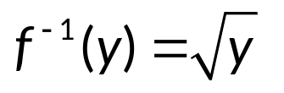
Inverse Functions
Example.
  Sometimes we restrict the domain or the codomain of a function or both, to have an invertible function
  The function f(x) = x², from R⁺ to R⁺ is
    one-to-one : If f(x) = f(y), then x² = y², then x+y = 0 or x-y = 0, so x = -y or x = y
    onto: y = x², every non-negative real number has a square root
    inverse function:

Slide 33
Composition of functions
Definition
  Let g be a function from A to B and f be a function from B to C, the composition (复合) of the functions f and g, denoted by f◦g, is defined by (f◦g)(a) = f(g(a))
  First apply g to a to obtain g(a)
  Then apply f to g(a) to obtain (f◦g)(a) = f(g(a))

Slide 34
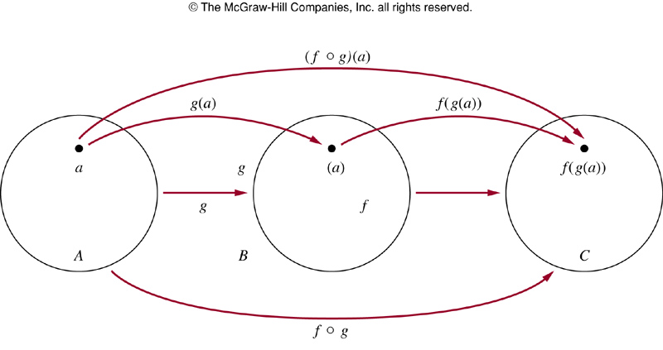
Composition of functions
Remark
  Note that f◦g cannot be defined unless the range of g is a subset of the domain of f

Slide 35
Composition of functions
Example.
  g: {a, b, c} → {a, b, c}, g(a) = b, g(b) = c, g(c) = a, and f: {a, b, c} → {1, 2, 3}, f(a) = 3, f(b) = 2, f(c) = 1. What are f◦g and g◦f?
    (f◦g)(a) = f(g(a)) = f(b) = 2,
    (f◦g)(b) = f(g(b)) = f(c) =1,
    (f◦g)(c) = f(a) = 3
    (g◦f)(a) = g(f(a)) = g(3) not defined. g◦f is not defined

Slide 36
Composition of functions
Example.
  f(x) = 2x+3, g(x) = 3x+2. What are f◦g and g◦f?
    (f◦g)(x) = f(g(x)) = f(3x+2) = 2(3x+2)+3 = 6x+7
    (g◦f)(x) = g(f(x)) = g(2x+3) = 3(2x+3)+2 = 6x+11
  Note that f◦g and g◦f are defined in this example, but they are not equal
  The commutative law does not hold for composition of functions

Slide 37
Composition of functions
Remark
  f and f ⁻¹ form an identity function in any order
  Let f: A →B with f(a) = b, and supposed to be one-to-one correspondence
  Then f⁻¹ is one-to-one correspondence from B to A
  The inverse function reverse the correspondence of f, so
  f⁻¹ (b) = a when f(a) = b, and f(a) = b when f⁻¹(b) = a
  (f⁻¹◦f)(a) = f⁻¹(f(a)) = f⁻¹(b) = a, and
  (f◦f⁻¹)(b) = f(f⁻¹)(b)) = f(a) = b
  f⁻¹◦f = ι_{A}, f◦f⁻¹ = ι_{B}. ι_{A}, ι_{B} are identity functions for A and B
  (f⁻¹)⁻¹ = f

Slide 38
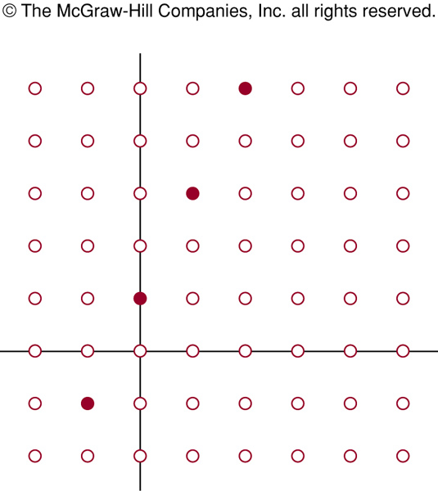
Graphs of Functions
Example.
  f(x)=2x+1

Slide 39
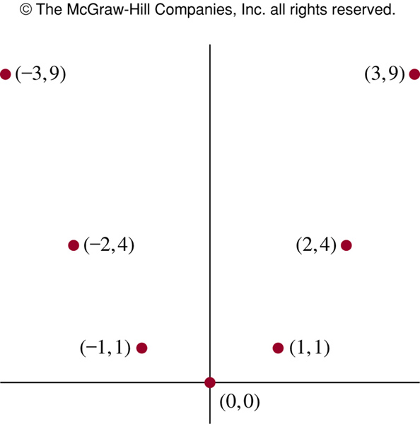
Graphs of Functions
Example.
  f(x)=x²

Slide 40
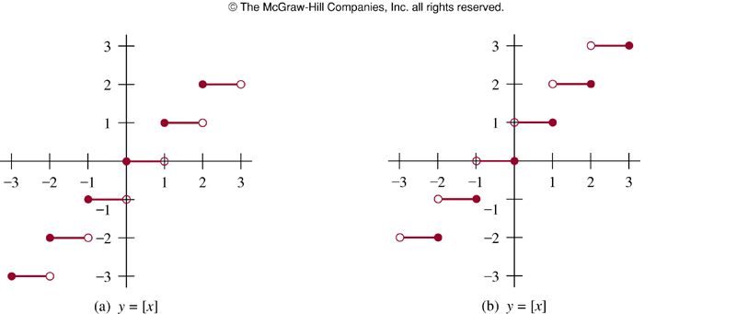
Graphs of Functions
Example.
  floor f(x) = ⎣x⎦ and ceiling f(x) = ⎡x⎤

Slide 41
The characteristic function
The characteristic function 特征函数
  The characteristic function f_{A} of A is defined for each x∈U as follows:
1 x∈A
0 x∉A
f_{A}(x) =
Theorem.
  Characteristic function of subsets satisfy the following properties:
    f_{A∩B} = f_{A}f_{B}, f_{A∩B}(x) = f_{A}(x)f_{B}(x) for all x.
    f_{A∪B} = f_{A} + f_{B} - f_{A}f_{B}, f_{A∪B}(x) = f_{A}(x)+f_{B}(x)-f_{A}(x)f_{B}(x) for all x.
    f_{A⊕B} = f_{A} + f_{B} - 2f_{A}f_{B}, f_{A⊕B}(x) = f_{A}(x)+f_{B}(x)-2f_{A}(x)f_{B}(x) for all x.

Slide 42
The characteristic function
  Proof: (c) f_{A⊕B} = f_{A} + f_{B} - 2f_{A}f_{B}, f_{A⊕B}(x) = f_{A}(x)+f_{B}(x)-2f_{A}(x)f_{B}(x) for all x
  For any x∈U:
    Case 1: x∈A∧x∈B
      Then x∉A⊕B, f_{A⊕B}(x)=0, and f_{A}(x)=1, f_{B}(x)=1
      f_{A}(x)+f_{B}(x)-2f_{A}(x)f_{B}(x) =1+1-2⋅1⋅1=0
    Case 2: x∈A∧x∉B
      Then x∈A⊕B, f_{A⊕B}(x) =1, and f_{A}(x)=1, f_{B}(x)=0
      f_{A}(x)+f_{B}(x)-2f_{A}(x)f_{B}(x) =1+0-2⋅1⋅0=1
    Case 3: x∉A∧x∈B (in the same way as case 2)
    Case 1: x∉A∧x∉B
      Then x∉A⊕B, f_{A⊕B}(x)=0, and f_{A}(x)=0, f_{B}(x)=0
      f_{A}(x)+f_{B}(x)-2f_{A}(x)f_{B}(x) =0+0-2⋅0⋅0=0
  In all the above cases, we have f_{A⊕B}(x) = f_{A}(x)+f_{B}(x)-2f_{A}(x)f_{B}(x)

Slide 43
The characteristic function
Recall
  Computer Representation of Sets in section 2.2

Slide 44
Assignment
Exercises after 2.3: No.12, 14, 22, 40 (Ver.7)

