Slide 1
Chapter 2 Basic Structures
Section 5
Cardinality基数

Slide 2
Outline
Cardinality
Countable Sets
Computability

Slide 3
Cardinality
Definition
  The cardinality of a set A is equal to the cardinality of a set B, denoted |A|=|B|, if and only if there is a one-to-one correspondence (i.e., a bijection) from A to B.
  If there is a one-to-one function (i.e., an injection) from A to B, the cardinality of A is less than or the same as the cardinality of B and we write |A|≤|B|.
  When |A|≤|B| and A and B have different cardinality, we say that the cardinality of A is less than the cardinality of B and write |A|<|B|.

Slide 4
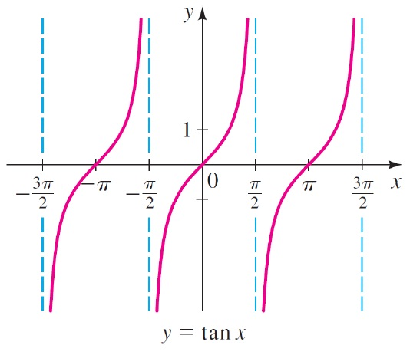
Cardinality
Theorem
  The interval (0, 1) has the same cardinality as R (the set of real numbers).
  Proof:
  The function f(x) = (x - ½)π establishes that
  |(0, 1)| = |(–π/2, π/2)|.
  The function g(x) = tan(x) gives
  that
  |(–π/2, π/2)| = |R|.
  Therefore, |(0, 1)| = |R|.

Slide 5
Countable
Definition
  A set that is either finite or has the same cardinality as the set of positive integers (Z⁺) is said to be countable. A set that is not countable is uncountable.
    Example: The set of real numbers R is an uncountable set.
  When an infinite set S is countable (countably infinite) we denote the cardinality of S by the symbol ℵ₀ (where ℵ is aleph [‘a:lif], the 1st letter of the Hebrew alphabet). That is, |S|=ℵ₀, and say that S has cardinality “aleph null”.
  We denote the cardinality of any uncountable set by the symbol ℵ₁, pronounced “aleph one”

Slide 6
Countable
Remark
  An infinite set is countable if and only if it is possible to list the elements of the set in a sequence (indexed by the positive integers).
  The reason for this is that a one-to-one correspondence f from the set of positive integers to a set S can be expressed in terms of a sequence a₁, a₂, …, a_{n} ,… where a₁ = f(1), a₂ = f(2), …, a_{n} = f(n), …
  For instance, the set of odd integers, a_{n}=2n-1

Slide 7
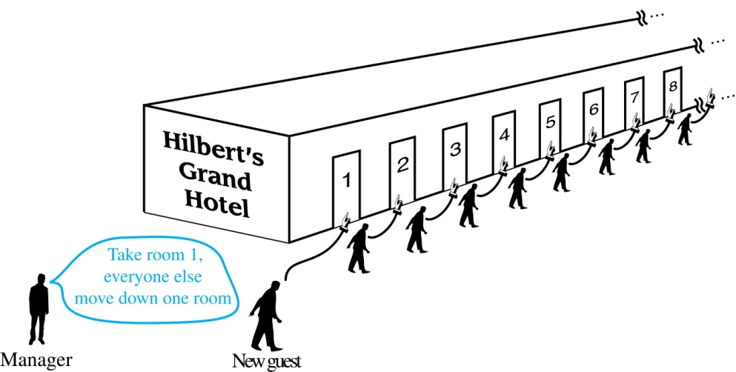
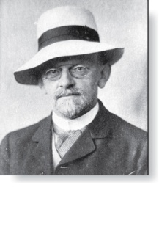
Countable
Hilbert’s Grand Hotel
  The Grand Hotel (example due to David Hilbert) has countably infinite number of rooms, each occupied by a guest. We can always accommodate a new guest at this hotel. How is this possible?
David Hilbert

Slide 8
Countable
Hilbert’s Grand Hotel
  Explanation:
  Because the rooms of Grand Hotel are countable, we can list them as Room 1, Room 2, Room 3, and so on.
  When a new guest arrives, we move the guest in Room 1 to Room 2, the guest in Room 2 to Room 3, and in general the guest in Room n to Room n+1, for all positive integers n.
  This frees up Room 1, which we assign to the new guest, and all the current guests still have rooms.

Slide 9
Showing that a Set is Countable
Example
  The set of all integers is countable
  Solution:
  This means that there is a one-to-one correspondence between the set of all integers and the set of positive integers
  We can list all integers in a sequence by 0, 1, -1, 2, -2, … ,or f(n)=n/2 when n is even and f(n)=-(n-1)/2 when n is odd (n=1, 2, 3, …)
  The one-to-one correspondence as follows:
… 11 9 7 5 3 1 2 4 6 8 10…
… -5 -4 -3 -2 -1 0 1 2 3 4 5 …

Slide 10
Showing that a Set is Countable
Example
  The set of odd positive integers is countable
  Solution:
  Form a f(n)=2n-1 from Z⁺ to the set of odd positive integers
  One-to-one: suppose that f(n)=f(m) then 2n-1=2m-1, so n=m
  Onto: suppose t is an odd positive integer, then t is 1 less than an even integer 2k where k is a natural number. Hence t=2k-1=f(k)

Slide 11
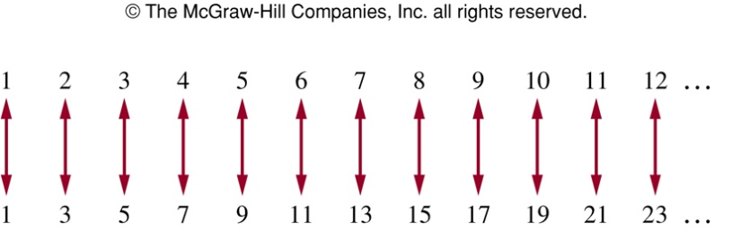
Showing that a Set is Countable
Example
  A one-to-one correspondence between the set of positive integers and the set of odd positive integers

Slide 12
Showing that a Set is Countable
Example
  The set of positive rational numbers is countable
  Solution:
  Every positive rational number is p/q
  First consider p+q=2, then p+q=3, p+q=4, …
  The sequence as 1, ½, 2/1,3/1,1/3,¼, 2/3, 3/2,4/1, 5/1,…
  Because all positive rational numbers are listed once, the set is countable

Slide 13
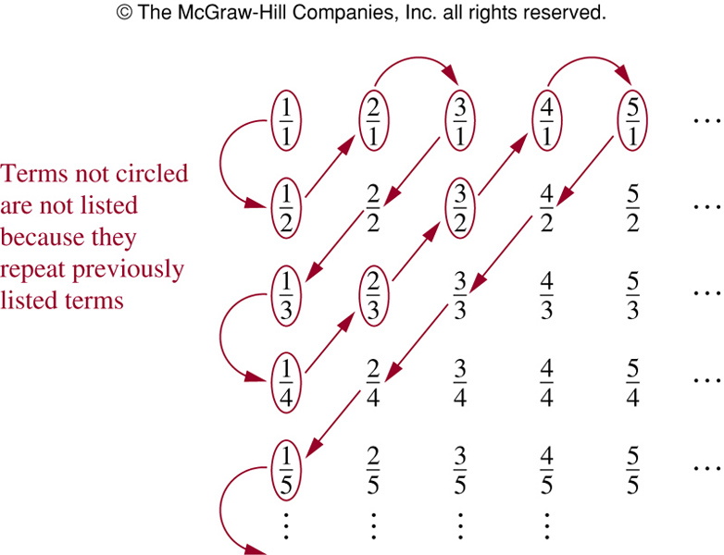
Showing that a Set is Countable
  Further more, we set up the positive rational numbers in a 2-D matrix in which the numerators increase as we move to the right in a row, and the denominators increase as we go down a column.
  We count them by moving along the diagonals of the matrix, skipping any rational numbers that we have already counted previously

Slide 14
Showing that a Set is Countable
  list all positive rational numbers in a sequence

Slide 15
Showing that a Set is Countable
Example
  The set of finite strings S over a finite alphabet A is countably infinite. Assume an alphabetical ordering of symbols in A.
  Solution:
  Show that the strings can be listed in a sequence.
    First list All the strings of length 0 in alphabetical order.
    Then all the strings of length 1 in lexicographic order (as in a dictionary) .
    Then all the strings of length 2 in lexicographic order.
    And so on.
  This implies a bijection from N to S and hence it is a countably infinite set.

Slide 16
Showing that a Set is Countable
Theorem
  The set of all possible computer programs is countable
  Solution:
  Any given computer program can be represented in binary form, as a finite sequence of 0’s and 1’s
  Any finite sequence of 0’s and 1’s can be interpreted as an integer
  The set of integers is countable
  Therefore, the set of all possible computer programs is countable

Slide 17
Showing that a Set is Countable
Remark
  Once compiled, a computer program is a finite string of 0s and 1s.
  The set of all computer programs is a subset of the set of all finite binary strings.
  This set may be listed
  ε,
  0, 1,
  00, 01, 10, 11,
  000, 001, 010, …, 111,
  0000, 0001, 0010, 0011, …, 1111, …
  Therefore, it is countable.
  As a subset of this set, the set of computer programs is countable.

Slide 18
Cantor diagonalization proof
Example
  The set of real numbers is uncountable
  Goerg Cantor showed that we cannot count the set of real numbers, using the Cantor diagonalization proof (康托对角线证明法)
  Basically, this proof assumes that we can, and that this implies that we can put all the real numbers into a sequence, in which we can specify for any real number x what the “next” real number y is
  However, for any two real numbers, no matter how close they are, we can always find another real number between them. Thus, we have a contradiction

Slide 19
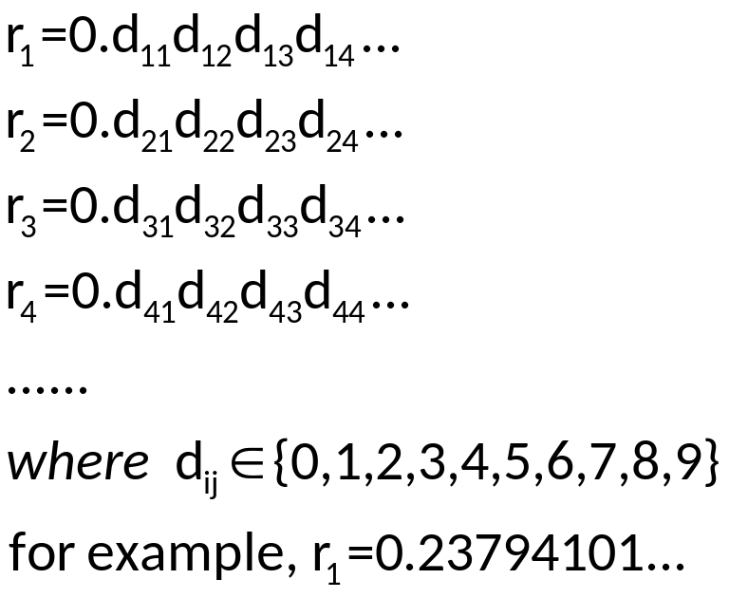
Cantor diagonalization proof
  Assume that the set is countable, then the subset of all real numbers that fall between 0 and 1 would be countable (as any subset of a countable set is also countable)
  The real numbers can then be listed in some order, say, r₁, r₂, r₃, …
  Suppose that

Slide 20
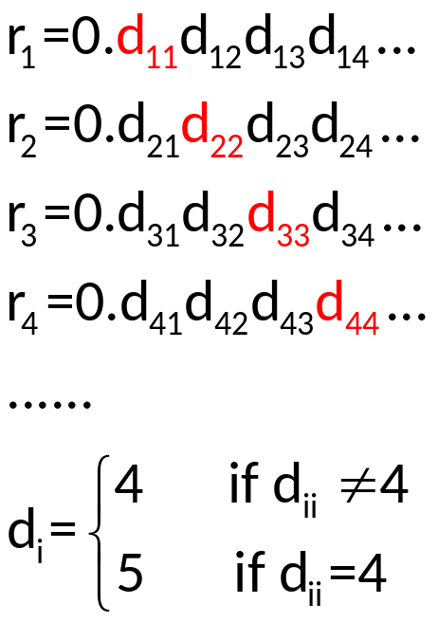
Cantor diagonalization proof
  Now form a new real number r=0.d₁d₂d₃d₄… with

Slide 21
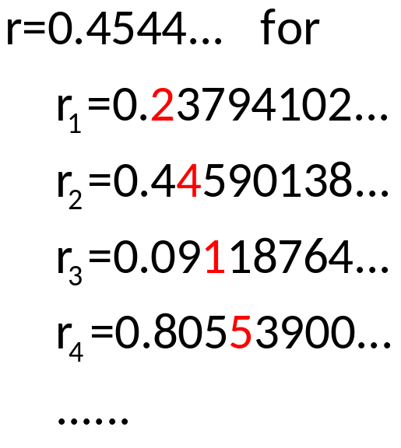
Cantor diagonalization proof
  For example

Slide 22
Cantor diagonalization proof
  Every real number has a unique decimal expansion
  The real number r is not equal to r₁, r₂, … as its decimal expansion of r_{i} in the i-th place
  So there is a real number between 0 and 1 that is not in the list
  So the assumption that all real numbers between 0 and 1 can be listed must be false
  So all the real numbers between 0 and 1 cannot be listed
  The set of real numbers between 0 and 1 is uncountable

Slide 23
Examples
Theorem
  The set of functions f : Z⁺ → Z⁺ is uncountable
  Proof:
  Suppose there are only countably many. List them
  f₁, f₂, f₃, …
  Define a function f : Z⁺ → Z⁺ as follows.
    f(i) = 0 if f_{i}(i) ≠ 0.
    f(i) = 1 if f_{i}(i) = 0.
  Then f(i) ≠ f_{i}(i) for all i in Z⁺. Therefore, f is not in the list.
  This is a contradiction. Therefore, the set is uncountable.
Corollary
  There exists a function f : Z⁺ → Z⁺ which cannot be computed by any computer program.
  (Remember the set of computer programs is countable)

Slide 24
Examples
Example
  The set of all functions is uncountable
  Solution:
  Let us assume that each different function returns a different subset of R, the set of real numbers
  There are 2^{|R|} different subsets of R. Since R is uncountable, 2^{|R|} is certainly also uncountable
  So the set of all functions is uncountable
Remark
  So there are fewer computer programs than there are functions that we might want to compute

Slide 25
Examples
Example
  There are uncountably many subsets of N.
  However, there are countably many finite subsets of N.
    Can you prove it?

Slide 26
Examples
Theorem
  For any set A, the cardinality of A is less than that of the power set of A. i.e.,
  |A| < |℘(A)|.
  Proof:
  There is a one-to-one function f : A → ℘(A) defined by
  f(x) = {x}.
  Therefore, |A| ≤ |℘(A)|.
  We must prove that there does not exist a one-to-one correspondence from A to ℘(A).
  Now we prove that there does not exist any onto function from A to ℘(A) by contradiction.

Slide 27
Examples
  Proof: (continued)
  Assume that g is an onto function from A to ℘(A)
  g : A → ℘(A).
  For every x∈A, g(x)∈℘(A) is a subset of A. Thus either x∈g(x) or x∉g(x).
  Define a set B = {x|x∈A∧x∉g(x)}.
  Then B∈℘(A), since B is a subset of A.
  So B = g(a) for some a∈A (since g is onto, by assumption).

Slide 28
Examples
  Proof: (continued)
  Is a∈g(a)?
    Case 1: Suppose a∈g(a).
      Then a∉B, by the definition of B.
      But B = g(a), so a∉g(a), a contradiction.
    Case 2: Suppose a∉g(a).
      Then a∈B, by the definition of B.
      But B = g(a), so a∈g(a), a contradiction.
  Either way, we have a contradiction.
  Therefore, no such onto function exists.
  Thus, |A|<|℘(A)|.

Slide 29
Hierarchy of Cardinalities
Hierarchy of Cardinalities
  Beginning with Z⁺, consider the sets
  Z ⁺, ℘(Z⁺), ℘(℘(Z⁺)), …
  Each set has a cardinality strictly greater than its predecessor.
  |Z⁺|<|℘(Z⁺)|<|℘(℘(Z⁺))| < …
  These cardinalities are denoted ℵ₀,ℵ₁,ℵ₂, …(aleph-naught, aleph-one, aleph-two, …)

Slide 30
Assignment
Exercises after 2.4: No.42 (Ver.6)
Exercises after 2.5: No.28 (Ver.7)

