Slide 1
Discrete Mathematical
Structures
离散数学结构
Bernard Kolman
Robert C. Busby
Sharon Cutler Ross
《离散数学》教学组

Slide 2
Chapter 8 Topics in Graph Theory
中山大学软件学院
Graphs
Euler Paths and Circuits
Hamiltonian Paths and Circuits
Transport Networks
Matching Problems
Coloring Graphs

Slide 3
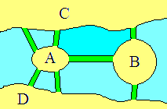
History and applications
1. Könisberge 七桥问题
[问题] 能否从某一块陆地出发，走遍每一座桥，且每一座桥只能走一次，最后回到出发点。

Slide 4
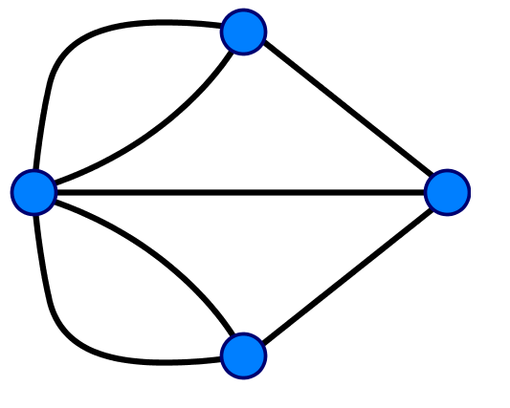
The Königsberg Bridges graph

Slide 5
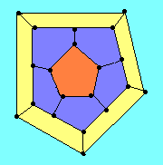
3. Hamilton 回路
1859年，Hamilton的周游世界游戏：由12个正五边形构成一个12面体，上面有20个顶点。
[问题] 能否从某一顶点出发，走遍每一个顶点一次且仅仅一次，最后回到出发点。

Slide 6
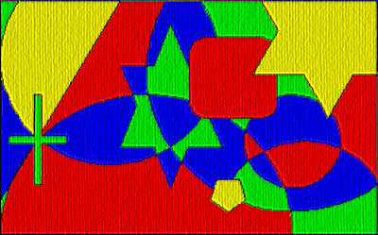
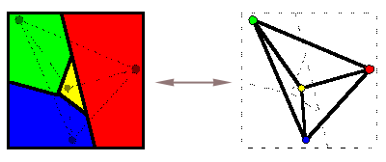
2. 四色猜想(Four Color Conjecture)
在任何平面或球面上的地图，只用四种颜色涂色，就可使得相邻区域涂上不同颜色。
1976年，Appel, Haken 和 Koch 利用计算机辅助证明了四色猜想。

Slide 7
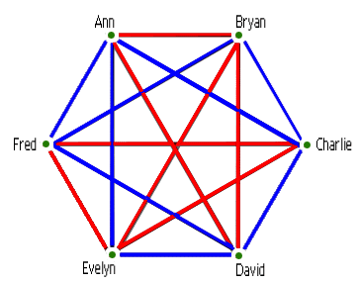
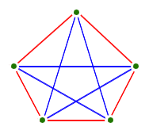
4. Ramsey 问题
任何六个人中，或有三个人互相认识，或有三个人互不认识，二者必居其一。
更一般性的问题：若一群人中或有m个人互相认识，或有n个人互不认识，则这群人最少得有多少人？记为Ramsey(m,n)
[例] Ramsey(3,3)=6

Slide 8
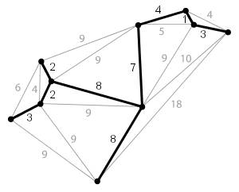
5. 最小生成树问题
如何设计通信线路使得所有电话能够通信，并且造价最低？

Slide 9
8.1 Graphs
中山大学软件学院
p
A
q
B
r
s
E
C
t
u
D
A graph G contains of
a finite set V of objects called vertices(结点),
a finite set E of objects called edges（边）, and
a function γ that assigns to each edge a subset {v, w}, where v and w are vertices (and may be the same). Edge e between v and w is denoted by γ(e)={v,w}, vertices v and w are called the end points of e.
we will write G=(V, E, γ).

Slide 10
8.1 Graphs
中山大学软件学院
e₁
Ex. V={1,2,3,4}, E={e₁, e₂, e₃, e₄, e₅}
γ: γ(e₁) = γ(e₅) = {1,2},
γ(e₂) = {4,3},
γ(e₃) = {1,3},
γ(e₄) = {2,4}.
A number of different pictures may represent the same graph.
Ex. Other pictorial representations of the above graph.
1
e₅
2
e₃
e₄
e₂
4
3
1
2
1
2
3
4
3
4

Slide 11
8.1 Graphs
中山大学软件学院
p
The degree （度数）of a vertex is the number of edges having that vertex as an end point.
A loop （环）is an edge from a vertex to itself. A loop contributes 2 to the degree of a vertex.
Ex.
deg(A)=2, deg(B)=4, deg(D)=3
deg(a)=4, deg(b)=2, deg(e)=0
deg(*)=2
A
q
B
r
s
E
C
t
u
D
a
b
c
2
5
3
4
d
e
1
6

Slide 12
8.1 Graphs
中山大学软件学院
An isolated vertex（孤立点）: a vertex with degree 0;
Adjacent vertices（邻接点）: a pair of vertices that determine an edge.
Ex.
Isolated vertex: e.
Adjacent vertices: a and b, a and d are not.
a
b
c
d
e

Slide 13
8.1 Graphs
中山大学软件学院
A path（路径） π in a graph G contains of a pair (V_{π}, E_{π}) of sequence:
a vertex sequence V_{π}: v₁, v₂, … , v_{k} and an edge sequence E_{π}: e₁, e₂, … , e_{k} for which
1). Each successive pair of v_{i}, v_{i+1} of vertices is adjacent in G, and edge e_{i} has v_{i} and v_{i+1} as end points for i=1..k-1;
2). No edge occurs more than once in the edge sequence.
A circuit （回路）is a path that begins and ends at the same vertex.
A path π is called simple if no vertex appears more than once in the vertex sequence, except possibility if v₁=v_{k}.
the circuit is called a simple circuit if it is simple.

Slide 14
8.1 Graphs
中山大学软件学院
Remark
The vertices alone would not be sufficient to define a path, the edges alone would not be enough to define a path in multigraph.
A path is defined by V_{π1}: A, B, E, D, D and E_{π1}: p, r, t, u.
Another path is defined by V_{π2}: A, B, A and E_{π2}: p, q.
If vertex sequence is only given, for π₁,
which edge to travel from A to B, p or q?
For π₂, which edge to use first p or q?
If edge sequence is only given for π₂: p, q,
which vertex to start with, A or B?
p
A
q
B
r
s
E
C
t
u
D

Slide 15
8.1 Graphs
中山大学软件学院
Remark
If vertices in a path have only one edge between each adjacent pair, then the edge sequence is completely determined by the vertex sequence.
In this case, a path can be specified by the vertex sequence alone, it is not necessary to label the edges.
π₃: 1, 3, 4, 2.
1
2
3
4

Slide 16
8.1 Graphs
中山大学软件学院
Ex.
π₁: V_{π1}(A, B, E, D, D) and E_{π1}( p, r, t, u).
not simple – D twice
π₂: V_{π2}(A, B, A) and E_{π2}( p, q).
simple circuit – A twice at the beginning and at the end
π₄: (D, E, B, C) no mention of edges
a simple path.
p
A
q
B
r
s
E
C
t
u
D

Slide 17
8.1 Graphs
中山大学软件学院
Ex.
π₅: (a, b, c, a) is a simple circuit.
π₆: (d, c, a, a) is not a simple path.
π₇: (c, a, b, c, d) is not a simple path.
(1, 2, 3, 2) does not specify a path since the single edge between 2 and 3 is traveled twice.
a
b
2
5
3
4
c
1
6
d
e

Slide 18
8.1 Graphs
中山大学软件学院
A graph is called connected （连通的）if there is a path from any vertex to any other vertex in the graph. Otherwise, the graph is disconnected.
If the graph is disconnected, the various connected pieces are called the component（连通块） of the graph.
p
a
b
1
2
A
q
B
2
5
r
s
3
4
c
E
4
3
C
t
1
6
u
d
e
D
disconnected
two components
connected

Slide 19
8.1 Graphs
中山大学软件学院
U_{n} / discrete graph on n≥1 vertices: a graph with n vertices and no edges.
K_{n} / complete graph on n≥1 vertices: a graph with vertices {v₁, v₂ , … , v_{n}} and with an edge for every i and j.
A graph is called regular (正则的) if each vertex has the same degree as the other vertex.
The graph U_{n} and K_{n} are also regular.
U₂
U₅
K₃
K₄
K₅

Slide 20
8.1 Graphs
中山大学软件学院
L_{n} / linear graph on n≥1 vertices: a graph with vertices {v₁, v₂, ... , v_{n}} and with edges {v_{i}, v_{i+1}} for 1≤i≤n.
Ex.
K_{n} and L_{n} are connected.
U_{n} (n≥1) are disconnected with exactly n components.
L₂
L₄

Slide 21
8.1 Graphs
中山大学软件学院
Subgraphs and Quotient Graphs
In a graph G=(V, E, γ), E₁⊆E and V₁⊆V, so that V₁ contains (at least) all the end points of edges in E₁.
H=(V₁, E₁, γ₁) is also a graph where γ₁ is γ restricted to edges in E₁. Such a graph H is called a subgraph of G.
Ex.
a
b
b
i
f
i
f
i
f
h
g
h
g
h
g
d
c
d
c
d
c

Slide 22
8.1 Graphs
中山大学软件学院
Subgraphs and Quotient Graphs
Important subgraphs by deleting one edge and no vertices.
If G=(V, E, γ) is a graph and e∈E, then we denote G_{e} the subgraph obtained by omitting the edge e from E and keeping all vertices.
a
b
a
b
i
f
i
f
h
g
h
g
d
c
d
c

Slide 23
8.1 Graphs
中山大学软件学院
Subgraphs and Quotient Graphs
Important subgraphs by merging all the vertices in each equivalence class into a single vertex.
Suppose that G=(V, E, γ) is such a graph that R is an equivalence relation on the set V.
We construct the quotient graph G^{R} in such a way:
vertices: the equivalence classes of V produced by R;
edges : if [v] and [w] are the equivalence classes of V, then there is an edge in G^{R} from [v] to [w] iff some vertex in [v] is connected to some vertex in [w] in the graph G.

Slide 24
8.1 Graphs
中山大学软件学院
Subgraphs and Quotient Graphs
We get G^{R} by merging all the vertices in each class into a single vertex and combining any edges superimposed by such a process.
Ex. Equivalence relation R on V defined by the partition {{a,m,i}, {b,f,j}, {c,g,k}, {d,h,l}}
a
b
[a]
[b]
m
f
j
i
l
k
h
g
[d]
[c]
d
c

Slide 25
8.1 Graphs
中山大学软件学院
Subgraphs and Quotient Graphs
Ex. Equivalence relation R on V defined by the partition {{a,m}, {i,j,k,l}, {f,b,c}, {d}, {g}, {h}}
[a]
[b]
a
b
m
f
[i]
j
i
l
k
h
g
[h]
[g]
[d]
d
c

Slide 26
8.1 Graphs
中山大学软件学院
Subgraphs and Quotient Graphs
Important subgraphs by merging two adjacent vertices and leaving anything else alone.
If e is an edge between vertex v and vertex w in G=(V, E, γ), then we consider the equivalence relation whose partition consists of {v,w} and {v_{i}} for each v_{i}≠v and v_{i}≠w.
The resulting quotient graph is denoted G^{e}.
a
b
a
b
m
f
m
f
j
j
i
i
[i]
k
e={i,j}
k
G^{e}
l
l
h
g
h
g
d
c
d
c

Slide 27
8.1 Graphs
中山大学软件学院
Two categories of problem in graph theory:
To travel a path using each edge of the graph exactly once ⇒ Euler Paths and Circuits.
To visit each vertex exactly once, except the beginning one ⇒ Hamiltonian Paths and Circuits.

Slide 28
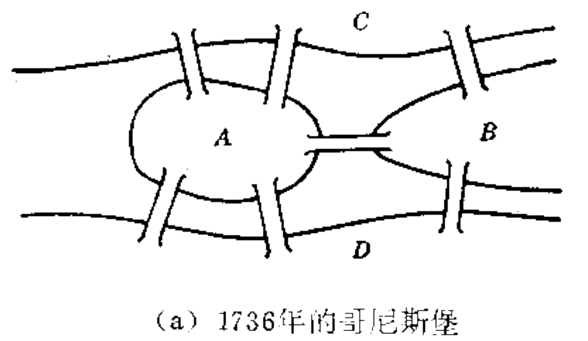
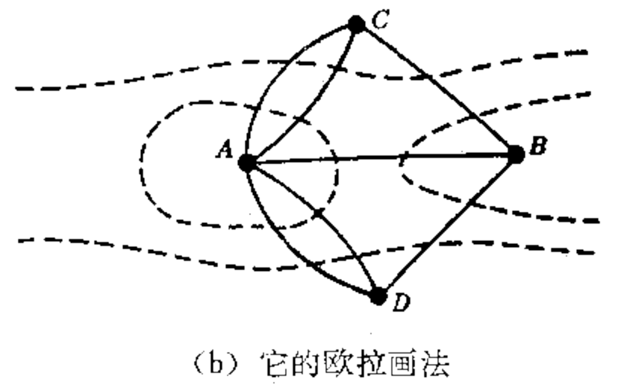
8.2 Euler Paths and Circuits
中山大学软件学院
(a). 1736年的哥尼斯堡
(b). 哥尼斯堡的欧拉画法
A path in a graph G is called an Euler path if it includes every edge exactly once.
An Euler circuit is an Euler path that is a circuit.

Slide 29
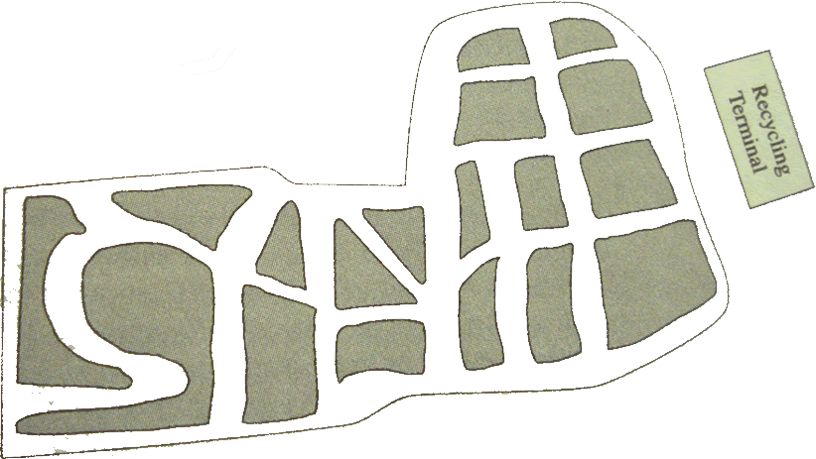
8.2 Euler Paths and Circuits
中山大学软件学院
Ex. Truck rout for the street map

Slide 30
8.2 Euler Paths and Circuits
中山大学软件学院
Ex. Find an Euler path for each of the following graphs
E
2
4
D
3
B
C
1
5
A
An Euler path:
E, D, B, A, C, D.
An Euler path:
5, 3, 2, 1, 3, 4, 5.

Slide 31
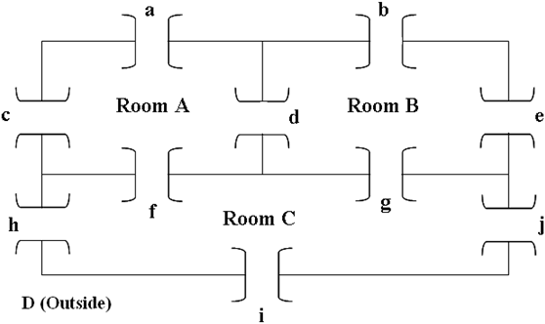
8.2 Euler Paths and Circuits
中山大学软件学院
Ex. Is it possible to begin in a room or the outside and take a walk that goes through each door exactly once?
d
A
B
a
b
c
D
e
f
g
h
i
j
C
Euler path?

Slide 32
8.2 Euler Paths and Circuits
中山大学软件学院
Questions for Euler paths or Euler circuits:
1) Existence? 2) Ways to find?
A discussion for a graph with a vertex
E of degree 1:
1) there cannot be an Euler circuit;
2) there might be an Euler path.
if so, the path must begin or end at this vertex E.
A similar discussion for a graph with a vertex v of odd degree 2n+1: travel in and out v n times respectively and leave or arrive (but not simultaneously) v for the last time.
E
D
B
C
A

Slide 33
8.2 Euler Paths and Circuits
中山大学软件学院
Theorem 1 (a) If a graph G has a vertex of odd degree, there can be no Euler circuit in G.
(b) If G is a connected graph and every vertex has even degree, then there is an Euler circuit in G.
Proof:
Suppose that there are connected graphs where every vertex has even degree, but there is no Euler circuit.
Choose such a G with the smallest number of edges.
G must have more than one vertex, otherwise, there is clearly an Euler circuit (a cycle).
We can show that “G must have at least one circuit” …

Slide 34
8.2 Euler Paths and Circuits
中山大学软件学院
Proof:
…
If v is a fixed vertex of G, (“connected” and “more than one vertex”) there must be an edge between v and v₁, it is a simple path.
By the existence of simple path, let π₀ be the longest one: v₁, v₂,
…, v_{s}.
v_{s} has even degree, and π₀ uses only one edge that has v_{s} as a vertex, there must be an edge e not in π₀ that also has v_{s} as a vertex;
if the other vertex of e is not one of v_{i}, then we can construct a longer simple path, a contradiction to the previous longest one.
then a circuit v_{i} ,v_{i+1}, … , v_{s}, v_{i} exists.

Slide 35
8.2 Euler Paths and Circuits
中山大学软件学院
Theorem 1 (b) If G is a connected graph and every vertex has even degree, then there is an Euler circuit in G.
Proof: G has circuits.
Choose a circuit π in G that has the longest possible length.
Since G has no Euler circuit, π cannot contain all edges of G.
Let G₁ be the graph formed from G by deleting all edges in π.
G₁ is also a graph with all vertices of even degree.
G₁ may not be connected, choose a largest connected component G₂.
Now G₂ has fewer edges than G, so G₂ must have an Euler path π′.
If π′ passes all vertices on G, then π′ and π′ have vertices in common.
If not, then there must be an edge e in G between some vertex v′ in π′ and some vertex not in π′.

Slide 36
8.2 Euler Paths and Circuits
中山大学软件学院
Theorem 1 (b) If G is a connected graph and every vertex has even degree, then there is an Euler circuit in G.
Proof:
…
e is not in π′, it must have been deleted when creating G₁, v′ is also in vertex sequence of π.
In any case, π and π′ have at least a vertex in common. Then we can construct a circuit in G that is longer than π by combining π and π′.
A contradiction to the longest circuit π.

Slide 37
8.2 Euler Paths and Circuits
中山大学软件学院
Proof strategy:
Suppose there is a largest object, we can construct a large object, thereby creating a contradiction.
If G has vertices of odd degree, then it is not possible to construct an Euler circuit for G, but an Euler path may be possible.
A vertex of odd degree must be either the beginning or the end of any possible Euler path.

Slide 38
8.2 Euler Paths and Circuits
中山大学软件学院
Theorem 2: (a) If a graph G has more than two vertices of odd degree, then there can be no Euler path in G.
(b) If G is connected and has exactly two vertices of odd degree, then there is an Euler path in G. Any Euler path in G must begin at one vertex of odd degree and end at the other vertex of odd degree.
Proof:
Let v₁, v₂, v₃ be vertices of odd degree.
Any Euler path must leave each of v₁, v₂, v₃ with no way to return.
One vertex of these three vertices may be the beginning of the E-path, and another be the end of the E-path.
This leave the third vertex at one end of an untraveled edge.
Thus there is no Euler path.

Slide 39
8.2 Euler Paths and Circuits
中山大学软件学院
Theorem 2: (a) If a graph G has more than two vertices of odd degree, then there can be no Euler path in G.
(b) If G is connected and has exactly two vertices of odd degree, then there is an Euler path in G. Any Euler path in G must begin at one vertex of odd degree and end at the other vertex of odd degree.
Proof:
Let u and v be two vertices of odd degree.
Adding the edge {u, v} to G produces a connected graph G′, all of whose vertices has even degree.
By Th 1(b), there is an Euler circuit π′ in G′.
Omitting {u, v} from π′ produces an Euler path that begins at u (or v) and ends at v(or u).

Slide 40
8.2 Euler Paths and Circuits
中山大学软件学院
Ex. Which of the following graphs have an Euler circuit, an Euler path but not an Euler circuit, or neither.
Euler circuit: No
Euler path: No
Euler circuit: No
Euler path: Yes
Euler circuit: Yes
Euler path: Yes

Slide 41
8.2 Euler Paths and Circuits
中山大学软件学院
Ex. Which of the following graphs have an Euler circuit, an Euler path but not an Euler circuit, or neither.
d
A
B
a
b
c
D
e
f
g
h
i
j
C
degrees of 4, 4, 5, 7

Slide 42
8.2 Euler Paths and Circuits
中山大学软件学院
Theorem 1: (a) If a graph G has a vertex of odd degree, then there can be no Euler circuit in G.
(b) If G is a connected graph and every vertex has even degree, then there is an Euler circuit in G.
Theorem 2: (a) If a graph G has more than two vertices of odd degree, then there can be no Euler path in G.
(b) If G is connected and has exactly two vertices of odd degree, then there is an Euler path in G. Any Euler path in G must begin at one vertex of odd degree and end at the other vertex of odd degree.
EXISTENCE theorem!
HOW to proceed?
26

Slide 43
8.2 Euler Paths and Circuits
中山大学软件学院
One possible Euler path:
V_{π}: B, A, D, C, A, B, C
E_{π}: a, c, d, f, e
An edge is a bridge in a connected graph G if deleting it would create a disconnected graph.
{B, E} is a bridge in the right-hand graph.
A
b
B
a
c
f
e
D
d
C
p
A
B
q
r
s
E
C
t
u
D

Slide 44
8.2 Euler Paths and Circuits
中山大学软件学院
Algorithm to produce an Euler circuit for a connected graph with no vertices of odd degree.
Fleury’s Algorithm
A connected graph G=(V, E, γ) with each vertex of even degree.
Step 1: Select e₁=(v₁,v₂) that is not a bridge, π: V_{π}: v₁, v₂; E_{π}: e₁.
Remove e₁ from E and let G₁ be the resulting subgraph.
Step 2: Suppose that V_{π}: v₁, v₂, … , v_{k} and E_{π}: e₁, e₂, …, e_{k-1} constructed so far, and all these edges and isolated vertices be removed from G_{k-1}. There must be e_{k}=(v_{k},v_{k+1}) in G_{k-1} that is not a bridge.
Add v_{k+1} to V_{π} and e_{k} to E_{π}. Remove e_{k} and any isolated vertices from G_{k-1} to form G_{k}.
Step3: Repeat Step 2 until no edges remain in E.

Slide 45
8.2 Euler Paths and Circuits
中山大学软件学院
Ex. Use Fleury’s Algorithm to construct an Euler circuit.
B
F
A
C
E
G
D
H

Slide 46
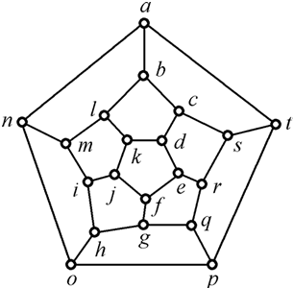
8.3 Hamiltonian Paths and Circuits
中山大学软件学院
The problem: to visit each vertex exactly once, with the exception of the beginning vertex if it must also be the last vertex.
A Hamiltonian path is a path that contains each vertex exactly once.
A Hamiltonian circuit is a circuit
that contains each vertex exactly
once except for the first vertex,
which is also the last.
Note: loops and multiple edges
are of no use for Hamiltonian circuit.

Slide 47
8.3 Hamiltonian Paths and Circuits
中山大学软件学院
Ex. Find Hamiltonian paths or circuits.
d
A
B
A
B
2
5
c
e
E
3
4
C
b
D
C
1
6
D
a
Path: Yes
Circuit: No
Path: Yes
Circuit: Yes
Path: No
Circuit: No
Path: No
Circuit: No

Slide 48
8.3 Hamiltonian Paths and Circuits
中山大学软件学院
Ex. For complete graph K_{n}, they all have Hamiltonian circuits: starting at any vertex, visiting the other vertices in any order
Questions for Hamiltonian paths or Euler circuits:
1) Existence? 2) Ways to find?
Not completely answered for the first question!
the second is still unanswered!

Slide 49
8.3 Hamiltonian Paths and Circuits
中山大学软件学院
Theorem 1: G be a connected graph with n vertices, and no loops or multiple edges. G has a Hamiltonian circuit if for any two vertices u and v of G that are not adjacent, the degree of u plus the degree of v is greater than or equal to n. deg(u)+deg(v) ≥ n.
Corollary 1: G has a Hamilton circuit if each vertex has degree ≥ n/2.

Slide 50
8.3 Hamiltonian Paths and Circuits
中山大学软件学院
Theorem 2: Let G be graph with m edges and n vertices. Then G has a Hamiltonian circuit if m ≥ (n²-3n+6)/2.
Proof
two nonadjacent vertices of G: u and v.
Graph H: eliminating u and v from G along with their edges. n-2 vertices and m-deg(u)-deg(v) edges.
m-deg(u)-deg(v) ≤ C_{n-2}² = (n-2)(n-3)/2
deg(u)+deg(v) ≥ m-(n-2)(n-3)/2
≥ (n²-3n+6)/2-(n-2)(n-3)/2
= n
Thus, the result follows from Theorem 1.

Slide 51
8.3 Hamiltonian Paths and Circuits
中山大学软件学院
Theorem 1: G has a Hamiltonian circuit if deg(u)+deg(v) ≥ n.
Theorem 2: G has a Hamiltonian circuit if m ≥ (n²-3n+6)/2.
Ex. The converse of Th1 and Th2 are not true, sufficient conditions but not necessary ones.
A
H
B
G
C
F
D
E

Slide 52
Example. Simple observations: if a vertex has degree 2, then the adjacent edges are on HC, and if for a vertex some adjacent edges are already on HC, then other edges could be removed.

Slide 53
Example 1 The following graph has no Hamilton circuit. We may label vertices by ‘A’ and ‘B’ if they are adjacent. The number of A’ s and number of B’s are different.

Slide 54
Example Peterson Graph has no Hamilton circuit.

Slide 55
HC problem and TSP are NP-hard.
See more on wikipedia: Hamiltonian path,
http://en.wikipedia.org/wiki/Hamiltonian_path
http://en.wikipedia.org/wiki/Hamiltonian_path_problem
http://en.wikipedia.org/wiki/Travelling_salesman_problem

Slide 56
8.4 Transport Networks（网络流图）
中山大学软件学院
The label on an edge represents the maximum flow that can be passed through the edge and is called the capacity of the edge.
Capacity
4
5
4
3
4
1
2
2
6
5
3
3
2
3
Node

Slide 57
8.4 Transport Networks
中山大学软件学院
A transport network, or a network, is a connected digraph N with the following properties:
(1). A unique source(源) with in-degree 0 is labeled as 1.
(2). A unique sink(汇) with out-degree 0 is labeled as n.
(3). The graph N is labeled. The label, c_{ij}≥0, on edge (i, j) is called the capacity(容量) of the edge.
4
5
Sink
Source
4
3
4
1
2
2
6
Capacity on (1,2) C₁₂ =5
5
3
3
2
3

Slide 58
8.4 Transport Networks
中山大学软件学院
A flow（流） F by labeling each edge (i, j) with (c_{ij}, f_{ij})
4
5
(4,3)
(3,3)
4
(4,2)
3
4
1
(2,1)
6
2
(2,0)
2
(5,3)
5
3
(3,2)
(3,2)
3
2
3
value(F)=5

Slide 59
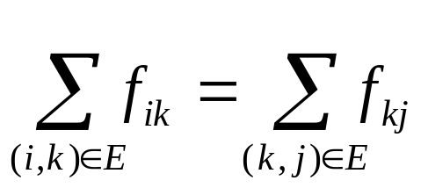
8.4 Transport Networks
中山大学软件学院
A flow in a network N is a function that assign to each edge (i, j) of N a nonnegative number F_{ij,}
amount passsing through the edge (i,j) cannot exceeds the capacity: f_{ij} ≤ c_{ij}
conservation of flow (流的守恒) on every node other than source and sink:
27

Slide 60
8.4 Transport Networks
中山大学软件学院
Theorem. The sum of the flows leaving the source must equal the sum of the flows entering the sink.
The sum is called the value of the flow, written value(F).
A flow F by labeling each edge (i, j) with (c_{ij}, f_{ij})
4
5
(4,3)
(3,3)
4
(4,2)
3
4
1
(2,1)
6
2
(2,0)
2
(5,3)
5
3
(3,2)
(3,2)
3
2
3
value(F)=5

Slide 61
8.4 Transport Networks
中山大学软件学院
Maximum Flow Problem:
Find a flow that has the maximum value, or find the maximum flow.
This problem is called the maximum flow problem.
2
2
(6,4)
(6,6)
(6,6)
(6,6)
1
(2,2)
4
1
(2,0)
4
(4,4)
(4,2)
(4,4)
(4,4)
3
value(F)=8
3
value(F)=10

Slide 62
8.4 Transport Networks
中山大学软件学院
Figure 8.73 displays a portion of the flow shown in Figure 8.72(a).
Although edge (j, i) is not in network N, there is no harm in considering such a virtual flow as long as it only has the effect of reducing the existing flow in the actual edge (i, j).
The path π:1,2,3,4 is not an actual
path in this network, since (2,3) is not
an actual edge.
π is a path in the symmetric closure
of the network.
2
(6,4)
1
(2,2)
4
virtual flow
(4,2)
3

Slide 63
8.4 Transport Networks
中山大学软件学院
If we consider a virtual flow of two units through π, the effect on the network is to increase the flows through edges (1,2) and (3,4) by two units and decrease the flow through edge (3,2) by two units.
2
(6,6)
(6,6)
(6,4)
1
(2,0)
4
(2,2)
(4,4)
(4,4)
(4,2)
3

Slide 64
8.4 Transport Networks
中山大学软件学院
Let N be a network and let G be the symmetric closure of N.
Choose a path π in G and an edge (i, j) in π.
(1) If (i, j) belongs to N, the edge has positive excess capacity（剩余容量） (e_{ij}=C_{ij} - F_{ij}) if e_{ij} > 0;
(2) If (i, j) is not an edge of N, the edge has excess capacity e_{ij}=f_{ji} if f_{ji}>0. Then increasing flow through (i, j) will have the effect of reducing f_{ji}.
c₄₅=3, f₄₅=0
3
4
5
4
4
c₁₄=4, f₁₄=0
c₅₆=4, f₅₆=0
1
c₂₄=2
f₂₄=0
6
2
c₂₅=2
f₂₅=0
2
c₁₂=5, f₁₂=0
5
c₃₆=3, f₃₆=0
3
2
3
3
c₂₃=3, f₂₃=0

Slide 65
8.4 Transport Networks
中山大学软件学院
We present Ford and Fulkerson’s algorithm for the maximum flow problem, it also call labeling algorithm.
Let N be a network with n nodes, and G be the symmetric closure of N, all edges and paths used are in G.
Begin with all flows set to 0, it will be convenient to track the excess capacities in the edges and how they change rather than tracking the increasing flows.
When the algorithm terminates, it is easy to find the maximum flow from the final excess capacities.

Slide 66
8.4 Transport Networks
中山大学软件学院
THE LABELING ALGORITHM
Step 1. let N₁ be the set of all nodes connected to the source by edges of positive excess capacity.
For ∀j∈N₁, label it with [E_{j},1], E_{j}=c_{1j}.
[4,1]
c₄₅=3, f₄₅=0
4
5
c₁₄=4, f₁₄=0
c₅₆=4, f₅₆=0
1
c₂₄=2
f₂₄=0
6
c₂₅=2
f₂₅=0
c₁₂=5, f₁₂=0
c₃₆=3, f₃₆=0
2
3
c₂₃=3, f₂₃=0
N₁={2,4}
[5,1]

Slide 67
8.4 Transport Networks
中山大学软件学院
THE LABELING ALGORITHM
Step 2. j is the smallest node number in N₁.
Let N₂(j) be the set of all unlabeled nodes, other than the source, that are joined to node j and have positive excess capacity.
For ∀k∈N₂(j), label k with [E_{k}, j], E_{k}=min{f_{jk}, E_{j}).
N₂=∪_{j∈N1}N₂(j).
[4,1]
[2,2]
c₄₅=3, f₄₅=0
N₁={2,4}, j=2
N₂(2)={3,5}
N₂(4)={}
N₂={3,5}
4
5
c₁₄=4, f₁₄=0
c₅₆=4, f₅₆=0
1
c₂₄=2
f₂₄=0
6
c₂₅=2
f₂₅=0
c₁₂=5, f₁₂=0
c₃₆=3, f₃₆=0
2
3
c₂₃=3, f₂₃=0
[5,1]
[3,2]

Slide 68
8.4 Transport Networks
中山大学软件学院
THE LABELING ALGORITHM
Step 3. Repeat Step 2, labeling all unlabeled nodes N₃ that can be reached from a node in N₂ by an edge having positive excess capacity. Continue this process forming sets N₄, N₅, …, until after a finite number of steps either
(i) the sink has not been labeled and no other nodes can be labeled. It can happen that no nodes have been labeled.
(ii) the sink has been labeled.
Step 4. For case (i), the algorithm terminates and the total flow is the maximum flow.

Slide 69
8.4 Transport Networks
中山大学软件学院
N₂={3,5}, j=3
N₃(3)={6}
[4,1]
[2,2]
c₄₅=3, f₄₅=0
4
5
c₁₄=4, f₁₄=0
c₅₆=4, f₅₆=0
1
c₂₄=2
f₂₄=0
6
[3,3]
c₂₅=2
f₂₅=0
c₁₂=5, f₁₂=0
c₃₆=3, f₃₆=0
2
3
c₂₃=3, f₂₃=0
[5,1]
[3,2]

Slide 70
8.4 Transport Networks
中山大学软件学院
THE LABELING ALGORITHM
Step 5. For case (ii), the sink, node n, labeled with [E_{n}, m], E_{n} is the amount of extra flow that can be made to reach the sink through a path π.
We now examine π in reverse order:
(1) If (i, j)∈N, we increase the flow in (i, j) by E_{n}
(2) If (i, j)∉N, we decrease the flow in (j, i) by E_{n}
We now have a new flow E_{n} units greater than before and Return to Step 1.

Slide 71
8.4 Transport Networks
中山大学软件学院
[4,1]
[2,1]
[2,2]
[3,4]
[1,4]
c₄₅=3, f₄₅=2
c₄₅=3, f₄₅=0
2
4
5
c₁₄=4, f₁₄=2
c₁₄=4, f₁₄=0
2
c₅₆=4, f₅₆=0
4
c₅₆=4, f₅₆=2
c₅₆=4, f₅₆=4
c₂₄=2
f₂₄=0
1
0
2
6
[2,5]
c₂₅=2
f₂₅=0
c₂₅=2
f₂₅=2
c₁₂=5, f₁₂=3
5
c₁₂=5, f₁₂=0
3
c₁₂=5, f₁₂=5
c₃₆=3, f₃₆=0
2
3
c₃₆=5, f₃₆=3
3
c₂₃=3, f₂₃=3
c₂₃=3, f₂₃=0
[2,1]
[2,1]
flow value:
0
0+3
0+3+2
0+3+2+2
π₁: 1, 2, 3, 6. ⇒ 3
π₂: 1, 2, 5, 6. ⇒ 2
π₃: 1, 4, 5, 6. ⇒ 2
No further labeling is possible.
F_{ij} = C_{ij} - e_{ij}

Slide 72

8.4 Transport Networks
中山大学软件学院
The Labeling Algorithm
While (1) {
Step 1. N₀={1}, label all nodes connected to the node of N₀ by edges of positive excess capacity, and get set N₁.
Repeat
Step 2. label all unlabeled nodes connected to the node of N_{i} by edges of positive excess capacity, and get set N_{i+1}.
Until Case I or Case II
if (Case I) break
Step 4. get a path π from source to sink, change (c_{ij}, f_{ji}) of edge in the path in reverse order
}
Step 5. Output the value(F)
Step 3

Slide 73
8.4 Transport Networks
中山大学软件学院
We define a cut in a network N as a set K of edges having the property that every path from the source to the sink contains at least one edge from K.
A cut does cut a digraph into two pieces, one containing the source and one containing the sink.
If the edges of a cut were removed, nothing could flow from the source to the sink.
The capacity of a cut K, c(K), is the sum of the capacities of all edges in K.

Slide 74
8.4 Transport Networks
中山大学软件学院
4
5
4
3
4
1
2
2
6
5
3
3
Cut K₁
2
3
Cut K₂
K₁={(1,2), (2,4), (4,5)}
c(K₁)=10
K₂={(3,6),(5,6)}
c(K₂)=7

Slide 75
8.4 Transport Networks
中山大学软件学院
If F is any flow and K is any cut, then value(F)≤c(K). Because all parts of F must pass through the edges of K, and c(K) is the maximum amount that can pass through the edges of K.
Suppose that for some flow F and some edges in K, value(F)=c(K), the flow F uses the full capacity of all edges in the cut K.
Then F would be a flow with maximum value, since no flow can have value bigger than c(K).
Similarly the K must be a minimum capacity cut, because every cut must have capacity at least equal to value(F).

Slide 76
8.4 Transport Networks
中山大学软件学院
Theorem 1 (The Max Flow Min Cut Theorem) A maximum flow F in a network has value equal to the capacity of a minimum cut of the network.

Slide 77
8.4 Transport Networks
中山大学软件学院
To show the labeling algorithm does results in a maximum flow by finding a minimum cut whose capacity is equal to this flow.
Suppose that the algorithm runs and stops at Step 4.
The sink has not been labeled.
Divide the nodes in two sets, M₁ and M₂:
M₁={the source, nodes have been labeled}
M₂={unlabeled nodes that is not the source}
K={ e_{ij} | v_{i}∈M₁, v_{j}∈M₂}
Any path π from the source to the sink begins with a node in M₁ and end with a node in M₂.
If i is the last node in π, i∈M₁, and j is the node that follow i in π, then j∈M₂.
so, (i, j) is in K. Therefore K is a cut.

Slide 78
8.4 Transport Networks
中山大学软件学院
Suppose that (i, j)∈K, i∈M₁ and j∈M₂.
The final flow F produced by the algorithm must result in (i, j) carrying its full capacity; otherwise, we could use node i and the excess capacity to label node j, which by definition is not labeled.
Thus the value of the final flow of the algorithm is equal to the capacity c(K), and so F is a maximum flow.

Slide 79
8.4 Transport Networks
中山大学软件学院
[2,1]
[4,1]
4
5
4
3
4
1
2
2
6
5
3
3
2
3
[5,2]
The minimum cut corresponding to the maximum flow is K={(5,6),(3,6)}.
c(K)=7=value(F).

Slide 80
8.4 Transport Networks
中山大学软件学院
The definition of a transport network can be extended.
A network has multiple sources or multiple sinks.
1
2
2
4
6
3
2
2
4
2
5
7
3
4
3

Slide 81
8.4 Transport Networks
中山大学软件学院
Supersources: a node connected to all sources of N.
Supersinks : a node connected to all sinks of N.
Capacities of new edges: the sum of all capacities leaving sources of N.
1
2
2
11
4
6
3
11
a
2
2
4
b
11
2
11
11
5
7
3
4
3

Slide 82
8.4 Transport Networks
中山大学软件学院
Applying the labeling algorithm: Maximum flow with value of 9.
1
(2,2)
2
2
(2,2)
(11,2)
4
6
11
(3,1)
(11,6)
3
11
a
2
2
b
(2,1)
4
(11,3)
(4,4)
11
(11,3)
(2,2)
11
(11,4)
2
11
5
7
3
(3,3)
(4,4)
3
4
28

Slide 83

Matching

Slide 84
Marriage Problem
g₁
b₁
boys | Girls
b₁ | g₁,g₄,g₅
b₂ | g₁
b₃ | g₂,g₃,g₄
b₄ | g₂,g₄
g₂
b₂
g₃
b₃
g₄
b₄
g₅
Marriage problem: can all boys marry a girl he loves?

Slide 85
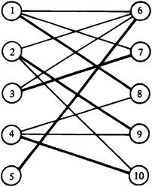
Matching

Slide 86
8.5 Matching Problems
中山大学软件学院
Matching problem(匹配问题)
We have two finite sets A and B, a relation R from A to B.
A matching function M is a one-to-one function from a subset of A to a subset of B.
a is matched with b if M(a)=b
M is compatible with R if M⊆R; if M(a)=b, then a R b.
Ex. Let A be a set of girls and B be a set of boys attending a school dance.
a R b : a knows b;
M(a)=b: a and b dance the third dance together
M is compatible with R if each girl knows her partner for the third dance.

Slide 87
8.5 Matching Problems
中山大学软件学院
Matching problem
Ex. A={s₁, s₂, s₃, s₄, s₅}, the set of students working on a research project.
B={b₁, b₂, b₃, b₄, b₅}, the set of reference books on reserve in the library for the project.
s_{i} R b_{k} iff s_{i} wants to sign out book b_{k}
A matching of students to books would be compatible with R if each student is matched with a book he wants to sign out.

Slide 88
8.5 Matching Problems
中山大学软件学院
Matching problem
Given any relation R from A to B, a matching M that is compatible with R.
M is called maximal if its domain is as large as possible.
M is called complete if its domain is A.
A matching problem is, given A, B and R, find a maximal matching from A to B that is compatible with R.
Matching problems can be solved using network.
sources : elements of A;
sinks : elements of B;
edge(a,b) : a R b;
capacity : all assigned with 1.

Slide 89
8.5 Matching Problems
中山大学软件学院
Matching problem
One maximal matching M can be found by inspection:
M(s₁)=b₂
M(s₂)=b₁
M(s₃)=b₃
M(s₄)=b₄
No complete matching exists.
Usually, it can be very difficult to
find a maximal matching.
s₁
b₁
s₂
b₂
s₃
b₃
s₄
b₄
s₅
b₅
bipartite graph 二分图

Slide 90
8.5 Matching Problems
中山大学软件学院
Use the labeling algorithm to solve the matching problem.
s₁
1
b₁
1
1
1
s₂
1
b₂
1
1
1
1
1
1
x
s₃
b₃
y
1
1
1
1
1
1
1
s₄
b₄
1
1
1
1
s₅
1
b₅

Slide 91
8.5 Matching Problems
中山大学软件学院
It is not obvious to find a complete matching for a particular problem.
A condition that will guarantee the existence of a complete matching was first found for the matching problem for a set of men and a set of women with the relation “suitable for marriage”.
“Is it possible for each man to marry a suitable woman” often referred to as the marriage problem.

Slide 92
8.5 Matching Problems
中山大学软件学院
Theorem 1 (Hall’s Marriage Theorem) Let R be a relation from A to B. Then there exists a complete matching M iff for each X⊆A, |X|≤|R(X)|.
Proof
(1) A complete matching M exists ⇒ |X|≤|R(X)| for each X ⊆A.
If a complete matching M exists, then M(X)⊆R(X) for every subset X of A. But M is one-to-one, |X|=M(X)≤|R(X)|.

Slide 93
8.5 Matching Problems
中山大学软件学院
(2) |X|≤|R(X)| for each X⊆A ⇒ a complete matching M exists.
Suppose that for any X⊆A, |X|≤|R(X)|.
Construct the network N that corresponds to R.
Suppose that |A|=n.
There is a flow in N with value n, which will correspond to a complete matching.
It is sufficient to show that the minimal cut in N has value n by Max Flow Min Cut Theorem.

Slide 94
8.5 Matching Problems
中山大学软件学院
A typical situation is shown in Figure 8.97, with the wavy line representing a cut in N.
S₃
s₁
b₁
S₂
x
s₂
b₂
y
S₁
┆
┆
s_{n}
b_{p}
Figure 8.97
Divide the edges in the minimum cut K into three sets:
S₁ contains the edges beginning at the supersource x;
S₂ contains the edges corresponding pairs in R;
S₃ contains the edges ending with the supersink y;

Slide 95
8.5 Matching Problems
中山大学软件学院
Consider removing the edges of K one set at a time.
Suppose that |S₁|=k, A₁⊆A;
When the edges in S₁ are removed, no path from x to y can pass through an element of A₁.
Since K is minimal, we can suppose that no edge that begins in A₁.
Let A₂=A-A₁, |A₂|=n-k, B₂=R(A₂).
Each element of B₂ labels the terminal node of an edge that begins in A₂.
Since x is connected to each element in A₂, x is also connected each element in B₂.
We know that |A₂|≤|R(A₂)=|B₂|, so |B₂|≥n-k.

Slide 96
8.5 Matching Problems
中山大学软件学院
Let |S₂|=r.
Removing an edge in S₂ may or may not disconnect x from any element of B₂, but it cannot disconnect x from more than one element of B₂.
Thus, when edges in S₂ are removed, x is still connected to at least (n-k)-r elements in B₂.
These elements must be disconnected from y to ensure there is no path from x to y.
So S₃ must contain at least (n-k)-r edges, i.e. |S₃| ≥ (n-k)-r.
c(K)=|K|=|S₁|+ |S₂|+ |S₃| ≥ k+r+((n-k)-r)=n.
Since the cut has capacity n, the minimal cut, the maximum flow, is n.

Slide 97
8.5 Matching Problems
中山大学软件学院
Ex. Let M_{R} be the matrix of a marriage
suitability between five men and five women.
Can each man marry a suitable women?
Solution
S: any subset of men
E: the set of edges that begin in S
|E|=2|S|
Each edge in E must terminate in a node of R(S).
The number of edges terminating at elements of R(S) is 2|R(S)|.
Thus, 2|S|≤2|R(S)|, and so |S|≤|R(S)|.
By Hall’s marriage theorem, a complete matching is possible.
1 1 0 0 0
0 0 0 1 1
1 0 1 0 0
0 0 1 0 1
0 1 0 1 0
M_{R}=

Slide 98


Coloring
http://www.coloring4all.com/

Slide 99
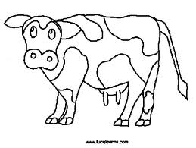

Slide 100


Slide 101
8.6 Coloring Graphs
中山大学软件学院
G=(V, E, γ): a graph with no multiple edges
C={c₁, c₂, …, c_{n}}: a set of n color
Any function f: V→C is called a coloring of the graph G using n colors (or using the colors of C).
f(v) is the color of the vertex v.
A coloring is proper if any two adjacent vertices v and w have different colors.

Slide 102
8.6 Coloring Graphs
中山大学软件学院
Ex. C = {r,w,b,y}
w
r
χ(G)=3
b
y
r
r
b
w
w
r
proper coloring
using three colors
proper coloring
using four colors
We can not color the graph with two or fewer colors.
The chromatic number of the graph G (图的着色数): the smallest number of colors needed to produce a proper coloring of G, denoted by χ(G). χ(读: Kai)

Slide 103
Examples
Find the Chromatic Numbers for U_{n}, K_{n}, K_{m,n,} L_{n}, C_{n}, S_{n} (star graphs), W_{n} (wheel graphs).

Slide 104

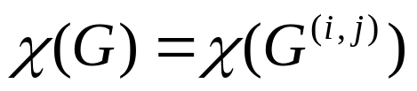
Coloring
ij
example
i
i
j
j
G: i and j are adjacent
G+(i,j)
G^{(i,j)}
if the coloring make i and j colored differently, then
If the coloring make i and j have the same color，then
So, χ(G) = min(χ(G+(i,j), χ(G^{(I,j)}))

Slide 105
Find χ(G)。
χ(K₅)=5
χ(K₄)=4
χ(K₄)=4
χ(K₃)=3

Slide 106
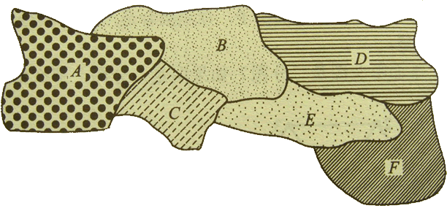
8.6 Coloring Graphs
中山大学软件学院
One of the oldest graph-coloring problems is the map-coloring problem.
A coloring of map is a way to color each region so that no two distinct regions sharing a common border have the same color.

Slide 107
8.6 Coloring Graphs
中山大学软件学院
Given a map M, construct a graph G_{M} with one vertex for each region and an edge connecting any two vertices whose corresponding regions share a common boundary.
The proper colorings of G_{M} correspond exactly the colorings of M.
A
B
D
F
A conjecture was that four colors are always enough to color any map drawn on a plane. – 四色定理
The conjecture was proved to be true in 1976 with the aid of computer computations performed on almost 2000 configuration of graphs.
There is still no proof known that does not depend on computer checking.
C
E

Slide 108
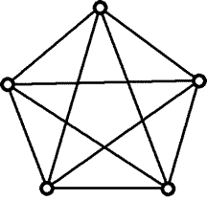
8.6 Coloring Graphs
中山大学软件学院
A planar graph is a graph that be drawn in a plane so that no edges cross except at vertices.
A
B
D
F
C
E
planar graph
K₅: not a planar graph

Slide 109
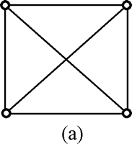
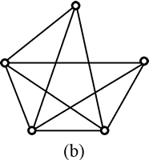
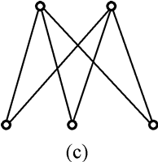
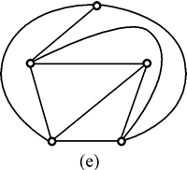
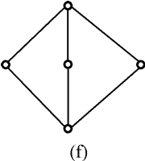
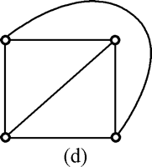
8.6 Coloring Graphs
中山大学软件学院
Some examples of planar graph.

Slide 110


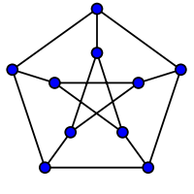
8.6 Coloring Graphs
中山大学软件学院
Some examples of non-planar graph.

Slide 111
Euler’s Formula
Euler's formula states that if a finite, connected, planar graph is drawn in the plane without any edge intersections, and v is the number of vertices, e is the number of edges and f is the number of faces (regions bounded by edges, including the outer, infinitely large region), then
  v − e + f = 2.
  See http://en.wikipedia.org/wiki/Planar_graph

Slide 112
Kuratowski's theorem
Kuratowski's theorem:
  A finite graph is planar if and only if it does not contain a subgraph that is a subdivision of K₅ (the complete graph on five vertices) or K_{3,3} (complete bipartite graph on six vertices, three of which connect to each of the other three).

Slide 113
Five Color Theorem
Any planar graph can be colored using no more than five colors.
Proof:
A fact: any planar graph has at least one vertex of degree less than 5.

Slide 114
五色定理证明
v1
对结点数n归纳。假定<n个结点的平面图可5着色。当G有n个结点时，必有一个结点v其度数<6. 不妨设 dev(v)=5, 其邻接点是v1,…,v5. 至少有两个结点不相邻，否则G包含K5, 是非平面图。设v1,v3不相邻，将v1,v3”拉至v”与v合并，其结点数<n, 故可5 着色。现在将v1,v3”从中拉出”，v1,v3着色不变，此时v1,v2,…,v5着4种颜色，故v可着第五种颜色。
v5
v2
v
v4
v3
v1
v5
v2
v
v4
v3

Slide 115
8.6 Coloring Graphs
中山大学软件学院
Chromatic Polynomials
χ(G) is the smallest number of colors needed to produce a proper coloring of G.
Computing the total number of different coloring of a graph.
If G is a graph and n ≥ 0 is an integer,
let P_{G}(n) be the number of ways to color G using n or fewer colors, P_{G}(n) is polynomial in n.
P_{G}: a function called the chromatic polynomial.

Slide 116
8.6 Coloring Graphs
中山大学软件学院
Ex. x colors for L₄.
1st vertex: colored with any of x colors;
2nd vertex: colored with any of the x-1 colors not chosen for vertex 1.
3rd vertex: colored with any of the x-1 colors not chosen for vertex 2.
4th vertex: colored with any of the x-1 colors not chosen for vertex 3.
Total number of proper coloring is x(x-1)³. Thus P_{L4}=x(x-1)³.
P_{L4}(0)= 0; P_{L4}(1)= 0, P_{L4}(2)= 2
So, χ(L₄)=2.
L₄

Slide 117
8.6 Coloring Graphs
中山大学软件学院
In general, for the graph G with no multiple edges, χ(G) is the smallest positive integer x for which P_{G}(x)≠0.
P_{Ln}(x)=x(x-1)^{n-1}
So, χ(L_{n})=2.
Ex. x colors for K_{n}.
For x<n, no proper coloring is possible.
For x≥n, P_{Kn}(x)=x(x-1)(x-2)…(x-n+1)
So, χ(G)=n.

Slide 118
8.6 Coloring Graphs
中山大学软件学院
Theorem 1 If G is a disconnected graph with components G₁, G₂, …, G_{m}, then P_{G}(x)=P_{G1}(x) P_{G2}(x) … P_{Gm}(x).
Ex. For x ≥ 3,
P_{K3}(x) = x(x-1)(x-2).
P_{G}(x) = x²(x-1)²(x-2)².
P_{G}(3) = 36
P_{G}(4) = 576
χ(G) = 3.
Ex. For U_{n}
P_{Un}(x)=x^{n}, χ(U_{n})=1.
2
5
3
4
1
6
U_{n}

Slide 119
8.6 Coloring Graphs
中山大学软件学院
G : a graph (V, E, γ) with no multiple edges
e : e={a,b}∈E
G_{e}: subgraph of G obtained by deleting e.
G^{e}: quotient graph of G obtained by merging end points of e.
Theorem 2 With the preceding notation and using x colors,
P_{Ge}(x) =P_{G}(x) + P_{G}^{e}(x).
P_{G}(x) = P_{Ge}(x) - P_{G}e(x).
Proof
Two types of proper colorings of G_{e}:
(1) a and b have different colors;
(2) a and b have the same colors.
Coloring of type (1) is also a proper coloring of G.
Coloring of type (2) corresponds to a proper coloring of G^{e}.
Thus P_{Ge}(x)=P_{G}(x) - P_{G}e(x), or P_{G}(x)=P_{Ge}(x) - P_{G}e(x).

Slide 120
8.6 Coloring Graphs
中山大学软件学院
Ex. x colors for G.
If x ≥ 2, P_{Ge}(x) = x(x(x-1)(x-2));
P_{Ge}(x) = x(x-1)(x-2);
P_{G}(x) = P_{Ge}(x) - P_{Ge}(x)
= x²(x-1)(x-2) - x(x-1)(x-2)
= x(x-1)²(x-2)
P_{G}(1) = 0; P_{G}(2) = 0; P_{G}(3) = 12
χ(G) = 3.
e
29

Slide 121
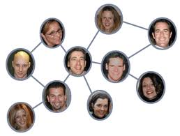

Shortest Path and BFS
Bacon number

Slide 122
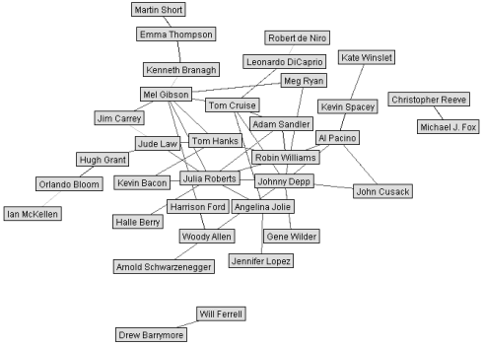
BFS- Breadth-First-Search

Slide 123
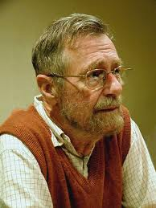
Dijkstra’s Algorithm for Shortest Paths
Edsger W. Dijkstra

Slide 124
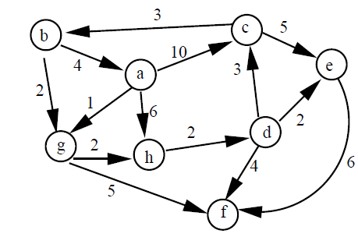
Single Source Shortest Paths Problem

Slide 125
Summary
Graphs, definition, sub-graphs, paths
Euler circuit (conditions), Hamiltonian Circuit (simple methods to show if there is any HC)
Networks, flow, Ford-Fulkerson algorithm, maximum flow and minimum cut theorem
Matching, maximal, complete matching, the method, Hall’s marriage theorem
Coloring, planar graphs, chromatic number, chromatic polynomials

