Slide 1
Discrete Mathematical Structures
离散数学结构
(SE-106)
Mon: 10~11 (16:15~17:55)/C501
Wed: 4~5 (10:45~12:25)/C305
中山大学计算机科学系 蔡国扬 email: isscgy@mail.sysu.edu.cn mailbox for courseware: dm_ss2010_sysu@163.com

Slide 2
Textbook
Bernard Kolman, Robert C. Busby & Sharon C. Ross, Discrete Mathematical Structures (Fifth Edition), 高等教育出版社（影印版）, 2005.
References
Kenneth H. Rosen, Discrete Mathematics and its Applications (Sixth Edition), 机械工业出版社（影印版）, 2008.
D. S. Malik, Discrete Mathematical Structures – Theory and Applications, 高等教育出版社, 2005.
Kenneth A. Ross, Charles R. B. Wright, Discrete Mathematics (Fifth Edition), 清华大学出版社, 2003.
耿素云、屈婉玲, 《离散数学》(修订版), 高等教育出版社, 2004.
左孝凌等,《离散数学》, 上海科技文献出版社, 2002.
李盘林等,《离散数学》, 高等教育出版社, 1999.

Slide 3
Chapter 1 Fundamentals
1.1 Sets and Subsets
1.2 Operations on Sets
1.3 *Sequences
1.4 *Division in the Integers
1.5 *Matrices
1.6 Mathematical Structures

Slide 4
1.1 Sets and Subsets
A Set is any well-defined collection of objects called the elements or members of the set (集合的元素).
1. Describe a set
(1) List the elements of the set between braces
The set of all positive integers that are less than 4 can be written as { 1, 2, 3 }.
(2) Describe a set by statement P
{ x | P(x) } is just a set which P(x) is true.
Ex. { x | 0<x<4 }, P(x) is sentence “0<x<4”.
{ y | y is a letter in the word “Hello” }.

Slide 5
1.1 Sets and Subsets
2. The order of elements of set
The order in which the elements of a set are listed is not important.
{ 1, 2, 3 } = { 2, 3, 1 } = { 3, 2, 1 } = …
3. Denotation for element of set
We use uppercase letters such as A, B, C to denote sets, lowercase letters such as a, b, c to denote the members of sets.
(1) x is a member of set A, write x∈A
(2) x is not a member of set A, write x∉A

Slide 6
1.1 Sets and Subsets
4. Some important sets
N = { x | x ≥ 0, x is an integer }
Z = { x | x is an integer } = { 0, ±1, ±2, ±3, … }
Z⁺ = { x | x>0, x ∈ Z }
Q = { x | x is a rational number }
= { x | x = a/b, a, b∈Z, b ≠ 0 }
R = { x | x is a real number }
∅ or { } stands for empty set, it has no elements.
Ex. { x | x² = −1, x∈R } is ∅.

Slide 7
1.1 Sets and Subsets
Venn diagrams
文氏图
5. Subset and Proper Subset (子集和真子集)
If whenever x∈A then x∈B, we say A is a subset of B, or A is contained in B. we write A⊆B.
If A is not a subset of B, we write A⊄B.
Ex. N ⊆Z⊆Q⊆R, but Z⊄N.
If A is a set, then A⊆A. i.e. every set is a subset of itself.
Ex. A = { 1, 2, 3, 4, 5, 6 }, B = { 2, 4, 5 }, C = { 1, 2, 3, 4, 5 }
Then B⊄A, B⊄C, C⊄A, A⊆B, A⊆C, C⊆B.
If B⊆A and B≠A, then B is a proper subset of A (真子集), and is denoted by B⊂A.
B
B
A
A

Slide 8
1.1 Sets and Subsets
6. Differences between ∈ and ⊆
B = {A, {A}}, A is a set.
A∈B, {A}∈B, {A} ⊆ B and {{A}} ⊆ B.
A⊄B.
If A is a set, then ∅⊆A is true.
The empty set is a subset of any set.
7. Equality of two sets
Two sets A and B are equal if they have same elements, we write A = B.
A = { 1, 2, 3 }, B = { x | x² < 12, x∈Z⁺ } ⇒ A=B
A = B iff A⊆B and B⊆A.

Slide 9
1.1 Sets and Subsets
8. Universal set (全集)
An universal set is a set which contains all objects for which the discussion is meaningful. U is abbreviated from “Universal Set”.
If set A is a set in the discussion, then A is a subset of U.
In Venn diagrams, set U is denoted by a rectangle.
U
A

Slide 10
1.1 Sets and Subsets
9. Cardinality of set (集合基数, 元素个数)
A set A is called finite(有限) if it has n distinct elements, where n∈N.
In this case, n is called the cardinality of set A, and is denoted by |A|, or # of A.
If a set is not finite, it is called infinite(无限).
Ex. N, Z, R, etc.

Slide 11
1.1 Sets and Subsets
10. Power set (幂集)
If A is a set, the set of all subset of A is called the power set of A, and is denoted by P(A) or ρ(A).
Ex. A = { 1, 2, 3 }
P(A) = { ∅, {1}, {2}, {3}, {1,2}, {1,3}, {2,3}, {1,2,3} }
|P(A)| = 8.
|P(A)| = 2^{|A|}.

Slide 12
1.1 Exercises
1. , 14. , 16. , 22. , 32.

Slide 13
1.2 Operations on Sets
1. Union－并
The union of A and B is a set which contains all elements of A or B, we write A∪B.
A∪B = { x | x ∈ A or x ∈ B }
Ex. A = { 1, 2, 3, 4, 5 }, B = { 3, 5, 6, 7, 8 }
A∪B = { 1, 2, 3, 4, 5, 6, 7, 8 }
A
B
A∪B

Slide 14

1.2 Operations on Sets
2. Intersection－交
The intersection of A and B is a set which contains all elements of A and B, we write A∩B.
A∩B = { x | x ∈ A and x ∈ B }
Ex. A = { 1, 2, 3, 4, 5 }, B = { 3, 5, 6, 7, 8 }
A∩B = { 3, 5 }
If set A and B have no common elements, they are called disjoint sets(不相交集合).
A
B
A
B
A∩B
Disjoint Sets

Slide 15

1.2 Operations on Sets
A∪B∪C = { x | x∈A or x∈B or x∈C }
∪_{i=1..n}A_{i} = A₁∪A₂∪ … ∪A_{n}
A∩B∩C = { x | x∈A and x∈B and x∈C }
∩_{i=1..n}A_{i} = A₁∩A₂∩ … ∩A_{n}
A
B
A
B
C
C
A∪B∪C
A∩B∩C

Slide 16
1.2 Operations on Sets
3. Complement of B with respect to A
If A and B are two sets, The complement of B with respect to A is defined the set of all elements that belong to A but not to B, and is denoted by A−B.
A − B = { x | x∈A and x∉B }
Ex. A = { 1, 2, 3, 4, 5 }, B = { 3, 5, 6, 7, 8 }
A−B = { 1, 2, 4 }
A
B
A
B
A - B
B - A

Slide 17

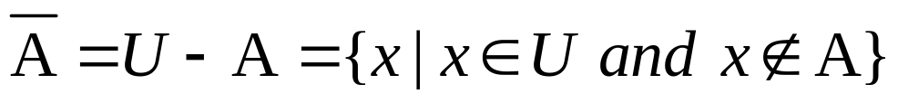
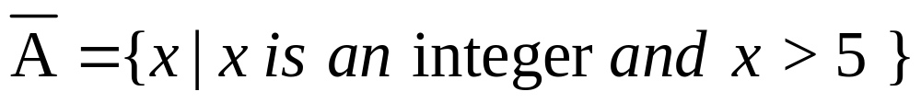
1.2 Operations on Sets
4. Complement of A－A的补集
If U is a universal set containing A, U−A is the complement of A, and is denoted by
4. Complement of A－A的补集
If U is a universal set containing A, U−A is the complement of A, and is denoted by
Ex. A = { 1, 2, 3, 4, 5 }, U = Z⁺
U
A
A

Slide 18

1.2 Operations on Sets
5. Symmetric difference －对称差
A and B are two sets, their symmetric difference is the set of all elements that belong to A or to B, but not to A and B. It is denoted by A⊕B.
A⊕B = { x | (x∈A and x∉B) or ( x∈B and x∉A) }
= (A–B)∪(B–A)
= (A∪B)–(A∩B)
Ex. A = { 1, 2, 3, 4, 5 }, B = { 3, 5, 7, 9 }
A⊕B = { 1, 2, 4, 7, 9 }
A
B
A⊕B

Slide 19
1.2 Operations on Sets
6. Algebraic properties of set operations
(1) Commutative Properties – 交换律
A∪B = B∪A A∩B = B∩A
(2) Associative Properties – 结合律
(A∪B)∪C = A∪(B∪C)
(A∩B)∩C = A∩(B∩C)
(3) Distributive Properties – 分配律
A∩(B∪C) = (A∩B)∪(A∩C)
A∪(B∩C) = (A∪B)∩(A∪C)
(4) Idempotent Properties – 等幂律
A∪A = A A∩A = A

Slide 20
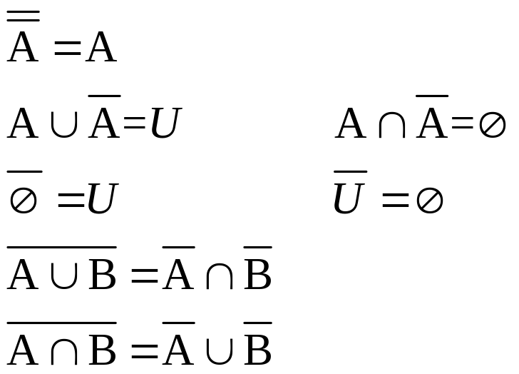
1.2 Operations on Sets
6. Algebraic properties of set operations
(5) Properties of the Complement－补集的性质
De Morgan’s Laws
迪⋅摩根定律
(6) Properties of a Universal Set －全集的性质
A∪U = U A∩U = A
(7) Properties of the Empty Set －空集的性质
A∪∅ = A A∩∅ = ∅

Slide 21
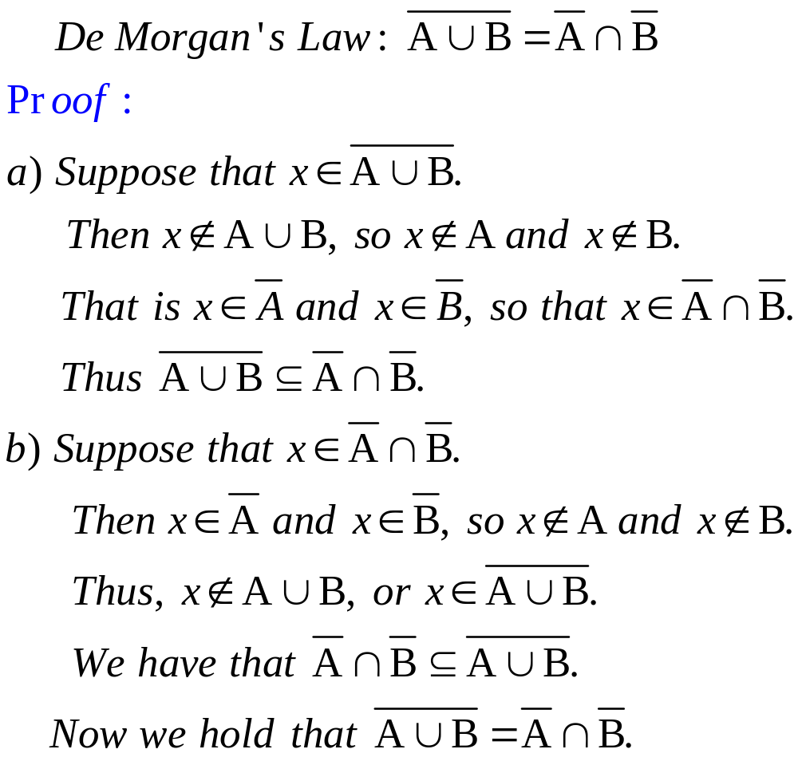
1.2 Operations on Sets
6. Algebraic properties of set operations
A common style of proof for statements of sets is to choose an element in one of the sets.

Slide 22
1.2 Operations on Sets
7. The addition principle
Theorem 2. If A and B are finite sets, then
|A∪B| = |A|+|B|−|A∩B|
Ex. A = { a, b, c, d, e }, B = { c, e, f, h, k, m }, |A∪B| = ?
A∩B = { c, e }, |A∩B| = 2.
|A∪B| = |A|+|B|−|A∩B| = 5+6-2 = 9.
Theorem 3. If A, B and C are finite sets, then
|A∪B∪C |=|A|+|B|+|C|-|A∩B|-|A∩C|
-|B∩C|+|A∩B∩C|
Ex. A = { a, b, c, d, e }, B = { a, b, e, g, h },
C = { b, d, e, g, h, k, m, n }, |A∪B∪C | = ?

Slide 23
1.2 Operations on Sets
例 对24名人员掌握外语情况的调查.其统计结果如下:
会英、日、德、法分别为: 13, 5, 10和9人;
同时会英语和日语的有2人;
会英、德和法语中任两种语言的都是4人.
已知会日语的人既不懂法语也不懂德语, 分别求只会一种语言(英、德、法、日)的人数和会三种语言的人数.
解 令A, B, C和D分别表示会英、法、德、日语的人的集合.
设同时会三种语言的有x人, 只会英、法或德语一种语言的分别为y₁, y₂和y₃.画出的图如右图.
列出下面方程组:
y₁ + 2(4-x) + x + 2 = 13
y₂ + 2(4-x) + x = 9
y₃ + 2(4-x) + x = 10
y₁ + y₂ + y₃ + 3(4-x) + x = 19
解得: x = 1, y₁ = 4, y₂ = 3, y₃ = 3.
B
y₂
y₁
4-x
2
5-2
x
4-x
4-x
A
y₃
D
C

Slide 24
1.2 Operations on Sets
例 求1到1000之间(包含1和1000在内), 既不能被5和6, 也不能被8整除的数有多少个.
解 设
A
S = { x | x∈Z∧1 ≤ x ≤ 1000 }
A = { x | x∈S∧x可被5整除 }
B = { x | x∈S∧x可被6整除 }
C = { x | x∈S∧x可被8整除 }
|A| = ⎣1000/5⎦ = 200
|B| = ⎣1000/6⎦ = 166
|C| = ⎣1000/8⎦ = 125
|A∩B| = ⎣1000/lcm(5,6)⎦ = 33
|A∩C| = ⎣1000/lcm(5,8)⎦ = 25
|B∩C| = ⎣1000/lcm(6,8)⎦ = 41
|A∩B∩C| = ⎣1000/lcm(5,6,8)⎦ = 8
1000-(200+100+33+67)=600
B
150
200
167
133
166
100
25
33
8
25
41
17
33
125-25-41
+A∩B∩C
67
125
C

Slide 25
1.2 Operations on Sets
8. The characteristic function－特征函数
The characteristic function f_{A} of A is defined for each x∈U as follows:
1 x∈A
0 x∉A
f_{A}(x) =
Theorem 4. Characteristic function of subsets satisfy the following properties:
(1) f_{A∩B} = f_{A}f_{B}, f_{A∩B}(x) = f_{A}(x)f_{B}(x) for all x.
(2) f_{A∪B} = f_{A} + f_{B} - f_{A}f_{B}, f_{A∪B}(x) = f_{A}(x)+f_{B}(x)-f_{A}(x)f_{B}(x) for all x.
(3) f_{A⊕B} = f_{A} + f_{B} - 2f_{A}f_{B}, f_{A⊕B}(x) = f_{A}(x)+f_{B}(x)-2f_{A}(x)f_{B}(x) for all x.

Slide 26
1.2 Exercises
10. , 36. , 37. , 38. , 39.

Slide 27
1.3 Sequences
1.4 Division in the Integers
1.5 Matrices

Slide 28
1.6 Mathematical Structures
A collection of objects with operations defined on them and the accompanying properties form a mathematical structure or system.
Ex. <Sets,∪,∩, ~> is a mathematical structure, where Sets is the collection of sets, with the operations of Union, Intersection and complement, and their accompanying properties.
Ex. <3×3 matrices, +, *, ^{T}>, <Odd integers, +, *> are mathematical structures too.

Slide 29
1.6 Mathematical Structures
(1) An operation that contains two objects is a binary operation (二元运算).
Ex. ∪,∩, +, *.
(2) An operation that contains one objects is a unary operation (一元运算).
Ex. ~(集合的补), ^{T}(矩阵转置).

Slide 30
1.6 Mathematical Structures
If the order of the objects does not affect the outcome of a binary operation, we say that the operation is commutative (可交换的).
If x  y = y  x, where  is a binary operation,  is com-mutative.
If (x  y)  z = x  (y  z), where  is a binary operation,  is associative (可结合的) or has the associative property.
If  and  are two binary operations of a mathematical structure, a distributive property has the following pattern:
x  (y  z) = (x  y)  (x  z)
We say that “ distributes over ”. (  对  可分配)

Slide 31
1.6 Mathematical Structures
Ex. a*(b + c) = a*b + a*c
A∪(B∩C) = (A∪B)∩(A∪C)
If  is the unary operation,  and  are two binary operations, then De Morgan’s laws are
(x  y) = x  y (x  y) = x  y

Slide 32
1.6 Mathematical Structures
A structure with a binary operation  may contain a distinguished object e, with the property x  e = e  x = x for all x in the collection. We call e an identity (幺元) for .
Theorem 5. If e is an identity for a binary operation , then e is unique.
Proof:
Assume another object i also has the identity property, so x  i = i  x = x.
Then e  i = e, but since e is an identity for , e  i = i.
Thus, i = e.
Therefore there is at most one object with the identity property for .

Slide 33
1.6 Mathematical Structures
For <n×n matrices, +, *, ^{T} >, I_{n} is the identity for matrix multiplication and the n×n zero matrix is the identity for matrix addition.
If a binary operation  has an identity e, we say y is a -inverse (逆元) of x if x  y = y  x = e.
Theorem 6. If  is an associative operation and x has a -inverse y, then y is unique.
Proof:
Assume z is another -inverse of x.
Then (z  x)  y = e  y = y, z  (x  y) = z  e = z.
Since  is associative, (z  x)  y = z  (x  y).
so y = z.

Slide 34
1.6 Mathematical Structures
Let ,  and  be defined for the set {0,1} by the following tables.

0
1

0
1
x
x
0
0
1
0
0
0
0
1
1
1
0
1
0
1
1
0
Determine if each of the following is true for <{0,1}, , , >.
(a)  is commutative. (b)  is associative.
(c) De Morgan’s laws hold.
(d) Two distributive properties hold the structure.
Solution: Check the following properties.
(a) x  y = y  x.
(b) x  (y  z) = (x  y)  z).
(c) (x  y) = y  x (x  y) = y  x
(d) x  (y  z) = (x  y)  (x  z) x  (y  z) = (x  y)  (x  z)

Slide 35
1.6 Exercises
17. ~ 23.

