Slide 1
Discrete Mathematical Structures
离散数学结构
(SE-106)
Mon: 10~11 (16:15~17:55)/C501
Wed: 4~5 (10:45~12:25)/C305
中山大学计算机科学系 蔡国扬
email: isscgy@mail.sysu.edu.cn
mailbox for courseware: dm_ss2010_sysu@163.com

Slide 2
Chapter 4 Relations and Digraphs
4.1 Product Sets and Partitions
4.2 Relations and Digraph
4.3 Paths in Relations and Digraphs
4.4 Properties of Relations
4.5 Equivalence Relations
4.6 Computer Representation of Relations & Digraphs
4.7 Operations on Relations
4.8 Transitive Closure & Warshall’s Algorithm

Slide 3
4.1 Product Sets and Partitions
1. Product Sets
An Ordered Pair (a, b) is a list of the objects a and b in a prescribed order, with a appearing first and b appearing second.
The length of (a, b) is 2.
Equality : (a₁, b₁) = (a₂, b₂) iff a₁ = a₂ and b₁ = b₂

Slide 4
4.1 Product Sets and Partitions
1. Product Sets
If A and B are nonempty sets, the Product Set or Cartesian Product (笛卡儿积) A×B is the set of all ordered pairs (a, b) with a∈A and b∈B.
A×B = { (a, b) | a∈A and b∈B }
Let A = { 1, 2, 3 } and B = { r, s }, then
A×B = { (1, r), (1, s), (2, r), (2, s), (3, r), (3, s) }
B×A = { (r, 1), (r, 2), (r, 3), (s, 1), (s, 2), (s, 3) }
We know that A×B ≠ B×A.

Slide 5
4.1 Product Sets and Partitions
1. Product Sets
Theorem 1. For two finite nonempty sets A and B, |A×B| = |A|×|B|.
Proof :
Suppose that |A|=m and |B|=n.
To form an ordered pair (a, b), a∈A and b∈B, we must perform two successive tasks.
Task 1 is to choose a first element from A, and task 2 is to choose a second element from B.
There are m ways to perform task 1 and n ways to perform task 2.
By the multiplication principle (Section 3.1), there are m×n ways to form an ordered pair (a, b).
In other word, |A×B| = m·n = |A| · |B|.

Slide 6
4.1 Product Sets and Partitions
1. Product Sets
Ex. A marketing research firm classifies a person according to the following two criteria:
Gender: male (m), female (f).
Education: elementary school (e), high school (h), college (c), graduate school (g).
Let S = { m, f }, L = { e, h, c, g }.
S×L: all the categories into which the population is classified.
(f, g) : a female who has completed graduate school.
S×L has eight ordered pairs (categories).

Slide 7
4.1 Product Sets and Partitions
1. Product Sets
If A = B = R, the set of all real numbers, then R×R, also denoted by R², is the set of all points in the plane.
The ordered pair (a, b) gives the coordinates of a point in the plane.
The Cartesian Product A₁×A₂×…×A_{m} of the nonempty sets A₁ , A₂ , …, A_{m} is the set of all ordered m-tuples (a₁, a₂,
…, a_{m}), where a_{i}∈A_{i}, i=1..m.
A₁×A₂× …×A_{m} = { (a₁, a₂, …, a_{m}) | a_{i} ∈A_{i}, i=1..m }
Theorem 1’ For finite nonempty sets A₁, A₂, … ,A_{m},
|A₁×A₂×…×A_{m}| = |A₁| × |A₂| × … × |A_{m}|

Slide 8
4.1 Product Sets and Partitions
1. Product Sets
Ex. Computer Technologies
Program characteristics: Language, Memory, Operation System.
Language: f – Fortran, p – Pascal, l – Lisp
Memory : 2 – 2 Meg, 4 – 4 Meg, 8 – 8 Meg
OS : u – Unix, d – DOS
L = { f, p, l }, M = { 2, 4, 8 }, O = { u, d }
L×M×O: all categories (3×3×2=18) to describe a program.

Slide 9
4.1 Product Sets and Partitions
1. Product Sets
Ex. Application (Relational Database)
Relational Database D: A subset of A₁×A₂×…×A_{n}, where each A_{i} designates a characteristic/attribution of the data.
n - tuples in D ⇔ Record.
A single attribute (or set of attributes) uniquely identifies the record.
The attribute(s) is called a key.
Key: Employee ID
Table 4.1 Employees
Employee ID | Last Name | Department | Year with Company
8341 | Croft | Front office | 2
7984 | Cottongim | Sales | 2
2086 | King | Human Resources | 4
… | … | … | …
2914 | Salamat | Sales | 5
5703 | Sahni | Research | 7
3465 | Harris | Sales | 4

Slide 10
4.1 Product Sets and Partitions
Select: select D [a_{i1}=required₁, …, a_{ik}= required_{k}]
select Employee [Department = Human Resources]
= { (2086, King, Human Resources, 4),
(7182, Chin, Human Resources, 3),
(4596, Greene, Human Resources, 1) }
select * from Employee where Department = Human Resources
Project: Choosing columns project D[A_{i1}, …, A_{ik}]
project Employee [Employee ID, Year with Company]
= { (8341, 2), (7984, 2), (2086, 2), (0340,3), (7182, 3), (1748, 1),
(4039, 6), (4596, 1), (2914, 5), (5703, 7), (3465, 4) }
select Employee ID, Year with Company from Employee
project (select Employee [Year with Company >=5]) [ID, Last Name]
= { (4039, Gonzalez), (2914, Salamat), (5703, Sahni) }
the employees who have worked for the company for at least 5 years.
select ID, Last Name from Employee where Year with Company >=5
1. Product Sets
Operations: Retrieve, Insert, Delete.
Table 4.1 Employees
Employee ID | Last Name | Department | Year with Company
8341 | Croft | Front office | 2
7984 | Cottongim | Sales | 2
2086 | King | Human Resources | 4
0340 | Boswell | Research | 3
7182 | Chin | Human Resources | 3
1784 | Harris | Sales | 1
4039 | Gonzalez | Public Relations | 6
4596 | Greene | Human Resources | 1
2914 | Salamat | Sales | 5
5703 | Sahni | Research | 7
3465 | Harris | Sales | 4
8341
2
7984
2
2086
King
Human Resources
2086
4
4
0340
3
7182
Chin
Human Resources
7182
3
3
1784
1
4039
4039
Gonzalez
6
4596
4596
Human Resources
Greene
1
1
2914
2914
Salamat
5
5703
5703
Sahni
7
3465
4

Slide 11
4.1 Product Sets and Partitions
2. Partitions
A Partition/Quotient Set of a nonempty set A is a collection P of nonempty subsets of A such that
(1) Each element of A belongs to one of the sets in P.
(2) If A₁ and A₂ are distinct elements of P, then A₁∩A₂ = ∅.
The sets in P are called the Blocks or Cells of the Partition.
A₄
A₁
A₃
A₇
A₆
A₂
A₅

Slide 12
4.1 Product Sets and Partitions
2. Partitions
Ex. A = { a, b, c, d, e, f, g, h }
A₁ = { a, b, c, d }, A₂ = { a, c, e, f, g, h }, A₃ = { a, c, e, g },
A₄ = { b, d }, A₅ = { f, h }
{ A₁, A₂ }: not a partition (A₁∩A₂ ≠ ∅)
{ A₁, A₅ }: not a partition (e∉A₁ and e∉A₂)
{ A₃, A₄, A₅ }: a partition
Ex. Z = set of all integers
A₁ = set of all even integers, A₂ = set of all odd integers
{ A₁, A₂ }: a partition of Z.
Notes: The partition of A is a subset of the power set P(A).

Slide 13
4.1 Exercises
9. , 17. , 23. , 24. , 35.

Slide 14
4.2 Relations and Digraphs
The notion of a relation between two sets of objects is quite common and intuitively clear.
A = all living human males, B = all living human females
The relation F (father) can be defined between A and B.
If x∈A and y∈B, and x is the father of y, then x is related to y by the relation F, and we write xFy.
A relation R from A to B is a subset of A×B, i.e., R⊆A×B.
♦ (a, b)∈R: a is related to b by R, written as aRb;
♦ (a, b)∉R: a is not related to b by R, written as aRb.
R⊆A×A is a relation on A.
Ex. A = { 1, 2, 3 } and B = { r, s }
R = { (1, r), (2, s), (3, r) } is a relation from A to B.

Slide 15
4.2 Relations and Digraphs
Ex. A and B are sets of real numbers, a relation R (Equals) is a relation from A to B:
aRb iff a = b
Ex. A = { 1, 2, 3, 4, 5 }, Relation R (less than) on A:
aRb iff a < b
R = { (1,2), (1,3), (1,4), (1,5), (2,3), (2,4), (2,5), (3,4), (3,5), (4,5) }
Ex. A = Z⁺ (the set of all positive integers)
Relation R on A: aRb iff a divides b
4R12, 5R7.

Slide 16
4.2 Relations and Digraphs
Ex. A: the set of all people in the world
Relation R on A : aRb iff there exists a sequence a₀, a₁, …, a_{n} of people such that a₀= a, a_{n}= b and a_{i-1} knows a_{i}
(i = 1..n).
Ex. A: the set of all real numbers
Relation R on A : xRy iff x and y satisfy the equation x²/4 + y²/9 = 1.
The set R consists of all points on the ellipse.
y
(0,3)
(-2,0)
(2,0)
x
(0,-3)

Slide 17
4.2 Relations and Digraphs
Ex. A is the set of all possible inputs to the computer program, B is the set of all possible outputs from the same program.
Relation R from A to B : aRb iff b is the output produced by the program whose input is a.
Ex. A : all lines in the plane
Relation R on A : l₁ R l₂ iff l₁ is parallel to l₂.

Slide 18
4.2 Relations and Digraphs
Ex. Airline Service
A : the set of five cities { c₁, c₂, c₃, c₄ ,c₅ }.
COST : Table 4.2
To
From | c₁ | c₂ | c₃ | c₄ | c₅
c₁ |  | 140 | 100 | 150 | 200
c₂ | 190 |  | 200 | 160 | 220
c₃ | 110 | 180 |  | 190 | 250
c₄ | 190 | 200 | 120 |  | 150
c₅ | 200 | 100 | 200 | 150
Relation R on A : c_{i} R c_{j} iff the cost from c_{i} to c_{j} is less than or equal to $180.
Solution: R = { (c₁,c₂), (c₁,c₃), (c₁,c₄), (c₂,c₄), (c₃,c₁), (c₃,c₂), (c₄,c₃), (c₄,c₅), (c₅,c₂),(c₅,c₄) }

Slide 19
4.2 Relations and Digraphs
1. Sets Arising from Relation
Relation R is a relation from A to B.
Domain of R, denoted by Dom(R), is the set of elements in A that are related to some element in B, Dom(R) is all first elements in the pairs in R. Dom(R)⊆A.
Range of R, denoted by Ran(R), is the set of elements in B that are second elements of pairs in R, all elements in B that are related to some element in A.

Slide 20
4.2 Relations and Digraphs
1. Sets Arising from Relation
Ex. (For Example 1) A = { 1, 2, 3 } and B = { r, s }
R = { (1, r), (2, s), (3, r) }
Dom(R) = A, Ran(R) = B
Ex. (For Example 3) The “less than” on A = { 1,2,3,4,5 },
R = { (1, 2), (1, 3), (1, 4), (1, 5), (2, 3), (2, 4), (2, 5),
(3, 4), (3, 5), (4, 5) }
Dom(R) = { 1, 2, 3, 4 }, Ran(R) = { 2, 3, 4, 5 }
Ex. (For Example 6)
R : points on the ellipse x²/4+y²/9 = 1
Dom(R) = [-2, 2], Ran(R) = [-3, 3]
y
(0,3)
(-2,0)
(2,0)
x
(0,-3)

Slide 21
4.2 Relations and Digraphs
1. Sets Arising from Relation
R is a relation from A to B and x∈A, R-relative set of x is the set of all y in B with the property that x is R-related to y.
R(x) = { y | xRy, y∈B }
R-relative set of A₁⊆A, is the set of all y in B with the property that x is R-related to y for some x in A₁.
R(A₁) = { y | xRy for some x in A₁, y∈B }
= ∪_{x∈A1}R(x)
Ex. A = { a, b, c, d } and
R = { (a, a), (a, b), (b, c), (c, a), (d, c), (c, b) }
R(a) = { a, b }, R(b) = { c }
A₁ = { c, d }, R(A₁) = { a, b, c }

Slide 22
4.2 Relations and Digraphs
y
1. Sets Arising from Relation
Ex. Relation R in Example 6
For x not in [-2,2], R(x) = Ø
For x = -2, R(-2) = { 0 }
For x = 2, R(2) = { 0 }
For x ∈(-2, 2), R(x) = { (9-9x²/4)^{1/2}, -(9-9x²/4)^{1/2} }
For x = 1, R(1) = { 3^{1/2}×3/2, -3^{1/2}×3/2 }
(0,3)
(-2,0)
(2,0)
x
(0,-3)

Slide 23
4.2 Relations and Digraphs
1. Sets Arising from Relation
Theorem 1. Let R be a relation from A to B, let A₁ and A₂ be subsets of A. Then,
(a) If A₁⊆ A₂ , then R(A₁) ⊆ R(A₂)
(b) R(A₁∪A₂) = R(A₁)∪R(A₂)
(c) R(A₁∩A₂) ⊆ R(A₁)∩R(A₂)
Proof
(a) For any y∈R(A₁), xRy for some x∈A₁.
Since A₁⊆A₂, so x∈A₂.
Thus, y∈R(A₂).
Hence, R(A₁)⊆R(A₂).

Slide 24
4.2 Relations and Digraphs
1. Sets Arising from Relation
Theorem 1. Let R be a relation from A to B, let A₁ and A₂ be subsets of A. Then,
(b) R(A₁∪A₂) = R(A₁)∪R(A₂)
(c) R(A₁∩A₂) ⊆ R(A₁)∩R(A₂)
Proof
(b.1) R(A₁∪A₂) ⊆ R(A₁)∪R(A₂)
For any y∈R(A₁∪A₂) , xRy for some x∈A₁∪A₂.
If x∈A₁, then since xRy, we have y∈R(A₁);
If x∈A₂, then since xRy, we have y∈R(A₂);
In either case, we have y∈R(A₁)∪R(A₂).
Hence, R(A₁∪A₂) ⊆ R(A₁)∪R(A₂).

Slide 25
4.2 Relations and Digraphs
1. Sets Arising from Relation
Theorem 1. Let R be a relation from A to B, let A₁ and A₂ be subsets of A. Then,
(b) R(A₁∪A₂) = R(A₁)∪R(A₂)
(c) R(A₁∩A₂) ⊆ R(A₁)∩R(A₂)
Proof
(b.2) R(A₁)∪R(A₂) ⊆ R(A₁∪A₂)
A₁ ⊆ A₁∪A₂, then R(A₁) ⊆ R(A₁∪A₂). (part(a))
A₂ ⊆ A₁∪A₂, then R(A₂) ⊆ R(A₁∪A₂).
So, R(A₁)∪R(A₂) ⊆ R(A₁∪A₂).
Therefore, R(A₁∪A₂) = R(A₁)∪R(A₂).

Slide 26
4.2 Relations and Digraphs
1. Sets Arising from Relation
Theorem 1. Let R be a relation from A to B, let A₁ and A₂ be subsets of A. Then,
(c) R(A₁∩A₂) ⊆ R(A₁)∩R(A₂)
Proof
(c) For any y∈R(A₁∩A₂) , we have some x∈A₁∩A₂, xRy.
From x∈A₁ , we get y∈R(A₁); and also y∈R(A₂) from x∈A₁ . Then y is in both R(A₁) and R(A₂) , i.e. ,
y∈R(A₁)∩R(A₂).
Thus, R(A₁∩A₂) ⊆ R(A₁)∩R(A₂) holds.

Slide 27
4.2 Relations and Digraphs
1. Sets Arising from Relation
Ex. A = Z, R be “≤”, A₁ = { 0, 1, 2 }, A₂ = { 9, 13 }.
R(A₁) = { 0, 1, 2, … }
R(A₂) = { 9, 10, 11, … }
R(A₁ )∩R(A₂) = { 9, 10, 11, … }
R(A₁∩A₂) = R(Ø) = Ø.
We always have R(A₁∩A₂) ⊆ R(A₁)∩R(A₂).
The containment in R(A₁∩A₂) ⊆ R(A₁)∩R(A₂) (Theorem 1(c)) is not always an equality.

Slide 28
4.2 Relations and Digraphs
1. Sets Arising from Relation
Ex. A = { 1, 2, 3 }, A₁ = { 1, 2 }, A₂ = { 2, 3 }
B = { x, y, z, w, p, q }
R ={ (1, x), (1, z), (2, w), (2, p), (2, q), (3, y) }
R(A₁) = { x, z, w, p, q }
R(A₂) = { w, p, q, y }
R(A₁)∪R(A₂) = { x, y, z, w, p, q }
= R(A₁∪A₂) = R(A) Th.1(b)
R(A₁ )∩R(A₂) = { w, p, q }
= R({2}) = R(A₁∩A₂) Equality in Th.1(c)

Slide 29
4.2 Relations and Digraphs
1. Sets Arising from Relation
Theorem 2. Let R and S be relation from A to B,
If R(a) = S(a) for all a in A, then R = S.
Proof:
For any (a,b)∈R, then b∈R(a), b∈S(a), so (a,b)∈S. We have R ⊆ S.
For any (a,b)∈S, then b∈S(a), b∈R(a), so (a,b)∈R. We have S ⊆ R.
Thus R = S.
The sets R(a) for a in A completely determine a relation R.

Slide 30
4.2 Relations and Digraphs
2. The Matrix of a Relation
A = { a₁, a₂, …, a_{m} }, B = { b₁, b₂, …, b_{n} } are finite sets containing m and n elements, R is a relation from A to B.
R is represented by the m×n matrix M_{R} = [ m_{ij} ] where
1 if (a_{i}, b_{j}) ∈ R
0 if (a_{i}, b_{j}) ∉ R
M_{R} is called the matrix of R. It provides an easy way to check whether R has a given property.
m_{ij} =

Slide 31
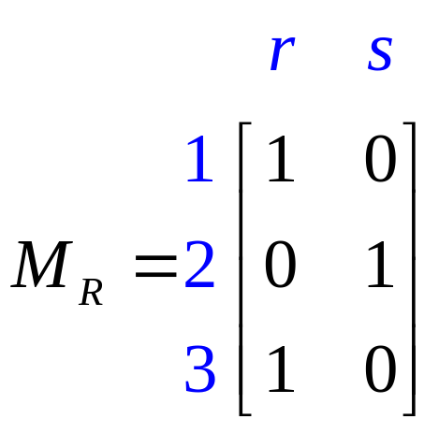
4.2 Relations and Digraphs
2. The Matrix of a Relation
Ex. (For Example 1)
A = { 1, 2, 3 } and B = { r, s }, R = { (1,r), (2,s), (3,r) }

Slide 32
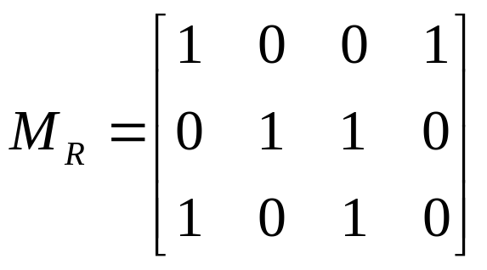
4.2 Relations and Digraphs
2. The Matrix of a Relation
Given sets A and B with |A|=m and |B|=n, an m×n matrix whose entries are zeros and ones determines a relation.
Ex.
Let A = { a₁, a₂, a₃ }, B = { b₁, b₂, b₃, b₄ }
Then (a_{i}, b_{j})∈R iff m_{ij} = 1.
Thus R = { (a₁,b₁), (a₁,b₄), (a₂,b₂), (a₂,b₃), (a₃,b₁), (a₃,b₃) }

Slide 33
4.2 Relations and Digraphs
2
1
3
3. The Digraph of a Relation
A is a finite set and R is a relation on A.
(1) Draw a small circle for each element of A and label the circle with the corresponding element of A. These circle are called vertices (vertex);
(2) Draw an arrow (edge) from vertex a_{i} to vertex a_{j} iff a_{i} R a_{j}.
The resulting pictorial representation of R is called a directed graph or digraph of R.
Ex. A = { 1,2,3,4 }
R = { (1,1), (1,2), (2,1), (2,2), (2,3), (2,4), (3,4), (4,1) }
4

Slide 34


4.2 Relations and Digraphs
3. The Digraph of a Relation
Ex. Find the relation determined by Fig. 4.5.
2
1
3
4
R = { (1,1), (1,3), (2,3), (3,2), (3,3), (4,3) }

Slide 35
4.2 Relations and Digraphs
3. The Digraph of a Relation
If R is a relation on a set A and a∈A, then
the In-Degree of a (relative to the relation R) is the number of b∈A such that (b, a)∈R, the number of arrows terminating at the vertex a, denoted by d⁻(a).
the Out-Degree of a (relative to the relation R) is the number of b∈A such that (a, b)∈R, the number of arrows leaving the vertex a, denoted by d⁺(a).

Slide 36
4.2 Relations and Digraphs
Ex.
2
1
3
4
d⁻(1) = 3, d⁺(1) = 2.

Slide 37
4.2 Relations and Digraphs
Ex.
2
1
3
4
d⁻(3) = 4, d⁺(3) = 2.
d⁻(4) = 0, d⁺(4) = 1.

Slide 38
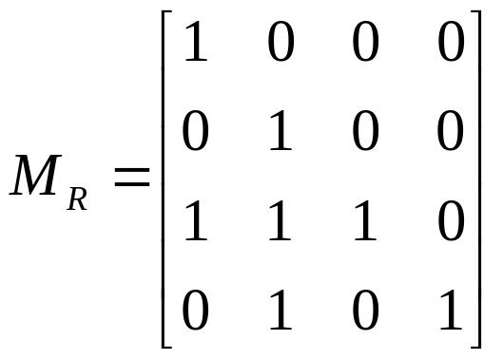

4.2 Relations and Digraphs
3. The Digraph of a Relation
Ex. A={ a, b, c, d }, R is a relation on A that has the matrix
b
a
c
Construct the digraph of R, and list in-degree and out-degree of all vertiecs.
d
a
b
c
d
In-degree
2
3
1
1
Out-degree
1
1
3
2

Slide 39
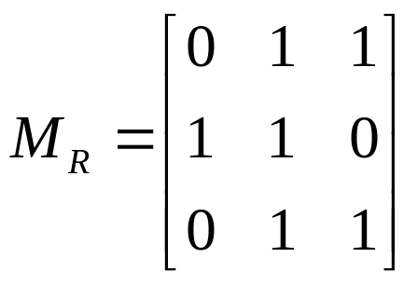
4.2 Relations and Digraphs
3. The Digraph of a Relation
Ex. A = { 1, 4, 5 }, R is given by the digraph below. Find R and its matrix M_{R}.
1
4
5
R ={ (1,4), (1,5), (4,1), (4,4), (5,4), (5,5) }

Slide 40
4.2 Relations and Digraphs
3. The Digraph of a Relation
If R is a relation on a set A and B is a subset of A, then the restriction of R to B is R∩(B×B).
Ex. A = { a, b, c, d, e, f }
R = { (a,a), (a,c), (b,c), (a,e), (b,e), (c,e) }
B = { a, b, c }
The restriction of R to B :
R∩(B×B)
= { (a,a), (a,c), (b,c), (a,e), (b,e), (c,e) }∩
{ (a,a), (a,b), (a,c), (b,a), (b,b), (b,c), (c,a), (c,b), (c,c) }
= { (a,a), (a,c), (b,c) }
R∩(B×B) = { (x, y) | (x, y) ∈ R, x, y ∈ B }
= { (a,a), (a,c), (b,c) }

Slide 41
4.2 Exercises
14. , 16. , 18. , 21. , 26.

Slide 42
4.3 Paths in Relations and Digraphs
Suppose that R is a relation on a set A.
A path of length n in R from a to b is a finite sequence
π : a, x₁, x₂, …, x_{n-1}, b, beginning with a and ending with b, such that
aRx₁, x₁Rx₂, … , x_{n-1}Rb
A path of length n involves n+1 elements of A, although they are not necessarily distinct.
The length of a path is the number of edges in the path.
A path begins and ends with the same vertex is called a cycle.

Slide 43

4.3 Paths in Relations and Digraphs
Ex.
1
2
3
5
4
π₁ : 1,2,5,4,3 — of length 4
π₂ : 1,2,5,1 — of length 3, a cycle
π₃ : 2,2 — of length 1, a cycle
π : ordered pair (x,y) — a path of length 1

Slide 44
4.3 Paths in Relations and Digraphs
Paths in a relation R can be used to define new relations: R^{n}, R∞.
R^{n}: xR^{n}y means there is a path of length n from x to y in R.
R∞: xR∞y means there is some path from x to y in R.
sometimes called the connectivity relation for R.
R^{n}(x): consists of all vertices that can be reached from x by means of a path in R of length n.
R∞(x): consists of all vertices that can be reached from x by some in R.

Slide 45
4.3 Paths in Relations and Digraphs
Ex.
A: the set of all living human beings
R: the relation of mutual acquaintance
aRb means that a and b know one another
R²: aR²b means that a and b have an acquaintance in common
R^{n}: aR^{n}b if a knows someone x₁, who knows x₂, …, who knows x_{n-1}, who knows b.
R∞: aR∞b means that some chain of acquaintances exists that begins at a and ends at b.
Is aR∞b for any pair (a,b) in this country? Interesting but unknown.

Slide 46
4.3 Paths in Relations and Digraphs
Ex.
A: a set of cities
R: xRy if there is a direct flight from x to y on at least one airline.
R^{n}: xR^{n}y if one can book a flight from x to y having exactly n-1 intermediate stops.
R∞: xR∞y if one can get from x to y by plane

Slide 47
4.3 Paths in Relations and Digraphs
Ex. A = { 1, 2, 3, 4, 5, 6 }
1
2
5
1
2
5
R
R²
3
4
6
3
4
6
A line connects two vertices in R² iff they are R²-related, there is a path of length 2 connecting those vertices in R.

Slide 48
4.3 Paths in Relations and Digraphs
Ex. Let A = { a, b, c, d, e } and R = { (a,a), (a,b), (b,c), (c,e), (c,d), (d,e) }. Compute R² and R∞.
R² = { (a,a), (a,b), (a,c), (b,e), (b,d), (c,e) }.
R∞ = { (a,a), (a,b), (a,c), (a,d), (a,e), (b,c),
(b,d), (b,e), (c,d), (c,e), (d,e) }.
When |R| is large, it is difficult to compute R∞, or even R² by searching the digraph.
M_{R} helps to accomplish these tasks more efficiently.
a
b
d
c
e

Slide 49
4.3 Paths in Relations and Digraphs
Theorem 1. If R is a relation on A = { a₁, a₂, …, a_{n} }, then M_{R}2 = M_{R}⊙M_{R}. (A⊙B is the Boolean product of A and B)
Proof:
Let M_{R}=[m_{ij}] and M_{R}2 =[n_{ij}].
The i, jth element of M_{R}⊙M_{R} is equal to 1 iff row i of M_{R} and column j of M_{R} have a 1 in the same relative position.
This means that m_{ik}=1 and m_{kj}=1 for some k, 1 ≤ k ≤ n.
By the definition of M_{R}, it means that a_{i} R a_{k} and a_{k} R a_{j}, so a_{i} R² a_{j}, n_{ij}=1.
The i, jth element of M_{R}⊙M_{R} is 1 iff n_{ij}=1.
It means that M_{R}⊙M_{R} = M_{R}2.

Slide 50
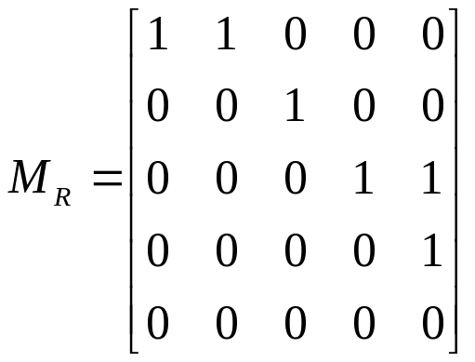
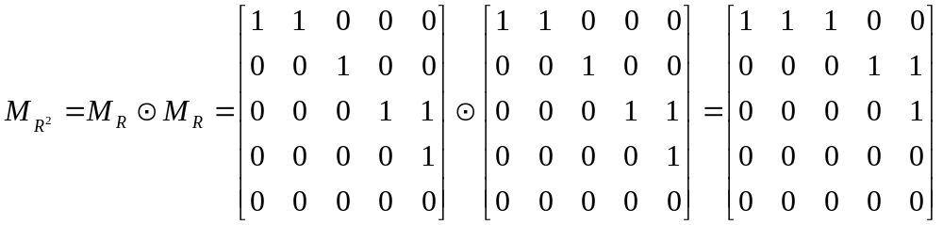
4.3 Paths in Relations and Digraphs
Ex. Matrix calculation for Example 5.
R = { (a,a), (a,b), (b,c), (c,e), (c,d), (d,e) }.
Compute R².
a
b
d
c
e

Slide 51
4.3 Paths in Relations and Digraphs
Theorem 2. For n ≥ 2 and R is a relation on a finite set A, we have M_{R}n = M_{R}⊙M_{R}⊙…⊙M_{R} (n factors).
Proof
Let P(n) be the assertion that the statement holds for n ≥ 2.
Basis Step: P(2) is true by Theorem 1.
Induction Step: Use P(k) to show P(k+1): M_{R}k+1 = M_{R}k⊙M_{R}.
let M_{R} =[ m_{ij} ], M_{R}k = [ y_{ij} ], M_{R}k+1 = [ x_{ij} ].
(1) If x_{ij} = 1, we have a path of length k+1 from a_{i} to a_{j}: a_{i}, a_{i+1}, …, a_{s}, a_{j}.
Then, there is two paths: a_{i}, a_{i+1}, …, a_{s} and a_{s}, a_{j}.
Thus, y_{is} =1 and m_{sj} =1.
So, M_{R}k⊙M_{R} is 1 in position (i, j).
(2) If M_{R}k⊙M_{R} is 1 in position (i, j), then x_{ij} = 1.
This means that M_{R}k+1 =M_{R}k⊙M_{R}.
n
Using
P(k): M_{R}k = M_{R}⊙M_{R}⊙…⊙M_{R} (k factors)
We have M_{R}k+1 = M_{R}k⊙M_{R} = (M_{R}⊙M_{R}⊙…⊙M_{R})⊙M_{R}
And hence
P(k+1): M_{R}k+1 = M_{R}⊙M_{R}⊙…⊙M_{R}⊙M_{R} (k+1 factors)
is true. Thus, by the principle of mathematical induction, P(n) is true for all n ≥ 2.
We write M_{R}⊙M_{R}⊙…⊙M_{R}⊙M_{R} (n factors) as (M_{R})⊙^{n}.

Slide 52
4.3 Paths in Relations and Digraphs
R∞ = R∪R²∪R³∪… =∪_{k=1..∞}R^{k}
M_{R}∞ = M_{R} ∨ M_{R}2 ∨ M_{R}3 ∨ …
= M_{R} ∨ (M_{R})⊙² ∨ (M_{R})⊙³ ∨ …
The reachability relation R* of a relation R on a set A is defined as followings:
xR*y means that x = y or xR∞y
M_{R}* = I_{n} ∨ M_{R}∞ (I_{n} : the n×n identity matrix)
= I_{n} ∨ M_{R} ∨ (M_{R})⊙²∨ (M_{R})⊙³ ∨ …

Slide 53
4.3 Paths in Relations and Digraphs
Let π₁: a, x₁, x₂, …, x_{n-1}, b be a path in a relation R of length n from a to b, and let π₂: b, y₁, y₂, …, y_{m-1}, c be a path in a relation R of length m from b to c.
The composition of π₁ and π₂ is the path a, x₁, x₂, …, x_{n-1}, b, y₁, y₂, …, y_{m-1}, c of length n+m, which is denoted by π_{2 °}π₁. This is a path from a to c.
Ex. Consider the relation
whose digraph is given and the paths
π₁: 1, 2, 3 and π₂: 3, 5, 6, 2, 4.
Then the composition of π₁ and π₂
is the path π_{2 °}π₁: 1, 2, 3, 5, 6, 2, 4
from 1 to 4 of length 6.
1
2
3
4
5
6

Slide 54
4.4 Properties of Relations
1. Reflexive and Irreflexive
A relation R on a set A is reflexive(自反的) if (a,a)∈R (aRa) for all a∈A.
A relation R on a set A is irreflexive(反自反的) if (a,a)∉R (aRa) for all a∈A.
R is reflexive if every element is related to itself.
R is irreflexive if no element is related to itself.
Matrix: all 1’s in its main diagonal.
Digraph: a cycle of length 1 at every vertex.
Matrix: all 0’s in its main diagonal.
Digraph: no cycle of length 1 at any vertex.

Slide 55
4.4 Properties of Relations
1. Reflexive and Irreflexive
Ex.
(1) Δ = { (a,a) | a∈A }
the relation of equality on A: reflexive.
(2) R = { (a,b)∈A×A | a≠b }
the relation of inequality: irreflexive.
(3) A = { 1,2,3 }, R = { (1,1),(1,2) }
R is not reflexive and not irreflexive.
(4) A is nonempty set, R = Ø ⊆ A×A, the empty relation.
R is not reflexive, and is irreflexive.
R is reflexive iff Δ ⊆ R, R is irreflexive iff Δ∩R= Ø.
If R is reflexive on a set A, then Dom(R) = Ran(R) = A.

Slide 56
4.4 Properties of Relations
2. Symmetric, Asymmetric and Antisymmetric
(1) A relation R on a set A is symmetric (对称的):
∀(a,b)((a,b)∈R→ (b,a)∈R)
(2) A relation R on a set A is not symmetric:
∃(a,b)((a,b)∈R∧(b,a)∉R)
(3) A relation R on a set A is asymmetric (非对称的):
∀(a,b)((a,b)∈R→ (b,a)∉R)
(4) A relation R on a set A is not asymmetric:
∃(a,b)((a,b)∈R∧(b,a)∈R)

Slide 57
4.4 Properties of Relations
2. Symmetric, Asymmetric and Antisymmetric
(5) A relation R on a set A is antisymmetric (反对称的):
∀(a,b)∀(b,a)((a,b), (b,a)∈R→ b=a)
(6) A relation R on a set A is not antisymmetric:
∃(a,b)∃(b,a)((a,b), (b,a)∈R∧ b≠a)
Notice: Difference between Asymmetric and Antisymmetric relations.

Slide 58
4.4 Properties of Relations
2. Symmetric, Asymmetric and Antisymmetric
Ex. A = Z, the set of integers, R = { (a,b)∈A×A | a < b },
Is R symmetric, asymmetric or antisymmetric?
Symmetry: “If a < b, then b < a ” is not true, so R is not symmetric;
Asymmetry: “If a < b, then b < a ” is true, so R is asymmetric;
Antisymmetry: “ If a < b and b < a, then a = b ” is true, so R is antisymmetric.

Slide 59
4.4 Properties of Relations
2. Symmetric, Asymmetric and Antisymmetric
Ex. A: a set of people
R = { (x,y) ∈A×A | x is a cousin of y }
R is a symmetric relation
Ex. A = { 1,2,3,4 }
R = { (1,2), (2,2), (3,4), (4,1) }
R is not symmetric
R is not asymmetric
R is antisymmetric
(1,2)∈R but (2,1)∉R
(2,2)∈R
(2,1)∉R, (4,3)∉R,(1,4)∉R

Slide 60
4.4 Properties of Relations
2. Symmetric, Asymmetric and Antisymmetric
Ex. A = Z⁺, the set of positive integers
R = { (a,b) ∈A×A | a divides b }
R is not symmetric If a|b, it does not follow b|a for a ≠ b
R is not asymmetric For a=b, a|b and b|a
R is antisymmetric If a|b and b|a, then a=b

Slide 61
4.4 Properties of Relations
2. Symmetric, Asymmetric and Antisymmetric
The matrix M_{R} = [m_{ij}] of a symmetric relation satisfies the property that “If m_{ij}=1, then m_{ji}=1”.
Each pair of entries symmetrically placed about the main diagonal are either both 0 or both 1.
If M_{R} = M_{R}^{T} , M_{R} is a symmetric matrix.
The matrix M_{R} of an asymmetric relation satisfies the property that “If m_{ij}=1, then m_{ji}=0”.
If R is asymmetric, it follows that m_{ii}=0 for all i, the main diagonal of the matrix M_{R} consists entirely 0’s.
The matrix M_{R} of an antisymmetric relation satisfies the proper that “If m_{ij}= m_{ji}=1, then i = j ”.

Slide 62
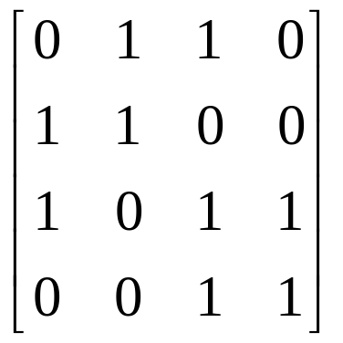
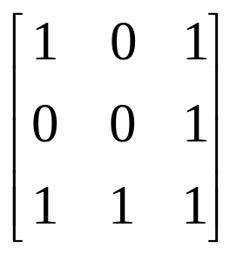
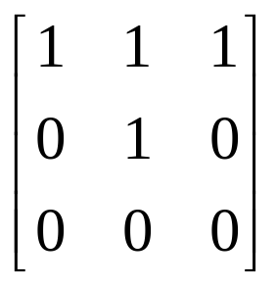
4.4 Properties of Relations
2. Symmetric, Asymmetric and Antisymmetric
Symmetric
not asymmetric
not antisymmetric
symmetric
not asymmetric
not antisymmetric
not symmetric
not asymmetric
antisymmetric

Slide 63
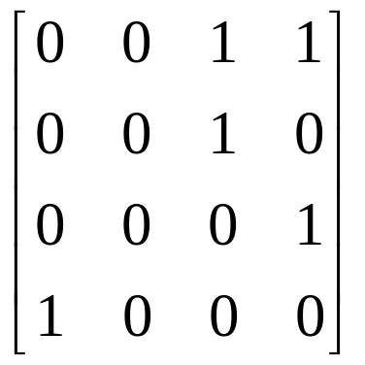
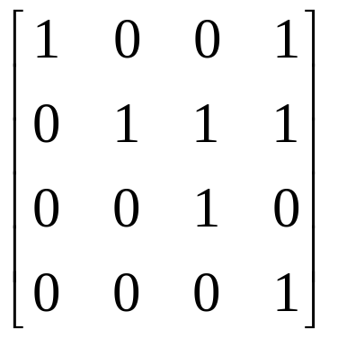
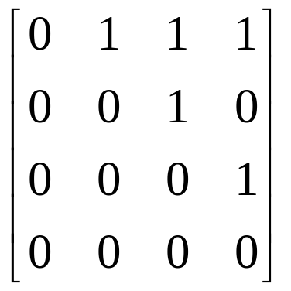
4.4 Properties of Relations
2. Symmetric, Asymmetric and Antisymmetric
not symmetric
not asymmetric
not antisymmetric
not symmetric
not asymmetric
antisymmetric
not symmetric
asymmetric
antisymmetric

Slide 64
4.4 Properties of Relations
2. Symmetric, Asymmetric and Antisymmetric
The digraph of a symmetric relation has the property that if there is an edge from vertex i to vertex j, then there is an edge from vertex j to vertex i.
If two vertices are connected by an edge, then they must always be connected in both directions.
If vertices a and b are connected by edges in each direction, we replace the two edges with one undirected edges, “two-way street”. The undirected edge is a single line without arrows and connects a and b.
The resulting diagram will be called the graph of the symmetric relation.

Slide 65
4.4 Properties of Relations
2. Symmetric, Asymmetric and Antisymmetric
Ex. A = { a, b, c, d, e }
R = { (a,b), (b,a), (a,c), (c,a), (b,c), (c,b), (b,e), (e,b), (e,d), (d,e), (c,d), (d,c) }
a
c
a
c
b
b
e
d
e
d

Slide 66
4.4 Properties of Relations
2. Symmetric, Asymmetric and Antisymmetric
A symmetric relation R on a set A is called connected (连通的) if there is a path from any element of A to any other element of A.
The graph of R is all in one piece.
a
b
1
2
c
3
e
5
d
4
connected
not connected

Slide 67
4.4 Properties of Relations
2. Symmetric, Asymmetric and Antisymmetric
The digraph of an asymmetric relation can not simultaneous-ly have
an edge from vertex i to vertex j and
an edge from vertex j to vertex i
for any i and j
INCLUDING the case i = j (no cycle of length 1)

Slide 68
4.4 Properties of Relations
2. Symmetric, Asymmetric and Antisymmetric
The digraph of an antisymmetric relation can not simultaneously have
an edge from vertex i to vertex j and
an edge from vertex j to vertex i
for different i and j
No condition is imposed when i = j ( there may be cycles of length 1)

Slide 69
4.4 Properties of Relations
3. Transitive relation
A relation R on a set A is transitive (传递的):
(a,b), (b,c)∈R ⇒ (a,c)∈R
A relation R on a set A is not transitive:
(a,b), (b,c)∈R ⇒ (a,c)∉R
Ex. A = Z, R = “<”
R is transitive.
Assume that aRb and bRc, thus a<b and b<c. It then follows that a<c, so aRc.

Slide 70
4.4 Properties of Relations
3. Transitive relation
Ex. A = Z+, R = { (a,b)∈A×A | a divides b }
R is transitive.
Suppose that aRb and bRc, thus a|b and b|c.
It then follows that a|c, so aRc.
Ex. A = { 1, 2, 3, 4 }, R = { (1,2), (1,3), (4,2) }
R is transitive.
Since (a,b), (b,c)∈R ⇒ (b,c)∈R, we conclude that R is transitive.

Slide 71
4.4 Properties of Relations
3. Transitive relation
A relation R is transitive if and only if its matrix M_{R}=[m_{ij}] has the property:
If m_{ij}=1 and m_{jk}=1, then m_{ik}=1
(M_{R})⊙²[i,k]=1
M_{R}[i,k] =1
If (M_{R})⊙² = M_{R} then R is transitive.
The converse is not true!

Slide 72
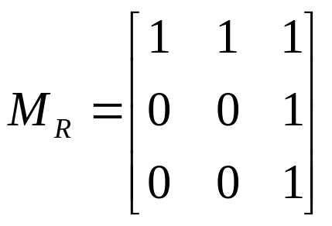
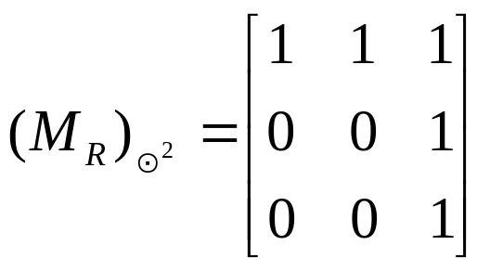
4.4 Properties of Relations
3. Transitive relation
Ex. A = { 1, 2, 3 }
By direct computation,
(M_{R})⊙² = M_{R}, therefore, R is transitive.

Slide 73
4.4 Properties of Relations
3. Transitive relation
Equivalent Definition of Transitivity.
A relation R on a set A is transitive If for any a, c∈R, aR²c ⇒ aRc.
In other words, if a and c are connected by a path of length 2 in R, then they must be connected by a path of length 1, or R² ⊆ R.

Slide 74
4.4 Properties of Relations
3. Transitive relation
Theorem 1. A relation R is transitive if and only if it satisfies the following property:
If there is a path of length greater than 1 from vertex a to vertex b, then there is a path of length 1 from a to b (that is, a is related to b).
R is transitive if and only if R^{n}⊆R for n ≥ 1.
Theorem 2. Let R be a relation on a set A. Then
(1) Reflexivity of R means that a∈R(a) for all a in A.
(2) Symmetry of R means that a∈R(b) iff b∈R(a).
(3) Transitivity of R means that if b∈R(a) and c∈R(b), then c∈R(a).

Slide 75
4.4 Exercises
13. , 14. , 15. , 16. , 17. , 18. , 21.

Slide 76
4.5 Equivalence Relations
A relation R on a set A is called an equivalence relation (等价关系) if it is reflexive, symmetric and transitive.
Ex. A : the set of all triangles in the plane,
R = { (a,b)∈A×A | a is congruent (≅) to b }
R is an equivalence relation. (三角形全等关系)
Ex. A = { 1, 2, 3, 4 }
R = { (1,1), (1,2), (2,1), (2,2), (3,4), (4,3), (3,3), (4,4) }
R is an equivalence relation.
Ex. A = Z, the set of integers,
R defined by “aRb iff a ≤ b”
R is not an equivalence relation (not symmetric).

Slide 77
4.5 Equivalence Relations
Ex. A = Z, R = { (a,b)∈A×A | a ≡ b (mod 2)}. Show that R is an equivalence relation. a ≡ b (mod 2) denoted by a ≡₂b
Solution
(1) Reflexivity: a ≡₂ a, thus R is reflexive;
(2) Symmetry: If a ≡₂ b, then b ≡₂ a. R is symmetric;
(3) Transitivity: Suppose a ≡₂ b and b ≡₂ c,
then a, b and c yield the same remainder when divided by 2. Thus a ≡₂ c. R is transitive.
So R is an equivalence relation.
Ex. A = Z, n ∈ Z⁺, R = { (a,b)∈A×A| a ≡_{n} b }.
We can show that R is an equivalence relation.

Slide 78
4.5 Equivalence Relations
Theorem 1. Let P be a partition of a set A. Define the relation R on A as follows:
aRb iff a and b are members of the same block.
Then R is an equivalence relation on A.
Proof:
(1) Reflexivity If a∈A, then a is in the same block as itself; so aRa.
(2) Symmetry If aRb, then a and b are in the same block; so bRa.
(3) Transitivity If aRb and bRc, then a, b and c must all lie in the same block of P. Thus, aRc.
Since R is reflexive, symmetric and transitive, R is an equivalence relation.
R is called the equivalence relation determined by P.

Slide 79
4.5 Equivalence Relations
Ex. A = { 1, 2, 3, 4 }, P = {{1,2,3},{4}}. Find the equivalence relation R on A determined by P.
Solution
The blocks of P are {1,2,3} and {4}, each element in a block is related to every other element in the same block and only to those elements.
{1,2,3} ⇒ { (1,1),(1,2),(1,3),(2,1),(2,2),(2,3),(3,1),(3,2),(3,3) }
{4} ⇒ { (4,4) }
Thus, R = { (1,1), (1,2), (1,3), (2,1), (2,2), (2,3), (3,1), (3,2), (3,3), (4,4) }.

Slide 80
4.5 Equivalence Relations
Lemma 1. Let R be an equivalence relation on a set A, a∈A and b∈A. Then, aRb iff R(a) = R(b).
Proof:
(1) Sufficiency: Suppose that R(a) = R(b)
Since R is reflexive, b∈R(b) = R(a), so aRb.
(2) Necessity: Suppose that aRb
(2.1) For any x∈R(b), bRx by definition.
Since aRb, bRx, and R is transitive, we have aRx.
Hence x∈R(a). So R(b) ⊆ R(a).
(2.2) For any y∈R(a), aRy .
Since R is symmetric and aRb, we have bRa.
Since bRa, aRy, R is the transitivity, we have bRy.
Hence y∈R(b). So R(a) ⊆ R(b).
Therefore R(a)=R(b) held.

Slide 81
4.5 Equivalence Relations
Theorem 2. Let R be an equivalence relation on A, and let P be the collection of all distinct relative sets R(a) for a in A. Then P is a partition of A, and R is an equivalence relation determined by P.
Proof
According to the definition of a partition, we have to show the following two properties:
(1) Every element of A belongs to some relative set.
(2) If R(a) and R(b) are not identical, then R(a)∩R(b)=Ø.

Slide 82
4.5 Equivalence Relations
Since a∈R(a) by reflexivity of R, property (1) is true.
Suppose that R(a)∩R(b)≠Ø.
We assume that c∈R(a)∩R(b), then aRc and bRc.
Since R is symmetrical, we have cRb.
By transitivity of R, with aRc and cRb, we have aRb.
Lemma 1 tells us that R(a) = R(b).
With (1) and (2), P is proved to be a partition.
By Lemma 1, aRb iff a and b belong to the same block of P.
Thus, P determines R.

Slide 83
4.5 Equivalence Relations
If R is an equivalence relation on A, then the sets R(a) are called an equivalence class of R. R(a) is denoted by [a].
The partition P constructed in Th.2 consists of all equivalence classes of R. This partition is denoted by A/R.
Recall that partitions of A are called quotient sets (商集) of A. P is one of A’s quotient sets and the notation A/R reminds us that is P constructed from and determines R, which is an equivalence relation.

Slide 84
4.5 Equivalence Relations
Ex. Determine A/R in Example 2
A = { 1, 2, 3, 4 }
R = { (1,1), (1,2), (2,1), (2,2), (3,4), (4,3), (3,3), (4,4) }
Solution
R(1) = { 1,2 } = R(2)
R(3) = { 3,4 } = R(4)
A/R = { R(1), R(3) } = { {1,2}, {3,4} }

Slide 85
4.5 Equivalence Relations
Ex. Determine A/R in Example 4
A = Z, R = { (a,b)∈A×A| a ≡₂ b }
Solution
R(0) = { …,-6,-4,-2,0,2,4,6,… } is the set of even integers
R(1) ={ …,-5,-3,-1,1,3,5,… } is the set of odd integers
A/R = { set of even integers, set of odd integers }

Slide 86
4.5 Equivalence Relations
General Procedure for determining partition A/R for A finite or countable, R is an equivalence Relation on A.
Step 1: i = 0;
Step 2: For some a∈A, compute R(a) , denoted by A_{i} ;
Step 3: A ← A – A_{i} , i ← i + 1;
Step 4: Repeat step 2~3 until A=∅;
Step 5: {A₀ , A₁ , …, A_{i-1} } are the partition A/R.

Slide 87
4.5 Exercises
18. , 20. , 24.

Slide 88
4.6 Computer Representation of Relations and Digraphs
这里讲解的关系和图的存储方式比较简单，仅是一种存储方式，图的多样存储方式将在《数据结构》课程中有更多的讲解，而且存储方式也不是《离散数学》课程的重要内容。
所以，不在此进行讲解，感兴趣的同学自行阅读理解。

Slide 89
4.7 Operation on Relations
The complement of R from A to B, R, referred to as the complementary relation is a relation expressed in terms of R:
aRb iff aRb
Intersection: The relation R∩S of R and S:
a (R∩S) b iff aRb and aSb
Union: The relation R∪S of R and S:
a (R∪S) b iff aRb or aSb
Symmetric difference: The relation R⊕S of R and S:
a (R⊕S) b iff aRb and aSb or aRb and aSb
The complement of R from A to B, R, referred to as the complementary relation is a relation expressed in terms of R:
aRb iff aRb
Intersection: The relation R∩S of R and S:
a (R∩S) b iff aRb and aSb
Union: The relation R∪S of R and S:
a (R∪S) b iff aRb or aSb
Symmetric difference: The relation R⊕S of R and S:
a (R⊕S) b iff aRb and aSb or aRb and aSb

Slide 90
4.7 Operation on Relations
The inverse relation of R from A to B , R⁻¹, is a relation from B to A defined by:
a R⁻¹ b iff bRa
(R⁻¹)⁻¹ = R, Dom(R⁻¹) = Ran(R), Ran(R⁻¹) = Dom(R).

Slide 91
4.7 Operation on Relations
Ex. A = { 1, 2, 3, 4 }, B = { a, b, c },
R = { (1,a), (1,b), (2,b), (2,c), (3,b), (4,a) },
S = { (1,b), (2,c), (3,b), (4,b) }.
Compute R, R∩S, R∪S, R⁻¹.
Solution
A×B = { (1,a), (1,b), (1,c), (2,a), (2,b), (2,c), (3,a), (3,b), (3,c), (4,a), (4,b), (4,c) }
R = { (1,c), (2,a), (3,a), (3,c), (4,b), (4,c) }
R∩S = { (1,b), (3,b), (2,c) }
R∪S = { (1,a), (1,b), (2,b), (2,c), (3,b), (4,a), (4,b) }
R⁻¹ = { (a,1), (b,1), (b,2), (c,2), (b,3), (a,4) }
Ex. A = { 1, 2, 3, 4 }, B = { a, b, c },
R = { (1,a), (1,b), (2,b), (2,c), (3,b), (4,a) },
S = { (1,b), (2,c), (3,b), (4,b) }.
Compute R, R∩S, R∪S, R⁻¹.
Solution
A×B = { (1,a), (1,b), (1,c), (2,a), (2,b), (2,c), (3,a), (3,b), (3,c), (4,a), (4,b), (4,c) }
R = { (1,c), (2,a), (3,a), (3,c), (4,b), (4,c) }
R∩S = { (1,b), (3,b), (2,c) }
R∪S = { (1,a), (1,b), (2,b), (2,c), (3,b), (4,a), (4,b) }
R⁻¹ = { (a,1), (b,1), (b,2), (c,2), (b,3), (a,4) }

Slide 92
4.7 Operation on Relations
Ex. A = R , the set of real numbers.
R: ≤ , S: ≥
The complement of R is >
The complement of S is <
R⁻¹ = S;
S⁻¹ = R;
R∩S: =
R∪S: A×A, the universal relation on A

Slide 93
4.7 Operation on Relations
Ex. A = { a, b, c, d }, R and S shown in the Figures.
R
b
S
R∩S
b
b
a
c
a
c
a
c
e
d
e
d
e
d
R = { (a,a), (b,b), (a,c), (b,a), (c,b), (c,d), (c,e), (c,a), (b,d), (d,a), (d,e), (e,b), (e,a), (e,d), (e,c) }
R⁻¹ = { (b,a), (e,b), (c,c), (c,d), (d,d), (d,b), (c,b), (d,a), (e,e), (e,a) }
R∩S = { (a,b), (b,e), (c,c) }

Slide 94
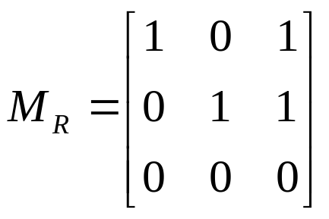
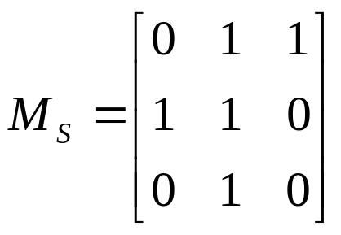
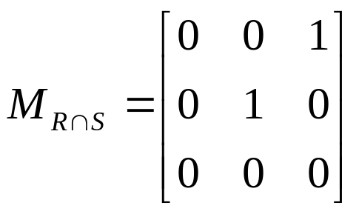
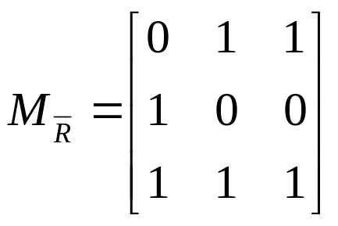
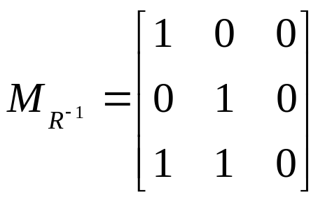
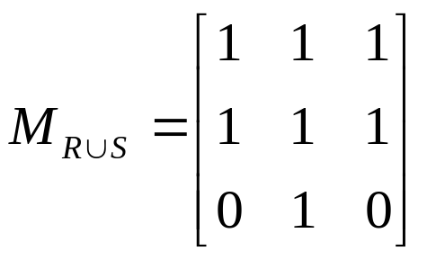
4.7 Operation on Relations
Ex. A = { 1, 2, 3 }; R, S relations on A.

Slide 95
4.7 Operation on Relations
General facts about operations on Boolean matrices
M_{R∩S} = M_{R} ∧ M_{S}
M_{R∪S} = M_{R} ∨ M_{S}
M_{R}-1 = (M_{R})^{T}
M_{R} = M_{R}
For a symmetric relation, M_{R} = (M_{R})^{T}.
Since M_{R}-1 = (M_{R})^{T}, Then, R is symmetric iff R=R⁻¹.

Slide 96
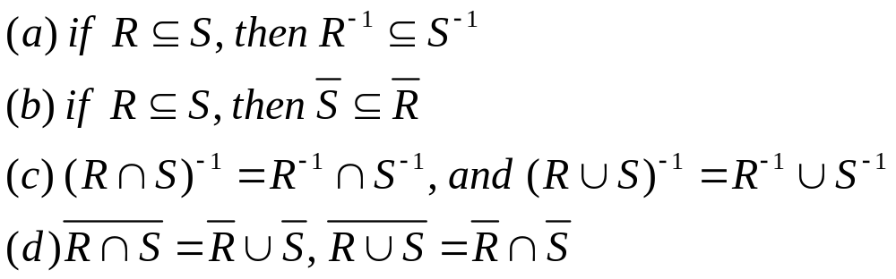
4.7 Operation on Relations
Theorem 1. Suppose that R and S are relation from A to B.
Part (b) & (d) are special cases of general set properties proven in Section 1.2.
We only prove part (a) and (c) here.

Slide 97
4.7 Operation on Relations
Theorem 1. Suppose that R and S are relation from A to B.
Proof
(a) For any (a,b)∈R⁻¹, (b,a)∈R ⊆ S,
then (b,a)∈S and so (a,b)∈S⁻¹.
thus, R⁻¹ ⊆ S⁻¹.

Slide 98
4.7 Operation on Relations
Theorem 1. Suppose that R and S are relation from A to B.
Proof:
First Part: (R∩S)⁻¹ = R⁻¹∩S⁻¹.
(1) (R∩S)⁻¹ ⊆ R⁻¹∩S⁻¹
For any (a,b)∈(R∩S)⁻¹, (b,a)∈R∩S, so (b,a)∈R and (b,a)∈S
it means that (a,b)∈R⁻¹ and (a,b)∈S⁻¹,
So, (a,b)∈R⁻¹∩S⁻¹.
Thus, (R∩S)⁻¹ ⊆ R⁻¹∩S⁻¹
(2) R⁻¹∩S⁻¹ ⊆ (R∩S)⁻¹ (Similarly)
So, (R∩S)⁻¹ = R⁻¹∩S⁻¹.

Slide 99
4.7 Operation on Relations
Theorem 1. Suppose that R and S are relation from A to B.
Proof:
Second part: (R∪S)⁻¹ = R⁻¹∪ S⁻¹.
(1) (R∪S)⁻¹ ⊆ R⁻¹∪ S⁻¹
(2) R⁻¹∪ S⁻¹ ⊆ (R∪S)⁻¹
Similar argument.

Slide 100
4.7 Operation on Relations
Theorem 2. Let R and S be relation on A.
(a) If R is reflexive, then so is R⁻¹.
(b) If R and S are reflexive, then so are R∩S and R∪S.
(c) R is reflexive iff R is irreflexive.
Proof:
Let Δ be the equality relation on A, Δ = Δ⁻¹.
(a) We know that “R is reflexive iff Δ ⊆ R”.
By Th.1(a), Δ ⊆ R, then Δ⁻¹ ⊆ R⁻¹, or Δ ⊆ R⁻¹.
So (a) follows.

Slide 101
4.7 Operation on Relations
Theorem 2. Let R and S be relation on A.
(a) If R is reflexive, then so is R⁻¹.
(b) If R and S are reflexive, then so are R∩S and R∪S.
(c) R is reflexive iff R is irreflexive.
Proof:
Let Δ be the equality relation on A, Δ = Δ⁻¹.
(b) We know that R is reflexive iff Δ ⊆ R.
Since Δ⊆R and Δ⊆S, then Δ⊆ R∩S and Δ⊆R∪S.
so R∩S and R∪S are reflexive.
(c) We note that S is irreflexive iff Δ∩S=Ø.
So, R is reflexive iff Δ⊆R iff Δ∩R=Ø iff R is irreflexive.

Slide 102
4.7 Operation on Relations
Ex. A = { 1, 2, 3 } and two reflexive relations,
R = { (1,1), (1,2), (1,3), (2,2), (3,3) },
S = { (1,1), (1,2), (2,2), (3,2), (3,3) }.
Then
(a) R⁻¹ = { (1,1), (2,1), (3,1), (2,2), (3,3) }. R and R⁻¹ are both reflexive.
(b) R = { (2,1), (2,3), (3,1), (3,2) } is irreflexive while R is reflexive.
(c) R∩S = {(1,1), (1,2), (2,2), (3,3) }
R∪S = { (1,1), (1,2), (1,3), (2,2), (3,2), (3,3) }
R∩S, R∪S are both reflexive.

Slide 103
4.7 Operation on Relations
Theorem 3. Let R be relation on A. Then
(a) R is symmetric iff R = R⁻¹.
(b) R is antisymmtric iff (R∩R⁻¹) ⊆ Δ.
(c) R is asymmetric iff R∩R⁻¹ = Ø.

Slide 104
4.7 Operation on Relations
Theorem 4. Let R and S be relations on A. Then
(a) If R is symmetric, so are R⁻¹ and R.
(b) If R and S are symmetric, so are R∩S and R∪S.
Proof
(a) If R is symmetric, then R=R⁻¹, and thus
(R⁻¹)⁻¹=R=(R⁻¹), which means that R⁻¹ is symmetric.
(a,b)∈(R)⁻¹ iff (b,a)∈R
iff (b,a)∉R
iff (a,b)∉R⁻¹=R
iff (a,b)∈R.
It means that (R)⁻¹ = R. Thus R is symmetric.

Slide 105
4.7 Operation on Relations
Theorem 4. Let R and S be relations on A. Then
(a) If R is symmetric, so are R⁻¹ and R.
(b) If R and S are symmtric, so are R∩S and R∪S.
Proof
(b) If R and S are symmetric, then R⁻¹=R and S⁻¹=S.
By Th.1(c), (R∩S)⁻¹ = R⁻¹∩S⁻¹ and (R∪S)⁻¹ = R⁻¹∪S⁻¹
Then, we have (R∩S)⁻¹ = R⁻¹∩S⁻¹ = R∩S
and (R∪S)⁻¹ = R⁻¹∪S⁻¹ = R∪S.
So R∩S and R∪S both are symmetric.

Slide 106
4.7 Operation on Relations
Ex. A = { 1, 2, 3 } and two symmetric relations,
R = { (1,1), (1,2), (2,1), (1,3), (3,1) },
S = { (1,1), (1,2), (2,1), (2,2), (3,3) }.
Then
(1) R⁻¹ = { (1,1), (2,1), (1,2), (3,1), (1,3) }
R = { (2,2), (2,3), (3,2), (3,3) }
R⁻¹ and R are symmetric.
(2) R∩S = { (1,1), (1,2), (2,1) }
R∪S = { (1,1), (1,2), (1,3), (2,1), (2,2), (3,1), (3,3) }
R∩S, R∪S are both symmetric.

Slide 107
4.7 Operation on Relations
Theorem 5. Let R and S be relations on A. Then
(a) (R∩S)² ⊆ R²∩S².
(b) If R and S are transitive, so is R∩S.
(c) If R and S are equivalence relation, so is R∩S.
Proof
(a) Proving Geometrically.
a(R∩S)²b iff there is a path of length 2 from a to b in R∩S.
Both edges of this path lie in R and S, so aR²b and aS²b, which implies that a(R²∩S²)b.
So, (R∩S)² ⊆ R²∩S².

Slide 108
4.7 Operation on Relations
Theorem 5. Let R and S be relations on A. Then
(a) (R∩S)² ⊆ R²∩S².
(b) If R and S are transitive, so is R∩S.
(c) If R and S are equivalence relation, so is R∩S.
Proof
(b) T is transitive iff T²⊆T.
If R and S are transitive, then R²⊆R and S²⊆S.
So, by (a), (R∩S)² ⊆ R²∩S²⊆ R∩S.
Thus, R∩S is transitive.

Slide 109
4.7 Operation on Relations
Theorem 5. Let R and S be relations on A. Then
(a) (R∩S)² ⊆ R²∩S².
(b) If R and S are transitive, so is R∩S.
(c) If R and S are equivalence relation, so is R∩S.
Proof
(c) R and S are each reflexive, symmetric and transitive,
By Th.2(b) “If R and S are reflexive, then so is R∩S”.
Th.4(b) “If R and S are symmetric, so is R∩S”.
Th.5(b) “If R and S are transitive, so is R∩S”.
respectively, R∩S is reflexive, symmetric and transitive, So (c) holds.

Slide 110
4.7 Operation on Relations
Ex. R and S: equivalence relation on a finite set A
A/R and A/S: the corresponding partitions.
R∩S is an equivalence relation.
A/(R∩S) is the corresponding partition.
Describe A/(R∩S) in terms of A/R and A/S
(R∩S)(x) = R(x)∩S(x).

Slide 111
4.7 Operation on Relations
Let W: a block of A/(R∩S), and a∈W, b∈W.
a(R∩S)b, then aRb and aSb;
a and b belong to the same block X of A/R
a and b belong to the same block Y of A/S
This means that W⊆X∩Y.
The steps in this argument are reversible (X∩Y⊆W), therefore, W=X∩Y.
Thus, We can directly compute the partition A/(R∩S) by finding all possible interactions of blocks in A/R with blocks in A/S.

Slide 112
4.8 Transitive Closures & Warshall’s Alg
1. Transitive Closure
Theorem 1. R is a relation on A. Then R∞ is the transitive closure of R.
Proof.
We know that aR∞b iff there is a path in R from a to b.
(1) R∞ is transitive since if aR∞b and bR∞c, then aR∞c (path);
(2) We need to prove that if S is transitive and R ⊆ S, then R∞⊆ S. (Minimum)

Slide 113
4.8 Transitive Closures & Warshall’s Alg
1. Transitive Closure
Proof (Theorem 1)
Th.1 in Section 4.4 says that S is transitive iff S^{n} ⊆S for all n.
It follows that S∞=∪_{n=1..∞}S^{n} ⊆S.
It is also true that if R⊆S then R∞⊆ S∞, since any path in R is also a path in S.
Putting these facts together, we hold that if S is transitive and R⊆S, then R∞⊆S∞⊆S. So, R∞ is the smallest of all transitive relations on A that contain R.
The reachability relation R* is R∞∪Δ.

Slide 114
4.8 Transitive Closures & Warshall’s Alg
1. Transitive Closure
Ex. A={ 1,2,3,4 } and R={ (1,2), (2,3), (3,4), (2,1) }. Find the transitive closure of R.
Method 1 - Computing all paths
From vertex 1, we have paths to vertices 2, 3, 4 and 1;
From vertex 2, we have paths to vertices 2, 1, 3 and 4;
From vertex 3, we have path only to vertex 4.
So, we have
R∞= { (1,1), (1,2), (1,3),(1,4),
(2,1), (2,2), (2,3), (2,4), (3,4) }.
2
1
3
4

Slide 115
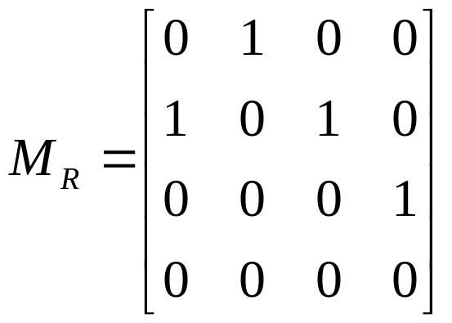
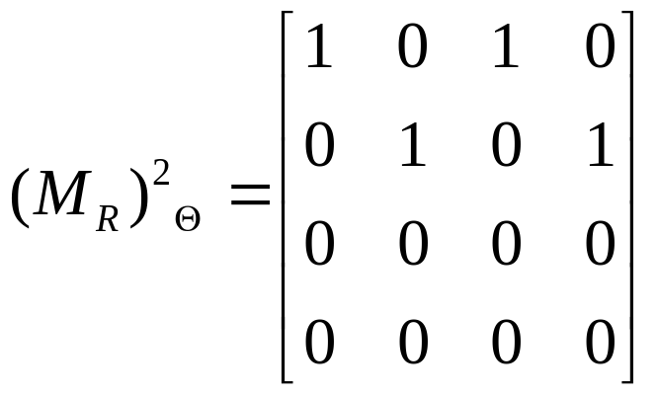
4.8 Transitive Closures & Warshall’s Alg
1. Transitive Closure
Ex. A={ 1,2,3,4 } and R={ (1,2), (2,3), (3,4), (2,1) }. Find the transitive closure of R.
Method 2 - Computing matrices

Slide 116
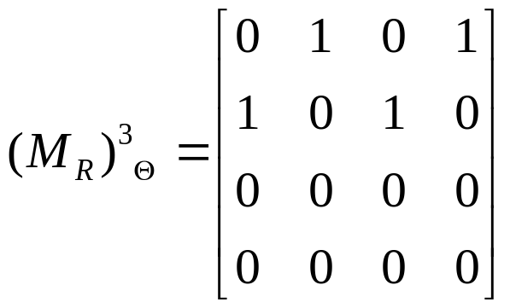
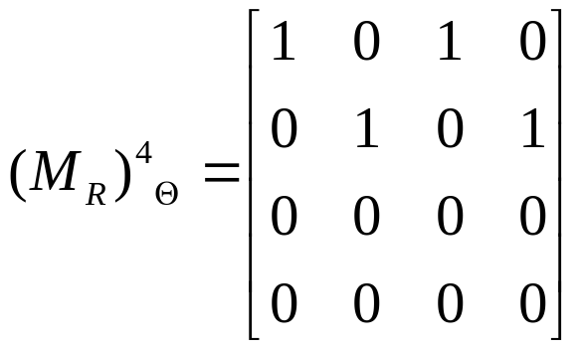
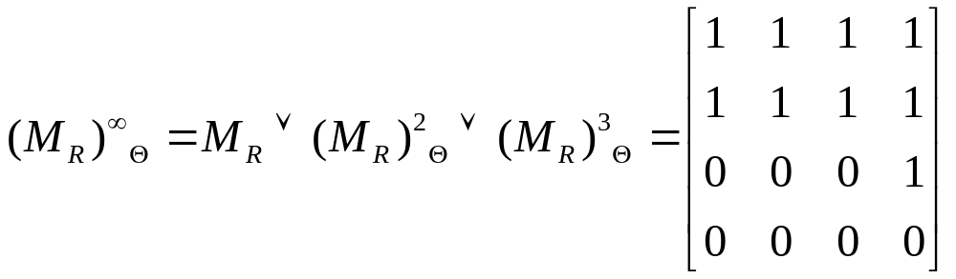
4.8 Transitive Closures & Warshall’s Alg
1. Transitive Closure
(M_{R}) ^{2k}⊙ = (M_{R}) ²⊙, (M_{R}) ^{2k+1}⊙ = (M_{R}) ³⊙
We do not need to compute all power R^{n} to obtain R∞!

Slide 117
4.8 Transitive Closures & Warshall’s Alg
x_{i+1}
x_{j-1}
1. Transitive Closure
Theorem 2. Let A be a set with |A|=n, and let R be a relation on A.
Then R∞ = R∪R²∪…∪R^{n}.
Proof
Let a and b be in A, suppose that a, x₁, x₂, …, x_{m}, b is a path from a to b in R; that is (a,x₁),(x₁,x₂), …, (x_{m},b) are all in R.
If x_{i}=x_{j}, i<j, then the path can be divided into three sections: a path from a to x_{i}, x_{i} to x_{j} (a cycle), x_{j} to x_{b}.
So, we leave the cycle and get a shorter path from a to b: a, x₁, x₂, …, x_{i}, x_{j+1}, …, b.
(1) If a≠b, then a, x₁, x₂, …, x_{k}, b are distinct (Otherwise, shorter path found), thus the length of the path is at most n-1.
(2) If a=b, then a, x₁, x₂, …, x_{k} are distinct, so the length of the path is at most n.
In other words, if a R∞ b then a R^{k} b for some 1≤k≤n.
Thus R∞ = R∪R²∪…∪R^{n}.
a
x₁
x₂
x_{i}/x_{j}
x_{i}
x_{j}
x_{j+1}
b

Slide 118
4.8 Transitive Closures & Warshall’s Alg
Warshall 算法 -Warshall Algorithm
输入: M (R的关系矩阵)
输出: M_{t} (t(R)的关系矩阵)
1) M_{t} ← M
2) for k ← 1 to n do
3) for i ← 1 to n do
4) for j ← 1 to n do
5) M_{t}[i, j] = M_{t}[i, j] ∨ M_{t}[i, k] ∧ M_{t}[k, j]
逻辑加
逻辑乘

Slide 119
4.8 Transitive Closures & Warshall’s Alg
[Warshall 算法] 设 A_{n×n} 是图 G 的邻接矩阵, 求 G 的道路矩阵 P。
  P ←A
  i ← 1
  j ← 1
  p_{jk} ← p_{jk}∨ (p_{ji} ∧ p_{ik})，k = 1 ... n
  j ← j+1，若 j≤n，转 4
  i ← i+1，若 i≤n，转 3
  Stop
计算复杂度 O(n³)

Slide 120
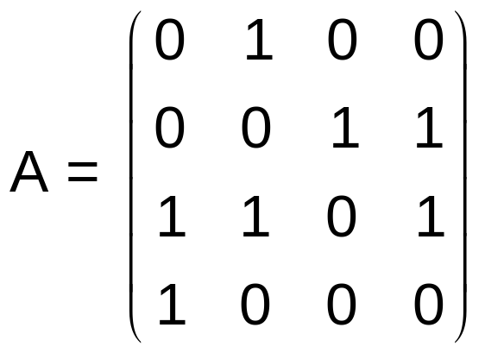
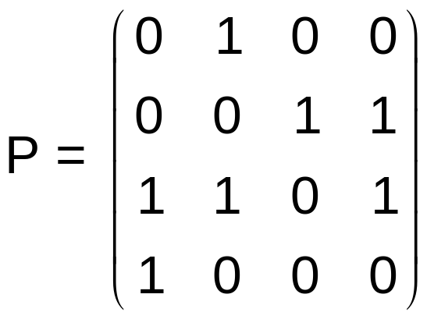
4.8 Transitive Closures & Warshall’s Alg
[例] 图 G 的邻接矩阵 A 如右，使用 Warshall 算法求 G 的道路矩阵 P。
[解] P ←A

Slide 121
4.8 Transitive Closures & Warshall’s Alg
(1) i =1
← j =1,2,3,4
↓ 增量方向
↑
i =1
矩阵元素处理次序： p₁₁， p₁₂， p₁₃， p₁₄，
p₂₁， p₂₂， ……
p₃₁，……
p₄₁，…… ， p₄₄，

Slide 122
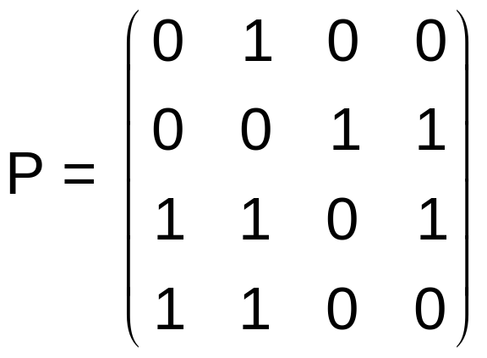
4.8 Transitive Closures & Warshall’s Alg
如： p₁₁ = p₁₁∨ (p_{1i} ∧ p_{i1}) = p₁₁∨ (p₁₁ ∧ p₁₁) = 0
p₁₂ = p₁₂∨ (p_{2i} ∧ p_{i2}) = p₁₂∨ (p₂₁ ∧ p₁₂) = 1
p₁₃ = p₁₃∨ (p_{3i} ∧ p_{i3}) = p₁₃∨ (p₃₁ ∧ p₁₃) = 0
…………
结果为

Slide 123
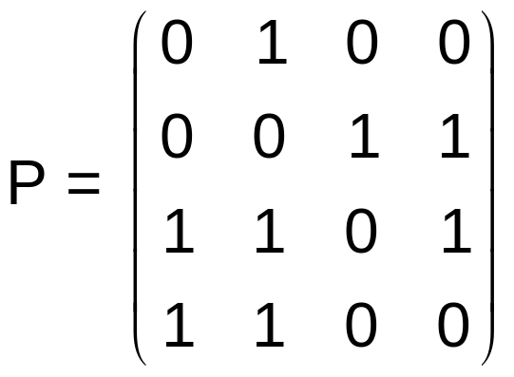
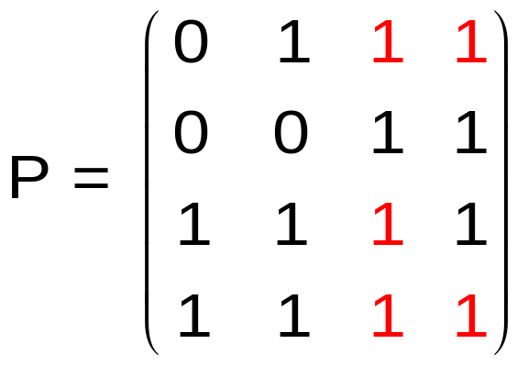
4.8 Transitive Closures & Warshall’s Alg
考察第 i 次循环。第 i 列的0元对应的行， p_{ji}=0，故 p_{jk} = p_{jk}∨ (p_{ji} ∧ p_{ik}) = p_{jk}∨ (0 ∧ p_{ik}) = p_{jk；}第 i 列的1元对应的行， p_{ji}=1，故 p_{jk} = p_{jk}∨ (p_{ji} ∧ p_{ik}) = p_{jk}∨ (1 ∧ p_{ik}) = p_{jk}∨ p_{ik} , 即将该行与第 i 行做“或”运算。
(2) i=2

Slide 124
4.8 Transitive Closures & Warshall’s Alg
[表上作业法] 第 i 次循环时，将第 i 行分别“叠加”到第 i 列的非0元对应的那些行， “叠加”运算是一对行向量各个对应元素的逻辑“或”运算。（i =1..n）
如上例：
非0元
i =2
i↑

Slide 125
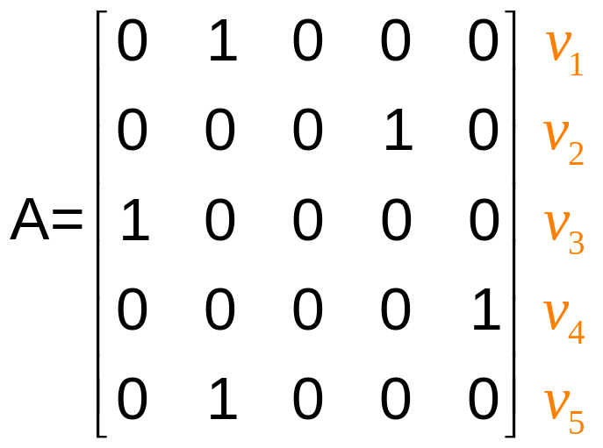
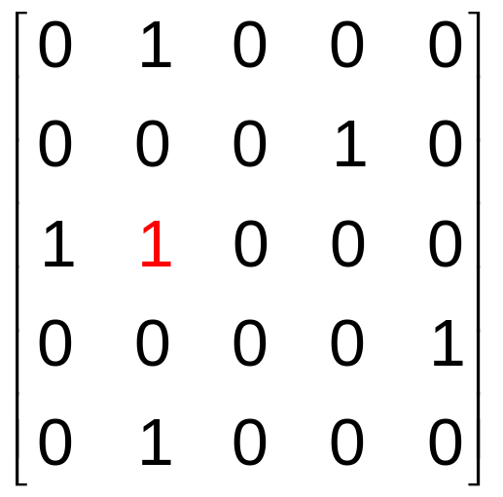
4.8 Transitive Closures & Warshall’s Alg
[例]
i=1
i↑

Slide 126
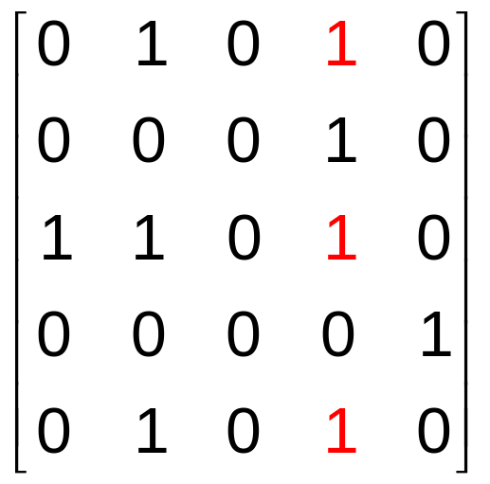
4.8 Transitive Closures & Warshall’s Alg
i=2
i↑

Slide 127
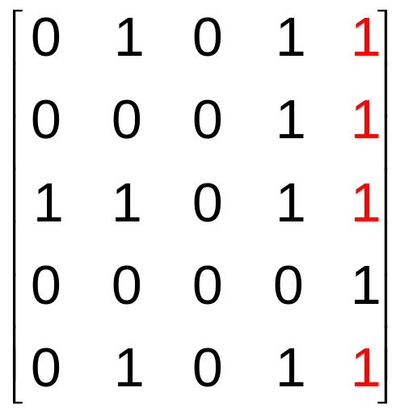
4.8 Transitive Closures & Warshall’s Alg
i=4
i↑

Slide 128
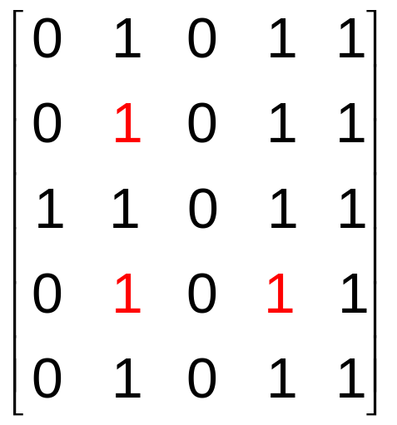
4.8 Transitive Closures & Warshall’s Alg
i=5
i↑

Slide 129
4.8 Transitive Closures & Warshall’s Alg
Theorem 3. If R and S are equivalence relation on a set A, then the smallest equivalence relation containing both R and S is (R∪S)∞.
Proof
Let Δ be the relation of equality on A and a relation T is reflexive iff Δ ⊆T and symmetric iff T = T⁻¹.
(1) Δ⊆R, Δ⊆S. So, Δ⊆R∪S⊆(R∪S)∞.
(2) R=R⁻¹ and S=S⁻¹. So, (R∪S)⁻¹=R⁻¹∪S⁻¹= R∪S. R∪S is symmetric.
By definition of (R∪S)∞, (R∪S)∞ is also symmetric.
(3) (R∪S)∞ is the transitive closure of R∪S. Transitivity holds.

Slide 130
4.8 Transitive Closures & Warshall’s Alg
Ex. A = { 1, 2, 3, 4, 5 }
R = { (1,1), (1,2), (2,1), (2,2), (3,3), (3,4), (4,3), (4,4), (5,5) }
S = { (1,1), (2,2), (3,3), (4,4), (4,5), (5,4), (5,5) }
Both R and S are equivalence relations
A/R = { {1,2}, {3,4,5} }
A/S = { {1}, {2}, {3}, {4,5} }
Find the smallest equivalence containing R and S, and Compute the partition of A that it produces.

Slide 131
4.8 Transitive Closures & Warshall’s Alg
Solution to the example (Matrices)
1 1 0 0 0
1 1 0 0 0
0 0 1 1 0
0 0 1 1 0
0 0 0 0 1
1 0 0 0 0
0 1 0 0 0
0 0 1 0 0
0 0 0 1 1
0 0 0 1 1
M_{R} =
M_{S} =
1 1 0 0 0
1 1 0 0 0
0 0 1 1 0
0 0 1 1 1
0 0 0 1 1
M_{R∪S} =

Slide 132
4.8 Transitive Closures & Warshall’s Alg
Solution to the example (Compute M_{(R∪S)}∞)
1 1 0 0 0
1 1 0 0 0
0 0 1 1 0
0 0 1 1 1
0 0 0 1 1
1 1 0 0 0
1 1 0 0 0
0 0 1 1 0
0 0 1 1 1
0 0 0 1 1
1 1 0 0 0
1 1 0 0 0
0 0 1 1 0
0 0 1 1 1
0 0 0 1 1
W₀=M_{R ∪S} =
W₁ =
W₂ =
1 1 0 0 0
1 1 0 0 0
0 0 1 1 0
0 0 1 1 1
0 0 0 1 1
1 1 0 0 0
1 1 0 0 0
0 0 1 1 1
0 0 1 1 1
0 0 1 1 1
1 1 0 0 0
1 1 0 0 0
0 0 1 1 1
0 0 1 1 1
0 0 1 1 1
W₃ =
W₄ =
W₅ =

Slide 133
4.8 Transitive Closures & Warshall’s Alg
Solution to the example (Compute M_{(R∪S)}∞)
1 1 0 0 0
1 1 0 0 0
0 0 1 1 1
0 0 1 1 1
0 0 1 1 1
M_{(R∪S)}∞ = W₅ =
(R∪S)∞: { (1,1), (1,2), (2,1), (2,2), (3,3), (3,4), (3,5), (4,3), (4,4), (4,5), (5,3), (5,4), (5,5 }
Partition: { {1,2}, {3,4,5} }

