Slide 1
Discrete Mathematical Structures
离散数学结构
(SE-106)
Mon: 10~11 (16:15~17:55)/C501
Wed: 4~5 (10:45~12:25)/C305
中山大学计算机科学系 蔡国扬
email: isscgy@mail.sysu.edu.cn
mailbox for courseware: dm_ss2010_sysu@163.com

Slide 2
Chapter 5 Functions
5.1 Functions
5.2 Functions For Computer Science
5.3 Growth of Functions
5.4 Permutation Functions

Slide 3
5.1 Functions
1. Concept of Functions (函数)
A function is a special type of relation.
Let A and B be nonempty sets. A function f from A to B, which is denoted f : A→B, is a relation from A to B such that for all a∈Dom(f ), f(a) contains just one element of B.
If a∉Dom(f ), then f(a)=∅.
If f(a)={b}, it is traditional to identify the set {b} with the element b and write f(a)=b.
The function f can then be described as the set of pairs
f = {(a, f(a))| a∈Dom(f )}
The element a is called an argument (自变量) of the function f, and f(a) is called the value of the function (函数值) for the argument a.

Slide 4
5.1 Functions
1. Concept of Functions
Functions are also called mappings (映射) or trans-formations(变换).
The value of the function f for argument a, f(a), is also referred to as the image (像) of a under f.
f
b=f(a)
a
A
B
Figure 5.1

Slide 5
5.1 Functions
1. Concept of Functions
Ex. Let A={1, 2, 3, 4} and B={a, b, c, d}, and
f ={(1, a), (2, a), (3, d), (4, c)}
Here we have f(1)=a, f(2)=a, f(3)=d, f(4)=c.
So, f is a function.
Ex. Let A={1, 2, 3} and B={x, y, z}.
Consider the relations R={(1, x), (2, x)},
S={(1, x), (1, y), (2, z), (3, y)}
    The relation R is a function with Dom(R)={1, 2} and Ran(R) ={x}.
The relation S is not a function since S(1)={x, y}.

Slide 6
5.1 Functions
1. Concept of Functions
Ex. Let P be a computer program that accepts an integer as input and produces an integer as output.
Let A=B=Z, P determines a relation f_{P} defined as follows:
    (m, n)∈f_{P} means that n is the output produced by program P when the input is m.
It is clear that f_{P} is a function.
This example can be generalized to a program with any set A of possible inputs and set B of corresponding outputs.
In general, we may think of functions as input-output relations.

Slide 7
5.1 Functions
1. Concept of Functions
Ex. Let A=R (real number), and let p(x)=a₀+a₁x+…+a_{n}x^{n} be a real polynomial.
p may be viewed as a relation on R and it is actually a function.
[Remark]
(1) If the formula defining the function does not make sense for all elements of A, then the domain of function is taken to be the set of elements for A for which the formula does make sense.
(2) In elementary mathematics, the formula is sometimes confused with the function it produces.
For example

Slide 8
5.1 Functions
1. Concept of Functions
A labeled digraph (标定有向图) is a digraph in which the vertices or the edges (or both) are labeled with information from a set.
If V is the set of vertices and L is the set of labels of a labeled digraph, and let f: V→L, where, for each v∈V, f(v) is the label we wish to attach to v, then f is a function.
We define a labeling of the edges E
as a function g: E→L, for each e∈E,
g(e) is the label.
Boston
44
Worcester
49
64
51
Providence
Hartford
39
106
New Haven

Slide 9
5.1 Functions
1. Concept of Functions
Ex. Let A=Z and let B={0, 1}. Let f: A→B be found by
0 if a is even
1 if a is odd
f(x) =
f is a function, since each set f(a) consists of a single element.
Ex. Let A be an arbitrary nonempty set. The identity function on A (A上的恒等函数), denoted by I_{A}, is defined by I_{A}(a)=a.

Slide 10
5.1 Functions
2. Composition of functions
Suppose that f: A→B and g: B→C are functions.
The composition (复合) of f and g, g ° f is a relation.
Let a∈Dom(g ° f ), Then, (g ° f )(a)=g(f(a)).
Since f and g are functions, thus g ° f is a function.
g ° f
C
B
a
f
g
A
b=f(a)
c=g(b)=(g ° f)(a)
Figure 5.3

Slide 11
5.1 Functions
2. Composition of functions
Ex. Let A=B=Z, and C be the set of even integers.
Let f: A→B and g: B→C be defined by
f(a)=a+1, g(b)=2b
Find g ° f.
[Solution]
(g ° f )(a) = g(f(a))
= g(a+1)
= 2a+2

Slide 12
5.1 Functions
3. Special Types of Functions
Let f be a function from A to B. We say that
(1) f is everywhere defined (处处有定义) if Dom(f )=A.
(1) f is onto (满射) if Ran(f )=B.
(2) f is one to one (单射) if we cannot have f(a)=f(a') for two distinct elements a and a' of A.
The definition of one to one may be restated in the following equivalent form:
If f(a)=f(a′), then a=a′ .
Or, If a≠a′, and a,a′∈Dom(f ), then f(a)≠f(a′) .

Slide 13
5.1 Functions
3. Special Types of Functions
Ex. Consider the function f defined in Ex.1.
Let A={1, 2, 3, 4} and B={a, b, c, d}, and let
f ={(1, a), (2, a), (3, d), (4, c)}
(1) Is f a onto function?
(2) Is f a one-to-one function?
b
a
a
No
No

Slide 14
5.1 Functions
3. Special Types of Functions
Ex. Let A=B=Z and let f: A→B be defined by
f (a)=a+1, for a∈A.
Which of the special properties, if any, does f possess?
[Solution]
It is clear that f is everywhere defined, and f is one to one.
For any b∈B, we wish to find an element a in A such that f(a)=b.
So, from a+1 = b we get a = b-1
Thus, For any b∈B, we have b-1∈A, such that f(a)=b.
Hence, f is a onto function.

Slide 15
5.1 Functions
3. Special Types of Functions
Ex. Let A={a₁, a₂, a₃}, B={b₁, b₂, b₃}, C={c₁, c₂}, and D={d₁, d₂, d₃, d₄}. Consider the following four functions, from A to B, A to D, B to C, and D to B, respectively.
(a) f₁={(a₁, b₂), (a₂, b₃), (a₃, b₁)}
(b) f₂={(a₁, d₂), (a₂, d₁), (a₃, d₄)}
(c) f₃={(b₁, c₂), (b₂, c₂), (b₃, c₁)}
(d) f₄={(d₁, b₁), (d₂, b₂), (d₃, b₁)}
Determine whether each function is one to one, whether each function is onto, and whether each function is everywhere defined.
everywhere defined, one to one, and onto
everywhere defined, one to one, not onto
everywhere defined, not one to one, onto
not everywhere defined, not one to one, not onto

Slide 16
5.1 Functions
3. Special Types of Functions
If a function f: A→B is one-to-one, everywhere defined and onto, then f is called a one-to-one correspondence (一一对应) or a bijection (双射) between A and B.
Ex. Let R be the set of all equivalence relations on a given set A, and let Π be the set of all partition on A. Then we can define a function f: R→Π as follows:
For each equivalence relation R on A, let
f(R)=A/R
The partition of A that corresponds to R. Then f is a one-to-one correspondence between R and Π.

Slide 17
5.1 Functions
4. Invertible Functions
A function f: A→B is said to be invertible (可逆的) if its inverse relation, f ⁻¹, is also a function.
Ex. Let f be the function of Ex.1,
A={1, 2, 3, 4 },
B={a, b, c, d },
f ={(1, a), (2, a), (3, d), (4, c)}.
Is f invertible?

Slide 18
5.1 Functions
4. Invertible Functions
Theorem 1. Let f: A→B be a function.
(a) f ⁻¹ is a function from B to A iff f is one to one.
(b) If f ⁻¹ is a function, then f ⁻¹ is also one to one.
(c) f ⁻¹ is everywhere defined iff f is onto.
(d) f ⁻¹ is onto iff f is everywhere defined.

Slide 19
5.1 Functions
[Proof]
(a) We prove the following equivalent statement:
f ⁻¹ is not a function iff f is not one to one.
Suppose first that f ⁻¹ is not a function. Then, for some b in B, f ⁻¹(b) must contain at least two distinct elements, a₁ and a₂. Then f(a₁)=b=f(a₂), so f is not one to one.
Conversely, suppose that f is not one to one. Then f(a₁)=f(a₂)=b for two distinct elements a₁ and a₂ of A. Thus f ⁻¹(b) contains both a₁ and a₂, so f ⁻¹ is not a function.
(b) Since (f ⁻¹)⁻¹ is the function f, part (a) shows that f ⁻¹ is one to one.
(c) and (d) are obvious.

Slide 20
5.1 Functions
Corollary
(a) If f is a one-to-one correspondence between A and B, then f ⁻¹ is a one-to-one correspondence between B and A.
(b) If f : A→B is a one-to-one function, then the equation b=f(a) is equivalent to a=f ⁻¹(b), i.e.
f ⁻¹(f(a))=a, f(f ⁻¹(b))=b.
Ex. The function f defined in p.14 is a one-to-one correspondence between A and B. Thus f is invertible, and f ⁻¹ is a one-to-one correspondence between B and A.
Ex. Let R be the set of real numbers, and let f: R→R be defined by f(x)=x². Is f invertible?

Slide 21
5.1 Functions
Theorem 2. Let f : A→B be any function. Then
(a) I_{B} ° f =f , (b) f ° I_{A}=f .
If f is a one-to-one correspondence between A and B, then
(c) f ⁻¹ ° f =I_{A}, (d) f ° f ⁻¹=I_{B} .
[Proof]
(a) (I_{B} ° f )(a) = I_{B}(f (a))=f(a), for any a∈Dom(f ).
(b) (f ° I_{A})(a)=f(I_{A}(a))=f(a), for any a∈Dom(f ).
(c) and (d) can be proved by Corollary (b) of Theorem 1.

Slide 22
5.1 Functions
Theorem 3.
(a) Let f : A→B and g: B→A be functions such that g ° f =I_{A} and f ° g=I_{B}. Then f is a one-to-one correspondence between A and B, g is a one-to-one correspondence between B and A, and each is the inverse of the other.
(b) Let f : A→B and g: B→C be invertible. Then g ° f is invertible, and (g ° f )⁻¹=f ⁻¹ ° g⁻¹.
[Proof]
(a) The assumptions mean that g(f(a))=a and f(g(b))=b, for any a∈A and b∈B.
This shows that Ran(f )=B and Ran(g)=A, so each function is onto. (Note that I_{A} and I_{B} is defined everywhere.)

Slide 23
5.1 Functions
If f(a₁)=f(a₂), then a₁=g(f(a₁))=g(f(a₂))=a₂. Thus f is one to one. In similar way, g is one to one, so both f and g are invertible.
Note that f ⁻¹ is everywhere defined since Dom(f ⁻¹)=Ran(f ) =B.
Now, for any b∈B, we have
f ⁻¹(b)=f ⁻¹(f(g(b)))=(f ⁻¹ ° f )g(b)=I_{A}(g(b))=g(b).
Thus g=f ⁻¹, so also f=(f ⁻¹)⁻¹=g⁻¹.
Since g and f are onto, f ⁻¹ and g⁻¹ are onto, so f and g must be everywhere defined. This proves all parts of part (a).

Slide 24
5.1 Functions
Theorem 3. (b) Let f: A→B and g: B→C be invertible. Then g ° f is invertible, and (g ° f )⁻¹=f ⁻¹ ° g⁻¹.
[Proof]
(b) We know that (g ° f )⁻¹=f ⁻¹ ° g⁻¹, since this is true for any two relations.
Since g⁻¹ and f ⁻¹ are function by assumption, so is their composition, and then (g ° f )⁻¹ is a function.
Thus g ° f is invertible.

Slide 25
5.1 Functions
Ex. Let A=B=R, the set of real numbers. Let f: A→B be given by f(x)=2x³-1 and let g: B→A be given by
g(y)=(y/2+1/2)^{1/3}
Show that f is a bijection between A and B and g is a bijection between B and A.
[Solution]
Let x∈A and y=f (x)=2x³-1. Then
x = (y/2+1/2)^{1/3} = g(y) = g(f(x)) = (g ° f )(x).
Thus g ° f =I_{A}.
Similarly, f ° g=I_{B}, so by Theorem 3(a) both f and g are bijections.

Slide 26
5.1 Functions
Theorem 4. Let A and B be two finite sets with the same number of elements, and let f: A→B be an everywhere defined function.
(a) If f is one to one, then f is onto.
(b) If f is onto, then f is one to one.
A | B | C | D | E | F | G | H | I | J | K | L | M | N | O | P | Q | R | S | T | U | V | W | X | Y | Z
D | E | S | T | I | N | Y | A | B | C | F | G | H | J | K | L | M | O | P | Q | R | U | V | W | X | Z
I AM A STUDENT ⇒ B DH D PQRTIJQ

Slide 27
5.1 Exercises
1, 16, 21,30

Slide 28
5.2 Functions for Computer Science
Ex. Let A be a subset of the universal set U={u₁, u₂, …, u_{n}}.
The characteristic function of A (特征函数)
f: U→{0, 1},
1 if u_{i}∈A
0 if u_{i}∉A
f(u_{i})=
If A={4, 7, 9} and U={1, 2, …, 10}, then f_{A}(2)=0, f_{A}(7)=1 and f_{A}(12) is undefined.
f_{A} is everywhere defined and onto, but is not one to one.

Slide 29
5.2 Functions for Computer Science
Ex. Let A be the set of nonnegative integers, B=Z⁺, and let f: A→B be defined by f(n)=n!
Ex. The mod-n functions f_{n}(m)=m (mod n).
For a fixed positive integer n, any nonnegative integer z can be written as z=kn+r with 0≤r<n. Then f_{n}(z)=r.
Let A be the set of nonnegative integers, then
f: A→{0, 1, 2, … , n-1}.
The mod-n functions are everywhere defined and onto, but not one to one.

Slide 30
5.2 Functions for Computer Science
Ex. The floor function (弱/下取整函数)
For a rational number q, f(q) is the largest integer less than or equal to q. It is expressed as f(q)= ⎣q⎦.
f(1.5)= ⎣1.5⎦ =1, f(-3)= ⎣-3⎦=-3, f(-2.7)= ⎣-2.7⎦=-3.
Ex. The ceiling function (强/上取整函数)
For a rational number q, c(q) is the smallest integer greater than or equal to q. It is expressed as c(q)=⎡q⎤.
c(1.5)=⎡1.5⎤=2, c(-3)=⎡-3⎤=-3, c(-2.7)=⎡-2.7⎤=-2.

Slide 31
5.2 Functions for Computer Science
Ex.
(a) The polynomial with integer coefficients (整系数多项式函数)
p(z)=a₀+a₁z+a₂z²+⋯+a_{n}z^{n}, z∈Z.
(b) The base 2 exponential function (以2为底的指数函数)
f: A→B, A=B=Z⁺, f(z)=2^{z}.
(c) The logarithm to the base n of x (对数函数)
f_{n}(x)=log_{n}(x), x∈R, n>1 is a positive integer,
f_{n}: R→R.
In computer science applications, the base 2 and 10 are particularly useful.

Slide 32
5.2 Functions for Computer Science
Ex.
(a) Let B be a finite subset of the universal set U (so B is an element of the power set of U ) and define pow(B) to be the power set of B. Then pow: V→P(V) is a function, where V is the power set of U and P(V) is the power set of V .
(b) Let A=B=the set of all 2×2 matrices with real number entries and let t(M)=M^{T}, the transpose of M.
The function t is everywhere defined, onto, and one to one.

Slide 33
5.2 Functions for Computer Science
Ex.
(a) Let g(z₁, z₂)=GCD(z₁, z₂), for any (z₁, z₂)∈Z⁺×Z⁺, where GCD(z₁, z₂) is the greatest common divisor (最大公约数).
Then g is a function from Z⁺×Z⁺ to Z⁺.
(b) Let m(z₁, z₂)=LCM(z₁, z₂), for any (z₁, z₂)∈Z⁺×Z⁺, where LCM(z₁, z₂) is the least common multiple (最小公倍数).
Then m is a function from Z⁺×Z⁺ to Z⁺.

Slide 34
5.2 Functions for Computer Science
A Boolean function plays a key role in nearly all computer programs.
Let B={true, false}. Then a function from a set A to B is called a Boolean function (布尔函数).
Ex.
(a) Let P(x): x is even, Q(y): y is odd.
Then P and Q are Boolean functions from Z to B.
For example, P(4) is true, Q(4) is false.
(b) The predicate (谓词) R(x, y): x is even or y is odd is a Boolean function from Z×Z to B.
Here R(3, 4) is false, R(6, 4) is true.

Slide 35
5.2 Functions for Computer Science
Hashing Functions
一台计算机要为一大型公司保存所有客户的信息作为客户记录，怎样分配内存地址才能迅速检索到客户记录？
适当选一个散列函数 (Hashing function)。
客户记录用关键码 key 识别，每个关键码唯一地识别一个客户记录。例如，为每一位客户安排一个由7位数字组成的帐号作为他的记录的关键码。散列函数 h 将内存地址 h(n) 分配给以 n 为关键码的记录。
实践中使用许多不同的散列函数。最常用的散列函数之一是：
h(n)=n (mod m)
其中 m 是可供使用的内存地址的数目。

Slide 36
5.2 Functions for Computer Science
例如, 当 m=101 时, h(n)=n (mod 101), 散列函数 h 是从客户帐号的集合到集合 {0, 1, 2, …, 100} 的函数. 因为h(2473871)=2473871 (mod 101)=78，帐号为2473871的客户的记录分配到的地址是78。
[Remark]
由于散列函数不是一对一的，有可能不同帐号的记录分配到同一个内存地址。这时，我们说出现了冲突。消除冲突的一个简单有效的办法是在已存在的记录后面插入新的记录。

Slide 37
5.3 Growth of Functions
O and Θ
Let f and g be functions whose domains are subsets of Z⁺. We say that f is O(g) ( f is big-Oh of g , f 是大写O-g), if there exist constants c>0 and k such that |f(n)|≤c ⋅ |g(n)|, for all n≥k.
If f is O(g), then f grows no faster than g does.
The symbol O is extensively applied to an analysis of algorithms.
Ex. Let g(n)=n³, then f(n)=n³/2+n²/2 is O(g). Since
n³/2+n²/2 ≤ n³/2+n³/2 ≤ n³/2, if n≥1
In fact, f is not only O(n³), but also O(n³/2), and O(3n³), etc.

Slide 38
5.3 Growth of Functions
We say that f and g have the same order (同阶) if f is O(g) and g is O(f ).
Ex. Let f (n)=3n⁴-5n² and g(n)=n⁴ be defined for positive integer n. Then f and g have the same order.
[Solution]
First, 3n⁴-5n² ≤ 3n⁴+5n²
≤ 3n⁴+5n⁴, if n≥1
≤ 8n⁴.
Thus f is O(g).
Conversely, if n≥2, then 2n²>5 and 2n⁴>5n².
Therefore n⁴=3n⁴-2n⁴ ≤ 3n⁴-5n², if n≥2.
Thus g is O(f).

Slide 39
5.3 Growth of Functions
If f is O(g) but g is not O(f ), we say that f is lower order (低阶) than g or that f is grows more slowly than g.
Ex. The f (n)=n⁵ is lower order than g(n)=n⁷.
[Solution]
Clearly, if n ≥ 1, than n⁵ ≤ n⁷. Thus f is O(g).
Suppose that there exist c and k such that
n⁷ ≤ c ⋅ n⁵ for all n ≥ k.
Choose N so that N > k and N² > c. Then N⁷ ≤ cN⁵ < N²·N⁵,
but this is a contradiction. Hence g is not O(f ), and f is lower order than g.

Slide 40
5.3 Growth of Functions
We define a relation Θ, big-theta, on functions whose domains are subsets of Z⁺ as f Θ g if and only if f and g have the same order.
Theorem 1. The relation Θ is an equivalence relation.
[Proof]
Clearly, Θ is reflexive and symmetric.
To see that Θ is transitive, suppose f Θ g. Then there exist c₁ and k₁ with |f(n)|≤c₁|g(n)| for all n≥k₁, and there exist c₂ and k₂ with |g(n)|≤c₂|f(n)| for all n≥k₂.
Suppose g Θ h. Then there exist c₃ and k₃ with |g(n)|≤c₃|h(n)| for all n≥k₃, and there exist c₄ and k₄ with |h(n)|≤c₄|g(n)| for all n≥k₄.
Then |f(n)|≤c₁c₃|h(n)| for all n≥max{k₁, k₃}, and |h(n)|≤c₂c₄|f(n)| for all n≥max{k₂, k₄}. Thus f Θ h and Θ is transitive.

Slide 41
5.3 Growth of Functions
The equivalence classes of Θ consist of functions that have the same order. We use any simple function in the equivalence class to represent the order of all functions in that class.
One Θ-class is said to be lower than another Θ-class if a representative function from the first is of lower order than one from second class.
Ex. All functions that have the same order as g(n)=n³ are said to have order Θ(n³).
The most common orders in computer science applications are Θ(1), Θ(n), Θ(n²), Θ(n³), Θ(lg(n)), Θ(nlg(n)) and Θ(2^{n}).

Slide 42
5.3 Growth of Functions
Ex. Every logarithmic function f(n)=log_{b}(n) has the same order as g(n)=lg(n).
[Solution]
There is a logarithmic change-of-base identity
log_{b}(x) = log_{a}(x) / log_{a}(b)
in which log_{a}(b) is a constant. Or
|log_{b}(x)| = |log_{a}(x)| / |log_{a}(b)| and
|log_{a}(x)| = |log_{a}(b)|·|log_{b}(x)|
Thus (let a=10)
|log_{b}(n)| ≤ |lg(n)| / |lg(b)| and
|lg(n)|≤|lg(b)|·|log_{b}(n)|.
Hence f is O(g) and g is O(f ).

Slide 43
5.3 Growth of Functions
Rules for Determining the Θ-Class of a Function
  Θ(1) functions are constant and have zero growth, the slowest growth possible.
  Θ(lg(n)) is lower than Θ(n⋅k) if k>0.
  Θ(nª) is lower than Θ(n^{b}) iff 0<a<b.
  Θ(a^{n}) is lower than Θ(b^{n}) iff 0<a<b.
  Θ(n^{k}) is lower than Θ(a^{n}) for any power n^{k} and any a>1.
  If r is not zero, then Θ(r⋅ f )=Θ(f ) for any function f.
  If h is a nonzero function and Θ(f ) is lower than (or the same as) Θ(g), then Θ(f ⋅ h) is lower than (or the same) Θ(g ⋅ h).
  If Θ(f ) is lower than Θ(g), then Θ(f +g)=Θ(g).

Slide 44
5.3 Growth of Functions
Ex. Determine the Θ-class of each of the following.
(a) f(n)=4n⁴-6n⁷+25n³
(b) g(n)=lg(n)-3n
(c) h(n)=1.1^{n}+n¹⁵
[Solution]
(a) By Rules 3, 6, and 8, the degree of the polynomial determines the Θ-class of a polynomial function. Θ(f )=Θ(n⁷).
(b) Using Rules 2, 6, and 8, we have that Θ(g)=Θ(n).
(c) By Rules 5 and 8, Θ(h)=Θ(1.1^{n}).

Slide 45
5.3 Growth of Functions
Ex. Using the rules for ordering Θ-classes, arrange the following in order from lowest to highest.
Θ(nlgn), Θ(1000n²-n), Θ(n^{0.2}),
Θ(1, 000, 000), Θ(1.3^{n}), Θ(n+10⁷)
[Solution]
Θ(1, 000, 000), Θ(n^{0.2}), Θ(n+10⁷),
Θ(nlgn), Θ(1000n²-n), Θ(1.3^{n})

Slide 46
5.3 Growth of Functions
[Remark]
The Θ-class of a function that describes the number of steps performed by an algorithm is frequently referred to as the running time of the algorithm.
In general, algorithms with exponential running times are impractical for all but very small values of n.

Slide 47
5.3 Exercises
4, 5, 7, 21

Slide 48
5.4 Permutation Functions
We discuss bijections from a finite set A to itself.
A bijection from a set A to itself is called a permutation (置换/排列) of A.
Ex. Let A=R and let f : A→A be defined by f(a)=2a+1.
then f is a permutation.
Ex. 1_{A} is a permutation of A.
It is called the identity permutation (恒等置换) of A.

Slide 49
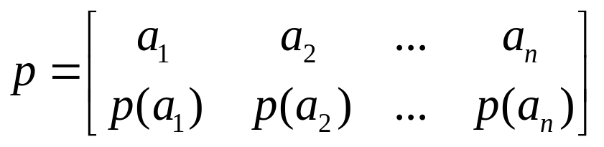
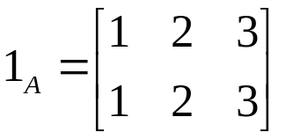
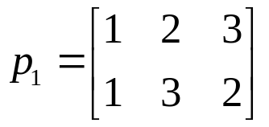
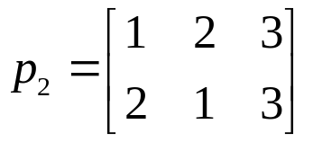
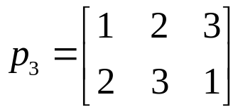

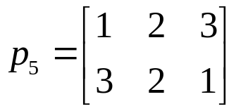
5.4 Permutation Functions
Let A={a₁, a₂, …, a_{n}} be a finite set and let p be a permutation of A, then p={(a₁, p(a₁)), (a₂, p(a₂)), …, (a_{n}, p(a_{n}))}.
We often write
where the sequence p(a₁), p(a₂), … , p(a_{n}) is just a rearrangement of the elements of A.
Ex. Let A={1, 2, 3}. Then all the permutations of A are

Slide 50
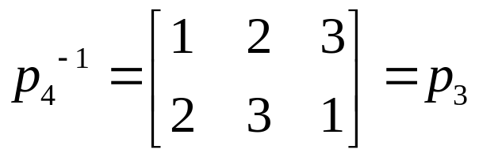
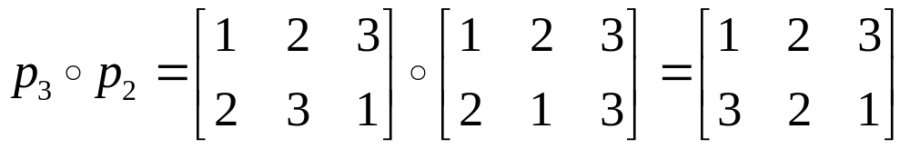
5.4 Permutation Functions
Ex. Using the permutations of Ex.2, p.49, compute
(a) p₄⁻¹; (b) p₃ ° p₂.
[Solution]
(a) Viewing p₄ as a function, we have p₄={(1,3), (2,1), (3,2)}.
Then p₄⁻¹={(3, 1), (1, 2), (2, 3)}.
Thus
(b)

Slide 51
5.4 Permutation Functions
The composition of two permutations is another permutation, usually referred to as the product of these permutations.
The following theorem is obvious.
Theorem 1. If A={a₁, a₂, … , a_{n}} is a set containing n elements, then there are n! ( n factorial ) permutations of A.

Slide 52
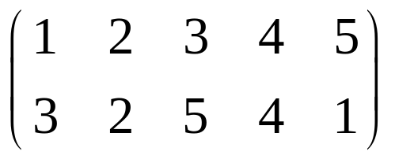
5.4 Permutation Functions
Let b₁, b₂, … , b_{r} be r distinct elements of A={a₁, a₂, … , a_{n}}. The permutation p: A→A defined by
p(b₁)=b₂, p(b₂)=b₃, … , p(b_{r-1})=b_{r}, p(b_{r})=b₁,
p(x)=x, if x∈A and x∉{b₁, b₂, … , b_{r}}
is called a cyclic permutation (循环置换) of length r, or simply a cycle (循环) of length r, and will be denoted by (b₁, b₂, … , b_{r}).
Ex. Let A={1, 2, 3, 4, 5}. The cycle (1, 3, 5) denotes the permutation

Slide 53
5.4 Permutation Functions
[Remark 1] If p=(b₁, b₂, … , b_{r}) is a cycle of length r, then we can also write p by starting with any b_{i}, 1≤b_{i}≤r, and moving in a clockwise direction.
For example, (1, 3, 5)=(3, 5, 1)=(5, 1, 3).
[Remark 2] The notation for a cycle does not include the number of elements in the set A.
Thus the cycle (3, 2, 4, 1) could be a permutation of the set {1, 2, 3, 4} or of {1, 2, 3, 4, 5, 6, 7, 8}. We need to be told explicitly the set on which a cycle is defined.
[Remark 3] Since cycles are permutations, we can form their product. However, the product of two cycles need not be a cycle.

Slide 54
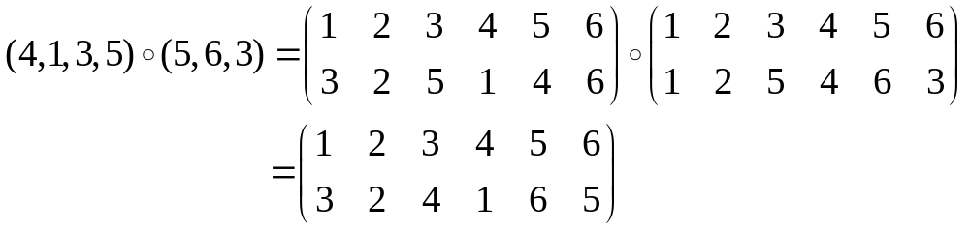
5.4 Permutation Functions
Ex. Let A={1, 2, 3, 4, 5, 6}. Compute
(4, 1, 3, 5)∘(5, 6, 3) and (5, 6, 3)∘(4, 1, 3, 5).
[Solution]

Slide 55
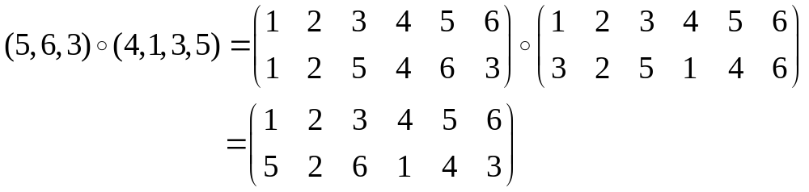
5.4 Permutation Functions
Ex. Let A={1, 2, 3, 4, 5, 6}. Compute
(4, 1, 3, 5)∘(5, 6, 3) and (5, 6, 3)∘(4, 1, 3, 5).
[Solution]
Observe that (4, 1, 3, 5)∘(5, 6, 3)≠(5, 6, 3)∘(4, 1, 3, 5)
and that neither product is a cycle.

Slide 56
5.4 Permutation Functions
Two cycles of a set A are said to be disjoint (不相交) if no element of A appears in both cycles.
Ex. Let A={1, 2, 3, 4, 5, 6}. Then the cycle (1, 2, 5) and (3, 4, 6) are disjoint, whereas the cycles (1, 2, 5) and (2, 4, 6) are not.
Theorem 2. A permutation of a finite set that is not the identity (恒等置换) or a cycle can be written as a product of disjoint cycles of length ≥ 2.

Slide 57
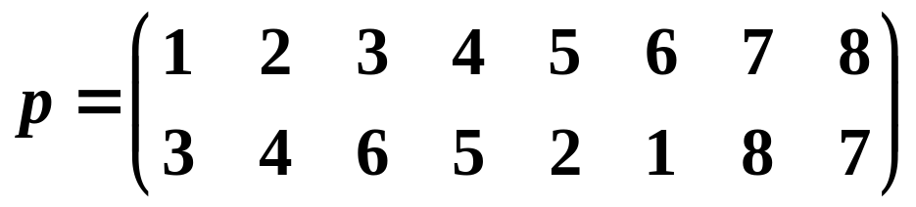
5.4 Permutation Functions
Ex. Write the permutation
of A={1, 2, 3, 4, 5, 6, 7, 8} as a product of disjoint cycles.
[Solution]
p=(7, 8)∘(2, 4, 5)∘(1, 3, 6).

Slide 58
5.4 Permutation Functions
Even and Odd Permutations
A cycle of length 2 is called a transposition (变换) . That is, a transposition is a cycle p=(a_{i}, a_{j}), where p(a_{i})=a_{j} and p(a_{j})=a_{i}.
If p=(a_{i}, a_{j}) is a transposition of A, then p ° p=1_{A}.
Theorem 3. Every cycle can be written as a product of transposition. In fact,
(b₁, b₂, … , b_{r})=(b₁, b_{r}) ° (b₁, b_{r-1}) ° … ° (b₁, b₃) ° (b₁, b₂).
[Proof] it can be verified by induction on r.
Corollary 1. Every permutation of a finite set with at least two elements can be written as a product of transpositions.

Slide 59
5.4 Permutation Functions
Ex. Write the permutation p of Ex.7, p.57 as a product of transpositions.
[Solution]
We have p=(7, 8)∘(2, 4, 5)∘(1, 3, 6). Since
(1, 3, 6)=(1, 6)∘(1, 3)
(2, 4, 5)=(2, 5)∘(2, 4)
Thus, p=(7, 8)∘(2, 5)∘(2, 4)∘(1, 6)∘(1, 3).
[Remark] A cycle can be written as a product of trans-positions in many different ways. For example,
(1, 3, 6)=(1, 6)∘(1, 3)
=(3, 1)∘(3, 6)
=(3, 6)∘(6, 3)∘(1, 6)∘(1, 3)

Slide 60
5.4 Permutation Functions
Theorem 4. If a permutation of a finite set can be written as a product of an even number of transpositions, then it can never be written as a product of an odd number of transpositions, and conversely.
A permutation of a finite set is called even (偶置换) if it can be written as a product of an even number of transpositions, and it is called odd (奇置换) if it can be written as a product of an odd number of transpositions.

Slide 61
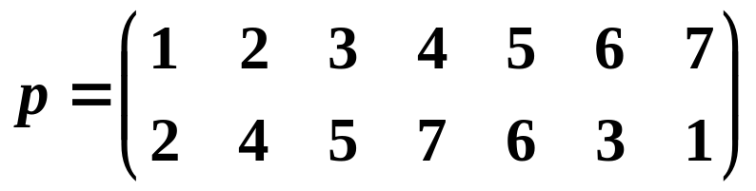
5.4 Permutation Functions
Ex. Is the following permutation even or odd?
[Solution]
p = (3, 5, 6) ∘ (1, 2, 4, 7)
(1, 2, 4, 7) = (1, 7) ∘ (1, 4) ∘ (1, 2)
(3, 5, 6) = (3, 6) ∘ (3, 5)
p = (3, 5, 6) ∘ (1, 2, 4, 7)
= (3, 6) ∘ (3, 5) ∘ (1, 7) ∘ (1, 4) ∘ (1, 2)
So, p is an odd permutation.

Slide 62
5.4 Permutation Functions
The properties of even and odd permutations:
(a) The product of two even permutations is even.
(b) The product of two odd permutations is even.
(c) The product of an even and an odd permutation is odd.
Theorem 4. Let set A={a₁, a₂, …, a_{n}}, n≥2. There are n!/2 even permutations and n!/2 odd permutations.
[Proof ]
Let A_{n} be the set of all even permutations of A, and let B_{n} be the set of all odd permutations.
We can define a function f: A_{n}→B_{n}, which is one to one and onto, and this will show that A_{n} and B_{n} have the same number of elements.

Slide 63
5.4 Permutation Functions
Choosing a particular transposition q₀ of A, say that q₀=(a_{n-1}, a_{n}), we define the function f : A_{n}→B_{n} by f(p)=q₀∘p, p∈A_{n}.
Suppose that p₁, p₂∈A_{n} and f(p₁)=f(p₂). Then q₀∘p₁=q₀∘p₂.
We compose each side of equation with q₀:
q₀∘(q₀∘p₁)=q₀∘(q₀∘p₂).
so, by the associative, (q₀∘q₀)∘p₁=(q₀∘q₀)∘p₂, or
1_{A}∘p₁=1_{A}∘p₂, p₁=p₂.
Thus f is one to one.

Slide 64
5.4 Permutation Functions
Now let q∈B_{n}. Then q₀∘q∈A_{n}, and
f(q₀∘q)=q₀∘(q₀∘q)=(q₀∘q₀)∘q=1_{A}∘q=q
which means that f is onto. Since f : A_{n}→B_{n} is one to one and onto, we conclude that A_{n} and B_{n} have the same number of elements.
Note that A_{n}∩B_{n}=∅, n!=|A_{n}∪B_{n}|=|A_{n}|+|B_{n}|-|A_{n}∩B_{n}|=2|A_{n}|. We then have |A_{n}|=|B_{n}|=n!/2.

Slide 65
5.4 Exercises
1, 8, 17, 27

