Slide 1
Discrete Mathematical
Structures
离散数学结构
Wed: 4~5 (10:45~12:25)/C502
Thu: 7~8 (13:30~15:10)/C202
中山大学计算机科学系 蔡国扬
email: isscgy@mail.sysu.edu.cn

Slide 2
Chapter 8 Topics in Graph Theory
Graphs
Euler Paths and Circuits
Hamiltonian Paths and Circuits
Transport Networks
Matching Problems
Coloring Graphs

Slide 3
Warm-Up Question: 任意选六个人 r₁, r₂, r₃, r₄, r₅ 和 r₆, 那么，在这六个人中，一定存在：三人都相互认识，或三人都相互不认识。
[证]
在这六个人中，任取一个人，不妨假设该人为r₁。
用“认识”关系来分析 r₁ 和其它五人中之间的关系。
由“鸽笼原理”可知，在其它五人中，至少有三个人和 r₁ “认识”或“不认识”。
若用线段表示二人之间的“认识”关系，即若 r_{s} 和 r₁ 有“认识”关系，则在 r_{s} 和 r₁ 之间画一线段。
(1) 至少有三个人和 r₁ 认识
r₁
r_{j}
不妨假设三个人 r_{i}, r_{j}, r_{k} 和 r₁ 认识。
若有线段 (r_{i}, r_{j})、(r_{j}, r_{k}) 或 (r_{i}, r_{k}) 其中之一, 那么，三人 r₁, r_{i} 和 r_{j} 都相互认识，命题成立；
若不存在线段 (r_{i}, r_{j}),(r_{j}, r_{k}) 和(r_{i}, r_{k}), 那么，三人 r_{i}, r_{j} 和 r_{k} 都相互不认识, 命题也成立。
r_{i}
r_{k}
(2) 至少有三个人和 r₁ 都不认识
不妨假设三个人 r_{i}, r_{j}, r_{k} 和 r₁ 都不认识.
若同时存在线段 (r_{i}, r_{j}), (r_{j}, r_{k}) 和 (r_{i}, r_{k})，那么，三人 r_{i}, r_{j} 和 r_{k} 都相互认识，命题成立。
若上述线段有一条不存在，比如 (r_{i}, r_{j})，则三人 r₁, r_{i} 和 r_{j} 都相互不认识，命题同样成立；
r₁
r_{j}
r_{i}
r_{k}

Slide 4
8.1 Graphs
A graph G contains of a finite set V of objects called vertices, a finite set E of objects called edges, and a function γ that assigns to each edge a subset {v, w}, where v and w are vertices (and may be the same).
we will write G=(V, E, γ).
edge e between v and w is denoted by γ(e)={v,w}, vertices v and w are called the endpoints of e.
Graph are often used to record information about relationships or connections.

Slide 5
8.1 Graphs
e₁
Ex. V={1,2,3,4}, E={e₁, e₂, e₃, e₄, e₅}
γ: γ(e₁) = γ(e₅) = {1,2},
γ(e₂) = {4,3},
γ(e₃) = {1,3},
γ(e₄) = {2,4}.
A number of different pictures may represent the same graph.
Ex. Other pictorial representations of the above graph.
1
e₅
2
e₃
e₄
e₂
4
3
1
2
1
2
3
4
3
4

Slide 6
8.1 Graphs
p
The degree of a vertex is the number of edges having that vertex as an end point.
A loop is an edge from a vertex to itself. A loop contributes 2 to the degree of a vertex.
Ex.
deg(A)=2, deg(B)=4, deg(D)=3
deg(a)=4, deg(b)=2, deg(e)=0
deg(*)=2
A
q
B
r
s
E
C
t
u
D
a
b
c
2
5
3
4
d
e
1
6

Slide 7
8.1 Graphs
An isolated vertex: a vertex with degree 0;
Adjacent vertices: a pair of vertices that determine an edge.
Ex.
Isolated vertex: e.
Adjacent vertices: a and b, a and d are not.
a
b
c
d
e

Slide 8
8.1 Graphs
A path π in a graph G contains of a pair (V_{π} , E_{π}) of sequence: a vertex sequence V_{π}: v₁, v₂, … , v_{k} and an edge sequence E_{π}: e₁, e₂, … , e_{k} for which
(1) Each successive pair of v_{i}, v_{i+1} of vertices is adjacent in G, and edge e_{i} has v_{i} and v_{i+1} as endpoints for i=1..k-1;
(2) No edge occurs more than once in the edge sequence.
A circuit is a path that begins and ends at the same vertex.
A path π is called simple if no vertex appears more than once in the vertex sequence, except possibly if v₁=v_{k}.
The circuit is called a simple circuit if it is simple.

Slide 9
8.1 Graphs
[Remark]
The vertices alone would not be sufficient to define a path, the edges alone would not be enough to define a path in multigraph.
A path is defined by V_{π1}: A, B, E, D, D and E_{π1}: p, r, t, u.
Another path is defined by V_{π2}: A, B, A and E_{π2}: p, q.
If vertex sequence is only given, for π₁,
which edge to travel from A to B, p or q?
For π₂, which edge to use first p or q?
If edge sequence is only given for
π₂: p, q,which vertex to start with, A or B?
p
A
q
B
r
s
E
C
t
u
D

Slide 10
8.1 Graphs
[Remark]
If vertices in a path have only one edge between each adjacent pair, then the edge sequence is completely determined by the vertex sequence.
In this case, a path can be specified by the vertex sequence alone, it is not necessary to label the edges.
π₃: 1, 3, 4, 2.
1
2
3
4

Slide 11
8.1 Graphs
Ex.
π₁: V_{π1}(A, B, E, D, D) and E_{π1}( p, r, t, u).
not simple – D twice
π₂: V_{π2}(A, B, A) and E_{π2}( p, q).
simple circuit – A twice at the beginning and at the end
π₄: (D, E, B, C) no mention of edges
a simple path.
p
A
q
B
r
s
E
C
t
u
D

Slide 12
8.1 Graphs
Ex.
π₅: (a, b, c, a) is a simple circuit.
π₆: (d, c, a, a) is not a simple path.
π₇: (c, a, b, c, d) is not a simple path.
a
b
c
d
e

Slide 13
8.1 Graphs
Ex.
(1, 2, 3, 2) does not specify a path since the single edge between 2 and 3 is traveled twice.
2
5
3
4
1
6

Slide 14
8.1 Graphs
A graph is called connected if there is a path from any vertex to any other vertex in the graph. Otherwise, the graph is disconnected.
If the graph is disconnected, the various connected pieces are called the component of the graph.
p
a
b
1
2
A
q
B
2
5
r
s
3
4
c
E
4
3
C
t
1
6
u
d
e
D
disconnected
two components
connected

Slide 15
8.1 Graphs
U_{n} / discrete graph on n≥1 vertices: a graph with n vertices and no edges.
K_{n} / complete graph on n≥1 vertices: a graph with vertices {v₁, v₂ , … , v_{n}} and with an edge for every i and j.
A graph is called regular (正则的) if each vertex has the same degree as the other vertex.
The graph U_{n} and K_{n} are also regular.
U₂
U₅
K₃
K₄
K₅

Slide 16
8.1 Graphs
L_{n} / linear graph on n≥1 vertices: a graph with vertices {v₁, v₂, ... , v_{n}} and with edges {v_{i}, v_{i+1}} for 1≤i≤n.
Ex.
K_{n} and L_{n} are connected.
U_{n} (n≥1) are disconnected with exactly n components.
L₂
L₄

Slide 17
8.1 Graphs
Subgraphs and Quotient Graphs
In a graph G=(V, E, γ), E₁⊆E and V₁⊆V, so that V₁ contains (at least) all the end points of edges in E₁.
H=(V₁, E₁, γ₁) is also a graph where γ₁ is γ restricted to edges in E₁. Such a graph H is called a subgraph of G.
Ex.
a
b
b
i
f
i
f
i
f
h
g
h
g
h
g
d
c
d
c
d
c

Slide 18
8.1 Graphs
Subgraphs and Quotient Graphs
Important subgraphs by deleting one edge and no vertices.
If G=(V, E, γ) is a graph and e∈E, then we denote G_{e} the subgraph obtained by omitting the edge e from E and keeping all vertices.
a
b
a
b
i
f
i
f
h
g
h
g
d
c
d
c

Slide 19
8.1 Graphs
Subgraphs and Quotient Graphs
Important subgraphs by merging all the vertices in each equivalence class into a single vertex.
Suppose that G=(V, E, γ) is such a graph that R is an equivalence relation on the set V.
We construct the quotient graph G^{R} in such a way:
vertices: the equivalence classes of V produced by R;
edges : if [v] and [w] are the equivalence classes of V, then there is an edge in G^{R} from [v] to [w] iff some vertex in [v] is connected to some vertex in [w] in the graph G.

Slide 20
8.1 Graphs
Subgraphs and Quotient Graphs
We get G^{R} by merging all the vertices in each class into a single vertex and combining any edges superimposed by such a process.
Ex. Equivalence relation R on V defined by the partition {{a,m,i}, {b,f,j}, {c,g,k}, {d,h,l}}
a
b
[a]
[b]
m
f
j
i
l
k
h
g
[d]
[c]
d
c

Slide 21
8.1 Graphs
Subgraphs and Quotient Graphs
Ex. Equivalence relation R on V defined by the partition {{a,m}, {i,j,k,l}, {f,b,c}, {d}, {g}, {h}}
[a]
[b]
a
b
m
f
[i]
j
i
l
k
h
g
[h]
[g]
[d]
d
c

Slide 22
8.1 Graphs
Subgraphs and Quotient Graphs
Important subgraphs by merging two adjacent vertices and leaving anything else alone.
If e is an edge between vertex v and vertex w in G=(V, E, γ), then we consider the equivalence relation whose partition consists of {v,w} and {v_{i}} for each v_{i}≠v and v_{i}≠w.
The resulting quotient graph is denoted G^{e}.
a
b
a
b
m
f
m
f
j
j
i
i
[i]
k
e={i,j}
k
G^{e}
l
l
h
g
h
g
d
c
d
c

Slide 23
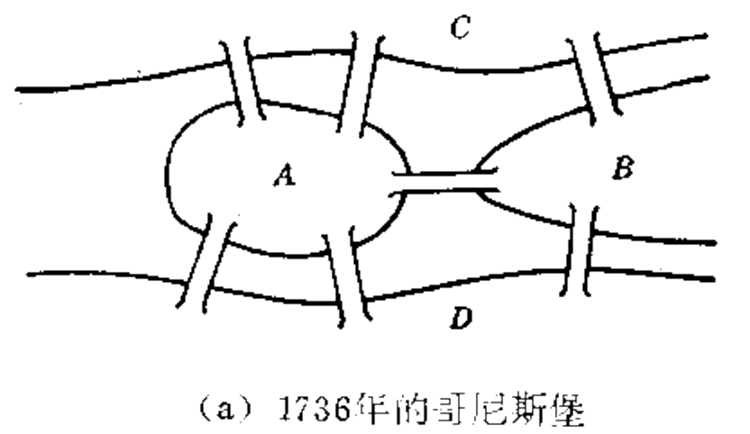
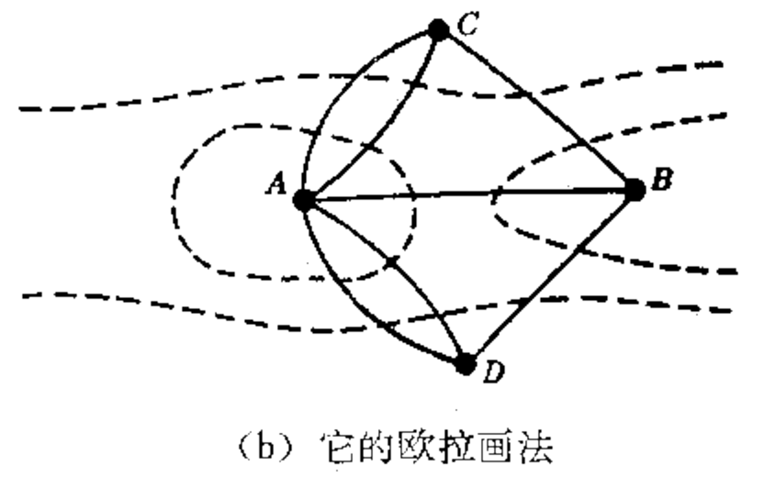
8.2 Euler Paths and Circuits
(a)1736年的哥尼斯堡
(b)哥尼斯堡问题的欧拉画法
A path in a graph G is called an Euler path if it includes every edge exactly once.
An Euler circuit is an Euler path that is a circuit.

Slide 24
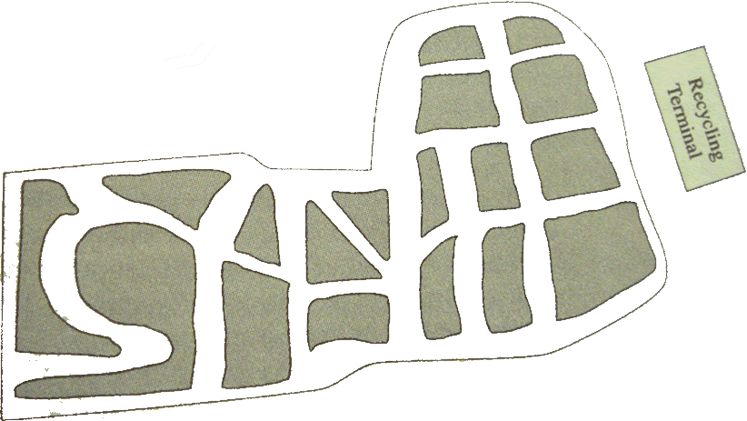
8.2 Euler Paths and Circuits
Ex. Truck rout for the street map

Slide 25
8.2 Euler Paths and Circuits
Ex. Find an Euler path for each of the following graphs
E
2
4
D
3
B
C
1
5
A
An Euler path:
E, D, B, A, C, D.
An Euler path:
5, 3, 2, 1, 3, 4, 5.

Slide 26
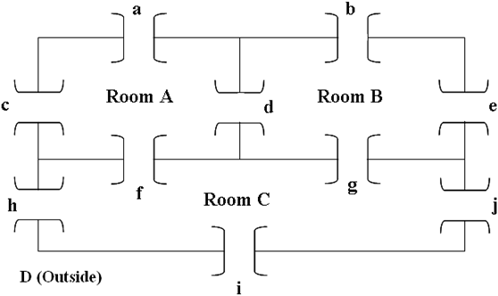
8.2 Euler Paths and Circuits
Ex. Is it possible to begin in a room or the outside and take a walk that goes through each door exactly once?
d
A
B
a
b
c
D
e
f
g
h
i
j
C

Slide 27
8.2 Euler Paths and Circuits
Questions for Euler paths or Euler circuits:
1) Existence? 2) Ways to find?
A discussion for a graph with a vertex
E of degree 1:
1) there cannot be an Euler circuit;
2) there might be an Euler path.
if so, the path must begin or end at this vertex E.
A similar discussion for a graph with a vertex v of odd degree 2n+1: travel in and out v n times respectively and leave or arrive (but not simultaneously) v for the last time.
E
D
B
C
A

Slide 28
8.2 Euler Paths and Circuits
Theorem 1. (a) If a graph G has a vertex of odd degree, there can be no Euler circuit in G.
(b) If G is a connected graph and every vertex has even degree, then there is an Euler circuit in G.
[Proof]
(a) is easy to be proved.
(b) Suppose that there are connected graphs where every vertex has even degree, but there is no Euler circuit.
Choose such a G with the smallest number of edges.
G must have more than one vertex, otherwise, there is clearly an Euler circuit (a cycle).

Slide 29
8.2 Euler Paths and Circuits
We show first that “G must have at least one circuit” …
If v is a fixed vertex of G (“connected” and “more than one vertex”), there must be an edge between v and some other vertex v₁. it is a simple path of length 1.
Let π₀ : v₁, v₂, …, v_{s} be a longest simple path in G.
Since v_{s} has even degree, and π₀ uses only one edge that has v_{s} as a vertex, there must be an edge e not in π₀ that also has v_{s} as a vertex;
if the other vertex of e is not one of v_{i}, then we can con-struct a simple path longer than π₀ , which is a contradiction. Thus a circuit v_{i} ,v_{i+1}, … , v_{s}, v_{i} exists in G.

Slide 30
8.2 Euler Paths and Circuits
[Continued] G has at least one circuits as showed.
Choose a circuit π in G that has the longest possible length. Since G has no Euler circuit, π cannot contain all edges of G.
Let G₁ be the graph formed from G by deleting all edges in π (but no vertices). G₁ is also a graph with all vertices of even degree, also may not be connected.
Choose a largest connected component of G₁ ,called G₂. Now G₂ has fewer edges than G, so G₂ must have an Euler path π′ (because of the way G₂ was chosen).

Slide 31
8.2 Euler Paths and Circuits
[Continued] If π′ passes through all the vertices on G, then π′ and π have vertices in common. If not, then there must be an edge e in G between some vertex v′ in π′ and some vertex not in π′.
e is not in π′, it must have been deleted when creating G₁, v′ is also in vertex sequence of π.
In any case, π and π′ have at least a vertex in common. Then we can construct a circuit in G that is longer than π by combining π and π′.
A contradiction to the longest circuit π.

Slide 32
8.2 Euler Paths and Circuits
Proof strategy:
Suppose there is a largest object, we can construct a large object, thereby creating a contradiction.
If G has vertices of odd degree, then it is not possible to construct an Euler circuit for G, but an Euler path may be possible.
A vertex of odd degree must be either the beginning or the end of any possible Euler path.

Slide 33
8.2 Euler Paths and Circuits
Theorem 2. (a) If a graph G has more than two vertices of odd degree, then there can be no Euler path in G.
(b) If G is connected and has exactly two vertices of odd degree, then there is an Euler path in G. Any Euler path in G must begin at one vertex of odd degree and end at the other vertex of odd degree.

Slide 34
8.2 Euler Paths and Circuits
Theorem 2. (a) If a graph G has more than two vertices of odd degree, then there can be no Euler path in G.
[Proof]
Let v₁, v₂, v₃ be vertices of odd degree.
Any Euler path must leave each of v₁, v₂, v₃ with no way to return.
One vertex of these three vertices may be the beginning of the E-path, and another be the end of the E-path. This leave the third vertex at one end of an untraveled edge.
Thus there is no Euler path.

Slide 35
8.2 Euler Paths and Circuits
Theorem 2. (b) If G is connected and has exactly two vertices of odd degree, then there is an Euler path in G. Any Euler path in G must begin at one vertex of odd degree and end at the other vertex of odd degree.
[Proof]
Let u and v be two vertices of odd degree.
Adding the edge {u, v} to G produces a connected graph G′, all of whose vertices has even degree.
By Th.1(b), there is an Euler circuit π′ in G′.
Omitting {u, v} from π′ produces an Euler path that begins at u (or v) and ends at v (or u).

Slide 36
8.2 Euler Paths and Circuits
Ex. Which of the following graphs have an Euler circuit, an Euler path but not an Euler circuit, or neither.
Euler circuit: No
Euler path: No
Euler circuit: No
Euler path: Yes
Euler circuit: Yes
Euler path: Yes

Slide 37
8.2 Euler Paths and Circuits
Ex. Which of the following graphs have an Euler circuit, an Euler path but not an Euler circuit, or neither.
d
A
B
a
b
c
D
e
f
g
h
i
j
C
degrees of 4, 4, 5, 7

Slide 38
8.2 Euler Paths and Circuits
One possible Euler path:
V_{π}: B, A, D, C, A, B, C
E_{π}: a, c, d, f, a, e
An edge is a bridge in a connected graph G if deleting it would create a disconnected graph.
{B, E} is a bridge in the right-hand graph.
A
b
B
a
c
f
e
D
d
C
p
A
B
q
r
s
E
C
t
u
D

Slide 39
8.2 Euler Paths and Circuits
Algorithm to produce an Euler circuit for a connected graph with no vertices of odd degree.
Fleury’s Algorithm
A connected graph G=(V, E, γ) with each vertex of even degree.
Step 1: Select e₁=(v₁,v₂) that is not a bridge, π: V_{π}: v₁, v₂; E_{π}: e₁.
Remove e₁ from E and let G₁ be the resulting subgraph.
Step 2: Suppose that V_{π}: v₁, v₂, … , v_{k} and E_{π}: e₁, e₂, …, e_{k-1} constructed so far, and all these edges and isolated vertices be removed from G_{k-1}. There must be e_{k}=(v_{k},v_{k+1}) in G_{k-1} that is not a bridge.
Add v_{k+1} to V_{π} and e_{k} to E_{π}. Remove e_{k} and any isolated vertices from G_{k-1} to form G_{k}.
Step3: Repeat Step 2 until no edges remain in E.

Slide 40
8.2 Euler Paths and Circuits
Ex. Use Fleury’s Algorithm to construct an Euler circuit.
B
F
A
C
E
G
D
H

Slide 41
8.2 Euler Paths and Circuits
Ex. Use Fleury’s Algorithm to construct an Euler circuit.
B
F
A
C
E
G
D
H

Slide 42
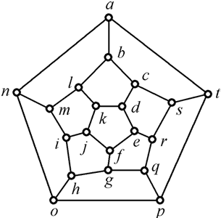
8.3 Hamiltonian Paths and Circuits
The problem: to visit each vertex exactly once, with the exception of the beginning vertex if it must also be the last vertex.
A Hamiltonian path is a path that contains each vertex exactly once.
A Hamiltonian circuit is a circuit
that contains each vertex exactly
once except for the first vertex,
which is also the last.
[Note] loops and multiple edges
are of no use for Hamiltonian circuit.

Slide 43
8.3 Hamiltonian Paths and Circuits
Ex. Find Hamiltonian paths or circuits.
d
A
B
A
B
2
5
c
e
E
3
4
C
b
D
C
1
6
D
a
Path: Yes
Circuit: No
Path: Yes
Circuit: Yes
Path: No
Circuit: No
Path: No
Circuit: No

Slide 44
8.3 Hamiltonian Paths and Circuits
Ex. For complete graph K_{n}, they all have Hamiltonian circuits: starting at any vertex, visiting the other vertices in any order.
Questions for Hamiltonian paths or circuits:
1) Existence? 2) Ways to find?
Not completely answered for the first question!
the second is still unanswered!

Slide 45
8.3 Hamiltonian Paths and Circuits
Theorem 1. G be a connected graph with n vertices, and no loops or multiple edges. G has a Hamiltonian circuit if for any two vertices u and v of G that are not adjacent, the degree of u plus the degree of v is greater than or equal to n. deg(u)+deg(v) ≥ n.
Corollary 1. G has a Hamilton circuit if each vertex has degree ≥ n/2.

Slide 46
8.3 Hamiltonian Paths and Circuits
[Remark]
Suppose that G is a simple graph with n vertices.
(1) G is connected if for any two vertices u and v of G that are not adjacent, deg(u)+deg(v) ≥ n-1.
(2) G has a Hamilton path if for any two vertices u and v of G that are not adjacent, deg(u)+deg(v) ≥ n-1.
(3) G has a Hamilton circuit if for any two vertices u and v of G that are not adjacent, deg(u)+deg(v) ≥ n.

Slide 47
8.3 Hamiltonian Paths and Circuits
Theorem 2. Let G be graph with m edges and n vertices. Then G has a Hamiltonian circuit if m ≥ (n²-3n+6)/2.
[Proof]
Let u and v be two nonadjacent vertices of G.
Graph H: eliminating u and v from G along with their edges. H has n-2 vertices and m-deg(u)-deg(v) edges.
m-deg(u)-deg(v) ≤ C(n-2,2) = (n-2)(n-3)/2
deg(u)+deg(v) ≥ m-(n-2)(n-3)/2
≥ (n²-3n+6)/2-(n-2)(n-3)/2
= n
Thus, the result follows from Theorem 1.

Slide 48
8.3 Hamiltonian Paths and Circuits
Theorem 1. G has a Hamiltonian circuit if deg(u)+deg(v) ≥ n.
Theorem 2. G has a Hamiltonian circuit if m ≥ (n²-3n+6)/2.
Ex. The converse of Th.1 and Th.2 are not true, sufficient conditions but not necessary ones.
A
H
B
G
C
F
D
E

Slide 49
8.4 Transport Networks
The label on an edge represents the maximum flow that can be passed through the edge and is called the capacity of the edge.
Capacity
4
5
4
3
4
1
2
2
6
5
3
3
2
3
Node

Slide 50
8.4 Transport Networks
A transport network, or a network, is a connected digraph N with the following properties:
(1) A unique source(源) with in-degree 0 is labeled as 1.
(2) A unique sink(汇) with out-degree 0 is labeled as n.
(3) The graph N is labeled. The label, C_{ij}≥0, on edge (i, j) is called the capacity of the edge.
4
5
Source
4
3
4
Sink
1
2
2
6
5
3
3
2
3

Slide 51
8.4 Transport Networks
A flow in a network N is a function that assign to each edge (i, j) of N a nonnegative number F_{ij} that does not exceed C_{ij}.
When the flow is F, F_{ij} represents amount of material passing through the edge (i, j).
For each node other than the source and the sink, the sum of the F_{ik} on edges entering node k must be equal to the sum of F_{kj} on edges leaving node k.
This means that material cannot accumulate, be create, dissipate, or be lost at any node other than the source or the sink.
This is called conservation of flow (流的守恒).

Slide 52
8.4 Transport Networks
The sum of the flows leaving the source must equal the sum of the flows entering the sink.
The sum is called the value of the flow, written value(F).
A flow F by labeling each edge (i, j) with (C_{ij}, F_{ij})
4
5
(4,3)
(3,3)
4
(4,2)
3
4
1
(2,1)
6
2
(2,0)
2
(5,3)
5
3
(3,2)
(3,2)
3
2
3
value(F)=5

Slide 53
8.4 Transport Networks
Maximum Flows
For any network an important problem is to determine the maximum value of a flow through the network and to describe a flow that has the maximum value.
This problem is called the maximum flow problem.
2
2
(6,4)
(6,6)
(6,6)
(6,6)
1
(2,2)
4
1
(2,0)
4
(4,4)
(4,2)
(4,4)
(4,4)
3
value(F)=8
3
value(F)=10

Slide 54
8.4 Transport Networks
Figure 8.73 displays a portion of the flow shown in Figure 8.72(a).
Although edge (j, i) is not in network N, there is no harm in considering such a virtual flow as long as it only has the effect of reducing the existing flow in the actual edge (i, j).
The path π :1,2,3,4 is not an actual
path in this network, since (2,3) is not
an actual edge.
π is a path in the symmetric closure
of the network.
2
(6,4)
1
(2,2)
4
virtual flow
(4,2)
3

Slide 55
8.4 Transport Networks
If we consider a virtual flow of two units through π, the effect on the network is to increase the flows through edges (1,2) and (3,4) by two units and decrease the flow through edge (3,2) by two units.
2
(6,6)
(6,6)
(6,4)
1
(2,0)
4
(2,2)
(4,4)
(4,4)
(4,2)
3

Slide 56
8.4 Transport Networks
Let N be a network and let G be the symmetric closure of N.
Choose a path π in G and an edge (i, j) in π.
(1) If (i, j) belongs to N, the edge has positive excess capacity (e_{ij}=C_{ij} - F_{ij}) if e_{ij} > 0;
(2) If (i, j) is not an edge of N, the edge has excess capacity e_{ij}=F_{ji} if F_{ji}>0. Then increasing flow through (i, j) will have the effect of reducing F_{ji}.

Slide 57
8.4 Transport Networks
Let N be a network and let G be the symmetric closure of N.
Choose a path π in G and an edge (i, j) in π.
(1) If (i, j) belongs to N, the edge has positive excess capacity (e_{ij}=C_{ij} - F_{ij}) if e_{ij} > 0;
(2) If (i, j) is not an edge of N, the edge has excess capacity e_{ij}=F_{ji} if F_{ji}>0. Then increasing flow through (i, j) will have the effect of reducing F_{ji}.
e₄₅=3, e₅₄=0
3
4
5
4
4
e₁₄=4, e₄₁=0
e₅₆=4, e₆₅=0
1
e₂₄=2
e₄₂=0
6
2
e₂₅=2
e₅₂=0
2
e₁₂=5, e₂₁=0
5
e₃₆=3, e₆₃=0
3
2
3
3
e₂₃=3, e₃₂=0

Slide 58
8.4 Transport Networks
We present Ford and Fulkerson’s algorithm for the maximum flow problem, it also call labeling algorithm.
Let N be a network with n nodes, and G be the symmetric closure of N, all edges and paths used are in G.
Begin with all flows set to 0, it will be convenient to track the excess capacities in the edges and how they change rather than tracking the increasing flows.
When the algorithm terminates, it is easy to find the maximum flow from the final excess capacities.

Slide 59
8.4 Transport Networks
THE LABELING ALGORITHM
Step 1. let N₁ be the set of all nodes connected to the source by edges of positive excess capacity.
For any j∈N₁, label it with [E_{j},1], E_{j}=e_{1j}.
[4,1]
e₄₅=3, e₅₄=0
4
5
e₁₄=4, e₄₁=0
e₅₆=4, e₆₅=0
1
e₂₄=2
e₄₂=0
6
e₂₅=2
e₅₂=0
e₁₂=5, e₂₁=0
e₃₆=3, e₆₃=0
2
3
e₂₃=3, e₃₂=0
N₁={2,4}
[5,1]

Slide 60
8.4 Transport Networks
THE LABELING ALGORITHM
Step 2. j is the smallest node number in N₁.
For any k∈N₂(j), label k with [E_{k}, j], E_{k}=min{e_{jk}, E_{j}).
N₂=∪_{j∈N1}N₂(j).
Let N₂(j) be the set of all unlabeled nodes, other than the source, that are joined to node j and have positive excess capacity.
[4,1]
[2,2]
e₄₅=3, e₅₄=0
N₁={2,4}, j=2
N₂(2)={3,5}
N₂(4)={}
N₂={3,5}
4
5
e₁₄=4, e₄₁=0
e₅₆=4, e₆₅=0
1
e₂₄=2
e₄₂=0
6
e₂₅=2
e₅₂=0
e₁₂=5, e₂₁=0
e₃₆=3, e₆₃=0
2
3
e₂₃=3, e₃₂=0
[5,1]
[3,2]

Slide 61
8.4 Transport Networks
THE LABELING ALGORITHM
Step 3. Repeat Step 2, labeling all unlabeled nodes N₃ that can be reached from a node in N₂ by an edge having positive excess capacity. Continue this process forming sets N₄, N₅, …, until after a finite number of steps either
(i) the sink has not been labeled and no other nodes can be labeled. It can happen that no nodes have been labeled.
(ii) the sink has been labeled.
Step 4. For case (i), the algorithm terminates and the total flow is the maximum flow.

Slide 62
8.4 Transport Networks
N₂={3,5}, j=3
N₃(3)={6}
[4,1]
[2,2]
e₄₅=3, e₅₄=0
4
5
e₁₄=4, e₄₁=0
e₅₆=4, e₆₅=0
1
e₂₄=2
e₄₂=0
6
[3,3]
e₂₅=2
e₅₂=0
e₁₂=5, e₂₁=0
e₃₆=3, e₆₃=0
2
3
e₂₃=3, e₃₂=0
[5,1]
[3,2]

Slide 63
8.4 Transport Networks
THE LABELING ALGORITHM
Step 5. For case (ii), the sink, node n, labeled with [E_{n}, m], E_{n} is the amount of extra flow that can be made to reach the sink through a path π.
We now examine π in reverse order:
(1) If (i, j)∈N, we increase the flow in (i, j) by E_{n} and decrease the excess capacity e_{ij} by E_{n}, increase the excess capacity of (j, i) by E_{n}.
(2) If (i, j)∉N, we decrease the flow in (j, i) by E_{n} and increase its excess capacity by E_{n}, decrease the excess capacity of (j, i) by E_{n}.
We now have a new flow E_{n} units greater than before and Return to Step 1.

Slide 64
8.4 Transport Networks
[4,1]
[2,1]
[2,2]
[3,4]
[1,4]
e₄₅=3, e₅₄=0
e₄₅=1, e₅₄=2
2
4
5
e₁₄=4, e₄₁=0
e₁₄=2, e₄₁=2
2
4
e₅₆=4, e₆₅=0
e₅₆=2, e₆₅=2
e₅₆=0, e₆₅=4
1
e₂₄=2
e₄₂=0
6
[2,5]
0
2
e₂₅=2
e₅₂=0
e₂₅=0
e₅₂=2
e₁₂=5, e₂₁=0
e₁₂=2, e₂₁=3
e₁₂=0, e₂₁=5
5
3
e₃₆=3, e₆₃=0
e₃₆=0, e₆₃=3
2
3
e₂₃=3, e₃₂=0
e₂₃=0, e₃₂=3
3
[2,1]
π₁: 1, 2, 3, 6. ⇒ 3
π₂: 1, 2, 5, 6. ⇒ 2
π₃: 1, 4, 5, 6. ⇒ 2
No further labeling is possible.
F_{ij} = C_{ij} - e_{ij}
flow value:
0
0+3
0+3+2
0+3+2+2

Slide 65

8.4 Transport Networks
The Labeling Algorithm
While (1) {
Step 1. N₀={1}, label all nodes connected to the node of N₀ by edges of positive excess capacity, and get set N₁.
Repeat
Step 2. label all unlabeled nodes connected to the node of N_{i} by edges of positive excess capacity, and get set N_{i+1}.
Until Case I or Case II
if (Case I) break
Step 4. get a path π from source to sink, change (e_{ij}, e_{ji}) of edge in the path in reverse order
}
Step 5. Output the value(F)
Step 3

Slide 66
8.4 Transport Networks
We define a cut (割集) in a network N as a set K of edges having the property that every path from the source to the sink contains at least one edge from K.
A cut does cut a digraph into two pieces, one containing the source and one containing the sink.
If the edges of a cut were removed, nothing could flow from the source to the sink.
The capacity of a cut (割集容量) K, c(K), is the sum of the capacities of all edges in K.

Slide 67
8.4 Transport Networks
4
5
4
3
4
1
2
2
6
5
3
3
Cut K₁
2
3
Cut K₂
K₁={(1,2), (2,4), (4,5)}
c(K₁)=10
K₂={(3,6),(5,6)}
c(K₂)=7

Slide 68
8.4 Transport Networks
If F is any flow and K is any cut, then value(F)≤c(K). Because all parts of F must pass through the edges of K, and c(K) is the maximum amount that can pass through the edges of K.
Suppose that for some flow F and some edges in K, value(F)=c(K), the flow F uses the full capacity of all edges in the cut K.
Then F would be a flow with maximum value, since no flow can have value bigger than c(K).
Similarly the K must be a minimum capacity cut, because every cut must have capacity at least equal to value(F).

Slide 69
8.4 Transport Networks
Theorem 1. (The Max Flow Min Cut Theorem) A maximum flow F in a network has value equal to the capacity of a minimum cut of the network.

Slide 70
8.4 Transport Networks
To show the labeling algorithm does results in a maximum flow by finding a minimum cut whose capacity is equal to this flow.
Suppose that the algorithm runs and stops at Step 4.
The sink has not been labeled.
Divide the nodes in two sets, M₁ and M₂:
M₁={the source and all nodes that have been labeled}
M₂={all unlabeled nodes, other than the source}
K={ e_{ij} | v_{i}∈M₁, v_{j}∈M₂}
Any path π from the source to the sink begins with a node in M₁ and end with a node in M₂.

Slide 71
8.4 Transport Networks
Suppose that (i, j)∈K, i∈M₁ and j∈M₂.
If i is the last node in π, i∈M₁, and j is the node that follow i in π, then j∈M₂.
so, (i, j) is in K. Therefore K is a cut by definition.
The final flow F produced by the algorithm must result in (i, j) carrying its full capacity; otherwise, we could use node i and the excess capacity to label node j, which by definition is not labeled.
Thus the value of the final flow of the algorithm is equal to the capacity c(K), and so F is a maximum flow.

Slide 72
8.4 Transport Networks
4
5
4
3
4
1
2
2
6
5
3
3
2
3
The minimum cut corresponding to the maximum flow is K={(5,6),(3,6)}.
c(K)=7=value(F).

Slide 73
8.5 Matching Problems
The definition of a transport network can be extended.
A network has multiple sources or multiple sinks.
1
2
2
4
6
3
2
2
4
2
5
7
3
4
3

Slide 74
8.5 Matching Problems
Supersources: a node connected to all sources of N.
Supersinks : a node connected to all sinks of N.
Capacities of new edges: the sum of all capacities leaving sources of N.
1
2
2
11
4
6
3
11
a
2
2
4
b
11
2
11
11
5
7
3
4
3

Slide 75
8.5 Matching Problems
Applying the labeling algorithm: Maximum flow with value of 9.
1
(2,2)
2
2
(2,2)
(11,2)
4
6
11
(3,1)
(11,6)
3
11
a
2
2
b
(2,1)
4
(11,3)
(4,4)
11
(11,3)
(2,2)
11
(11,4)
2
11
5
7
3
(3,3)
(4,4)
3
4

Slide 76
8.5 Matching Problems
Matching problem
We have two finite sets A and B, a relation R from A to B.
A matching function M is a one-to-one function from a subset of A to a subset of B.
a is matched with b if M(a)=b
M is compatible with R if M⊆R; if M(a)=b, then a R b.
Ex. Let A be a set of girls and B be a set of boys attending a school dance.
a R b : a knows b
M(a)=b: a and b dance the third dance together.
M is compatible with R if each girl knows her partner for the third dance.

Slide 77
8.5 Matching Problems
Matching problem
Ex. A={s₁, s₂, s₃, s₄, s₅}, the set of students working on a research project.
B={b₁, b₂, b₃, b₄, b₅}, the set of reference books on reserve in the library for the project.
s_{i} R b_{k} iff s_{i} wants to sign out book b_{k}
A matching of students to books would be compatible with R if each student is matched with a book he wants to sign out.

Slide 78
8.5 Matching Problems
Matching problem
Given any relation R from A to B, a matching M that is compatible with R.
M is called maximal if its domain is as large as possible.
M is called complete if its domain is A.
A matching problem is, given A, B and R, find a maximal matching from A to B that is compatible with R.
Matching problems can be solved using network.
sources : elements of A;
sinks : elements of B;
edge(a,b) : a R b;
capacity : all assigned with 1.

Slide 79
8.5 Matching Problems
Matching problem
One maximal matching M can be found by inspection:
M(s₁)=b₂
M(s₂)=b₁
M(s₃)=b₃
M(s₄)=b₄
No complete matching exists.
Usually, it can be very difficult to
find a maximal matching.
s₁
b₁
s₂
b₂
s₃
b₃
s₄
b₄
s₅
b₅

Slide 80
8.5 Matching Problems
Use the labeling algorithm to solve the matching problem.
s₁
1
b₁
1
1
1
s₂
1
b₂
1
1
1
1
1
1
x
s₃
b₃
y
1
1
1
1
1
1
1
s₄
b₄
1
1
1
1
s₅
1
b₅

Slide 81
8.5 Matching Problems
It is not obvious to find a complete matching for a particular problem.
A condition that will guarantee the existence of a complete matching was first found for the matching problem for a set of men and a set of women with the relation “suitable for marriage”.
“Is it possible for each man to marry a suitable woman” often referred to as the marriage problem.

Slide 82
8.5 Matching Problems
Theorem 1 (Hall’s Marriage Theorem) Let R be a relation from A to B. Then there exists a complete matching M iff for each X⊆A, |X|≤|R(X)|.
Proof
(1) A complete matching M exists ⇒ |X|≤|R(X)| for each X ⊆A.
If a complete matching M exists, then M(X)⊆R(X) for every subset X of A. But M is one-to-one, |X|=M(X)≤|R(X)|.

Slide 83
8.5 Matching Problems
(2) |X|≤|R(X)| for each X⊆A ⇒ a complete matching M exists.
Suppose that for any X⊆A, |X|≤|R(X)|.
Construct the network N that corresponds to R.
Suppose that |A|=n.
There is a flow in N with value n, which will correspond to a complete matching.
It is sufficient to show that the minimal cut in N has value n by Max Flow Min Cut Theorem.

Slide 84
8.5 Matching Problems
A typical situation is shown in Figure 8.97, with the wavy line representing a cut in N.
S₃
s₁
b₁
S₂
x
s₂
b₂
y
S₁
┆
┆
s_{n}
b_{p}
Figure 8.97
Divide the edges in K into three sets:
S₁ contains the edges beginning at the supersource x;
S₂ contains the edges corresponding pairs in R;
S₃ contains the edges ending with the supersink y;

Slide 85
8.5 Matching Problems
Consider removing the edges of K one set at a time.
Suppose that |S₁|=k, A₁⊆A;
When the edges in S₁ are removed, no path from x to y can pass through an element of A₁.
Since K is minimal, we can suppose that no edge that begins in A₁.
Let A₂=A-A₁, |A₂|=n-k, B₂=R(A₂).
Each element of B₂ labels the terminal node of an edge that begins in A₂.
Since x is connected to each element in A₂, x is also connected each element in B₂.
We know that |A₂|≤|R(A₂)=|B₂|, so |B₂|≥n-k.

Slide 86
8.5 Matching Problems
Let |S₂|=r.
Removing an edge in S₂ may or may not disconnect x from any element of B₂, but it cannot disconnect x from more than one element of B₂.
Thus, when edges in S₂ are removed, x is still connected to at least (n-k)-r elements in B₂.
These elements must be disconnected from y to ensure there is no path from x to y.
So S₃ must contain at least (n-k)-r edges, i.e. |S₃| ≥ (n-k)-r.
c(K)=|K|=|S₁|+ |S₂|+ |S₃| ≥ k+r+((n-k)-r)=n.
Since the cut has capacity n, the minimal cut, the maximum flow, is n.

Slide 87
8.5 Matching Problems
Ex. Let M_{R} be the matrix of a marriage
suitability between five men and five women.
Can each man marry a suitable women?
[Solution]
S: any subset of men
E: the set of edges that begin in S
|E|=2|S|
Each edge in E must terminate in a node of R(S).
The number of edges terminating at elements of R(S) is 2|R(S)|.
Thus, 2|S|≤2|R(S)|, and so |S|≤|R(S)|.
By Hall’s marriage theorem, a complete matching is possible.
1 1 0 0 0
0 0 0 1 1
1 0 1 0 0
0 0 1 0 1
0 1 0 1 0
M_{R}=

Slide 88
8.6 Coloring Graphs
G=(V, E, γ): a graph with no multiple edges
C={c₁, c₂, …, c_{n}}: a set of n colors
Any function f: V→C is called a coloring of the graph G using n colors (or using the colors of C).
f(v) is the color of the vertex v.
A coloring is proper if any two adjacent vertices v and w have different colors.

Slide 89
8.6 Coloring Graphs
Ex. C = {r,w,b,y}
w
r
χ(G)=3
b
y
r
r
b
w
w
r
proper coloring
using three colors
proper coloring
using four colors
We can not color the graph with two or fewer colors.
The chromatic number of the graph G (图的着色数): the smallest number of colors needed to produce a proper coloring of G, denoted by χ(G). χ(读: Kai)

Slide 90
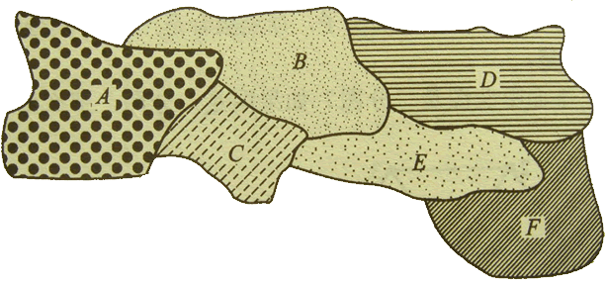
8.6 Coloring Graphs
One of the oldest graph-coloring problems is the map-coloring problem.
A coloring of map is a way to color each region so that no two distinct regions sharing a common border have the same color.

Slide 91
8.6 Coloring Graphs
Given a map M, construct a graph G_{M} with one vertex for each region and an edge connecting any two vertices whose corresponding regions share a common boundary.
The proper colorings of G_{M} correspond exactly the colorings of M.
A
B
D
F
A conjecture was that four colors are always enough to color any map drawn on a plane. – 四色定理
The conjecture was proved to be true in 1976 with the aid of computer computations performed on almost 2000 configuration of graphs. There is still no proof known that does not depend on computer checking.
C
E

Slide 92
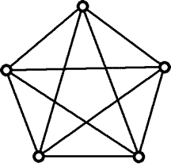
8.6 Coloring Graphs
A planar graph is a graph that be drawn in a plane so that no edges cross except at vertices.
A
B
D
F
C
E
planar graph
K₅: not a planar graph

Slide 93
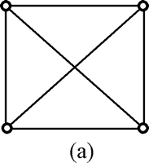
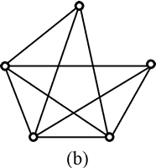
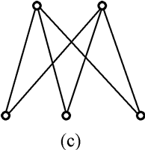
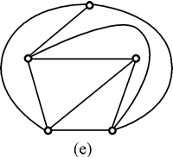
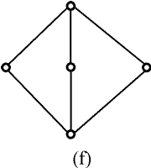
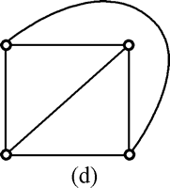
8.6 Coloring Graphs
Some examples of planar graph.

Slide 94
8.6 Coloring Graphs
Chromatic Polynomials
χ(G) is the smallest number of colors needed to produce a proper coloring of G.
Computing the total number of different coloring of a graph.
If G is a graph and n ≥ 0 is an integer,
let P_{G}(n) be the number of ways to color G using n or fewer colors, P_{G}(n) is polynomial in n.
P_{G}: a function called the chromatic polynomial.

Slide 95
8.6 Coloring Graphs
Ex. x colors for L₄.
1st vertex: colored with any of x colors;
2nd vertex: colored with any of the x-1 colors not chosen for vertex 1.
3rd vertex: colored with any of the x-1 colors not chosen for vertex 2.
4th vertex: colored with any of the x-1 colors not chosen for vertex 3.
Total number of proper coloring is x(x-1)³. Thus P_{L4}=x(x-1)³.
P_{L4}(0)= 0; P_{L4}(1)= 0, P_{L4}(2)= 2
So, χ(L₄)=2.
L₄

Slide 96
8.6 Coloring Graphs
In general, for the graph G with no multiple edges, χ(G) is the smallest positive integer x for which P_{G}(x)≠0.
P_{Ln}(x)=x(x-1)^{n-1}
So, χ(L_{n})=2.
Ex. x colors for K_{n}.
For x<n, no proper coloring is possible.
For x≥n, P_{Kn}(x)=x(x-1)(x-2)…(x-n+1)
So, χ(G)=n.

Slide 97
8.6 Coloring Graphs
Theorem 1. If G is a disconnected graph with components G₁, G₂, …, G_{m}, then P_{G}(x)=P_{G1}(x) P_{G2}(x) … P_{Gm}(x).
Ex. For x ≥ 3,
P_{K3}(x) = x(x-1)(x-2).
P_{G}(x) = x²(x-1)²(x-2)².
P_{G}(3) = 36
P_{G}(4) = 576
χ(G) = 3.
Ex. For U_{n}
P_{Un}(x)=x^{n}, χ(U_{n})=1.
2
5
3
4
1
6
U_{n}

Slide 98
8.6 Coloring Graphs
G : a graph (V, E, γ) with no multiple edges
e : e={a,b}∈E
G_{e}: subgraph of G obtained by deleting e.
G^{e}: quotient graph of G obtained by merging end points of e.

Slide 99
8.6 Coloring Graphs
Theorem 2. With the preceding notation and using x colors, P_{G}(x) = P_{Ge}(x) - P_{G}e(x).
[Proof]
Two types of proper colorings of G_{e}:
(1) a and b have different colors;
(2) a and b have the same colors.
Coloring of type (1) is also a proper coloring of G.
Coloring of type (2) corresponds to a proper coloring of G^{e}.
Thus P_{Ge}(x)=P_{G}(x) - P_{G}e(x), or P_{G}(x)=P_{Ge}(x) - P_{G}e(x).

Slide 100
8.6 Coloring Graphs
Ex. x colors for G.
If x ≥ 2, P_{Ge}(x) = x(x(x-1)(x-2));
P_{Ge}(x) = x(x-1)(x-2);
P_{G}(x) = P_{Ge}(x) - P_{Ge}(x)
= x²(x-1)(x-2) - x(x-1)(x-2)
= x(x-1)²(x-2)
P_{G}(1) = 0; P_{G}(2) = 0; P_{G}(3) = 12
χ(G) = 3.
e

