Slide 1

Software Architecture
SSE USTC Qing Ding
dingqing@ustc.edu.cn
http://staff.ustc.edu.cn/~dingqing

Slide 2

Basic Concepts

Slide 3
Learning Objectives
Formally define software architecture
Distinguish prescriptive Versus descriptive architectures
List the causes and types of architectural degradation, and the challenges of architecture recovery
Understand elements of software architecture and differentiate between components and connectors
Delineate the role of architectural styles and patterns in a software architecture

Slide 4
What is Software Architecture?
Definition:
  A software system’s architecture is the set of
principal design decisions about the system
Software architecture is the blueprint for a software system’s construction and evolution
Design decisions encompass every facet of the system under development
  Structure
  Behavior
  Interaction
  Non-functional properties

Slide 5
Examples of Design Decisions
System Structure (e.g., central component)
Functional behaviour (e.g., sequence of opeations)
Interactions (e.g., event notifications)
Non-functional properties (e.g., no single point of failure)
System’s Implementation (e.g., Using Java Swing toolkit)

Slide 6
What is “Principal”?
“Principal” implies a degree of importance that grants a design decision “architectural status”
  It implies that not all design decisions are architectural
  That is, they do not necessarily impact a system’s architecture
How one defines “principal” will depend on what the stakeholders define as the system goals

Slide 7
Temporal Aspect
Design decisions are and unmade over a system’s lifetime → Architecture has a temporal aspect
At any given point in time the system has only one architecture
A system’s architecture will change over time
  Architectures can be forked, converge etc.
  Typically many related architectures are in play

Slide 8
What is “good” Architecture
The architecture is appropriate for the context of use.
E.g. a 3-Tier e-commerce architecture is not appropriate for an avionics project
Guidance on “good architecture” focusses on:
  Process
  Structure
Architecture should capture the principal design decisions about the system.
The blueprint – focussing on Structure, Component Behaviour, Component Interaction and how that inﬂuences Quality Attributes of Systems

Slide 9
Process
The architect team is small and maintains the integrity of the architecture
The architecture is justiﬁed in relation to a prioritized list of quality attributes that need to be managed
Document using views that reﬂect stakeholder interest
Evaluate the architecture in terms of how well it delivers the quality attributes
Choose architectures that allow incremental implementation

Slide 10
Structure
Use good modular structure: hide information, separate concerns, good robust interfaces that are unlikely to change
Structure depends on perspective/viewpoint: at least static (captures e.g. dependency in code), dynamic (captures e.g. dependency in data ﬂow), deployment (captures e.g. dependency on resources)
Use well known patterns and tactics (see later) to achieve quality attributes
Don’t depend on particular versions of tools
Modules producing data should be separate from those consuming data

Slide 11
Structure
Don’t expect simple mapping between modules (static structure) and components (dynamic structure)
Don’t depend on special features in the deployment environment unless essential
Architecture should use a small number of ways of interaction between components
Should be clearly identiﬁed resource contention issues
e.g. if network capacity is a potential issue the architect should budget capacity across components or some other management approach

Slide 12
Importance of Architecture
Software Architecture:
  Enables us to manage the key attributes of a system
  Allows reasoning about and managing change
  Allows prediction of the key quality attributes
  Allows better communication among stakeholders
  Carries the earliest (most fundamental) design decisions
  Deﬁnes constraints on implementation

Slide 13
Importance of Architecture
Software Architecture:
  Reﬂects the structure of an organisation
  Provides the basis for evolutionary prototyping
  Is the key artifact in reasoning about cost and scheduling
  Can be used as the transferrable, reuseable model at the heart of a product line
  Focusses on the assembly of components rather than on the creation of the components
  Restricts design alternatives and channels developer eﬀort in a coordinated way
  Provides the basis for training new team members.

Slide 14
Structure
Structure is slippery to describe
Sometimes we want to be prescriptive (this is how it should be) – often too tidy
Sometimes we want to be descriptive (this is how it is) – often a mess.

Slide 15
Prescriptive vs. Descriptive Architecture
A system’s prescriptive architecture captures the design decisions made prior to the system’s construction
  It is the as-conceived or as-intended architecture
A system’s descriptive architecture describes how the system has been built
  It is the as-implemented or as-realized architecture

Slide 16
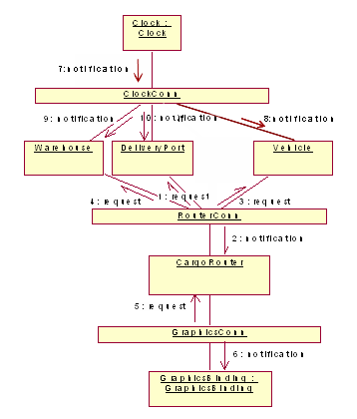
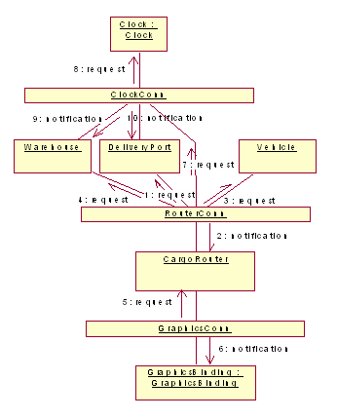
Prescriptive vs. Descriptive

Slide 17
Prescriptive vs. Descriptive
Which architecture is “correct”?
Are the two architectures consistent with one another?
What criteria are used to establish the consistency between the two architectures?
On what information is the answer to the preceding questions based?

Slide 18
Architectural Evolution
When a system evolves, ideally its prescriptive architecture is modified first
In practice, the system – and thus its descriptive architecture – is often directly modified
This happens because of
  Developer sloppiness
  Perception of short deadlines which prevent thinking through and documenting
  Lack of documented prescriptive architecture
  Need or desire for code optimizations
  Inadequate techniques or tool support

Slide 19
Architectural Degradation
Two related concepts
  Architectural drift
  Architectural erosion
Architectural drift is introduction of principal design decisions into a system’s descriptive architecture that
  are not included in, encompassed by, or implied by the prescriptive architecture
  but which do not violate any of the prescriptive architecture’s design decisions
Architectural erosion is the introduction of architectural design decisions into a system’s descriptive architecture that violate its prescriptive architecture

Slide 20
Architectural Drift or Erosion ?

Slide 21
Architectural Recovery
If architectural degradation is allowed to occur, one will be forced to recover the system’s architecture sooner or later
Architectural recovery is the process of determining a software system’s architecture from its implementation- level artifacts
Implementation-level artifacts can be
  Source code
  Executable files
  Java .class files

Slide 22
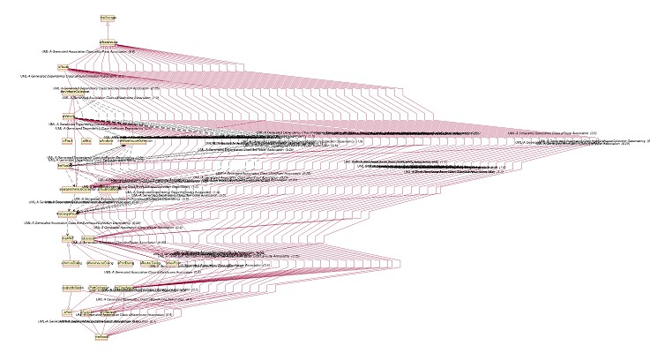
Can you recover this architecture ?

Slide 23
Software Architecture’s Elements
A software system’s architecture typically is not (and should not be) a uniform monolith
A software system’s architecture should be a composition and interplay of different elements
  Processing
  Data, also referred as information or state
  Interaction

Slide 24
Components
Elements that encapsulate processing and data in a system’s architecture are referred to as software components
Definition
  A software component is an architectural entity that
    encapsulates a subset of the system’s functionality and/or data
    restricts access to that subset via an explicitly defined interface
    has explicitly defined dependencies on its required execution context
Components typically provide application-specific services

Slide 25
Examples of Components
Application-specific components
  Examples: Cargo, warehouse, vehicle
Limited reuse components
  Examples: Web servers, clocks, connections
Reusable components
  Examples: GUI components, class and math libraries

Slide 26
Connectors
In complex systems interaction may become more important and challenging than the functionality of the individual components
Definition
  A software connector is an architectural building block tasked with effecting and regulating interactions among components
In many software systems connectors are usually simple procedure calls or shared data accesses
Connectors typically provide application-independent interaction facilities
  Can be described independent of the components

Slide 27
Examples of Connectors
Procedure call connectors
Shared memory connectors
Message passing connectors
Streaming connectors
Distribution connectors
Wrapper/adaptor connectors

Slide 28
Configurations
Components and connectors are composed in a specific way in a given system’s architecture to accomplish that system’s objective
Definition
  An architectural configuration, or topology, is a set of specific associations between the components and connectors of a software system’s architecture

Slide 29
Architectural Styles
Certain design choices regularly result in solutions with superior properties
  Compared to other possible alternatives, solutions such as this are more elegant, effective, efficient, dependable, evolvable, scalable, and so on
Definition
  An architectural style is a named collection of architectural design decisions that
    are applicable in a given development context
    constrain architectural design decisions that are specific to a particular system within that context
    elicit beneficial qualities in each resulting system

Slide 30
Architectural Style: Example
REST style (Representational State Transfer) – HTTP
  Uniform Interface between clients and servers
  Stateless: No client context stored on server between requests. All state is carried in the request URL.
  Clients should be able to cache responses to requests
  Layered architecture: Clients cannot tell if they are connected directly to the server or thro’ a proxy
  Code on demand (optional): Server should be able to extend the client’s functionality thro’ client-side scripts

Slide 31
Architectural Patterns
Definition
  An architectural pattern is a set of architectural design decisions that are applicable to a recurring design problem, and parameterized to account for different software development contexts in which that problem appears
A widely used pattern in modern distributed systems is the three-tiered system pattern
  Science
  Banking
  E-commerce
  Reservation systems

Slide 32
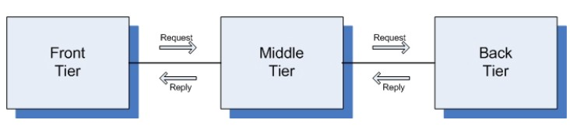
Three-Tiered Pattern
Front Tier
  Contains the user interface functionality to access the system’s services
Middle Tier
  Contains the application’s major functionality
Back Tier
  Contains the application’s data access and storage functionality

Slide 33
Differences between Style and Pattern
Style
  Provides a set of guiding principles in adopting solutions
  Requires considerable effort to apply.
Architect needs to justify the design choices based on the architectural style.
Pattern
  Provides concrete solutions, although parameterized to the specific problem.
  Requires very little manual effort or justification to apply.
  Usually applies to specific systems (e.g., GUI-based systems)

Slide 34
Architectural Models, Views, and Visualizations
Architecture Model
  An artifact documenting some or all of the architectural design decisions about a system
Architecture Visualization
  A way of depicting some or all of the architectural design decisions about a system to a stakeholder
Architecture View/Perspective
  A subset of related architectural design decisions
  Typically pertain to a cross-cutting functionality

Slide 35
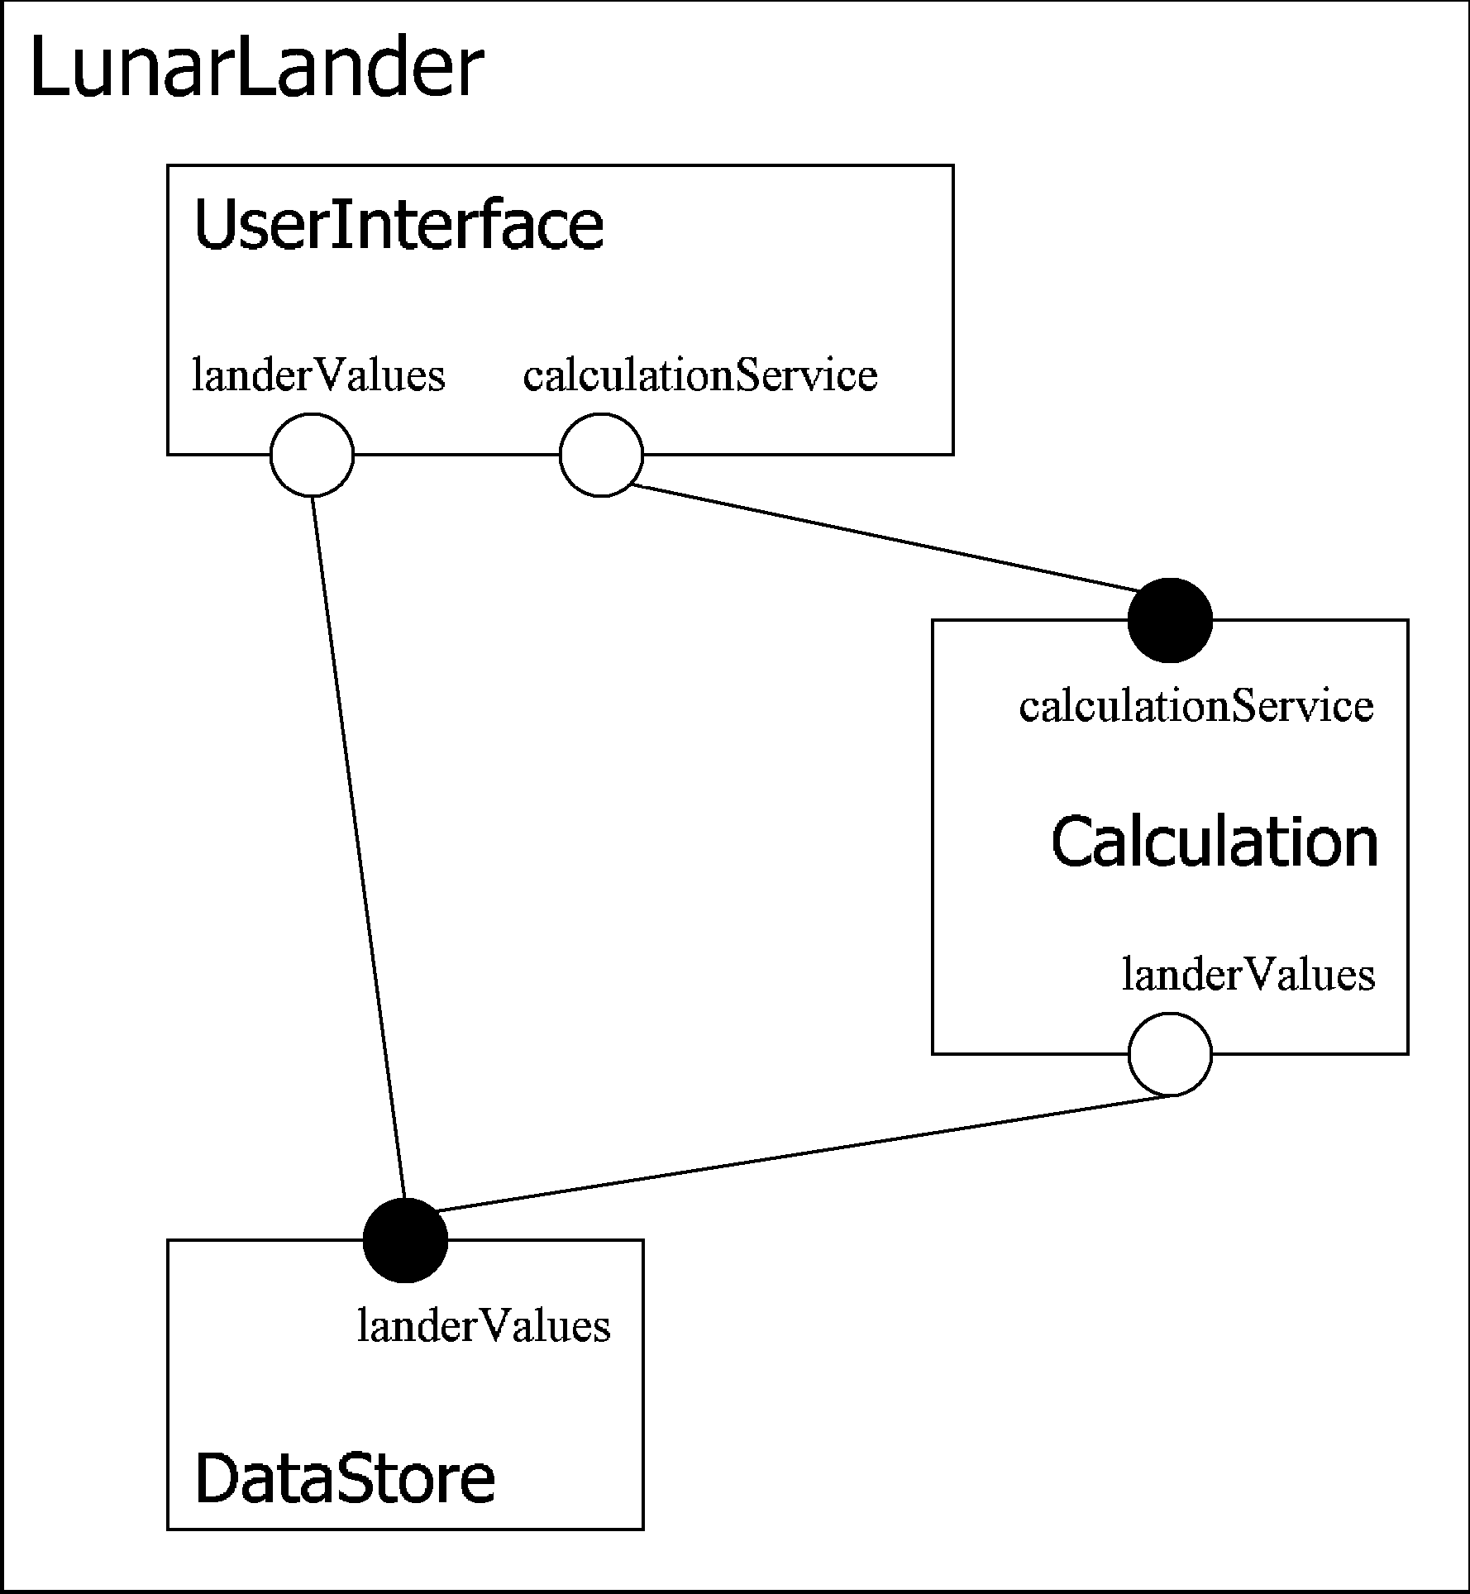
Architectural Visualization: Example
Graphical Diagram
Textual descriptions
component DataStore{ provide landerValues;
}
component Calculation{ require landerValues;
provide calculationService;
}
component UserInterface{ require calculationService; require landerValues;
}
component LunarLander{ inst
U: UserInterface; C: Calculation; D: DataStore;
bind
C.landerValues -- D.landerValues; U.landerValues -- D.landerValues; U.calculationService --
C.calculationService;
}

Slide 36
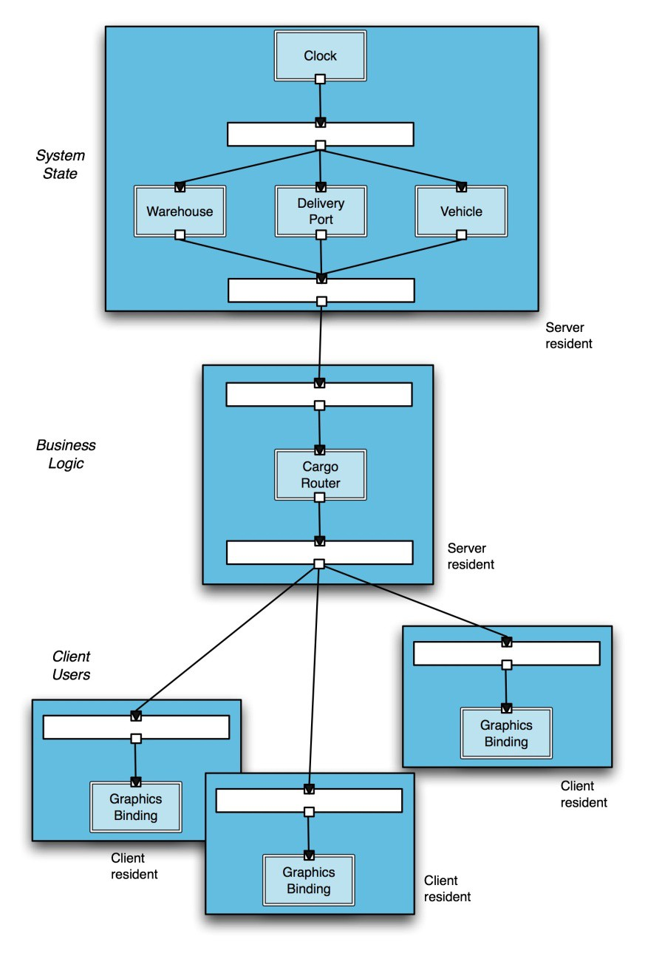
Architectural Views: Example
Structural View
Deployment View

Slide 37
How Architecture
Stakeholders
Quality
Attributes
Constraints
Principles
Community
experience
Architect
Architecture
Patterns &
Anti-patterns
Key
people
A “deliverable”
Technology
Produce
Is an input

