Slide 1

Software Architecture
SSE USTC Qing Ding
dingqing@ustc.edu.cn
http://staff.ustc.edu.cn/~dingqing

Slide 2

Architecture and Architect

Slide 3
Learning Objectives
Define software architecture and its elements
Distinguish between accidental and essential difficulties in software and enumerate them
Compare and contrast software architecture to building architecture and understand the role of the architect
Identify essential elements of the architecture of the WWW and the UNIX pipes and filters paradigm
Understand software product lines and the role of reuse in software design

Slide 4
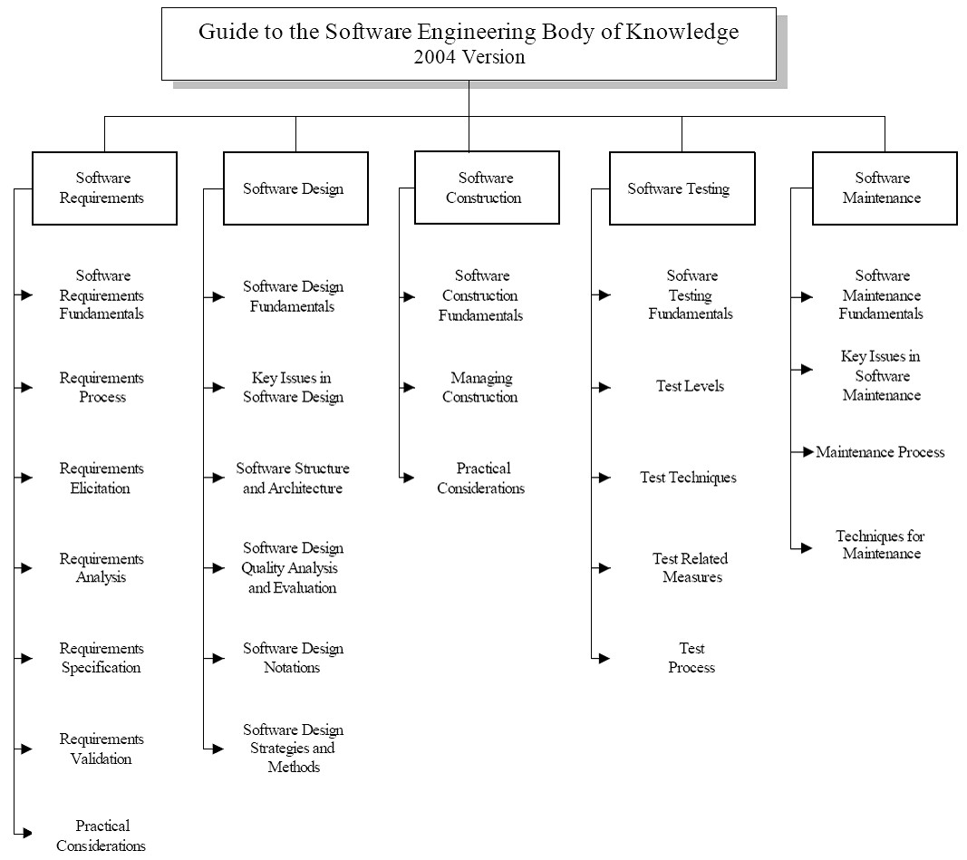
SWEBOK
Guide to the Software Engineering Body of Knowledge
– A project of the IEEE Computer Society Professional Practices Committee

Slide 5
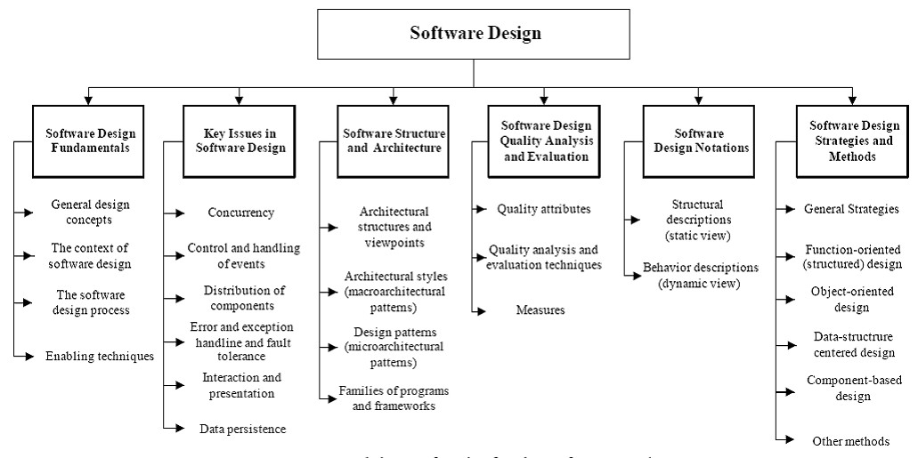
SWEBOK
REliable, INtelligent & Scalable Systems
Guide to the Software Engineering Body of Knowledge
– A project of the IEEE Computer Society Professional Practices Committee

Slide 6
Architecture
What is architecture?

Slide 7
What is Software Architecture?
It’s all about software design
  Architecture is software design, but not all design is software architecture
    part of the design process
[Gorton] Architecture focuses on ‘issues that will be difficult/impossible to change once the system is built’
  E.g., quality attributes like security, performance
  E.g., non-functional requirements like cost, deployment hardware

Slide 8
Definitions – Taylor et al.
[Software architecture is] the set of principal design decisions governing a system

Slide 9
Definitions - ANSI/IEEE Std 1471-2000
“Architecture is the fundamental organization of a system, embodied in its components, their relationships to each other and the environment, and the principles governing its design and evolution.”

Slide 10
Definitions - SEI
“The software architecture of a program or computing system is the structure or structures of the system, which comprise software elements, the externally visible properties of those elements, and the relationships among them.”

Slide 11
What is Software Architecture?
There are two common elements:
  One is the highest-level breakdown of a system into its parts;
  the other, decisions that are hard to change.
It's also increasingly realized that there isn't just one way to state a system's architecture;
  rather, there are multiple architectures in a system, and the view of what is architecturally significant is one that can change over a system's lifetime.

Slide 12
Main point: Architecture Defines Structure
Decomposition of system into components/modules/subsystems
Architecture defines:
  Component interfaces
    What a component can do
  Component communications and dependencies
    How components communicate
  Component responsibilities
    Precisely what a component will do

Slide 13
Typical System Architecture
Enterprise/Product Architecture
Business Architecture
Application Architecture
Technical Architecture
Product Architecture

Slide 14
What is Software Architecture
Software Architecture
  transforms Business Architecture into an set of designs and guidelines to realize business process in an information systems
Software Architecture
  relies on Technical Architecture to provide an efficient/scalable/secure environment

Slide 15
Software Engineering Difficulties
Software engineers deal with unique set of problems
  Young field with tremendous expectations
  Building of vastly complex, but intangible systems
  Often software is not useful on its own
    (e.g., unlike a car)
    thus it must conform to changes in other engineering areas
Some problems can be eliminated
  “accidental difficulties”
Other problems can be lessened, but not eliminated
  “essential difficulties”

Slide 16
Accidental Difficulties
Solutions exist
  Possibly waiting to be discovered
Past productivity increases were the result of overcoming
  Inadequate programming constructs & abstractions
    Remedied by high-level programming languages
    Increased productivity by factor of five
    Complexity was never inherent in program at all

Slide 17
Accidental Difficulties (cont’d)
Past productivity increases were the result of overcoming (cont’d)
  Inadequate tools:
    E.g., Viewing results of programming decisions took long time
      Remedied by time–sharing
      Turnaround time approaching limit of human perception
  Difficulty of using heterogeneous programs
    Addressed by integrated software development environments
    Support task that was conceptually always possible

Slide 18
Essential Difficulties
Only partial solutions exist for them, if any
Cannot be abstracted away
  Complexity
  Conformity
  Changeability
  Intangibility

Slide 19
Complexity
No two software parts are alike
  If they are, they are abstracted away into one
Complexity grows super-linearly with size
  E.g., it is impossible to enumerate all states of program
    Except perhaps “toy” programs

Slide 20
Conformity
Software is required to conform to its
  Operating environment
  Hardware
Often “last kid on block”
Perceived as most conformable

Slide 21
Changeability
Software is viewed as infinitely malleable
Change originates with
  New applications, users, machines, standards, laws
  Hardware problems

Slide 22
Intangibility
Software is not embedded in space
  Often no constraining physical laws
No obvious representation
  E.g., familiar geometric shapes

Slide 23
Promising Attacks On Complexity
Buy vs. Build
Requirements refinement & rapid prototyping
  Hardest part is deciding what to build (or buy?)
  Must show product to customer to get complete spec.
  Need for iterative feedback

Slide 24
Promising Attacks On Complexity (cont’d)
Incremental/Evolutionary/Spiral Development
  Grow systems, don’t build them
  Good for morale
  Easy backtracking
  Early prototypes
Great designers
  Good design can be taught; great design cannot
  Nurture great designers

Slide 25
Primacy of Design
Software engineers collect requirements, code, test, integrate, configure, etc.
An architecture-centric approach to software engineering places an emphasis on design
  Design pervades the engineering activity from the very beginning
But how do we go about the task of architectural design?

Slide 26
Analogy: Architecture of Buildings
We all live in them
(We think) We know how they are built
  Requirements
  Design (blueprints)
  Construction
  Use
This is similar (though not identical) to how we build software

Slide 27
Some Obvious Parallels
Satisfaction of customers’ needs
Specialization of labor
Multiple perspectives of the final product
Intermediate points where plans and progress are reviewed

Slide 28
Deeper Parallels
Architecture is different from, but linked with the product/structure
Properties of structures are induced by the design of the architecture
The architect has a distinctive role

Slide 29
Deeper Parallels (cont’d)
Process is not as important as architecture
  Design and resulting qualities are at the forefront
  Process is a means, not an end
Architecture has matured over time into a discipline
  Architectural styles as sets of constraints
  Styles also as wide range of solutions, techniques and palettes of compatible materials, colors, and sizes

Slide 30
More about the Architect
A distinctive role in a project
Very broad training
Amasses and leverages extensive experience
A keen sense of aesthetics
Deep understanding of the domain
  Properties of structures, materials, and environments
  Needs of customers

Slide 31
More about the Architect (cont’d)
Even first-rate programming skills are insufficient for the creation of complex software applications
  But are they even necessary?

Slide 32
Limitations of the Analogy…
We know a lot about buildings, much less about software
The nature of software is different from that of building architecture
Software is much more malleable than physical materials
The two “construction industries” are very different
Software deployment has no counterpart in building architecture
Software is a machine; a building is not

Slide 33
…But Still Very Real Power of Architecture
Giving preeminence to architecture offers the potential for
  Intellectual control
  Conceptual integrity
  Effective basis for knowledge reuse
  Realizing experience, designs, and code
  Effective project communication
  Management of a set of variant systems
Limited-term focus on architecture will not yield significant benefits!

Slide 34
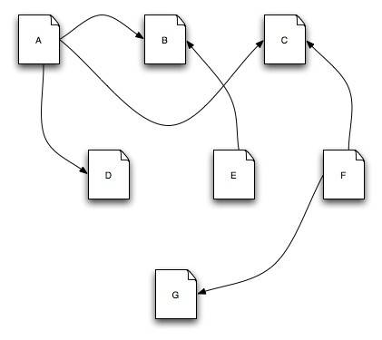
Architecture in Action: WWW
This is the Web

Slide 35
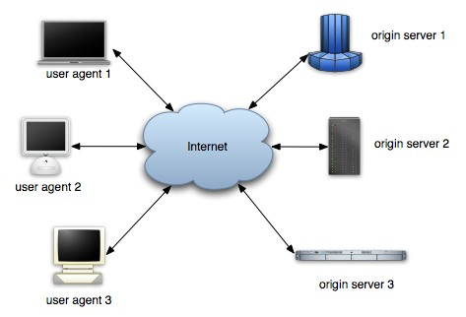
Architecture in Action: WWW
So is this

Slide 36
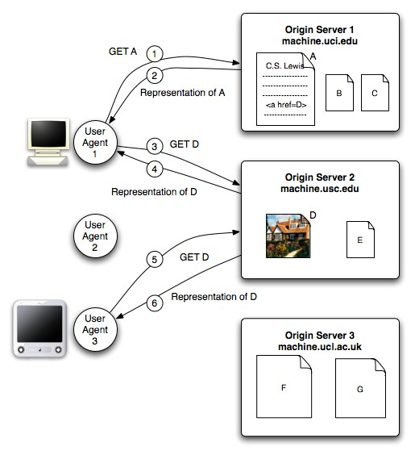
Architecture in Action: WWW
And this

Slide 37
WWW in a (Big) Nutshell
The Web is a collection of resources, each of which has a unique name known as a “uniform resource
locator” (URL)
Each resource denotes, informally, some information.
URI’s can be used to determine the identity of a machine on the Internet, known as an origin server, where the value of the resource may be ascertained.
Communication is initiated by clients, known as user agents, who make requests to servers.
  Web browsers are common instances of user agents.

Slide 38
WWW in a (Big) Nutshell (cont’d)
Resources can be manipulated through their representations.
  HTML is a very common representation language used on the Web.
All communication between user agents and origin servers must be performed by a simple, generic protocol (HTTP), which offers the command methods GET, POST, etc.
Communication between user agents and origin servers is fully self-contained.
  (So-called “stateless interactions”)

Slide 39
WWW’s Architecture
Architecture of the Web is wholly separate from the code
There is no one piece of code that implements the architecture.
There are multiple pieces of code that implement the various components of the architecture.
  E.g., different Web browsers

Slide 40
WWW’s Architecture (cont’d)
Stylistic constraints of the Web’s architectural style are not apparent in the code
  The effects of the constraints are evident in the Web
One of the world’s most successful applications is only understood adequately from an architectural vantage point.

Slide 41
Architecture in Action (2): @ small scale
Unix command line
ls invoices |
grep
-e august
| sort
Application architecture can be understood based on very few rules
Applications can be composed by non-programmers
  Akin to Lego blocks
A simple architectural concept that can be comprehended and applied by a broad audience

Slide 42
Software Product Line
Motivating example
  A consumer is interested in a 35-inch HDTV with a built-in DVD player for the North American market.
Such a device might contain upwards of a million lines of embedded software.
This particular television/DVD player will be very similar to a 35- inch HDTV without the DVD player, and also to a 35-inch HDTV with a built-in DVD player for the European market, where the TV must be able to handle PAL or SECAM encoded broadcasts, rather than North America’s NTSC format.
These closely related televisions will similarly each have a million or more lines of code embedded within them.

Slide 43
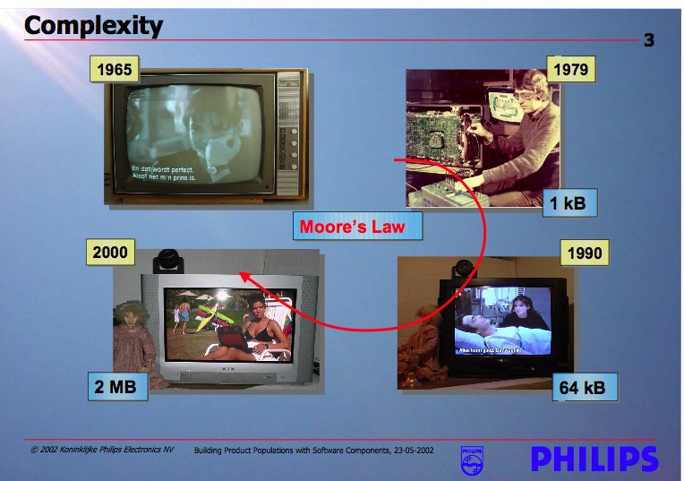
Growing Sophistication of Consumer Devices

Slide 44
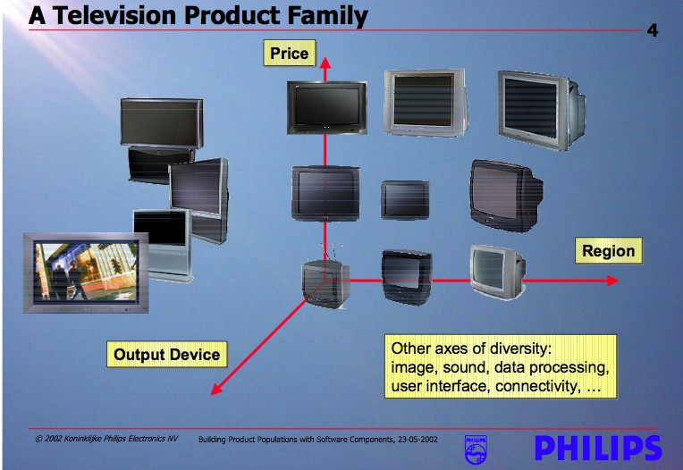
Families of Related Products

Slide 45
The Necessity and Benefit of PLs
Building each of these TVs from scratch would likely put Philips out of business
Reusing structure, behaviors, and component implementations is increasingly important to successful business practice
  It simplifies the software development task
  It reduces the development time and cost
  it improves the overall system reliability
Recognizing and exploiting commonality and variability across products

Slide 46
Reuse as the Big Win
Architecture: reuse of
  Ideas
  Knowledge
  Patterns
  Engineering guidance
  Well-worn experience
Product families: reuse of
  Structure
  Behaviors
  Implementations
  Test suites…

Slide 47
Architect
What is an architect?

Slide 48
What is Software Architect
Circa 25 BCE, Vitruvius described the role of an architect as:
  The ideal architect should be a man of letters,
  a mathematician, familiar with historical studies,
  a diligent of philosophy,
  acquainted with music,
  not ignorant of medicine,
  learned in the responses of Juri sconsultis,
  familiar with astronomy and astronomical calculations

Slide 49
The Architect’s Role
The architect:
  Visualizes the behavior of the system
  Creates the blueprint for the system
  Defines the way in which the elements of the system work together
  Distinguishes between functional and nonfunctional system requirements
  Is responsible for integrating non-functional requirements into the system

Slide 50
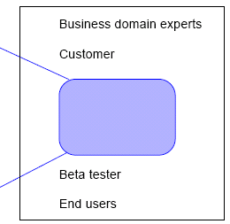
Development Team
The architect is a member of a development team.
  Team leads
  Enterprise modeler
  Architect
  System designers
  Developers
  Testers
  QA staff
  Configuration experts

Slide 51
What Architect Do
Gather System Requirements
Translate requirement to architecture design
Implement proof of concept, define development environment
Develop Architecture Module
Communicate Architecture Design
Be the technical expert
Mentor/help Developers

Slide 52
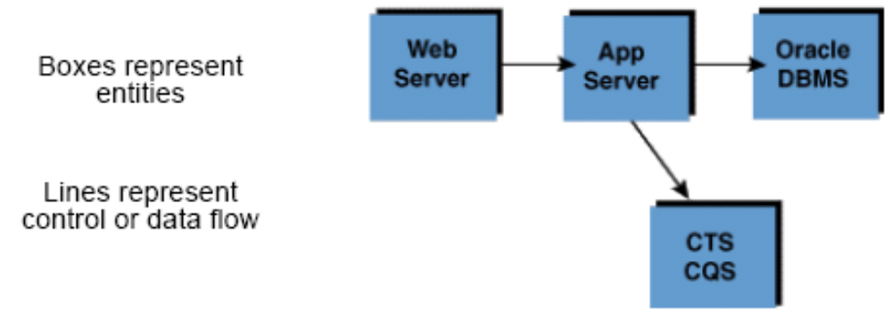
Defining Architecture
Architecture refers to an abstract representation of a system’s components and behaviors.
Architecture does not contain details about implementation.
Architectures are best represented graphically.

Slide 53
Technical Skills
Requirement gathering/Management
Modeling and analysis methodology
Full Software Development Life Cycle
Modern architectural technologies, such as Java EE and .NET
In depth knowledge of programming languages
Network, Security, hardware platforms
Database

Slide 54
None Technical Skills
Facilitation/consulting
Communication/Presentation/Sales skill
Mentoring
Domain Knowledge of area you working on
Leadership
Organizational politics
Business acumen/Strategy

Slide 55
What is a the best Architect
The best architects are
good technologists,
and command respect in the technical community,
but also are good strategists, organizational politicians (in the best sense of the word), consultants and leaders

Slide 56
Things to remember
Focus on people, not technology or techniques.
The greatest architecture model in the world has little value if you can't find a way to work with developers effectivelyand convince them to use it.
Keep it simple.
The simpler the architecture, the greater the chance that it will be understood and actually followedby developers.

Slide 57
Things to remember
Work iteratively and incrementally.
Your architecture will evolve over time due to new requirements, new technological choices, and greater understanding amongst your enterprise architecture team.
Roll up your sleeves.
Developerswon't respect you, and therefore won't accept your architecture, if you aren't willing to get actively involved in their project efforts.

Slide 58
Things to remember
Build it before you talk about it.
Everything works in diagrams but can fail miserably in practice. Just like in the RUP, you should prove your application architecture via technical prototyping; there is no reason why you can't do the same at the enterprise level.
Look at the whole picture.
This is a primary skill of enterprise architects, which is one of the reasons why a multi-view approach is so important to you

Slide 59
Things to remember
7. Make architecture attractive to your customers.
If your enterprise architecture artifacts aren't easy to understand, to access, and to work with, your customers (developers and senior managers) will very likely ignore your work.

Slide 60
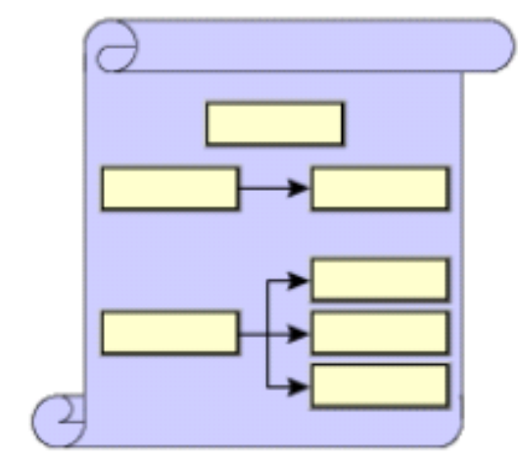
The Art of Architecture
An architect communicates the
design of the system to other
members of the team.
Defining an architecture is a
creative process.
The creative process can have
positive and negative aspects.
Architects try to balance creativity with science in the
form of models, frameworks, and patterns.

Slide 61
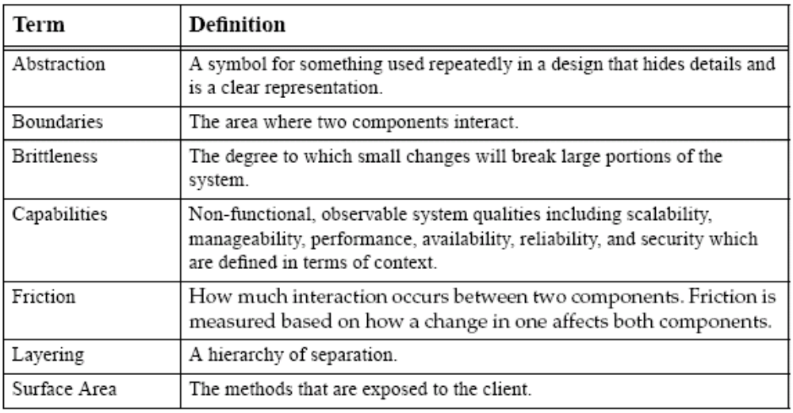
Defining Architecture Terminology

Slide 62
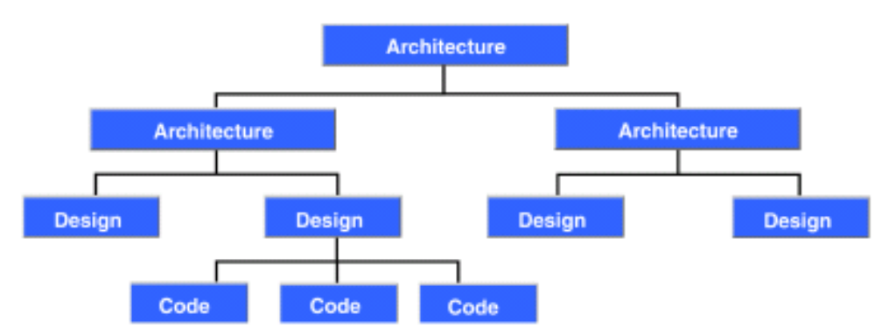
Architecture and Design
Key difference is in the level of details.
Architecture operates at a high level of abstraction.
Design operates at a low level of abstraction.

Slide 63
Architectural Building Blocks
Capabilities and design goals
Process and artifacts
Communication mechanisms
To build an architecture, the architect uses the following:
Architectural fundamentals
Experience:
  Best practices
  Frameworks, patterns, and idioms

Slide 64
Capabilities and Design Goals
Capabilities:
Are non-functional, observable system qualities that affect the long term viability of your architecture.
Depend on the context of your system.
Can be specified, measured, and prioritized.
  Example of specifying reliability — No more than 1 failure per 1000 attempts or 99.9 percent.
Design goals:
Are non-functional, non-observable system qualities designed into a system to achieve the capabilities.

Slide 65
Process and Artifacts
A process consists of an orderly sequence of steps from initiation to delivery to deployment.
The purpose of a process is to:
  Address assumptions
  Minimize the impact of risks
  Identify constraints
Artifacts result from the process.
UML is used to communicate the architecture and design to other members of the team, both present and future.

Slide 66
Communication Mechanisms
HTTP, HTTPS
RMI
IIOP
Messaging
Transactions (ACID)

Slide 67
Architectural Fundamentals
Top-down design approach
Identifying layers, tiers, and services
Establishing service-based architectures
Abstraction

Slide 68
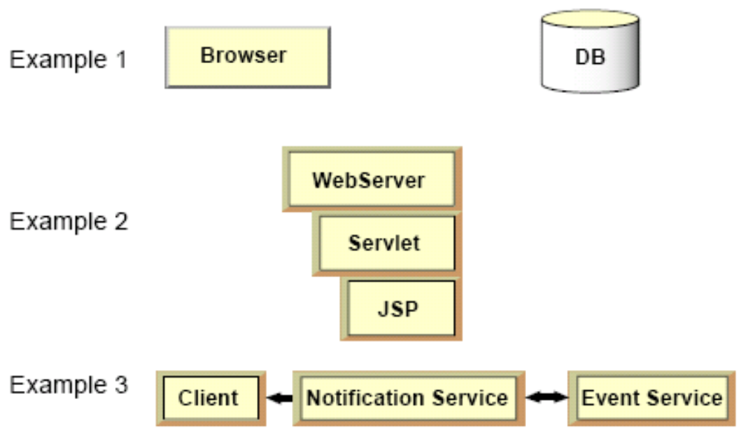
Abstraction
Abstraction refers to creating symbols that hide design details:

Slide 69
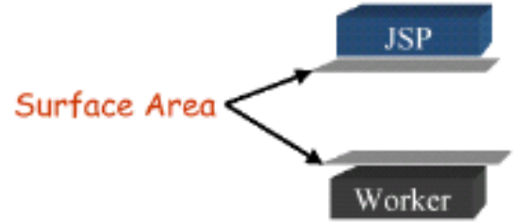
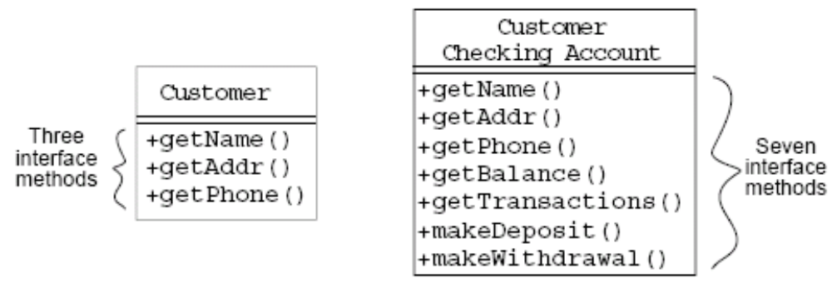
Abstraction – Surface Area
Well-defined modules interact with one another in simple, well-defined ways.
Surface area is the different ways that modules interact.

Slide 70
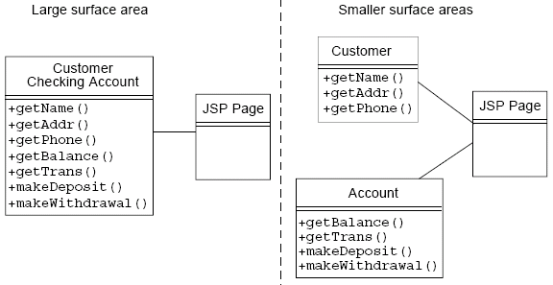
Abstraction – Surface Area
The greater the surface area, the more ways a change in one module can affect another.

Slide 71
Check Your Progress
Define the role of an architect
Define the term “architecture”
Explain architectural terms such as abstraction, boundaries, brittleness, and capabilities
List the differences between “architecture” and “design”
Identify the fundamentals of system architecture
Identify and define key architectural principles
Explain the concept of abstraction, and how it is implemented in system architecture

Slide 72
Think Beyond
The architect has many issues to consider, as discussed in this module.
How absolute are these issues?
Can you think of how they relate to each other?
Can you think of other issues that should be considered?

Slide 73
Conclusion
How do I start
  Become an excellent developer who knows why not just how
  Understand the relationship of underline technical architecture and software systems
  Understand current platform specific architecture
  Know the domain you are working on, become an expert
  Read, read, read, think, think, think

Slide 74

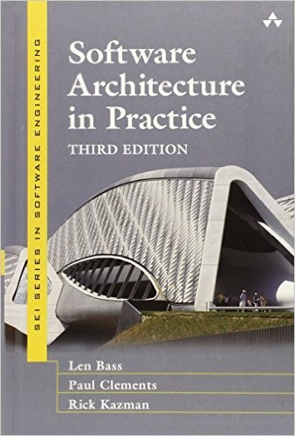





Books

