Slide 1

Software Architecture
SSE USTC Qing Ding
dingqing@ustc.edu.cn
http://staff.ustc.edu.cn/~dingqing

Slide 2

Implementation Architecture

Slide 3
Outline
Definition
Design
Behaviour
Requirements
Prototypes

Slide 4
Definition
What is implementation architecture?

Slide 5
Implementation Architecture
Focuses on how the system is built
Which technological elements are needed to implement the system
Software packages, libraries, frameworks, classes, ...
Addresses non-runtime requirements & quality attributes: configurability, testability, reusability, ...
Comprised of components and connectors

Slide 6
Implementation Architecture
Components and connectors reflect software entities and their relationships at the level of source and binary code
Typically a number of implementation models
Each model focuses on one of the concurrent subsystems or processes from the execution view

Slide 7
Components
Two types of components:
Application
Infrastructure

Slide 8
Components
Application components
  ... are responsible for implementing domain-level responsibilities
  These are responsibilities found in a detailed conceptual architecture
  Application components might be realized as binary packages, source packages, and files

Slide 9
Components
Infrastructure components
  ... are needed to make the system run but are not related to the application functionality
    E.g. HTTP Connection Handler in our sample is a typical infrastructure component
  Whether a particular component is an application or an infrastructure component depends on the application
    E.g. if we are building a Web application server then HTTP Connection Handler is an application component

Slide 10
Components
Often an infrastructure component acts as a ``container'' for application components
A container component provides an execution environment for the contained components and manages their lifetime
Typically, the container executes within a process and creates threads for application components
  E.g. a Web application server which runs multiple applications, each of them in their own threads

Slide 11
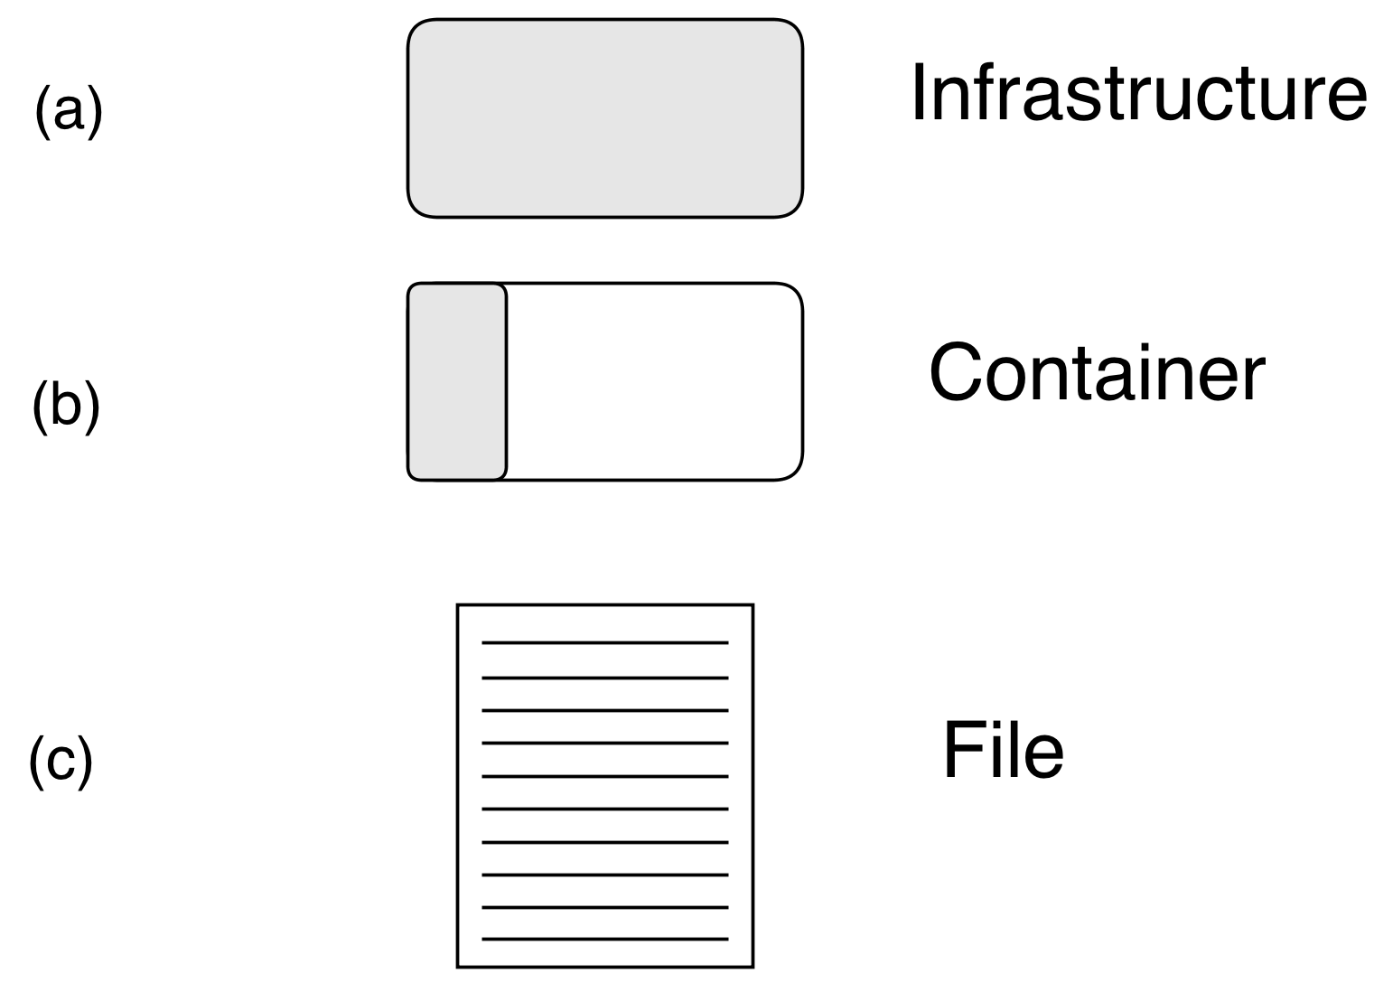
Component stereotypes
Figure : Implementation stereotypes from Software Architecture Primer

Slide 12
Connectors
In implementation architecture connectors represent a ''uses'' relation
The arrow depicts the direction of this relation
The nature of communication is depicted through the connector styles

Slide 13
Connectors
API call: A component calls a method in another component (possibly only if both components are in the same process)
Callback: The caller passes a reference of an object to the callee. The callee invokes a method on that object later.
Network protocol: Needed when implementation components reside in diﬀerent processes on networked machines. Components need to agree on a common protocol or use a standardized protocol
OS signals: Communication between processes running on the same machine

Slide 14
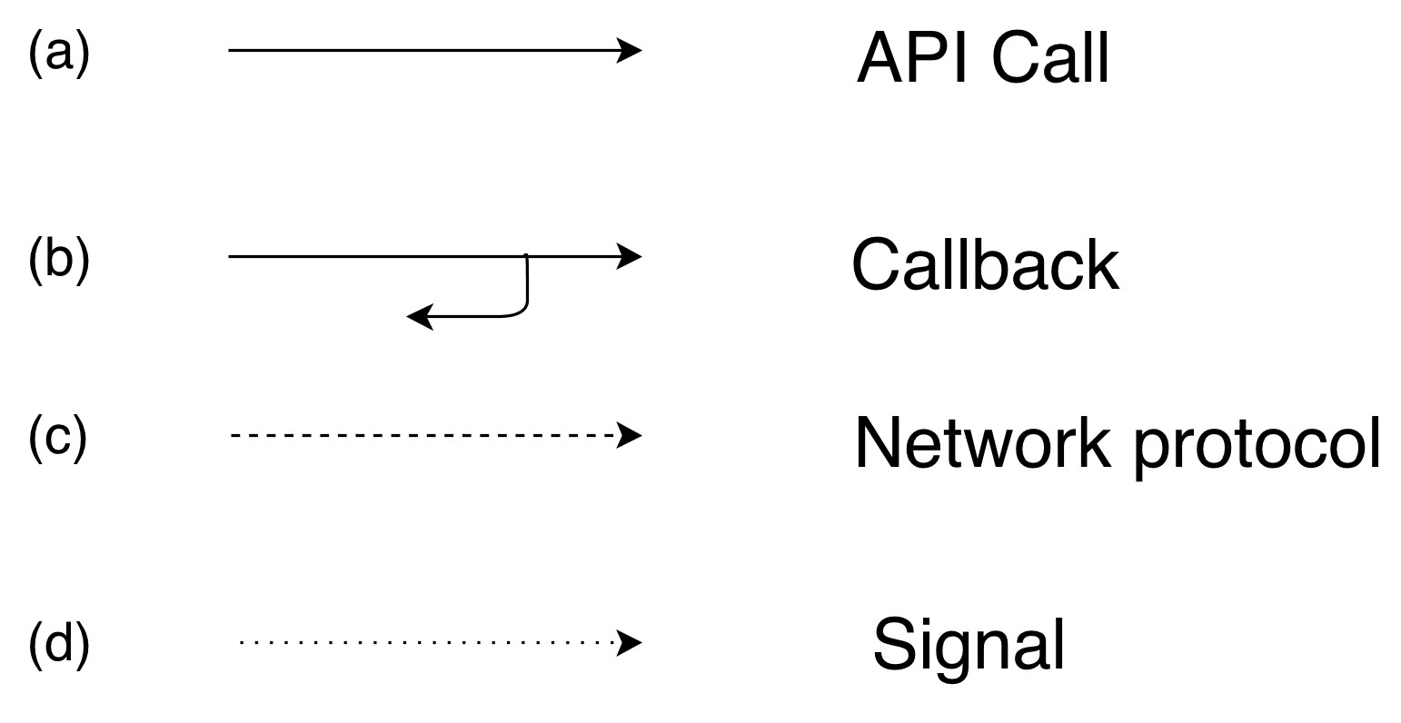
Connectors
Figure : Implementation connectors from Software Architecture Primer

Slide 15
Connectors
In some cases we depict ports as endpoints of connectors between components and their interfaces
Ports are used to represent the communication between inside and outside of a component
Interfaces are the specification how the communication looks like, e.g. the API
E.g. a component might be quite complex but it provides a simple interface for communication

Slide 16
Interfaces
Interfaces are part of the implementation architecture
Usually depicted via the lollipop notation, while ports are depicted as little squares
They expose the responsibilities
Typically interfaces change more slowly the components Interfaces abstract out hardware
... they can be standardised Interfaces allow distribution
Ports and interfaces are optional and should be used only if they are relevant for the model

Slide 17
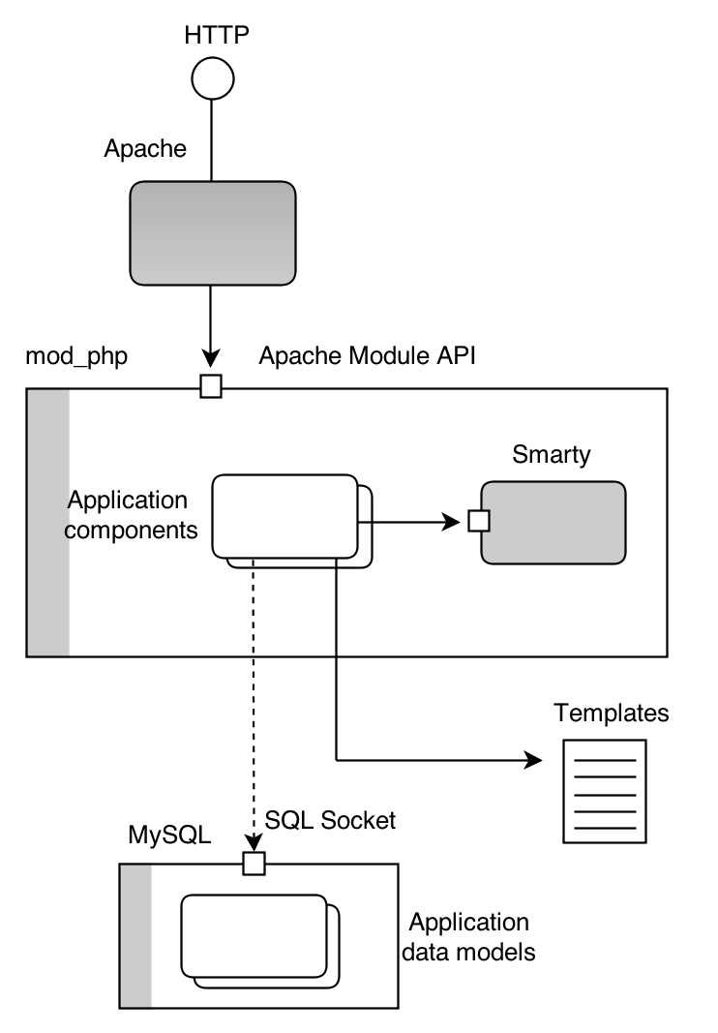
Example
Figure : Example of implementation architecture from Software Architecture Primer

Slide 18
Conceptual vs. Implementation
Element | Conceptual | Implementation
Components | Domain-level responsibilities | Implementation module
Connectors | Information flow | ``Uses'' relationship
Views | Single | Split

Slide 19
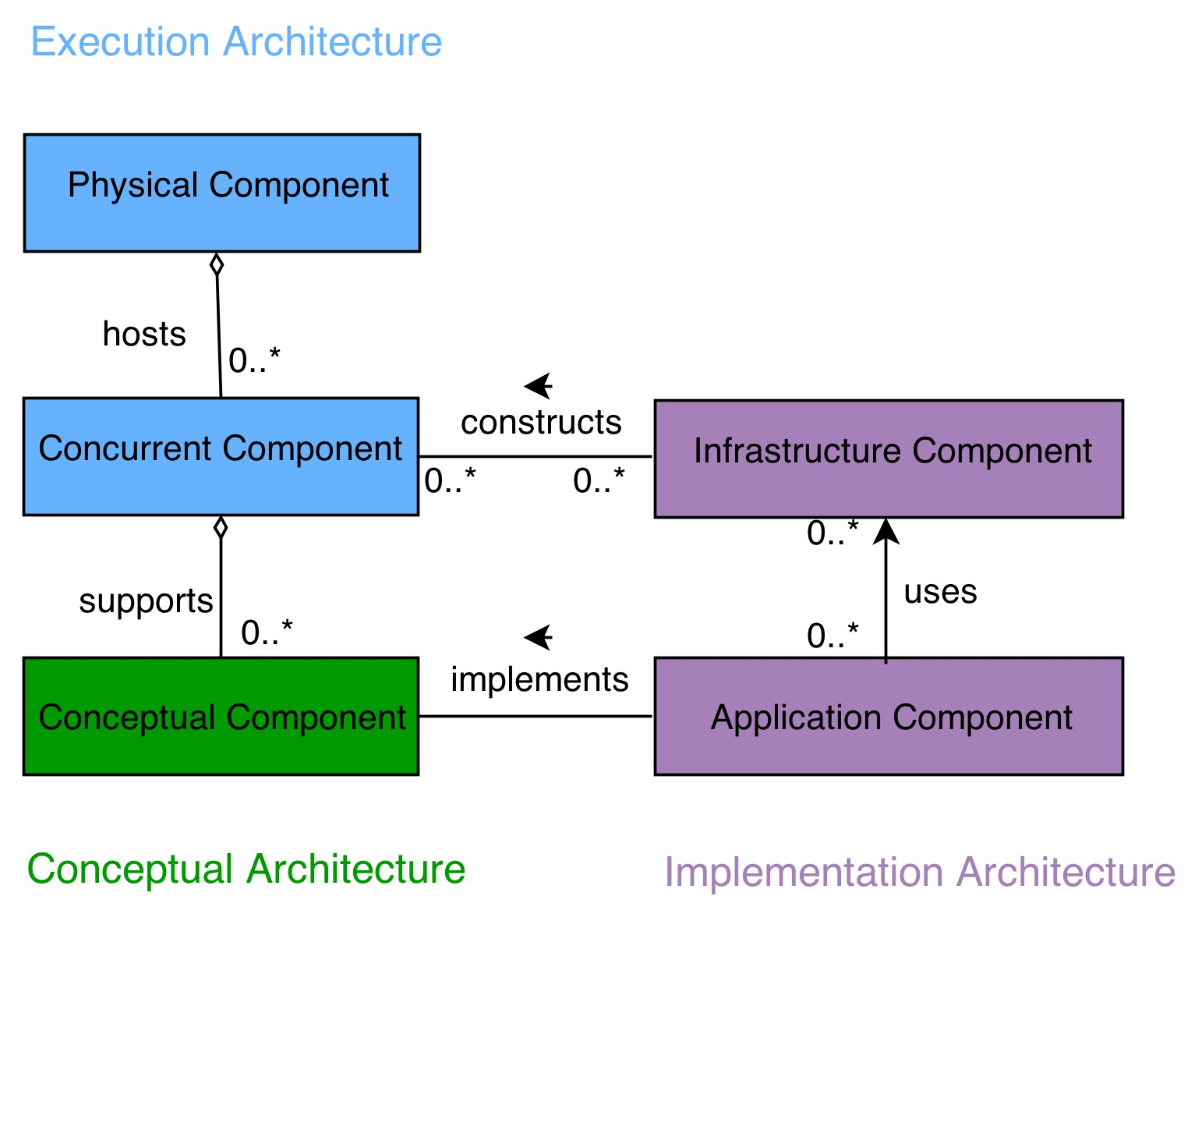
Conceptual vs. Execution vs. Implementation
Figure : Conceptual vs. execution vs. implementation from Software Architecture Primer

Slide 20
Design
How to design the implementation architecture

Slide 21
Implementation architecture design
Define application components
Define infrastructure components
Define interfaces
Behaviour design and verification
1
2
3
4

Slide 22
Application components
Ideal 1-to-1 mapping of conceptual components onto application components is typically not possible
Some conceptual components will become infrastructure components
  E.g. persistent storage (databases) are typically infrastructure components
Some conceptual components are spread over a number of application components
  ... if conceptual components have complex responsibilities

Slide 23
Application components
A number of conceptual components can be mapped onto a single application component
  ... if few and simple responsibilities
Complex conceptual components might map on additional application components
UI components map onto one application component (i.e. HTML UI)

Slide 24
Infrastructure components
Oﬀ-the-shelf components
Frameworks (e.g. application framework)
Servers (web, application, database, file)
Generic clients (browser)

Slide 25
Sample infrastructure components
Consider a simple Web application (e.g. the navigation application):
There are least two infrastructure components: browser, application server
Web browser
Web application server
Apache Tomcat: http://tomcat.apache.org/
Reference implementation of the Servlet API
Servlet API abstracts the HTTP protocol from programmers and allows to write Java classes that handle HTTP requests

Slide 26
Sample infrastructure components
public class SomeServlet extends HttpServlet { public void doGet(HttpServletRequest request,
HttpServletResponse response)
throws ServletException, IOException {
...
PrintWriter out = response.getWriter();
...
}
}

Slide 27
Sample infrastructure components
With a servlet we can read parameters from the user
  E.g. dataset name, dataset file We can respond with HTML
  E.g a new input form for selecting the start and end point for the route

Slide 28
Sample infrastructure components
Servlets are still very low level
We want to operate on a higher level of abstraction than reading/handling user parameters
There are frameworks which abstract e.g. HTTP request/response cycle
  For example, for general UI applications MVC frameworks
  Component-based frameworks such as GWT
  Also, Java servlets are just one possibility (Python, PHP, etc..)

Slide 29
Infrastructure selection
Research on which infrastructure to choose (or to develop)
Conceptual issues, e.g. MVC, component-based, service-based, ...
Execution issues, e.g. spawning of external processes
Implementation issues, e.g. programming language
Contextual issues, e.g. commercial products, open source, etc.
Organizational issues, e.g. know-how, team, ...

Slide 30
Infrastructure selection
Trough research you will obtain a list of several infrastructures Identification of criteria set (what is important)
Weighting of criteria (to what extent is some feature important)
Evaluation of modules
Selection (of the best infrastructure)

Slide 31
Weighted Scoring Method
There are n alternatives A₁, A₂, ..., A_{n}
There are m diﬀerent criteria C₁, C₂, ..., C_{m}
Each alternative is for each criterion with score S_{ij}
Each criterion has a weight relative to its importance W₁, W₂, ..., W_{m}
The final score for the alternative A_{i}:
m
S(A_{i}) = ∑ S_{ij}W_{j}
j=1
(1)

Slide 32
Weighted Scoring Method
For uniform distribution of weights:
m
∑
1
S(A_{i}) = _{m}
Sij
(2)
j=1

Slide 33
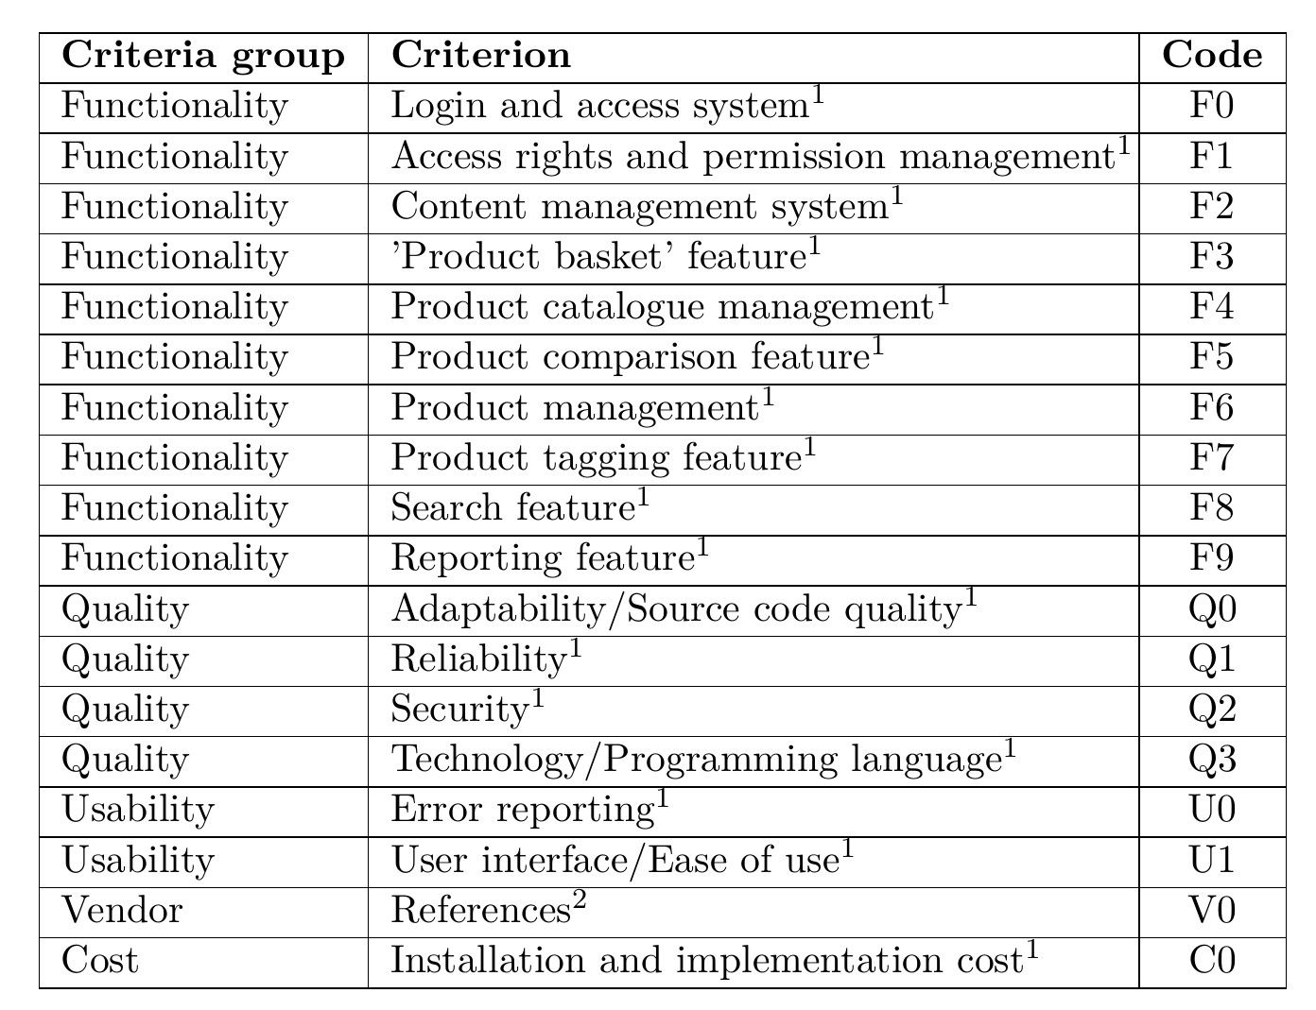
Weighted Scoring Method - Example

Slide 34
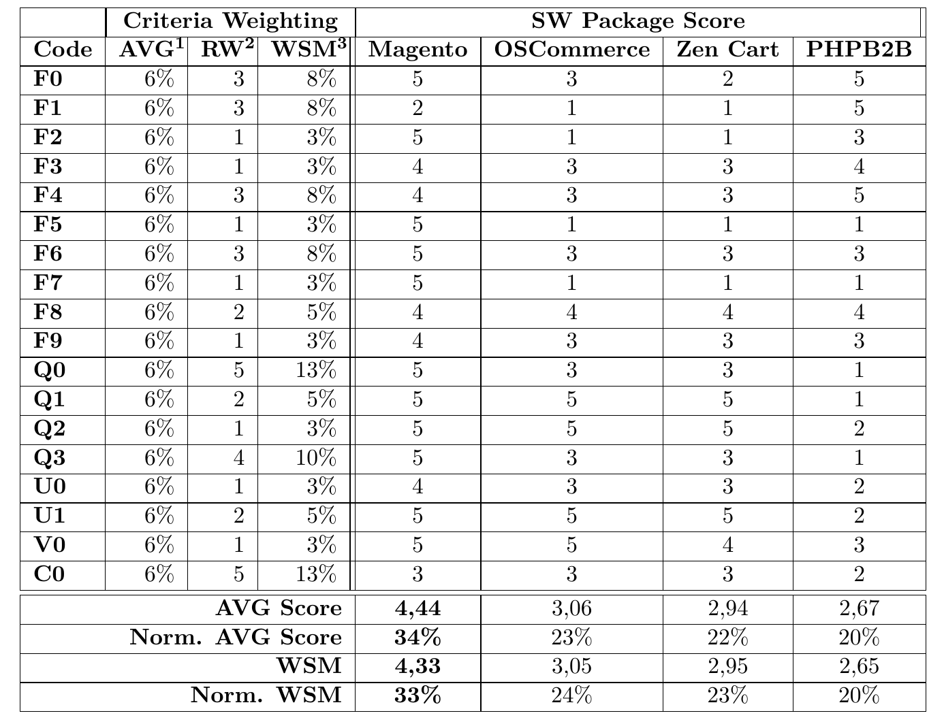
Weighted Scoring Method - Example

Slide 35
Sample infrastructure selection
Apply the same methodology for your projects
We select Open Source Java with Tomcat
We select component-based framework Apache Wicket as a Web application framework
We select Postgres as database backend
We selected to develop the navigation algorithm my ourselves

Slide 36
Interface design
For all application and infrastructure components we need to define interfaces (ports)
Helps in clarifying the responsibilities of a component
Some interfaces are also standardized
E.g. HTTP, SQL, File I/O

Slide 37
Sample interface design
UI: Combination of HTML/HTTP
It is standardized!
Web application server: HTTP/Servlet API
It is standardized
Component separation
Wicket components are specified by the framework

Slide 38
Sample interface design
We need to specify interface between Wicket and our application logic
A new interface is needed
We need to tell to the application logic that there is a request for an
e.g. calculation
e.g. findOptimalRoute(user, places, criteria)

Slide 39
Sample interface design
We should also tell to the system where to write routes, datasets, users, etc.
Typically these are only files
We can store users in an e.g. XML file
e.g. users.storeUser(user);

Slide 40
Behaviour
Dynamic aspects of implementation architecture?

Slide 41
Behavior design
Now we need to go into details
Use-case maps are too high level here
We need to investigate behaviour at the operation level
Thus, we need for example sequence diagrams
Still, use-case maps might be used to analyse e.g. runtime attributes

Slide 42
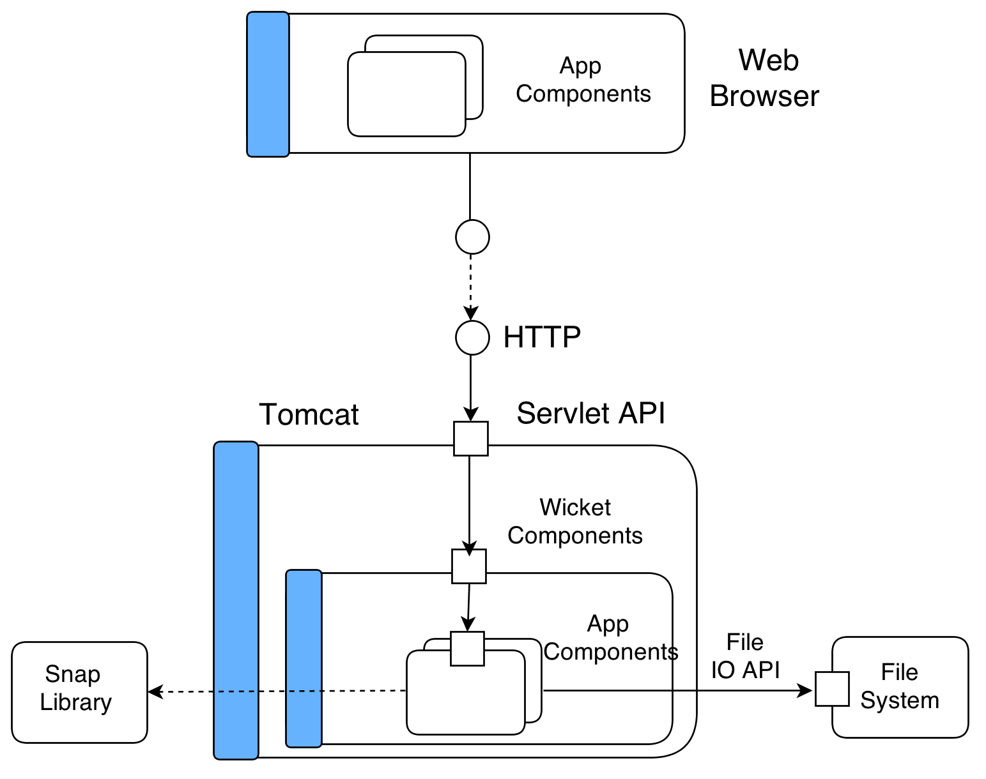
Sample implementation Architecture
Figure : Detailed sample implementation architecture

Slide 43
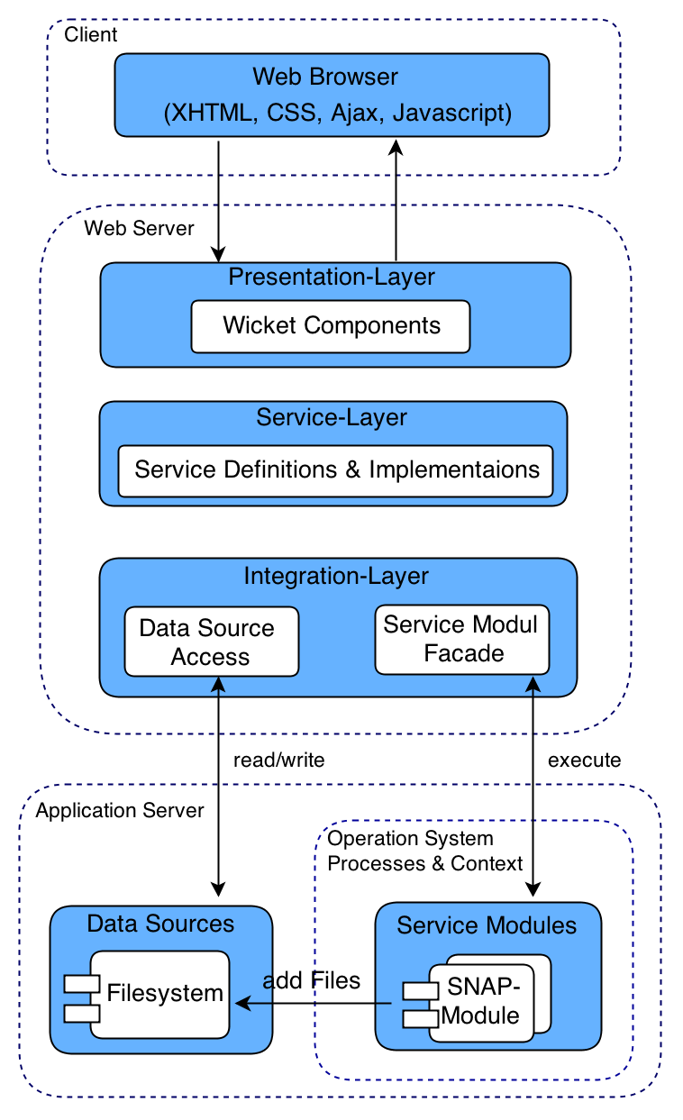
Sample implementation Architecture
Figure : Alternative implementation architecture

Slide 44
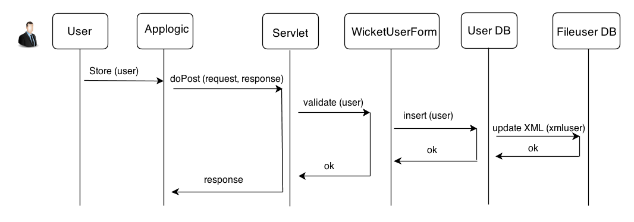
Sample interface Sequence Diagram
Figure : Sample sequence diagram

Slide 45
Practical Guidelines
Mapping of conceptual components to implementation components
One-to-one
▶ Implementation component supports all responsibilities
▶ Without breaking principles of granularity, cohesion and coupling
One-to-many
▶ Responsibilities cannot be mapped onto a single implementation component
▶ Specific architectural style requires multiple components
Many-to-one
▶ Existing product that encapsulates the functionality of multiple conceptual components
▶ Maintainance might be simpler for a single component
▶ Specific architectural style requires a single component

Slide 46
Requirements
What kind of requirements are addressed?

Slide 47
Non-runtime requirements
Since implementation view addresses build structure
It is the right place to consider non-runtime requirements & quality attributes
E.g. maintainability, extensibility, reusability, ... We can use a mechanism similar to use-case maps
Impact-maps: try to investigate what parts of the system need to change if ``something'' happens
Fault tree analysis: how does a failure cascade throughout the system
Tools to identify and explore architectural issues

Slide 48
Impact-maps
Map 1: new external system - interface to external system needs to be changed
Map 2: new optimal criterion - route finder application component needs to be changed
Map 3: new UI - UI component needs to be changed Goal: as few component changes as possible

Slide 49
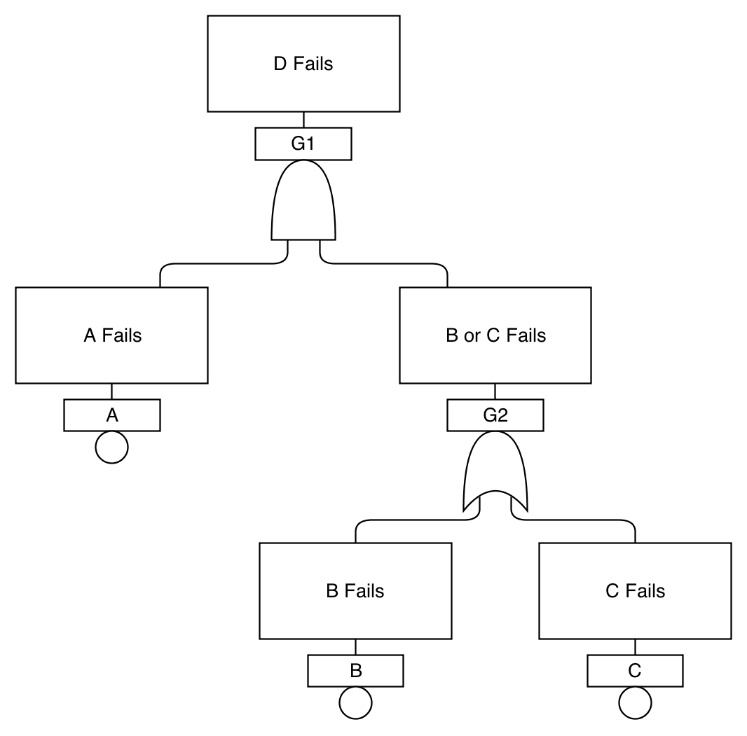
Fault Tree
Simple fault tree
Figure : A simple fault tree taken from the NASA handbook. D fails if A fails and either B or C fails.

Slide 50
Prototypes
About time to build the system

Slide 51
Prototype
To show that the architectural solution is feasible we implement prototypes
For each identified application component we provide implementation
Deploy it within the infrastructure components
Test it and check correctness, functionality, quality-attributes
Two types of prototypes: technical and executable

Slide 52
Technical Prototypes
Technical prototypes are used assess feasibility of an architecture
... or to discover and quantify parameters
Quickly developed to serve their purpose, but not at product quality level
This kind of prototype should be thrown away (should not make it into the final product)
Test out new technologies and components (or new versions)
e.g. is a certain database suitable? does are certain framework scale to our expected number of users?
... and also to test whether the skill of the team is suitable

Slide 53
Mock-Ups
Mock-ups are special technical prototypes, especially for user interfaces
Serve as the communication tool with the stakeholders (and within the team)
Should give an overview on how the system will look like
But does not contain any functionality
There are specialised tools to create mock-ups

Slide 54
Executable Prototypes
Executable prototypes are a skeleton of the system itself
First development cycles in an iterative process, evolutionary prototyping
... thus the code is not thrown away and code (and documentation) need to be at product quality level
Includes all components of the system (infrastructure, UI, ...), but only fragments of the functionality
The remaining functionality is then added iteratively
Discover flaws in the architecture early on
Assess the performance of the overall system
Blends well with agile development processes, e.g. Rapid Development [McConnel 1996], Unified Process
Within in evolutionary prototyping, technical prototypes might be develped → be precise, which type
of prototype is being developed

