Slide 1



STEWART TITLE · INFORMATION SECURITY
Information Security
Analyst Internship
Jair Maldonado
Exit Presentation · Summer 2026

Slide 2

CONTENTS
What I will walk through
01
About Me
Who I am and where I am headed
02
Internship Overview
Three rotations across the security team
03
Image Management Program
Making sure every new machine starts secure
04
AEGIS
Catching supply-chain attacks before they reach us
05
CVE-to-Patch Automation
Turning two days of patch work into twelve seconds
06
Summary
What this means for Stewart
TABLE OF CONTENTS
02

Slide 3


BACKGROUND
ABOUT ME
POSITION
Information Security Analyst Intern
Jair Maldonado
SCHOOL
Studying cybersecurity, with a focus on offensive security
BACKGROUND
Information Security Analyst Intern
Hands-on security work across vulnerability management, application security, and network security
CERTIFICATIONS
Working toward the PWPA and PJPT practical certifications
CAREER DIRECTION
Penetration testing — finding weaknesses before an attacker does
ABOUT ME
03

Slide 4
INTERNSHIP OVERVIEW
Three rotations across the security team
I moved through three different areas of Information Security. Each rotation produced one project.
01
02
03
Vulnerability Management
Application Security
Network Security
Finding known weaknesses across company machines and making sure they actually get fixed.
Checking the software we build and the outside code we rely on for weaknesses.
Protecting how machines talk to each other, and what is allowed in and out.
INTERNSHIP OVERVIEW
04

Slide 5
EXECUTIVE SUMMARY
Three problems, three working solutions
One from each rotation. Three separate gaps, three things the team keeps using — then the detail on each.
THE PROBLEM
WHAT I BUILT
THE PROOF
New machines could ship without the security tools they need.
A written framework naming all nine required tools and who owns each.
Drafted and staged for Q4 sign-off
Attackers hide malicious code inside the open-source packages we depend on.
AEGIS — a scanner that checks whether our code actually reaches the flaw.
1,518 packages scanned in a real Stewart repository, down to one upgrade
Matching every tracked flaw to its patch took about two days of analyst time.
A script that does the matching automatically, then consolidates the result.
117 matched in ~12 sec; 209 rows became 46 tickets
EXECUTIVE SUMMARY
05
Notes:
If you only take one thing from this: three separate problems, three working solutions, and I can show the evidence for each. The detail follows — feel free to tune in and out.

Slide 6
01
PROJECT 01
Image Management Program
Making sure every new machine ships with the security tools it needs — and that nobody can skip the step.
PROJECT 01
06

Slide 7
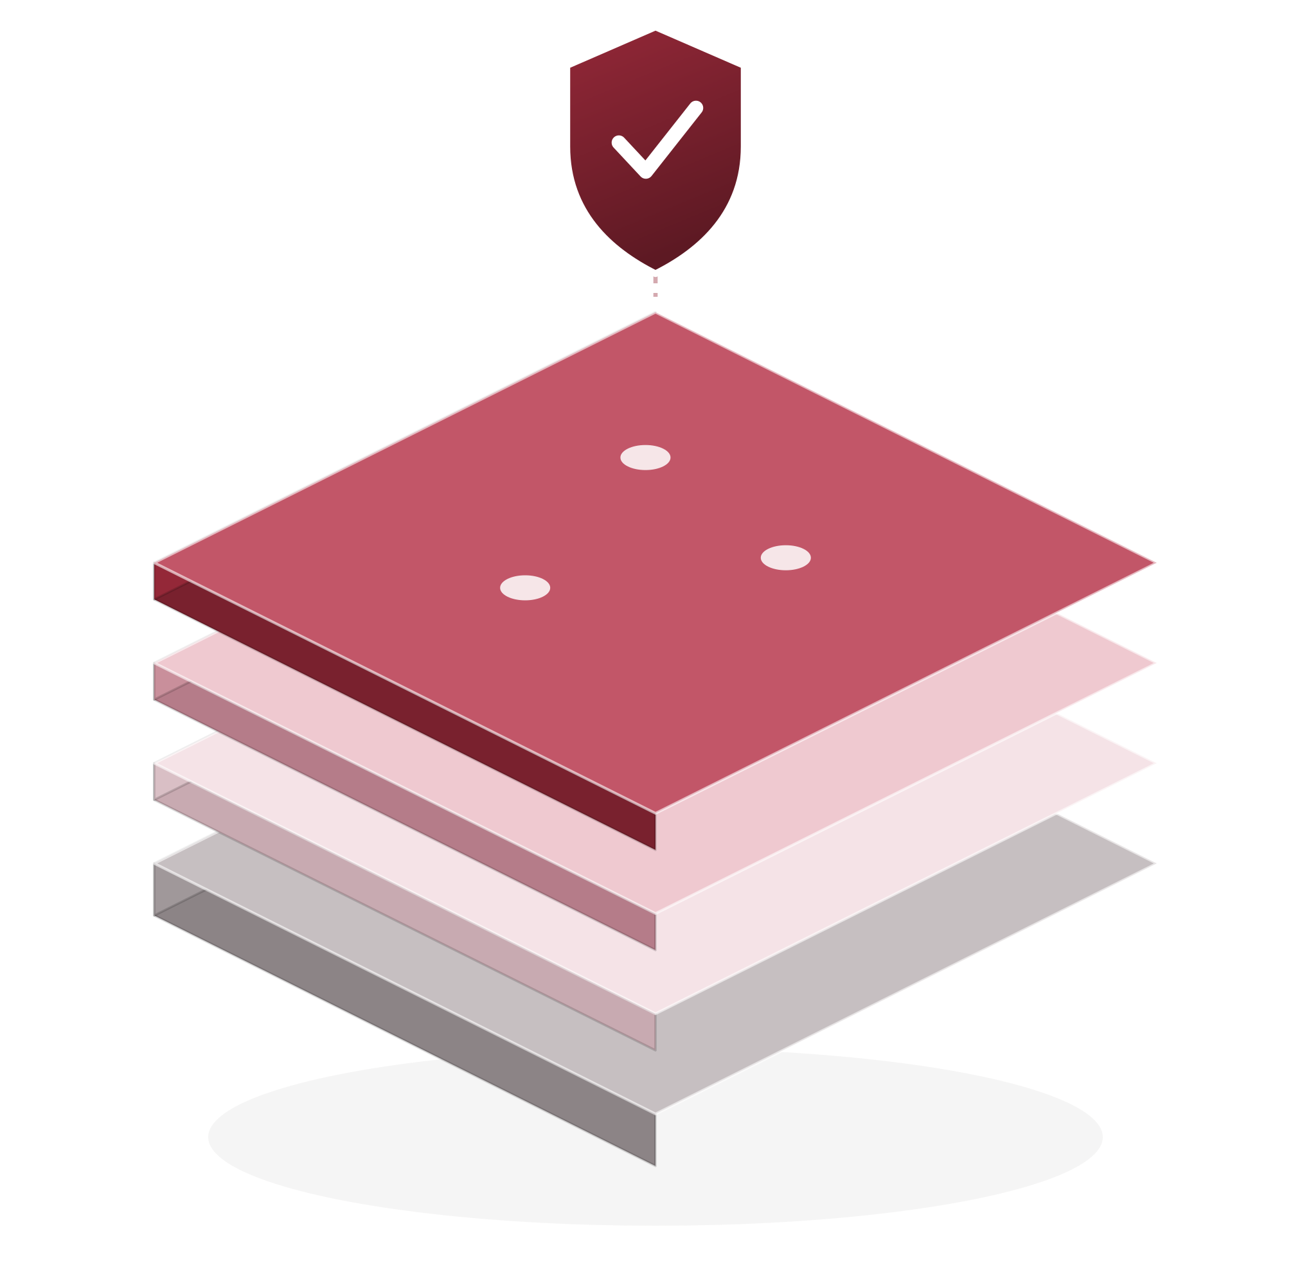
PROJECT 01 · THE PROBLEM
Nine required tools. No process to install them.
A Golden Image is the standard template every new virtual machine is built from — set it up once, and every machine created afterwards inherits it.
THE NINE REQUIRED TOOLS
Tenable Nessus Agent
CrowdStrike Falcon Sensor
Netskope
Cribl
Splunk
ThreatLocker
Proofpoint DLP Agent
SCCM Agent
ControlUp Agent
No single tool catches everything. Together they cover threat detection, web filtering, logging, vulnerability scanning, data-loss prevention, patch delivery and session visibility.
THE ACTUAL GAP
Each layer is security tooling the image should carry before it is ever deployed.
No dedicated process exists yet for installing these tools onto cloud images before deployment. My job was to define it.
IMAGE MANAGEMENT PROGRAM
07
Notes:
A Golden Image is the template every new virtual machine is built from. Set it up once and every machine after that inherits it. Q: Does this slow down provisioning? — No. The tools go into the image itself, so a machine built from it is already compliant on first boot.

Slide 8
PROJECT 01 · WHAT I BUILT
Building the process from scratch
My role was to coordinate and bridge teams — define what is required, name who owns it, and get it signed off. I did not build or provision the machines myself.
01
02
03
›
›
Define the Tools
Define the Owners
Get It Adopted
Agree on exactly which security tools belong on every image — nine of them.
Name the team responsible for installing and maintaining each one.
Turn that into a written framework the company formally signs off on.
DELIVERED
A written Roles & Responsibilities framework — drafted, staged for review, and set for formal adoption once the policy manager returns in Q4.
IMAGE MANAGEMENT PROGRAM
08

Slide 9
PROJECT 01 · WHAT COMES NEXT
From a drafted framework to a standing process
The framework exists on paper. Turning it into something the company runs without me is the next stretch.
01
02
03
Formal adoption
Owners take it from here
Check before deploy
The framework is drafted and staged for review. It goes for sign-off once the policy manager returns in Q4.
Each named team picks up the tool it owns, so responsibility sits with the people who can act on it.
The natural next step is a check that a newly built image actually carries all nine tools before it goes live.
The honest status: drafted and staged for review, not yet formally adopted. The decision sits with the policy manager in Q4.
It also closes an audit gap: once adopted, we can show that every new machine met a defined security baseline before it was deployed.
IMAGE MANAGEMENT PROGRAM
09
Notes:
Q: When does this actually get adopted? — Q4, when the policy manager returns. It is drafted and staged for sign-off now, not adopted. Q: Who owns the rollout? — The infrastructure security team; each named team owns its own tool.

Slide 10
02
PROJECT 02
AEGIS — Supply-Chain Defense
Catching risky code hidden inside the open-source packages our software depends on.
PROJECT 02
10

Slide 11
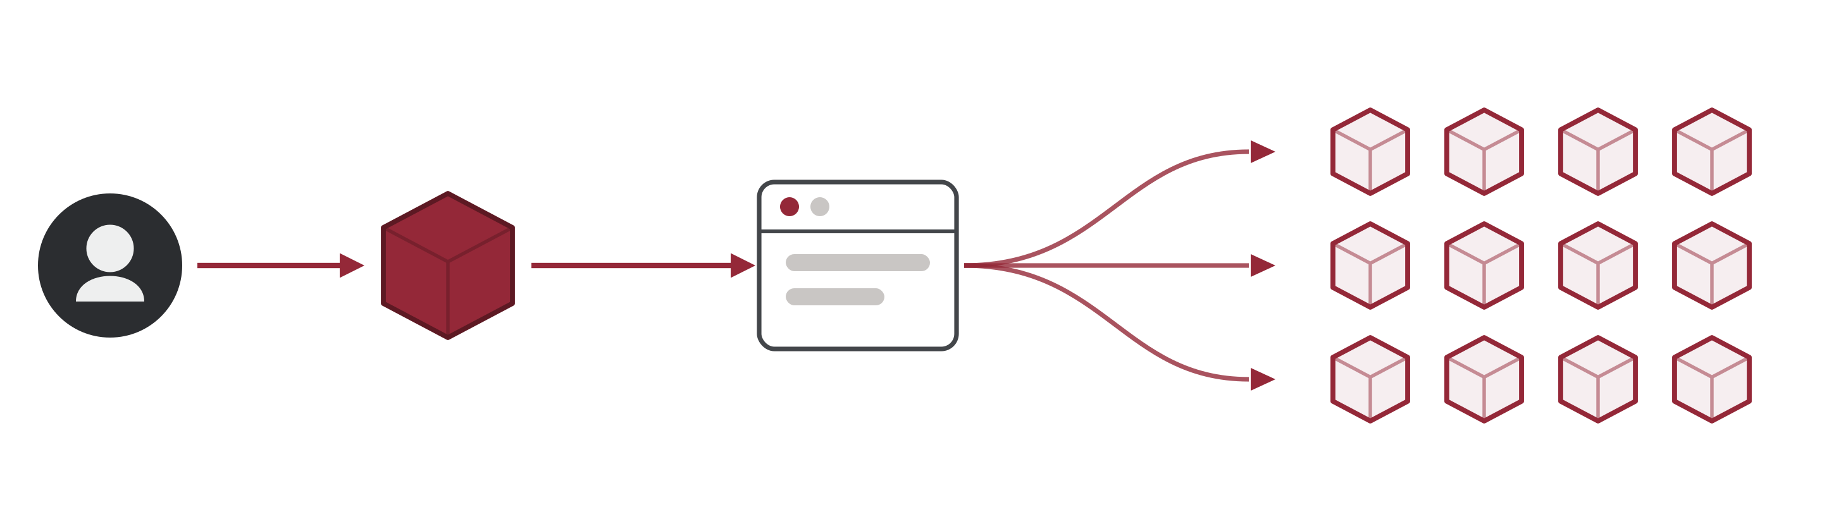
PROJECT 02 · THE PROBLEM
One poisoned package reaches everyone
In a supply-chain attack, an attacker hides malicious code inside a legitimate open-source package. Everyone who installs it inherits the compromise — including us. Real campaigns in 2025 and 2026 worked this way.
Attacker
Poisoned package
Public registry
Every project that installs it
WHY EXISTING TOOLS WERE NOT ENOUGH
Most scanners cry wolf: "you have 500 flaws." But our code never touches most of them, so nobody can tell what is urgent. AEGIS separates signal from noise by checking whether our code actually calls the vulnerable part.
AEGIS
11
Notes:
Plain version: someone poisons a popular free software package, and everyone who installs it gets the poison too. It has happened repeatedly in the last two years.

Slide 12
PROJECT 02 · WHAT I BUILT
A scanner that checks if the flaw is reachable
Knowing a flawed package is installed is not the same as knowing you are exposed.
THE SHIFT
THREE HONEST ANSWERS · NEVER COLLAPSED INTO ONE "SAFE"
MOST SCANNERS
REACHABLE
"This package has a known flaw."
Our code does call the vulnerable part. This one is real exposure, and it gets worked.
True, but the list runs to hundreds and everything on it looks equally urgent.
AEGIS
NO CALL SITE FOUND
"Does our code actually call the flawed part?"
Nothing in our code reaches it. Read with a real code parser rather than a text search, so it is a confident answer.
The list collapses to the few that can genuinely be reached — and those get worked first.
CAN'T PROVE
PROVEN AT SCALE
The tool cannot be certain either way — so it says exactly that, and a person makes the call.
5,675
packages read in a single production run,
by an earlier version of the tool.
The third answer is why the other two can be trusted.
AEGIS
12
Notes:
Q: Can AEGIS catch zero-days? — No. It catches publicly known flaws in open-source dependencies. Zero-days need different tooling entirely. Q: What about false positives? — Every finding it labels reachable is a real code path; anything it cannot confirm is labelled "can't prove", never "safe". I have not measured a false-positive rate, so I am not going to quote one.

Slide 13
PROJECT 02 · HOW IT WORKS
Five stages. Only one can change anything
THE CORE RULE Unknown is never reported as safe. If AEGIS cannot tell, it says so.
STAGES 00–03 · RUN AUTOMATICALLY, READ ONLY — NOTHING IS CHANGED
00
01
02
03
SCAN
REACH
BLAST
REGRESS
Checks every package version the project installs — its "lockfile" — against public records of known flaws.
Finds whether our own code calls the vulnerable part — and answers reachable, no call site, or can't prove.
Measures how much could be affected — how much of the codebase sits downstream, and whether it runs in production.
Checks whether the security fix could break something — test coverage and upgrade risk, kept separate.
Checks public flaw records
Analyses local code only
Analyses local code only
Analyses local code only
ONLY IF YOU ASK
STAGE 04
Builds and tests the fix — only when you ask, and one approved step at a time.
—
Every step needs explicit human approval
FIX
—
Refuses to touch a protected branch
—
Never merges, and never marks its own work resolved
AEGIS
13
Notes:
The point of the split: stages 00 to 03 only read. They cannot edit a file, open a pull request or touch a branch, so running AEGIS on a repository can never break it. Stage 04 is the only one that writes, and it will not start without someone asking for it. Q: What stops it running away with a fix? — It does one approved step at a time, refuses protected branches, never merges, and never marks its own work resolved.

Slide 14
PROJECT 02 · A REAL RUN
28 flagged. 25 need nothing. 3 are one upgrade.
A read-only scan of the Stewart.STEPS.Frontend repository. Real code, real flaws, pulled live.
1,518
28
3
›
›
packages scanned
carrying a known flaw
left needing a decision
WHAT THAT MEANS FOR THE TEAM
25 need nothing
3 are one upgrade
Verified, not hoped for
Build and development tooling the app never calls. AEGIS read the code to establish that, so it is an answer rather than an assumption.
All three are Angular, all three sit on version 20.3.18, and all three are fixed by moving to 20.3.22. One version bump, not three pieces of work.
The repository's own test suite runs, so the upgrade can be proven safe before it ships. Nothing on the list is a breaking change.
An ordinary scanner hands the team 28 findings to triage. This run handed them one upgrade.
Two of the three could not be ruled out, and AEGIS kept them on the list rather than calling them safe — but the same upgrade covers them, so the caution costs nothing. None of the 28 appear on the US government's actively-exploited list.
AEGIS
14
Notes:
Land the last line: 28 findings became one upgrade. Q: You said two could not be ruled out — so the tool failed on those? — No, and it costs nothing here. AEGIS has a hand-curated list of about nine packages where the exact dangerous function is documented; Angular is not on it yet, so it can confirm the app uses the package but not that the vulnerable function specifically is called. It said so instead of calling them safe. All three findings are the same Angular version bump, so the decision is identical either way. Q: Would you ship that upgrade? — Yes: it is in-range, non-breaking, and the repo's test suite runs, so it can be proven before it merges. Q: Was anything confirmed reachable? — No. Nothing was confirmed reachable and nothing was confirmed reaching production. Q: How do you know the 25 are really clear? — Read with a real code parser, not a text search, so it is a structural answer rather than string matching. Earlier, testing against an open-source project, I also found and fixed two bugs in my own code — one where a "can't prove" result was being described as a confirmed absence.

Slide 15
PROJECT 02 · WHAT COMES NEXT
What is still open, and how I would close it
Built, safety-rail tested, and already run against a real repository. Three things would take it further.
01
02
03
Teach it the framework packages
Keep the live lookups working everywhere
Get it into other people's hands
AEGIS knows exactly which function is the dangerous one for about nine packages. Angular is not among them yet — which is why two findings came back "can't prove" instead of a straight answer. Extending that list turns those into a verdict.
This run pulled real flaw data live. On networks where the security proxy inspects traffic it still fails, so the split-scan workaround stays until an inspection bypass is in place.
Packaged as a plugin so a developer can install it with one command. The install flow itself has not been run start to finish yet.
Said plainly: it works, and it has been run for real. What is left is widening what it can answer with certainty, and getting it into other hands.
AEGIS
15
Notes:
Q: Who maintains this after I leave? — The Vulnerability Management team. It is packaged as a plugin so it installs with one command, though that install flow still needs a real run.

Slide 16
03
PROJECT 03
CVE-to-Patch Automation
Turning a manual, one-at-a-time patch lookup into a job that finishes in seconds.
PROJECT 03
16

Slide 17
PROJECT 03 · THE PROBLEM
Every flaw needed its own patch, found by hand
117
WHAT A "KNOWN FLAW" IS
A publicly published weakness in software that attackers already know about. Each one has a matching fix released by the vendor.
high and critical flaws tracked
this cycle, every one of them
directly affecting the business
THE BOTTLENECK
Microsoft publishes the flaw and the fix in separate documents. Someone has to cross-reference them by hand, once per flaw, then check it against the real machine list. Do that 117 times and it is two days of work.
This is not a sample. Kevlar — the team's vulnerability tracker — flagged these because they met both bars: high or critical severity, and a direct effect on business operations.
BEFORE · DOING IT BY HAND
~17.5 hours about 2 to 2.5 business days
Estimated at 8–10 min per flaw from the steps above — a reasoned estimate based on the work involved, not a stopwatch measurement.
CVE-TO-PATCH AUTOMATION
17
Notes:
Q: Why 117 and not more? — Because that is the filtered set: high or critical severity AND directly affecting business operations. It is not a sample and it is not everything Kevlar sees.

Slide 18
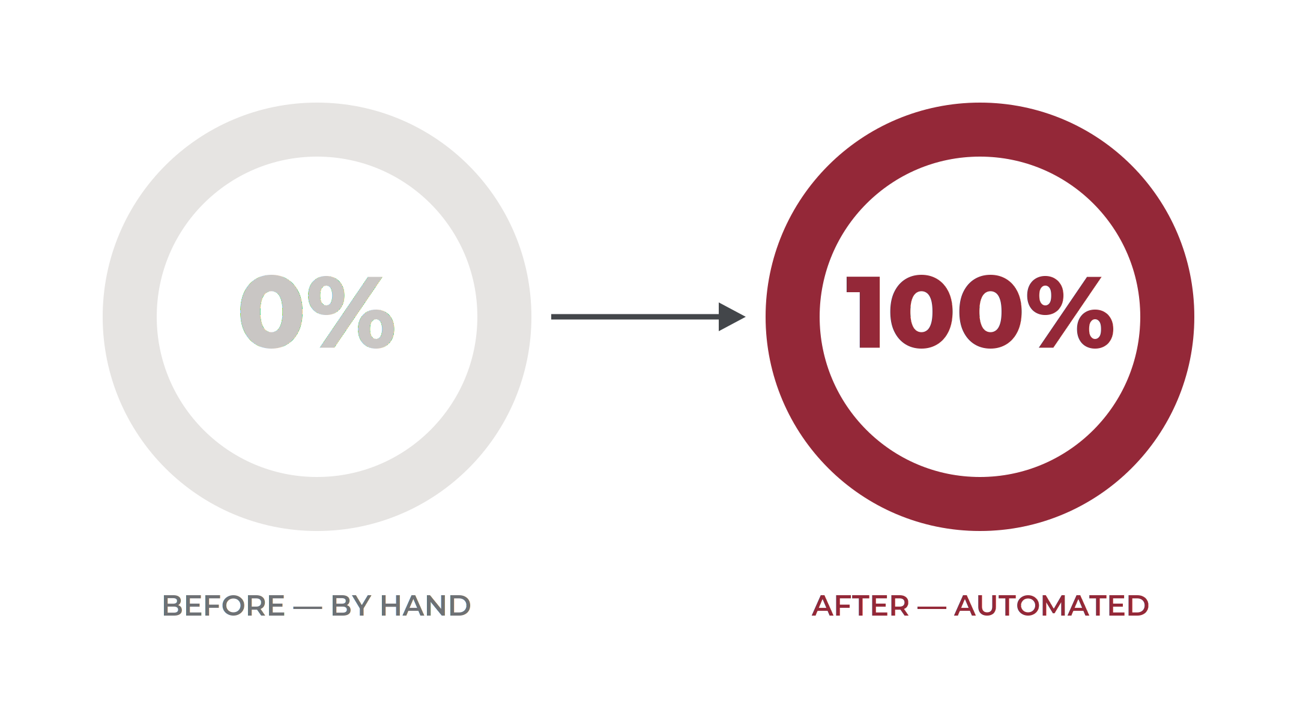
PROJECT 03 · THE RESULT
From about two days of work to twelve seconds
I built a Python script that matches each flaw to its Microsoft patch automatically, using Microsoft's own public security feeds — no API key, no manual searching.
117/117
flaws matched to the correct patch
~12 sec
total runtime, start to finish
29/29
spot-checked against Tenable, Rapid7 and public advisories — all confirmed correct
Share of the 117 flaws matched to their correct patch automatically
CVE-TO-PATCH AUTOMATION
18
Notes:
The ~17.5 hour baseline is a reasoned estimate at 8-10 minutes per flaw, not a stopwatch measurement. Say so if asked. If precision matters, have an analyst time a sample of ten.

Slide 19
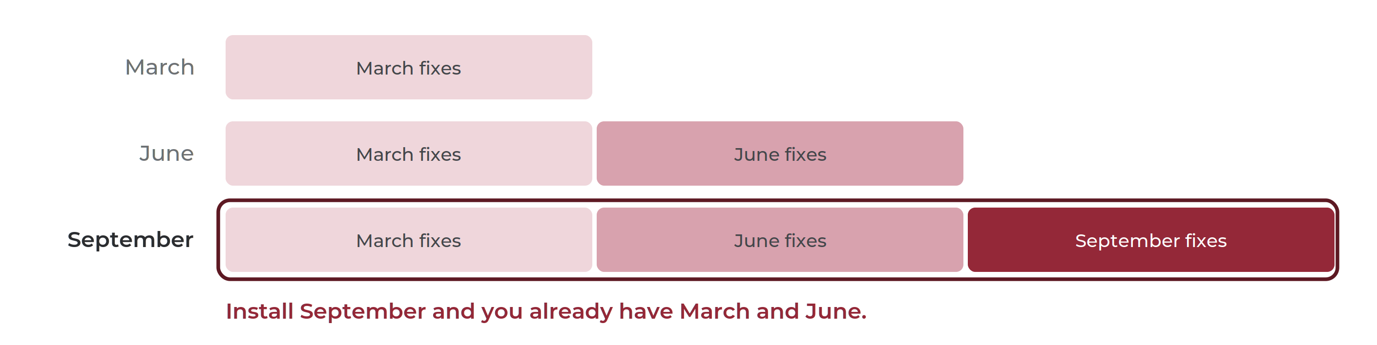
PROJECT 03 · THE FINDING
52 of the 117 were already fixed
THE ONE FACT Windows updates are cumulative. Installing the newest one automatically includes every older fix — exactly like a phone update.
SO WHEN WE CHECKED ALL 117
52
were already fixed on every
machine — nothing to do
65
were genuinely still open
somewhere
65 still needed patching
52 already covered — nobody had to do anything for these
CVE-TO-PATCH AUTOMATION
19
Notes:
Q: Were all 117 validated? — 29 were independently spot-checked and all 29 were correct. One entry, CVE-2025-47827, is double-classified in the Kevlar export (IGEL OS and Windows). That is a data-quality issue upstream, not a bug in the script, but worth flagging to whoever owns the export.

Slide 20
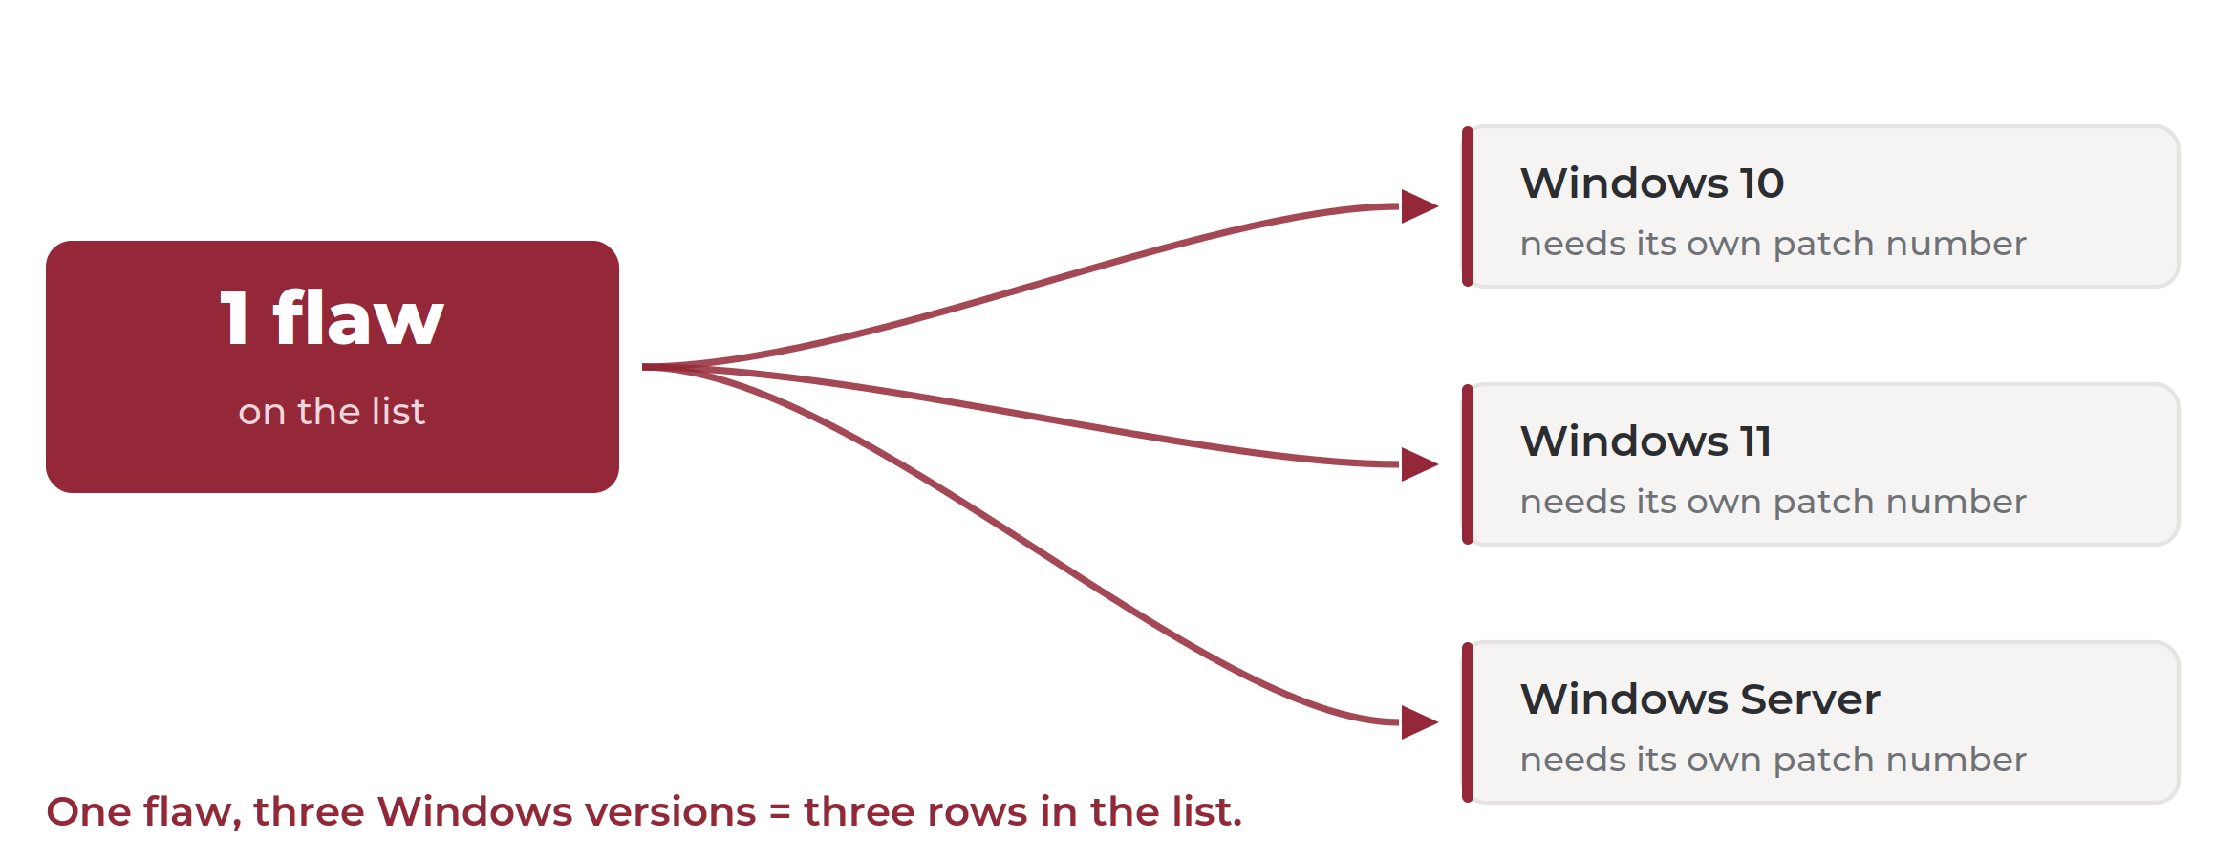
PROJECT 03 · GOING DEEPER
Why 65 flaws turn into 209 rows
One flaw does not mean one patch. The same flaw needs a differently numbered patch on each version of Windows we run — so one flaw becomes several rows on the list.
WHERE 209 COMES FROM
Kevlar’s own report
Do that fan-out for all 65 open flaws, across every Windows version in the fleet, and it adds up to 209 rows. Kevlar already publishes that list — I opened it and counted, I did not calculate it.
THE WHOLE CHAIN
117
65
209
46
›
›
›
flaws tracked
still open
rows once split
by Windows version
tickets, after the
next slide’s rule
CVE-TO-PATCH AUTOMATION
20
Notes:
Full chain if asked: 2,658 real host-and-product assignments, which Kevlar groups into 209 KB Priority rows, which the highest-fixed-build rule collapses to 46 tickets. The 78% is measured against Kevlar's 209, not against the 117.

Slide 21
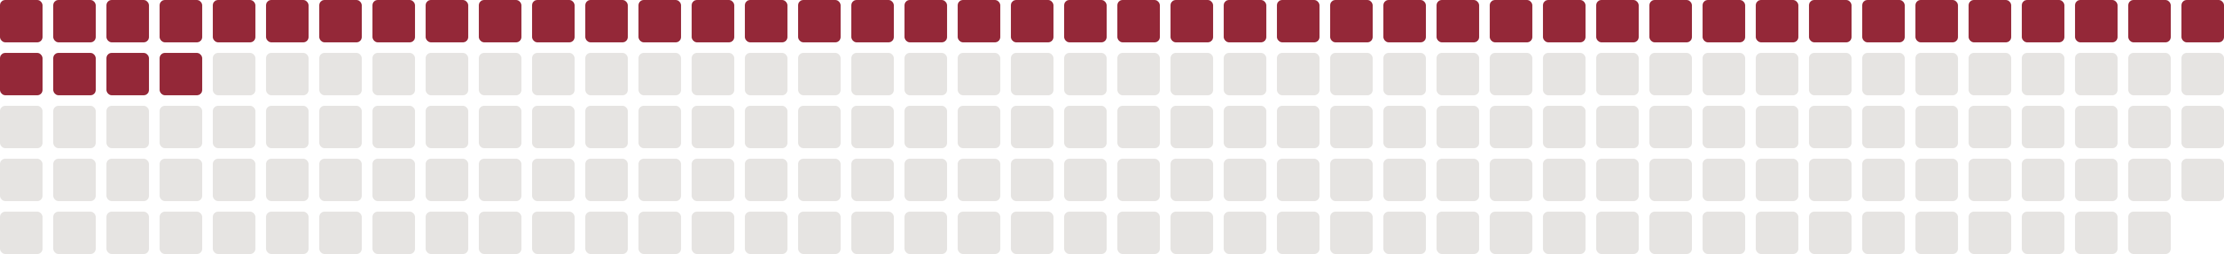
PROJECT 03 · THE PAYOFF
209 rows became 46 tickets
THE SAME FACT AGAIN Only now applied to one machine at a time — because the newest patch already contains the older ones, most of those rows are the same job twice.
ONE SERVER, THREE ROWS ON THE LIST
—
March patch for flaw 1
209
46
78%
—
June patch for flaw 2
✓
September patch for flaw 3
rows on Kevlar’s list
tickets actually opened
fewer — 163 absorbed
September already contains March and June — one action, not three.
EVERY SQUARE IS ONE ROW ON KEVLAR’S LIST · RED BECAME A TICKET
Nothing was skipped. Checked across all 2,658 machine-and-product combinations, not a sample.
CVE-TO-PATCH AUTOMATION
21

Slide 22
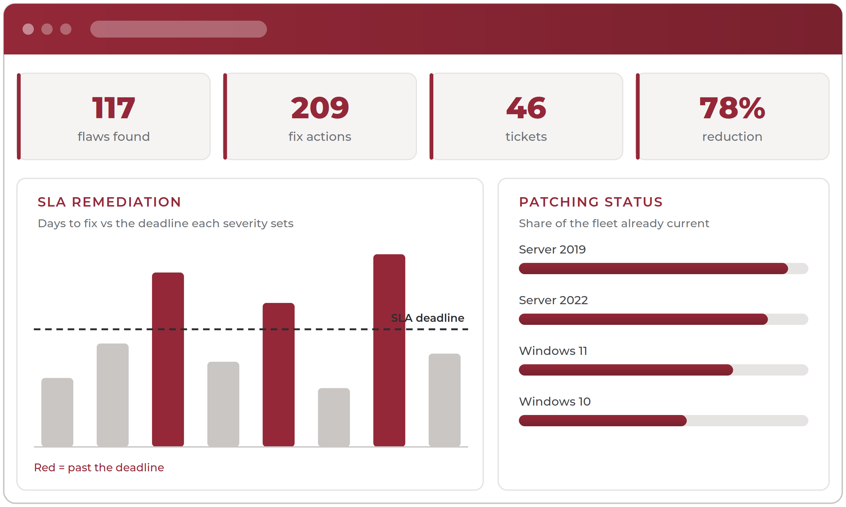
PROJECT 03 · WHAT COMES NEXT
Four systems, one screen
Two views would close the gap: an SLA remediation dashboard showing whether flaws are fixed inside their deadline, and a patching dashboard showing how much of the fleet is current.
Tenable
finds the flaw
Kevlar
tracks which machines are exposed
Jira
opens the ticket
Wiz
confirms the machine is real and reachable
To be clear: the scripts are done and tested. The dashboard is optional follow-up work for whoever picks up the pipeline — not a dependency.
Concept — not a live system
CVE-TO-PATCH AUTOMATION
22
Notes:
Q: Will this integrate with Jira? — The data is ready. The integration depends on a workflow decision with the team that owns ticketing. The scripts work today without it; the dashboard is the optional part.

Slide 23
SUMMARY
What this means for Stewart
Three gaps going in. Where each one stands now.
01
WAS
NOW
Machines could ship without their security baseline.
›
Nine required tools named, owners assigned, and a written framework staged for Q4 sign-off.
02
WAS
NOW
Attackers hide malicious code inside the open-source packages we depend on.
›
AEGIS built, its safety rails tested, and run for real: 1,518 packages in a Stewart repository down to a single upgrade.
03
WAS
NOW
Matching every tracked flaw to its patch took about two days of analyst time.
›
117 matched in ~12 seconds, and 209 rows collapsed to 46 tickets with nothing skipped.
All three leave something behind: a written framework, a working scanner, and a script the team can run every cycle.
SUMMARY
23

Slide 24
IN CLOSING
Thank you
Everything in this deck exists because people here made room for an intern to do real work — and because plenty of them pushed back on it until it was right.
To the Information Security team
For handing me problems that actually mattered, and trusting me to work on them properly.
To Vulnerability Management, Application Security and Network Security
Three rotations, three different ways of looking at the same job. I learned something distinct in each one.
To Cloud Operations and Development
For making time for someone from another team who kept turning up with questions.
Happy to take any questions.
Next up: the PWPA and PJPT certifications, heading toward penetration testing.
THANK YOU
24

