Slide 1

Actor
SUBMIT APPLICATIONS
CUSTOMER
Authorized to access all division applications
ADMIN
OPERATIONS
MANAGER
Authorized to access only the assigned department applications.
APPROVE APPLICATIONS
STAFF
Department/Division Details:
Freshwater Licensing -> License
Driver Licensing -> License
Freedom of Information -> Information

Slide 2
System Diagram
ADMIN SERVICES
ORBEON
FORM
BUILDER
REST
ORCHESTRATION SERVICES
SMARTFORM
PORTAL
HTTP/HTTPS
ORCHESTRATION DATA SERVICES
CAMUNDA
BPM
PLATFORM
REST
IDENTITY MANAGER
(KEYCLOAK)
.
.
PROCESS-ACCELERATOR
SERVICES
<ANY>
PROCESS-ACCELERATOR CORE
PROCESS-ACCELERATOR
CONTEXT
ORCHESTRATION CLIENT CONNECTOR
SCHEMA:SMARTFORM-PORTAL
PROCESS-ACCELERATOR
APIs
WEB TIER
APPLICATION TIER
INTEGRATION SYSTEM TIER

Slide 3
WEB COMPONENTS
Component Diagram
DATA SERVICES
CORE APIs
SMARTFORM
PORTAL
PROCESS-ACCELERATOR SERVICES
ORCHESTRATION CLIENT CONNECTOR
PROCESS-ACCELERATOR CORE
PROCESS-ACCELERATOR CONTEXT

Slide 4
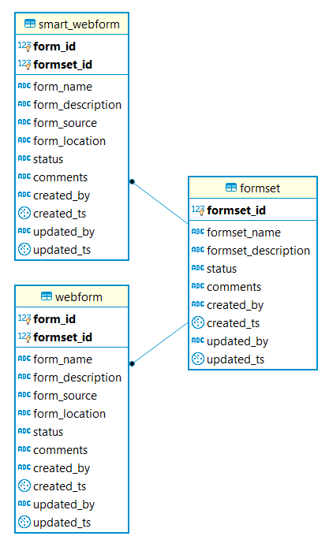
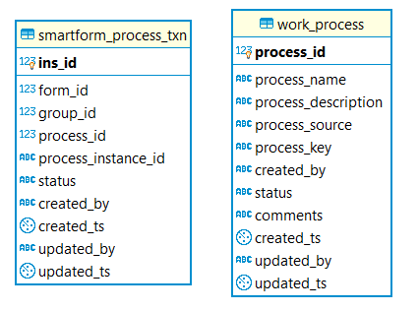
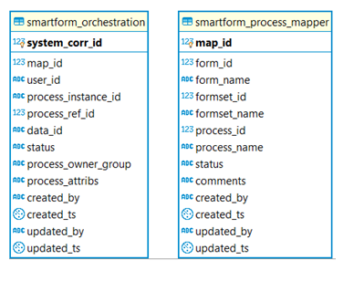
ER Model

Slide 5
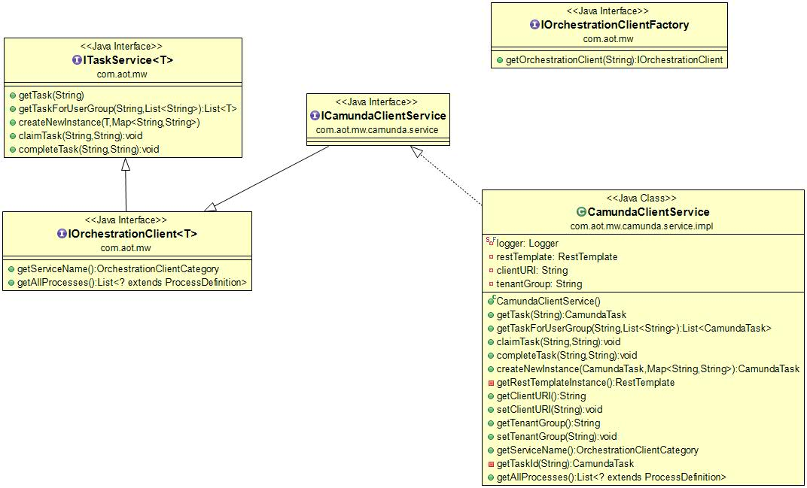
Orchestration Client Connector

