Slide 1

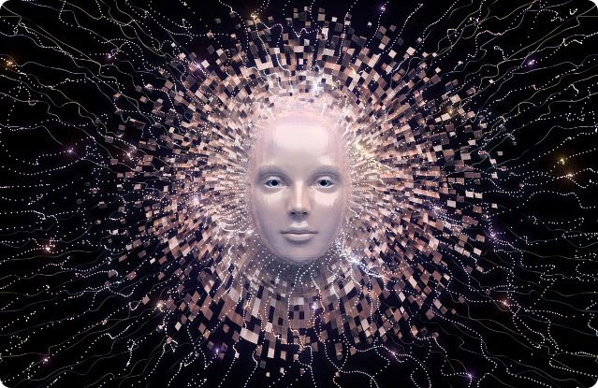

Introduction to Generative AI (GenAI)
Generative AI is a cutting-edge technology that enables machines to create original content, from images and text to music and code. It represents a significant leap forward in artificial intelligence, opening up new realms of creativity and innovation.

Slide 2
Difference between AI, ML, DL, and GenAI
AI
ML
DL
The broad field of Artificial Intelligence, which aims to create machines that can perform human-like tasks.
Recommendation Models
Autonomous Vehicle
Any AI Products
Machine Learning, a subset of AI that focuses on building algorithms that can learn from data and make predictions.
Predictive Analysis
Statistical Model
Forecasting Designs
Deep Learning, a more advanced ML technique that uses neural networks to analyze complex data and automate decision-making.
ANN & DNN – Array or Dataframe
CNN – Image
RNN – Text related & Time Series

Slide 3
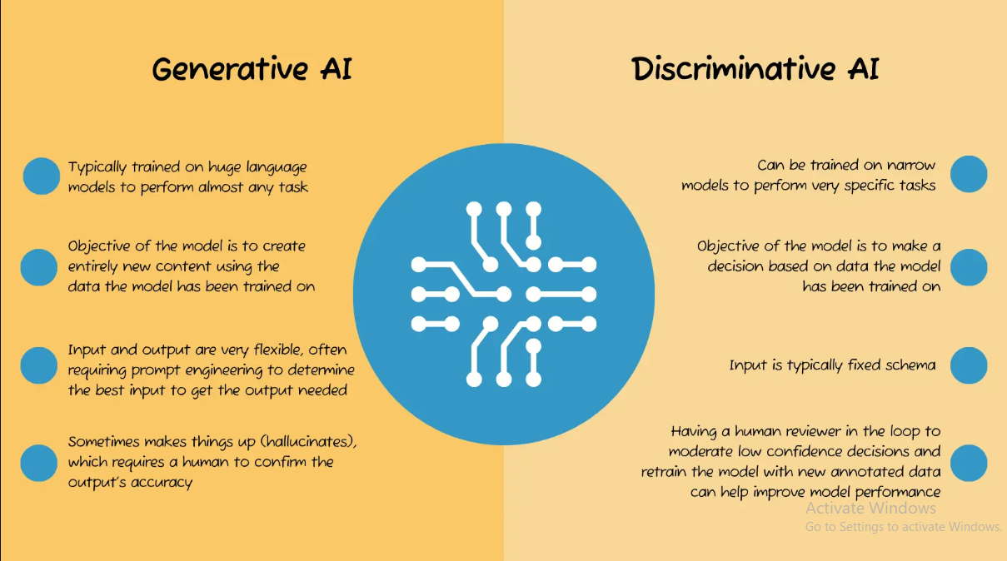
Difference between AI, ML, DL, and GenAI
AI
ML
DL
The broad field of Artificial Intelligence, which aims to create machines that can perform human-like tasks.
Recommendation Models
Autonomous Vehicle
Any AI Products
Machine Learning, a subset of AI that focuses on building algorithms that can learn from data and make predictions.
Predictive Analysis
Statistical Model
Forecasting Designs
Deep Learning, a more advanced ML technique that uses neural networks to analyze complex data and automate decision-making.
ANN & DNN – Array or Dataframe
CNN – Image
RNN – Text related & Time Series

Slide 4

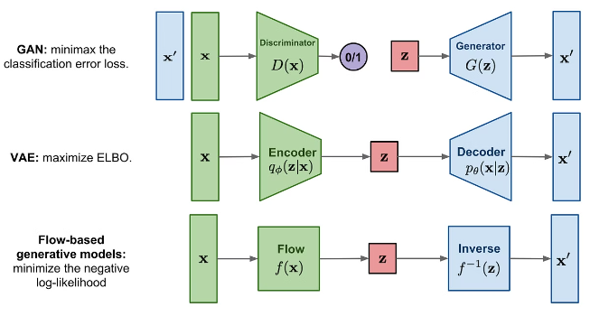
Fundamentals of Generative AI
1
Input Data
GenAI models are trained on vast datasets to learn patterns and generate new content.
2
Transformation
Using advanced neural networks, GenAI models can transform the input data into novel and creative outputs.
3
Output Generation
The models generate original content such as images, text, audio, or code based on the learned patterns.

Slide 5

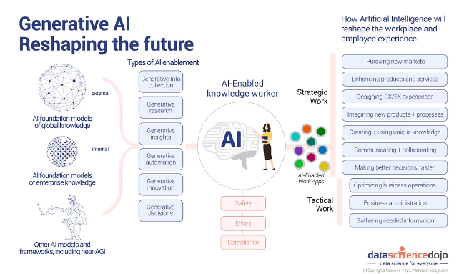
Prominent Generative AI Models
1
GPT-3
A powerful language model that can generate human-like text on a wide range of topics.
2
DALL-E
An image generation model that can create unique and imaginative visuals from textual descriptions.
3
Midjourney
An AI-powered art creation tool that generates stunning, surreal images based on user prompts.
4
Stable Diffusion
A highly versatile text-to-image model that can produce a wide range of photorealistic and abstract images.

Slide 6
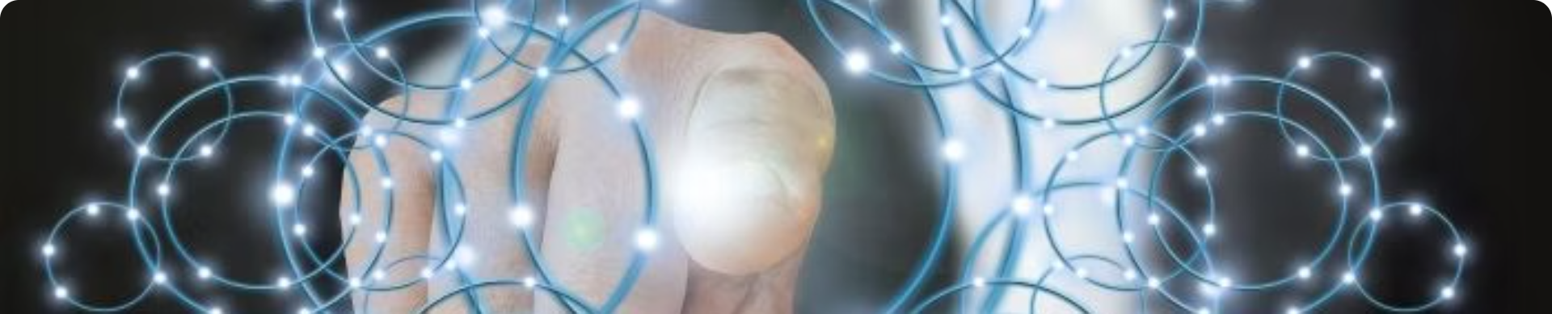




Applications of Generative AI
Art & Design
Content Creation
Audio & Music
Coding & Programming
Creating unique and innovative visual art, designs, and illustrations.
Generating text, scripts, articles, and other written content.
Composing and producing original music and soundscapes.
Automating the generation of software code and applications.

Slide 7

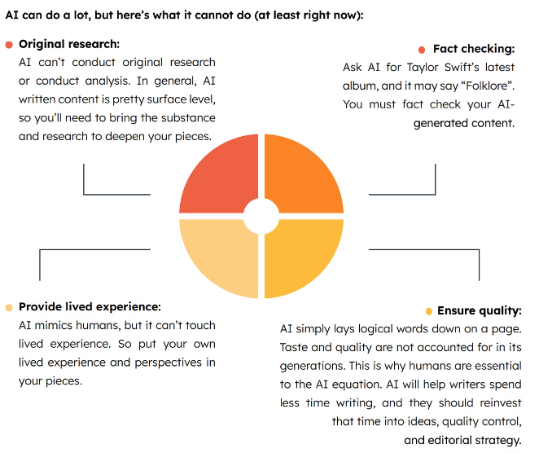
Limitations and Challenges of GenAI
Bias and Accuracy
GenAI models can perpetuate biases and produce inaccurate or unreliable outputs if not trained properly.
Lack of Contextual Understanding
GenAI models may struggle to fully comprehend the nuances and context required for certain tasks.
Computational Intensity
Training and running GenAI models requires significant computational resources and energy consumption.
Ethical Considerations
The use of GenAI raises important ethical questions about privacy, security, and the impact on jobs and society.

Slide 8
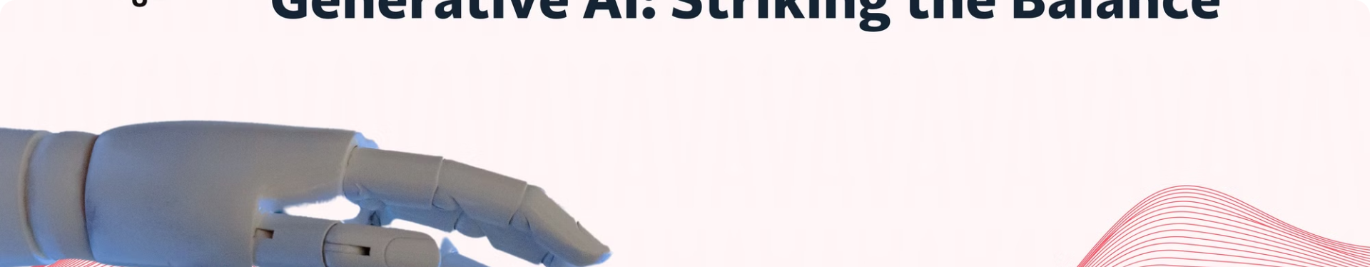



Ethical Considerations in GenAI
Privacy
Transparency
Bias Mitigation
Protecting personal data and information used to train GenAI models.
Ensuring the decision-making process of GenAI models is clear and accountable.
Identifying and addressing biases that may be present in GenAI outputs.

Slide 9

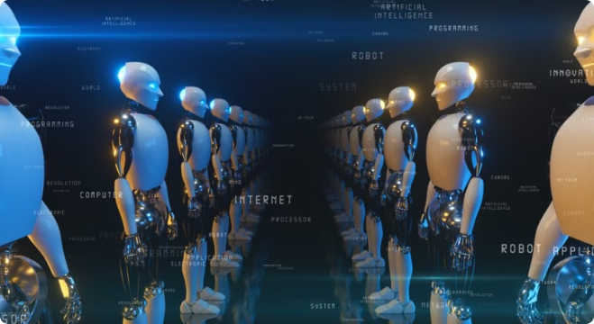
Future Outlook and Trends in Generative AI
Advancements in Model Architectures
Continued improvements in the complexity and capabilities of GenAI models.
Multimodal Integration
Combining text, image, audio, and other data inputs to create more versatile and expressive GenAI.
Ecosystem Development
Expansion of the GenAI ecosystem with more tools, platforms, and applications for diverse use cases.
Ethical Frameworks
Establishment of guidelines and regulations to ensure the responsible and ethical development of GenAI.

