Slide 1

Department of Information Science and Engineering
Academic year: 2025-26 Mini Project– Review Presentation
on
“CROP RECOMMENDATION AND FERTILIZER PREDICTION
SYSTEM”
Name of Student:
Ashok Gowda S P (1DB23IS023) Divya H S (1DB23IS050)
GUIDE:
Mr. Raghu M T Assistant Professor Department of IS&E DBIT, Bengaluru

Slide 2
Contents
Introduction
Problem Statement
Motivation
Aim & Objectives
System Design
Methodologies
Results and snapshots
Application of the Project
Conclusion
Future Scope of the paper
References

Slide 3
Introduction
The Crop and Fertilizer Recommendation System is a machine learning-based solution designed to assist farmers in making informed agricultural decisions. It recommends:
Suitable crops and
Appropriate fertilizers
by analyzing soil and environmental parameters such as Nitrogen (N), Phosphorus (P), Potassium (K),
pH, Temperature, Humidity and Rainfall to optimize yield.
The system compares the user’s soil and weather inputs with the Kaggle datasets- like crop_recommendation.csv and fertilizer.csv using Random Forest Algorithm to enhance farming efficiency and sustainability.
The system supports farmers with accurate, science-based suggestions. It helps improve decisions related to crop selection and fertilizer use.

Slide 4
Problem Statement
“ Farmers face challenges in selecting the suitable crop and fertilizer due to limited access to scientific, data- driven recommendations based on soil and environmental conditions. This leads to reduced crop yield, inefficient fertilizer use, environmental harm, and decreased agricultural productivity ”.

Slide 5
Motivation
Farmers often depend on traditional methods and guesswork to decide which crop or fertilizer to use, and this made us understand the importance of proper guidance.
During our exposure to agricultural programs and farm training, We realized how valuable expert guidance is in every stage, like from choosing right crop ,soil preparation to fertilizer application. Such guidance is not easily available to all farmers, especially in rural areas.
Our aim is to bring this expert support digitally through Farmer Assistant, making scientific recommendations accessible to everyone.
The system uses soil nutrient values(N, P, K, pH) instead of soil type names, since these parameters already represent the soil’s fertility and condition based on soil testing reports.

Slide 6
Aim & Objectives
Aim: To develop a smart web-based system that recommends the best crop and the suitable fertilizer based on soil nutrients and weather conditions using machine-learning techniques.
Objectives:
To provide farmers with scientific, data-based crop recommendations instead of traditional guesswork.
To identify nutrient deficiencies in the soil and recommend the most suitable fertilizer for correcting them.
To make farming more digital by offering an easy online system where users can enter soil values and receive instant recommendations.
To support better agricultural decision-making by converting soil test results into clear and useful suggestions.
To help farmers access simple, accurate guidance using a technology-based approach.

Slide 7
System Design
User Register/Login
Dashboard
Input Page (N, P, K, pH, Temp, Humidity, Rainfall)
Output Page
Predicts best crop
Crop Prediction ML (Random Forest)
Flask Backend Receives Input Loads ML Models
Fertilizer Recommendation ML (Random Forest)
Recommends Fertilizer
Block-diagram for Crop recommendation and fertilizer prediction system

Slide 8
Methodologies
1. Data Collection Collect crop dataset from Kaggle Collect fertilizer dataset with nutrient info | 2. Data Preprocessing Clean the data and remove errors Organize and prepare it for ML training
3. Model Training (using Random Forest) Train the crop prediction model u Train the fertilizer recommendation model | 4. Web Application Development Create a simple user interface for inputs Connect the interface to the Flask backend
5. Prediction & Output Take soil and weather inputs from users Generate suitable crop and fertilizer results | 6. Evaluation Check model accuracy using test data Verify predictions with agricultural references

Slide 9
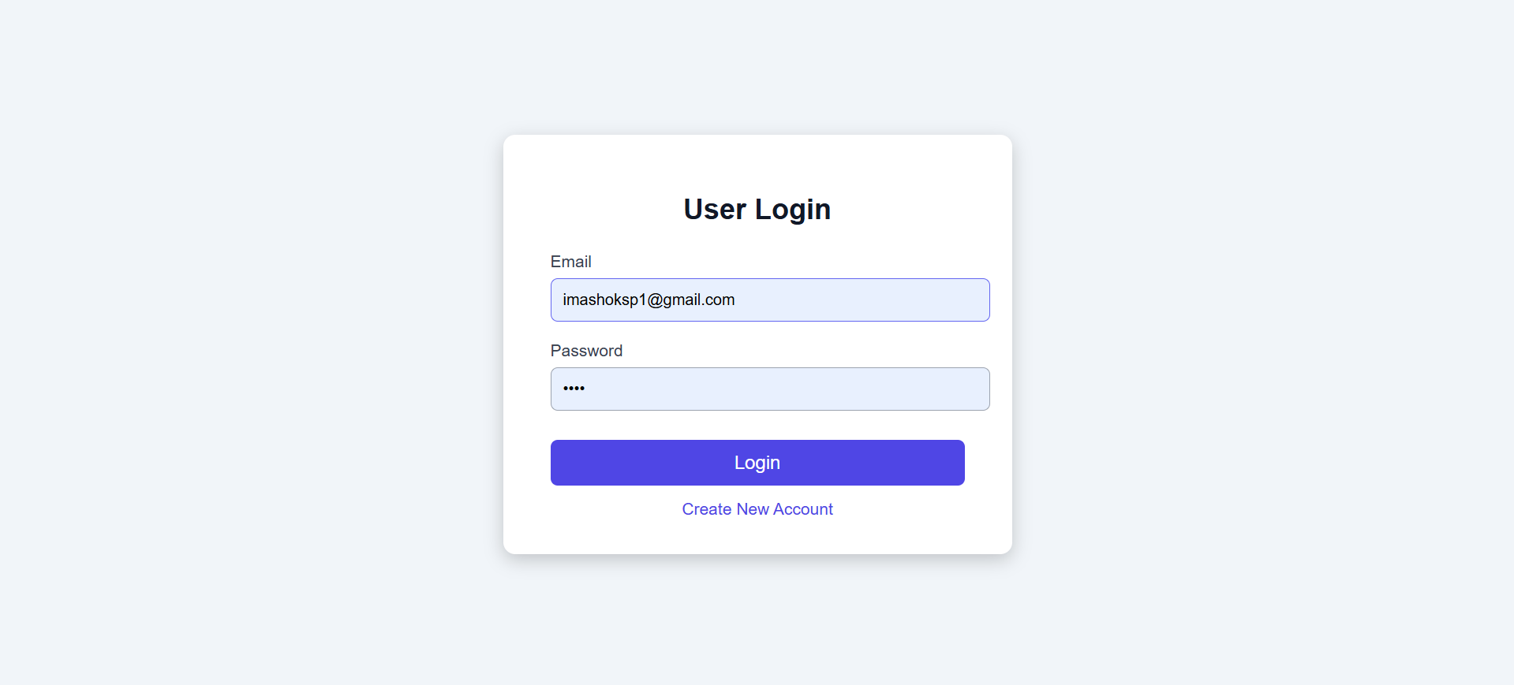
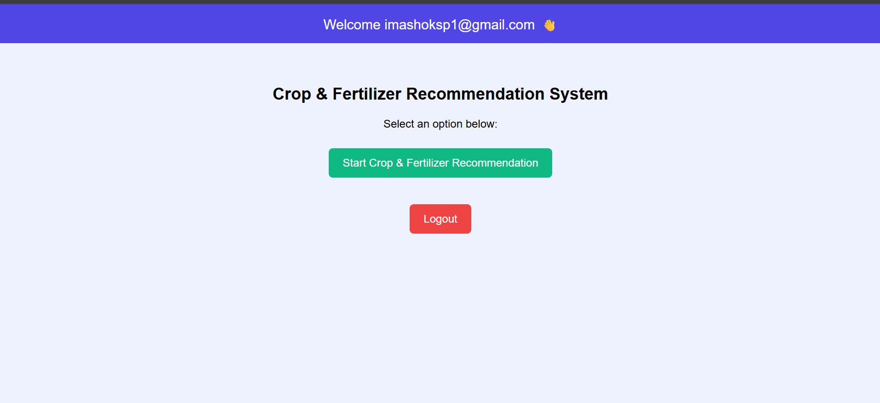
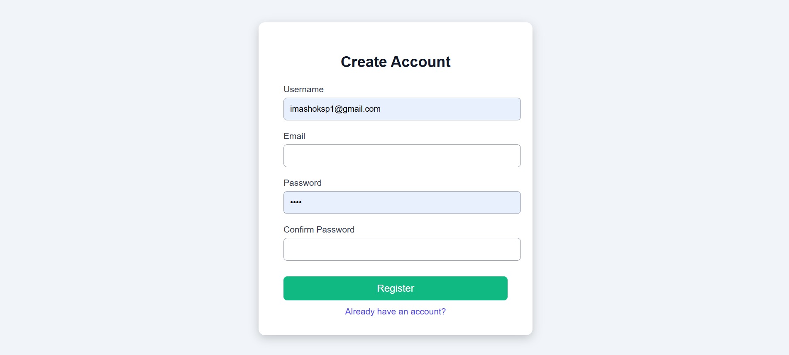
Results and Snapshots
Figure1 user login
Figure2. creating account
Figure3. Dashboard

Slide 10
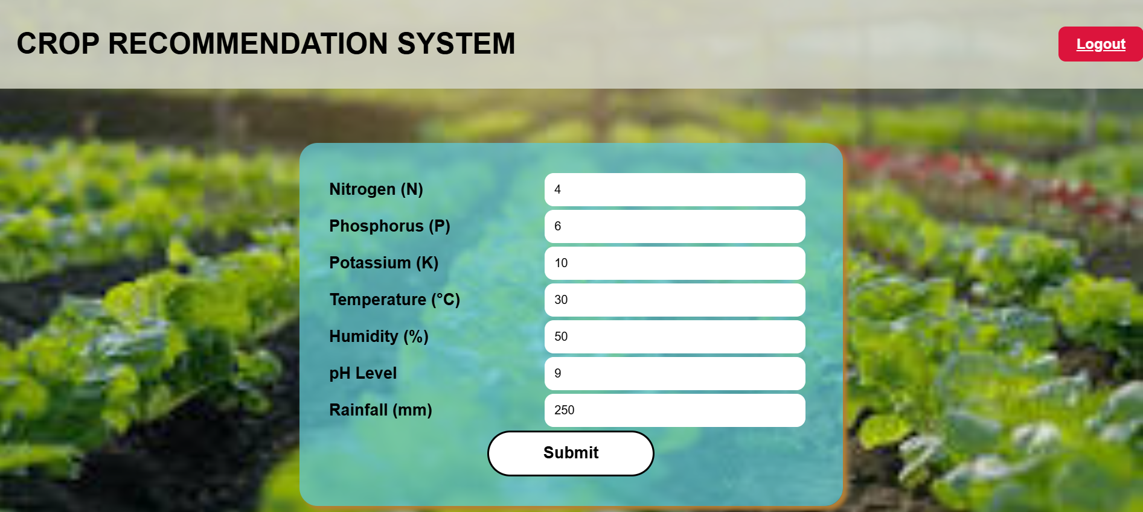
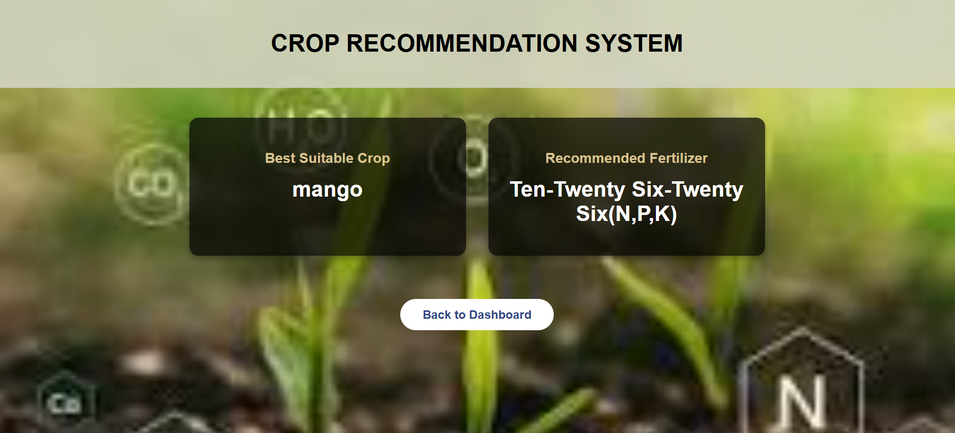
Results and Snapshots
Figure4. User Input page
Figure5. Output page

Slide 11
Application of the Project
1. Agriculture Sector:
Can be used by farmers to get crop and fertilizer recommendations.
2. Agricultural Research Institutes:
Useful for soil analysis studies and crop suitability research.
3. Soil testing Centers:
Can help convert soil test reports directly into recommendations.
4. Government Agricultural Departments:
Can be integrated into schemes that support farmers with crop planning.
5. Educational Use:
Students & researchers can use it to study ML applications in farming.

Slide 12
Conclusion
The Crop Recommendation and Fertilizer Prediction System provides a simple and effective way to assist farmers in making data-based agricultural decisions. By using soil nutrients and weather values as inputs, the system predicts the most suitable crop and recommends the fertilizer that matches the soil’s nutrient requirement.
The use of machine-learning models helps convert raw soil test data into meaningful guidance through an easy-to-use web interface.
This project demonstrates how technology can support better decision-making in agriculture and make scientific recommendations more accessible to farmers.

Slide 13
Future Scope of the work
Future Work:
1. Integration With IoT: Use real-time sensors for automated data collection.
2. Mobile App Development: Create a mobile-friendly interface for easier access by farmers including features like an Agriculture-scientist community, and image-based analysis for detecting & nutrient deficiencies.
3. Addition Of More Datasets: Including more regional/government datasets can improve the accuracy and diversity of crop suggestions.
4. Localization: Adapt the system for region-specific crop and fertilizer recommendation.
5. Cloud Deployment: Scale the system for wider accessibility and faster processing.
6. Fertilizer Quantity Estimation: Recommend the right amount of fertilizer at each farming stage for better yield.

Slide 14
References
[1] Sharma et al., “Machine Learning Techniques for Crop Recommendation,” IEEE Access, 2022.
[2] Patel & Singh, “AI in Precision Agriculture: Fertilizer and Crop Prediction Models,” Elsevier, 2023.
[3] Das, S., & Solgi, H. (2023). “Crop Recommender System Using Machine Learning Approach,” IEEE COMSOC MMTC Communications – Frontiers.
[4] Kumar, M., & Bhadane, S. (2023). “IoT-Enabled Smart Crop Recommendation System Using Machine Learning,” IEEE International Conference on Emerging Smart Computing and Informatics (ESCI).
[5] Kaggle Dataset - CropRecommendation.csv, fertilizer.csv, Crop and Fertilizer Data (2023).
[6] Open Source- GitHub source code.

Slide 15


