Slide 1

Seasonal Agriculture Performance Analysis
JAISHREE JANGID
Lucky Institute of Professional Studies
AICTE STU ID :STU6a6c7848ab0921785493576

Slide 2

PROBLEM STATEMENT
Agricultural activities are influenced by seasonal variations in environmental conditions, farming practices, resource availability and market conditions. As a result, agricultural performance may differ from one season to another. However, raw agricultural data does not clearly explain how agricultural performance changes across seasons or what patterns can be observed in different seasonal conditions. The problem is to analyze the given agricultural dataset and investigate seasonal differences in agricultural performance by identifying meaningful patterns, trends, relationships and variations within the available data.

Slide 3
Project Description This project analyze 4,000 agricultural records across different Indian states and seasons (Kharif, Rabi, and Zaid) to evaluate crop yield, water efficiency, and financial outcomes. Using Python (Pandas, NumPy, Matplotlib, and Seaborn), the data was cleaned, explored, and statistically assessed. Key findings reveal that Kharif delivers the highest average yield (5.63 t/ha) and profit (₹1.79L), while Zaid incurs negative returns (-₹24.8K) due to high heat and heavy irrigation needs. The study offers data-driven insights to optimize seasonal crop planning and water management.

Slide 4

WHO ARE THE END USERS?
Farmers: To understand seasonal crop performance, optimize farming practices, and manage resource usage (such as water and fertilizers) effectively.
Agricultural Planners: To support evidence-based seasonal planning, risk management, and strategic decision-making.
Government and Agriculture Departments: To analyze regional and seasonal agricultural patterns, allocate resources, and formulate targeted agricultural policies.
Agricultural Researchers: To study seasonal trends, environmental dependencies, and crop performance relationships within agricultural data.
Data Analysts : To model agricultural performance and generate actionable, data-driven insights

Slide 5

Technology Used
Python: Main programming language for data analysis
Jupyter Notebook : Used to write and execute the analysis
Pandas: Data cleaning, manipulation, and analysis
NumPy: Numerical and statistical calculations
Matplotlib: Creating core data visualizations
Seaborn: Creating advanced statistical graphs and chart

Slide 6
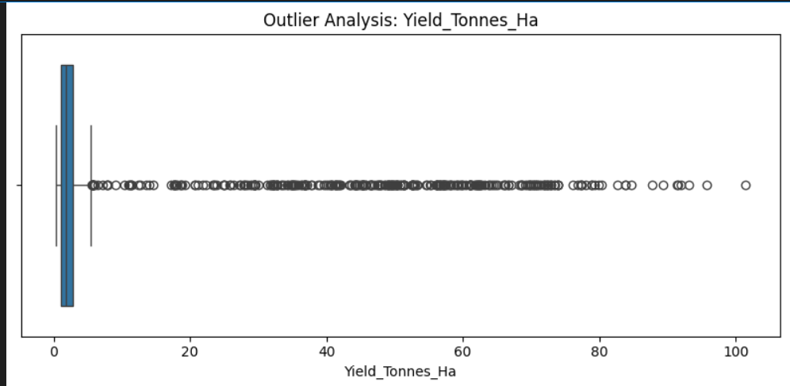
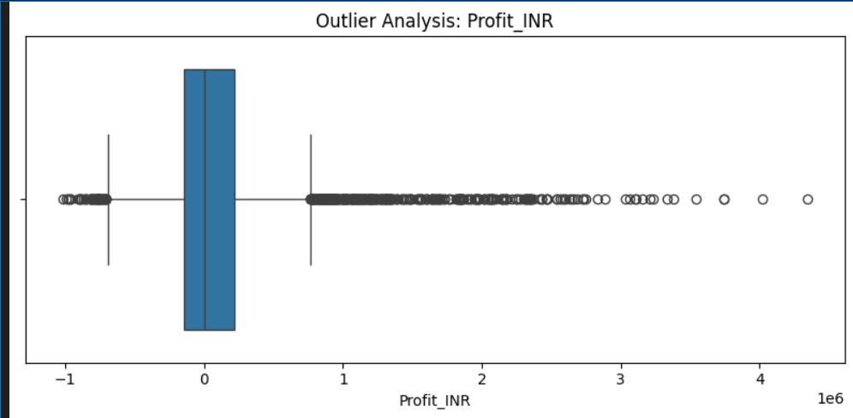
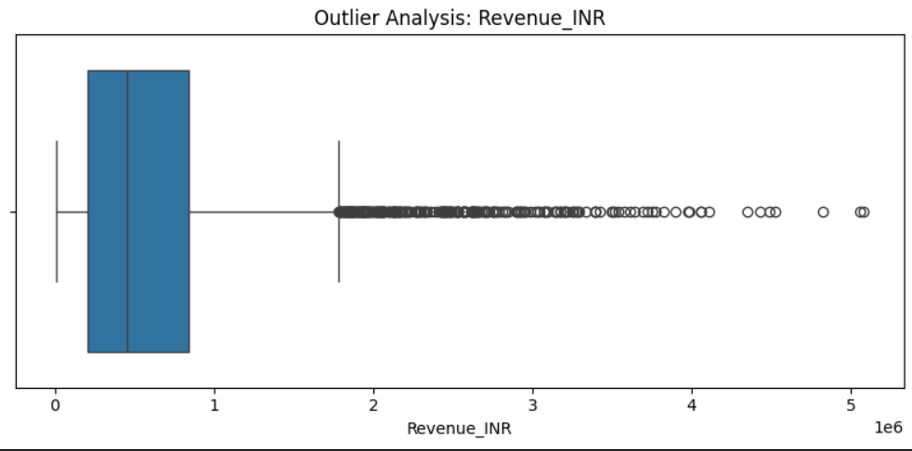
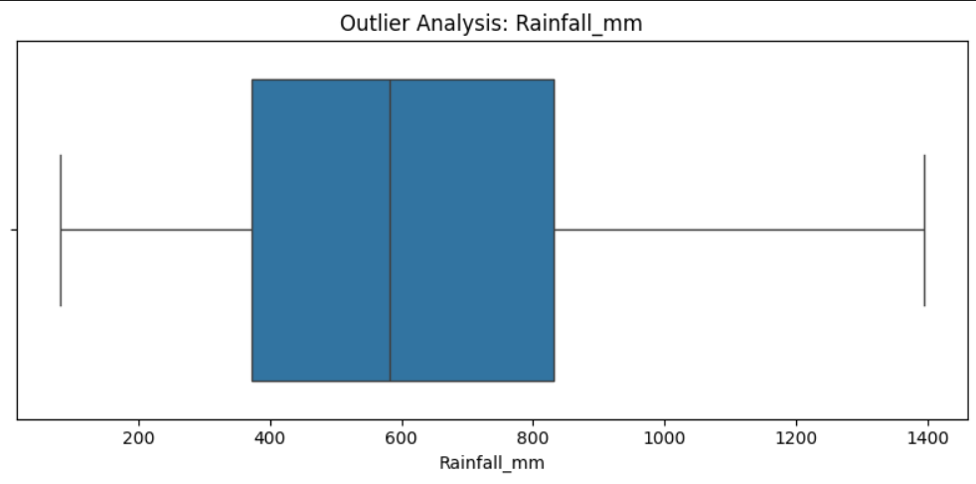
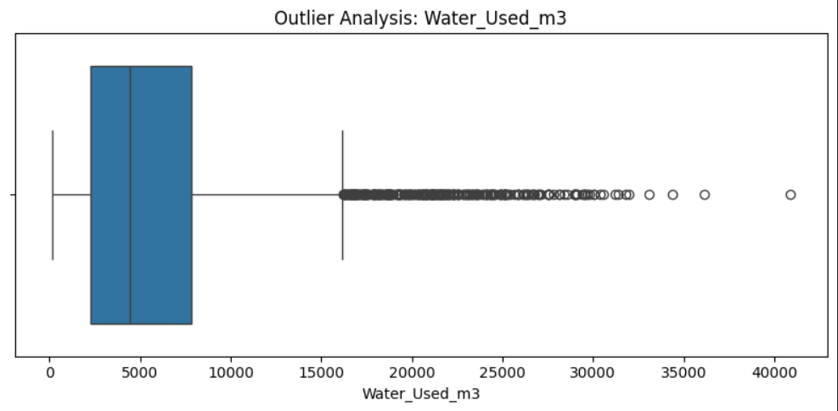
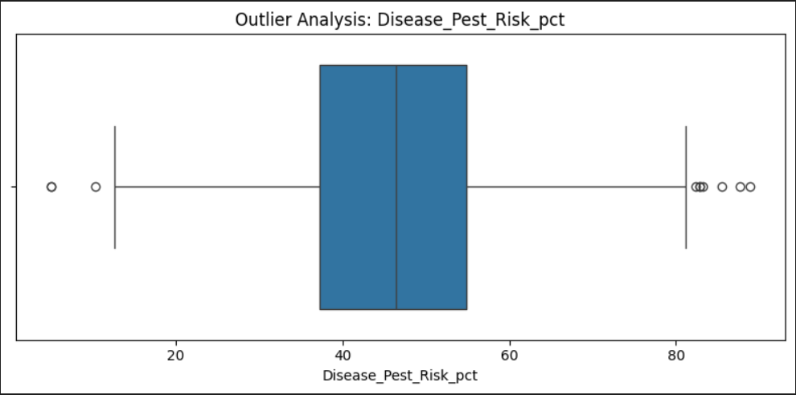
RESULTS
Outlier Analysis
Boxplots highlight significant right-skewed outliers in Yield, Profit, Revenue, and Water Used, while Rainfall and Pest Risk show balanced distributions.
Biological Context: High yield points (>30 t/ha) are not data errors, but genuine biological outputs of high-biomass crops like Sugarcane.

Slide 7
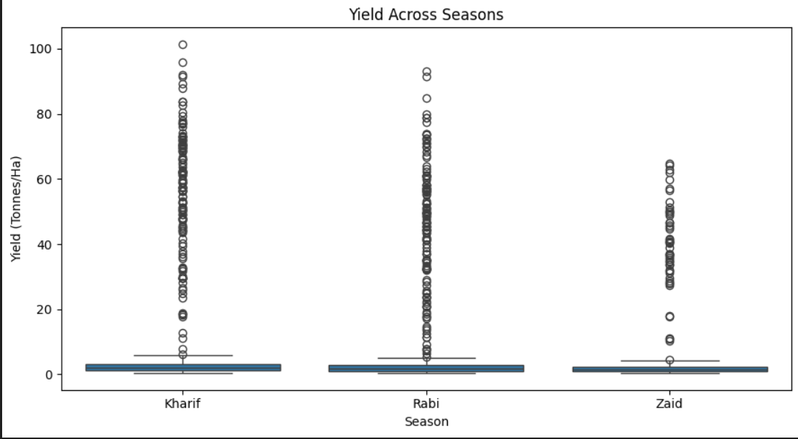
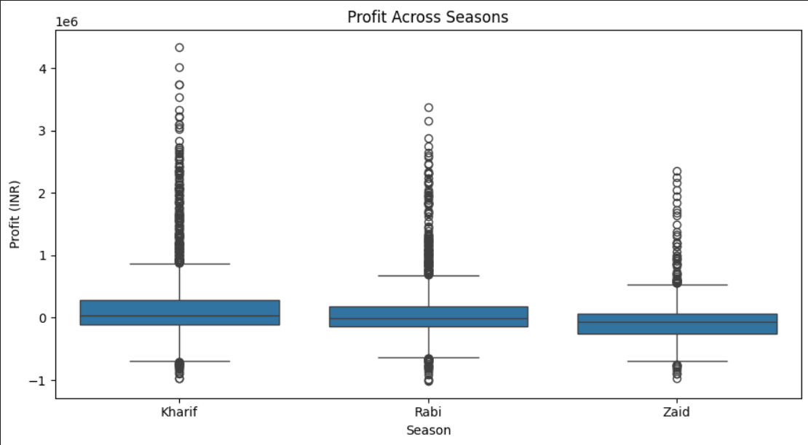
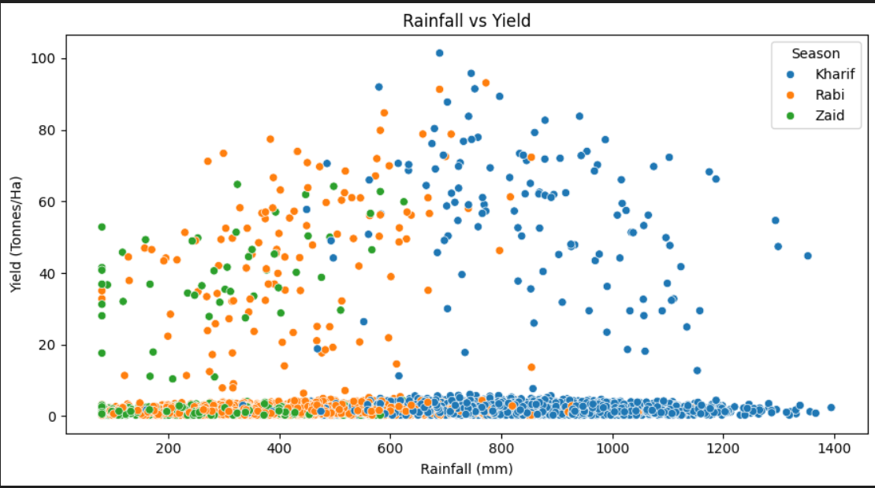
RESULTS
Economic performance by season
Profitability by Season: Kharif records the highest average profit (₹1.79L) with 58% profitable farms, followed by Rabi (₹87.7K). Conversely, Zaid incurs an average net loss (-₹24.8K) with only 35% profitable farms.
Revenue Dynamics: Total revenue peaks during Kharif (₹7.1L avg) due to robust crop yields and market realization, while Zaid yields the lowest revenue (₹5.19L avg).

Slide 8
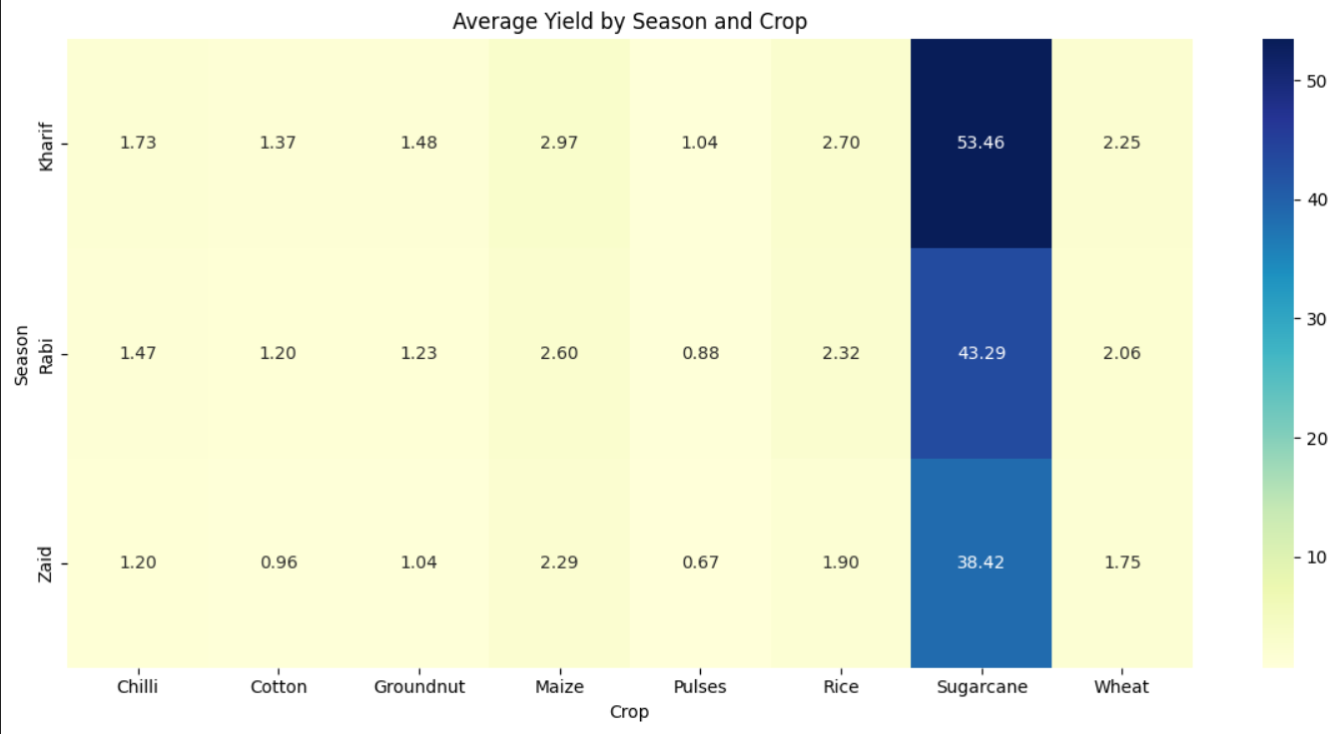
RESULTS
Average Yield by Season and Crop
Crop-Specific Yield Variance: Sugarcane achieves the highest average yield across all seasons (peaking at 53.46 t/ha in Kharif), vastly outperforming grain and pulse crops.
Seasonal Decline Pattern: For every crop type, yield strictly follows the hierarchical pattern Kharif > Rabi > Zaid, highlighting Zaid's thermal and moisture limitations.

Slide 9
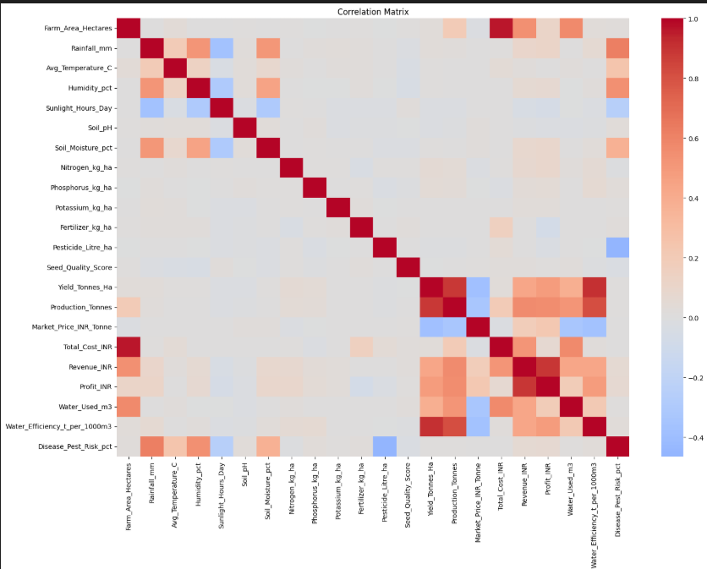
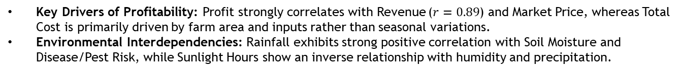
RESULTS
Correlation Matrix
Key Drivers of Profitability: Profit strongly correlates with Revenue ($r=0.89$) and Market Price, whereas Total Cost is primarily driven by farm area and inputs rather than seasonal variations.
Environmental Interdependencies: Rainfall exhibits strong positive correlation with Soil Moisture and Disease/Pest Risk, while Sunlight Hours show an inverse relationship with humidity and precipitation.

Slide 10
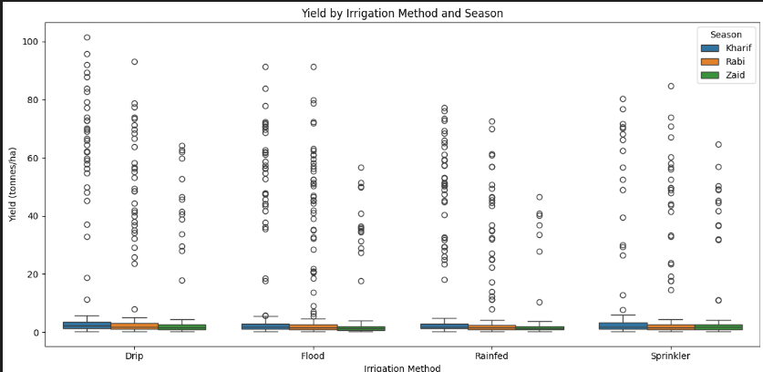
RESULTS
Yield by Irrigation Method and Season
Irrigation Efficiency: Drip and Sprinkler irrigation methods consistently maintain superior yield distributions and water efficiency compared to Flood and Rainfed systems across all seasons.
Seasonal Contrast: Kharif yields remain stable across all irrigation methods due to monsoon support, whereas Zaid crops heavily rely on advanced irrigation (Drip/Sprinkler) to mitigate thermal stress.

Slide 11
Future scope
Multi-Year Analysis: Extend data collection across multiple years to evaluate long-term climatic trends and multi-season variability.
Predictive Models: Implement Machine Learning algorithms to forecast seasonal crop yield and profitability under changing environmental conditions.
Real-Time Monitoring: Develop interactive dashboards for live agricultural performance tracking and district-level resource management.

Slide 12
GitHub Link
Jaishree12473

Slide 13

VOIS Course completion certificate - Course name- Data Visualization

Slide 14

VOIS Course completion certificate- POWER BI

Slide 15
Thank you
.
.

