Slide 1
NOTENEST
Jaishree Parashar , Shalu , Ayush , Kanishak Choudhary
Under Supervison Of
Internal :- Mr. Aijaz
External :- Mr. A.C. Bhatnagar
1.Jaishree 2.Shalu 3.Ayush 4.Kanishak
[NOTENEST]
Y1-2024-25-G57 1/12

Slide 2
INTRODUCTION
NotesNest is an innovative educational website designed to support students in their academic pursuits by providing a comprehensive, user-centric platform focused on the efficient distribution and management of study materials.
The platform hosts an extensive, meticulously categorized repository of high-quality notes, covering a wide range of subjects and academic levels — from high school curricula to professional certification materials. NotesNest ensures that students can quickly access precisely the resources they need by organizing content based on subject, topic, and difficulty level, thereby saving valuable time and enhancing academic preparation.
1.Jaishree 2.Shalu 3.Ayush 4.Kanishak
[NOTENEST]
Y1-2024-25-G57 2/12

Slide 3
OBJECTIVES
Easy note creation .
Video lectures
Organization and categorization .
Cross platform accessibility (mobile and desktop ).
Search fuctionality .
Collabration feature (other students can also add notes ).
1.Jaishree 2.Shalu 3.Ayush 4.Kanishak
[NOTENEST]
Y1-2024-25-G57 3/12

Slide 4
PROBLEM STATEMENT
Students could access quality notes/videos, study them, and track their learning.
Teachers could upload resources and manage their content without technical complexity.
This gap created a lack of communication, poor resource sharing, and no easy way to measure learning activity.
1.Jaishree 2.Shalu 3.Ayush 4.Kanishak
[NOTENEST]
Y1-2024-25-G57 4/12

Slide 5
METHODOLOGY
Frontend | Backend | Database Stored
HTML | PHP | SQL
CSS
Javascript
Bootstrap
1.Jaishree 2.Shalu 3.Ayush 4.Kanishak
[NOTENEST]
Y1-2024-25-G57 5/12

Slide 6
METHODOLOGY FLOW
Planning
Research
Design
Follow Up
Implementation
1.Jaishree 2.Shalu 3.Ayush 4.Kanishak
[NOTENEST]
Y1-2024-25-G57 6/12

Slide 7
EXPECTED OUTCOMES
Direct outcome
Web based development.
Safe learning environment.
Indirect outcome
Upskilling of users.
Problem solving skills through quizes.
Mastery of a specific topic.
1.Jaishree 2.Shalu 3.Ayush 4.Kanishak
[NOTENEST]
Y1-2024-25-G57 7/12

Slide 8
CONCLUSION
In conclusion, Notenest is a valuable online platform for students and educators, offering a centralized space to access, share, and organize academic notes. It enhances learning efficiency by providing well-structured study materials, making it easier for users to grasp complex concepts. By fostering a collaborative learning environment, Notenest helps students stay prepared and succeed in their academic pursuits.
1.Jaishree 2.Shalu 3.Ayush 4.Kanishak
[NOTENEST]
Y1-2024-25-G57 10/12

Slide 9
OUTPUT
1.Jaishree 2.Shalu 3.Ayush 4.Kanishak
[NOTENEST]
Y1-2024-25-G57 7/12

Slide 10
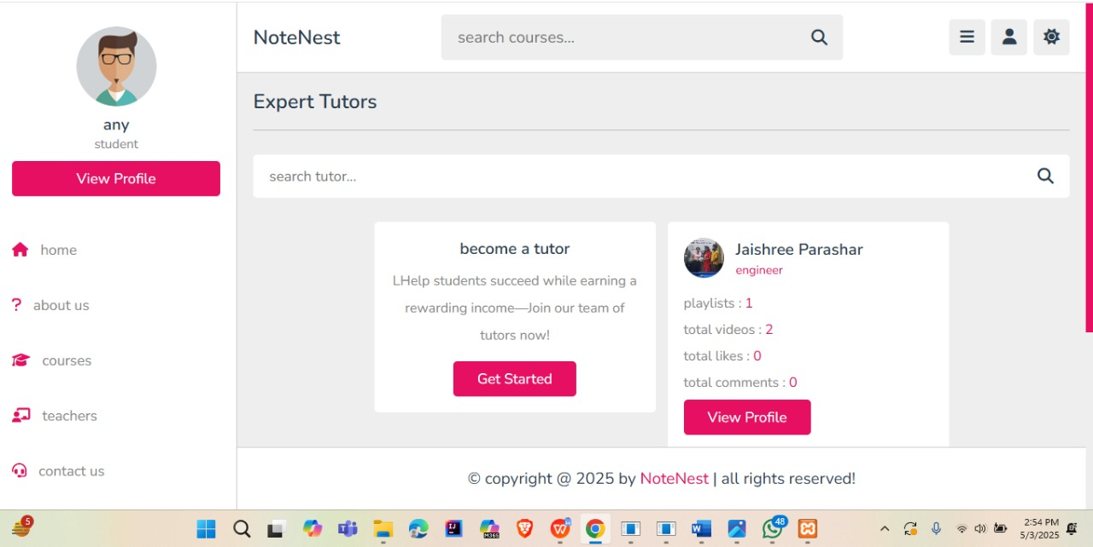
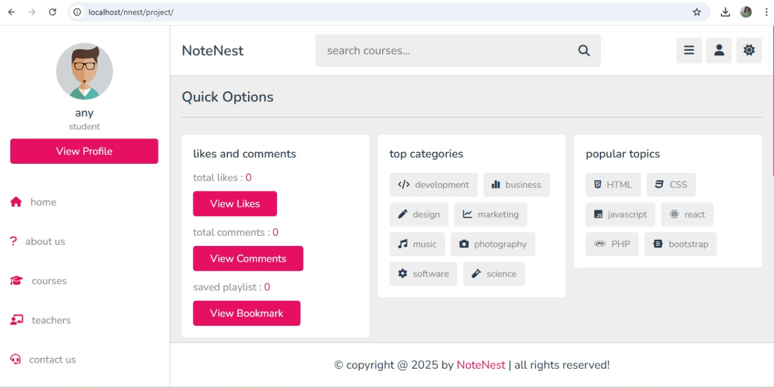
1.Jaishree 2.Shalu 3.Ayush 4.Kanishak
[NOTENEST]
Y1-2024-25-G57 7/12

Slide 11
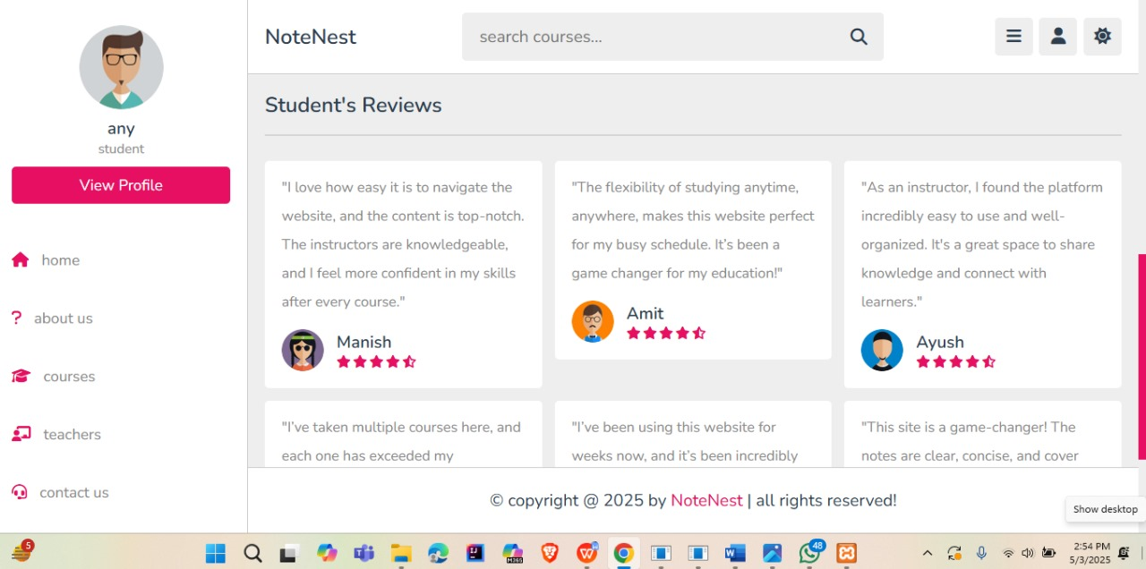
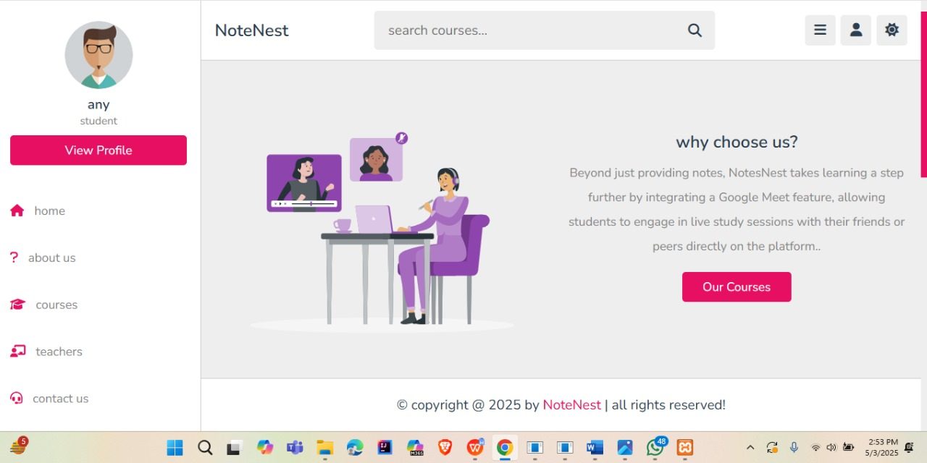
1.Jaishree 2.Shalu 3.Ayush 4.Kanishak
[NOTENEST]
Y1-2024-25-G57 7/12

Slide 12
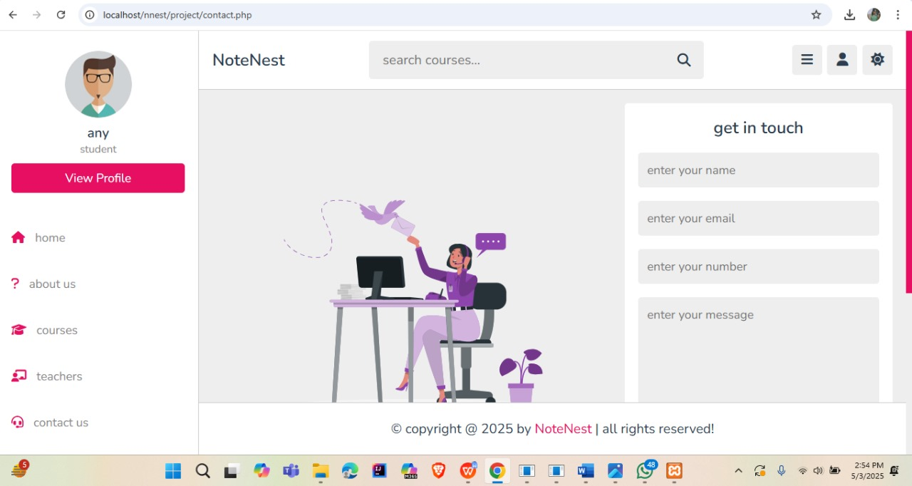
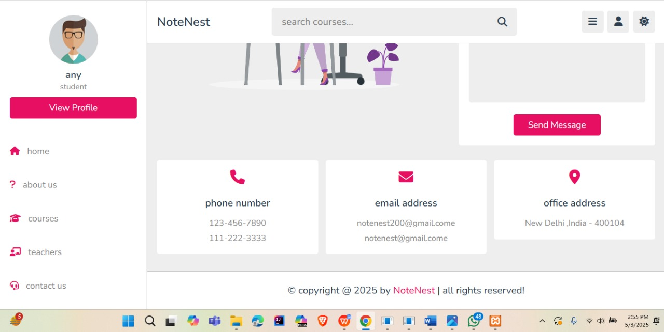
1.Jaishree 2.Shalu 3.Ayush 4.Kanishak
[NOTENEST]
Y1-2024-25-G57 7/12

Slide 13
FUTURE GOALS
Future integration of API.
Integrated feature of Google Meet.
1.Jaishree 2.Shalu 3.Ayush 4.Kanishak
[NOTENEST]
Y1-2024-25-G57 7/12

