Slide 1
EMPLOYEE DATA ANALYSIS USING EXCEL
NAME : JAISHREE B
REGISTER NO : 312208487
DEPARTMENT : B.COM GENERAL
COLLEGE :CHELLAMAL WOMEN’SCOLLEGE

Slide 2
EMPLOYEE PERFORMANCE ANALYSIS USING EXCEL

Slide 3
AGENDA
Problem statement
Project overview
End Users
Our Solution proposition
Data Description
Modelling Approach
Result and discussion
Conclusion

Slide 4
PROBLEM STATEMENT
This presentation aims to analyze existing employee performance data to uncover actionable insights develop targeted strategies for performance enhancement and support data driven decision making to foster a more efficient and motivated workforce.

Slide 5
PROJECT OVERVIEW
The employee performance data analysis project
evaluates metrics like productivity, quality of
work, and attendance to identify trends and areas
for improvement. By analyzing this data, the
project aims to uncover strengths and weaknesses,
offering actionable insights and recommendations
to enhance overall performance and align with
organizational goal.

Slide 6
WHO ARE THE END USERS?
HR Manager
Team Leaders
Department Heads
Senior Executives
Performance Analysis
Training and Development Teams
Employee Relations Specialists
Data Analysis etc.

Slide 7
OUR SOLUTION AND ITS VALUE PROPOSITION
➢ Filtering: Enhanced data accuracy by isolating relevant
subsets, which improved focus on specific performance
metrics and streamlined analysis.
➢ Slicer: Enabled interactive data exploration by providing
dynamic filtering options, allowing users to easily segment and
analyze data across different dimensions.
➢ Pivot Table: Summarized large datasets effectively by
aggregating and reorganizing data, facilitating in-depth
analysis and insight into key performance indicators.
➢ Graph: Visualized data trends and patterns through charts,
making complex information more accessible and actionable
for stakeholders.

Slide 8
DATA DESCRIPTION
Employee dataset - Naan Mudhalvan Dashboard
Total Features - 26
Features Used - 9
Employee ID - Number
Name - Text
Gender - Male and Female
Employee type - Full time, part time, contract
Employee status - Active
Employee Rating - Number
Business Unit - department

Slide 9
MODELLING
-Data Sources and Cleaning
Data was extracted from the NM dashboard for comprehensive analysis.
Cleaned data to remove inconsistencies and duplicates.
Ensured accuracy and completeness for reliable analysis.
- Key Metrics and Dimensions
Defined dimensions like departments and job roles for detailed analysis.
Ensured metrics align with organizational performance goals.
-Pivot Table Structure
Created pivot tables to summarize and analyze large data sets.
Organized data by dimensions like time periods and employee groups.
Enabled dynamic filtering for in-depth performance insights.
- Types of Visualizations
Developed charts and graphs to illustrate performance trends.
Used bar charts for departmental comparisons and line graphs for trends over time.
Applied heat maps to highlight areas of high and low performance.

Slide 10
MODELLING
- Insights and Conclusions :
Analyzed visualizations to identify performance patterns and
anomalies. Delved into trends to uncover factors influencing employee
performance.
- Provided actionable recommendations for improving productivity and engagement.
Data Integration and Transformation :
Applied transformation techniques to standardize and normalize data formats.
Ensured consistency and accuracy across integrated data points.
Reporting and Presentation :
Designed visual aids to effectively communicate insights and recommendations.
Presented key findings and actionable steps for strategic decision-making.

Slide 11
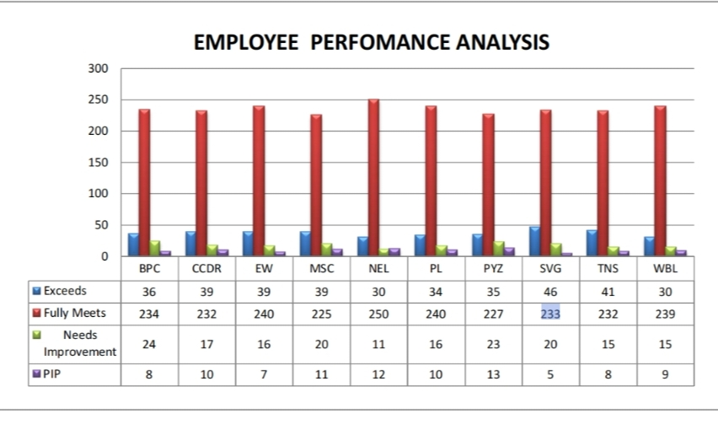
Result

Slide 12
Conclusion
WITH THE PERFORMANCE BEING SHOWN THAT MORE THAN OR EQUAL TO 100 EMPLOYEES IN BOTH MALE AND FEMALE(EACH DEPARTMENT ) HAVE FULLY MET THE PERFORMANCE) EXPECTATION AND LESS THAN OR EQUAL TO 20 EMPLOYEES EACH DEPARTMENT BEING EXCEEDING THE EXPECTAION THE REST ARE TAKEN AS ‘’PIP’’ AND ‘’NEEDS IMPROVEMENT’’.
PIP < 15 IN EACH DEPARTMENT
NEEDS IMPROVEMENT < 25 IN EACH DEPARTMENT
THESE NUMBER OF EMPLOYEES MIGHT NEED EXTRA MOTIVATION / TRAINING /
PRACTICE ON EFFICIENT PERFORMANCE .

