Slide 1

Master's Thesis Project
Optimizing Large Language Models and Blackjack Agent Using Reinforcement Learning Methods
by Adarsh Sharma(20ME3AI10)

Slide 2

Content
Introduction
Success of DeepSeek R1
Classical Value Based RL Algorithms
Policy Gradient Algorithms
Our Environments
Part 1. Blackjack
Types of Blackjack Environments
Results
Web Application
Conclusion

Slide 3
Content(continue)
Part 2. RLHF
Ways of Training LLMs
Dataset
Models
Results
Conclusions
Future work

Slide 4

Introduction

Slide 5

Success of DeepSeek R1
Reinforcement Learning-Driven Reasoning: DeepSeek-R1 employs pure reinforcement learning without supervised fine-tuning, enabling the model to develop advanced reasoning capabilities autonomously
Emergence of 'Aha Moments': The model exhibits self-correcting behavior by allocating additional processing time to complex problems, leading to improved solutions—a phenomenon described as "aha moments
Efficient Model Distillation: Through a multi-stage training pipeline, DeepSeek-R1 distills its capabilities into smaller models (ranging from 1.5B to 70B parameters) that maintain high reasoning performance, making advanced AI more accessible
Innovative Architectural Design: Incorporating Multi-Head Latent Attention (MLA) and a Mixture of Experts (MoE) framework, DeepSeek-R1 achieves efficient computation by activating only relevant sub-networks during inference, reducing resource usage

Slide 6


Classical Value Based RL algorithms
Monte Carlo Method
Temporal Difference Learning
Q Learning
SARSA

Slide 7
Comparison
S. No | RL Algorithm | Policy | Strength | Weakness
1. | Monte Carlo Method | On-policy / Off-policy | Unbiased estimates | High variance; needs full episode
2. | TD Learning | On Policy | Fast, online updates | Some bias; approximation errors
3. | Q learning | Off Policy | Learns optimal policy directly | Can overestimate; unstable
4. | SARSA | On Policy | Safer learning; more stable | Slower convergence; more conservative
5. | Deep Q Learning | Off Policy | Handles large/complex spaces | Requires replay buffer and target network

Slide 8



Policy Gradient RL algorithms
REINFORCE
A2C and A2C
DDPG
TRPO
PPO

Slide 9
Comparison
S. No | RL Algorithm | Policy | Strength | Weakness
1. | REINFORCE | On-Policy | Unbiased gradient estimate | High variance; slow convergence
2. | A2C/A3C | On-Policy | Lower variance via critic; parallelizable | Requires value-function tuning
3. | DDPG | Off-Policy | Handles continuous actions; sample-efficient | Unstable; sensitive to hyperparameters
4. | TRPO | On-Policy | Guaranteed policy improvement; stable updates | Computationally expensive
5. | PPO | PPO On-Policy | Stable and efficient; easy to implement | Still needs careful hyperparameter selection

Slide 10
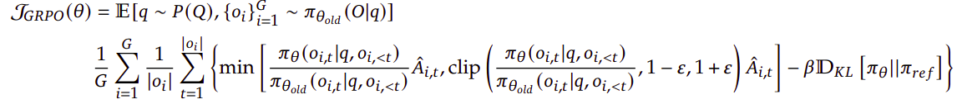


Group Relative Policy Optimization
It is an update on the Proximal Policy optimization algorithm where we don't need to have a separate critic network for advantage calculation which reduces training time and memory used for training
Objective Function:

Slide 11
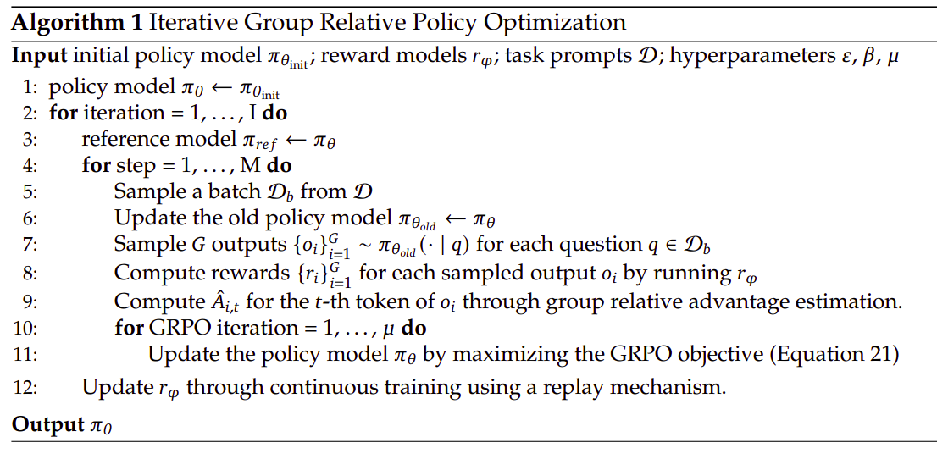
Training Pipeline for GRPO

Slide 12
Key hyperparameter for GRPO
Hyperparameter | Role in GRPO Training
batch_size | We will update old_policy to cur_policy after batch_size number of initial state were generated(See Line 3)
num_epochs | Number of outer iterations over the entire training process (Line 2: for iteration = 1, ..., I). Each epoch is a full pass over the data with multiple steps of policy updates.
num_episodes, G | Total number of initial state generated from which G episodes are generated for each initial state
μ (mu) | See Line 10
ε (epsilon) | clipping parameter in GRPO loss
β (beta) | Represents the weight on a KL-divergence penalty term in Overall GRPO loss term

Slide 13


Our Environments
Large Language Models
Blackjack

Slide 14

Part1: Large Language Models

Slide 15
Ways to train a LLM on Custom Dataset
Training LLM from scrach
Transfer learning
Supervised fine tuning

Slide 16

RLHF
Reward Model Loss function:
RL based finetuning of main model using reward model

Slide 17
Why PPO only for RL Part
Scalable
Popular
Easy to use
SAC are not scalable, TRPO is too difficult to implement

Slide 18
Dataset and Task
Our task is to do Abstractive Summarization of text
Dataset used is a subset of openai/summarize_from_feedback

Slide 19
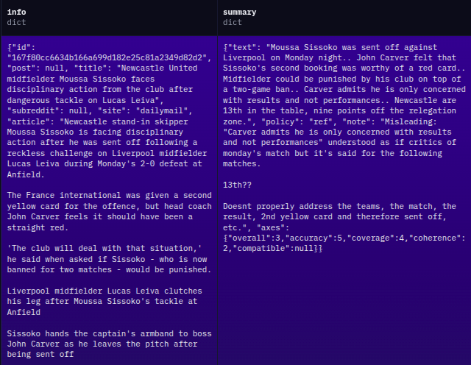

Slide 20
Models
LLama3.1 8B as both reward model and supervised finetuned model
GPT2 as both reward model and supervised finetuned model
Gemma 2B as reward model and LLama 3.18B as main supervised fine-tuned model
Direct Preference Optimization (DPO)

Slide 21
CUDA out of memory error
CUDA out of Memory error on LLama3.1 8B reward model and Main model
Tried to reduce batch size and increase gradient accumulation step
Passed only frozen parameters to optimizer but still CUDA out of memory

Slide 22
Results
Poor average reward score for GPT2 reward and main Model
Gemma 2B and Gemma 7B had similar results on IMDb dataset subset
DPO gave had loss simIiar to PPO with more than 3 times faster training

Slide 23
Conclusion
Use Gemma 2B as reward model and LLama3.1 8B as main model if VRAM is 16GB only
Take a note of the version of library installed
Since RLHF is an evolving field so PPOTrainer, etc from the trl library change significantly in its API
Code, results are available at: https://github.com/JaishreeramCoder/Masters-Thesis-Project1

Slide 24

Part 2 Blackjack

Slide 25
Blackjack
Game Setup: Blackjack is played between a player and a dealer. At the start, both are dealt two cards. The player's goal is to have a hand value as close to 21 as possible without exceeding it
Player Actions: After receiving the initial cards, the player can choose to Hit (take another card) or Stick (keep their current hand). Many casinos also allow additional actions like Surrender (forfeit half the bet and end the round) and Double Down (double the bet and receive only one more card), typically available as the first move
Dealer's Turn: Once the player decides to Stick, the dealer reveals their hand and draws additional cards until their hand total is 17 or higher. The dealer must Hit if the total is 16 or less and Stick otherwise
Card Counting and Strategy: When playing with a fixed number of decks, card counting becomes a viable strategy. The player's choice of action can be influenced by previously revealed cards, giving an edge in decision-making
Natural Blackjack: A "natural" blackjack occurs when the player’s first two cards are an Ace and a 10-value card, totaling 21. This usually pays out at 3:2 odds and beats any dealer hand except another natural blackjack, which results in a push (tie)

Slide 26
Types of Blackjack Environment
Simple Blackjack Environment
Actions allowed: HIT and STICK
Default environment available in Gymnasium library
No additional implementation required
Extended Blackjack Environment
Actions allowed: HIT, STICK, DOUBLE DOWN, and SURRENDER
Requires a custom class to implement the additional actions
Adds strategic depth to decision-making
Extended Blackjack Environment with Card Counting
Based on the Extended Environment
Uses a single deck of cards (no reshuffling after each round)
Enables implementation of card counting strategy
Custom class developed for this environment

Slide 27
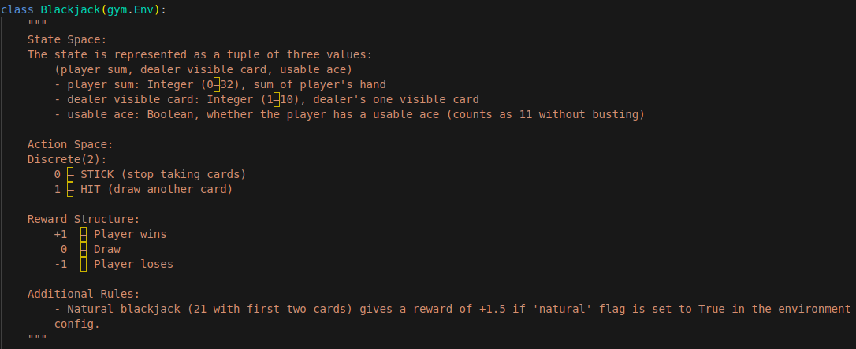
Simple Blackjack Environment

Slide 28
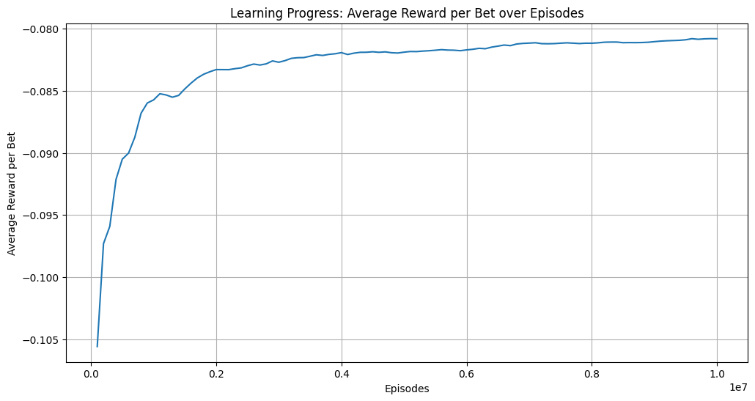
Training Results for Monte Carlo Method
The Monte Carlo agent was trained with the following hyperparameters:
γ = 1, ε-greedy with ε = 0.1, Episodes = 10,000,000

Slide 29
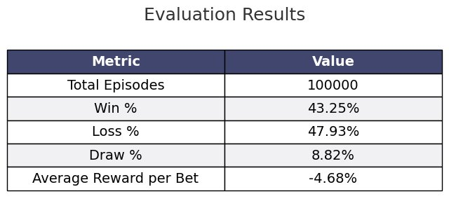
Evaluation Results for Monte Carlo Method

Slide 30
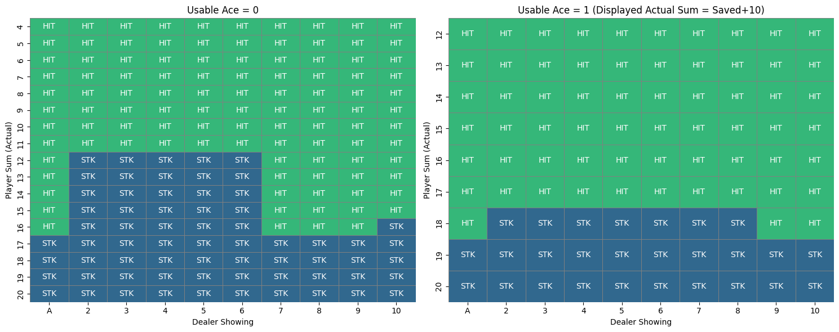
Strategy Chart Based on Trained Model

Slide 31
Key Hyperparameters in PPO (Stable Baseline)
Timestep vs Episode: A timestep is a single interaction between the agent and environment. An episode consists of all timesteps from the start state until termination.
batch size (default: 64): These 2048 timesteps observations are grouped into mini_batches of size batch_size(i.e total (2048/64)=32 mini-batches)
N_epochs (default: 10): Our PPO model is updated for each mini-batch one by one, such that an update of one full batch of size=2048 is 1 epoch. Therefore, for 10,000,000(≈1e7) timesteps we have (10,000,000/2048)*10*32(=1562496 ≈ 1e6) updates
N_steps (default: 2048): No. of timesteps after which the model execution is paused and weight update starts
Basically, Each minibatch will call gradient descent on the neural network one by one. Once all the mini batches for the current 2048 steps are completed, we will repeat the same process n_epoch no. of times

Slide 32
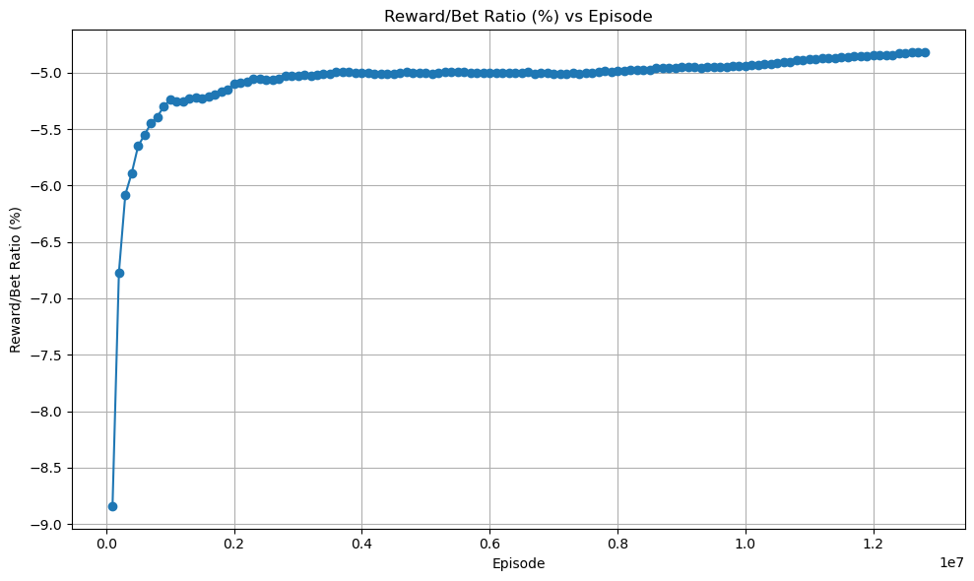
Training Result for PPO Model
The PPO agent was trained with the following hyperparameters:
γ = 1.0, n steps = 2048, batch size = 64, entropy_coef = 0.01, timesteps = 20,000,000
learning rate: cosine schedule with min = 1 × 10−6 , max = 1 × 10−4

Slide 33
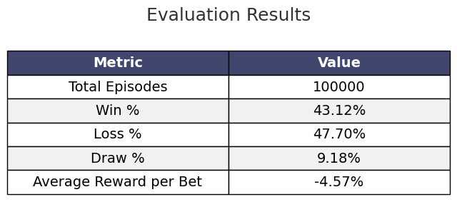
Evaluation Results for PPO Model

Slide 34
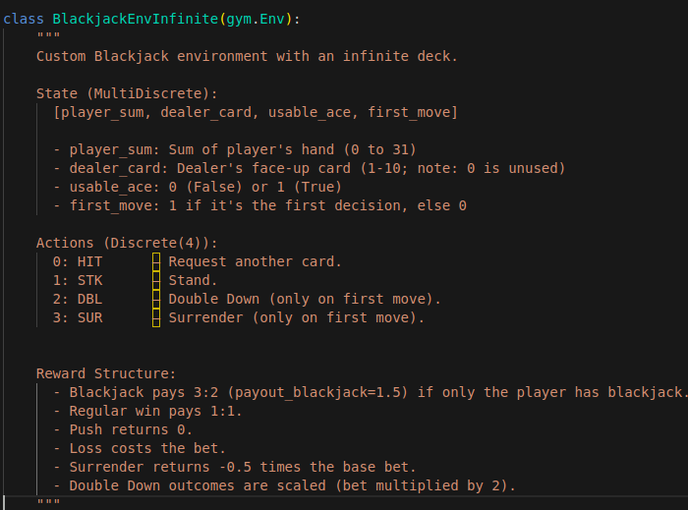
Extended Blackjack Environment

Slide 35
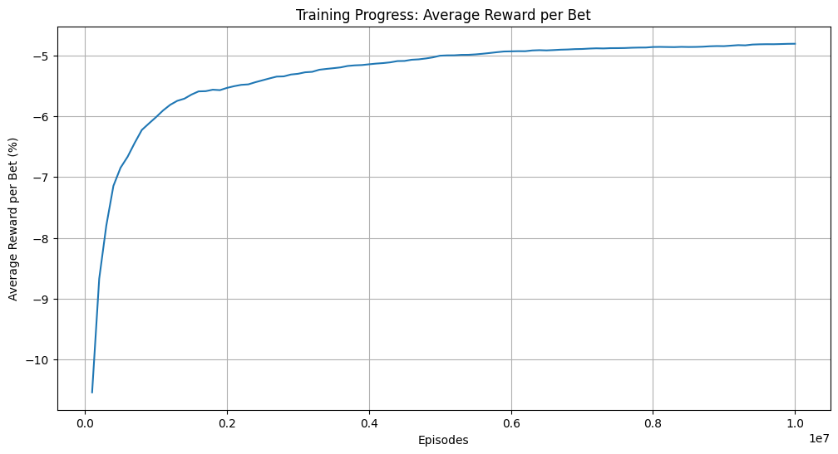
Training Results for Monte Carlo Method
The Monte Carlo agent was trained with the following hyperparameters:
γ = 1, ε-greedy with ε = 0.1, Episodes = 10,000,000

Slide 36
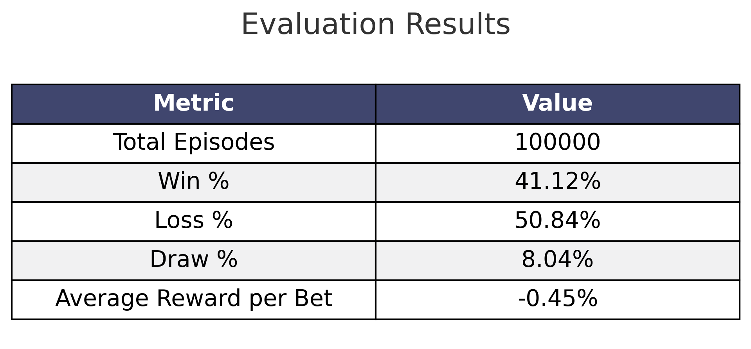
Evaluation Results for Monte Carlo Method

Slide 37
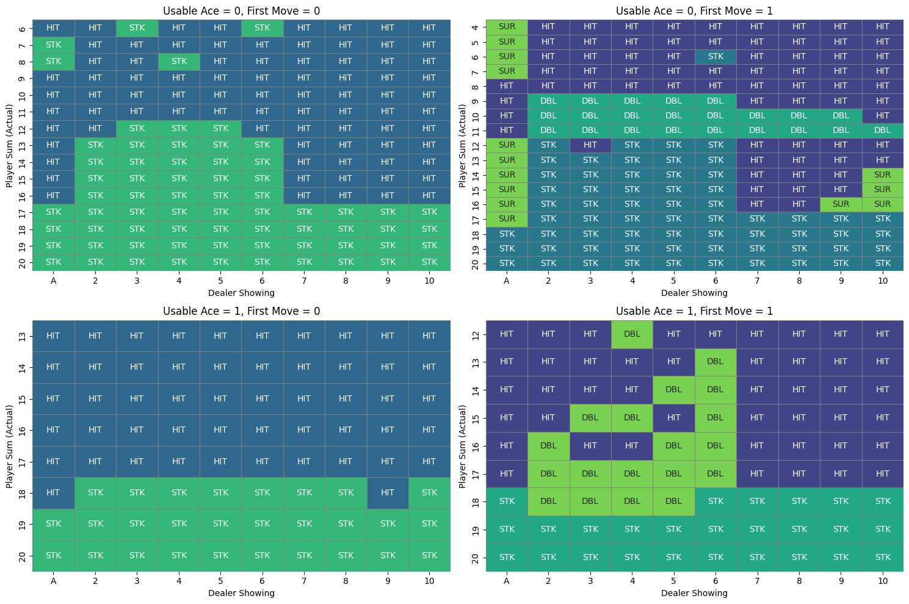
Strategy Chart Based on Trained Model

Slide 38
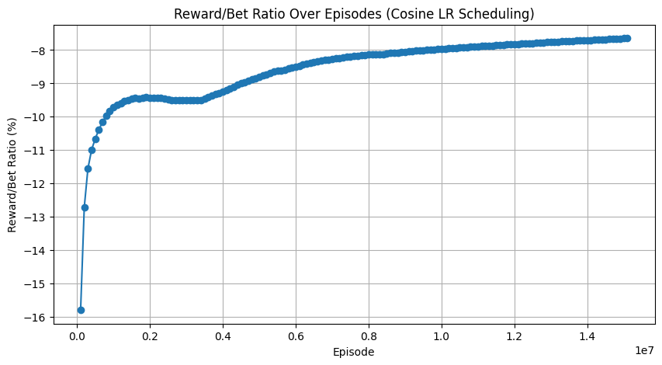
Training Results for PPO Model
The PPO agent was trained with the following hyperparameters:
γ = 1.0, n steps = 2048, batch size = 64, entropy_coef = 0.01, timesteps = 20,000,000
learning rate: cosine schedule with min = 1 × 10−6 , max = 1 × 10−4

Slide 39
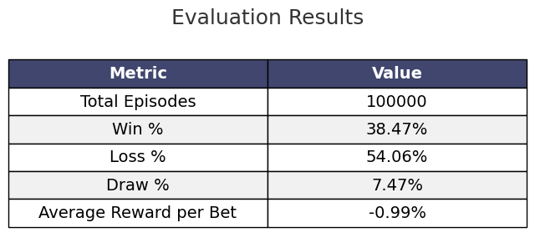
Evaluation Result for PPO Model

Slide 40
Important Insights
The average reward per bet and win percentage for the Monte Carlo and PPO models are nearly identical. The Monte Carlo method converged in approximately 30 minutes (training curves flattened), whereas PPO required around 11 hours and showed no improvement after an additional 20,000,000 timesteps (cosine LR from 1e-6 to 1e-7)). Thus, for the simple environment, traditional Monte Carlo remains the most efficient choice
Both models achieved an average reward per bet of about (-4.5%) in the simple environment. This lower performance stems from the lack of 1.5× (natural blackjack) and 2× (double down) payouts. Extended environments allowing these payouts yield substantially higher returns, and further training did not improve results in the simple setup

Slide 41
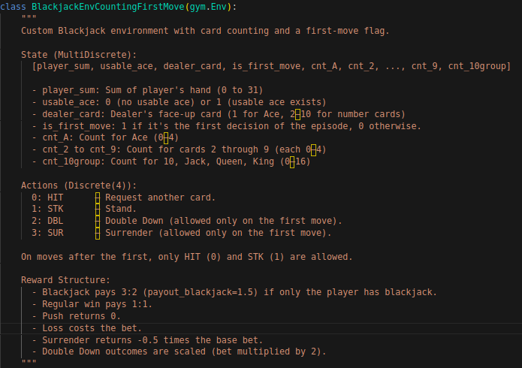
Extended Blackjack Environment with Card Counting

Slide 42
Why do we require deep RL based methods for card counting allowed environment?
The state for Extended Blackjack Environment with Card Counting is defined as:
This is vastly larger than the extended environment which has only 1,408 unique states
Such a massive state space cannot be represented using tabular RL methods like Q-Learning, Monte Carlo, or Temporal Difference learning, as storing and updating each state-action pair becomes infeasible
To overcome this, we need Deep Reinforcement Learning methods like DQN, PPO, or GRPO, which can handle high-dimensional state spaces using neural networks as function approximators
Deep RL allows the agent to generalize across similar states and learn an effective policy without needing to explicitly visit or store every single state

Slide 43
Proximal Policy Optimization(PPO)
When first evaluated on 100,000 episodes in the card-counting environment, the vanilla PPO agent achieved only a 32% win rate and an average reward per bet of −9% (i.e a $100 bet returned only $91), far below the > 40% win rates of other methods
Potential Issues and Remedies:
Learning Rate Instability: The initial default constant learning rate of 3 × 10−4 led to rapid early learning but excessive fluctuation around the optimum in later training. Solution: Adopted a cosine learning rate schedule that decays from 1×10−4 to 1×10−6 , which improved the average reward per bet to +2.36%, surpassing all previously trained models.
Network Capacity: The default Stable-Baselines PPO policy and value networks used two hidden layers of 64 units each. Increasing to three layers (128, 64, 32 units) did not yield further performance gains, indicating that model capacity was not the primary bottleneck.

Slide 44
Extended Training and Convergence
Phase 1: Trained for 10,000,000 time_steps (70 million episodes) with cosine LR 1 × 10−4 → 1 × 10−6 . Training took approximately 7 hours, but did not fully converge (average-reward curve still rising)
01
Phase 2: Continued training for an additional 20,000,000 time_steps with the LR schedule 1 × 10−6 → 1 × 10−7 . The average-reward per bet curve flattened, indicating convergence.

Slide 45
Additional Observations
Timesteps per Episode: Tracking average timesteps per episode could reveal whether the agent adopts a defensive (more STK) or aggressive (more HIT) style; this analysis remains future work
GPU vs. CPU: With a relatively small two-layer network, GPU acceleration offered no appreciable speedup or performance benefit.
Catastrophic forgetting: The knowledge that the model got by rewards from the initial episode is forgotten when we have a very large no. of episodes, due to which RL models can also similar to supervised learning algorithms face the same overfitting problem if we increase the number of training episodes too much

Slide 46
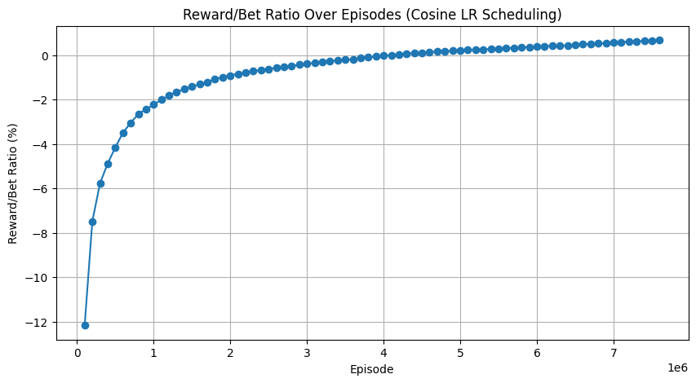
Training Results for Phase 1 PPO Model training
The PPO agent was trained with the following hyperparameters:
γ = 0.99, n steps = 2048, batch size = 64, ent coef = 0.01, timesteps = 10,000,000
learning rate: cosine schedule with min = 1 × 10−6 , max = 1 × 10−4

Slide 47

Evaluation Results for Phase 1 of PPO Model

Slide 48
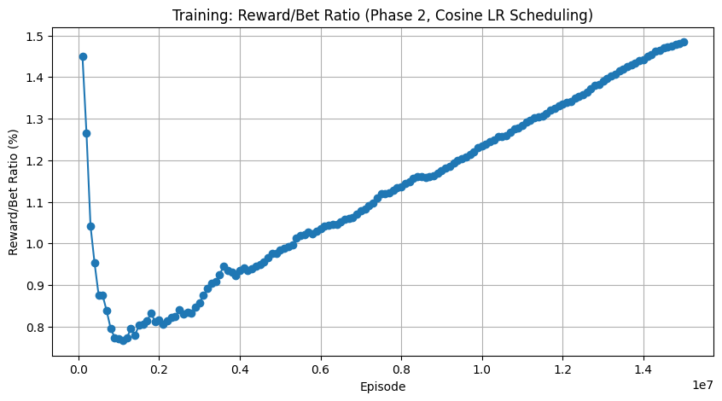
Training Results for Final Phase of PPO Model
The PPO agent was further trained with the following hyperparameters:
γ = 0.99, n steps = 2048, batch size = 64, ent coef = 0.01, timesteps = 20,000,000.
learning rate: cosine schedule with min = 1 × 10−7 , max = 1 × 10−6

Slide 49
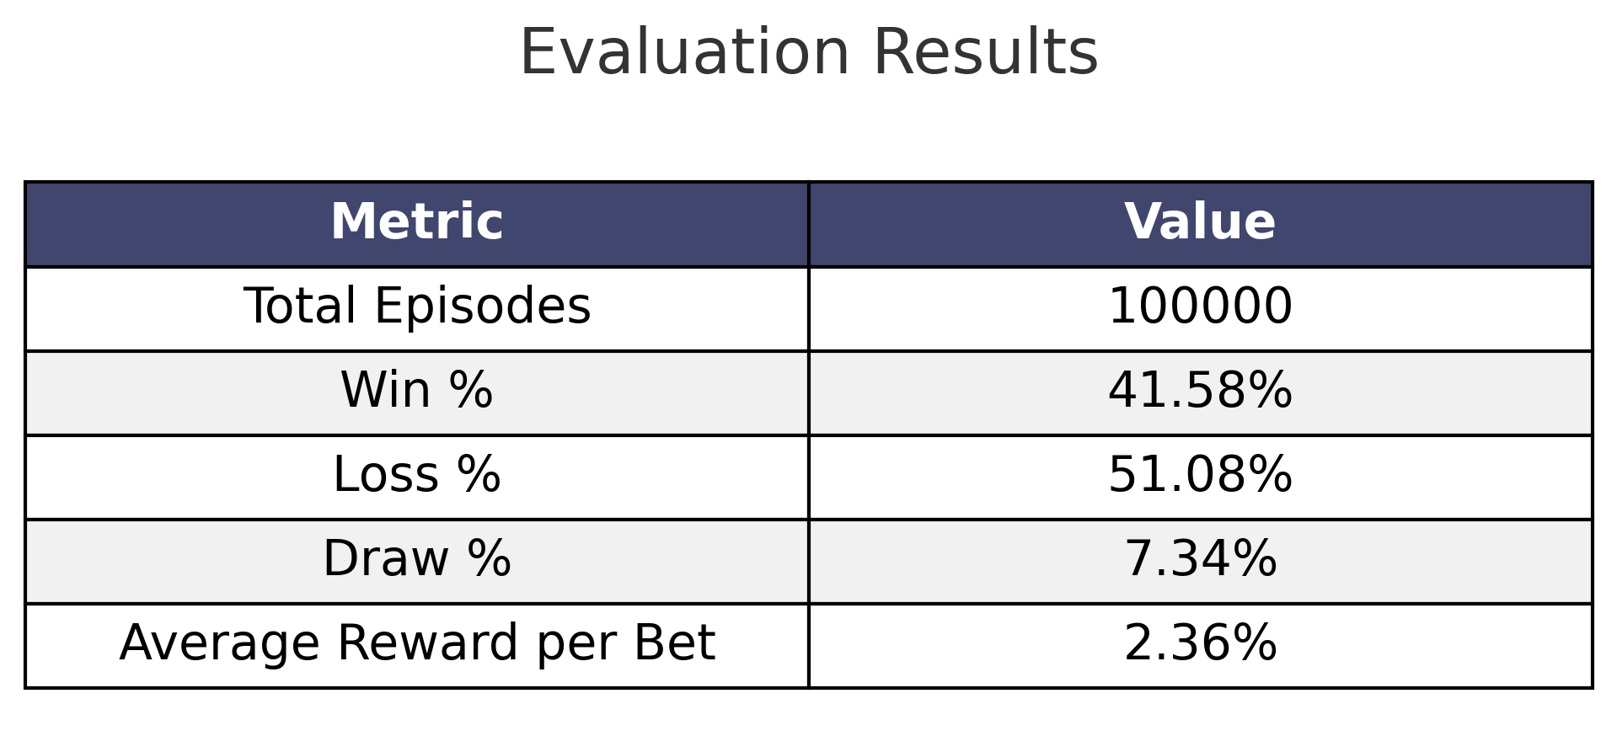
Evaluation Results for Final Phase of PPO Model

Slide 50
Workflow for GRPO implementation
For a gymnasium-based environment like blackjack. There is no implementation of GRPO present in any library, including stable baseline, RLlib, etc. Therefore, we had to implement the whole pipeline from scratch
Initially training hyperparameter: batch_size = 64 , num_epochs = 100 , num_episodes = 100_000 , G = 8, µ = 2, ε= 0.2, β= 0.04, learning rate: cosine schedule with min = 1 × 10−7, max = 1 × 10−4
Training GRPO in the card-counting environment initially proved very time-consuming due to setting µ = 10, which incurred ten backpropagation steps per episode
Despite achieving decent enough win rates, the GRPO agent’s average reward per bet was notably poor. We investigated to find possible reasons as follows:
1. Natural Blackjack Inclusion: I suspected natural blackjacks were omitted from reward history, since I faced a similar situation while training the PPO model. After recomputing, we confirmed they were correctly included.
2. Reward Distribution Analysis: We compared reward distributions for PPO and GRPO. GRPO made only 5 Double Down actions per 100 000 episodes versus PPO’s 11 000, explaining its lower average payoff despite similar win rates.
3. Hyperparameter Tuning: We reduced µ to 2, set G = 8, increased episodes to 50 000, and used 5 epochs. This expanded the variety of initial states and improved GRPO’s performance
4. Entropy Regularization: Noting the absence of entropy in GRPO’s loss, we integrated an entropy bonus guided by this paper, which modestly enhanced exploration.
5. Action Masking: Since illegal Double Down/Surrender after the first move incurred −1, we added masks in the policy logits to disable these actions when is first move=0

Slide 51
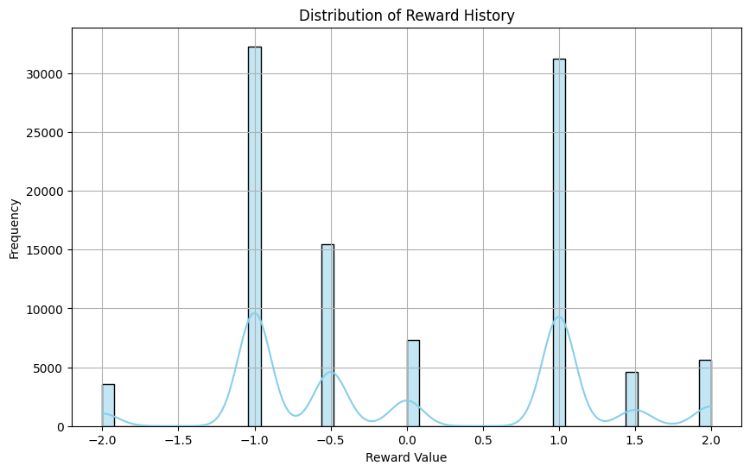
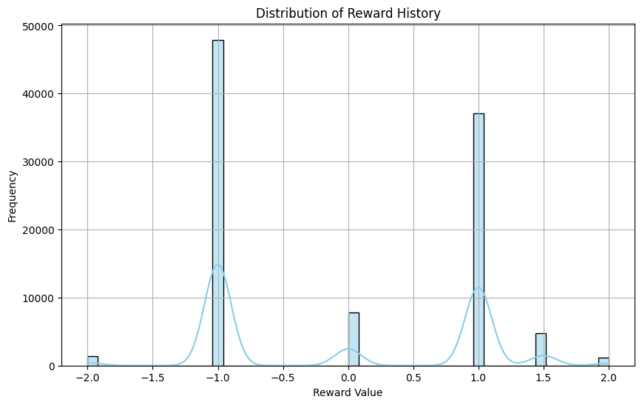
PPO vs Original GRPO Distribution of rewards
PPO
GRPO

Slide 52


DAPO Loss Integration
To further boost exploration and handle long sequences, we replaced GRPO’s objective with the DAPO loss in which:
GRPO with DAPO loss was faster and achieved the highest win rate (44.39%), though its average reward per bet remained below the PPO

Slide 53
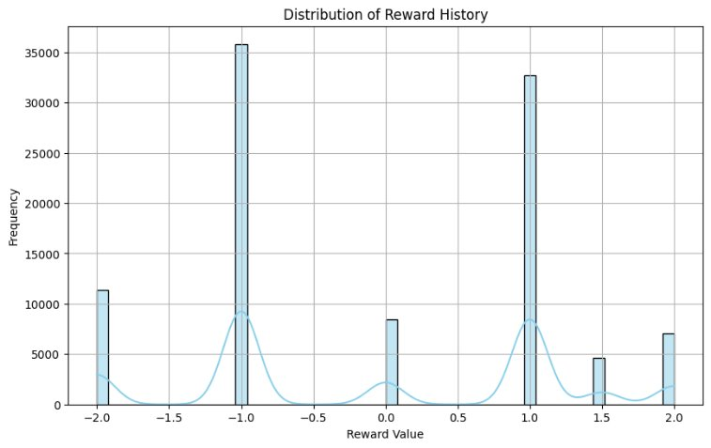
Original GRPO vs GRPO with DAPO Loss Distribution of rewards
Based on the distribution, we can clearly see that the number of Double-down actions have increased significantly compared to the original GRPO model distribution causing +2 rewards to go up
GRPO with DAPO loss function
Original GRPO

Slide 54
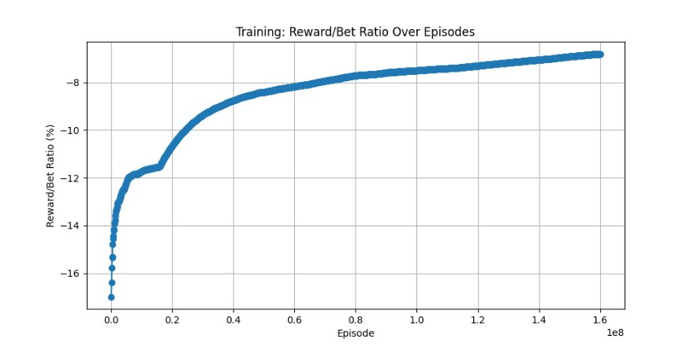
Training results for GRPO with DAPO Loss
The GRPO agent was trained with the following hyperparameters: batch_size = 64 , num_epochs = 10 , num_episodes = 20_000_000 , G = 8, miu = 2, epsilon = 0.2, beta = 0.04, learning rate: cosine schedule with min = 1 × 10−7, max = 1 × 10−4

Slide 55
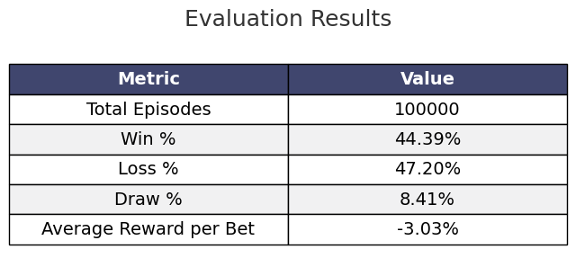
Evaluation results for GRPO with DAPO Loss
DAPO-trained GRPO was faster and achieved the highest win rate (44.39%), though its average reward per bet remained below the PPO

Slide 56
Web Application for the Extended Blackjack Environment with Card Counting
For the simple and extended Blackjack environments, the limited number of unique states allowed us to generate complete strategy charts. However, the card-counting environment has approximately 42.8 billion possible states, making a full chart infeasible. Instead, we built a web-based assistant to advise players on the optimal action for any given state
Access the live demo at https://blackjack-beta-kohl.vercel.app/

Slide 57
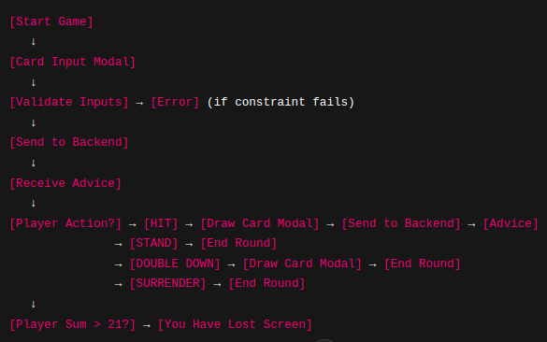
Web Application Decision Flow

Slide 58
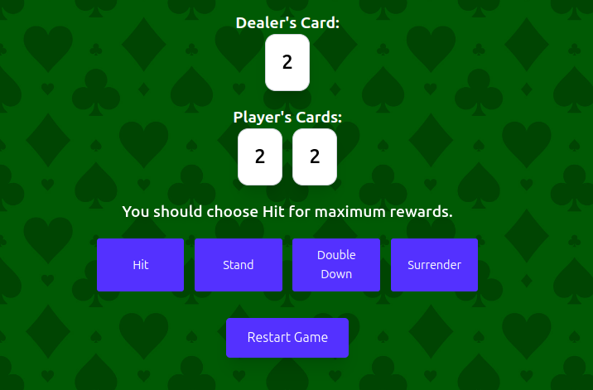
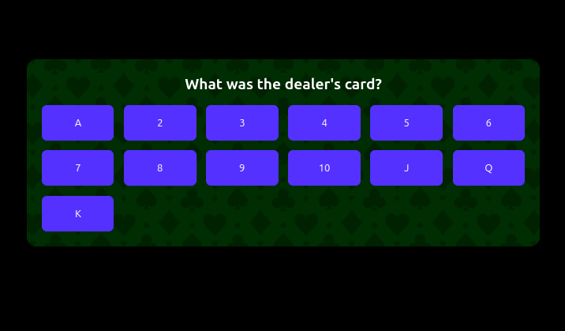
WebApp Interface Images
Main page
Modal

Slide 59
Implementation Details
Frontend: Built with React and styled using Tailwind CSS v4.0.
Backend: Developed with FastAPI.
Deployment: Frontend hosted on Vercel and Backend hosted on Hugging Face Spaces (16 GB RAM free tier), since Render’s 512 MB limit was insufficient for loading the 1 GB+ model
Styling Fixes: Some Tailwind classes did not apply in production; custom utility classes were created to restore desired styles
Cold Start Delay: Since I have deployed the backend on Hugging Face Spaces’ free tier, it takes a few minutes to reload the model into the server’s RAM. This is because after a few hours of inactivity, the backend server removes the code from RAM

Slide 60
Conclusion
Code, results, and trained model weights for all agents are available at: https://github.com/JaishreeramCoder/blackjack
GPU vs. CPU: For our relatively small two-layer networks in PPO and GRPO, GPU acceleration did not yield appreciable speedups or performance benefits over CPU
Catastrophic Forgetting: As with supervised learning, excessive training episodes can lead to overfitting and forgetting of earlier learned behaviors. Careful tuning of the number of episodes is necessary to avoid performance degradation
Simple and Extended (No Card Counting) Environments: Monte Carlo and PPO achieved nearly identical win rates and average rewards per bet. Monte Carlo converged in about 30 minutes (flattened training curves), whereas PPO required 11 hours and showed no gains after an extra 20 000 000 timesteps (cosine LR from 10−6 to 10−7 ). Thus, traditional Monte Carlo is the more efficient choice in these settings
Extended Environment with Card Counting: The DAPO-trained GRPO agent achieved the highest win rate (44.39%), while PPO obtained the best average reward per bet (2.36%). • GRPO Implementation Challenges:
There is currently no GRPO implementation for Gymnasium-based environments (e.g., card-counting Blackjack) in Stable Baselines or similar libraries. Consequently, I implemented pipeline for GRPO algorithm and its derivatives from scratch for our case. Note that the GRPOTrainer in the TRL library is tailored for LLM fine-tuning and cannot be applied to Gymnasium environments.

Slide 61
Future Work
Stepwise GRPO Updates: Develop a stepwise version of Group Relative Policy Optimization that performs policy updates at every timestep—analogous to the timestep-based update in Stable Baselines’ PPO, rather than waiting for episode termination.
ILQL for Blackjack: Implement and evaluate Implicit Language Q-Learning(ILQL) on the various Blackjack environments, including the card-counting variant, as no prior work has applied ILQL to this domain.
Extension to Bridge: Adapt and benchmark all implemented RL algorithms (Monte Carlo, PPO, GRPO, DAPO) in a Bridge game environment to investigate generalization to more complex, multi-agent card games
GRPO and ILQL for Text Summarization task: Train and evaluate ILQL and GRPO on the Text Summarization task using trl and trlX libraries

Slide 62

Thank you

