Slide 1


New Credit Card Fraud Detection System

Slide 2
Agenda
🞇 Objective
🞇 Background
🞇 Key Insights
🞇 Cost Benefit Analysis
🞇 Appendix:
Data Attributes
Data Methodology
Attached Files

Slide 3
Objective
🞇 Getting in place a credit card fraud detection system to save on incurred costs incurred
🞇 Huge costs are being incurred due to frauds and a manual detection system

Slide 4
Background
🞇 A machine learning model has been built to detect frauds early and mitigate losses
🞇 A cost benefit analysis has been done for the deployment of the same

Slide 5
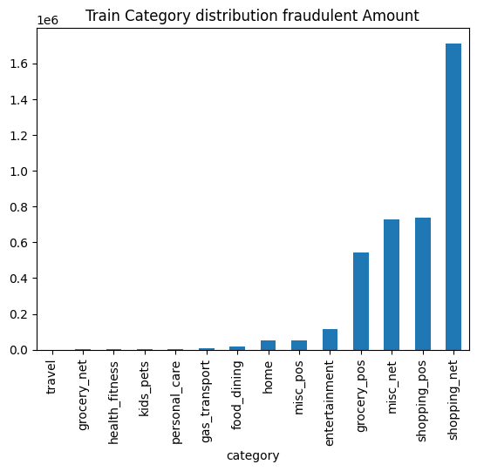
Key Insights
🞇 Transaction amount, category and gender are the most important variables
🞇 Shopping net shopping pos, misc net, grocery and entertainment are the top categories

Slide 6
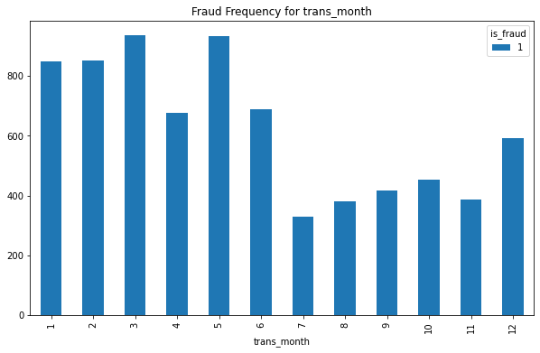
Current Incurred Losses
🞇 77,183 credit card transactions per month
🞇 626 fraudulent transactions per month
🞇 $ 531.32 amount per fraud transaction
🞇 Total costs incurred from fraud transactions is $ 3988088.61

Slide 7
After New Model Deployment
🞇 1720 fraudulent transactions detected by the model
🞇 $ 1.5 cost to provide customer support to
these transactions that is $ 2,580.38 in total
🞇 68 fraudulent transactions not detected by model which amounts to $ 35,908.09 loss
🞇 Total cost incurred after new model deployment is $ 38,488.46
🞇 Final savings after new model deployment is
$174,903.76 that is reduction in losses by ~82%

Slide 8
Appendix: Data Attributes
🞇 Snapshot of the data:
o index - Unique Identifier for each row
o o o
o o o o o o o o o o o
o o o o o o o o
transdatetrans_time - Transaction DateTime
cc_num - Credit Card Number of Customer
merchant - Merchant Name
category - Category of Merchant
amt - Amount of Transaction
first - First Name of Credit Card Holder
last - Last Name of Credit Card Holder
gender - Gender of Credit Card Holder
street - Street Address of Credit Card Holder
city - City of Credit Card Holder
state - State of Credit Card Holder
zip - Zip of Credit Card Holder
lat - Latitude Location of Credit Card Holder
long - Longitude Location of Credit Card Holder
city_pop - Credit Card Holder's City Population
job - Job of Credit Card Holder
dob - Date of Birth of Credit Card Holder
trans_num - Transaction Number
unix_time - UNIX Time of transaction
merch_lat - Latitude Location of Merchant
merch_long - Longitude Location of Merchant
is_fraud - Fraud Flag <--- Target Class

Slide 9
Appendix: Data Methodology
🞇 A random forest classifier built on top a Kaggle simulated dataset
🞇 Class imbalance adjusted using Adaptive Synthetic (ADASYN) sampling method
🞇 Manual hyperparameter tuning done due to extensive computational times when using Grid Search Cross Validation

