Slide 1
SALES DATASET ANALYSIS
JAISURYA R
16-12-2024
DA&DS
OCT 24

Slide 2

Project Overview & Objectives
Project Objectives:
Organize, analyze, and visualize data effectively,
enabling insightful decision-making.
Goals:
Analyze sales trends over time.
Identify high-performing products and sales channels.
Create a dynamic dashboard with key metrics.

Slide 3
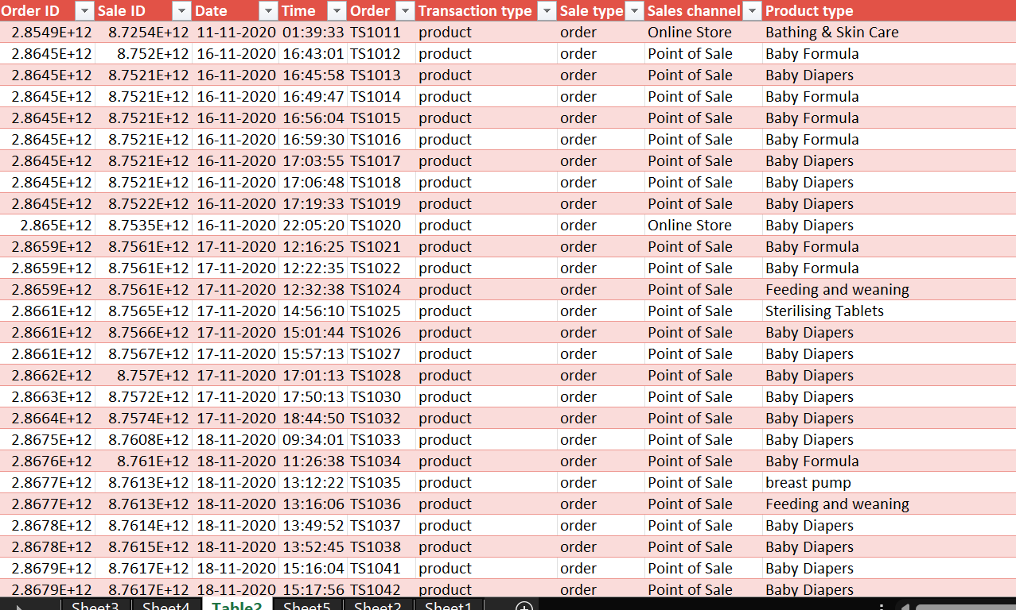
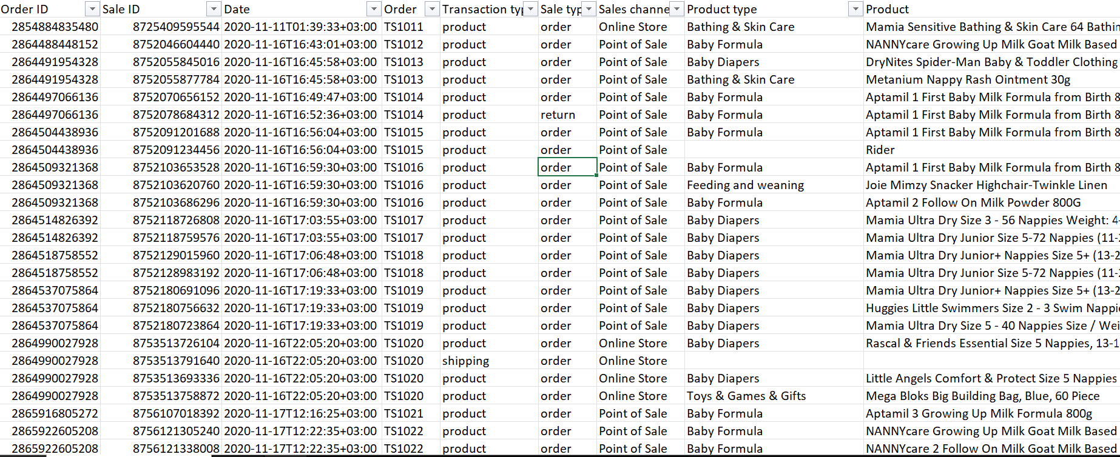
Data description & Preparation
Data Overview
Data Cleaning Process

Slide 4
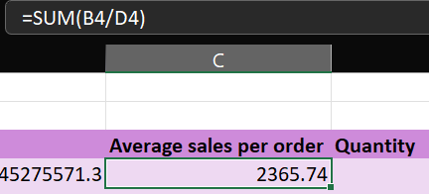
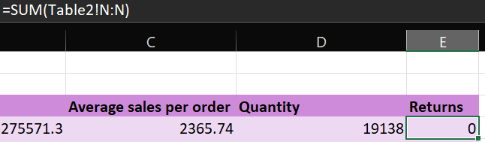
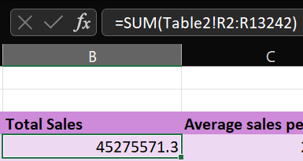
Key Metrics Calculations
Important Calculations:
Total Sales
Average Sales per Order
Discount Rates , Return Rates

Slide 5
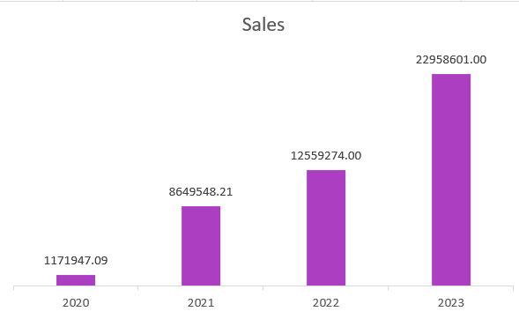
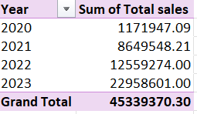
Pivot Tables and Pivot Charts
Pivot Table Summary
Pivot Chart Visualizations

Slide 6
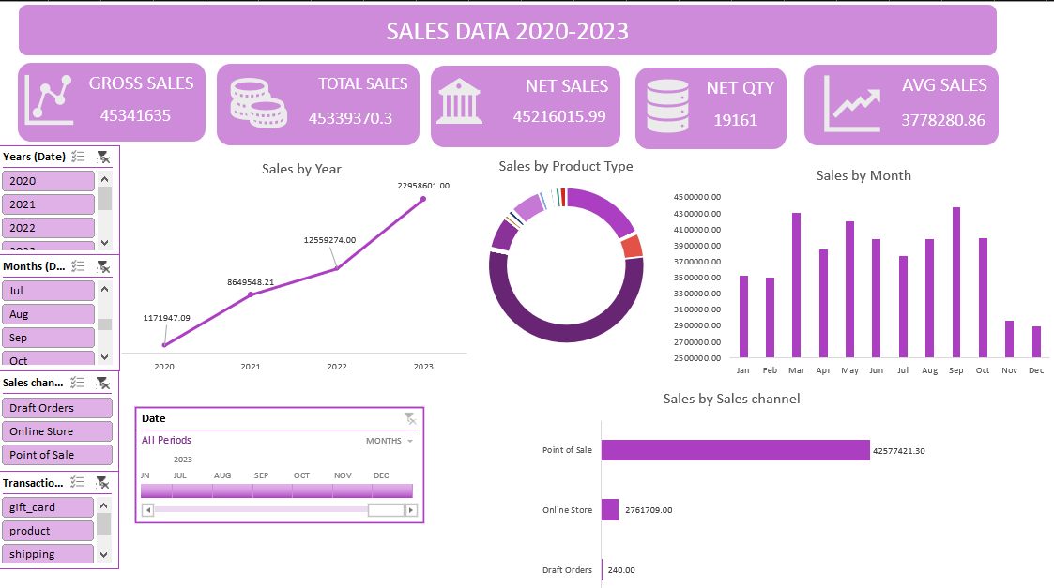
Dashboard Overview
Dashboard Design:
KPI
Slicers
Charts

Slide 7
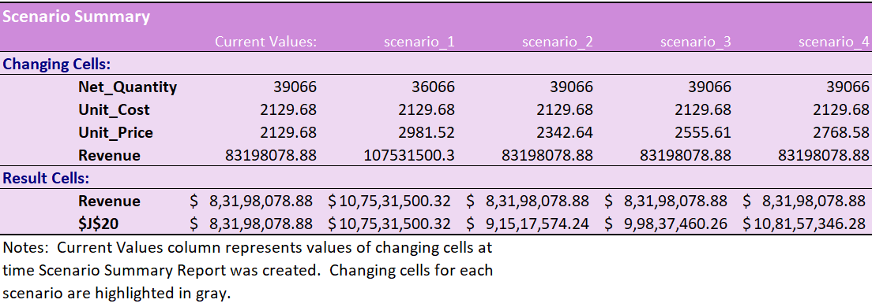
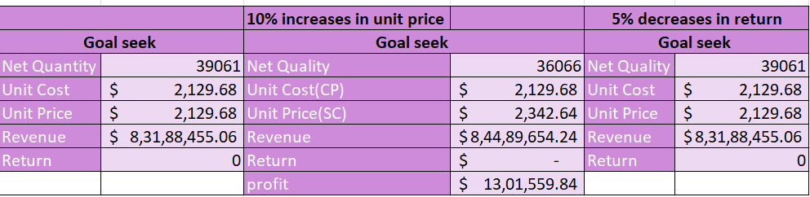
What-If Analysis & Goal Seek
What-If Scenarios
Goal Seek

Slide 8
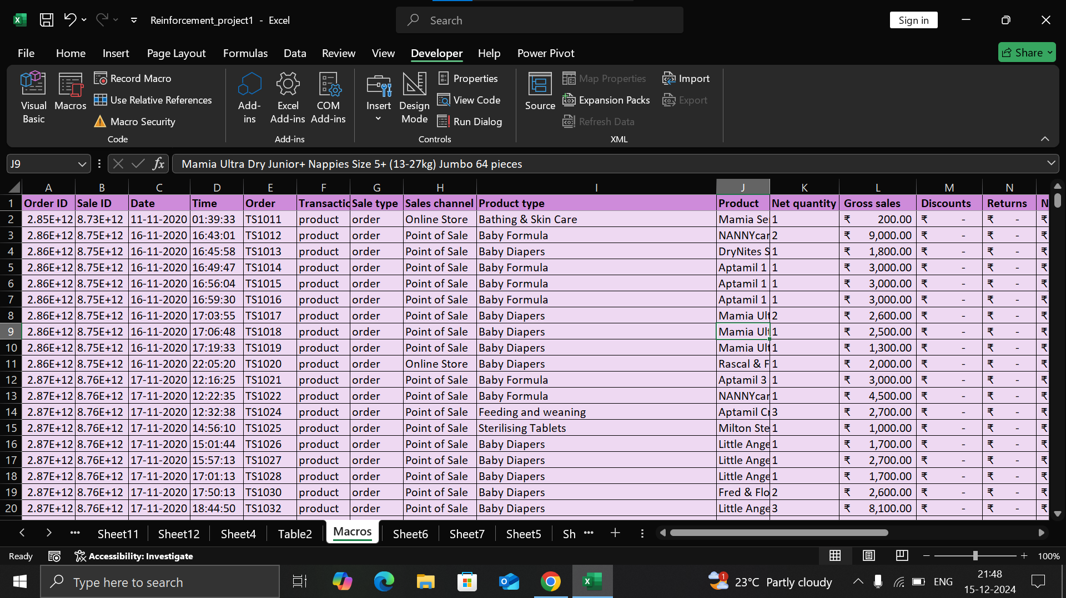
Macros and Automation
Macros Recording
Automation Benefits

Slide 9
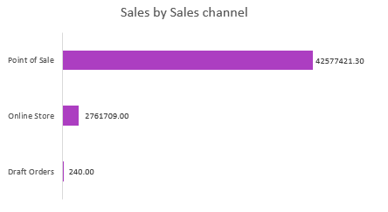
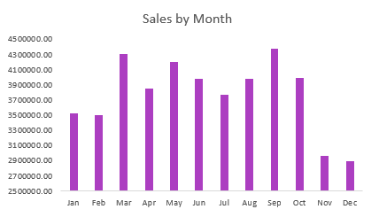
Insights and Recommendations
Key Insights:
Peak sales period 2023
Sales Channels-Point of sale
Focus on Online Store , Draft Orders

Slide 10
Conclusion
Focus on Draft Orders
Need to Improve in November and December months.
Baby Formula as the top-selling product with feeding and weaning products.
Top sales in September, with consistent year-over-year growth.

Slide 11
THANK YOU

