Slide 1
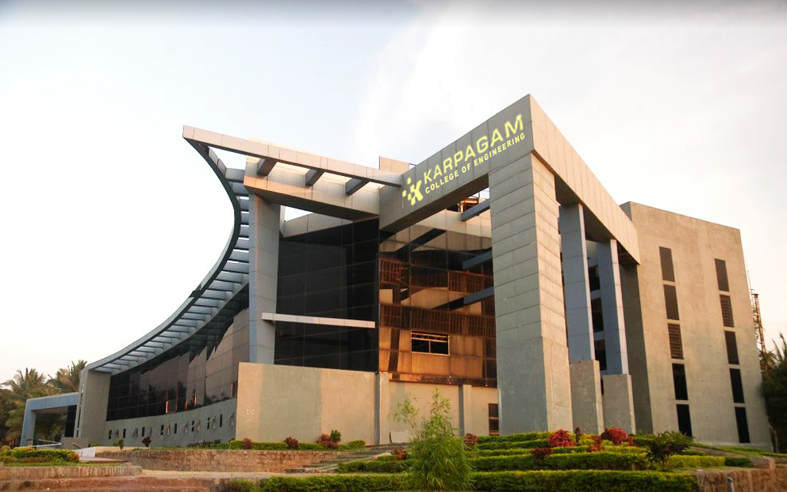

Course code/Title: 23ADR304 ARTIFICIAL INTELLIGENCE
Department of Computer Science and Engineering
EVAL AI : AUTONOMOUS RESUME ANALYZER &
AI INTERVIEW AGENT
TEAM : DEBUG DUO
Jai Surya.S (717824P120)
Karthikeyan.B (717824P124)
Mentor Name: Dr.J.Jasmine ASP/CS

Slide 2
AGENDA
1. Project Title & Vision
2. Abstract
3. Introduction & Problem Statement
4. System Architecture & Workflow
5. Literature Review & Methodology
6. Technology Stack & Tools Used
7. Design & Implementation (ML + GenAI)
8. Key Features & Industry Use Cases
9. Model Evaluation & Performance Metrics
10. Conclusion & Future Scope

Slide 3
TITLE
EVAL AI: RESUME ANALYZER, SUPERVISED ML
SUITABILITY PREDICTOR & AI INTERVIEW AGENT

Slide 4

ABSTRACT
EVAL AI is an enterprise-grade autonomous recruitment and talent evaluation system integrating Supervised Machine Learning and Generative AI. The platform performs multi-format resume parsing (PDF, DOCX, ZIP batch), extracts structured skill and experience vectors, and utilizes a trained Random Forest Classifier (120 estimators, max depth=9) to compute deterministic candidate-to-job suitability classifications and probability scores.
Suitable candidates are routed to an adaptive 4-round interview simulation (Quantitative Aptitude, Domain Technical MCQs, Architecture Scenarios, and Spoken Voice Assessment) powered by Groq LLMs with real-time MediaPipe biometric proctoring, automated scoring, and comprehensive PDF dossier generation.
EVAL AI is an enterprise-grade autonomous recruitment and talent evaluation system integrating Supervised Machine Learning and Generative AI. The platform performs multi-format resume parsing (PDF, DOCX, ZIP batch), extracts structured skill and experience vectors, and utilizes a trained Random Forest Classifier (120 estimators, max depth=9) to compute deterministic candidate-to-job suitability classifications and probability scores.
Suitable candidates are routed to an adaptive 4-round interview simulation (Quantitative Aptitude, Domain Technical MCQs, Architecture Scenarios, and Spoken Voice Assessment) powered by Groq LLMs with real-time MediaPipe biometric proctoring, automated scoring, and comprehensive PDF dossier generation.

Slide 5
INTRODUCTION
In contemporary talent acquisition, screening high-volume applicant pipelines manually or with static keyword-based ATS filters results in significant false positives, high operational latency, and lack of objective skill verification. Furthermore, relying purely on GenAI for scoring introduces hallucinations and non-deterministic decision boundaries.
EVAL AI solves this through a dual-engine architecture:
- Supervised ML Classifier: Evaluates an 11-dimensional numerical feature vector (skill match ratio, project density, experience, certifications) for transparent suitability prediction.
- GenAI Interview Agent: Conducts dynamic multi-round technical and behavioral assessments calibrated to candidate competency profiles and identified skill gaps.

Slide 6
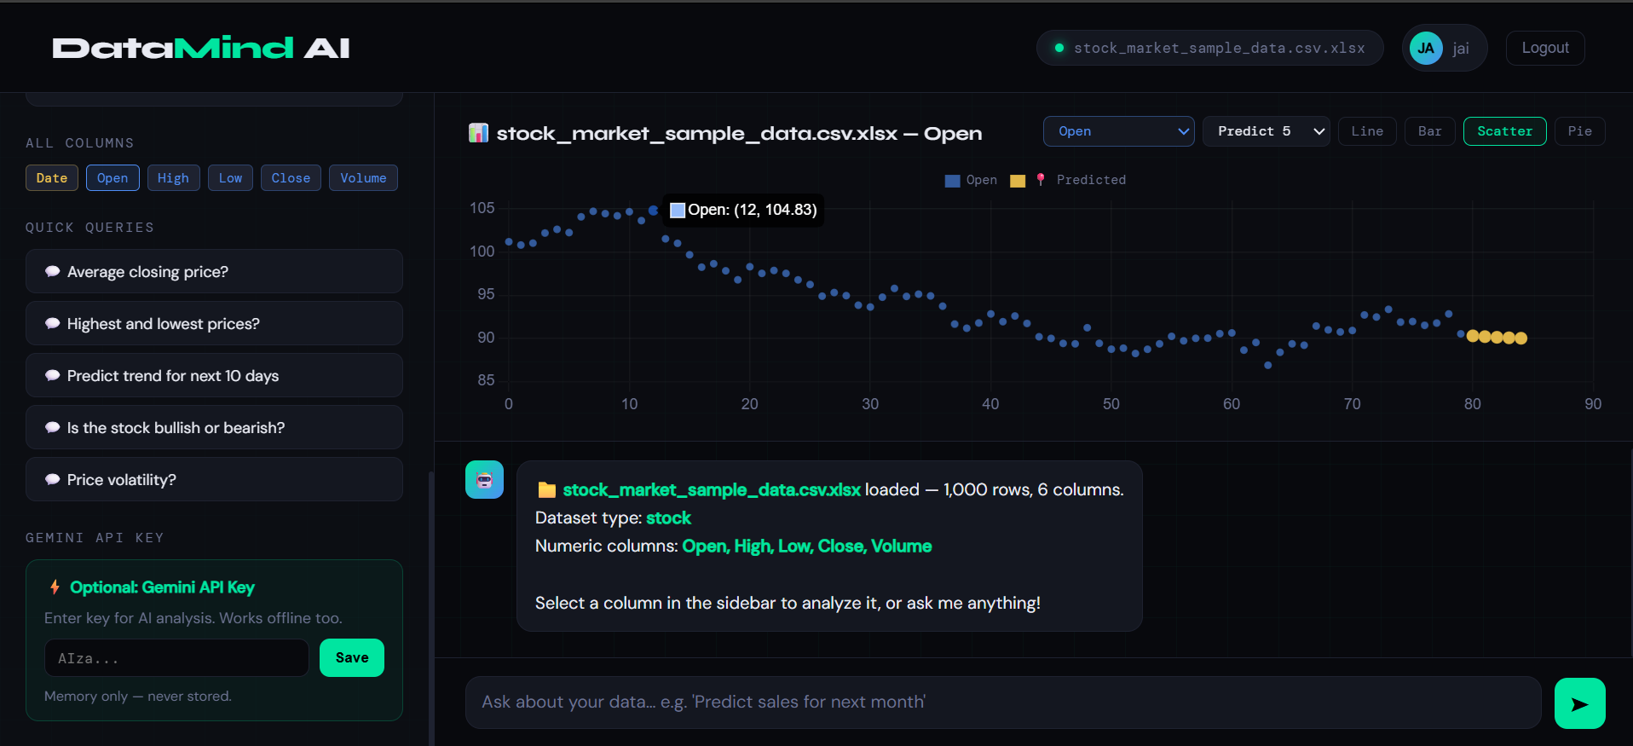
SYSTEM OVERVIEW
The proposed system follows a modular, reactive multi-tier architecture:
1. Document Ingestion Tier: High-throughput batch ZIP/PDF extraction with OCR fallback and structured JSON tokenization.
2. Supervised ML Tier (FastAPI): 11-feature mathematical extraction pipeline invoking a trained Random Forest model (89.75% test accuracy) for deterministic suitability probability.
3. GenAI Assessment Engine: 4-round dynamic interview engine (Quantitative Aptitude, Domain MCQs, Architecture Scenarios, and Web Speech API Voice Evaluation).
4. Anti-Malpractice Proctoring: MediaPipe facial biometric tracking, yaw/pitch pose estimation, multi-face alerts, and tab-switch detection.
5. Enterprise Core (Spring Boot + React): Java 21 JPA persistence, candidate ranking, and instant PDF dossier synthesis.

Slide 7
LITERATURE REVIEW
1. Resume Feature Extraction & NLP: Traditional TF-IDF keyword matching fails to capture semantic synonyms and contextual depth. Modern entity extraction combined with structured taxonomies drastically improves feature vector representations.
2. Ensemble Machine Learning in Hiring: Supervised ensemble algorithms (such as Random Forest Classifiers) provide non-linear decision boundaries, robust handling of multi-modal features, and Mean Decrease in Impurity (MDI) feature importance rankings without black-box opacity.
3. Adaptive Conversational AI in Interviewing: Large Language Models (LLMs) enable contextual, multi-turn technical dialogues and automated code/architecture critique, surpassing static questionnaire banks.

Slide 8
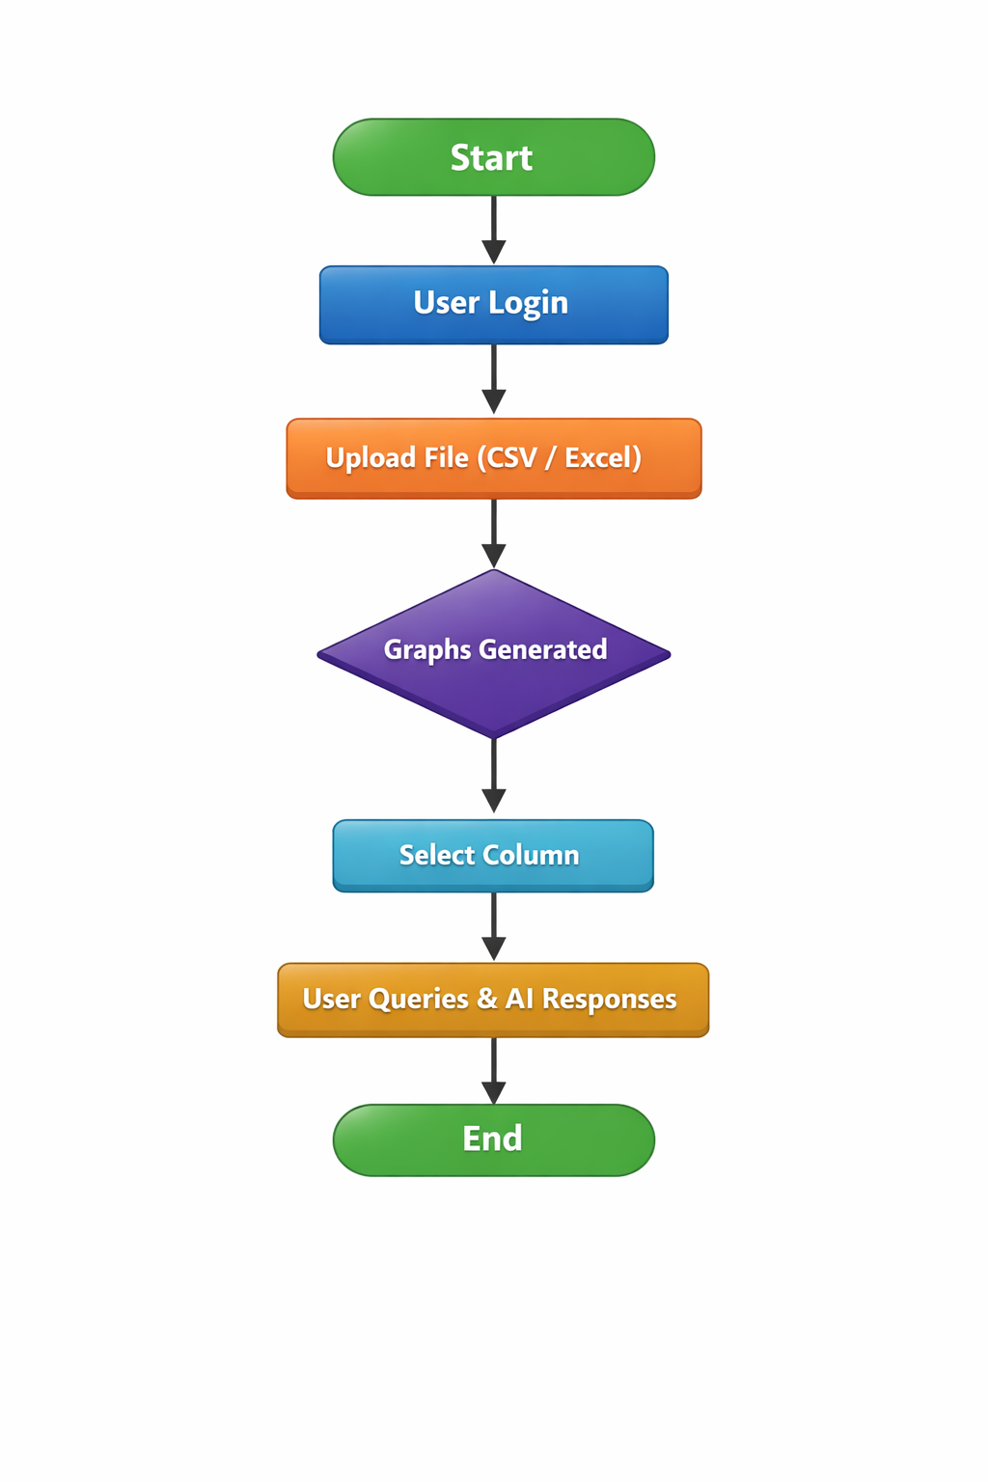
TOOLS USED:
• FRONTEND: React.js (Vite), Royal Dark Glassmorphism UI, Lucide Icons, Canvas Radar Charts.
• BACKEND: Spring Boot 3 (Java 21), Spring Data JPA, Oracle / H2 Database, Apache PDFBox, Apache POI.
• MACHINE LEARNING: Python 3.11, scikit-learn (RandomForestClassifier), Pandas, NumPy, Joblib, FastAPI, Uvicorn.
• GENAI & NLP: Groq Cloud API (Llama 3.3, Qwen 2.5), Web Speech API (Voice-to-Text).
• AI PROCTORING: MediaPipe Face Mesh, Live WebCam Biometrics & Tab Tracking.

Slide 9
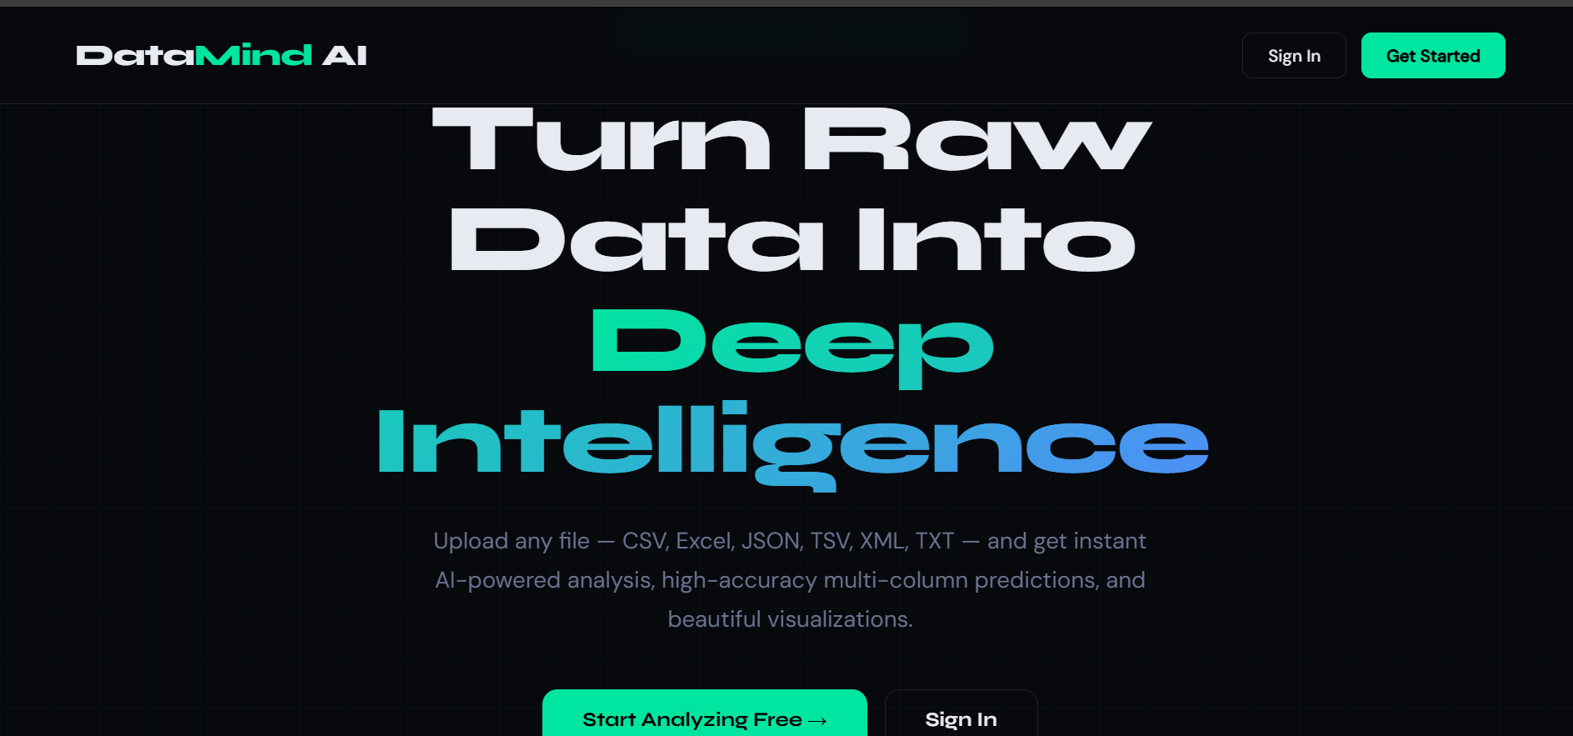
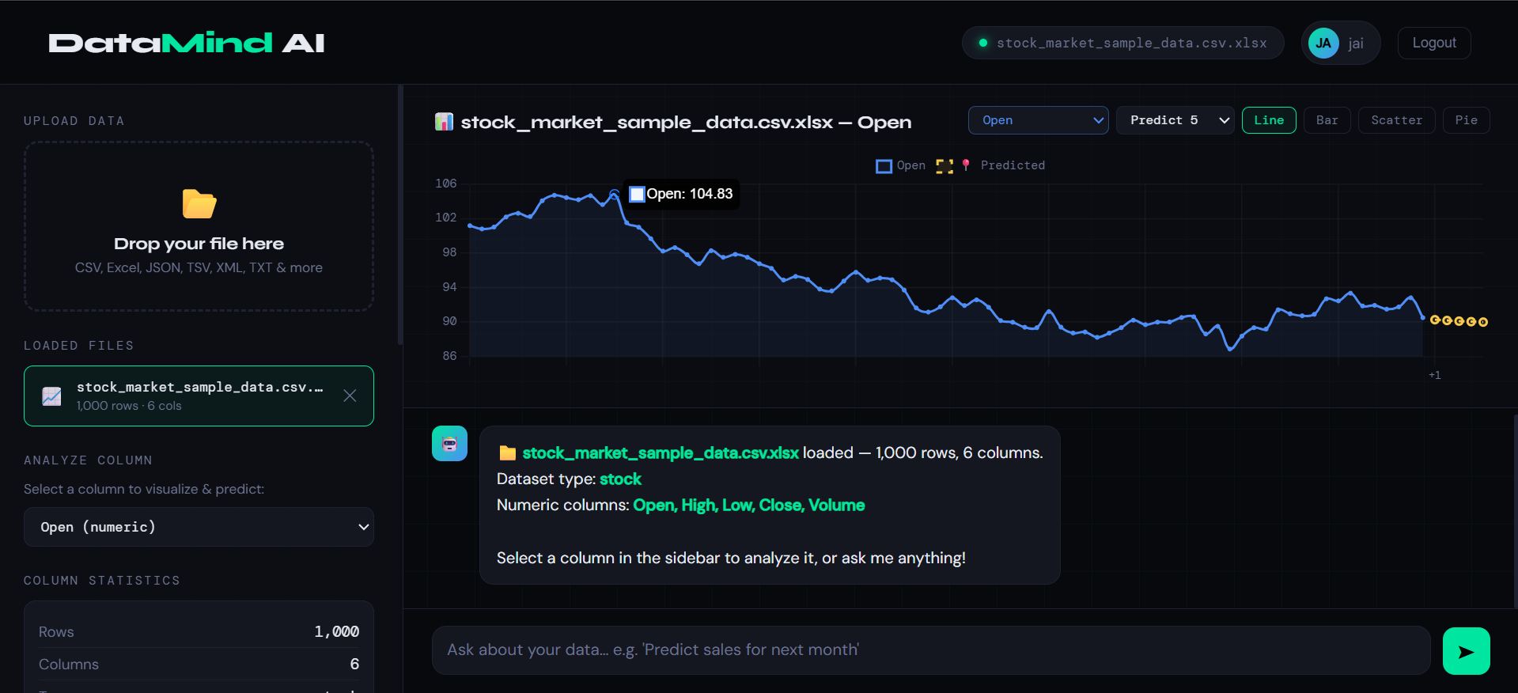
DESIGN AND IMPLEMENTATION ARCHITECTURE
Phase 1: Resume Parsing & Feature Extraction
- Multi-format PDF/DOCX parsed into structured JSON profile (skills, projects, experience).
- Extracted 11-dimensional numerical feature vector.
Phase 2: Supervised ML Suitability Classification
- RandomForestClassifier (n_estimators=120, max_depth=9, random_state=42).
- Returns binary classification (Suitable / Not Suitable) and probability score.
- Computes MDI feature importance rankings and identifies missing skill gaps.
Phase 3: 4-Round Adaptive AI Interview Simulation
- Round 1: Quantitative Aptitude & Logical Reasoning.
- Round 2: Domain Technical MCQs (Contextualized by ML suitability output).
- Round 3: Practical Architecture & Scenario Design.
- Round 4: Voice Speech & Linguistic Competency Evaluation.
Phase 4: Multi-Tier Assessment Dossier & Ranking
- Real-time biometric proctoring tracking (MediaPipe Face Mesh).
- Instant candidate dossier generation & PDF report synthesis.

Slide 10

USE CASES:
• Automated Campus Recruitment & Bulk ZIP Batch Processing
• Objective Role-Specific Candidate Suitability Shortlisting
• Supervised ML Skill Gap Analysis & Technical Profiling
• AI-Proctored Remote Screening & Integrity Verification
• Adaptive Multi-Round Technical Interview Simulation
• Voice Articulation & Linguistic Proficiency Assessment
• Instant Candidate PDF Dossier & Executive Report Generation
• Real-Time Recruiter Analytics & Cohort Leaderboard Tracking
.

Slide 11
CONCLUSION
EVAL AI successfully establishes a scalable, fair, and mathematically grounded recruitment automation platform.
• Separation of Concerns: Machine Learning handles deterministic numerical prediction and feature importances, while Generative AI powers interactive interview simulation and language critique.
• High Evaluation Precision: The Random Forest model delivers 89.75% test accuracy, 92.61% precision, and 90.17% F1-score on realistic hiring benchmarks.
• Integrity-First Evaluation: MediaPipe live face tracking and tab monitoring ensure fair, cheat-resilient remote assessments.
• End-to-End Automation: Reduces technical hiring triage cycles from days to minutes while delivering rich, verifiable candidate dossiers.
.

Slide 12
THANK YOU
EVAL AI: Autonomous Talent Assessment & ML Prediction Platform
Questions & Discussion

