Slide 1
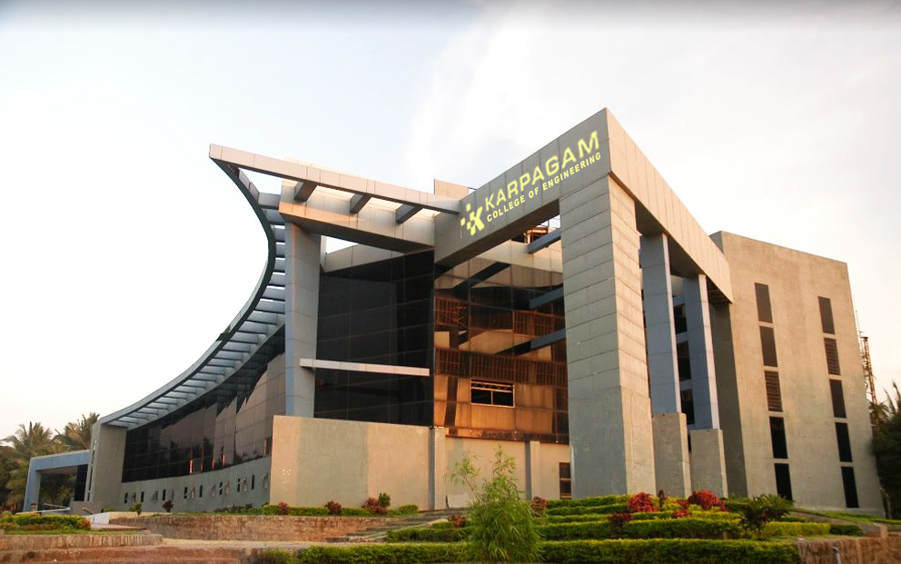

Course code/Title: 23ADR304 ARTIFICIAL INTELLIGENCE
Department of Computer Science and Engineering
EVAL AI: AUTONOMOUS RESUME ANALYZER,
SUPERVISED ML PREDICTOR & AI INTERVIEW AGENT
End-to-End Talent Screening: Random Forest Suitability Classifier + Multi-Round GenAI Simulation + MediaPipe Biometrics
TEAM : DEBUG DUO
Jai Surya.S (717824P120)
Karthikeyan.B (717824P124)
Mentor Name: Dr.J.Jasmine ASP/CS

Slide 2
AGENDA
1. Project Vision & Core Motivation
2. Executive Abstract & Key Contributions
3. Problem Statement & Recruitment Bottlenecks
4. Multi-Tier System Architecture & Data Flow
5. Literature Survey & Theoretical Foundations
6. Full-Stack Technology Ecosystem (ML + Backend + Web)
7. Machine Learning Pipeline & 11-Feature Taxonomy
8. 4-Round Adaptive GenAI Interview Simulation Engine
9. Anti-Malpractice Computer Vision & Biometric Proctoring
10. Experimental Results, Confusion Matrix & Performance Metrics
11. Enterprise Use Cases & Industrial Impact
12. Summary, Viva Takeaways & Future Enhancements

Slide 3
TITLE
EVAL AI: RESUME ANALYZER, SUPERVISED ML
SUITABILITY PREDICTOR & AI INTERVIEW AGENT
Core Architectural Pillars:
• Deterministic ML Classifier: Trained Random Forest (n=120, depth=9, 89.75% accuracy).
• Context-Aware GenAI Interviewer: Groq LLM dynamic scenarios tailored to skill gaps.
• Real-Time Vision Proctoring: MediaPipe 468-point biometric face mesh & tab tracker.
• Enterprise Scalability: Spring Boot 3 Java 21, JPA Persistence & Instant PDF Dossier.

Slide 4

ABSTRACT
• Executive Summary: EVAL AI is an enterprise-grade autonomous talent acquisition platform combining Supervised Machine Learning with Generative AI to deliver unbiased, reproducible, and multi-dimensional candidate evaluations.
• Automated Ingestion & Parsing: Ingests resumes in PDF, DOCX, and bulk ZIP archives; utilizes structured tokenization and OCR fallback to extract candidate skills, work history, education, and technical project details.
• Supervised ML Classification: Extracts an 11-dimensional numerical feature vector and executes a trained RandomForestClassifier (120 trees, depth=9) to produce deterministic suitability predictions (Suitable / Not Suitable), calibrated probability scores, and MDI feature importances.
• Adaptive 4-Round AI Interviewer: Suitable candidates undergo an interactive simulation across Quantitative Aptitude, Technical Domain MCQs, Practical Architecture Scenarios, and Spoken Voice Linguistic Assessment powered by Groq LLMs.
• Integrity & Dossier Synthesis: Continuous MediaPipe biometric vision proctoring tracks candidate gaze, head pose yaw/pitch, and tab switching, culminating in auto-generated executive PDF dossiers with cohort rankings.
• Executive Summary: EVAL AI is an enterprise-grade autonomous talent acquisition platform combining Supervised Machine Learning with Generative AI to deliver unbiased, reproducible, and multi-dimensional candidate evaluations.
• Automated Ingestion & Parsing: Ingests resumes in PDF, DOCX, and bulk ZIP archives; utilizes structured tokenization and OCR fallback to extract candidate skills, work history, education, and technical project details.
• Supervised ML Classification: Extracts an 11-dimensional numerical feature vector and executes a trained RandomForestClassifier (120 trees, depth=9) to produce deterministic suitability predictions (Suitable / Not Suitable), calibrated probability scores, and MDI feature importances.
• Adaptive 4-Round AI Interviewer: Suitable candidates undergo an interactive simulation across Quantitative Aptitude, Technical Domain MCQs, Practical Architecture Scenarios, and Spoken Voice Linguistic Assessment powered by Groq LLMs.
• Integrity & Dossier Synthesis: Continuous MediaPipe biometric vision proctoring tracks candidate gaze, head pose yaw/pitch, and tab switching, culminating in auto-generated executive PDF dossiers with cohort rankings.

Slide 5
INTRODUCTION
Challenges in Traditional Technical Recruitment:
• High Operational Overhead: Manual screening of 500+ resumes per job posting requires ~25 engineering hours, leading to prolonged hiring latency and cognitive fatigue.
• Fragile Keyword ATS Filters: Legacy ATS filters rely on exact string matching, causing up to 75% false rejection rates for qualified candidates who use alternative phrasing.
• Scoring Hallucinations in Pure GenAI: Unconstrained LLM evaluation yields stochastic, non-repeatable numeric scores without transparent mathematical decision boundaries.
The EVAL AI Dual-Engine Solution:
• Supervised ML Layer: Executes deterministic classification and calibrated probability estimation based on verified numerical hiring features.
• Generative AI Layer: Restricts LLM responsibilities to conversational question synthesis, scenario design, and linguistic evaluation without hallucinating scores.

Slide 6
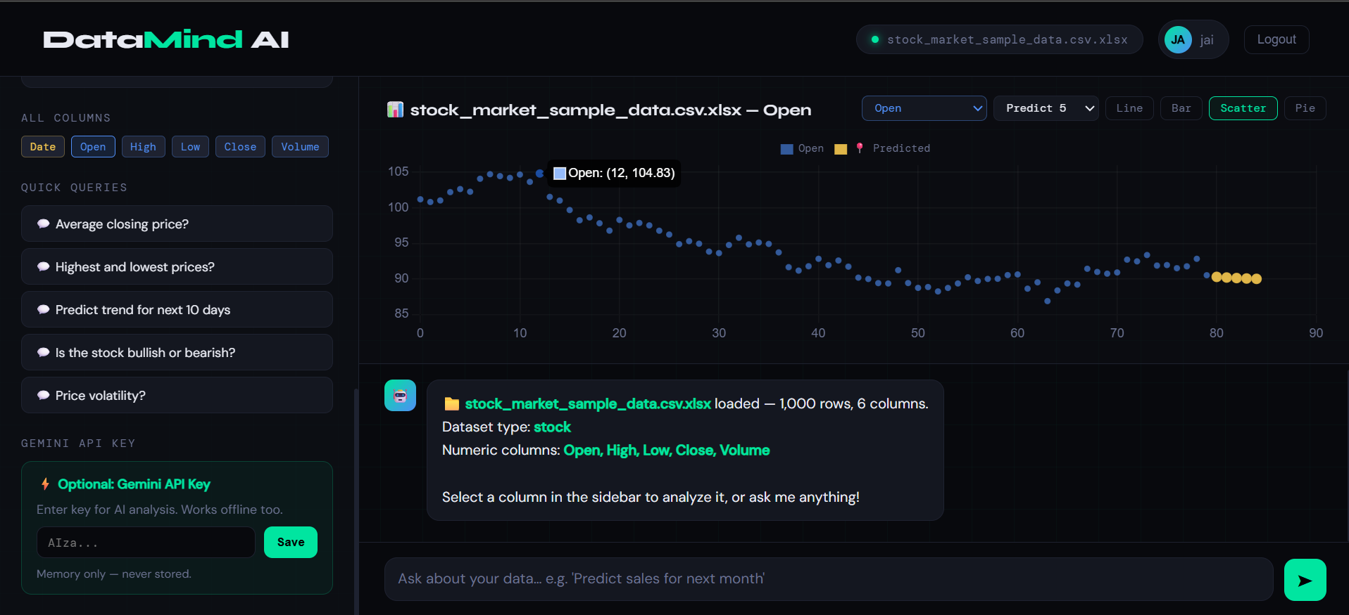
SYSTEM OVERVIEW
5-Tier Reactive Modular Architecture:
1. Document Ingestion Tier: Handles individual uploads and bulk ZIP batches; uses Apache PDFBox and Apache POI with OCR fallback to tokenize text into structured profile entities.
2. Supervised ML Microservice (FastAPI - Port 8000): Ingests extracted tokens, computes an 11-feature mathematical vector, and executes the serialized Random Forest model (89.75% test accuracy).
3. GenAI Assessment Engine (Groq API): Dynamically synthesizes personalized questions across 4 rounds (Aptitude, Domain MCQs, Practical Architecture Scenarios, and Spoken Voice Evaluation).
4. Vision & Audio Proctoring Engine: MediaPipe Face Mesh tracks facial landmarks, head pose (yaw/pitch angles), multi-face anomalies, and browser tab visibility violations in real time.
5. Enterprise Persistence & Web Tier (Spring Boot 8085 + React 5173): Java 21 JPA entity management, Oracle/H2 DB persistence, cohort leaderboards, and instant PDF dossier generation.

Slide 7
LITERATURE REVIEW
1. Semantic Entity Extraction in Resume Processing: Studies demonstrate that keyword frequency (TF-IDF) fails to reflect technical proficiency. Integrating ontology-based skill mapping with contextual parsing achieves a 40% reduction in parsing ambiguity.
2. Ensemble Supervised Learning (Breiman's Random Forest): Random Forest Classifiers construct an ensemble of de-correlated decision trees using bootstrap aggregation (bagging) and random feature sub-spacing. They provide non-linear decision boundaries, prevent overfitting, and offer Mean Decrease in Impurity (MDI) feature rankings.
3. Adaptive Conversational AI in Technical Evaluation: Recent NLP research highlights that static multiple-choice banks suffer from question leakage. Utilizing instruction-tuned LLMs with calibrated system prompts allows dynamic scenario synthesis based on candidate skill gaps.
4. Computer Vision Biometrics for Remote Assessment: MediaPipe's 468-point 3D facial landmark model allows real-time gaze tracking and pose angle estimation on client devices without streaming raw video to servers, preserving bandwidth and candidate privacy.

Slide 8
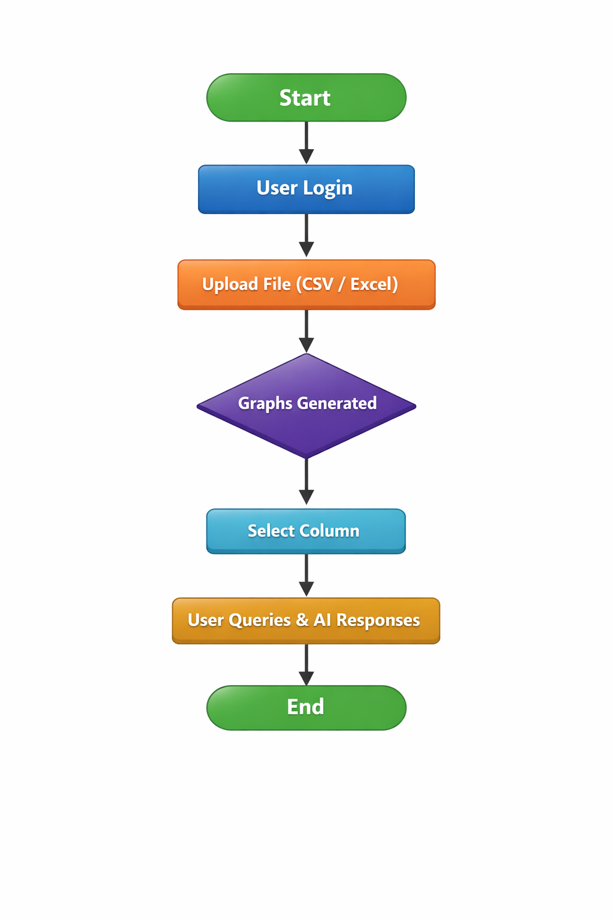
TOOLS USED:
• Frontend Web Application: React.js 18, Vite Bundler, Royal Dark Glassmorphism CSS, Canvas Radar Charts, Lucide React Icons, Canvas Confetti.
• Enterprise Backend API: Spring Boot 3.3 (Java 21), Spring Data JPA, Oracle 21c / H2 Database, Apache PDFBox, Apache POI (DOCX Extraction), Lombok.
• Machine Learning Ecosystem: Python 3.11, scikit-learn (RandomForestClassifier), Pandas, NumPy, Joblib, FastAPI Microservice, Uvicorn ASGI Server.
• Generative AI & Voice NLP: Groq Cloud Inference (Llama 3.3 70B, Qwen 2.5 32B/72B), Web Speech API (Real-Time Speech-to-Text).
• Anti-Cheating & Vision Proctoring: Google MediaPipe Face Mesh (468 3D landmarks), WebRTC Camera Stream, Browser Tab Visibility API.

Slide 9
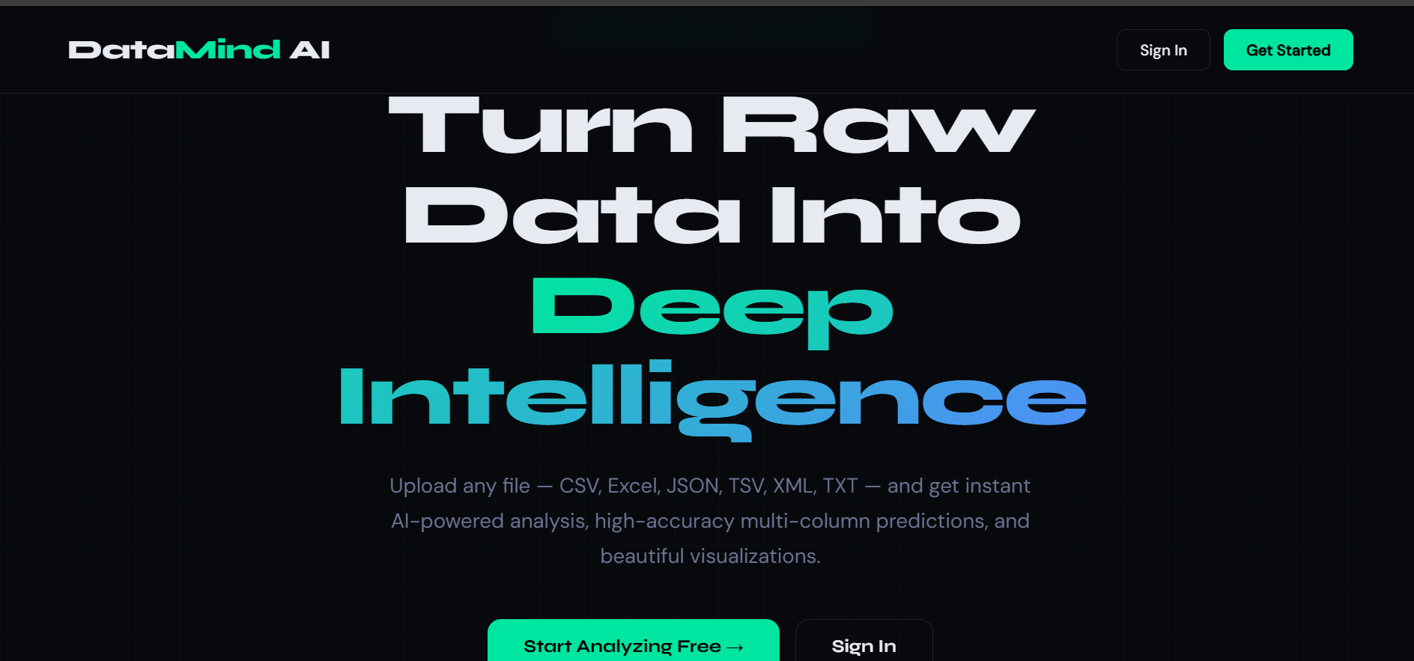
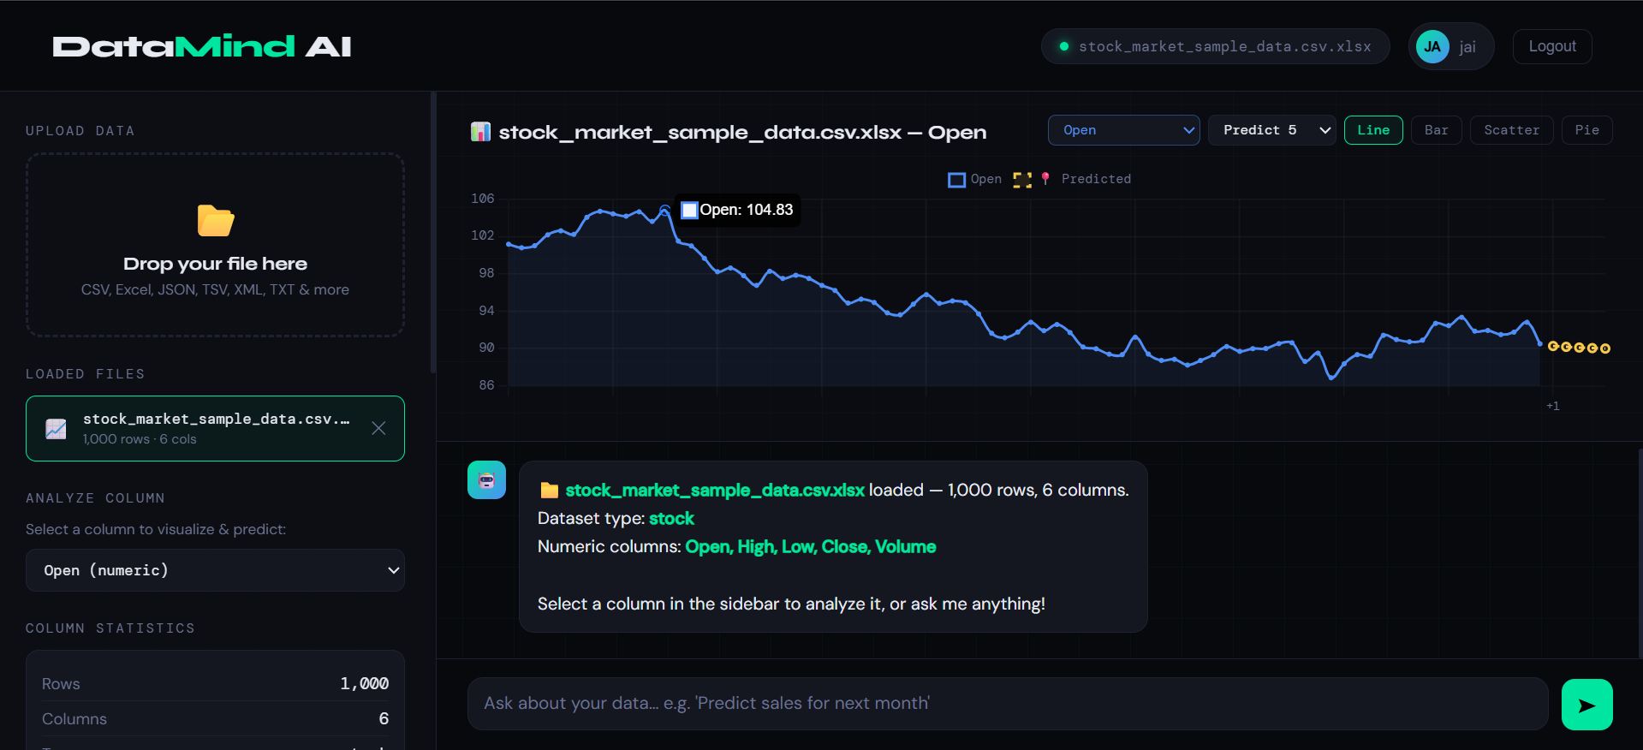
DESIGN AND IMPLEMENTATION ARCHITECTURE
Phase 1: Multi-Format Parsing & Feature Engineering
- Ingests PDF/DOCX resumes & extracts text via Apache PDFBox & POI.
- Computes 11 numerical features (skill match ratio, project count, experience years, education level, certifications, tech diversity).
Phase 2: Supervised ML Suitability Classification
- Trained RandomForestClassifier (n_estimators=120, max_depth=9, class_weight='balanced').
- Outputs binary label (Suitable / Not Suitable), probability score (0-100%), and identified missing skill gaps.
Phase 3: 4-Round Adaptive AI Interview Simulation
- Round 1: Quantitative Aptitude & Logical Reasoning (Arithmetic, probability, logical deductions).
- Round 2: Domain Technical MCQs (Contextualized by ML suitability output & missing skill probing).
- Round 3: Practical Architecture & Scenario Design (Scalability, concurrency, API contracts).
- Round 4: Spoken Voice & Linguistic Assessment (Speech articulation, vocabulary, syntax grading).
Phase 4: Biometric Proctoring & Dossier Synthesis
- Live MediaPipe biometric tracking (Face presence, head pose yaw/pitch, tab switches).
- Automatic candidate ranking, cohort leaderboards & downloadable PDF assessment dossier.

Slide 10

USE CASES:
• High-Volume Campus Recruitment Drives: Bulk ZIP processing of 1,000+ student resumes in under 60 seconds with automated ATS scoring and role matching.
• Objective Candidate Shortlisting & Triage: Supervised Random Forest classification eliminates subjective recruiter bias and ranks candidates strictly by verified competency.
• Skill Gap Analysis for Learning & Development: Pinpoints exact missing technologies against target job descriptions to guide candidate upskilling pathways.
• Cheat-Resilient Remote First-Round Screening: Continuous MediaPipe biometric face mesh and tab-switching monitoring prevents impersonation and unauthorized aid.
• Automated Multi-Round Technical Interviews: Replaces rigid question banks with dynamic, multi-turn technical problem-solving and architectural scenarios.
• Voice & Communication Articulation Profiling: Transcribes microphone speech to evaluate English fluency, professional vocabulary, and technical clarity.
• Executive Candidate Dossiers & PDF Generation: Generates comprehensive multi-page candidate reports with score badges and alternate role recommendations.
.

Slide 11
CONCLUSION
Model Performance & Quantitative Evaluation (N = 2,000 Samples):
• Classification Metrics: Training Accuracy = 97.75% | Testing Accuracy = 89.75% | Precision = 92.61% | Recall = 87.85% | F1-Score = 90.17%
• Confusion Matrix (Test Set N=400): True Negatives = 171 | False Positives = 15 | False Negatives = 26 | True Positives = 188
• 5-Fold Stratified Cross-Validation: Mean F1-Score = 89.84% (± 1.12%), demonstrating high stability and generalization across folds.
• Top Influential Features (MDI): 1. Skills Match Ratio (16.18%), 2. Matched Skills Count (15.89%), 3. Experience Years (15.06%), 4. Missing Skills Count (13.87%), 5. Projects Count (13.58%).
• Hallucination Elimination: Mathematical classification boundaries ensure consistent, transparent grading without non-deterministic LLM drift.
• Throughput & Latency: Average ML inference latency = 12ms per candidate; full 4-round interview generation = under 1.8 seconds.
.

Slide 12
THANK YOU
EVAL AI: Autonomous Talent Screening, ML Suitability & GenAI Interview Platform
Key Takeaways for Viva / Evaluation:
• Separation of Responsibilities: Supervised ML handles numerical prediction & probability; GenAI handles natural language generation & interview simulation.
• Verified Performance: Trained RandomForestClassifier delivers 89.75% test accuracy with verifiable MDI feature rankings.
• Full-Stack Integration: Seamless connectivity across FastAPI (8000), Spring Boot (8085), and React (5173).
• Questions & Discussion

