Slide 1
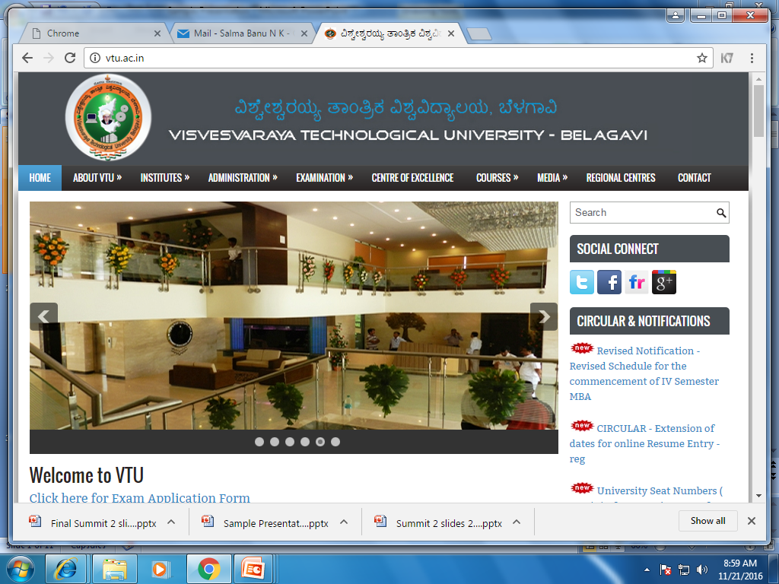
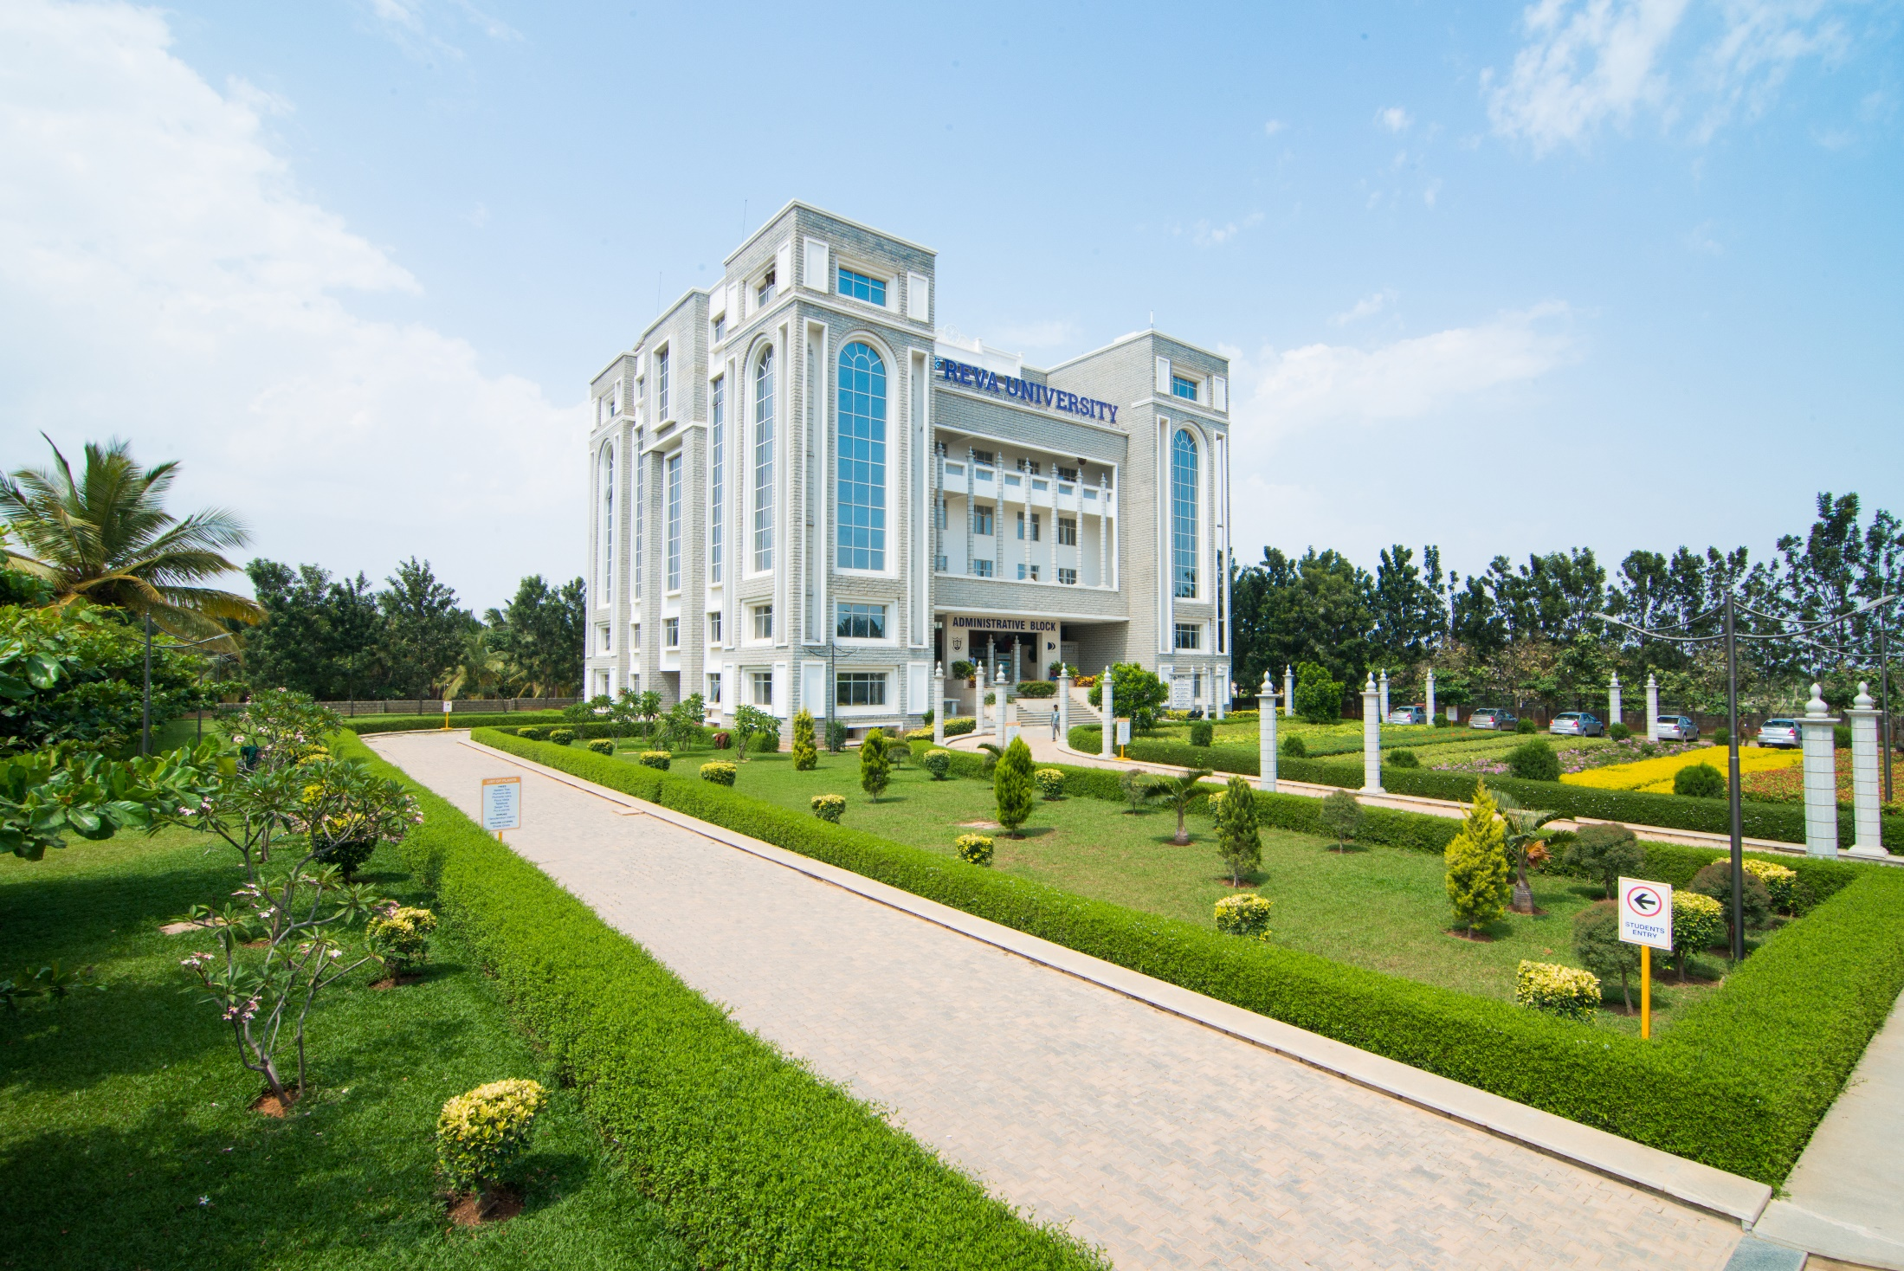
DEPARTMENT OF COMPUTER SCIENCE & ENGINEERING
REVA INSTITUTE OF TECHNOLOGY AND MANAGEMENT

Slide 2
8th Semester Project Proposal Presentation on
Unusual Event Detection in Low Resolution Video for Enhancing ATM Security

Slide 3
Unusual Event Detection in Low Resolution Video for Enhancing ATM Security
Presented By,
Sreeharsha M S
Prajwal B K
Sumanth Babu
Raghulan R
Under the Guidance of
Kiran M,
Asst. Prof.

Slide 4
Content
Abstract
Introduction
Problem Definition
Objectives of Proposed System
Hardware/Software Requirements
Methodology/ Technique to be applied
Conclusions

Slide 5
Abstract
In real world applications, tracking target in low resolution video is a challenging task because there is loss of discriminative detail and requires conversion to a higher resolution form.
This algorithm depicts a way to detect unusual events without any such conversions.
It uses morphological operation using disk like structuring element in the preprocessing steps to cope up with low resolution video.

Slide 6
It further uses background subtraction technique to detect foreground object from dynamic background in a scene.
The algorithm recognizes unusual events in low resolution video by simply using statistical property and standard deviation of objects.

Slide 7

Introduction
In the past few decades, significant efforts such as surveillance, robotics etc. have been done to make applications reliable, robust and efficient.
But there are challenges viz. dynamic background, camouflage, shadow etc.
This paper presents an algorithm which is able to detect unusual event in low resolution video to enhance the security of ATMs.

Slide 8
Problem Definition
The quality of the cameras used in ATMs are generally low and hence tracking of target becomes difficult due to loss of discriminative detail.
Enhancement of videos of such cameras using super resolution techniques require high computational cost.

Slide 9
Objective of proposed system
Unusual event detection in low resolution cameras to enhance ATM security.

Slide 10
Hardware/Software Requirement
Software Requirement:
MATLAB 7.6
Windows 7+
Hardware Requirement:
AMD Dual-Core E-450 APU
2 GB RAM

Slide 11
Methodology/ Technique to be applied
Morphological operation with disk like structuring element in the pre-processing steps to cope up with low resolution video.
Uses rolling average background subtraction technique to detect foreground object from dynamic background in a scene.
Recognition of occurrence of uncommon events simply by statistical property and standard deviation of moving objects.

Slide 12
Conclusions
This project proposes an algorithm which is able to detect unusual events in ATMs and enhance the security of the ATM.
The results show that the above algorithm is efficiently applicable on low resolution video without using super resolution techniques which require higher computational costs.
In future this can be extended to detect more uncommon events in ATMs.

