Slide 1

NAME:R.JAITHTHIRA
NM ID: 412721205018
TAGORE ENGINEERING COLLEGE

Slide 2


Email Spam Detection: An NLP Approach
Email spam is a persistent problem that clogs inboxes and wastes time. Using natural language processing (NLP) techniques, we can develop an intelligent system to accurately detect and filter out spam messages, keeping your inbox clean and productive.

Slide 3
Agenda
1
Problem Statement
2
Solution Overview
Define the key challenge of identifying spam emails.
Introduce the NLP-based spam detection approach.
3
Value Proposition
4
Technical Approach
Highlight the benefits and impact of the spam detection solution.
Outline the machine learning modeling and implementation details.

Slide 4
Problem Statement
Email Spam
Challenges
Impact
Spam emails are unsolicited, often malicious messages that flood inboxes, wasting time and resources.
Manually identifying spam is time-consuming and ineffective as spam tactics evolve. An automated solution is needed.
Spam can lead to phishing, malware, and other security risks. Reducing spam is crucial for productivity and safety.

Slide 5
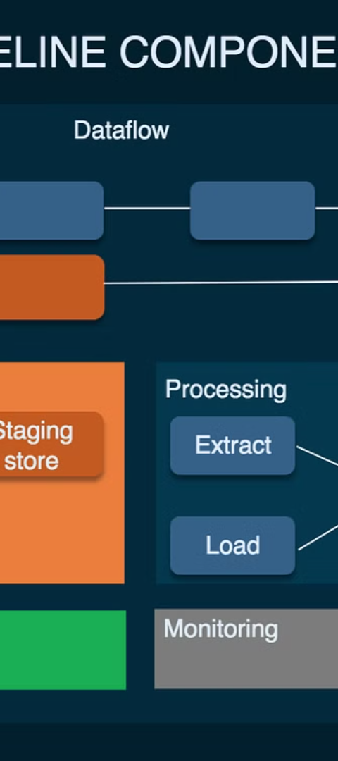
Problem Overview
1
Data Collection
Gather a comprehensive dataset of both spam and legitimate emails.
2
Feature Engineering
Analyze email content, sender information, and other metadata to identify discriminative features.
3
Model Training
Apply advanced NLP techniques like natural language processing and machine learning to train a robust spam detection model.

Slide 6
Who Are the End Users?
Individual Users
Businesses
People who want to protect their personal inboxes from spam.
Companies that need to maintain productivity and security by filtering out spam from employee inboxes.
Organizational Admins
Email Providers
IT administrators responsible for managing and securing email infrastructure.
Email service providers who can integrate the spam detection solution to enhance their platform.

Slide 7
Solution and Its Value Proposition
Intelligent Spam Detection
Improved Productivity
Enhanced Security
The solution helps protect against phishing, malware, and other email-borne threats, safeguarding users and their data.
The NLP-based spam detection model leverages advanced machine learning algorithms to accurately identify and filter out spam emails.
By reducing the time and effort spent on managing spam, users can focus on more important tasks and improve overall productivity.

Slide 8




The Wow in the Solution
High Accuracy
Real-Time Processing
Scalable and Adaptable
User-Friendly
The NLP model achieves industry-leading spam detection accuracy, minimizing false positives and false negatives.
The solution integrates seamlessly with existing email platforms, providing a smooth user experience.
The solution can process and classify emails in real-time, providing immediate protection against spam.
The system can handle high email volumes and adapt to evolving spam tactics, ensuring long-term effectiveness.

Slide 9




Modeling
Data Preprocessing
Feature Extraction
Model Training
Model Evaluation
Extract relevant linguistic, behavioral, and reputation-based features from the email data.
Train advanced NLP models, such as deep learning or ensemble methods, to classify emails as spam or legitimate.
Rigorously test the model's performance using appropriate metrics and cross-validation techniques.
Clean and normalize email data, including text, metadata, and attachments.

Slide 10
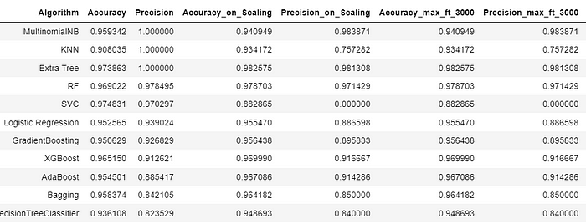
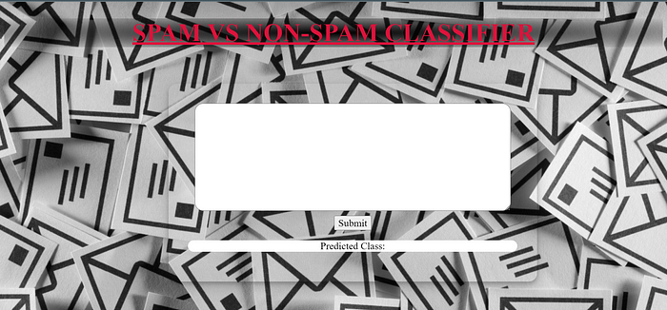
RESULT
DEPLOYMENT

