Slide 1

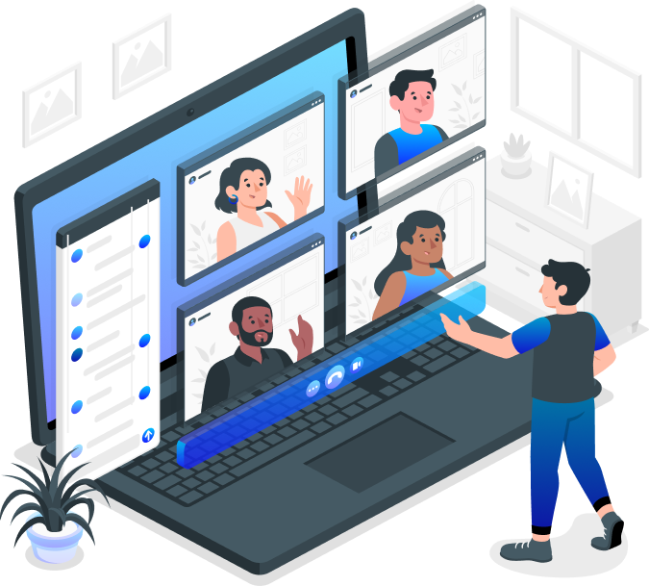

Swiggy i++ - Week 0 Case Study
Converge
Meeting Application
Ashwin Gopalsamy
swiggyb1019@datascience.manipal.edu

Slide 2

Introduction
Following the widespread of the COVID-19 Pandemic, there is a growing sense of urgency regarding the need to restore the education system and ‘lost learning' among learners.
However, little has been said about the pandemic as an opportunity to rethink our IT educational system in the future.
What can we do to ‘rebuild IT Education better’ ?
How do we want the ‘new normal' to look like in IT education?

