Slide 1

Meeting App Backend
Swiggy IPP (Week 0) Case Study Presentation
By:
Hardik Joshi
hardikj7321@gmail.com
CSE Senior Year, MSIT

Slide 2
Problem Statement Abstract
The task is to design and develop a backend server and APIs for an application that maintains meetings for a user.
Some features in these types of applications are:
- View user meetings (according to specified dates)
- Search for meetings based on the meetings description.
- Add (i.e. create) meetings. You will by default be part of a meeting you create.
- The users added when creating a meeting will automatically be part of the meeting (no concept of accepting a meeting!). However, they can excuse themselves from the meeting (drop off from a scheduled meeting).
- Creating teams with other users.

Slide 3
Things to keep in mind while designing the API
Should follow the principles of RESTful APIs with proper response status codes to maintain industry standards.
Should have ability to register and authenticate users.
Should allow only authenticated users to access protected routes and information.
Should support persistent data storage of Users, their Meetings and Teams with the ability CRUD operations.
Should follow best practices of software engineering with clean, maintainable, scalable code and architecture.

Slide 4
Tech Stack + Libraries used
RESTful APIs: Node.js + Express.js
Authentication: Passport.js (Maintains sessions with authenticated users) + Bcrypt.js (for password encryption)
Database Used: Local MongoDB Database + Mongoose.js
Generating short unique IDs for each team and meeting: Nanoid
Environment variables (only in dev mode): Dotenv
Package Manager: NPM (Node Package Manager)
Language Specification: ES6 (Heavy usage of spread operator, async-await, arrow functions, includes, let, const)
Comments: JSDoc3.0 Standard

Slide 5
Feature Development Workflow
Requirement Analysis and Planning
Database Schema Designing acc. to needs and features
Route definition and developing controller logic
Manual API endpoint testing using Postman
Integration of the feature to the main code and deployment.

Slide 6
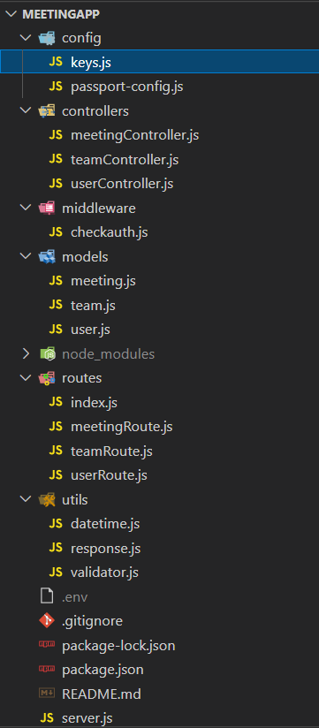
Code Architecture
The application follows a Model View/Route Controller (MVC) Architecture
to allow separation of concern between various layers of logic.
Directories:
./config: configuration files for Passport.js and local MongoDB database connections.
./controllers: controller methods for User, Team and Meeting database interactions.
./middleware: authentication check middleware to check if request is authenticated or not.
./models: schema definition and models for User, Team and Meeting.
./routes: API routes endpoints
./utils: utility functions such as server response, validation methods etc.
Files:
.env: environment variables
.gitignore: which files need not be tracked
package.json, package-lock.json: NPM files
README.md: readme file for project
server.js: Main file containing node.js server code. This is the starting point of code that will be run to start the server.

Slide 7
Proposed Solution Methodology
My proposed solution is designed with considering the whole full stack application structure in mind i.e. how API calls would be made, which properties need to be checked through frontend, what techniques would be more efficient considering time constraints etc.
For authentication, I have used Passport.js. It utilizes browser cookies along with backend sessions to manage logged-in and logged-out users. More precisely I have used Passport ’s Local Strategy. The Local Strategy allows to authenticate users by looking up their data in the app's database. In the same way, we secure the protected routes to be accessed by only logged in users. If the user is not currently logged in and tries to access the protected routes, he will be redirected to /login route and similarly non protected routes (such as login, register) can only be accessed if the user is NOT logged in else it redirects to home page only.
The main idea behind not using “userId” and “password” combination again and again is: 1. Considering the amount of server calls, checking every time if the user-password combination exists unnecessarily increases latency and database calls. 2. Encrypting the given input password (multiple times and dependent upon the salt/hash that we use) and then comparing it with the original password is every tedious and costly operation, instead we simply maintain a session between user and the server using passport.

Slide 8
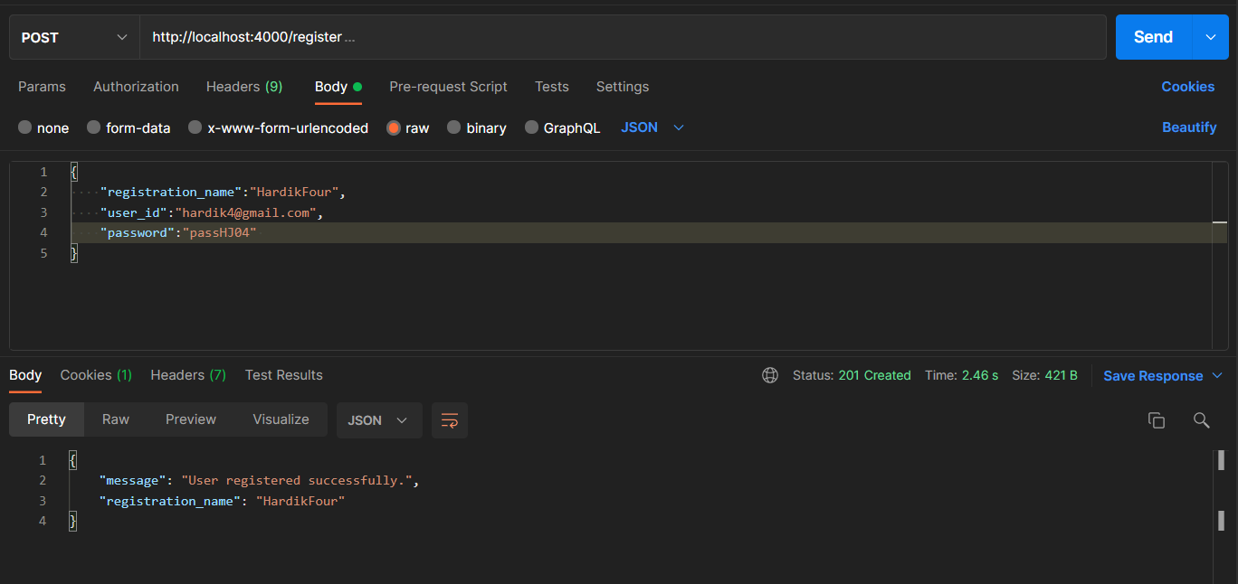
Features prescribed in Problem Statement:
Feature 1. Register User
All the fields are correct acc. to specifications
POST
Endpoint: /register
Input (JSON): {
"registration_name":"HardikFour",
"user_id":"hardik4@gmail.com",
"password":"passHJ04"
}
Scenario 1:
Successful Registration

Slide 9
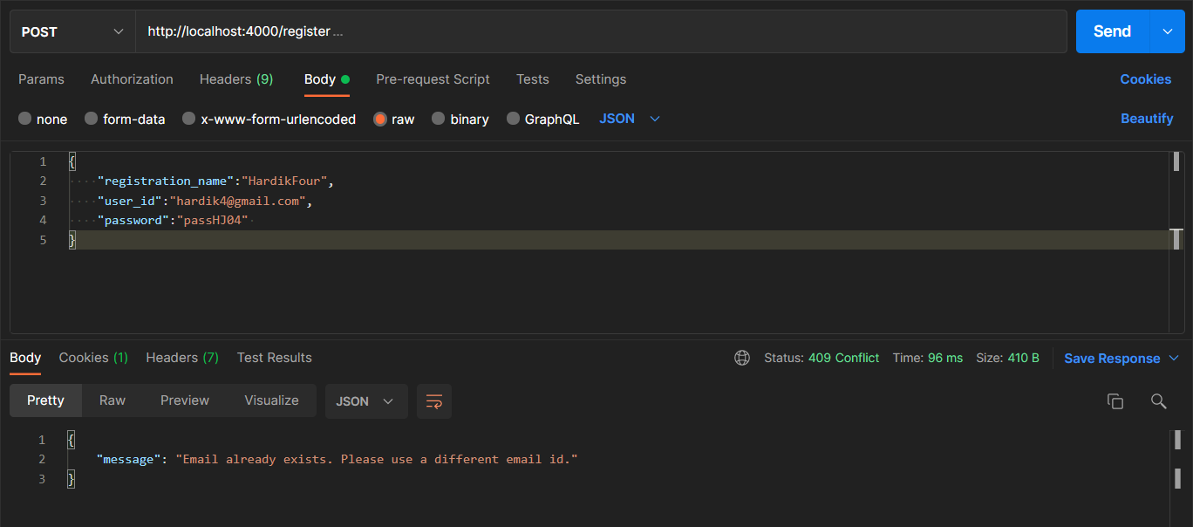
Because we used the same email for registration earlier again !
POST
Endpoint: /register
Input (JSON): {
"registration_name": "HardikFour",
"user_id":"hardik4@gmail.com",
"password":"passHJ04"
}
Scenario 2: Unsuccessful registration
Email Already Exists

Slide 10
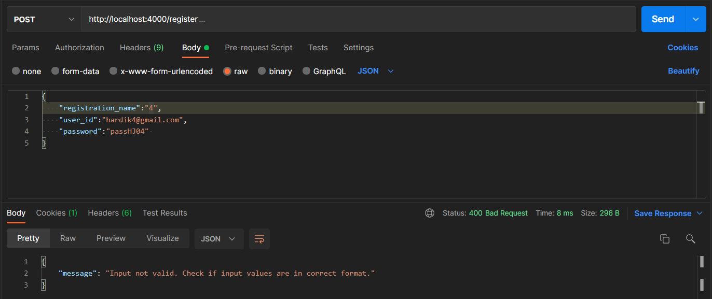
Name cannot contain any numeric digits !
POST
Endpoint: /register
Input (JSON): {
"registration_name":“4",
"user_id":"hardik4@gmail.com",
"password":"passHJ04"
}
Similar validation checks for “user_id” and “password” fields are also implemented (although usually these are more suitable in frontend)
Scenario 3: Unsuccessful registration
Invalid input field(s)

Slide 11
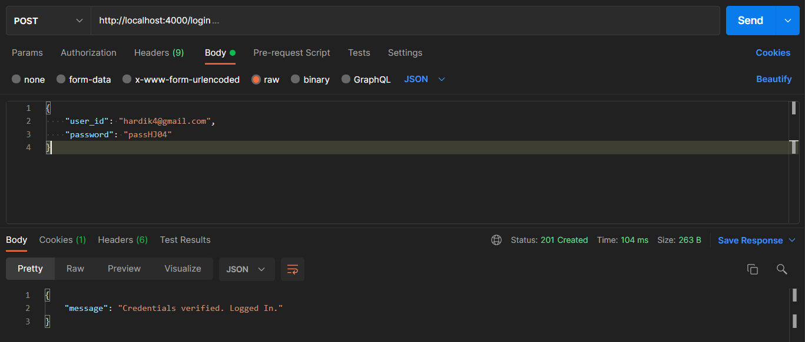
Features prescribed in Problem Statement:
Feature 2. Login User
Correct Credentials (same at the time of registration)
POST
Endpoint: /login
Input (JSON): {
"user_id": "hardik4@gmail.com",
"password":"passHJ04"
}
Scenario 1:
Successful Login

Slide 12
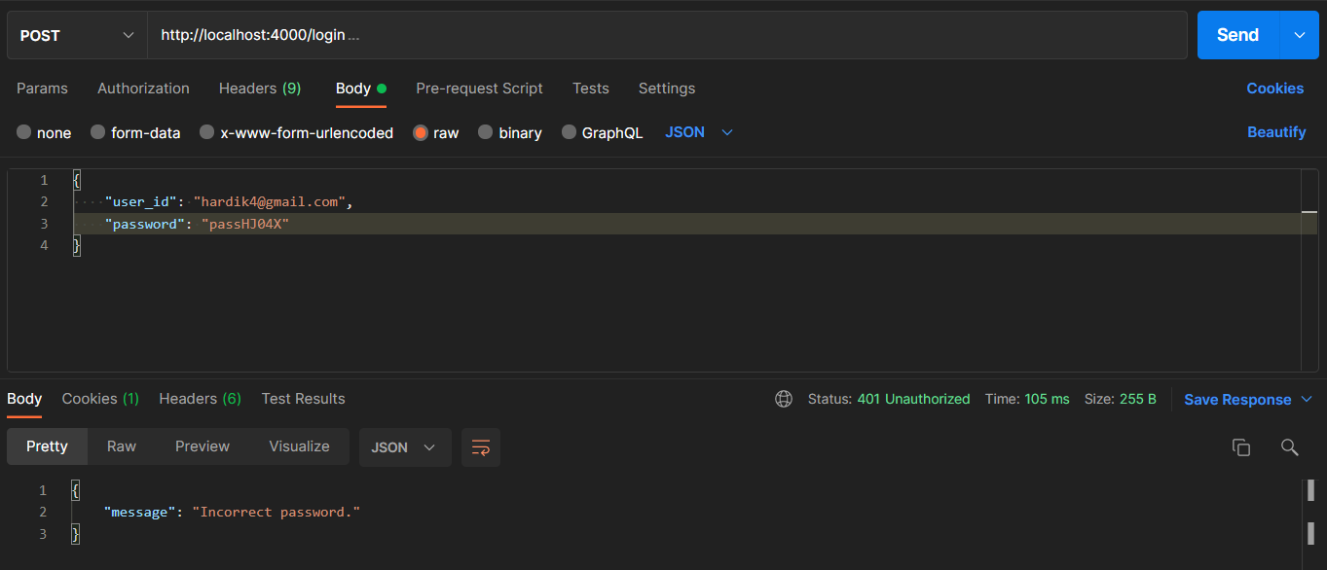
POST
Endpoint: /login
Input (JSON): {
"user_id": "hardik4@gmail.com",
"password":"passHJ04X"
}
Scenario 2:
Incorrect Credentials

Slide 13
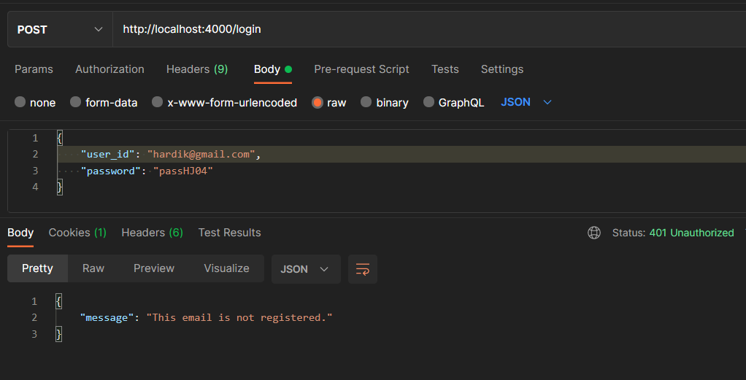
POST
Endpoint: /login
Input (JSON): {
"user_id": "hardik@gmail.com",
"password":"passHJ04"
}
Scenario 3: Non registered email

Slide 14
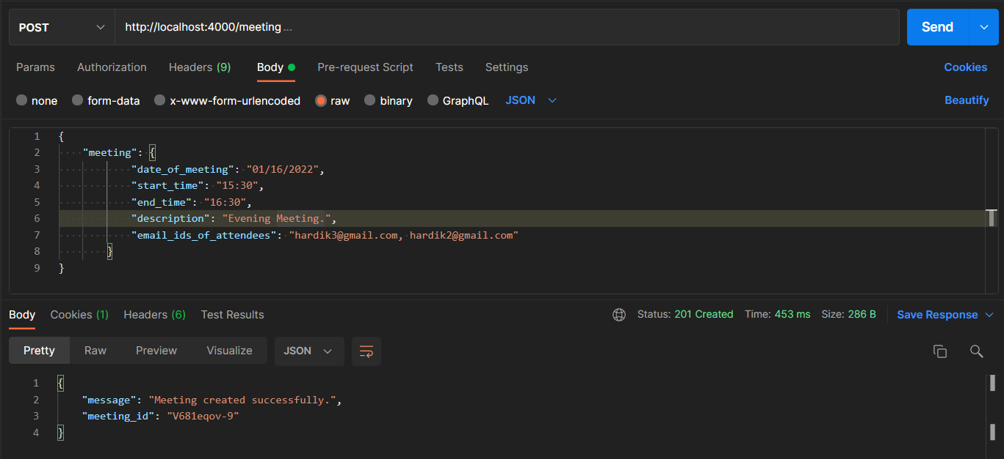
Features prescribed in Problem Statement:
3. Creating Meeting
POST
Endpoint: /meeting
Input (JSON): {
"meeting": {
"date_of_meeting": "01/11/2022",
"start_time": “15:30",
"end_time": “16:30",
"description": “Evening Meeting.",
"email_ids_of_attendees": "hardik3@gmail.com, hardik1@gmail.com"
}
}
Scenario 1:
Successful Creation of Meeting

Slide 15
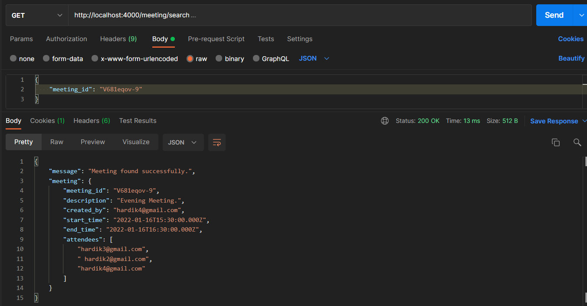
Features prescribed in Problem Statement:
4. Search Meeting:
Search from the meetings from meeting id
that the user is part of.
GET
Endpoint: /meeting/search
Input (JSON): {
"meeting_id": "V681eqov-9"
}
Scenario 1:
Meeting found

Slide 16
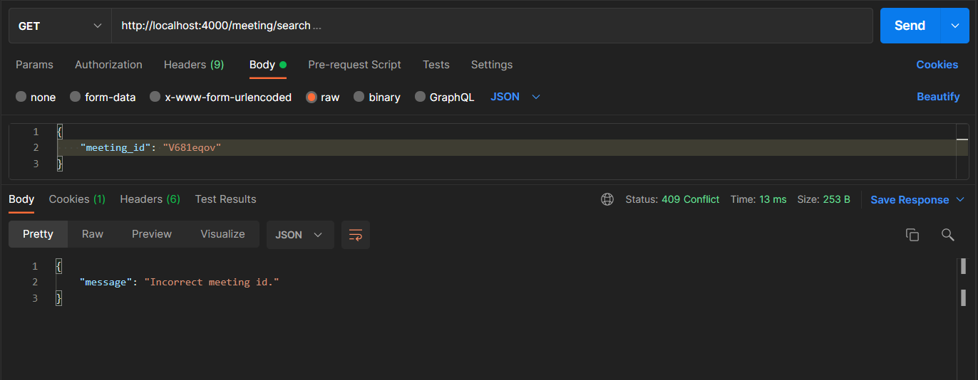
GET
Endpoint: /meeting/search
Input (JSON): {
"meeting_id": "V681eqov”
}
Scenario 2:
Invalid Meeting ID

Slide 17
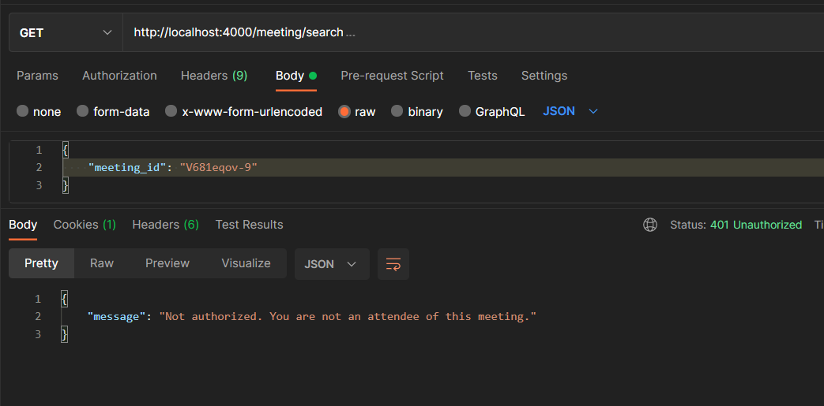
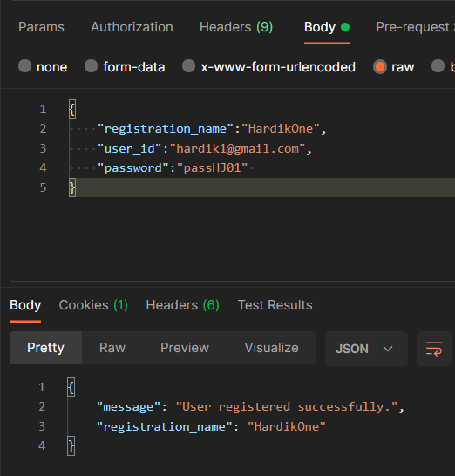
Scenario 3:
Meeting found but user is not authorized to view it.

Slide 18
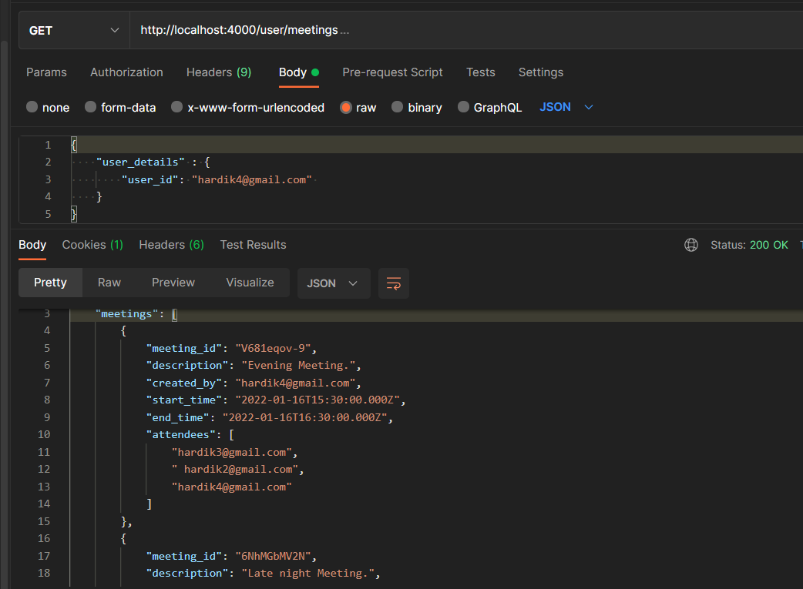
Features prescribed in Problem Statement:
5. View all user meetings
GET
Endpoint: /user/meeting
Input (JSON): {
"user_details" : {
"user_id": "hardik4@gmail.com"
}
}
Scenario 1:
Found User meetings successfully.

Slide 19
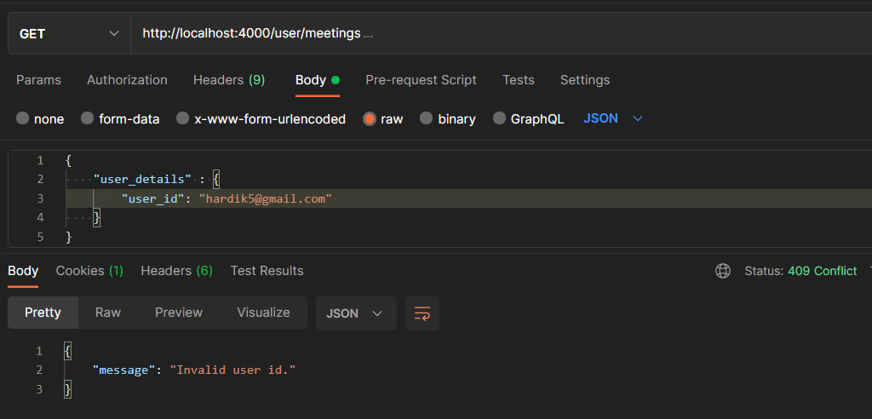
GET
Endpoint: /user/meeting
Input (JSON): {
"user_details" : {
"user_id": "hardik5@gmail.com"
}
}
Scenario 2:
Invalid User ID

Slide 20
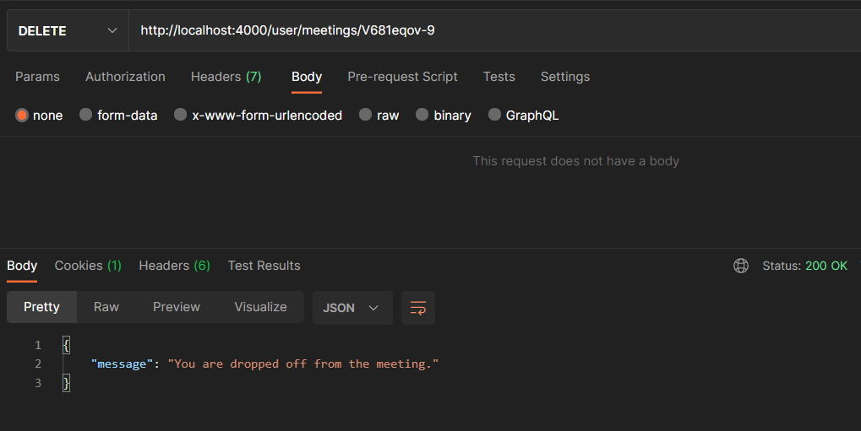
Features prescribed in Problem Statement:
6. Drop off from meeting
DELETE
Endpoint: /user/meetings/:meetingId
Scenario 1:
Found User meetings successfully.

Slide 21
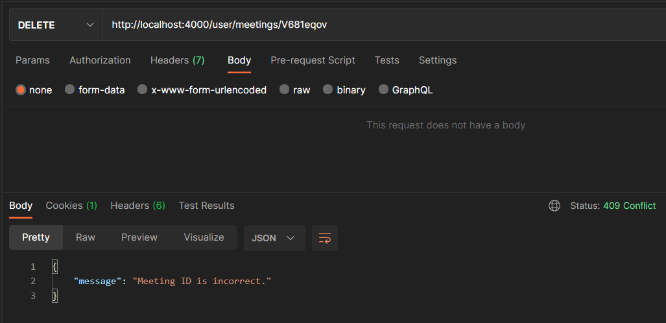
DELETE
Endpoint: /user/meetings/:meetingId
Scenario 2:
Meeting ID is incorrect.

Slide 22
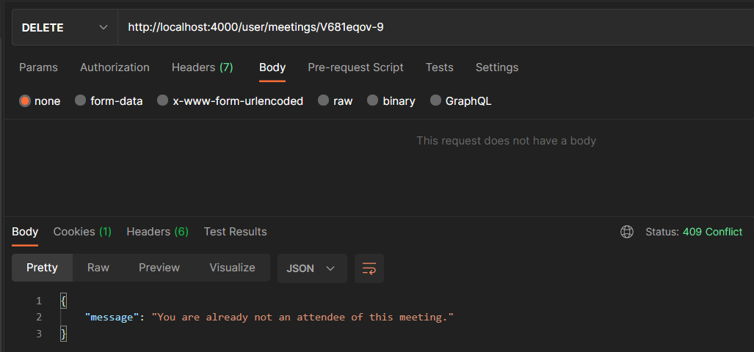
DELETE
Endpoint: /user/meetings/:meetingId
Scenario 3:
Already not an attendee

Slide 23
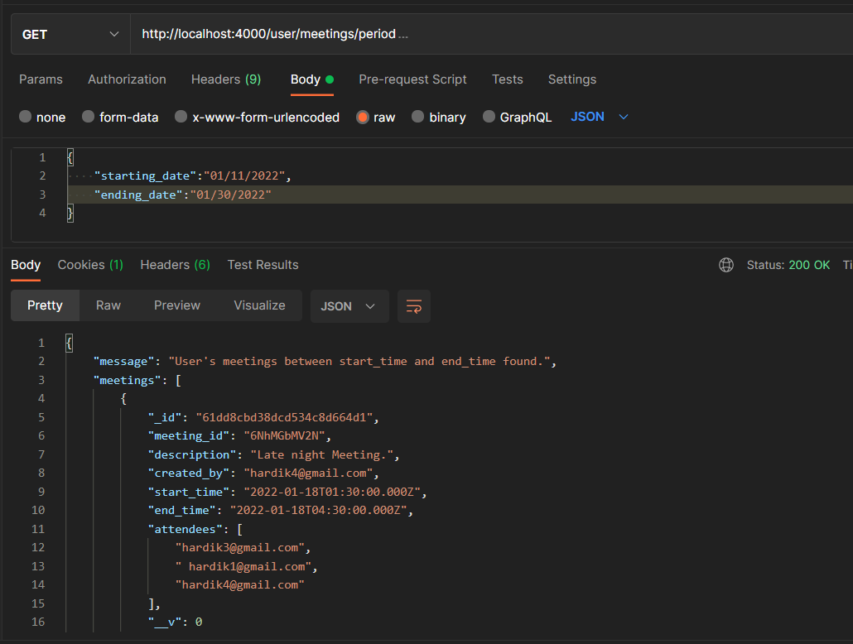
Additional Features implemented:
1. All user meetings between start date and end date:
GET
Endpoint: /user/period
Input (JSON): {
"starting_date":"01/11/2022",
"ending_date":"01/30/2022"
}
Lists all the user meetings from [starting_date, ending_date] (inclusive)

Slide 24
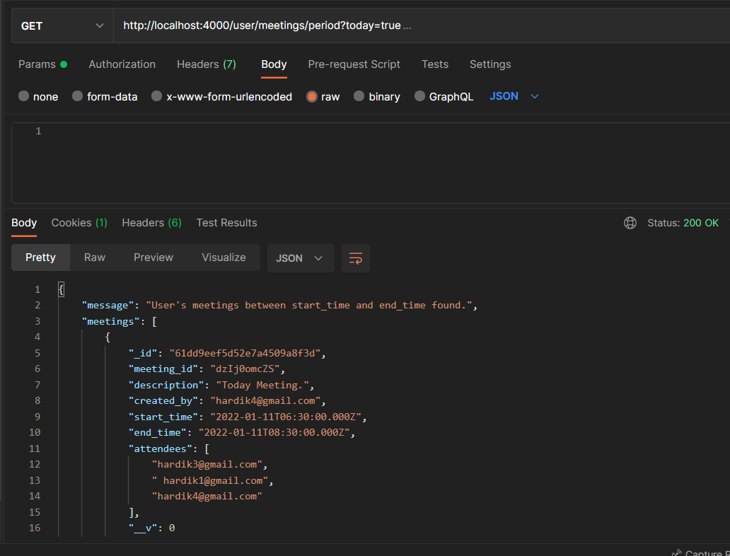
2. All meetings for today
GET
Endpoint: /user/period?today=true
Lists all the user meetings for today

Slide 25
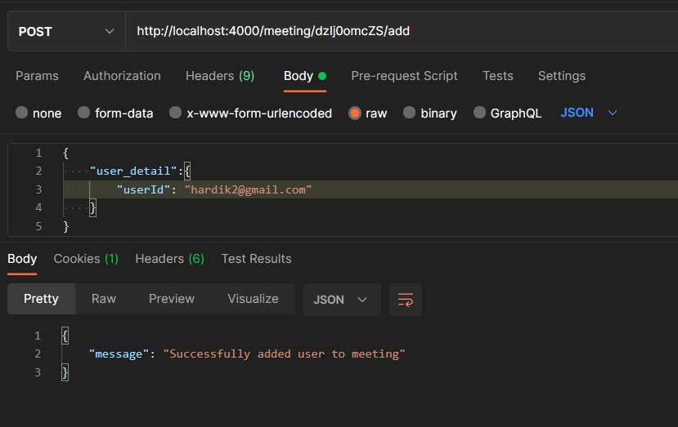
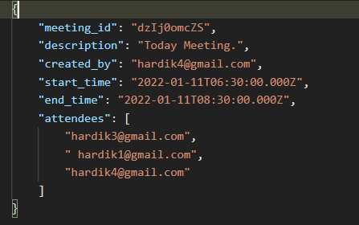
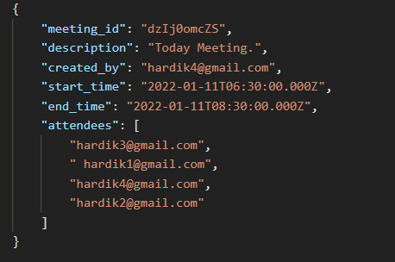
3. Add new attendees to meeting
POST
Endpoint: /meeting/dzIj0omcZS/add
Input (JSON): {
"user_detail":{
"userId": "hardik2@gmail.com"
}
}

Slide 26
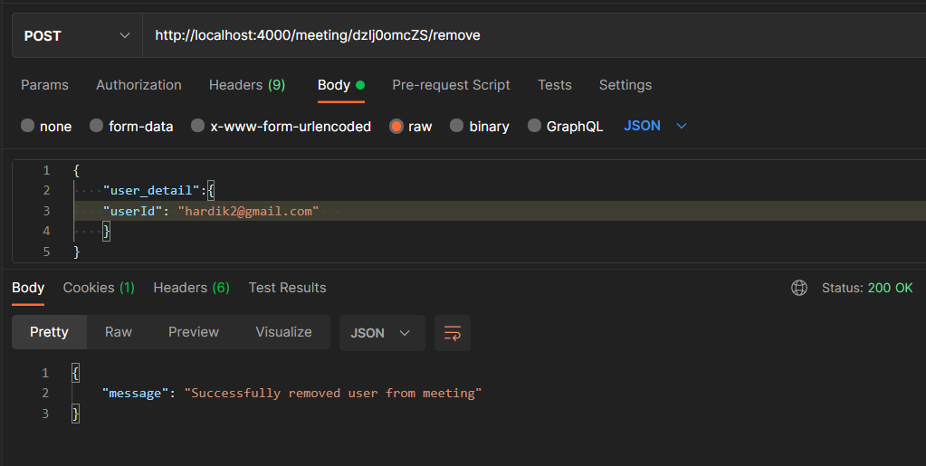
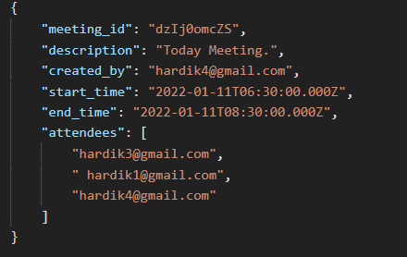
4. Remove attendees from meeting
POST
Endpoint: /meeting/dzIj0omcZS/remove
Input (JSON): {
"user_detail":{
"userId": "hardik2@gmail.com"
}
}

Slide 27
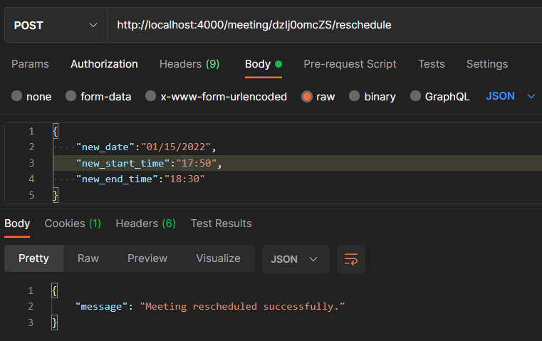
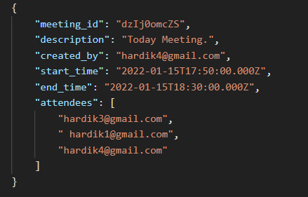
5. Reschedule meeting
POST
Endpoint: /meeting/dzIj0omcZS/reschedule
Input (JSON): {
"new_date":"01/15/2022",
"new_start_time":"17:50",
"new_end_time":"18:30"
}

Slide 28
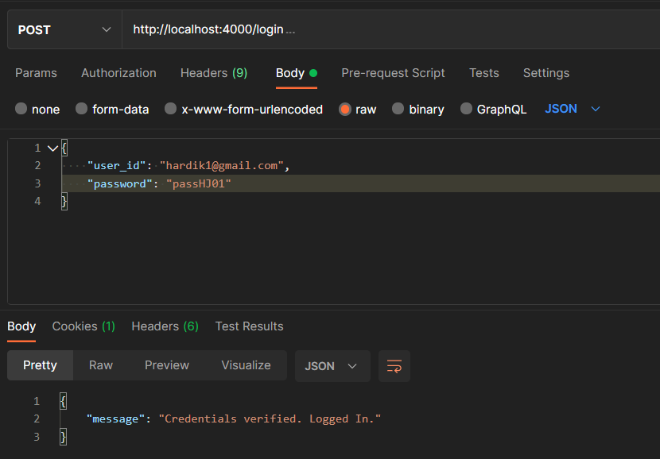
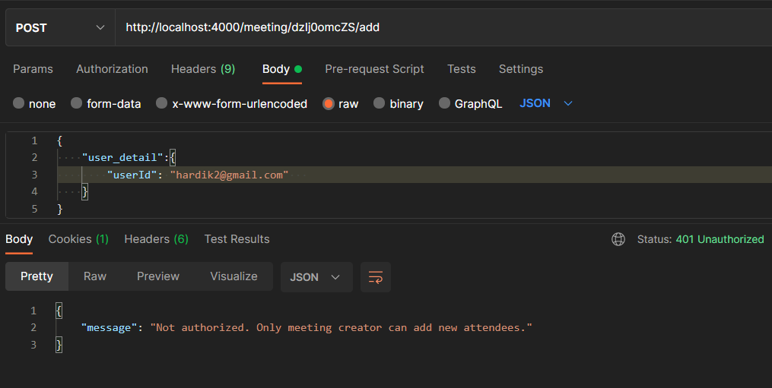
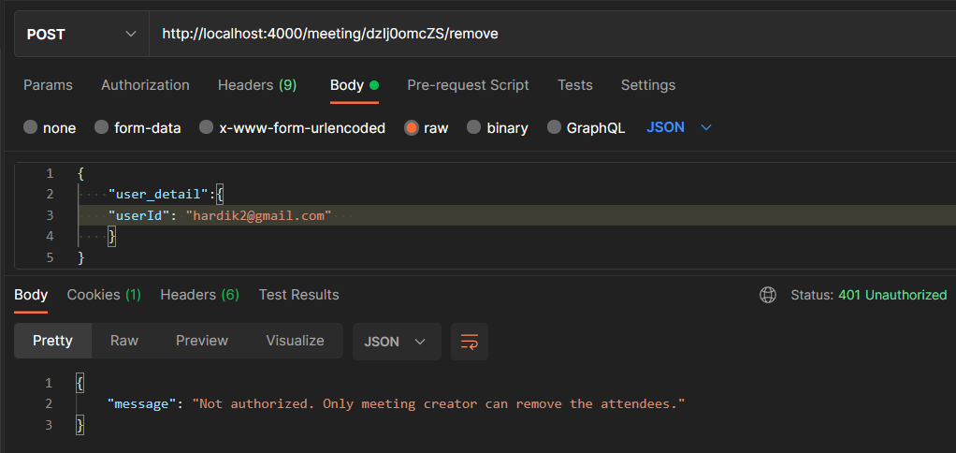
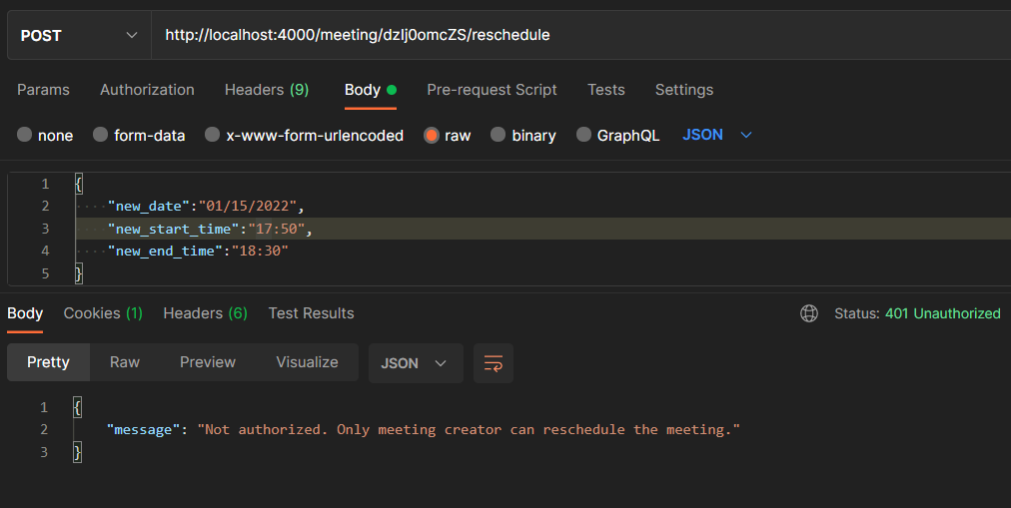
The above three routes can only be accessed by the creator of meeting otherwise it will return Unauthorized Response (401)

Slide 29
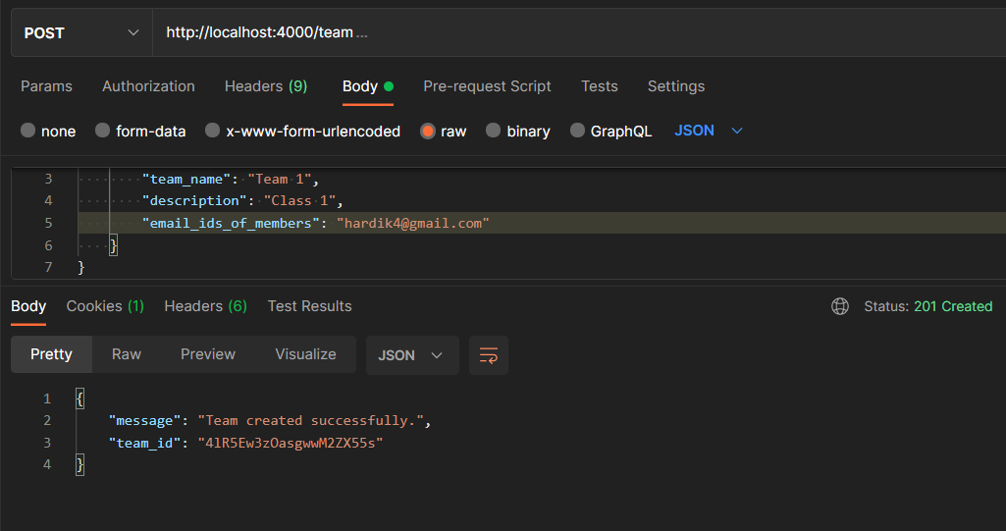
6. Create new team of users
Endpoint: /team
Input (JSON): {
"team":{
"team_name": "Team 1",
"description": "Class 1",
"email_ids_of_members": "hardik4@gmail.com"
}
}
Create team

Slide 30
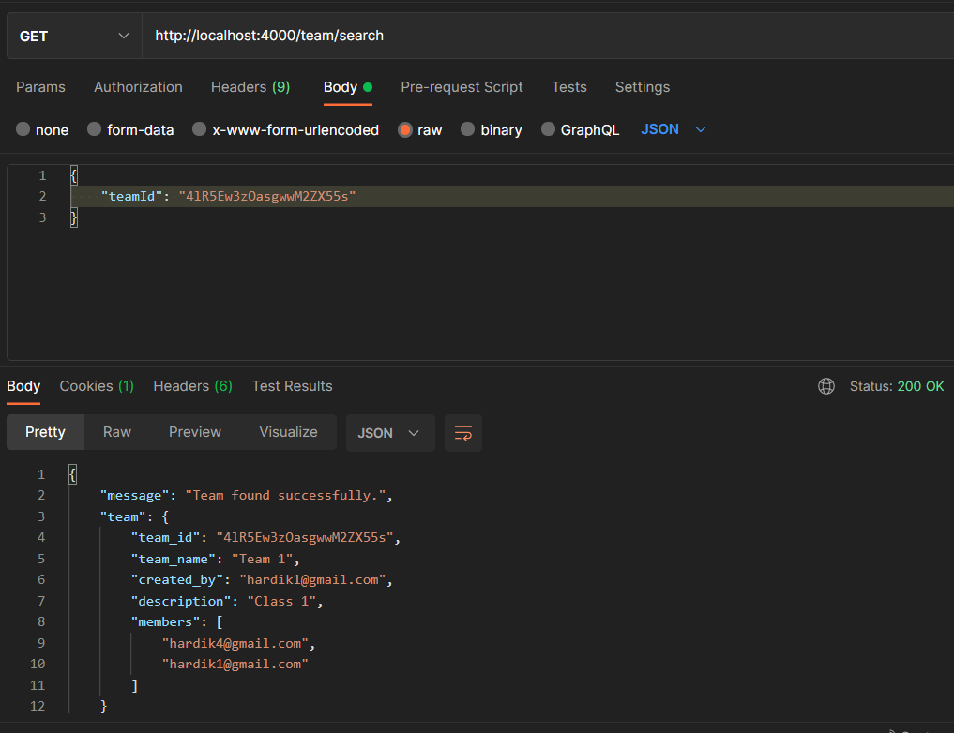
7. Search team
Endpoint: /team/search
Input (JSON): {
"teamId": "4lR5Ew3zOasgwwM2ZX55s"
}
Search team

Slide 31
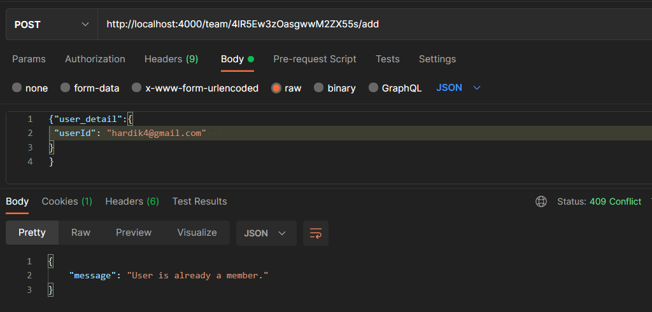
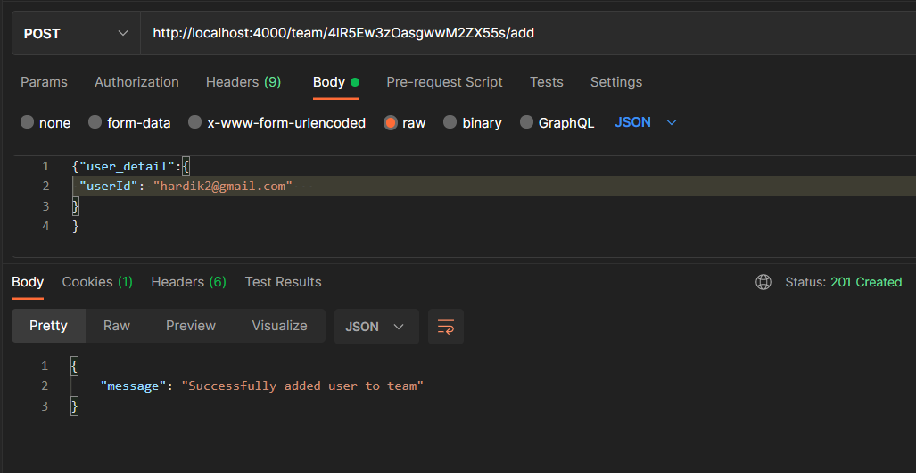
8. Add to team
Endpoint: team/4lR5Ew3zOasgwwM2ZX55s/add
Input (JSON): {"user_detail":{
"userId": "hardik4@gmail.com"
}
}
Scenario 1: User is already a member of the team
Scenario 2: User added successfully to the team

Slide 32
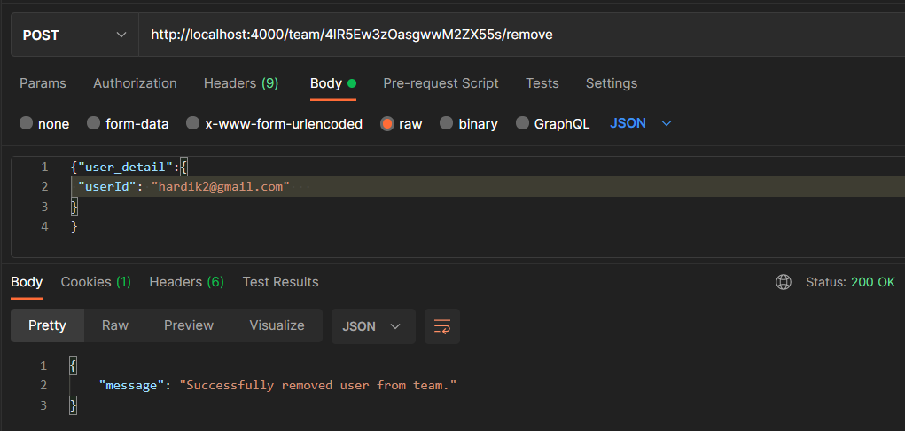
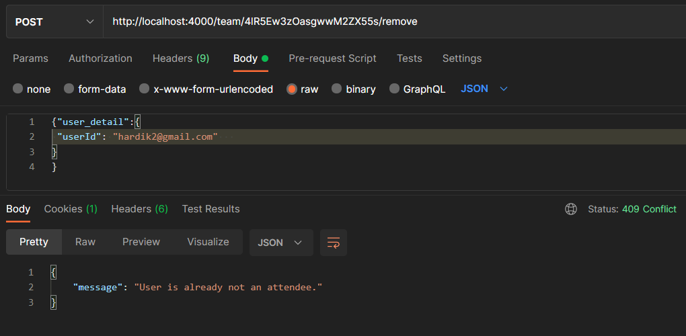
8. Remove user from team
Endpoint: team/4lR5Ew3zOasgwwM2ZX55s/remove
Input (JSON): {"user_detail":{
"userId": "hardik4@gmail.com"
}
}
Scenario 1: Removed user from team
Scenario 2: User is already not a member of the team

Slide 33
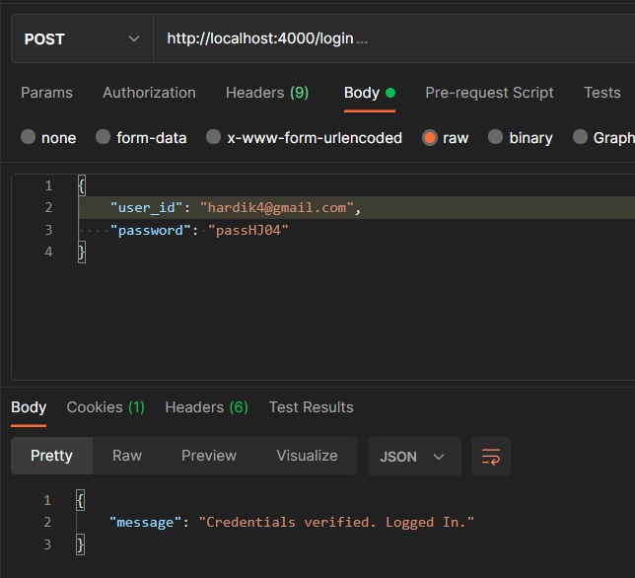
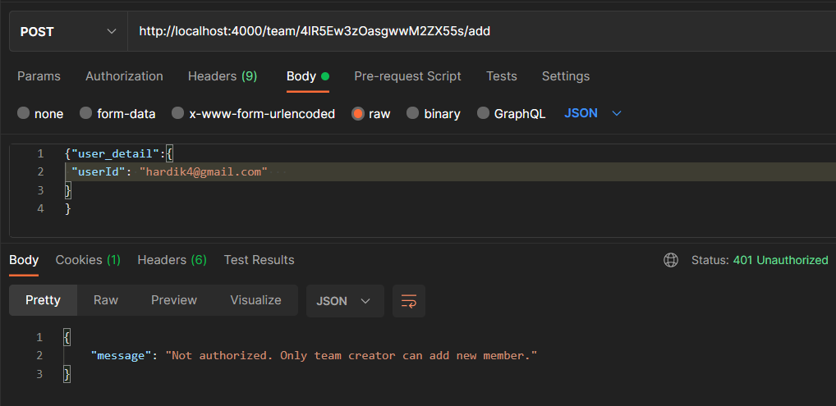
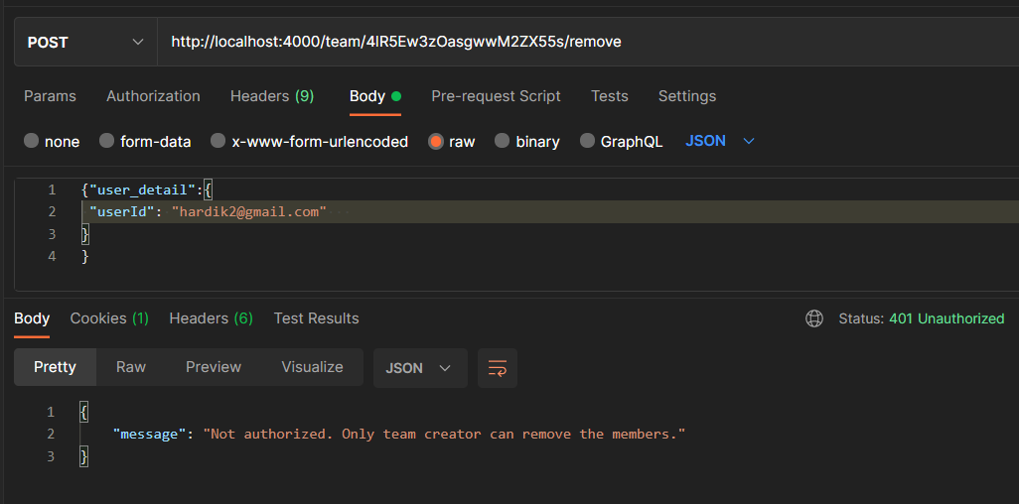
The above two routes can only be accessed by the creator of meeting otherwise it will return Unauthorized Response (401)

Slide 34
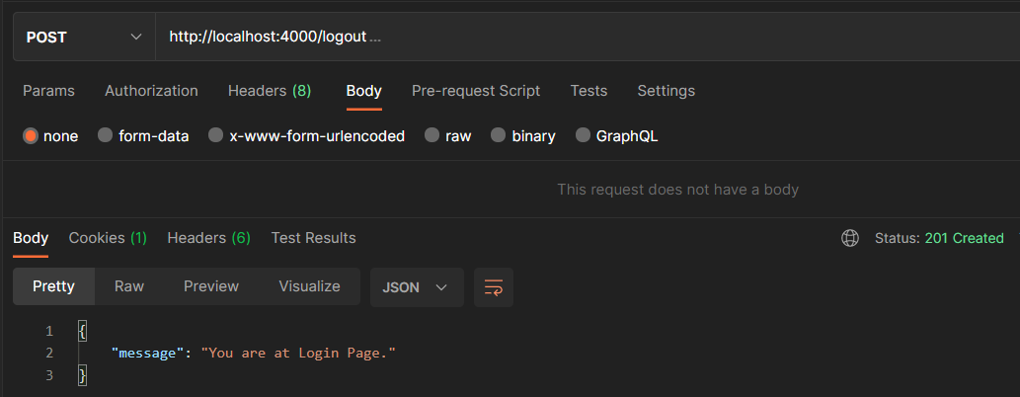
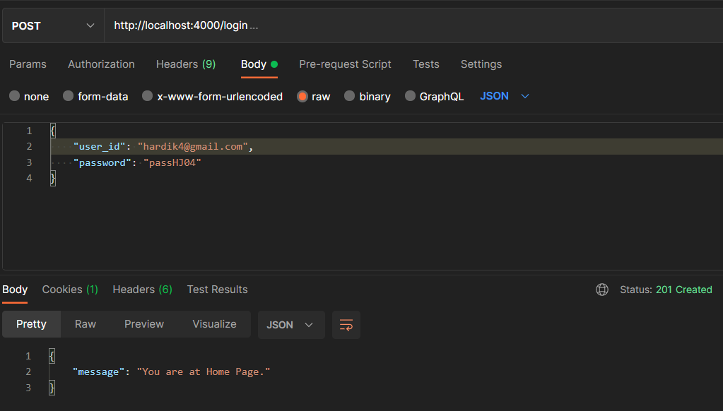
9. Incorrect access of Protected and Unprotected Routes

Slide 35
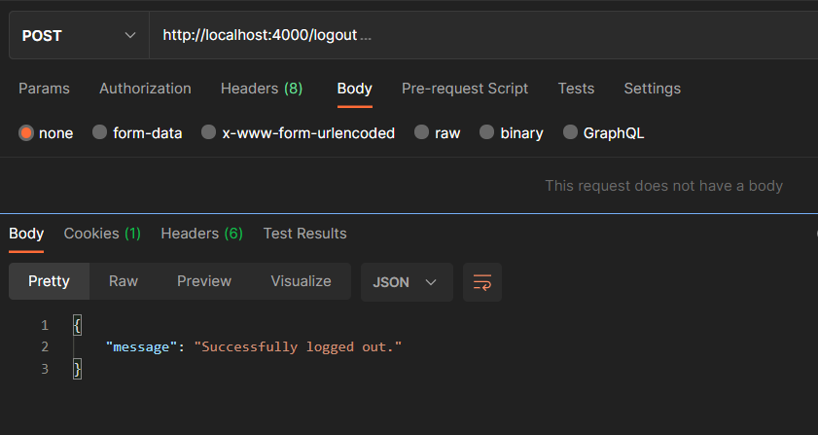
10. Logout route

Slide 36
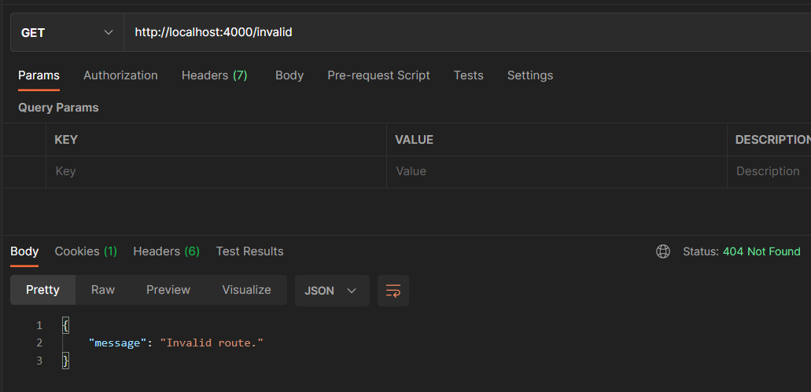
11. Invalid route

Slide 37
Personal Benefits gained from this Program
Revision of frontend JS and NodeJS.
Development of RESTful APIs using NodeJS.
Handling JSON as data transmission format, and NoSQL Key-Value databases.
Hands on experience building a backend application with multiple frameworks and packages like express, passport, bcrypt.
Time and date format importance. (BEST ONE since I didn’t know that Date() object produces date in the ISO format and we need to convert into local time in order to be consistent)
Intensive use of git, Github, commits, branch etc. helped to know more about the use and importance of Version Control Systems

Slide 38
Conclusion
This one week of collaborative and intensive training helped me to develop this backend API from scratch as per the given Problem Statement, along with many additional features and keeping performance as well as great architecture in mind.
The backend is up and running and is easily portable to any device running Node.js and MongoDB. Even the database can be easily portable to Cloud using MongoDB Atlas by changing only a single line in config file.

Slide 39
Thank you
To everyone at Swiggy and our respected teachers at UNext especially Girish Sir, Manjunath Sir, Ramya Sir and Pradeep Sir for conducting all the informative sessions smoothly and giving me the chance to learn from such talented people. I am very grateful to you all.
- Hardik Joshi

