Slide 1


SMART INDIA HACKATHON 2024
Problem Statement ID – SIH1775
Problem Statement Title- Fake social media accounts and their detection
Theme- Blockchain and Cyber Security
PS Category- Software
Team ID-
Team Name (Registered on portal)-
CRYPTIC CIPHERS

Slide 2

.
AI Tools for Detecting Fake Social Media Accounts: A National Security Strategy
Two types of Data Set
Auto Generated
Ex: Bots
Human Generated
Ex : Fraudsters
The datasets we deal with contain a variety of attributes, including post content, profile photos, follower and following counts, and other pertinent data.
Our goal is to create a Machine Learning (ML) program that forecasts possible hazards using probability-based analysis.
The datasets will be subjected to this algorithm in order to determine the authenticity of each account.
After it is built, this method will be implemented on a web application to guarantee public accessibility. Users will have the ability to verify for themselves if a certain social media account is authentic or fake.
Higher authorities can only solve the problem of identifying the person who created a phony account by using legal tools like subpoenas or warrants, which force the platforms to reveal pertinent information.The laws supporting such action include:
Indian Penal Code (IPC),1860.
Code of Criminal Procedure (CRPC),Section 91
UNIQUENESS
Our approach uniquely combines multiple ML models, from traditional methods like Naive Bayes, regression, and SVM, to advanced techniques like ANN and NLP, ensuring comprehensive analysis of both linear and non-linear data relationships.
INNOVATION
By integrating sentiment analysis with advanced neural networks and offering an intuitive web app, we make ML tools accessible, providing real-time insights for everyday users.

Slide 3
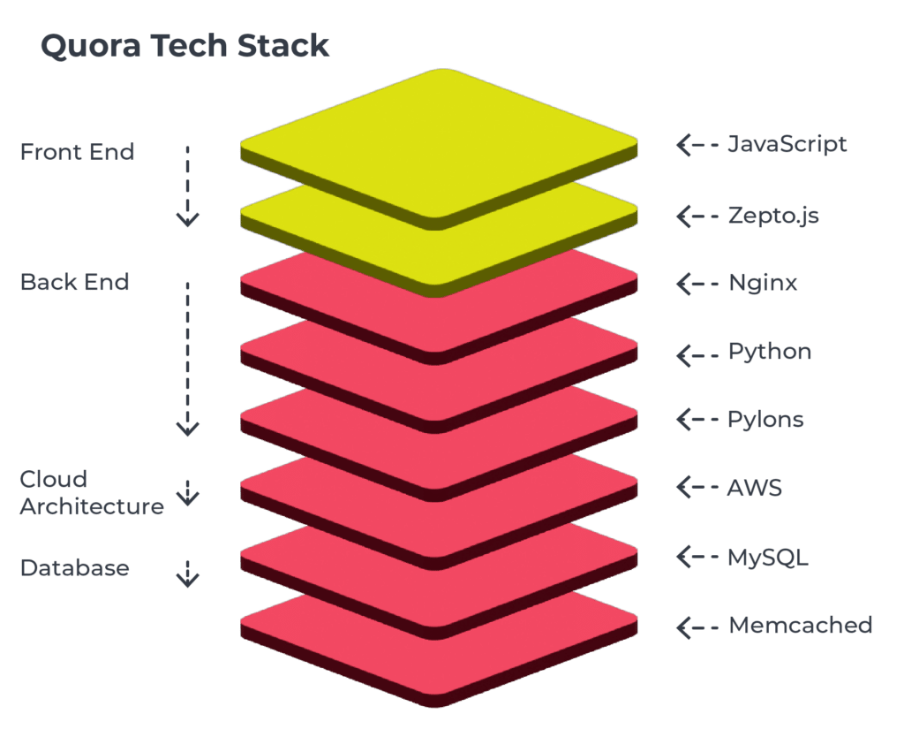
TECHNICAL APPROACH
WEB CRAWLING FOR SOCIAL MEDIA SITES
START
USER LIST
DATA PREPROCESSING
TRAINING THE DATA SET ON ML MODELS
ACCESSING THE API FOR ACCOUNT’S FEATURES
Training Data
MODEL BUILDING
TECH- STACK
Testing Data
MERN STACK
TESTING
ML APPROACHES on ensemble system:
Level 1:Naive Bayes , Support Vector Machine, Random Forest
Level 2:Logistic Regression(meta classification)
PREDICTIONS
ARTIFICIAL NEURAL NETWORKS (ANN)
WEB APP
NATURAL LANGUAGE PROCESSING (NLP)

Slide 4
FEASIBILITY AND VIABILITY
01
02
03
Analysis of the feasibility of the idea
Potential challenges and risks
Strategies for overcoming these challenges
Data Acquisition: Feasible but may face legal/privacy restrictions.
ML Approach: Effective algorithms (e.g., Decision Trees, SVM) with up to 97% accuracy, but requires careful data handling.
Implementation: Achievable with current tools; real-time processing may need optimization.
Resources: Needs AI/ML expertise and computational power.
The world of fraud is always changing swiftly. It demands updates to detect methods to keep up with the evolving tactics used by fraudsters.
Privacy concerns often arise when collecting data for analysis as it can raise issues related to privacy and necessitate adherence, to data protection laws.
Unnatural bias in dataset
Social media sites API have limited number of requests which is a barrier
Adaptive algorithms: implement machine-learning models that are capable of evolving to new tactics utilized by fake accounts.
Data collection: the data should be collected with the consent of users and should be in compliance with the laws of data protection.
A cost sensitive evolutionary algorithm is used for the detection of automated accounts
To buy the paid API’S with unlimited requests per day

Slide 5







IMPACT AND BENEFITS
Prevents impersonation of military personnel and protects soldiers' identities and privacy
Stop fake engagement on social media platforms
Enhances the platform’s algorithms for better target audiences
Protects against misappropriation of copyrighted material
Reduces the ability of extremists to incite violence and spread propaganda
Discourages the dissemination of false or misleading information
Prevent inappropriate tactics being used to artificially grow your social media following

Slide 6
RESEARCH AND REFERENCES
Research paper by : Sri Lavanya Sajja used for datasets https://www.researchgate.net/publication/378868478_INSTAGRAM_FAKE_PROFILE_DETECTION_USING_MACHINE_LEARNING
For ML Model:
https://www.academia.edu/download/88042038/83_25201_EMr_26Oct_6Mar_F.pdf
Detection of Fake Profiles in Social Media Aleksei Romanov, Alexander Semenov, Oleksiy Mazhelis and Jari Veijalainen.2017 for helping in initial ideas.
API references of Instagram (other platform’s are also to be used,
https://developers.facebook.com/products/instagram/apis/

