Slide 1


PRUBLE PAIRS
- A Memory Game
Prepared By:-
NAME : JAIVAL N DALAL
EROLL NO : 23002170120006
BATCH : D1
ROLL NO : 03
BRANCH : Computer Engineering (CE)

Slide 2
PROJECT OUTLINE:-
ABSTRACT:
This is a memory game.
It has cards with different images and emojis and user has to guess for the pair which has the same image or emoji.
It has 3 different difficulty levels – Easy, Medium and Hard.
The main idea is to make a light-weight, though enjoyable game that could be played in the moments of boredom to make oneself light!
TECHNOLOGIES USED:
HTML, CSS, JavaScript

Slide 3
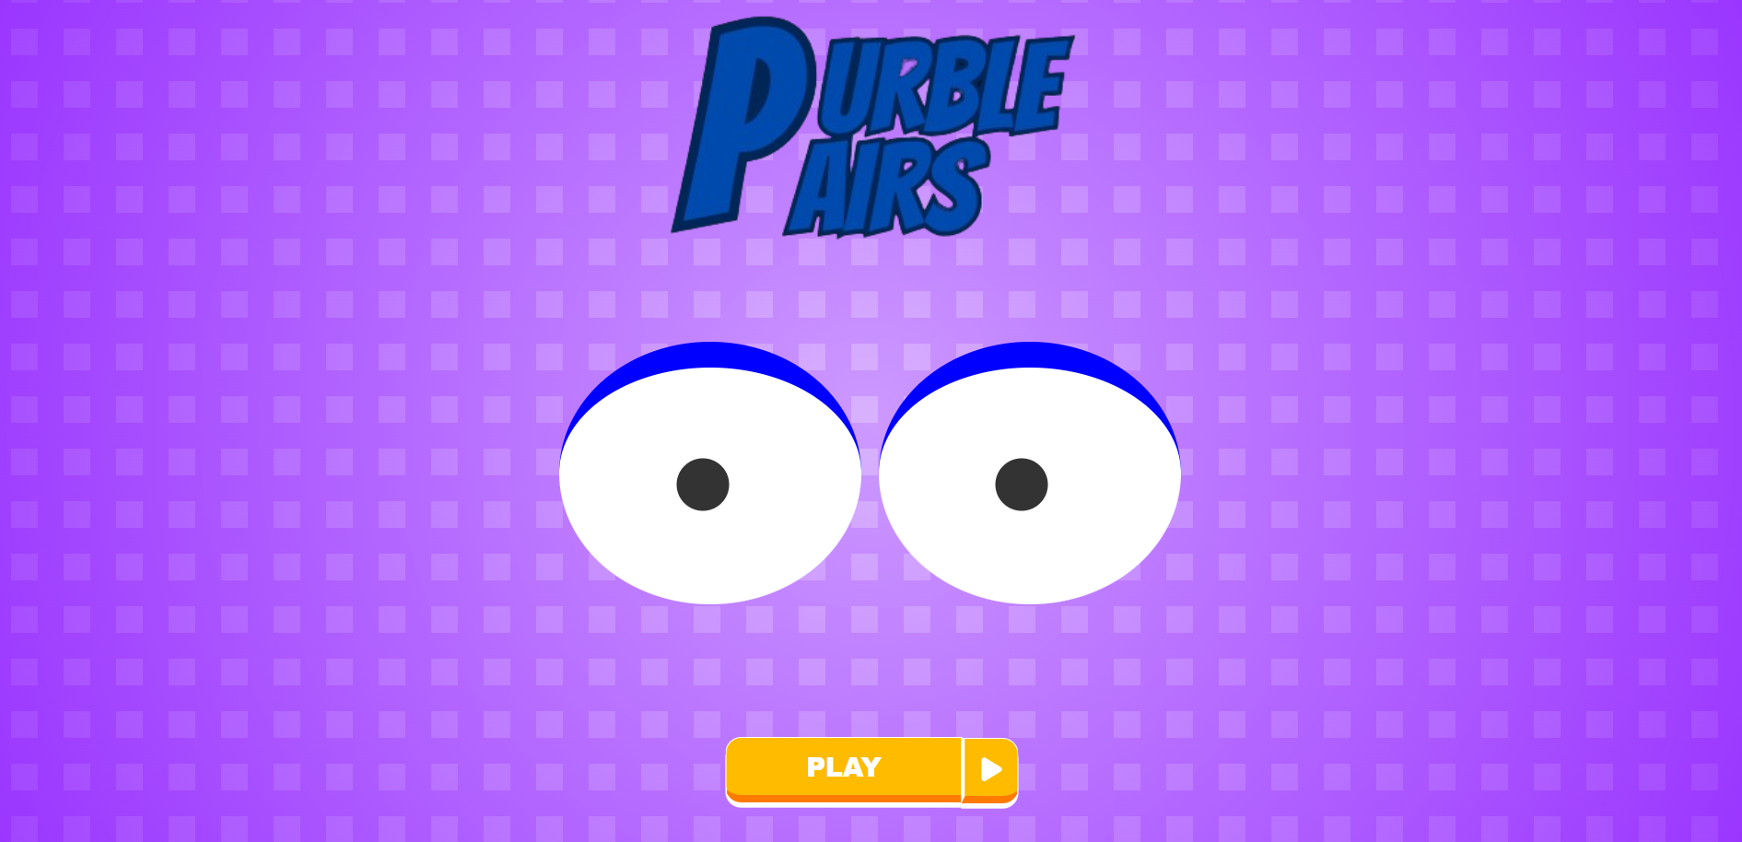
Game Window

Slide 4
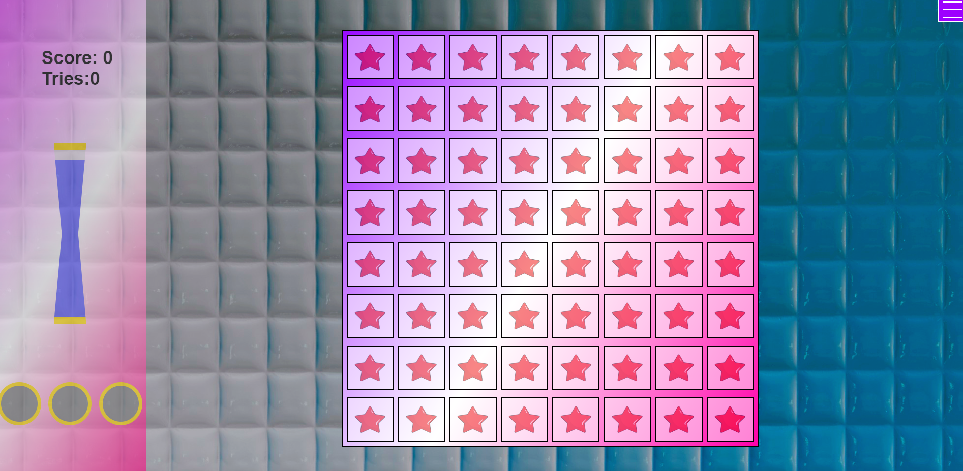
Game Window

Slide 5
THANK YOU….

