Slide 1

Department of Electrical Engineering
Indian Institute of Technology, Bombay
EE214 – 2024
Digital Circuits Lab
Scan Chain Demo
Anubhav Bhura

Slide 2
Objectives
● Need for Scan Chain
● Basic understanding of JTAG and Scan Chain
● What is BSCANE2 JTAG IP
● How Scan Chain works
● How to Run Scan Chain using BSCANE2 JTAG
Wadhwani Electronics Lab
Dept. of EE, IIT Bombay

Slide 3
Where did we left off?
Can We use this (Pin Planning ) method to verify any design?
Possible Issues?
1. Number of Switches and LEDs are Limited
2. Amount of time to verify all input combinations
Wadhwani Electronics Lab
Dept. of EE, IIT Bombay

Slide 4
Why Test on Hardware?
Already written a Testbench for verification
Verified Design through RTL Simulation
Hardware may have some timing Differences/ small faults.
Design may not be synthesizable(works only in simulation )
All simulated design may not work perfectly on board
Before releasing your design, need to confirm if it works on actual hardware or not.
Wadhwani Electronics Lab
Dept. of EE, IIT Bombay

Slide 5
Recap
Till now -
Written VHDL code for Full Adder, Multiplexer, Encoder etc.
Verified through a Testbench using a TRACEFILE (RTL Simulation)
Verified on Artix - 7 board using Switches and LEDs
Number of input- output pins needed were low.
Wadhwani Electronics Lab
Dept. of EE, IIT Bombay

Slide 6
Why Scan Chain
4-bit Adder-Subtractor
Number of input/output Pins = 8-10
Available switches/LEDs on Xen-10 Board = 8/8
How to give inputs and Check output?
Time required to check for all input combinations? - 256 combinations for adder.
Solution – Scan Chain
For a design with any number of input and output pins
Wadhwani Electronics Lab
Dept. of EE, IIT Bombay

Slide 7
Lets develop a testing method
Can we use existing Tracefile?
Possible Solution :
Send inputs through USB to FPGA
Allow FPGA to react to the inputs
Read outputs generated by FPGA through USB
Compare generated output with golden output
Wadhwani Electronics Lab
Dept. of EE, IIT Bombay

Slide 8
Basics of Testing and Verification
Verification | Testing
Guarantees Correctness of Design | Guarantees Correctness of Manufactured IC/Board/System
Done only once before actual manufacturing | Done after device is manufactured (on every physical device)
Using Simulation | Using Testing methods such as Scan Chain
Wadhwani Electronics Lab
Dept. of EE, IIT Bombay

Slide 9
NEED ELECTRICAL ACCESS TO EACH PIN OF ICs ON PCB
Wadhwani Electronics Lab
Dept. of EE, IIT Bombay

Slide 10
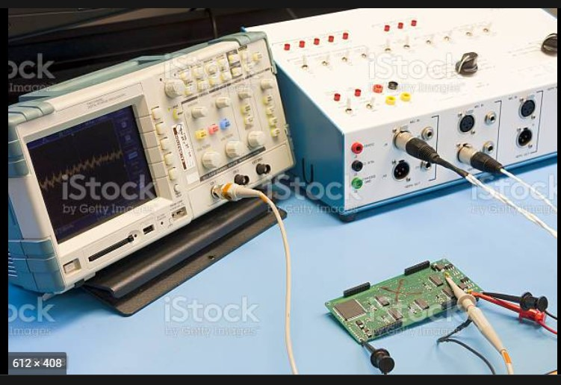
Methods of Testing
Using probes to excite and read data from IC
Issues?
-If large number of pins are to be excited and read – Need multiple CROs and Function Generators
Wadhwani Electronics Lab
Dept. of EE, IIT Bombay

Slide 11
JTAG
Scan Chain based testing method became very popular
Industry standard for verifying designs and testing PCBs
Subsequently, used for uploading design on FPGA/CPLD boards.
So much that it became an IEEE standard – IEEE-1149.1
Joint Test Action Group - 1990
One stop Solution for Programming and testing.
Every IC has Basic JTAG hardware Built in it.
Different Manufacturers follow the same standard
Wadhwani Electronics Lab
Dept. of EE, IIT Bombay

Slide 12
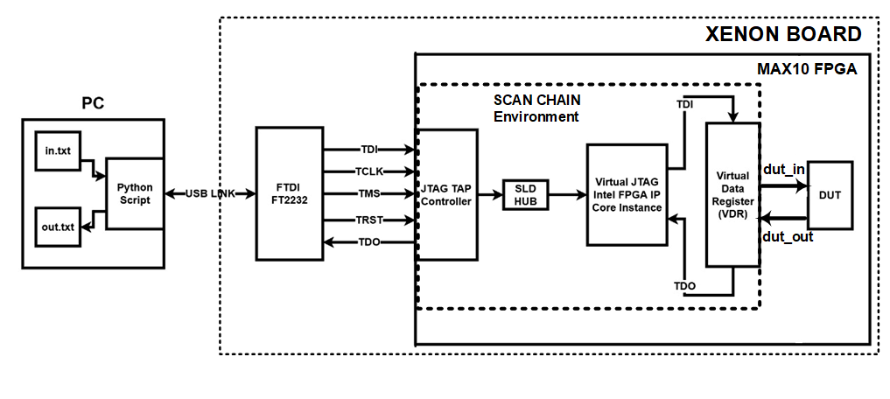
BSCANE 2 JTAG IP
FPGAs/CPLDs already have the basic JTAG Hardware built-in
To Control the basic hardware, need to write some VHDL code
Alternative – BSCANE2 Xilinx FPGA/CPLD IP Core
Intellectual Property: source code not visible
Artix-7 Board
Artix-7 FPGA Chip
BSCANE-2 Xilinx IP
Wadhwani Electronics Lab
Dept. of EE, IIT Bombay

Slide 13
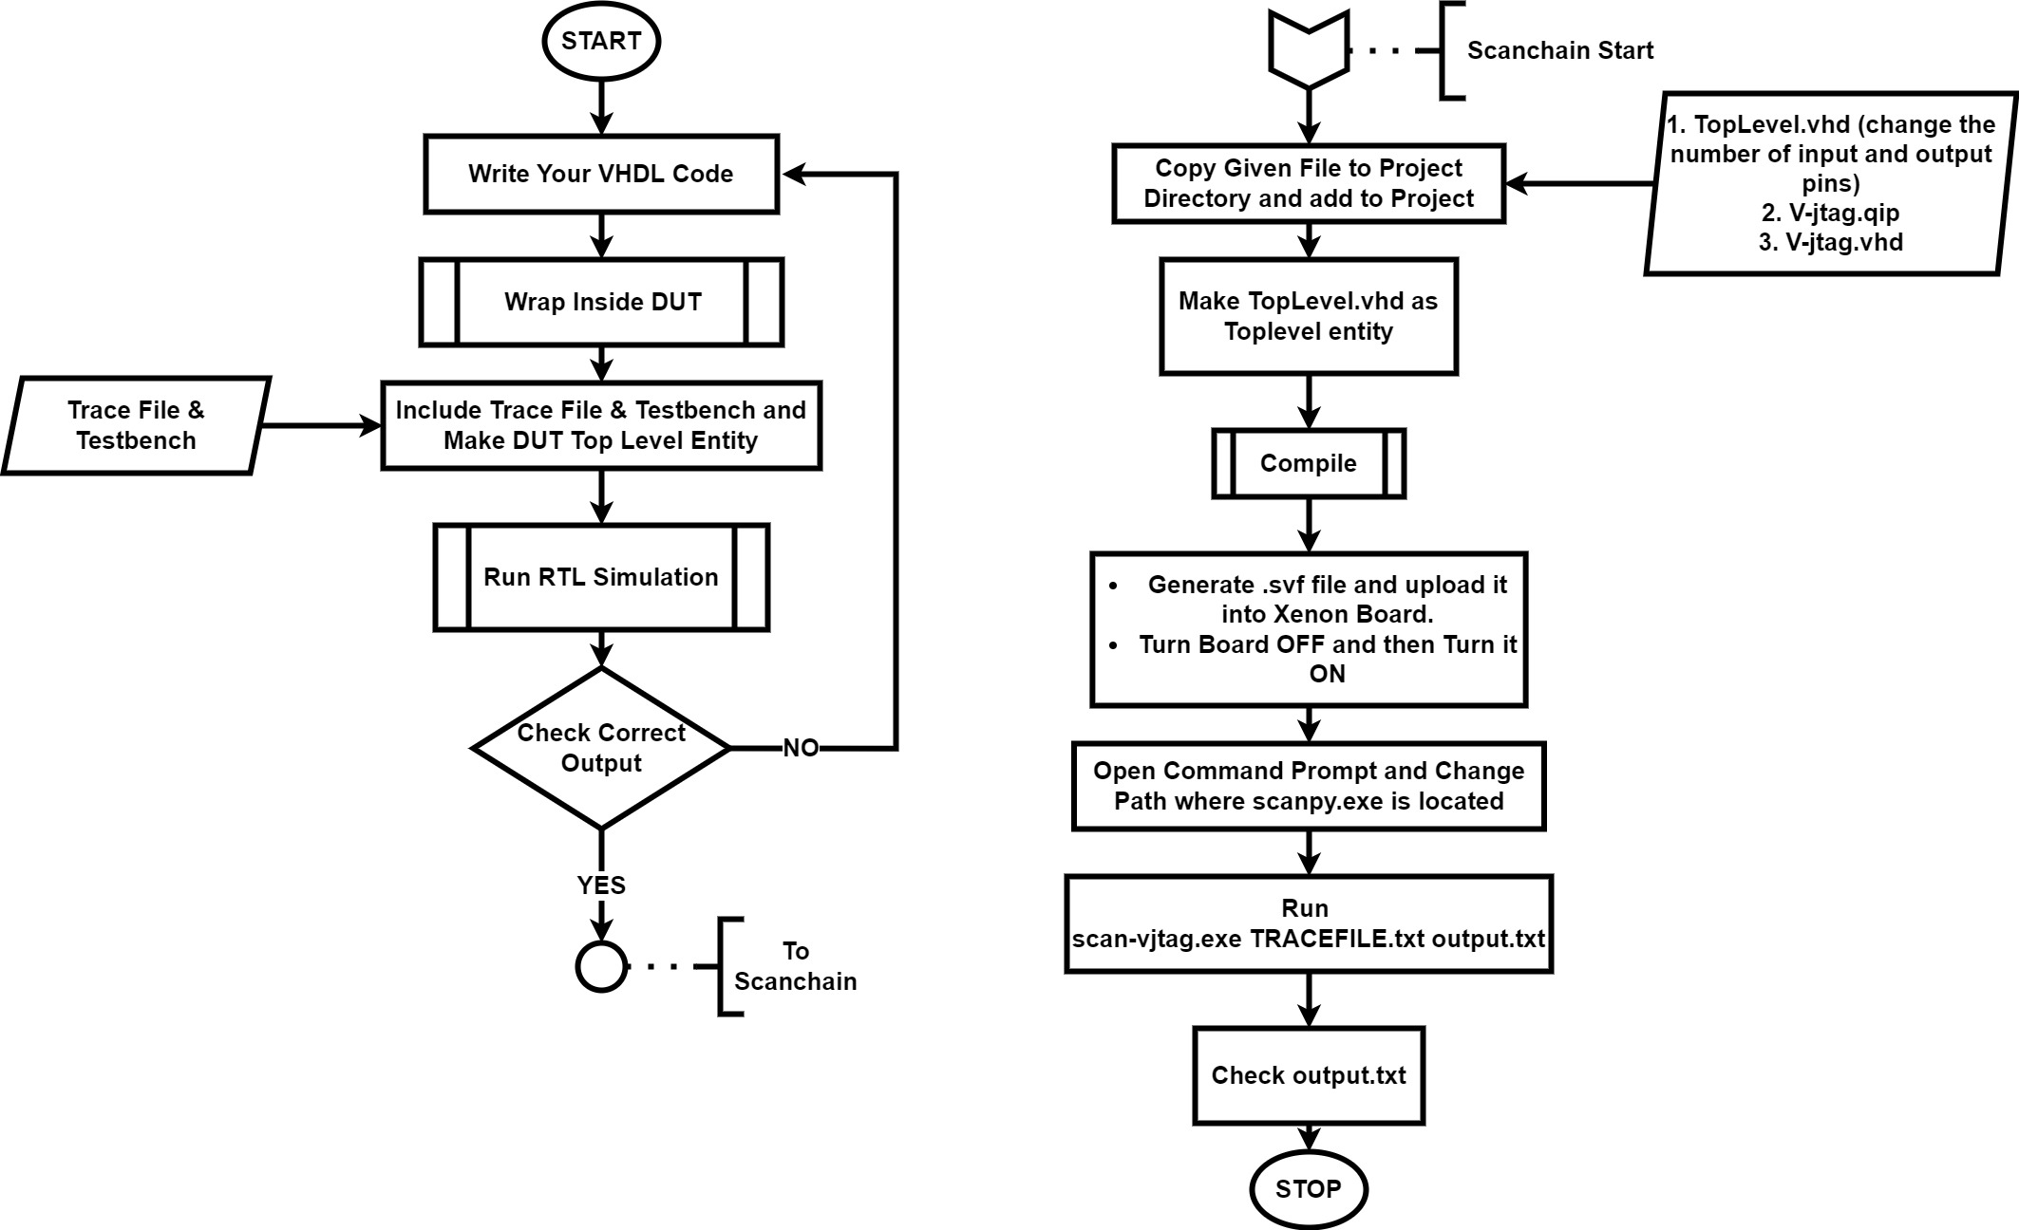
Design Flow
Add Toplevel.vhd (change number of input and output as needed)
Generate bitstream, and using Hardware manager dump to board.
Close hardware manager
Open command prompt and change directory to where scan_bscane2.exe/ scan_bscane2.py is located
Run “scan_bscane2.exe TRACEFILE.txt output.txt” or “python scan_bscane2.py TRACEFILE.txt output.txt”
Wadhwani Electronics Lab
Dept. of EE, IIT Bombay

Slide 14
Difference between verification using Testbench and Scan-Chain
Testbench -> Hardware is Simulated and design's functionality is checked
Scan-Chain -> Actual hardware is given the inputs and Outputs are then compared
Wadhwani Electronics Lab
Dept. of EE, IIT Bombay

Slide 15
Steps to run Scan Chain
Install Python, PIP, Python Packages
Install Python 3.7 or Python 3.8 ​
Install PIP ​
Install the following packages using the commands as shown ​
○ pip install bitstring ​
○ pip install ftd2xx ​
○ pip install pyusb
Wadhwani Electronics Lab
Dept. of EE, IIT Bombay

Slide 16
Setup Environment
● Necessary files
○ DUT wrapped design file and other dependent design files with working RTL simulation
○ Tracefile
● Files Required for Scan Chain (Shared)
○ TopLevel.vhd
○ scan_bscane2.exe (Windows only) OR
○ scan_bscane2.py (Linux / if python available for windows)
● Copy these files and paste them in the project directory/wherever Tracefile is
Wadhwani Electronics Lab
Dept. of EE, IIT Bombay

Slide 17
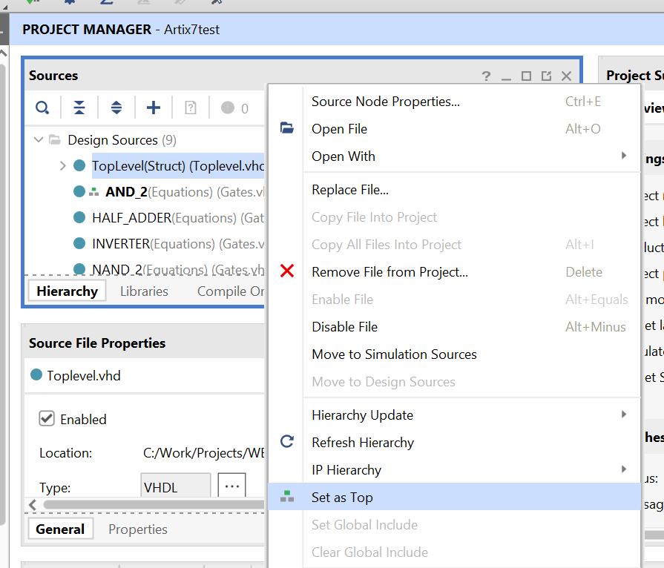
Modifications to Vivado Project
Modifications to Vivado Project
● Add TopLevel.vhdl to the Project
● Change the number of inputs and outputs to the design
● This change is the same as what was done for testbench
● Right click on TopLevel.vhdl in sources tab
● Set top level entity as TopLevel as shown
● Note that the presence or absence of testbench in the project does not matter during scan chain
Wadhwani Electronics Lab
Dept. of EE, IIT Bombay

Slide 18
Upload Bitstream on Board
● Note – Pin Planning is not needed.
● Note – Keeping Testbench in project doesn't matter
● Do a full implementation of the design (note you need to repeat the task since the top level entity has changed)
● Generate bitstream file again
● Dump the bitstream file on the Artix-7 Board
● Close the connection to board in Hardware manager
Wadhwani Electronics Lab
Dept. of EE, IIT Bombay

Slide 19
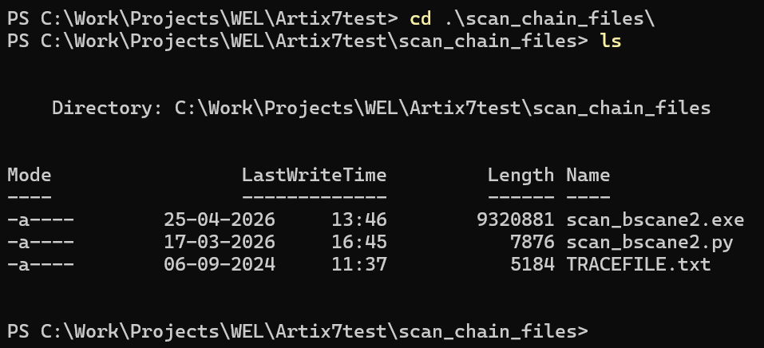
Run Scan Chain Python Script
● Open Command Prompt and change path using cd command
● In case the project is on C drive, use the following
○ cd ..\..
○ cd <absolute path of folder>
● This path can be copied from windows explorer
● In case you are in D/E/F drives, enter the following
○ D: or E: or F:
○ cd <absolute path of folder>
Wadhwani Electronics Lab
Dept. of EE, IIT Bombay

Slide 20
Run Scan Chain Python Script
● Run the following command to observe the output
○ scan_bscane2.exe TRACEFILE.txt out.txt OR
○ python scan_bscane2.py TRACEFILE.txt out.txt
● scan_bscane2.exe is the name of the file to run
● TRACEFILE.txt needs to be a text file in the specified format. It is an input to the exe file
● In case you have renamed it, write the new file name in the command
● out.txt is a file that is generated by the code. There need not be an existing file with the name. In case there is, the program will overwrite the file without warnings
● Check out.txt to find whether your design has successfully passed all test cases or not
Wadhwani Electronics Lab
Dept. of EE, IIT Bombay

Slide 21
Frequently Encountered Errors
● In case the .exe file is treated as a virus by your antivirus software, then give it permission by allowing the file in settings
● If the issue still persists, the scan_bscane2.py file can be used if python is available
● Verify installation of the pip packages in slide 15 (enter installation command again and you will get something similar to the following if it is installed successfully)
Repeat all steps until the command scan_bscane2.exe TRACEFILE.txt out.txt ​
● Enter the following command instead of that
○ python scan_bscane2.py TRACEFILE.txt out.txt​
Wadhwani Electronics Lab
Dept. of EE, IIT Bombay

Slide 22
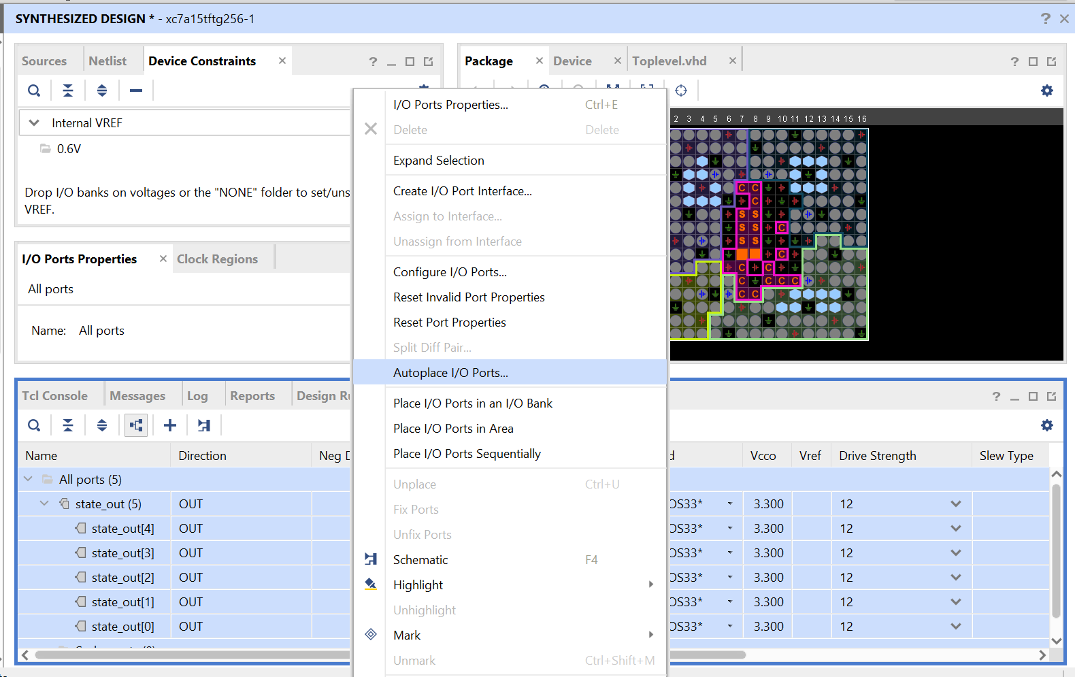
Frequently Encountered Errors
In case Vivado throws an error unrelated to your design, then do the following
● Before dumping the bitstream file, open I/O planning in Synthesis tab and auto assign as in image
● Compile design again, and proceed from slide 16
Wadhwani Electronics Lab
Dept. of EE, IIT Bombay

Slide 23
Questions?
Wadhwani Electronics Lab
Dept. of EE, IIT Bombay

