Slide 1

Automation of a Current-Mode Bandgap Reference
gm/Id-Based Synthesis and Simulation-Driven Optimization
Jaiveer Kiran S K (EE22B042)
Department of Electrical Engineering, IIT Madras

Slide 2
Motivation
Bandgap references are fundamental analog building blocks
Manual sizing is slow, iterative, and error-prone
Advanced CMOS tightens headroom, TC, and noise constraints
Need for automated and reusable design methodology

Slide 3
Key Contributions
Analytical pre-sizing using bandgap equations
gm/Id-based automated transistor synthesis
Simulation-in-the-loop DC optimization
Noise-aware refinement with per-device targeting

Slide 4
Overall Design Flow
Analytical pre-sizing of resistors and currents
gm/Id characterization and device synthesis
Three-stage DC temperature optimization
Noise and 1/f corner optimization

Slide 5
Circuit Architecture
Current-mode bandgap reference topology
Bandgap core, op-amp, and current mirrors
Designed for 1.2 V supply and 0.5 V reference

Slide 6
Pre-Sizing Methodology
Diode temperature sweep to extract VBE(T)
CTAT slope estimation from simulation data
PTAT voltage generation using ΔVBE
Closed-form computation of resistor ratios

Slide 7
gm/Id-Based Device Synthesis
NMOS and PMOS gm/Id lookup tables from Spectre
Mapping target gm/Id to current per finger
Automatic determination of finger counts and lengths

Slide 8
DC Optimization Strategy
Objective: smooth, centered, and low-TC Vout(T)
Hierarchical three-stage optimization loop
All updates validated via simulation

Slide 9
Noise Optimization
DC-optimized solution used as baseline
Dominant noise contributors identified from Spectre
Selective device scaling preserves DC behavior

Slide 10
Results Summary
Reference voltage ≈ 0.4995 V
Peak-to-peak Vout variation < 5 mV
Turning point within target temperature window
Power consumption ≈ 283 µW

Slide 11
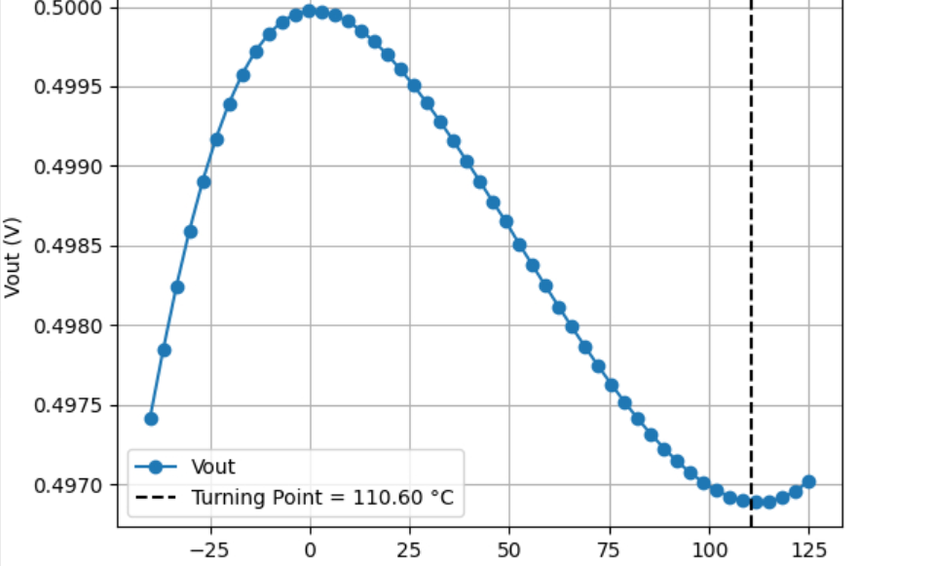
VOUT VS TEMPERATURE

Slide 12
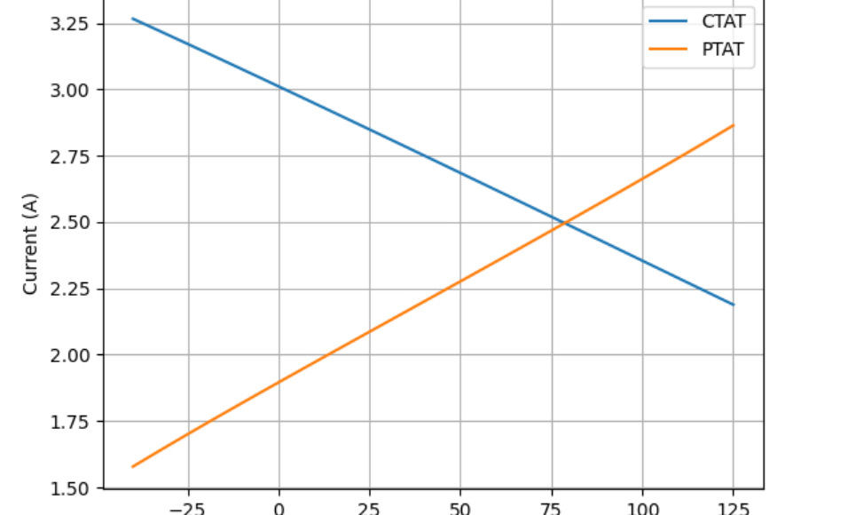
CTAT AND PTAT CURRENTS GENERATED

Slide 13
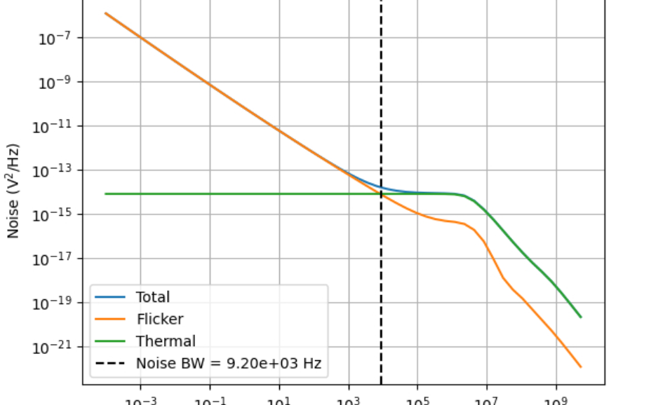
OUTPUT REFERRED NOISE

Slide 14
Conclusion
Fully automated current-mode bandgap design flow
Combines theory, gm/Id methodology, and simulation
Achieves low TC and low noise in scaled CMOS

Slide 15
Future Works
Extended to include PVT corners and Mismatch analysis.
Adding a Start-up Circuit.
Post layout extraction.
More advanced optimisation techniques can also be incorporated.

Slide 16
Thank You
Questions?

