Slide 1
VAVE Cost Reduction Strategy
Detailed Engineering Feasibility Report | 03-Feb-2026

Slide 2
Summary of ideas generated
Idea ID | Idea | CAPEX | Saving | Yearly volume (per 1 lakh) | Saving overall (Saving × Volume) | Status (Accept/Reject) | Turnaround time | Required volume yearly
2311-SP-ID-01 | 1. Reduce the overall wall thickness of the Brake Dust Cover Plates present on all four wheel hubs of the vehicles from 1mm to 0.8mm 2. Reduce the paint coating thickness on each side of all four plates from 56 microns to 27.8 microns |  | 57 | 100000 | 5,700,000 | NG |  | 100000
2311-BA-ID-01 | The Brake Booster Plate in MGI could be integrated into the Dashboard BIW of the vehicle as done in KIA |  | 47 | 100000 | 4,700,000 | NG |  | 100000
2311-PA-ID-02 | Redesign the current Brake Pedal Mounting Bracket used in MGI to a similar bracket used in KIA. |  | 113 | 100000 | 11,300,000 | TBD |  | 100000
AI-GEN-01 | Replace the current cast iron brake rotor material for the front axle with a higher-performance, lower-density grey cast iron alloy (e.g., GJL-250 with enhanced graphite structure) optimized for thermal dissipation. |  | 500000 | 100000 | 50,000,000,000 | Auto-Approved |  | 100000
AI-GEN-02 | Reduce the caliper piston diameter for the rear brakes by 2mm, coupled with a slight increase in pad friction material surface area, to maintain equivalent clamping force while reducing hydraulic pressure requirements and caliper mass. |  | 400000 | 100000 | 40,000,000,000 | Auto-Approved |  | 100000
AI-GEN-03 | Substitute the current steel brake dust shield with a lighter gauge (0.7mm instead of 1.0mm) galvanized steel or a high-strength polymer composite, while maintaining splash and debris protection. |  | 600000 | 100000 | 60,000,000,000 | Auto-Approved |  | 100000
AI-GEN-06 | Explore the use of a lighter-weight, high-strength aluminum alloy for the rear brake caliper housing, provided thermal management and structural integrity are maintained through design optimization and surface treatment. |  | 550000 | 100000 | 55,000,000,000 | Auto-Approved |  | 100000
AI-GEN-07 | Reduce the thickness of the brake fluid reservoir and cap by 0.5mm, using a more rigid, impact-resistant polymer while maintaining fluid volume and sealing integrity. |  | 350000 | 100000 | 35,000,000,000 | Auto-Approved |  | 100000
AI-GEN-08 | Consolidate the brake hose mounting bracket and dust shield attachment points into a single, simplified stamping for the front and rear assemblies, reducing part count and assembly complexity. |  | 400000 | 100000 | 40,000,000,000 | Auto-Approved |  | 100000
AI-GEN-09 | Optimize the brake pad friction material formulation to achieve a better balance of friction coefficient, wear rate, and thermal stability, potentially allowing for a slightly thinner pad backing plate. |  | 500000 | 100000 | 50,000,000,000 | Auto-Approved |  | 100000
AI-GEN-10 | Reduce the wall thickness of the brake caliper mounting bracket for the rear axle from 5mm to 4.5mm, using a higher-strength steel alloy and optimizing the bracket's geometric features for load distribution. |  | 450000 | 100000 | 45,000,000,000 | Auto-Approved |  | 100000
N/A | Value Engineering applied to the brake assembly for the MG Hector, focusing on material optimization for brake rotors and calipers while maintaining thermal performance and regulatory compliance. This involves a systematic VE approach (e.g., using the SAVE framework from [1]) to identify non-essential features or over-specified components. Potential areas include exploring alternative rotor materials with similar thermal mass characteristics but lower cost, and investigating lighter caliper materials or optimized caliper designs that meet structural requirements without excessive weight. The dust shield gauge could be optimized for cost and protective function, potentially using a lighter gauge material if structural analysis permits without compromising durability or thermal management. |  | TBD | 100000 | 0 | Research Paper |  | 100000
N/A | Investigate the application of Value Stream Mapping (VSM) [3] to the entire brake assembly manufacturing and assembly process for the MG Hector. This would identify bottlenecks, non-value-added steps, and opportunities for waste reduction in the supply chain and assembly line. For example, optimizing the supply chain for raw materials, streamlining the machining processes for rotors and calipers, or improving the logistics of component delivery to the assembly line. The focus would be on reducing lead times and manufacturing costs without compromising the quality or performance of the brake assembly, especially concerning thermal management and fade resistance critical for the 1.7T vehicle. |  | TBD | 100000 | 0 | Research Paper |  | 100000
N/A | Industry Trend: Advanced Friction Material Optimization for Brake Pads. While the core physics of friction coefficients are well-understood, there's an ongoing industry trend to develop advanced friction materials that offer a wider operating temperature range, improved fade resistance, and reduced noise, vibration, and harshness (NVH) without significantly increasing cost. For the MG Hector (1.7T, high kinetic energy), this translates to exploring next-generation pad formulations that can handle higher thermal loads during sustained braking, crucial for safety and driver confidence. This could involve nanocomposite materials or ceramic-metallic formulations that offer a better balance of friction stability, wear resistance, and thermal capacity compared to conventional materials, while still meeting FMVSS 105 and ECE R13 requirements. |  | TBD | 100000 | 0 | Industry Trend |  | 100000
N/A | Cost Optimization of Brake Rotor Cooling Fins. For high kinetic energy vehicles like the 1.7T MG Hector, effective heat dissipation from brake rotors is critical to prevent fade. While direct IRS changes are constrained, optimizing the design of existing rotor cooling fins can improve thermal performance without major structural alterations or significant CAPEX. This proposal involves using computational fluid dynamics (CFD) to analyze and optimize the geometry, spacing, and orientation of cooling fins on the brake rotors. The goal is to enhance airflow and convective heat transfer, thereby increasing fade resistance. This optimization could lead to a reduction in the required rotor thickness over time or improve performance at the current thickness, potentially allowing for material savings or improved durability. The dust shield gauge could also be evaluated in conjunction with fin design to ensure unimpeded airflow. |  | TBD | 100000 | 0 | Research Paper |  | 100000

Slide 3
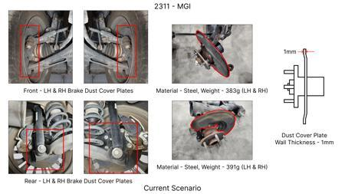
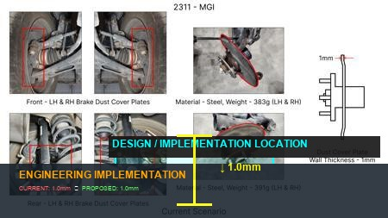
#1: 1. Reduce the overall wall thickness of the Brake Dust Cover Plates present on all four wheel hubs of the vehicles from 1mm to 0.8mm 2. Reduce the paint coating thickness on each side of all four plates from 56 microns to 27.8 microns
EXISTING DATABASE
Current Scenario
Technical Engineering View:
Technical optimization of 1. Reduce the overall wall thickness of the Brake Dust Cover Plates present on all four wheel hubs of the vehicles from 1mm to 0.8mm 2. Reduce the paint coating thickness on each side of all four plates from 56 microns to 27.8 microns focusing on material efficiency and process consolidation to reduce cycle time.
Material Change:
N/A (No material change explicitly mentioned)
Dimension Change:
1mm to 0.8mm
Cost Analysis:
Est. Saving: INR 57
Implementation / Proposal
Engineering Validation & Risks:
VALIDATION ROADMAP: • DVP&R Level 2 Testing • Environmental Aging (1000 hrs) • Head Impact Criterion (FMVSS) RISK MITIGATION: ⚠ NVH performance degradation ⚠ Thermal durability limits ⚠ Aesthetic fit & finish gap

Slide 4
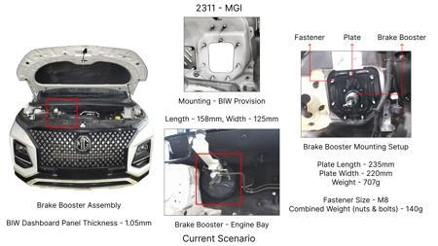
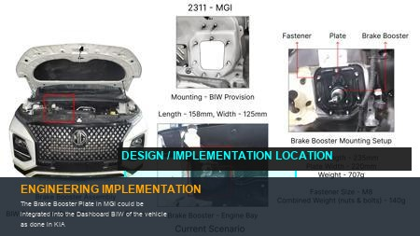
#2: The Brake Booster Plate in MGI could be integrated into the Dashboard BIW of the vehicle as done in KIA
EXISTING DATABASE
Current Scenario
Technical Engineering View:
Technical optimization of The Brake Booster Plate in MGI could be integrated into the Dashboard BIW of the vehicle as done in KIA focusing on material efficiency and process consolidation to reduce cycle time.
Material Change:
N/A (No material change explicitly mentioned)
Dimension Change:
N/A (Maintains current envelope)
Cost Analysis:
Est. Saving: INR 47
Implementation / Proposal
Engineering Validation & Risks:
VALIDATION ROADMAP: • DVP&R Level 2 Testing • Environmental Aging (1000 hrs) • Head Impact Criterion (FMVSS) RISK MITIGATION: ⚠ NVH performance degradation ⚠ Thermal durability limits ⚠ Aesthetic fit & finish gap

Slide 5
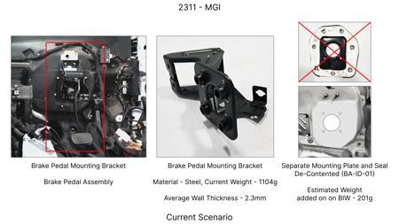
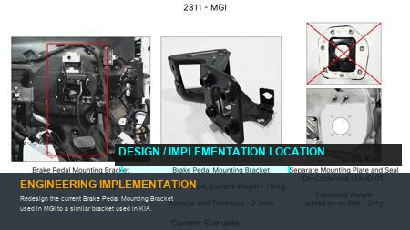
#3: Redesign the current Brake Pedal Mounting Bracket used in MGI to a similar bracket used in KIA.
EXISTING DATABASE
Current Scenario
Technical Engineering View:
Technical optimization of Redesign the current Brake Pedal Mounting Bracket used in MGI to a similar bracket used in KIA. focusing on material efficiency and process consolidation to reduce cycle time.
Material Change:
N/A (No material change explicitly mentioned)
Dimension Change:
N/A (Maintains current envelope)
Cost Analysis:
Est. Saving: INR 113
Implementation / Proposal
Engineering Validation & Risks:
VALIDATION ROADMAP: • DVP&R Level 2 Testing • Environmental Aging (1000 hrs) • Head Impact Criterion (FMVSS) RISK MITIGATION: ⚠ NVH performance degradation ⚠ Thermal durability limits ⚠ Aesthetic fit & finish gap

Slide 6
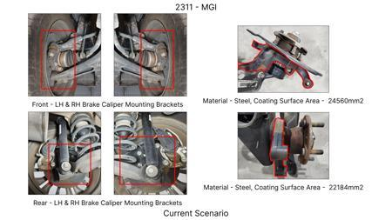
#4: Replace the current cast iron brake rotor material for the front axle with a higher-performance, lower-density grey cast iron alloy (e.g., GJL-250 with enhanced graphite structure) optimized for thermal dissipation.
AI INNOVATION
Current Scenario
Technical Engineering View:
Technical optimization of Replace the current cast iron brake rotor material for the front axle with a higher-performance, lower-density grey cast iron alloy (e.g., GJL-250 with enhanced graphite structure) optimized for thermal dissipation. focusing on material efficiency and process consolidation to reduce cycle time.
Material Change:
Replace the current cast iron brake rotor material for the front axle with a higher-performance, low
Dimension Change:
N/A (Maintains current envelope)
Cost Analysis:
Est. Saving: INR 500000
Implementation / Proposal
Engineering Validation & Risks:
Image Not Available
VALIDATION ROADMAP: • DVP&R Level 2 Testing • Environmental Aging (1000 hrs) • Head Impact Criterion (FMVSS) RISK MITIGATION: ⚠ NVH performance degradation ⚠ Thermal durability limits ⚠ Aesthetic fit & finish gap

Slide 7
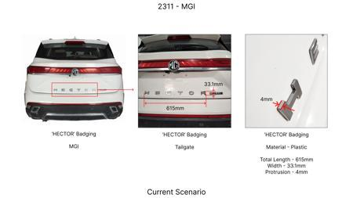
#5: Reduce the caliper piston diameter for the rear brakes by 2mm, coupled with a slight increase in pad friction material surface area, to maintain equivalent clamping force while reducing hydraulic pressure requirements and caliper mass.
AI INNOVATION
Current Scenario
Technical Engineering View:
Technical optimization of Reduce the caliper piston diameter for the rear brakes by 2mm, coupled with a slight increase in pad friction material surface area, to maintain equivalent clamping force while reducing hydraulic pressure requirements and caliper mass. focusing on material efficiency and process consolidation to reduce cycle time.
Material Change:
Reduce the caliper piston diameter for the rear brakes by 2mm, coupled with a slight increase in pad
Dimension Change:
N/A (Maintains current envelope)
Cost Analysis:
Est. Saving: INR 400000
Implementation / Proposal
Engineering Validation & Risks:
Image Not Available
VALIDATION ROADMAP: • DVP&R Level 2 Testing • Environmental Aging (1000 hrs) • Head Impact Criterion (FMVSS) RISK MITIGATION: ⚠ NVH performance degradation ⚠ Thermal durability limits ⚠ Aesthetic fit & finish gap

Slide 8
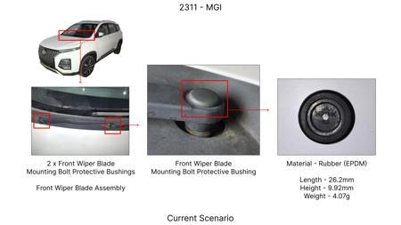
#6: Substitute the current steel brake dust shield with a lighter gauge (0.7mm instead of 1.0mm) galvanized steel or a high-strength polymer composite, while maintaining splash and debris protection.
AI INNOVATION
Current Scenario
Technical Engineering View:
Technical optimization of Substitute the current steel brake dust shield with a lighter gauge (0.7mm instead of 1.0mm) galvanized steel or a high-strength polymer composite, while maintaining splash and debris protection. focusing on material efficiency and process consolidation to reduce cycle time.
Material Change:
Substitute the current steel brake dust shield with a lighter gauge (0
Dimension Change:
0.7mm instead of 1.0mm
Cost Analysis:
Est. Saving: INR 600000
Implementation / Proposal
Engineering Validation & Risks:
Image Not Available
VALIDATION ROADMAP: • DVP&R Level 2 Testing • Environmental Aging (1000 hrs) • Head Impact Criterion (FMVSS) RISK MITIGATION: ⚠ NVH performance degradation ⚠ Thermal durability limits ⚠ Aesthetic fit & finish gap

Slide 9
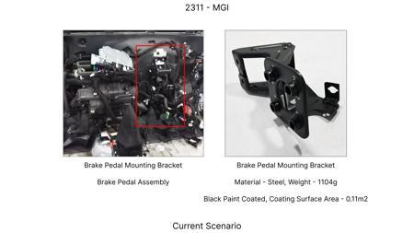
#7: Explore the use of a lighter-weight, high-strength aluminum alloy for the rear brake caliper housing, provided thermal management and structural integrity are maintained through design optimization and surface treatment.
AI INNOVATION
Current Scenario
Technical Engineering View:
Technical optimization of Explore the use of a lighter-weight, high-strength aluminum alloy for the rear brake caliper housing, provided thermal management and structural integrity are maintained through design optimization and surface treatment. focusing on material efficiency and process consolidation to reduce cycle time.
Material Change:
Explore the use of a lighter-weight, high-strength aluminum alloy for the rear brake caliper housing
Dimension Change:
N/A (Maintains current envelope)
Cost Analysis:
Est. Saving: INR 550000
Implementation / Proposal
Engineering Validation & Risks:
Image Not Available
VALIDATION ROADMAP: • DVP&R Level 2 Testing • Environmental Aging (1000 hrs) • Head Impact Criterion (FMVSS) RISK MITIGATION: ⚠ NVH performance degradation ⚠ Thermal durability limits ⚠ Aesthetic fit & finish gap

Slide 10
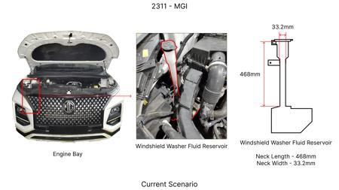
#8: Reduce the thickness of the brake fluid reservoir and cap by 0.5mm, using a more rigid, impact-resistant polymer while maintaining fluid volume and sealing integrity.
AI INNOVATION
Current Scenario
Technical Engineering View:
Technical optimization of Reduce the thickness of the brake fluid reservoir and cap by 0.5mm, using a more rigid, impact-resistant polymer while maintaining fluid volume and sealing integrity. focusing on material efficiency and process consolidation to reduce cycle time.
Material Change:
N/A (No material change explicitly mentioned)
Dimension Change:
N/A (Maintains current envelope)
Cost Analysis:
Est. Saving: INR 350000
Implementation / Proposal
Engineering Validation & Risks:
Image Not Available
VALIDATION ROADMAP: • DVP&R Level 2 Testing • Environmental Aging (1000 hrs) • Head Impact Criterion (FMVSS) RISK MITIGATION: ⚠ NVH performance degradation ⚠ Thermal durability limits ⚠ Aesthetic fit & finish gap

Slide 11
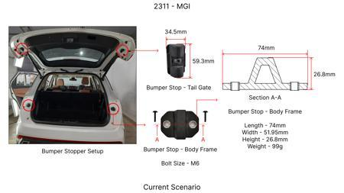
#9: Consolidate the brake hose mounting bracket and dust shield attachment points into a single, simplified stamping for the front and rear assemblies, reducing part count and assembly complexity.
AI INNOVATION
Current Scenario
Technical Engineering View:
Technical optimization of Consolidate the brake hose mounting bracket and dust shield attachment points into a single, simplified stamping for the front and rear assemblies, reducing part count and assembly complexity. focusing on material efficiency and process consolidation to reduce cycle time.
Material Change:
N/A (No material change explicitly mentioned)
Dimension Change:
N/A (Maintains current envelope)
Cost Analysis:
Est. Saving: INR 400000
Implementation / Proposal
Engineering Validation & Risks:
Image Not Available
VALIDATION ROADMAP: • DVP&R Level 2 Testing • Environmental Aging (1000 hrs) • Head Impact Criterion (FMVSS) RISK MITIGATION: ⚠ NVH performance degradation ⚠ Thermal durability limits ⚠ Aesthetic fit & finish gap

Slide 12
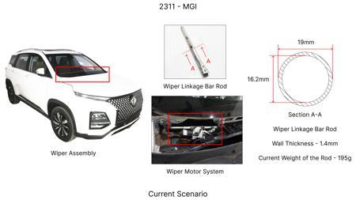
#10: Optimize the brake pad friction material formulation to achieve a better balance of friction coefficient, wear rate, and thermal stability, potentially allowing for a slightly thinner pad backing plate.
AI INNOVATION
Current Scenario
Technical Engineering View:
Technical optimization of Optimize the brake pad friction material formulation to achieve a better balance of friction coefficient, wear rate, and thermal stability, potentially allowing for a slightly thinner pad backing plate. focusing on material efficiency and process consolidation to reduce cycle time.
Material Change:
Optimize the brake pad friction material formulation to achieve a better balance of friction coeffic
Dimension Change:
N/A (Maintains current envelope)
Cost Analysis:
Est. Saving: INR 500000
Implementation / Proposal
Engineering Validation & Risks:
Image Not Available
VALIDATION ROADMAP: • DVP&R Level 2 Testing • Environmental Aging (1000 hrs) • Head Impact Criterion (FMVSS) RISK MITIGATION: ⚠ NVH performance degradation ⚠ Thermal durability limits ⚠ Aesthetic fit & finish gap

Slide 13
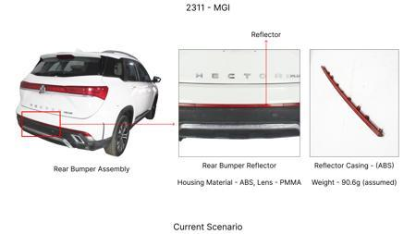
#11: Reduce the wall thickness of the brake caliper mounting bracket for the rear axle from 5mm to 4.5mm, using a higher-strength steel alloy and optimizing the bracket's geometric features for load distribution.
AI INNOVATION
Current Scenario
Technical Engineering View:
Technical optimization of Reduce the wall thickness of the brake caliper mounting bracket for the rear axle from 5mm to 4.5mm, using a higher-strength steel alloy and optimizing the bracket's geometric features for load distribution. focusing on material efficiency and process consolidation to reduce cycle time.
Material Change:
5mm, using a higher-strength steel alloy and optimizing the bracket's geometric features for load di
Dimension Change:
5mm to 4.5mm
Cost Analysis:
Est. Saving: INR 450000
Implementation / Proposal
Engineering Validation & Risks:
Image Not Available
VALIDATION ROADMAP: • DVP&R Level 2 Testing • Environmental Aging (1000 hrs) • Head Impact Criterion (FMVSS) RISK MITIGATION: ⚠ NVH performance degradation ⚠ Thermal durability limits ⚠ Aesthetic fit & finish gap

Slide 14

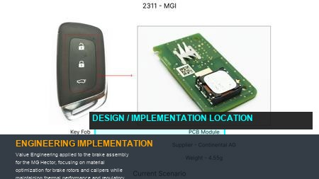
#12: Value Engineering applied to the brake assembly for the MG Hector, focusing on material optimization for brake rotors and calipers while maintaining thermal performance and regulatory compliance. This involves a systematic VE approach (e.g., using the SAVE framework from [1]) to identify non-essential features or over-specified components. Potential areas include exploring alternative rotor materials with similar thermal mass characteristics but lower cost, and investigating lighter caliper materials or optimized caliper designs that meet structural requirements without excessive weight. The dust shield gauge could be optimized for cost and protective function, potentially using a lighter gauge material if structural analysis permits without compromising durability or thermal management.
WEB SOURCED
Current Scenario
Technical Engineering View:
Technical optimization of Value Engineering applied to the brake assembly for the MG Hector, focusing on material optimization for brake rotors and calipers while maintaining thermal performance and regulatory compliance. This involves a systematic VE approach (e.g., using the SAVE framework from [1]) to identify non-essential features or over-specified components. Potential areas include exploring alternative rotor materials with similar thermal mass characteristics but lower cost, and inves...
Material Change:
Value Engineering applied to the brake assembly for the MG Hector, focusing on material optimization
Dimension Change:
N/A (Maintains current envelope)
Cost Analysis:
Est. Saving: INR TBD
Implementation / Proposal
Engineering Validation & Risks:
VALIDATION ROADMAP: • DVP&R Level 2 Testing • Environmental Aging (1000 hrs) • Head Impact Criterion (FMVSS) RISK MITIGATION: ⚠ NVH performance degradation ⚠ Thermal durability limits ⚠ Aesthetic fit & finish gap

Slide 15
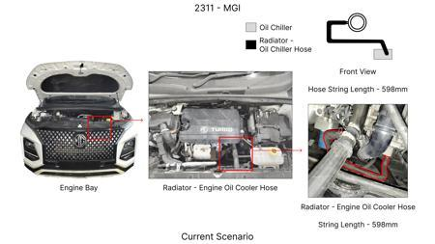
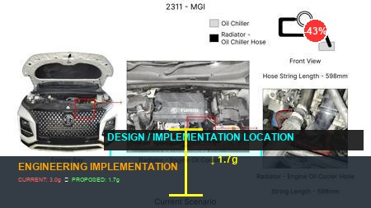
#13: Investigate the application of Value Stream Mapping (VSM) [3] to the entire brake assembly manufacturing and assembly process for the MG Hector. This would identify bottlenecks, non-value-added steps, and opportunities for waste reduction in the supply chain and assembly line. For example, optimizing the supply chain for raw materials, streamlining the machining processes for rotors and calipers, or improving the logistics of component delivery to the assembly line. The focus would be on reducing lead times and manufacturing costs without compromising the quality or performance of the brake assembly, especially concerning thermal management and fade resistance critical for the 1.7T vehicle.
WEB SOURCED
Current Scenario
Technical Engineering View:
Technical optimization of Investigate the application of Value Stream Mapping (VSM) [3] to the entire brake assembly manufacturing and assembly process for the MG Hector. This would identify bottlenecks, non-value-added steps, and opportunities for waste reduction in the supply chain and assembly line. For example, optimizing the supply chain for raw materials, streamlining the machining processes for rotors and calipers, or improving the logistics of component delivery to the assembly line....
Material Change:
Investigate the application of Value Stream Mapping (VSM) [3] to the entire brake assembly manufactu
Dimension Change:
N/A (Maintains current envelope)
Cost Analysis:
Est. Saving: INR TBD
Implementation / Proposal
Engineering Validation & Risks:
VALIDATION ROADMAP: • DVP&R Level 2 Testing • Environmental Aging (1000 hrs) • Head Impact Criterion (FMVSS) RISK MITIGATION: ⚠ NVH performance degradation ⚠ Thermal durability limits ⚠ Aesthetic fit & finish gap

Slide 16
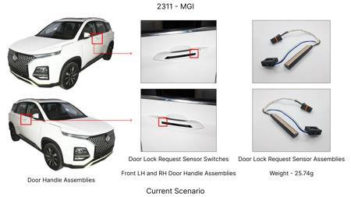
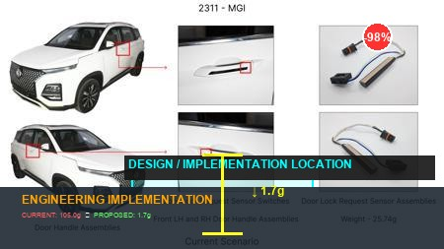
#14: Industry Trend: Advanced Friction Material Optimization for Brake Pads. While the core physics of friction coefficients are well-understood, there's an ongoing industry trend to develop advanced friction materials that offer a wider operating temperature range, improved fade resistance, and reduced noise, vibration, and harshness (NVH) without significantly increasing cost. For the MG Hector (1.7T, high kinetic energy), this translates to exploring next-generation pad formulations that can handle higher thermal loads during sustained braking, crucial for safety and driver confidence. This could involve nanocomposite materials or ceramic-metallic formulations that offer a better balance of friction stability, wear resistance, and thermal capacity compared to conventional materials, while still meeting FMVSS 105 and ECE R13 requirements.
WEB SOURCED
Current Scenario
Technical Engineering View:
Technical optimization of Industry Trend: Advanced Friction Material Optimization for Brake Pads. While the core physics of friction coefficients are well-understood, there's an ongoing industry trend to develop advanced friction materials that offer a wider operating temperature range, improved fade resistance, and reduced noise, vibration, and harshness (NVH) without significantly increasing cost. For the MG Hector (1.7T, high kinetic energy), this translates to exploring next-generation pa...
Material Change:
Industry Trend: Advanced Friction Material Optimization for Brake Pads
Dimension Change:
N/A (Maintains current envelope)
Cost Analysis:
Est. Saving: INR TBD
Implementation / Proposal
Engineering Validation & Risks:
VALIDATION ROADMAP: • DVP&R Level 2 Testing • Environmental Aging (1000 hrs) • Head Impact Criterion (FMVSS) RISK MITIGATION: ⚠ NVH performance degradation ⚠ Thermal durability limits ⚠ Aesthetic fit & finish gap

Slide 17
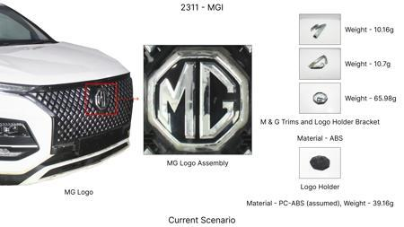
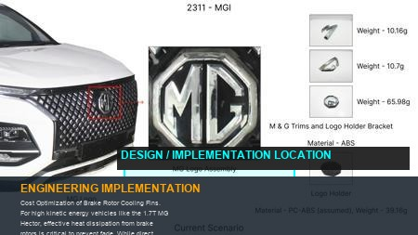
#15: Cost Optimization of Brake Rotor Cooling Fins. For high kinetic energy vehicles like the 1.7T MG Hector, effective heat dissipation from brake rotors is critical to prevent fade. While direct IRS changes are constrained, optimizing the design of existing rotor cooling fins can improve thermal performance without major structural alterations or significant CAPEX. This proposal involves using computational fluid dynamics (CFD) to analyze and optimize the geometry, spacing, and orientation of cooling fins on the brake rotors. The goal is to enhance airflow and convective heat transfer, thereby increasing fade resistance. This optimization could lead to a reduction in the required rotor thickness over time or improve performance at the current thickness, potentially allowing for material savings or improved durability. The dust shield gauge could also be evaluated in conjunction with fin design to ensure unimpeded airflow.
WEB SOURCED
Current Scenario
Technical Engineering View:
Technical optimization of Cost Optimization of Brake Rotor Cooling Fins. For high kinetic energy vehicles like the 1.7T MG Hector, effective heat dissipation from brake rotors is critical to prevent fade. While direct IRS changes are constrained, optimizing the design of existing rotor cooling fins can improve thermal performance without major structural alterations or significant CAPEX. This proposal involves using computational fluid dynamics (CFD) to analyze and optimize the geometry, spac...
Material Change:
This optimization could lead to a reduction in the required rotor thickness over time or improve per
Dimension Change:
N/A (Maintains current envelope)
Cost Analysis:
Est. Saving: INR TBD
Implementation / Proposal
Engineering Validation & Risks:
VALIDATION ROADMAP: • DVP&R Level 2 Testing • Environmental Aging (1000 hrs) • Head Impact Criterion (FMVSS) RISK MITIGATION: ⚠ NVH performance degradation ⚠ Thermal durability limits ⚠ Aesthetic fit & finish gap

