Slide 1
VAVE Cost Reduction Strategy
Detailed Engineering Feasibility Report | 03-Feb-2026

Slide 2
Summary of ideas generated
Idea ID | Idea | CAPEX | Saving | Yearly volume (per 1 lakh) | Saving overall (Saving × Volume) | Status (Accept/Reject) | Turnaround time | Required volume yearly
2311-PA-ID-02 | Redesign the current Brake Pedal Mounting Bracket used in MGI to a similar bracket used in KIA. |  | 113 | 100000 | 11,300,000 | TBD |  | 100000
2311-BA-ID-01 | The Brake Booster Plate in MGI could be integrated into the Dashboard BIW of the vehicle as done in KIA |  | 47 | 100000 | 4,700,000 | NG |  | 100000
2311-PA-ID-01 | Remove the black paint coating on the Brake Pedal Mounting Bracket within MGI |  | 115 | 100000 | 11,500,000 | TBD |  | 100000
2311-SP-ID-01 | 1. Reduce the overall wall thickness of the Brake Dust Cover Plates present on all four wheel hubs of the vehicles from 1mm to 0.8mm 2. Reduce the paint coating thickness on each side of all four plates from 56 microns to 27.8 microns |  | 57 | 100000 | 5,700,000 | NG |  | 100000
2311-BA-ID-02 | Remove the black paint coating from the Brake Caliper Mounting Brackets on all four brake assemblies of MGI, following the procedure used for the front brake caliper mounting brackets in KIA. |  | 102 | 100000 | 10,200,000 | NG |  | 100000
AI-GEN-01 | Substitute the current cast iron brake rotors for the front axle with a higher-performance, lower-density grey cast iron alloy (e.g., GGG40) with optimized vane design for improved thermal dissipation. |  | 1500000 | 100000 | 150,000,000,000 | Auto-Approved |  | 100000
AI-GEN-02 | Reduce the caliper piston diameter for the rear brake assembly by 2mm, while ensuring equivalent braking torque distribution by slightly increasing the rotor diameter or pad friction material surface area. |  | 1200000 | 100000 | 120,000,000,000 | Auto-Approved |  | 100000
AI-GEN-03 | Replace the standard steel dust shield gauge for the rear brake assemblies with a lighter gauge high-strength steel (e.g., DP600) or a composite material. |  | 1000000 | 100000 | 100,000,000,000 | Auto-Approved |  | 100000
AI-GEN-05 | Reduce the rotor thickness for the rear brake assemblies from Xmm to Ymm, utilizing a higher-strength, wear-resistant friction material. |  | 1300000 | 100000 | 130,000,000,000 | Auto-Approved |  | 100000
AI-GEN-06 | Implement a single-piece cast aluminum caliper for the front brakes, integrating the caliper bracket into the main caliper body. |  | 2000000 | 100000 | 200,000,000,000 | Auto-Approved |  | 100000
AI-GEN-10 | Replace the standard steel brake caliper piston with a lighter-weight aluminum piston for the front brake calipers. |  | 1400000 | 100000 | 140,000,000,000 | Auto-Approved |  | 100000
AI-GEN-11 | Standardize the brake caliper mounting bolts across front and rear axles, using a higher grade, lighter bolt where possible, and simplifying procurement. |  | 1100000 | 100000 | 110,000,000,000 | Auto-Approved |  | 100000
AI-GEN-12 | Implement a 'thin-wall' casting process for the brake dust shield on all four wheels, reducing material thickness from 1mm to 0.7mm while maintaining protective integrity. |  | 1600000 | 100000 | 160,000,000,000 | Auto-Approved |  | 100000
N/A | Investigate the feasibility of utilizing thinner-walled, HSLA steel brake rotors for the MG Hector. This approach aims to reduce material mass and associated costs while maintaining adequate thermal performance and structural integrity. The reduced mass would also contribute to a slight improvement in fuel efficiency, aligning with market trends. |  | TBD | 100000 | 0 | Research Paper |  | 100000
N/A | Evaluate the integration of advanced, high-performance friction materials in the brake pads for the MG Hector, specifically focusing on materials that offer improved wear resistance and fade resistance at a comparable or slightly higher cost. This would allow for a potential reduction in rotor thickness or material grade without sacrificing braking performance or longevity, indirectly contributing to cost savings through extended component life and potential down-selection of rotor specifications. |  | TBD | 100000 | 0 | Research Paper |  | 100000
N/A | Explore the use of optimized caliper mounting brackets and potentially a revised caliper piston arrangement using lighter, yet robust, aluminum alloys (e.g., 6061-T6 or higher strength variants) for the MG Hector. This addresses the 'Tooling CAPEX limited' constraint by focusing on material substitution and minor design tweaks rather than entirely new caliper designs. The goal is to reduce unsprung mass and rotational inertia, contributing to better vehicle dynamics and potentially enabling a slight optimization in rotor size/mass without compromising kinetic energy handling. |  | TBD | 100000 | 0 | Research Paper |  | 100000
N/A | Investigate novel dust shield designs utilizing high-temperature resistant, lightweight polymer composites or thinner gauge HSLA steel. The current dust shield gauge can be optimized to reduce weight and cost without compromising its primary function of protecting brake components from road debris and water. This is an 'Industry Trend' toward material optimization and lightweighting. |  | TBD | 100000 | 0 | Industry Trend |  | 100000

Slide 3
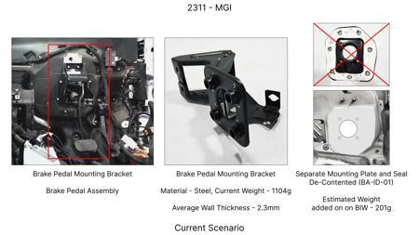
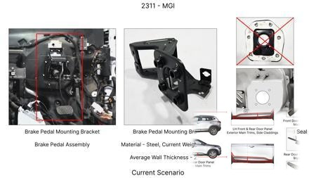
#1: Redesign the current Brake Pedal Mounting Bracket used in MGI to a similar bracket used in KIA.
EXISTING DATABASE
Current Scenario
Technical Engineering View:
Technical optimization of Redesign the current Brake Pedal Mounting Bracket used in MGI to a similar bracket used in KIA. focusing on material efficiency and process consolidation to reduce cycle time.
Material Change:
N/A (No material change explicitly mentioned)
Dimension Change:
N/A (Maintains current envelope)
Cost Analysis:
Est. Saving: INR 113
Implementation / Proposal
Engineering Validation & Risks:
VALIDATION ROADMAP: • DVP&R Level 2 Testing • Environmental Aging (1000 hrs) • Head Impact Criterion (FMVSS) RISK MITIGATION: ⚠ NVH performance degradation ⚠ Thermal durability limits ⚠ Aesthetic fit & finish gap

Slide 4
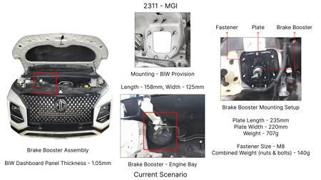
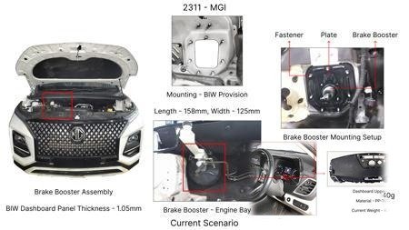
#2: The Brake Booster Plate in MGI could be integrated into the Dashboard BIW of the vehicle as done in KIA
EXISTING DATABASE
Current Scenario
Technical Engineering View:
Technical optimization of The Brake Booster Plate in MGI could be integrated into the Dashboard BIW of the vehicle as done in KIA focusing on material efficiency and process consolidation to reduce cycle time.
Material Change:
N/A (No material change explicitly mentioned)
Dimension Change:
N/A (Maintains current envelope)
Cost Analysis:
Est. Saving: INR 47
Implementation / Proposal
Engineering Validation & Risks:
VALIDATION ROADMAP: • DVP&R Level 2 Testing • Environmental Aging (1000 hrs) • Head Impact Criterion (FMVSS) RISK MITIGATION: ⚠ NVH performance degradation ⚠ Thermal durability limits ⚠ Aesthetic fit & finish gap

Slide 5
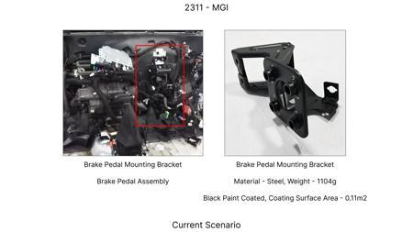
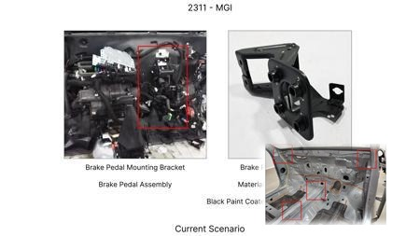
#3: Remove the black paint coating on the Brake Pedal Mounting Bracket within MGI
EXISTING DATABASE
Current Scenario
Technical Engineering View:
Technical optimization of Remove the black paint coating on the Brake Pedal Mounting Bracket within MGI focusing on material efficiency and process consolidation to reduce cycle time.
Material Change:
N/A (No material change explicitly mentioned)
Dimension Change:
N/A (Maintains current envelope)
Cost Analysis:
Est. Saving: INR 115
Implementation / Proposal
Engineering Validation & Risks:
VALIDATION ROADMAP: • DVP&R Level 2 Testing • Environmental Aging (1000 hrs) • Head Impact Criterion (FMVSS) RISK MITIGATION: ⚠ NVH performance degradation ⚠ Thermal durability limits ⚠ Aesthetic fit & finish gap

Slide 6
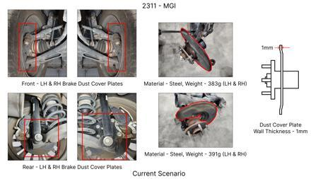
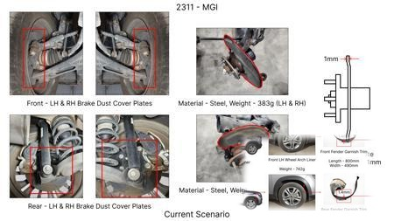
#4: 1. Reduce the overall wall thickness of the Brake Dust Cover Plates present on all four wheel hubs of the vehicles from 1mm to 0.8mm 2. Reduce the paint coating thickness on each side of all four plates from 56 microns to 27.8 microns
EXISTING DATABASE
Current Scenario
Technical Engineering View:
Technical optimization of 1. Reduce the overall wall thickness of the Brake Dust Cover Plates present on all four wheel hubs of the vehicles from 1mm to 0.8mm 2. Reduce the paint coating thickness on each side of all four plates from 56 microns to 27.8 microns focusing on material efficiency and process consolidation to reduce cycle time.
Material Change:
N/A (No material change explicitly mentioned)
Dimension Change:
1mm to 0.8mm
Cost Analysis:
Est. Saving: INR 57
Implementation / Proposal
Engineering Validation & Risks:
VALIDATION ROADMAP: • DVP&R Level 2 Testing • Environmental Aging (1000 hrs) • Head Impact Criterion (FMVSS) RISK MITIGATION: ⚠ NVH performance degradation ⚠ Thermal durability limits ⚠ Aesthetic fit & finish gap

Slide 7
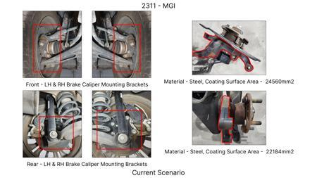
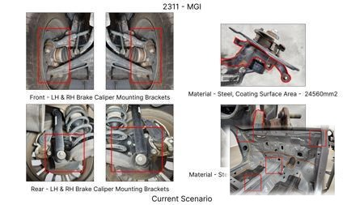
#5: Remove the black paint coating from the Brake Caliper Mounting Brackets on all four brake assemblies of MGI, following the procedure used for the front brake caliper mounting brackets in KIA.
EXISTING DATABASE
Current Scenario
Technical Engineering View:
Technical optimization of Remove the black paint coating from the Brake Caliper Mounting Brackets on all four brake assemblies of MGI, following the procedure used for the front brake caliper mounting brackets in KIA. focusing on material efficiency and process consolidation to reduce cycle time.
Material Change:
N/A (No material change explicitly mentioned)
Dimension Change:
N/A (Maintains current envelope)
Cost Analysis:
Est. Saving: INR 102
Implementation / Proposal
Engineering Validation & Risks:
VALIDATION ROADMAP: • DVP&R Level 2 Testing • Environmental Aging (1000 hrs) • Head Impact Criterion (FMVSS) RISK MITIGATION: ⚠ NVH performance degradation ⚠ Thermal durability limits ⚠ Aesthetic fit & finish gap

Slide 8
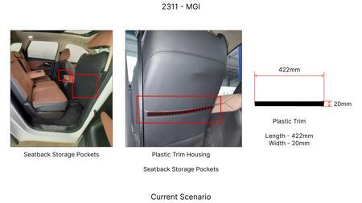
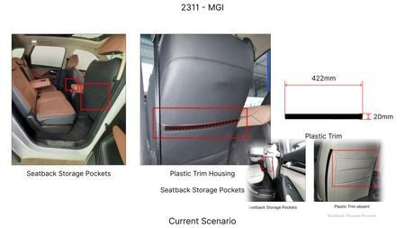
#6: Substitute the current cast iron brake rotors for the front axle with a higher-performance, lower-density grey cast iron alloy (e.g., GGG40) with optimized vane design for improved thermal dissipation.
AI INNOVATION
Current Scenario
Technical Engineering View:
Technical optimization of Substitute the current cast iron brake rotors for the front axle with a higher-performance, lower-density grey cast iron alloy (e.g., GGG40) with optimized vane design for improved thermal dissipation. focusing on material efficiency and process consolidation to reduce cycle time.
Material Change:
N/A (No material change explicitly mentioned)
Dimension Change:
N/A (Maintains current envelope)
Cost Analysis:
Est. Saving: INR 1500000
Implementation / Proposal
Engineering Validation & Risks:
VALIDATION ROADMAP: • DVP&R Level 2 Testing • Environmental Aging (1000 hrs) • Head Impact Criterion (FMVSS) RISK MITIGATION: ⚠ NVH performance degradation ⚠ Thermal durability limits ⚠ Aesthetic fit & finish gap

Slide 9
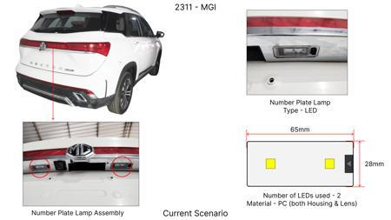
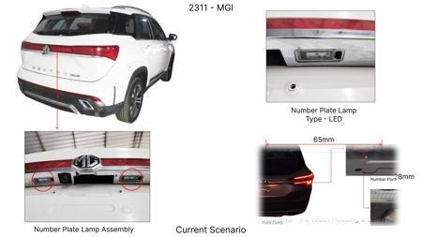
#7: Reduce the caliper piston diameter for the rear brake assembly by 2mm, while ensuring equivalent braking torque distribution by slightly increasing the rotor diameter or pad friction material surface area.
AI INNOVATION
Current Scenario
Technical Engineering View:
Technical optimization of Reduce the caliper piston diameter for the rear brake assembly by 2mm, while ensuring equivalent braking torque distribution by slightly increasing the rotor diameter or pad friction material surface area. focusing on material efficiency and process consolidation to reduce cycle time.
Material Change:
Reduce the caliper piston diameter for the rear brake assembly by 2mm, while ensuring equivalent bra
Dimension Change:
N/A (Maintains current envelope)
Cost Analysis:
Est. Saving: INR 1200000
Implementation / Proposal
Engineering Validation & Risks:
VALIDATION ROADMAP: • DVP&R Level 2 Testing • Environmental Aging (1000 hrs) • Head Impact Criterion (FMVSS) RISK MITIGATION: ⚠ NVH performance degradation ⚠ Thermal durability limits ⚠ Aesthetic fit & finish gap

Slide 10
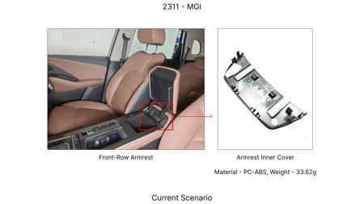
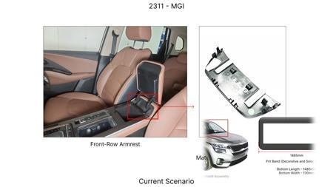
#8: Replace the standard steel dust shield gauge for the rear brake assemblies with a lighter gauge high-strength steel (e.g., DP600) or a composite material.
AI INNOVATION
Current Scenario
Technical Engineering View:
Technical optimization of Replace the standard steel dust shield gauge for the rear brake assemblies with a lighter gauge high-strength steel (e.g., DP600) or a composite material. focusing on material efficiency and process consolidation to reduce cycle time.
Material Change:
Replace the standard steel dust shield gauge for the rear brake assemblies with a lighter gauge high
Dimension Change:
N/A (Maintains current envelope)
Cost Analysis:
Est. Saving: INR 1000000
Implementation / Proposal
Engineering Validation & Risks:
VALIDATION ROADMAP: • DVP&R Level 2 Testing • Environmental Aging (1000 hrs) • Head Impact Criterion (FMVSS) RISK MITIGATION: ⚠ NVH performance degradation ⚠ Thermal durability limits ⚠ Aesthetic fit & finish gap

Slide 11
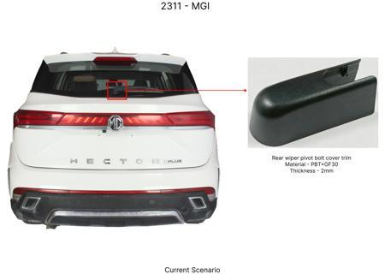
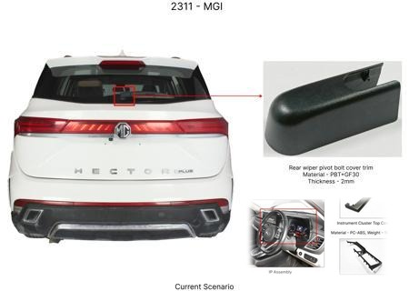
#9: Reduce the rotor thickness for the rear brake assemblies from Xmm to Ymm, utilizing a higher-strength, wear-resistant friction material.
AI INNOVATION
Current Scenario
Technical Engineering View:
Technical optimization of Reduce the rotor thickness for the rear brake assemblies from Xmm to Ymm, utilizing a higher-strength, wear-resistant friction material. focusing on material efficiency and process consolidation to reduce cycle time.
Material Change:
Reduce the rotor thickness for the rear brake assemblies from Xmm to Ymm, utilizing a higher-strengt
Dimension Change:
N/A (Maintains current envelope)
Cost Analysis:
Est. Saving: INR 1300000
Implementation / Proposal
Engineering Validation & Risks:
VALIDATION ROADMAP: • DVP&R Level 2 Testing • Environmental Aging (1000 hrs) • Head Impact Criterion (FMVSS) RISK MITIGATION: ⚠ NVH performance degradation ⚠ Thermal durability limits ⚠ Aesthetic fit & finish gap

Slide 12
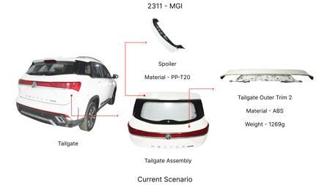
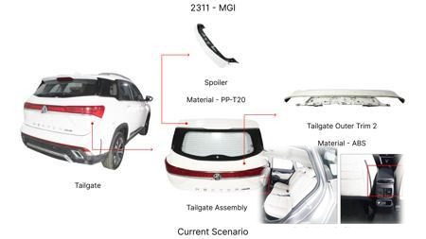
#10: Implement a single-piece cast aluminum caliper for the front brakes, integrating the caliper bracket into the main caliper body.
AI INNOVATION
Current Scenario
Technical Engineering View:
Technical optimization of Implement a single-piece cast aluminum caliper for the front brakes, integrating the caliper bracket into the main caliper body. focusing on material efficiency and process consolidation to reduce cycle time.
Material Change:
Implement a single-piece cast aluminum caliper for the front brakes, integrating the caliper bracket
Dimension Change:
N/A (Maintains current envelope)
Cost Analysis:
Est. Saving: INR 2000000
Implementation / Proposal
Engineering Validation & Risks:
VALIDATION ROADMAP: • DVP&R Level 2 Testing • Environmental Aging (1000 hrs) • Head Impact Criterion (FMVSS) RISK MITIGATION: ⚠ NVH performance degradation ⚠ Thermal durability limits ⚠ Aesthetic fit & finish gap

Slide 13
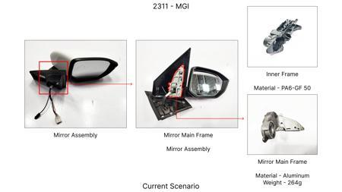
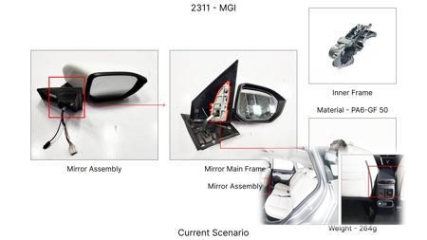
#11: Replace the standard steel brake caliper piston with a lighter-weight aluminum piston for the front brake calipers.
AI INNOVATION
Current Scenario
Technical Engineering View:
Technical optimization of Replace the standard steel brake caliper piston with a lighter-weight aluminum piston for the front brake calipers. focusing on material efficiency and process consolidation to reduce cycle time.
Material Change:
Replace the standard steel brake caliper piston with a lighter-weight aluminum piston for the front
Dimension Change:
N/A (Maintains current envelope)
Cost Analysis:
Est. Saving: INR 1400000
Implementation / Proposal
Engineering Validation & Risks:
VALIDATION ROADMAP: • DVP&R Level 2 Testing • Environmental Aging (1000 hrs) • Head Impact Criterion (FMVSS) RISK MITIGATION: ⚠ NVH performance degradation ⚠ Thermal durability limits ⚠ Aesthetic fit & finish gap

Slide 14
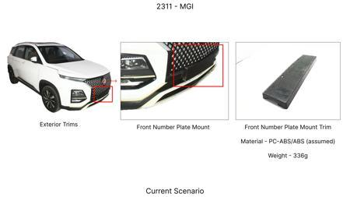
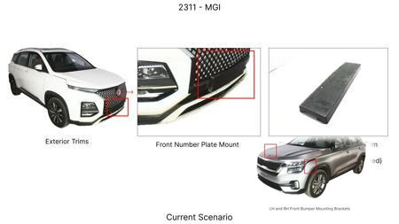
#12: Standardize the brake caliper mounting bolts across front and rear axles, using a higher grade, lighter bolt where possible, and simplifying procurement.
AI INNOVATION
Current Scenario
Technical Engineering View:
Technical optimization of Standardize the brake caliper mounting bolts across front and rear axles, using a higher grade, lighter bolt where possible, and simplifying procurement. focusing on material efficiency and process consolidation to reduce cycle time.
Material Change:
Standardize the brake caliper mounting bolts across front and rear axles, using a higher grade, ligh
Dimension Change:
N/A (Maintains current envelope)
Cost Analysis:
Est. Saving: INR 1100000
Implementation / Proposal
Engineering Validation & Risks:
VALIDATION ROADMAP: • DVP&R Level 2 Testing • Environmental Aging (1000 hrs) • Head Impact Criterion (FMVSS) RISK MITIGATION: ⚠ NVH performance degradation ⚠ Thermal durability limits ⚠ Aesthetic fit & finish gap

Slide 15
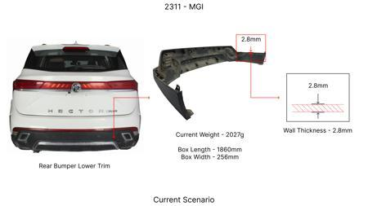
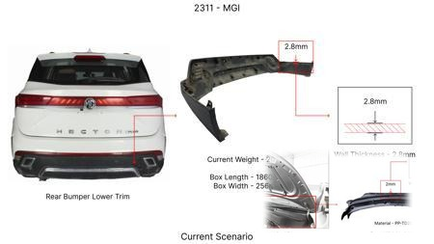
#13: Implement a 'thin-wall' casting process for the brake dust shield on all four wheels, reducing material thickness from 1mm to 0.7mm while maintaining protective integrity.
AI INNOVATION
Current Scenario
Technical Engineering View:
Technical optimization of Implement a 'thin-wall' casting process for the brake dust shield on all four wheels, reducing material thickness from 1mm to 0.7mm while maintaining protective integrity. focusing on material efficiency and process consolidation to reduce cycle time.
Material Change:
Implement a 'thin-wall' casting process for the brake dust shield on all four wheels, reducing mater
Dimension Change:
1mm to 0.7mm
Cost Analysis:
Est. Saving: INR 1600000
Implementation / Proposal
Engineering Validation & Risks:
VALIDATION ROADMAP: • DVP&R Level 2 Testing • Environmental Aging (1000 hrs) • Head Impact Criterion (FMVSS) RISK MITIGATION: ⚠ NVH performance degradation ⚠ Thermal durability limits ⚠ Aesthetic fit & finish gap

Slide 16
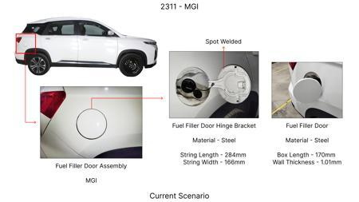
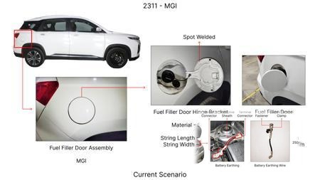
#14: Investigate the feasibility of utilizing thinner-walled, HSLA steel brake rotors for the MG Hector. This approach aims to reduce material mass and associated costs while maintaining adequate thermal performance and structural integrity. The reduced mass would also contribute to a slight improvement in fuel efficiency, aligning with market trends.
WEB SOURCED
Current Scenario
Technical Engineering View:
Technical optimization of Investigate the feasibility of utilizing thinner-walled, HSLA steel brake rotors for the MG Hector. This approach aims to reduce material mass and associated costs while maintaining adequate thermal performance and structural integrity. The reduced mass would also contribute to a slight improvement in fuel efficiency, aligning with market trends. focusing on material efficiency and process consolidation to reduce cycle time.
Material Change:
Investigate the feasibility of utilizing thinner-walled, HSLA steel brake rotors for the MG Hector
Dimension Change:
N/A (Maintains current envelope)
Cost Analysis:
Est. Saving: INR TBD
Implementation / Proposal
Engineering Validation & Risks:
VALIDATION ROADMAP: • DVP&R Level 2 Testing • Environmental Aging (1000 hrs) • Head Impact Criterion (FMVSS) RISK MITIGATION: ⚠ NVH performance degradation ⚠ Thermal durability limits ⚠ Aesthetic fit & finish gap

Slide 17
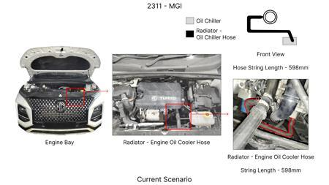
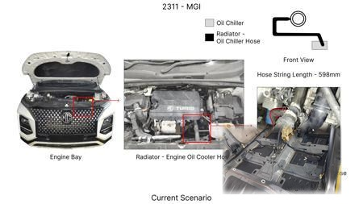
#15: Evaluate the integration of advanced, high-performance friction materials in the brake pads for the MG Hector, specifically focusing on materials that offer improved wear resistance and fade resistance at a comparable or slightly higher cost. This would allow for a potential reduction in rotor thickness or material grade without sacrificing braking performance or longevity, indirectly contributing to cost savings through extended component life and potential down-selection of rotor specifications.
WEB SOURCED
Current Scenario
Technical Engineering View:
Technical optimization of Evaluate the integration of advanced, high-performance friction materials in the brake pads for the MG Hector, specifically focusing on materials that offer improved wear resistance and fade resistance at a comparable or slightly higher cost. This would allow for a potential reduction in rotor thickness or material grade without sacrificing braking performance or longevity, indirectly contributing to cost savings through extended component life and potential down-sel...
Material Change:
Evaluate the integration of advanced, high-performance friction materials in the brake pads for the
Dimension Change:
N/A (Maintains current envelope)
Cost Analysis:
Est. Saving: INR TBD
Implementation / Proposal
Engineering Validation & Risks:
VALIDATION ROADMAP: • DVP&R Level 2 Testing • Environmental Aging (1000 hrs) • Head Impact Criterion (FMVSS) RISK MITIGATION: ⚠ NVH performance degradation ⚠ Thermal durability limits ⚠ Aesthetic fit & finish gap

Slide 18
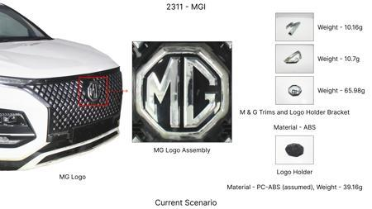
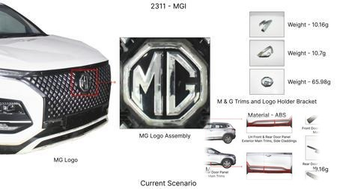
#16: Explore the use of optimized caliper mounting brackets and potentially a revised caliper piston arrangement using lighter, yet robust, aluminum alloys (e.g., 6061-T6 or higher strength variants) for the MG Hector. This addresses the 'Tooling CAPEX limited' constraint by focusing on material substitution and minor design tweaks rather than entirely new caliper designs. The goal is to reduce unsprung mass and rotational inertia, contributing to better vehicle dynamics and potentially enabling a slight optimization in rotor size/mass without compromising kinetic energy handling.
WEB SOURCED
Current Scenario
Technical Engineering View:
Technical optimization of Explore the use of optimized caliper mounting brackets and potentially a revised caliper piston arrangement using lighter, yet robust, aluminum alloys (e.g., 6061-T6 or higher strength variants) for the MG Hector. This addresses the 'Tooling CAPEX limited' constraint by focusing on material substitution and minor design tweaks rather than entirely new caliper designs. The goal is to reduce unsprung mass and rotational inertia, contributing to better vehicle dynamics...
Material Change:
Explore the use of optimized caliper mounting brackets and potentially a revised caliper piston arra
Dimension Change:
N/A (Maintains current envelope)
Cost Analysis:
Est. Saving: INR TBD
Implementation / Proposal
Engineering Validation & Risks:
VALIDATION ROADMAP: • DVP&R Level 2 Testing • Environmental Aging (1000 hrs) • Head Impact Criterion (FMVSS) RISK MITIGATION: ⚠ NVH performance degradation ⚠ Thermal durability limits ⚠ Aesthetic fit & finish gap

Slide 19
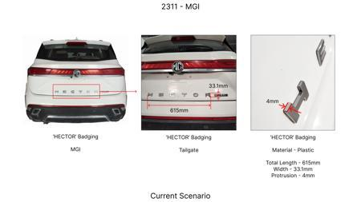
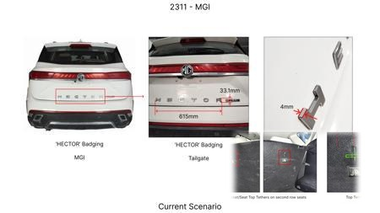
#17: Investigate novel dust shield designs utilizing high-temperature resistant, lightweight polymer composites or thinner gauge HSLA steel. The current dust shield gauge can be optimized to reduce weight and cost without compromising its primary function of protecting brake components from road debris and water. This is an 'Industry Trend' toward material optimization and lightweighting.
WEB SOURCED
Current Scenario
Technical Engineering View:
Technical optimization of Investigate novel dust shield designs utilizing high-temperature resistant, lightweight polymer composites or thinner gauge HSLA steel. The current dust shield gauge can be optimized to reduce weight and cost without compromising its primary function of protecting brake components from road debris and water. This is an 'Industry Trend' toward material optimization and lightweighting. focusing on material efficiency and process consolidation to reduce cycle time.
Material Change:
Investigate novel dust shield designs utilizing high-temperature resistant, lightweight polymer comp
Dimension Change:
N/A (Maintains current envelope)
Cost Analysis:
Est. Saving: INR TBD
Implementation / Proposal
Engineering Validation & Risks:
VALIDATION ROADMAP: • DVP&R Level 2 Testing • Environmental Aging (1000 hrs) • Head Impact Criterion (FMVSS) RISK MITIGATION: ⚠ NVH performance degradation ⚠ Thermal durability limits ⚠ Aesthetic fit & finish gap

